Slide 1



Pride
The WMC Experience
Tessitura Network
UK User Conference 2011
Ticketing for Ticketing People
Sarah Jones – Ticketing Services Co-ordinator
Chloë Lansdown – Ticketing Services Co-ordinator
Liz Baird – Ticketing Services Manager
Wales Millennium Centre
1

Slide 2
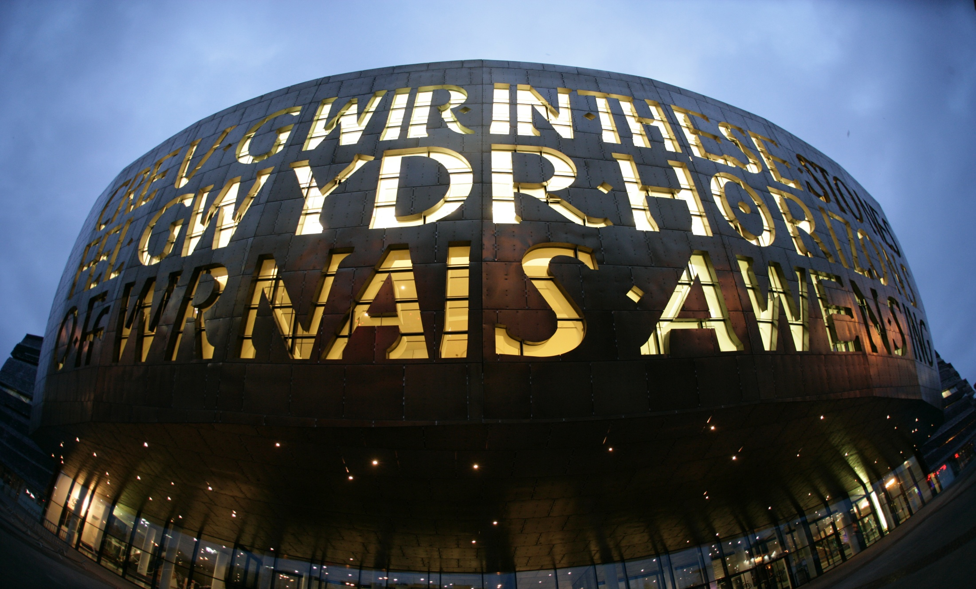
What we are
Wales Millennium Centre
Our facilities include:
  1,897 seat lyric theatre, the Donald Gordon Theatre
  250 seat theatre space, the Weston Studio
  Hoddinott Hall – 350 seat recital hall
  Function and conference rooms
  Restaurants and shops
  Concourse areas with free performance stage
  8 residents
Our vision:
  To bring the best of the world to Wales and to showcase the best of Wales to the world
Notes:
Croeso, Welcome
The building has 5 auditorium ranging from a 100 seat dance studio to the main auditorium the Donald Gordon Theatre which has a capacity of 1897 seats.
As well as us, the building is home to 8 other resident organisations:
BBC National Orchestra Wales
Hijinx
Literature Wales
National Dance Company Wales
Touch Trust
Ty Cerdd
Urdd Gobaith Cymru
Welsh National Opera
In addition to this we are a visitor attraction and are the 12th most visited cultural attraction in the UK and the largest in Wales with over 1m visitors per year.
Vision.

Slide 3
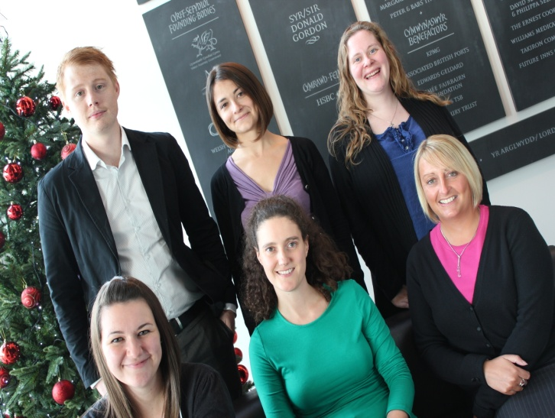
What we do
Ticketing Services Team
Team of six people
Responsible for auditing, reporting, monitoring, advising and training
Setting up and selling performances, workshops, events and products
One stop contact centre
Notes:
Just to give you a little bit of background information on us first of all
Introduce the team Ticketing Services Manager, two Ticketing Services Co-ordinators, Ticketing Services Administrator, Groups and Tours Sales Co-ordinator and Groups and Tours Sales Assistant. Whilst we are a part of the overall department of Visitor Services we do not directly line manage the ticket office staff who are called Visitor Services Assistants, or VSAs for short. We are however responsible for their training in Tessitura as well as assisting in training other departments, setting up all facilities, events and activities here at the Centre and in other venues.
We sell tickets for all Centre performances, events workshops and products, including Welsh National Opera performances at the Centre, performances in National Dance Company Wales’ Dance House, performances in BBC’s Hoddinott Hall, selling tickets on behalf of one of our consortium partners Pontio in North Wales and outside companies such as No Fit State Circus and Bafta Cymru. We’ve also set up events as diverse as harbour cruises, Bryn Terfel’s Faenol Festival and Santa’s sleigh!
As well as booking performance tickets through the Ticket Office we provide a range of other services, offering options to pre book pre show dining, programmes, pre show talks, tours, interval drinks, memberships, donations and car parking.
We are now going to talk you through some ways in which we have used Tessitura to improve our procedures and efficiency within the department.

Slide 4
Recording the Data Protection Act (DPA) questions
Sarah Jones – Ticketing Services Co-ordinator

Slide 5
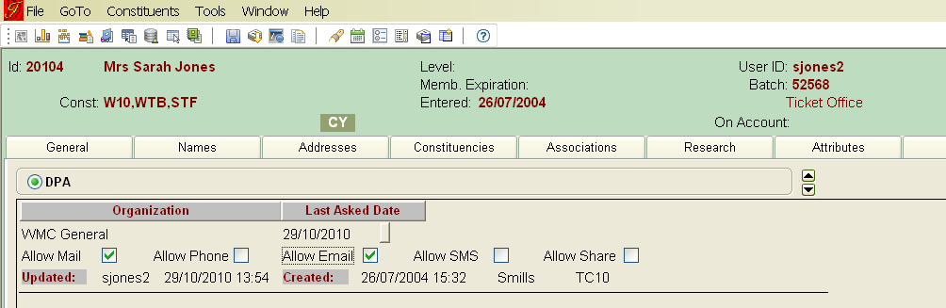
The issues
Lack of data and accuracy when recording DPA
Notes:
One of the main questions we were asking was ‘Would you like to join our mailing list?’ This information was then recorded in a custom screen in the Constituents tab. VSAs ticked the appropriate box depending on how the customer wanted to be contacted and added the last asked date.

Slide 6
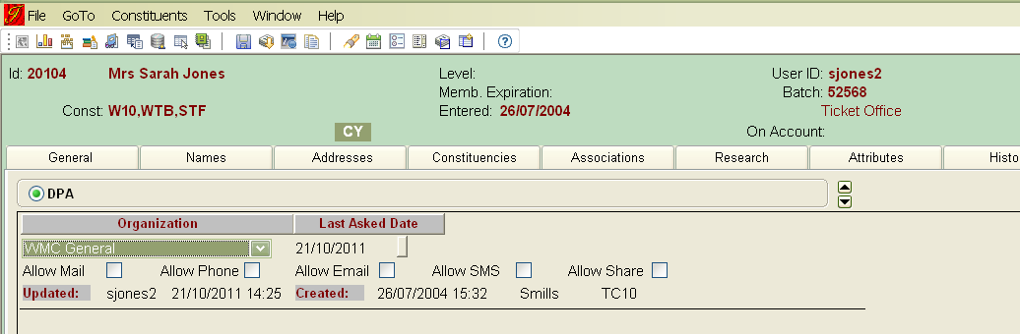
The issues
Staff were not prompted to always ask the questions – despite call monitoring
Unable to ensure that the question was regularly asked once a year
No real way of knowing how accurate data was
If someone said ‘No!’ then we wouldn’t know this

Slide 7
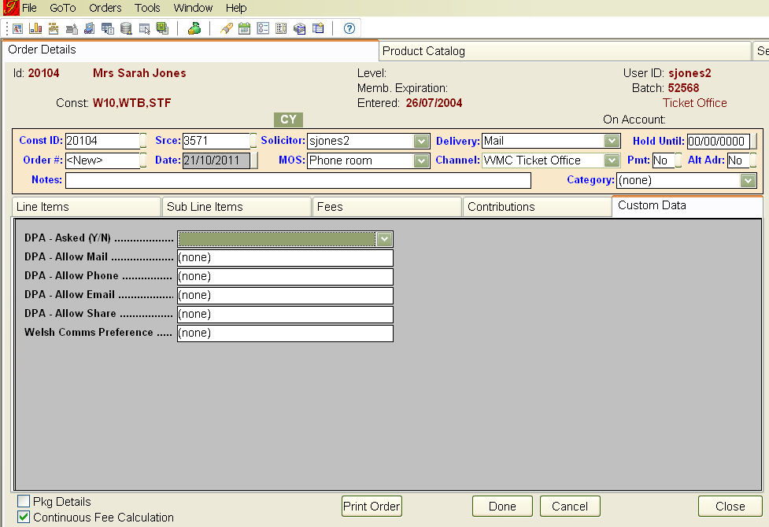
The solution
Custom Screen!
Notes:
The VSA fills in whether they asked the DPA questions yes or no. This is done on trust but we audit using a report and we conduct regular call monitoring so that we can see whether this (along with other processes) is being completed accurately.

Slide 8
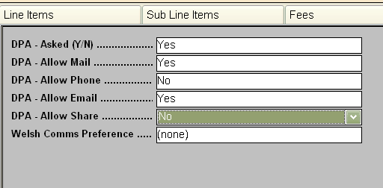
The solution
Would you like to receive further information about performances and activities taking place at the Centre? By email? By post? By phone?
On the occasion there is a show or an event elsewhere we think you would enjoy, would you like to hear from that organisation?
Notes:
Completed custom screen with DPA options selected.
A scheduled procedure automatically runs overnight and the custom tab in Constituents is updated with this information.
Welsh Comms Preference box - future
DPA questions – scripted, again this is something that is monitored.

Slide 9
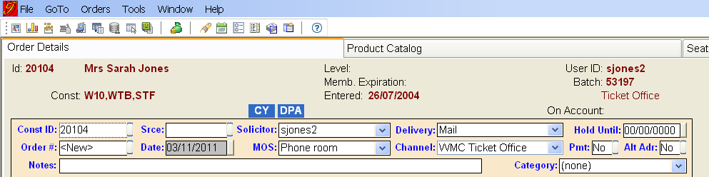
The solution
Staff are prompted by the header when they need to ask the questions
Notes:
A blue box appears in the header called ‘DPA’ and if this is on the customer record then staff members know they need to ask the DPA questions, either because the customer has never been asked, or they have not been asked in the last twelve months.

Slide 10
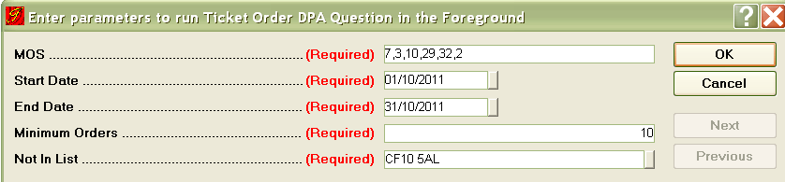
The solution
Custom report written
Notes:
As well as the custom procedure, a custom report has also been written
Report can be pulled on specific Modes of Sale (we don’t count Postal Bookings as there’s no opportunity to ask the customer the question, or Manager MOS as these are usually the more administrative types of orders where it may not be appropriate to ask the customer). We then pull on a specific date range, a minimum number of orders – which excludes orders taken by people in our Marketing and Development departments who may not need to or have the opportunity to ask the questions and we don’t include anyone who has a registered address at our own postcode as DPA isn’t likely to apply.

Slide 11
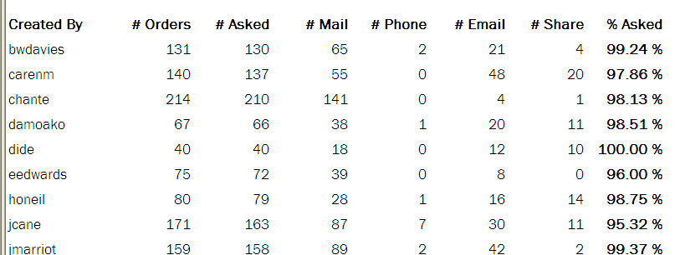
The solution
Custom report results
Notes:
This is an example of October’s report showing each person who has taken over 10 orders in the relevant MOS. Report pulled weekly, reported officially monthly

Slide 12
Results
95% target overall and individually
2010/11
Month | % asked | Number of orders | Orders asked
April | 98.28 | 3498 | 3438
May | 95.28 | 2521 | 2402
June | 98.95 | 2279 | 2255
July | 99.23 | 2723 | 2702
August | 99.32 | 2654 | 2636
September | 99.25 | 3079 | 3056
October | 99.86 | 2846 | 2842
November | 96.84 | 2978 | 2884
December | 98.21 | 3623 | 3558
January | 97.99 | 2742 | 2687
February | 95.06 | 2168 | 2061
March | 97.25 | 3857 | 3751
2010/11 Total | 98.01 | 34968 | 34272
Month | % asked | Number of orders | Orders asked
April | 93.53 | 3681 | 3443
May | 95.20 | 2668 | 2540
June | 96.63 | 2908 | 2810
July | 98.05 | 2920 | 2863
August | 98.26 | 3919 | 3851
September | 98.57 | 2526 | 2490
October | 98.27 | 2712 | 2665
November | #DIV/0!
December | #DIV/0!
January | #DIV/0!
February | #DIV/0!
March | #DIV/0!
2011 Total | 96.85 | 21334 | 20662
Notes:
Marketing asked us to set a target of asking the DPA questions on 95% of eligible orders.

Slide 13
Results
No DPA
161,264 constituents
£30.41
Positive DPA
124,877 constituents
£51.58
(Average £ per annum per person)
Positive DPA results increases our income!
Notes:
Data from 2010

Slide 14
The future
What we want to do to improve in the future
Increase the number of people signing up to receive emails from us
Decrease the number of people saying no
Created By | # Orders | # Asked | # Mail | # Phone | # Email | # Share | % Asked | # NO to ALL
amoreton | 207 | 204 | 110 | 0 | 22 | 0 | 98.55% | 74
carenm | 79 | 77 | 35 | 1 | 26 | 17 | 97.47% | 18
chante | 108 | 107 | 70 | 0 | 9 | 0 | 99.07% | 30
damoako | 144 | 144 | 97 | 0 | 26 | 40 | 100.00% | 30
dide | 46 | 46 | 21 | 2 | 17 | 11 | 100.00% | 13
eedwards | 139 | 136 | 86 | 1 | 13 | 0 | 97.84% | 43
erowland | 54 | 54 | 28 | 1 | 15 | 19 | 100.00% | 17
honeil | 14 | 14 | 6 | 0 | 2 | 0 | 100.00% | 6
jcane | 162 | 162 | 94 | 4 | 35 | 9 | 100.00% | 43
jmarriot | 176 | 175 | 88 | 1 | 50 | 13 | 99.43% | 43
jwong | 61 | 58 | 33 | 2 | 11 | 31 | 95.08% | 17
lwaller | 31 | 31 | 14 | 0 | 5 | 1 | 100.00% | 14
mbell | 77 | 74 | 29 | 1 | 12 | 7 | 96.10% | 34
mdavies | 144 | 143 | 86 | 0 | 42 | 31 | 99.31% | 20
mdoherty | 58 | 56 | 36 | 1 | 7 | 8 | 96.55% | 16
MMorgan | 22 | 22 | 10 | 1 | 6 | 3 | 100.00% | 7
ogriffit | 79 | 79 | 41 | 4 | 17 | 0 | 100.00% | 23
rthomas2 | 73 | 71 | 29 | 1 | 11 | 2 | 97.26% | 34
sbertaux | 49 | 48 | 28 | 2 | 17 | 4 | 97.96% | 11
sedwards | 53 | 53 | 34 | 0 | 5 | 4 | 100.00% | 17
sltyler | 89 | 87 | 49 | 0 | 14 | 1 | 97.75% | 24
srobbins | 91 | 91 | 55 | 2 | 17 | 12 | 100.00% | 21

Slide 15
Conclusion
Inaccuracies of recording DPA results
Custom work in Tessitura solved the problem
We now have a way to accurately record data and monitor staff
Revenue will increase as a result of positive DPA
We are consistently achieving above target and have plans to progress this in the future

Slide 16
Limiting Discounted Tickets (Capping)
Chloë Lansdown – Ticketing Services Coordinator
Notes:
I’ll be talking about limiting discounted tickets, which I’ll be referring to as Capping throughout this presentation
Where the Idea
Reasons Why
How
Benefits

Slide 17
The Idea
Our programming team was approached by a producer who requested we limit the number of concessions available on certain performance within a run.
Notes:
Original idea behind capping from our programming team who were approached by a producer.
At the time we had never capped any offers or discounted tickets previously and therefore it was something new to set up on Tessitura.

Slide 18
Benefits of Idea
Financial benefit
Sell out less popular performances
Early bookings
Notes:
Why start to cap prices for performances?
Financial Benefit, as we’d be restricting the number of discounted tickets available.
The Availability of discounted tickets on specific performances can encourage customers to book for those performances which may not be as popular (for example mid week evening performances)
Encourages customers to book earlier to secure the best price tickets as discounts are subject to availability when capped.

Slide 19
What is Capping?
The ability to limit a certain price type category which in turn limits the price types within that category. As a result, only a set number of tickets can be booked with those price types.
Notes:
What is Capping?
What does this mean?
Discounted tickets are available for customers
However once the capped amount has been reached the discounted price types are expired automatically by Tessitura.

Slide 20
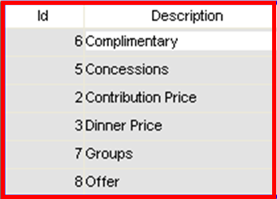
Setting up Price Type Categories
This is set up in system tables: TR_PRICE_CATEGORY
Notes:
CREATED NUMBER OF PRICE TYPE CATEGORIES
PRICE TYPE CATEGORY THAT IS CAPPED
PRICE TYPES WITHIN CATEGORY
SOME CATEGORIES CAME WITH TESSITURA
To begin, we’ve created a number of price type categories within system tables. These are set up as it’s the price type category that is capped and not the price type itself, therefore any price types within this category will become limited as determined by us. These Price Type categories can be used across all performances.
Some of the categories in the above example did come with Tessitura originally.

Slide 21
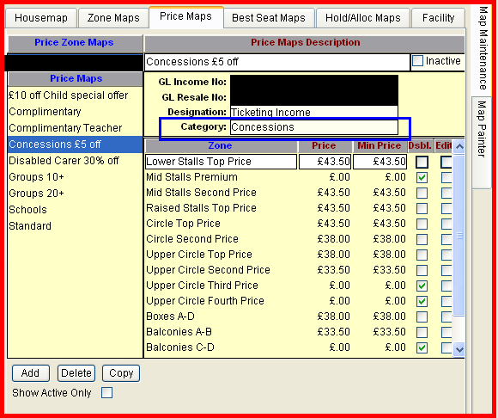
Facility Manager
Price Map > Amended the Category to Concessions (highlighted in blue box)
Notes:
This screen grab is taken within Facility Manager in the Price Map tab where we’ve created a discounted Price Map (in this circumstance it’s a general Concession price of £5 off certain price zones)
Within this price map we’ve amended the Category to Concessions (highlighted in blue box). As mentioned you can only cap a certain category and this is where the category is selected.

Slide 22
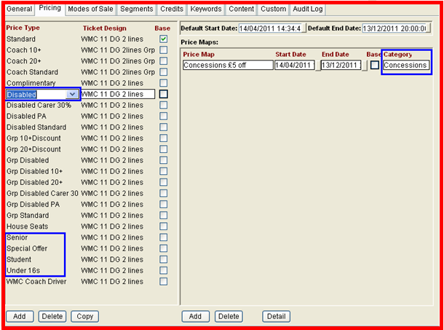
Production Elements
Production Elements > Performances Tab > Pricing
Certain price types are linking up to the same Price Map with our selected Category
Notes:
Next, within Production Elements > Performances Tab > Pricing we’ve added our usual price types. As you can see from the highlighted blue boxes, once linking the price type with the price map the Price Category is also show.
In this circumstance we’ve actually linked multiple price types – Disabled, Senior, Special Offer, Student and Under 16 with the same price map (Concessions £5 Off) and therefore all price types fall into the same category.

Slide 23
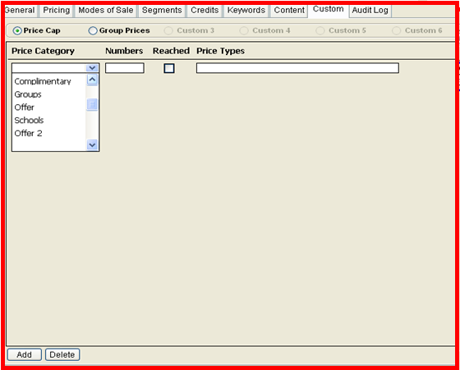
Custom Screen
Notes:
Our Database Team have created a custom feature in the Custom Tab as shown here.
I’ve clicked Add and now have the option to select a price category from the dropdown list – this lists all categories that are set up in system tables.

Slide 24
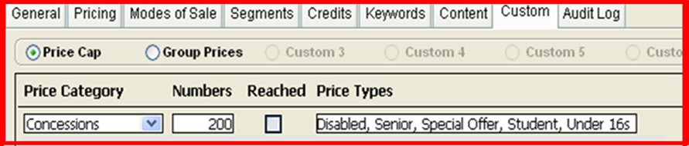
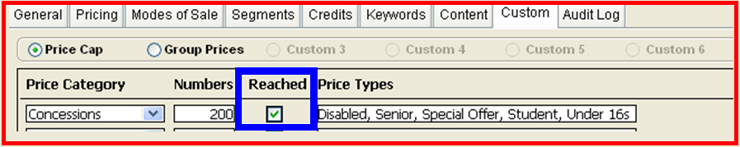
Custom Screen Continued
Notes:
SELECT CATEGORY – SET CAPPED AMOUNT, EXAMPLE
SAVED CHANGES – PRICE TYPES WITHIN CAPPING LIMIT
MIXTURE
LIGHTWEIGHT PROCEDURE – EVERY MINUTE – CHECK
IF REACHED - DATABASE EXPIRE EACH PRICE TYPE WITHIN CATEGORY
SECOND EXAMPLE - TICK
After selecting the price category I’ve set the capped amount for this category – which in this example is 200. I’ve saved my changes and as you can see all price types that are using the same price map with the concessions category have fell into my capping limit. Therefore a mixture of these price types can be used, however once the limit of 200 is reached the price type will become automatically unavailable. A lightweight procedure runs every minute checking whether the capping limit has been reached, if capping has been reached the database will expire the end date of each price type within that category, and as in the second example a tick has appeared, confirming the capping limit has been reached for this particular performance.

Slide 25
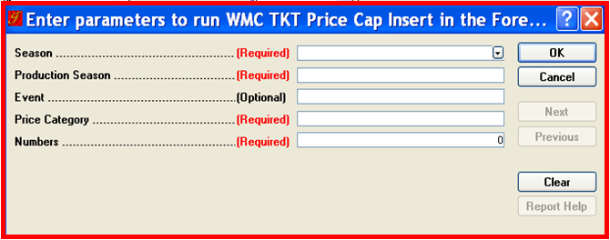
Mass Insert Capping
Notes:
Quick note – our database team have also created a mass insert capping report, so capping can be added retrospectively or at the end of setting up a performance.

Slide 26
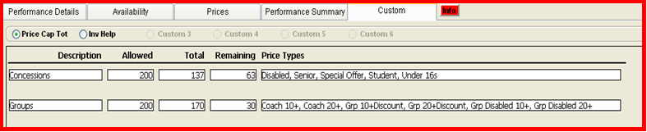
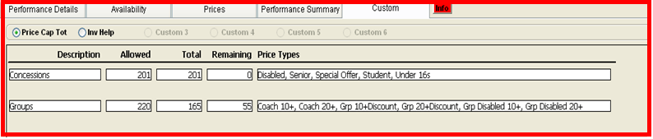
Product Reference Guide
Notes:
We encourage our staff to check the remaining number of capped tickets available by selecting the product reference guide which can be accessed by double clicking on a performance via the product catalogue.
This will detail the total number of capped tickets allowed as set during performance set up, total used, total remaining and also the price types that can be used as part of the capping.
Once capping has been reached, the total remaining amount will be zero as show in the second example

Slide 27
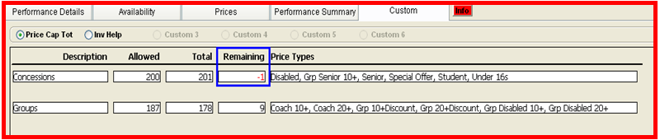
Potential Problem
Notes:
One problem that can occur is the potential to go above the capped amount (see highlighted blue box).
EVERY MINUTE – TWO ORDERS SAME TIME
3 TICKETS REMAIN – BOOK ABOVE
ONLY ONCE SAVED – PROCEDURE TAKE INTO CONSIDERATION UPDATED FIGURES
EXAMPLE – MINUS FIGURE
We’ve previously tried adding a lower amount as the set capped limit, that is if we’re allowed 200 – we’ve added 195 so we do have a safeguard to ensure we don’t go over. However, as our VSA’s become more confident with the capping procedure we train and monitor them to ensure they are checking the Product Reference Guide before applying the discounted price types to the order – which has proved successful.

Slide 28
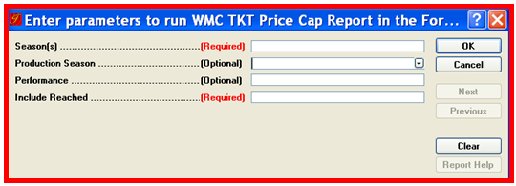
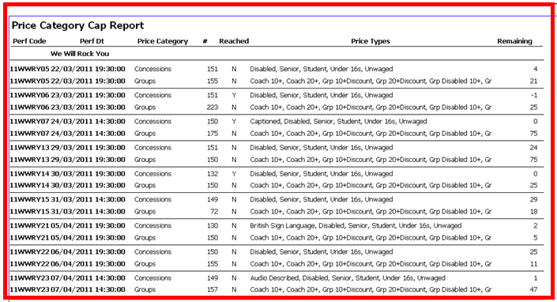
Reporting on Capping
Notes:
In addition to this, we report regularly on the remaining amount of capping for each performance.
A custom report has been created where we can PARAMETERS
REPORT ON CAPPING ACROSS A RUN
ADJUST CAPPING LIMIT PER PERFORMANCE – BALANCE ACROSS THE RUN.
That is, if we’ve gone over the allowed amount on one performance we can amend the total allowed on another performance where tickets are still available at the capped offer, thus balancing over the run.
This is of course, subject to the agreement with the Producer

Slide 29
Financial Benefit
Musical 1 – WITHOUT CAPPING
21 Performances. Approx 26,721 attendees
Total Concessions: Over 12,500 (Including Groups)
67% Reached of Gross Potential Income
Musical 2 – WITH CAPPING
16 performances. Approx 26,848 attendees
Total Concessions: Just over 4,300 (Including Groups)
97% Reached of Gross Potential Income
Mamma Mia (2010)– 79 Performances
Disabled Standard: 1,650 tickets
GRP Standard: 22,471 tickets
Potential Saving of over £120k
Notes:
Difficult to calculate however some clear differences
Compared 2 like for like performances one with capping and one without capping, with similar ticket prices – similar number of performances and similar number of attendees.
Calculated % based on the gross potential income (if every available ticket was sold at standard price)
Less Concessions given out for the 2nd Musical which in turn has increased revenue
Mamma Mia – Price Types > Standard. Based on those figures there was a potential saving of over £120k
SUMMARISE – CAPPING CAN BE ADDED TO TESSITURA AND CAN RESULT IN FINANCIAL SAVINGS

Slide 30
Centre Capping Facts
Capping was first used in 2009.
Capped around 50 of our Main Stage Performances per year– including most of the big hit musicals.
Group Discounts, Concessions, Staff Offers, Under 26 Offers, Corporate Offer, Members Offers, Resident Offers, Retailers Offers
Our customers have began to expect and accept capped performances

Slide 31
Access Scheme
Liz Baird – Ticketing Services Manager
Notes:
I’m going to talk to you today about our Access Scheme, which we launched in March of this year.
This presentation centres around the allocation of complimentary and reduced priced seats for the carers (or Personal Assistants) of disabled people who need additional support when attending shows.
To clarify our Access Scheme does not effect the price of seats for the disabled people themselves, it only effects the seats for the carers.

Slide 32
Aims for today
Processes Pre-Access Scheme
What is our Access Scheme?
How do customer’s join the Access Scheme?
Tessitura Features - CSI’s, Attributes, Constituent Headers and Associations
Custom Reports – Auditing and Finance
Review
Notes:
Here is a summary of the topics I am going to cover:

Slide 33
Background information
Centre has operated a system of trust
No control measure for allocation of complimentary seats
No real definition of the level of assistance needed to warrant a complimentary seat
Notes:
Here’s a bit of background to the way we used to allocated companion seats.
Basically beforehand we operated a system of trust. We would ask them “in the event of a fire would you need assistance?” and if they said yes then we would give them the complimentary seat.
no control measure
no real definition of the level of assistance needed
This led to inconsistencies and lack of clarity amongst customers and staff alike:
One customers idea of needing a complimentary seat would be different to another’s.
One VSA’s idea of needing a complimentary seat would be different to another’s.
On top of this, the VSA’s would sometimes feel awkward asking the customer questions and it sometimes felt that we were judging or assessing the customers needs ourselves.
The boundaries were very blurred and there were occasions where the complimentary carer seats had been given to customers who were not disabled at all but to those who had temporary injuries such has a broken leg.

Slide 34
Research
New Theatre
Diverse Cymru
Disability Arts Cymru
Notes:
As I’m sure you can appreciate, this situation was not at all ideal and of course also had quite significant financial drawbacks as well.
It was felt that a review was needed. We wanted a system that would be fair and we wanted to ensure that the complimentary seats were allocated to those with the most needs.
So Leonie Wallace, Head of Visitor Services at the Centre started researching and benchmarking to see what other venues were offering.
She found that less than a year prior to this, the New Theatre (which is a local theatre in Cardiff) had revised their access scheme. They had worked alongside major disability groups in wales – Diverse Cyrmu and Disability Arts Cymru to form their scheme. This had been well received and so we also met with them and worked in consultation with them to come up with our access scheme.
This ensured that our scheme was fair, consistent and importantly, was also endorsed by these working groups.

Slide 35
Qualifying Criteria
Complimentary seat
(Personal Assistant/Carer)
higher rate Disability Living Allowance care component OR higher rate Attendance Allowance OR Certificate of Visual Impairment
30% concession
(Personal Assistant/Carer)
middle rate Disability Living Allowance care component OR lower rate Attendance Allowance
Notes:
So What is Our Access Scheme then and how do we decide who is eligible to join the scheme?
There are two levels of discounts that can be applied for – a complimentary seat or a 30% concession.
The criteria was approved by the disability groups we consulted and is based on the levels set out by the Disability Living Allowance that is awarded by the government to disabled people.
To apply for a complimentary seat for the carer, (see screen)
To qualify for a 30% concession seat for their carer, (see screen)
If the patron is receiving Disability Living Allowance with the mobility component, or are receiving any other allowances then they do not qualify to join the scheme. They can still have a discount for their own ticket (if there is a disabled concession for the show) but they do not qualify for a complimentary or concession rate seat for their carer.
The main reason behind not including the mobility element was that the Centre was purpose built and is fully accessible to patrons in wheelchairs or who have mobility problems.
So, the Access Scheme has a strict criteria which is very black and white but this is what takes away the inconsistencies previously described and makes it very clear to both customer and staff as to who should get the complimentary/concessionary seats.

Slide 36
How to apply
Download a form from website or request a form from Ticket Office
Send in with a photocopy of the letter from the Department of Work & Pensions confirming the disabled person’s Disability Living Allowance or Attendance Allowance status or Certificate of Visual Impairment
Notes:
How to apply….
So that is the basics of the Access Scheme from a public point of view.
Now I will go through the Access Scheme in terms of our processes and how we use Tessitura to fulfil this.

Slide 37
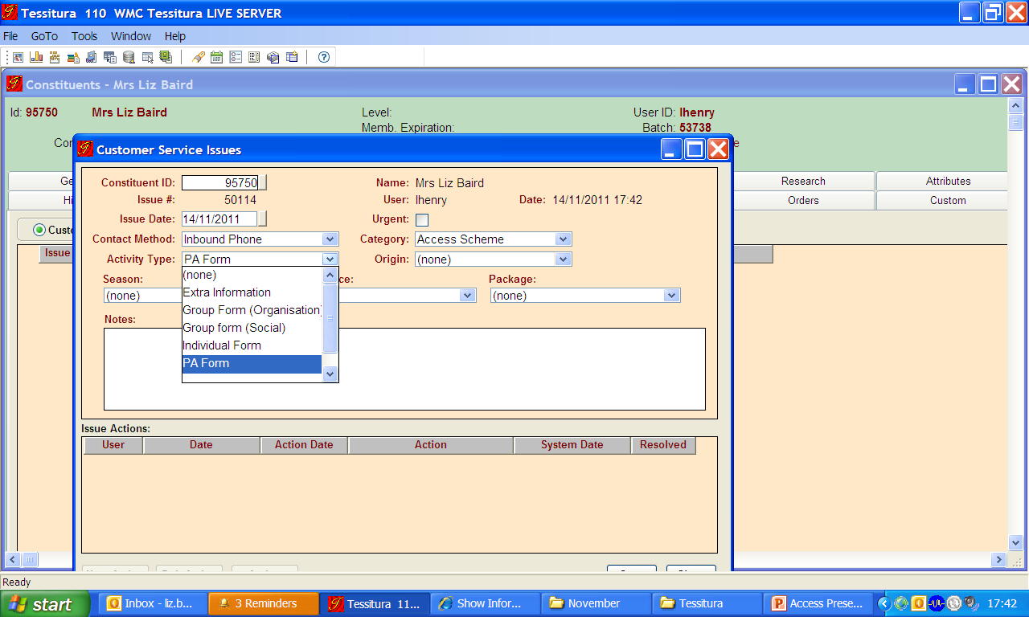
Our Process
Customer Service Issue (CSI)
Notes:
The challenge we faced in Ticketing Services was coming up with a way of logging all relevant information on Tessitura in an efficient way that is easy to locate. We wanted a way of auditing the scheme to make sure the correct discounts were being applied at all times. And we also wanted to be able to report on any financial variances the scheme brought.
We use various features or functions of Tessitura for the Access Scheme and the first one is the Customer Service Issue function or CSI’s.
Where possible download forms, not possible we will send one out to them. In these cases we use the Customer Service Issues (CSI) function in order to log the form requests that have come in via front counter or phone.
There are different application forms depending on who is applying – the Disabled Person, The carer or a Group Organiser.
Contact Method – Phone/Front Counter
Category – Access Scheme
Activity Type – *the form that they require*
Notes Section – if there is any extra info – ie more than 1 form needed, or reservation order number….?
Front counter VSA resolved the issue and so close the CSI.
Over the phone the CSI would remain unresolved and open.

Slide 38
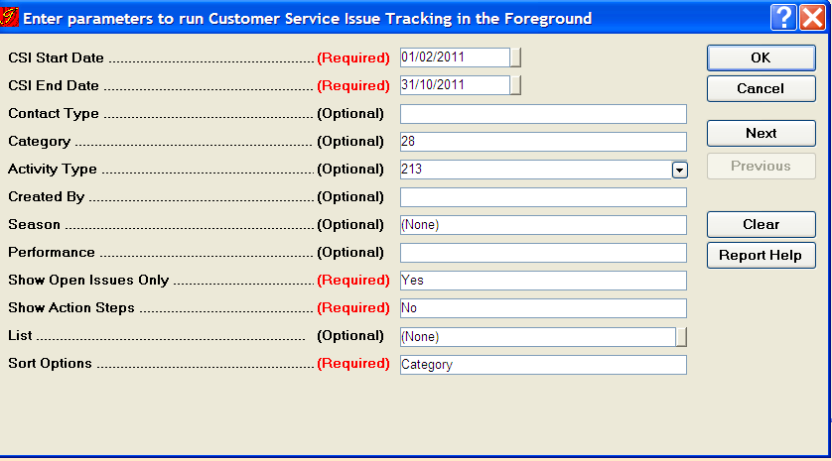
Sending out forms
CSI Tracking Report
Notes:
Rather than the VSA’s who are on the phone sending forms out on request we pull the form request list and send out from Ticketing Services, as we deal with most of the administration in the ticket office and this means that the VSA’s are more efficient with their time.
To do this we run a Customer Service Issue Tracking report for each type of form. We run it only for open CSI’s for the relevant date range. When we first launched the access scheme and lots of customers were applying we were running this daily. Now however as it has quietened down we tend to run it twice weekly.
Once the list has been pulled we then mail merge with the relevant covering letter, send out to the customer and resolve and close the CSI.

Slide 39
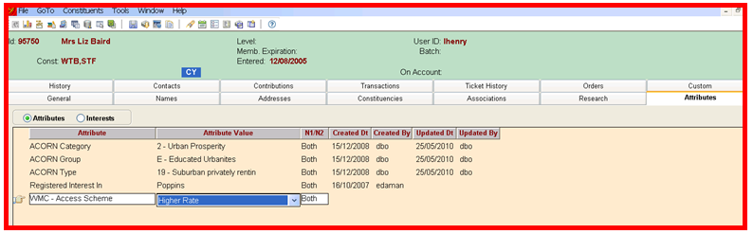
Attributes
Notes:
Then when the forms are completed and sent into us, along with the customers proof of benefits, the forms are processed by Ticketing Services and this information is added to Tessitura. This is security grouped on Tessitura – so only Ticketing Services can add this information.
The way we add the information is through the Attribute Tab, in the constituent record.
complimentary seat = attribute value of “higher rate”, 30% concession for the carer = “middle rate” and if they are not eligible for the scheme we add the attribute value “Not applicable” There are other values for groups and carers but these are the basic ones.
By adding an attribute value, this means that the constituent record is stamped with the information and so each time this customer books the information is ready for the operator to see and so the correct discount will be given.
Once the attribute is added we can send out a confirmation letter to the customer which outlines if they have been successful in joining the scheme and at what level. It also gives the customer their unique customer ID (Or constituent ID) which we ask that they quote each time they make a booking in future.

Slide 40
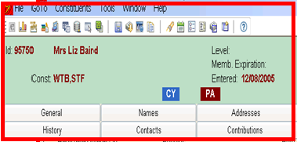
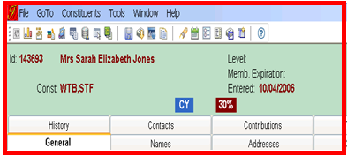
Constituent Headers
Notes:
To make it even easier for the VSA to see this information we have linked these attribute values to the constituent header. That way the operators don’t have to route around the constituent id to find the info. So in this example I am a disabled patron who is entitled to a complimentary PA seat and Sarah is a disabled patron who is entitled to a 30% concession rate for her carer.

Slide 41
Constituent Headers – cont.
Notes:
We have different headers for carers at both levels/organisations i.e. Care Homes and for social group organisers.
So that the VSA’s are fully aware of what all the header symbols mean, we’ve put together this crib sheet which is located by each desk and also can be found on our intranet. Of course the more regularly the headers are used the less the VSA’s will need to check this list.

Slide 42
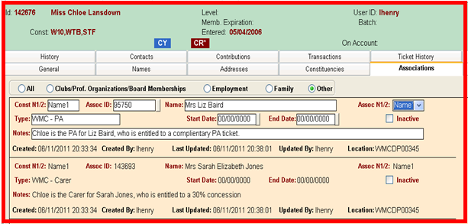
Carers, Groups and Associations
Notes:
This brings me onto talk about how we deal with Carer applications.
The carer can apply to join the Access Scheme on behalf of the disabled person. To facilitate this, we create a record for the disabled person and a separate record for the Carer. Both records are stamped with an attribute and a header. We then link these two records through Associations – within the constituent record. We do this so that both the carer and the disabled person can book tickets without being questioned again on their eligibility.
So, in this example, if Chloe was a Carer to both me and Sarah, the her record would look like this.
She has a header of CR* (which stands for multiple carer) and in the Associations Tab is a list of constituents to whom she is a carer/PA and a note of what they are entitled to.
Group bookings work in a similar way. A group organiser would simply by associated to anyone in the group who has joined the access scheme so we know how many complimentary or concession tickets are needed.
The only other variation is if the group is from a care home, where sometimes the individuals do not have these specific disability living allowances from the government but would only come as part of this group. In these cases we would accept a Risk Assessment from the Care Home which would give a ratio of the number of carers needed per disabled patrons.

Slide 43
Some Scenarios
Customer wants to book tickets for show in advance
Customer wants to book tickets that night
Customer does not agree with assessment made
Notes:
So here are some scenarios for you:
Not joined the access scheme - phones - This is the easiest one –need to follow all the procedures mentioned already.
If the same customer came in person –may not be ideal but they would need to join the access scheme first. reserve the tickets for them. If we hadn’t heard anything within 10 days, we’d contact the customer to doubled check they still wanted to go ahead with the order.
3)Not joined the access scheme phones to book for a show that night
Again we would reserve tickets and advise customer to come in early with proof of eligibility so that a Team Leader or Operations manager can assess it on the night
4) Walk up – for that performance – if they have no proof, then we would not give them a complimentary ticket for that performance, however they could apply for future bookings.
Arbitration
5) If the customer has applied to the scheme and has been assessed and either they have been turned down from the scheme entirely or have been given the 30% and that customer does not agree with the decision, they can appeal the decision made by the Centre.
The appeal system is reviewed independently by Diverse Cymru and the Centre will abide by its decision. This is great for us and for our customers. It ensures fairness at all times and this service gives advice to customers – and in some cases this has resulted in customers being reassessed by the government and in turn their Disability Living Allowances being increased.

Slide 44
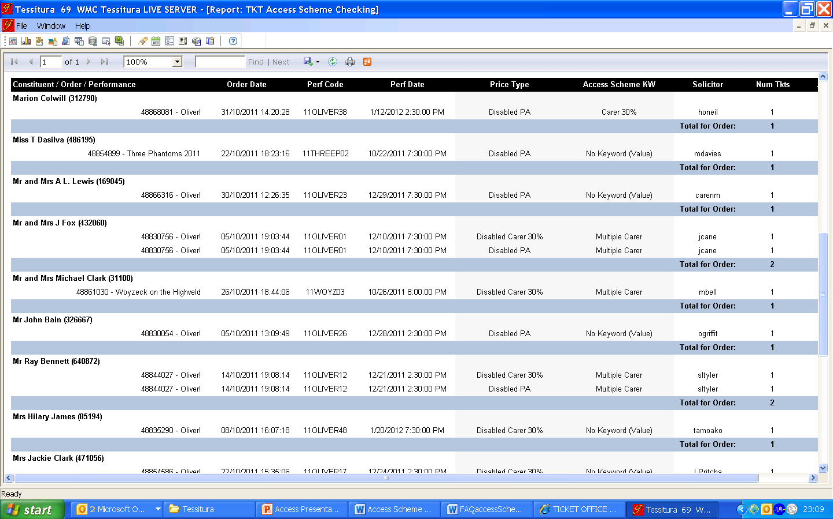
Auditing
Notes:
So now I am going to run through 2 custom reports that have been written for us in respect to the Access Scheme.
The first report is an audit
This custom report is based on cross-checking the attribute belonging to the constituent ID and the price type used in the order.
If this does not match or if this needs further checking the order will shows up in the report. **Orders where the correct Price Type to Attribute has been used, will not feature in this report.
We decided that the report would also always flag up the Group bookings as these need further checking in order to match up to the information found in the Associations Tab on the group organiser’s record or to the number outlined in their Risk Assessment. The report also always flags up Multiple Carers for the same reason.
So in this example there are two customers who have the Attribute of Multiple Carer. (Green Boxes). If a carer is a multiple Carer we ask them during the booking process who they will be bringing and make a note of this in a CSI. So to check if these bookings had been done correctly, we would simply go into this order/constituent ID, have a look at the CSI and make sure the correct number or type of discounts have been given.
Also in this example are three cases where the Disabled PA seat has been allocated but this does not match the Attribute on the constituent record. Reasons = reservations, carers yet to be associated (red box), form is yet to be processed by Ticketing Services. If unknown investigate further.

Slide 45
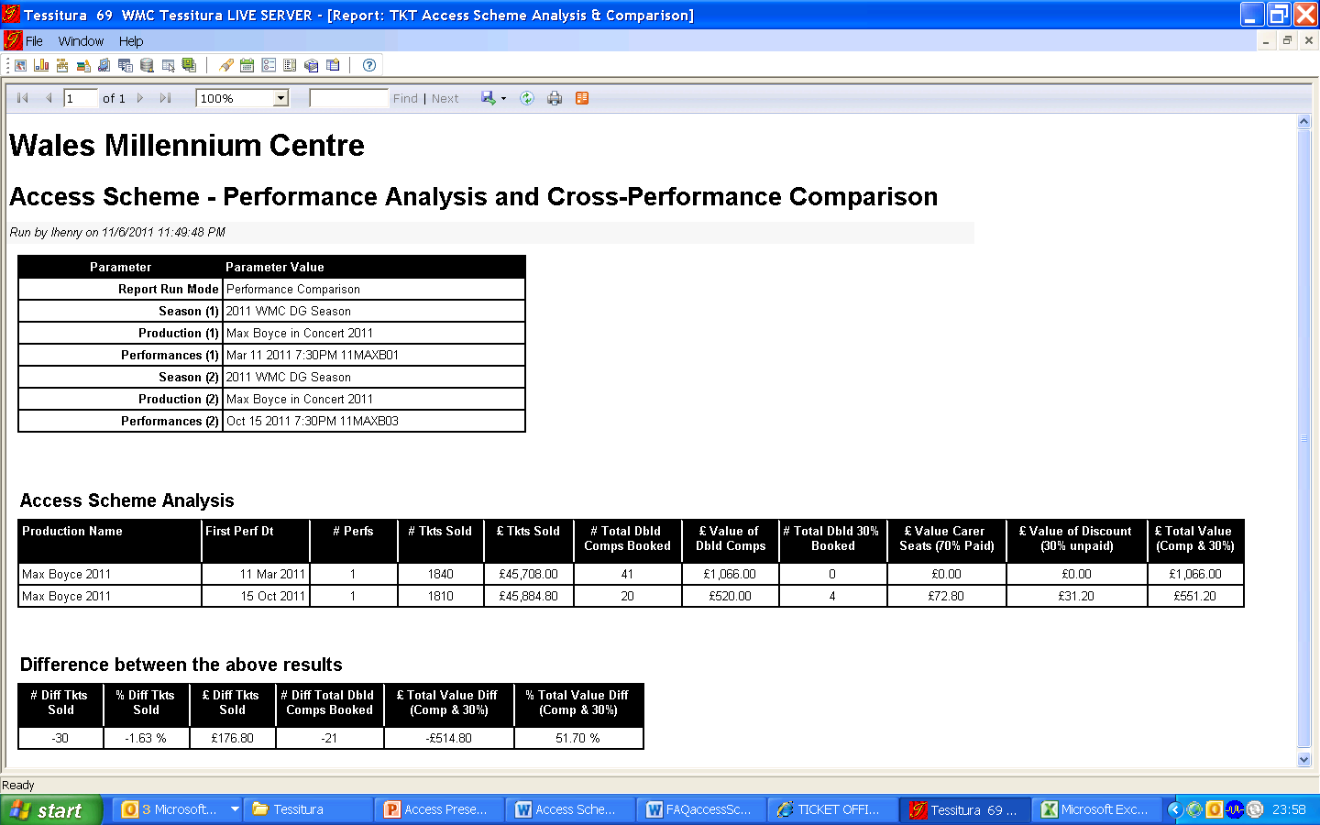
Financial Report
Access Scheme - Performance Analysis and Cross Performance Comparison
Performance 1
Performance 2
Overall comparison between 2010 and 2011 so far – 39% saving
Notes:
The other custom report for the Access Scheme that our Database team have written for us is “Access Scheme – Performance Analysis and Cross Performance Comparison”
It enables us to run a report per performance and see how many Complimentary Carer tickets have been booked, the value of these tickets, how many 30% concession tickets have been booked, the value of these and the total value of these combined. It then gives a comparison between the two performances – showing the difference in the number of Carer tickets booked, the value of these and the value as a % difference.
In this example I have compared 2 very similar one-night performances – the first was earlier this year and was before the Access Scheme was launched. The second was last month and it went on sale after the Access Scheme was launched.
Shows that we allocated 50% less complimentary tickets and the financial saving on carer seats was 51.7%
This of course is only a snap-shot but a similar pattern can be seen for many of the performances.
As we launched the scheme in March we have only 8 months worth of data, plus we’ve still got 2 shows and 6 weeks to go but so far it’s looking that we would have saved 39% on value of complimentary/concessionary tickets for carers, since introducing the scheme. So this is a significant saving.

Slide 46
Access Review
Drawbacks
Administration
Some negative feedback
“Mrs Lunn was, in her words, astounded that we have changed our access scheme and she is unhappy that we do not take higher mobility rate into account.”
“It has left me feeling angry and even more discriminated against as a disabled person as I have to prove my rate of care, something which I feel is an infringement of my privacy…”
Notes:
Finally then I’d like to talk about the Access Review that has taken place.
We are still in the very early stages of the Access Scheme. The first 6 months were run as a Trial Scheme so we have just gone through the 6 month review. We are still in the final stages of putting this official report together but I can share a few results with you.
Early implication is that overall the scheme has been a success. It has received a lot of praise from both the disability groups involved in the creation of the scheme and individual disabled people who have since joined the scheme.
Draw-backs have been: high administration needed and this is on-going.
There has been some negative feedback, as you would expect, mainly in respect of the criteria.
Here are some examples.

Slide 47
Access Review – Cont.
Positives
Clarity and fairness of the scheme
“The Access Scheme has broken down communication barriers and reduced the anxiety and discomfort sometimes felt by non-disabled people who are unfamiliar with disability. “
Arbitration system
“Thank you for considering and responding to my feedback. I'm glad to note that there was consultation with disabled groups.”
Financial savings
Notes:
But on the positive side, we have had lots of positive feedback for the scheme from both customers and staff – in particular, it’s fairness and it’s clarity on criteria. Staff have a clearer understanding over who is entitled to complimentary/concessionary seats. There are no more awkward conversations for the VSA’s where they feel they are the ones that need to assess. Here’s a nice quote from one VSA and then from a customer.
Arbitration system has been highly beneficial to all parties concerned
Financial savings have been great.

Slide 48
The End
Unrhyw Cwestiynau?
Any Questions?

Slide 49
Diolch yn fawr iawn
Thank you very much

