Slide 1

Managing Consortium Relationships
Mara Hazzard-Wallingford
Director, Yale Tessitura Consortium
mara.hazzard-wallingford@yale.edu

Slide 2
Agenda
Consortium Overview
Staff Structure
Committee Structure
  Takes 1, 2 and 3
Committee Deep Dive
Executive Communication Tools
User Communication Tools
Future Goals
Notes:
What am I going to talk about today?

Slide 3
Yale Consortium Overview
Live since 2005
4 organizations
125 users
All under the Yale University umbrella
Notes:
Yale University has been live on Tessitura since 2005.
We have four organizations within Yale University using Tessitura:
Yale School of Drama
Largest user, acts as master licensee
Includes Yale Repertory Theatre, Yale School of Drama, Yale Term-Time Cabaret and Yale Summer Cabaret
Uses Tessitura for subscriptions, ticketing, marketing, events, education and contributions
Yale School of Music
Includes Yale School of Music (student and presented performances) and Norfolk Summer Music Festival
Uses Tessitura for subscriptions, ticketing, marketing, events and contributions
Yale University Art Gallery
Uses Tessitura for memberships, events (including elevated events and ticketed events), constituent management and contributions
Yale Center for British Art
Uses Tessitura for memberships, events, constituent management and contributions
Those 4 organizations have about 125 total users.
I have been director of the consortium since 2008

Slide 4
Staff Structure
Me
Notes:
I made an org chart of our consortium staffing structure.

Slide 5

Staff Structure
Consortium Director
Technical Team (Yale ITS)
Consultants
Users
Notes:
Actually, there is a team. I work with a technical team from Yale University’s central Information Technology Services (ITS) department. We have a contract for the equivalent of one full-time person, but I have a team of 3 people who work on various projects. Their work includes custom reports, system customizations and web programming.
Occasionally, we use consultants for projects when our bandwidth exceeds our internal resources.
We rely heavily on the users to help us get things done.

Slide 6
Committee Structure, Take 1
Tessitura Executive Committee
Tessitura Partners
(Everyone Else)
Notes:
When I arrived at Yale in the summer of 2008, there were two Tessitura committees for the consortium.
There was a Tessitura Executive Committee, made up of one senior staff member from each organization, the technical lead from Yale ITS, my supervisor (executive project sponsor), and me.
Then, there was the other committee, which I like to call the Everyone Else committee. This committee was made up of power users and stakeholders from all four of the consortium members. Their meeting agendas were a rundown of status reports for all of the projects being worked on (or talked about).

Slide 7
Committee Structure, Take 1
Tessitura Executive Committee
(Everyone Else)
  Too many meetings
  Meetings are too long
  Meetings are too boring
  “Hardly anything applies to me.”
Notes:
When I started asking people what was working and what wasn’t working with Tessitura at Yale, I got a lot of feedback about this Everyone Else committee.

Slide 8
Committee Structure, Take 2
Tessitura Executive Committee
(Everyone Else)
  Too many meetings
  Meetings are too long
  Meetings are too boring
  “Hardly anything applies to me.”
Project Focused Committees
Notes:
So, in response to this feedback, I got rid of the Everyone Else committee and replaced it with project specific committees.

Slide 9
Committee Structure, Take 2
Tessitura Executive Committee
Project Focused Committees
Advantages
  Focused
  Specific Goals
  Relevant
  Effective
Notes:
In our new committee structure, we had the Executive committee, which was consortium wide, and we had project focused committees, which were usually self-contained within a single department or organization.
This had some advantages.
Agendas were focused on a specific project.
We were able to accomplish specific goals as a group.
The agenda items were relevant to everyone there.
We were more effective at accomplishing our goals

Slide 10
Committee Structure, Take 2
Tessitura Executive Committee
Project Focused Committees
Disadvantages
  Cross-Organization Relationships
  Shared Resources
  Big Picture Accountability
  Org Chart (Me)
Notes:
Our new structure had some disadvantages, too.
Decrease in cross-consortium communication and cooperation. We were gathering at the executive level, but the actual users were interacting less than they ever had. This led to issues related to shared data, personality conflicts, communication breakdowns, etc.
We were less effective at sharing resources. If one organization was working on a project that could potentially benefit another organization, it was less likely that I would find out about that so I could leverage our resources effectively.
Individual Tessitura projects don’t exist in a vacuum—they are all part of the Tessitura gestalt. By breaking down the group into individual project teams, there was no one left to look at the big picture. (Except me)
Which brings me to the biggest disadvantage to this approach. I was still only one person. And I was overseeing an ever increasing number of meetings as project work increased.

Slide 11
Committee Structure, Take 3
Tessitura Executive Committee
Project Focused Committees
  Tessitura Next Generation
  Large customizations
  Web projects
Tessitura Super Users
Tessitura Data Management Work Group
Notes:
So that brings me to our current structure. We still have the Tessitura Executive Committee, but its membership has evolved to include a more senior member of the ITS team.
We still have project-focused committees, but they aren’t our only source of face-to-face communication outside of the Executive Committee, and we have only the meetings necessary to complete our high priority projects.
We have added a Super User committee and a Data Management Work Group.
With the exception of some of the project teams, all of our committees are cross-organizational and include representation from all four consortium member organizations.

Slide 12
Data Management Work Group
Resolve issues & create policy related to shared data usage across the consortium
Box office, gift entry, events, lists
Major policy shifts are reviewed and approved by Executive Committee
Notes:
The mission of the Data Management Work Group is to resolve issues and create policy related to shared data usage across the consortium.
The members are users on the front lines who are directly affected by shared data issues.
This group is empowered to make decisions related to how we manage Tessitura data. Major policy shifts are reviewed and approved by the Executive Committee.

Slide 13
Super Users
Serve as the subject matter expert in their field.
Provide basic support and training to Yale Tessitura Users across the consortium.
Share information about Tessitura innovations and customizations.
Increase Tessitura knowledge through advanced trainings.
Notes:
The mission of the Super User group is to provide basic support and training to users across the consortium and to share information about Tessitura innovations and customizations.
The Super User group is made up of motivated and skilled individuals who use at least one area of Tessitura intensively. These users are available to provide basic support and training to all users across the consortium, not just within their own organization. They are also encouraged to share information about Tessitura innovations or customizations that have improved efficiency and effectiveness within their own department or organization. The Super Users also have access to advanced training sessions to help them increase their Tessitura knowledge.

Slide 14
Executive Committee
Prioritize projects, considering consortium wide and organization-specific needs
Maintain an understanding of the big picture and how their needs fit in
Communicate and provide guidance within their organizations on priorities, issues, deadlines
Notes:
The Tessitura Executive Committee still meets once as month as well. Their primary mission is to provide guidance on how to prioritize our enormous Tessitura project backlog. I also provide an overview of our monthly Tessitura activity and keep them apprised of any issues. Executive Committee members provide guidance and information within their own organizations as well.

Slide 15
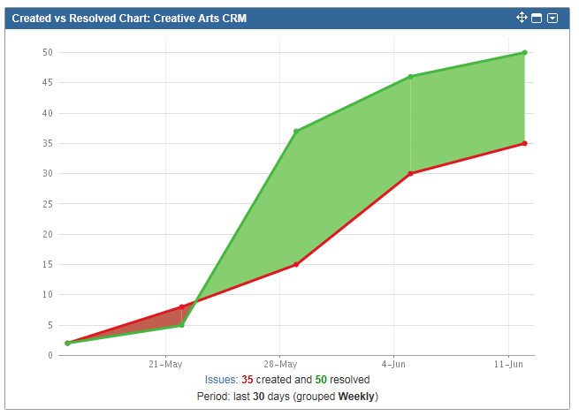
Executive Project Report
Notes:
The executive project report always includes a screen shot from the dashboard of our project management software, JIRA. This snapshot shows how many new tickets were created and how many were resolved since our last meeting. This is a screen shot of a very productive month! This visual helps executive committee members understand at a gut level when work is really starting to pile up.
In addition to the graph, I provide them with a list of the specific items that were created and resolved since the last meeting, along with our long term, big-picture project plan. This information helps provide a context for them in their road map voting.

Slide 16
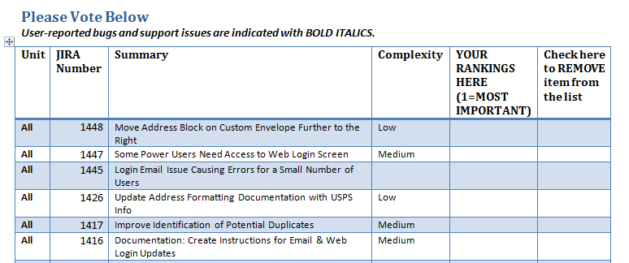
Executive Road Map
Notes:
Before every meeting, I give each of the four organizational executive representatives their organization’s Tessitura road map. The Tessitura road map includes all issues that have been entered into our project management software that are not already in progress. Currently there are over 100 total items on our road map. A road map item can be something simple, like moving the address block on the envelope report over a little bit or writing up documentation on something, or it can be something really complicated, like creating an integration with our finance system. Road map items are added every time I become aware of an issue that needs to be addressed. Each representative’s road map includes all of the items that affect their organization.
Each month, they pick three items they would like to see the team address. I prioritize these items with the technical team. Once something is in progress, it drops off the list. If it isn’t addressed before the next meeting, it remains on the list for future voting.
Representatives can also remove items or add items to the list during monthly voting.

Slide 17
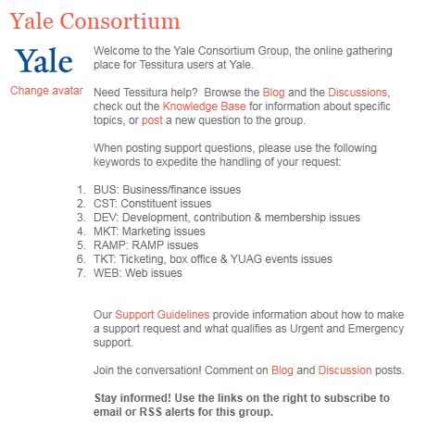
Online Group
Notes:
My communication with the Executive Committee really centers around our monthly meetings. Occasionally, something important comes up that can’t wait until the next meeting, but that is the exception.
With the users, there is a need for more frequent and immediate communication. That’s where our online group comes in.
How many of you use the Tessitura Network website? At Yale, we have a private group, open only to people who use or support Tessitura in our consortium. Every user in our consortium is required to sign up for the Tessitura Network website and for our online group in order to stay up to date on consortium information and have access to support and documentation.

Slide 18
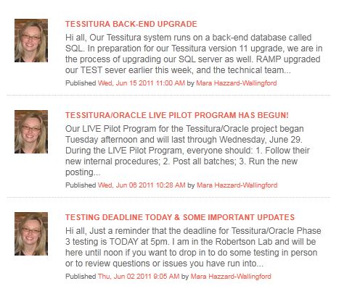
Blog
Notes:
I use the blog for announcements and updates. Unless something is extremely urgent and time sensitive, I never send email to the users anymore. Instead, I post all of my updates to the blog. Users are required to sign up for email notifications or check the group page frequently for updates.
Everyone has a single source for information, and it’s easier for me to keep track of what I have said in the past and what new information needs to go out to the community.

Slide 19
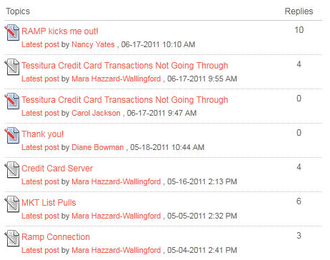
Discussions
Notes:
We use the discussion area of our group as a support forum. Any user who has a question or a support issue is encouraged to post it to the group. Members of the Super User group and the technical team are all subscribed to email alerts and can jump in to assist as needed. I also monitor all of these messages to ensure that users receive appropriate support. We often see users helping each other across organizations.
Discussion posts that contain answers to frequently asked questions become part of our knowledge base.

Slide 20
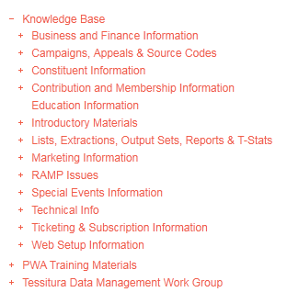
Knowledge Base
Notes:
We use the Wiki area of the group as our online knowledge base. Our knowledge base is organized by topic. The articles typically link out to standard documentation on the Tessitura Network site, custom documentation on Yale’s Share Point site, or discussion threads with helpful information.
We also use the Wiki to keep track of notes for our committees and project teams.

Slide 21
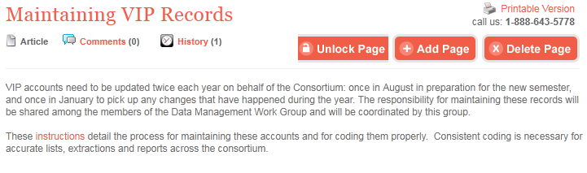
Knowledge Base
Notes:
Here’s a sample article. The instructions link goes out to our Share Point site, so we are not storing any documents and using up memory on the Tessitura Network website.

Slide 22
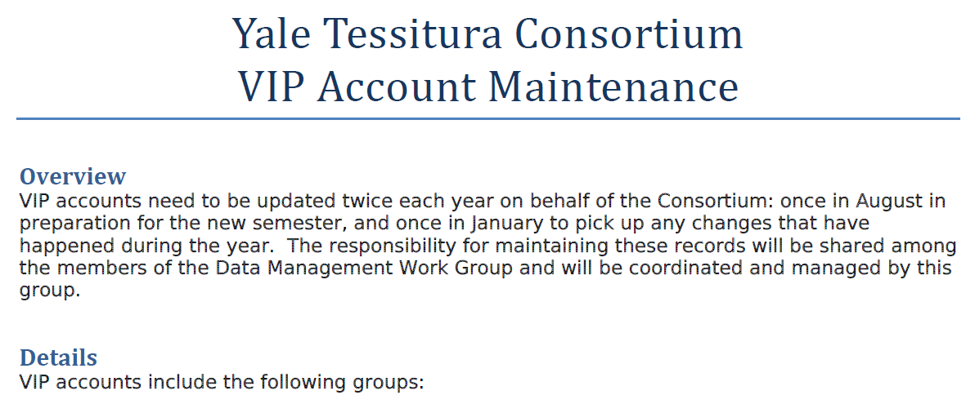
SharePoint
Notes:
With Share Point, users link directly from the online group to the specific document they need in Share Point. Users don’t have to navigate through Share Point. The online group provides the navigation and Share Point stores the documents.

Slide 23
Future Goals
Guest posters on Blog
Monthly series on Blog
Even more engagement
Even more information exchange
Org Chart
Notes:
Overall, the users are really happy with the changes we’ve made over the past few years and with our overall direction.
My future goals are to incorporate users and technical team members as guest posters on the blog. Right now, the blog is really all my voice, and I think people get tired of hearing from me (maybe you can relate?)
I would like to create some monthly blogging series, like a series on Tessitura smart tips, new project of the month, etc. This could also include posts from guest bloggers.
I would like to see even more engagement from users who are on committees, and even more information exchange across organizations.
Finally, I would love to see just a few more boxes on that org chart.

Slide 24
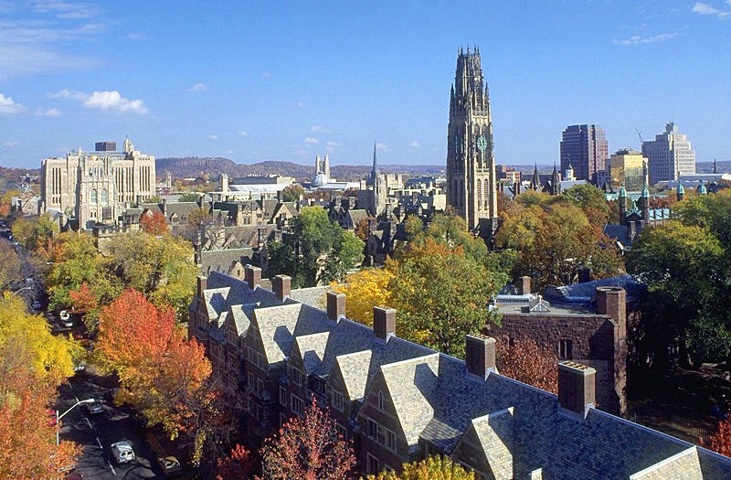
Thank you!

