Slide 1
Gift Aid
Free Money!
UK Tessitura Conference 2011
Ben Magson

Slide 2

Introduction

Slide 3
Overview
Standard Gift Aid Screens and Reports
Setup and Configuration
Processing

Slide 4
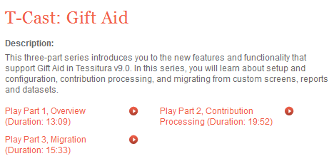
Resources
Search TessituraNetwork.com for “Gift Aid T-Cast”

Slide 5
Standard Gift Aid Screens and Reports
Gift Aid Screens
Reports
List Criteria

Slide 6
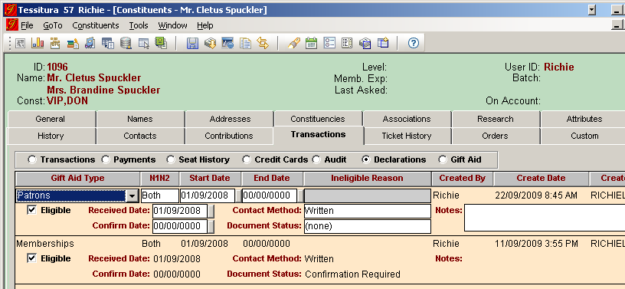
Standard Gift Aid Screens and Reports
Gift Aid Declarations
  Constituent Record > Transactions tab > Declarations

Slide 7
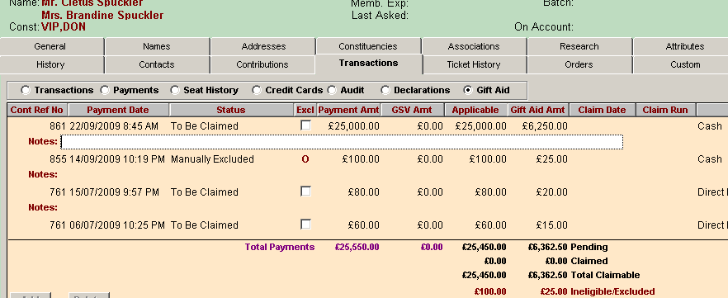
Standard Gift Aid Screens and Reports
Gift Aid Payments
  Constituent Record > Transactions tab > Gift Aid

Slide 8


Standard Gift Aid Screens and Reports
Reports
  Gift Aid Claims
  Gift Aid Claims R68
  Gift Aid Claims Reversal (yayy!!)
  Gift Aid Declarations
  Gift Aid Payment Status
  Gift Aid Payment Update

Slide 9
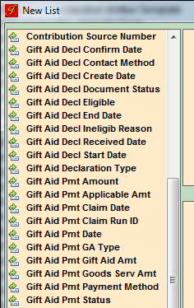
Standard Gift Aid Screens and Reports
List Criteria
  20 elements
  Declaration and payment
  More could be added by you…

Slide 10
Setup and Configuration
System Tables
Scope

Slide 11
Setup and Configuration
System Tables
    T_DEFAULTS
    TR_GIFTAID_TYPE
    TR_GIFTAID_CONTACT_METHOD
    TR_GIFTAID_DOCUMENT_STATUS
    TR_GIFTAID_INELIGIBLE_REASON
    TR_GIFTAID_RATE

Slide 12

T_DEFAULTS
GIFTAID_ENABLE = Yes
  Turns on Gift Aid functionality
GIFTAID_DEDUCT_GSV = Yes
  Yes excludes the GSV of memberships from Gift Aid payments, and subtracts the GSV from the payment amounts for the membership contribution

Slide 13
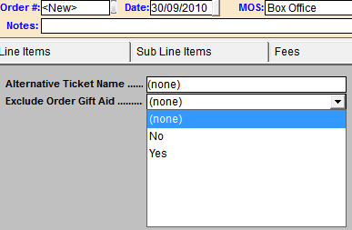
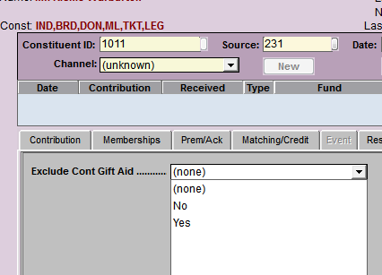
T_DEFAULTS
GIFTAID_CONT_EXCLUDEKEY
GIFTAID_ORDER_EXCLUDEKEY
  Number of order custom attribute
  (custom_#, not keyword_no)
  For manually excluding gift aid payments

Slide 14
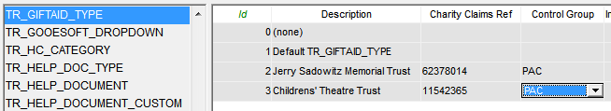
TR_GiftAid_TYPE
“Charitable Entity” name and Charity Claims Reference #
  Assigned to FUNDS and to DECLARATIONS
  Specified when running claims and confirming declarations

Slide 15
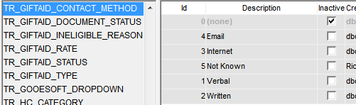
TR_GiftAid_CONTACT_METHOD
User-defined statuses for a constituent’s gift aid declaration contact method
  Shouldn’t need to add anything (comes pre-filled-in)

Slide 16
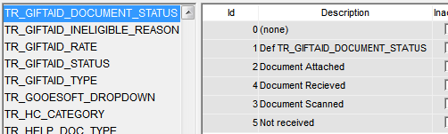
TR_GiftAid_DOCUMENT_STATUS
Not used in standard reports – purely for your internal custom reporting and process management
  Often used to manage the scanning of declarations and attaching to constituent records

Slide 17
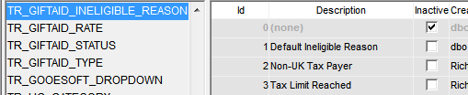
TR_GiftAid_INELIGIBLE_REASON
  Ineligible reason for declarations of ineligibility
  e.g. Non-UK Tax Payer or Tax Limit Reached

Slide 18

TR_GiftAid_RATE
  Current Base Tax Rate
  Changes over time are managed with multiple rows, so current rate has no end date

Slide 19
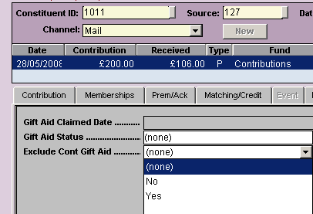
T_KEYWORD – Contribution Exclusions
Exclusion Custom Fields, Contributions:
T_KEYWORD entry:

Slide 20
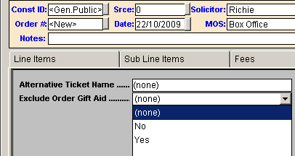
T_KEYWORD – Order Exclusions
Exclusion Custom Fields, Ticket Orders:
T_KEYWORD entry:

Slide 21
Setup and Configuration
Scope
A valid declaration + four more things must be in scope for a payment to be eligible:
    FUND
    PAYMENT METHOD
    CUSTOMER TYPE
    CREDITEE TYPE

Slide 22
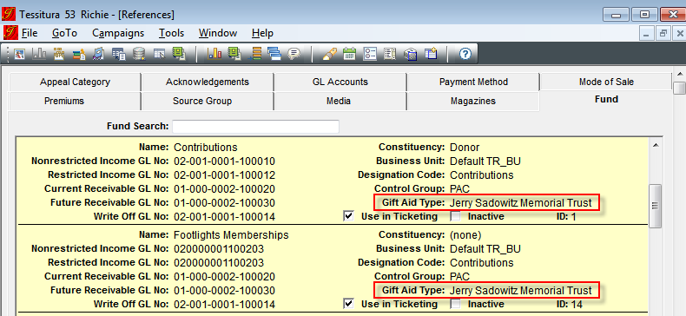
Setup and Configuration
Scope - FUNDS
  Select your charitable entity against each Fund that should be in scope:

Slide 23
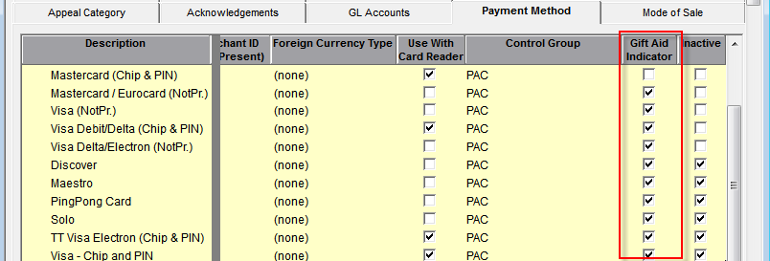
Setup and Configuration
Scope – PAYMENT METHODS
  Check the Gift Aid Indicator against each Payment Method that should be in scope:

Slide 24
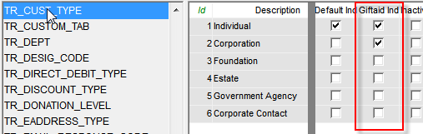
Setup and Configuration
Scope – CUSTOMER TYPE (TR_CUST_TYPE)
  Check ‘Giftaid Ind’ where appropriate

Slide 25
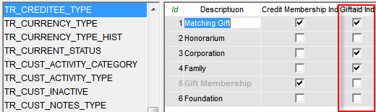
Setup and Configuration
Scope – CREDITEE TYPE (TR_CREDITEE_TYPE)
  The creditee is the customer who receives the benefit for the money donated by a creditor
  (e.g. the recipient of a gift membership)
  Check ‘Giftaid Ind’ where appropriate

Slide 26
Processing (the standard-ish way)
Add a declaration
Run the Declarations report for verbal declarations
Process a contribution
View claimable money on constituent record
View claimable money in Payment Status Report
Run a claim

Slide 27
Processing (other things to consider)
Managing a Declarations drive
Back-dated declarations
Contribution adjustments
GSV amounts and upgrades/downgrades
Changes to scope
Changes to base tax rate
Reversing a claim

Slide 28
Processing (other things to consider)
Managing a Declarations drive
  Use Gift Aid Payment Status Report
  Save output to a List.. or use List Manager
  Create a source code / promotion
  Update in Constituents > Contacts > Promotions on receipt of declaration

Slide 29
Processing (other things to consider)
Back-dated Declarations
  Contributions are updated to
  ‘To Be Claimed’
  If necessary, Gift Aid Payment Update utility can be run for a single constituent or List

Slide 30
Processing (other things to consider)
Contribution Adjustments
  -ve row added
  Original claimable amount amended
  Status - ‘Adjusted Pre/Post Claim’

Slide 31
Processing (other things to consider)
GSV Amounts
  Deducted from initial pledge payments
  First contribution row amended to reflect changes due to upgrade or downgrade

Slide 32
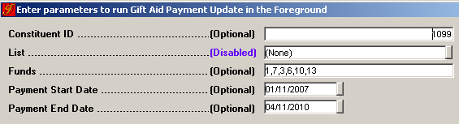
Processing (other things to consider)
Changes to Scope and Base Tax Rate
  Gift Aid Payment Update Report
  Run for List, Fund, payments within date range or even a single constituent

Slide 33
Processing (other things to consider)
Reversing a claim
  Claim Run #
  “Reason text”

Slide 34

Questions…

Slide 35

The End

