Slide 1
“Building a Better Package”
Paul Callas
Information & Sales Manager
Birmingham Hippodrome

Slide 2
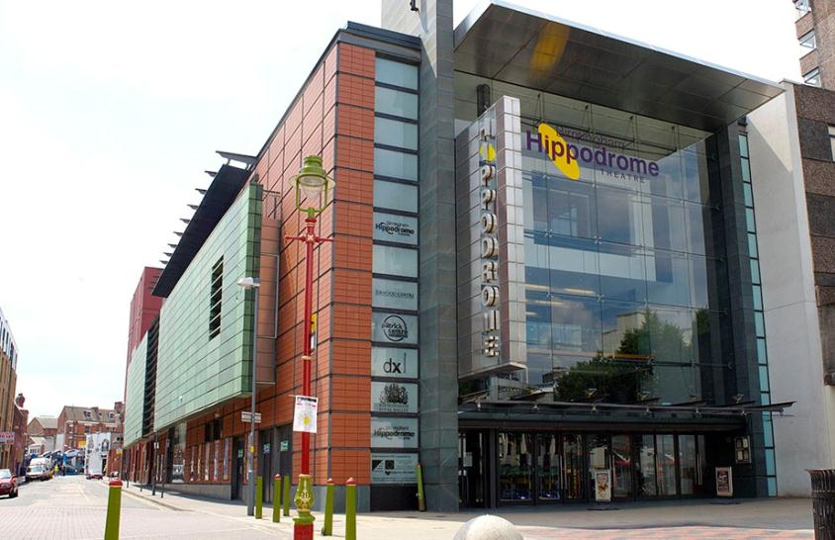
The busiest independent theatre in the UK
  500,000 paying visitors every year
  Contribute over £40m to local economy every year
  Busiest visitor attraction in the City Centre
  One of the top 5 paid visitor attractions in the region and one of the top 20 in the UK.

Slide 3
Hospitality Packages
VIP Experience - £78/£93 per person*
Receive a warm welcome on arrival at the theatre
Indulge in a glass of Champagne on arrival
Complimentary show programme (one per couple)
Enjoy a luxury 3-course meal at our best tables
Enjoy the show from top-price seats
Return to your table at the interval for your dessert and coffee

Slide 4
Hospitality Packages
Stage Side Experience - £69/79 per person*
Be escorted to the theatre's Stage Side Bar & Restaurant
Enjoy a 2 course meal (starter & main course) in this lively setting
Complimentary show programme (one per couple)
Enjoy the show from top price seats
Glass of champagne and a dessert, served at the interval
At curtain-down, enjoy a farewell drink at our Stage Side Bar (A glass of wine, beer, soft drink or coffee)

Slide 5
Hospitality Packages
Royal Box Romance - £82/£97 per person*
Receive a warm welcome on arrival at the theatre
Enjoy a luxury 3-course meal, followed by coffee, at one of our best tables
Complimentary show programme (one per couple)
Indulge in a glass of champagne, chocolate-dipped strawberries and nibbles in the privacy of your Box

Slide 6
Original Set Up:
Processed part in Artifax and part Tessitura.
Function Sheet necessary for each package.
Only 1 person could sell packages.
What happens during their Holiday’s or Sickness?
Overall this system didn’t work and only generated customer complaints.

Slide 7
Can we improve this?
What about VAT?
Can we make the sales process easier?
How can we make it possible for more people to sell them?

Slide 8
What is the Answer?
“Anything is possible with a little help from Tessitura!”

Slide 9
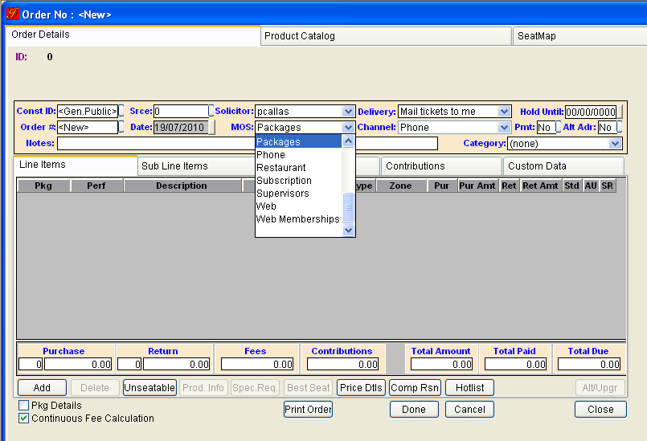
Step 1 – New Mode of Sale

Slide 10
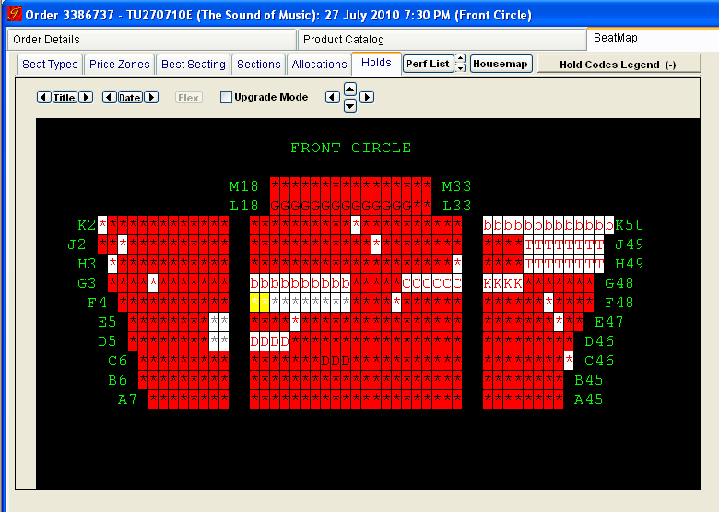
Step 2 – Select You Seats
Notes:
Allocations

Slide 11
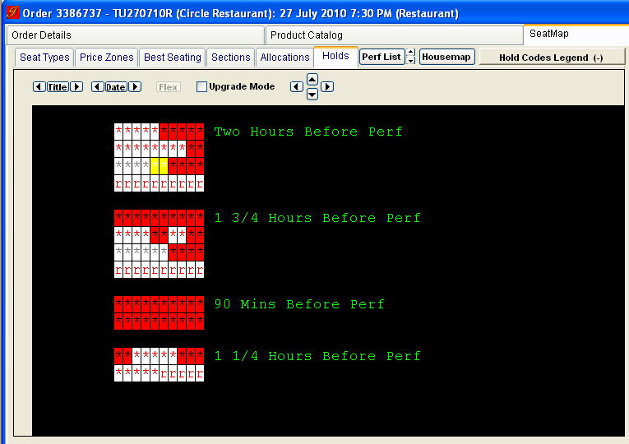
Step 2 – Book the Restaurant

Slide 12
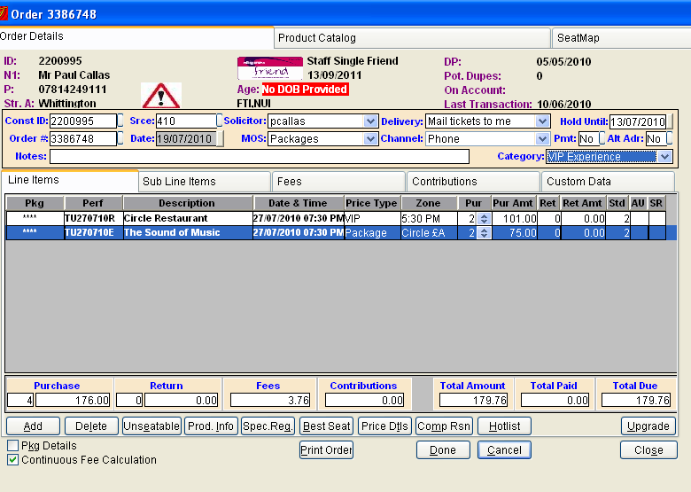
Step 3 – Sell the Package
Notes:
Category Configured in System Table – TR_Order_Category
It is made mandatory in Campaigns, References, Mode of Sale Tab – Click “Req Category”

Slide 13
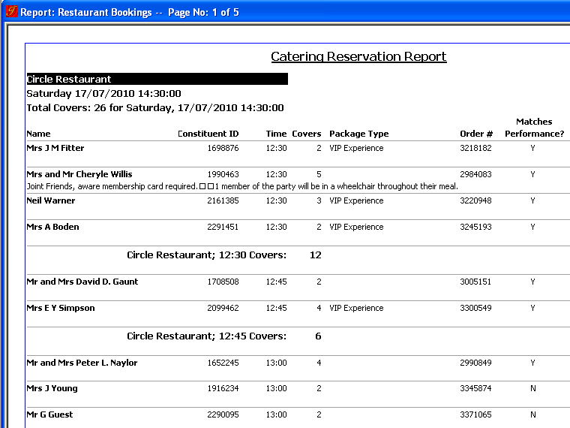
Restaurant Report...

Slide 14
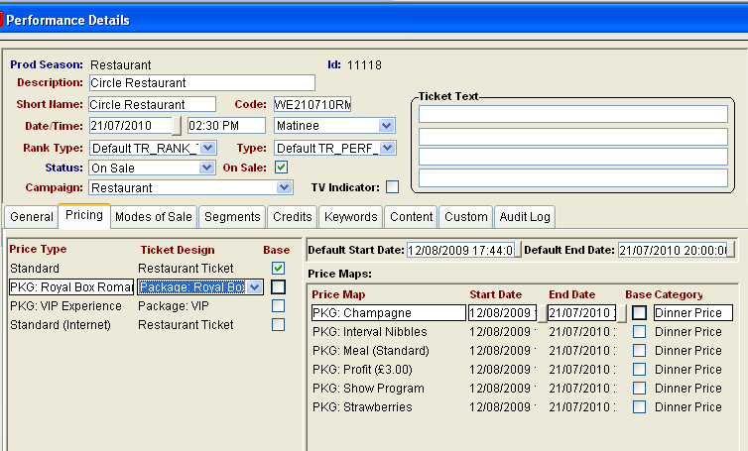
Multiple Price Maps...
Notes:
All price maps are prefaced with PKG to allow easy suppression from other reports.

Slide 15
VAT Breakdown...
Already Included in the gross price.
1-(1/VAT) = Vat Rate Calculation
Gross Price x Vat Rate Calculation = Vat Rate
1-(1/1.175) = .1489
£48 x .1489 = £7.15 – Tickets are VAT Exempt

Slide 16
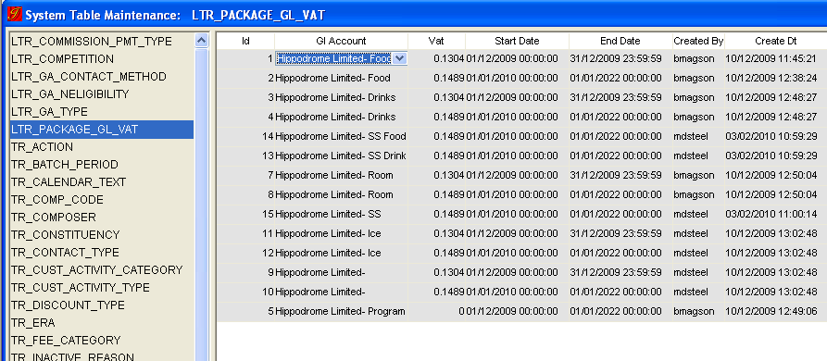
VAT System Table

Slide 17
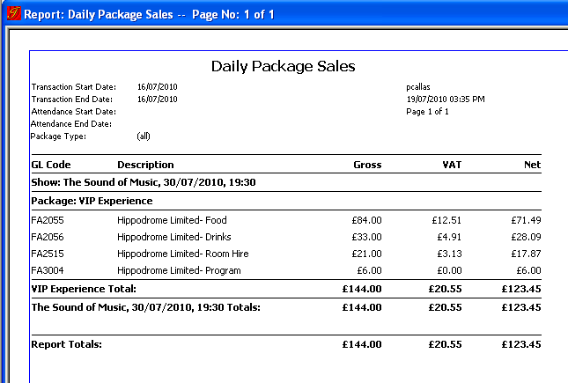
VAT Report

Slide 18
How successful has it been?
Sold 2601 packages as of 19/07/10.
£132,198 turnover in the restaurant’s.
On average we are currently selling 200 packages a month.
Projected turnover in 1st year is £152,000.
Patrons consistently give positive feedback.

Slide 19
Other Projects...
Up selling Memberships – Auto Add Constituencies
Selling Programmes in Advance
Interval Suppers
Canapés with Wine - Before Show & Interval

Slide 20
Any Queries:
Paul Callas – Information & Sales Manager
PaulCallas@birminghamhippodrome.com

