Slide 1

Elevated Events
Matthew Collins
Strategy and Planning Officer, RSC
UK Tessitura User Group Conference, Bridgewater Hall

Slide 2






Definition
Event campaign, target, date, expenses, levels
Guest lists and promoting event invitations
Contributions, acceptances
Acknowledgements, invoices
Reporting
Guests of guests (associations)
Guest names, tables, seats, performance
Complimentary tickets

Slide 3
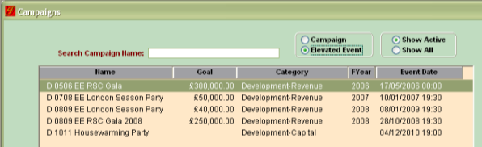
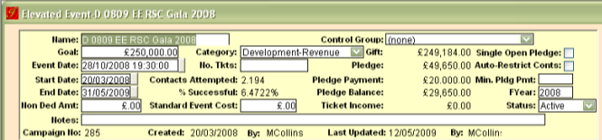
Event campaign, target, date
Create an Elevated Event in Campaigns
This differs to a financial campaign in that there is an additional event date / time, event cost, and number of tickets

Slide 4
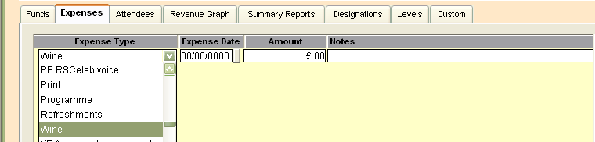
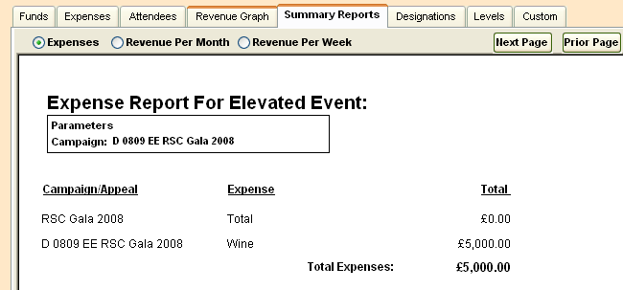
Event expenses
Expenses do not feed through to transaction reports: rather, they are for information only
The dropdown for expenses is created in the table TR_ITEM_TYPE

Slide 5
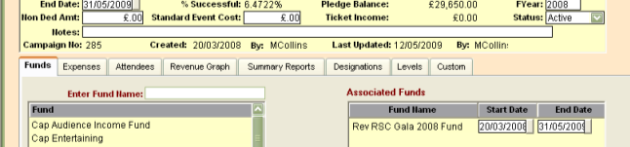
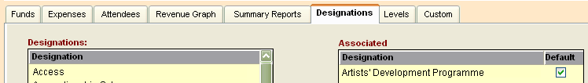
Event campaign fund(s) and designation(s)
Recommendation: create a distinct fund for your Elevated Event
We created one fund for all event-generated income, whether tickets, auctions or donations
Add a designation if the event is in support of a particular area of work

Slide 6
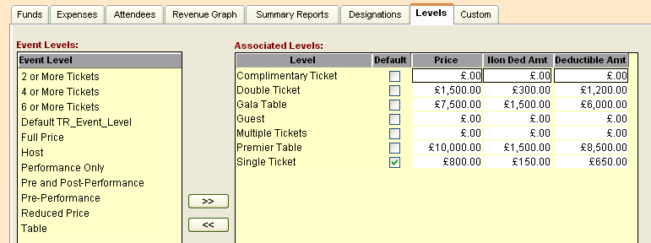
Event campaign levels
Create different ticket price types, each with a deductible/non-deductible amount for Gift Aid claims.
Recommendation… create a “Donation only” level (with non-deductible amt = £0.00) and “Complimentary” level for alumni / staff tracking.
All levels are created in TR_EVENT_LEVEL and the cost recorded in Campaign > Levels

Slide 7
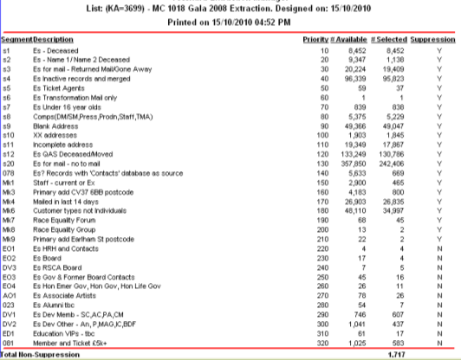
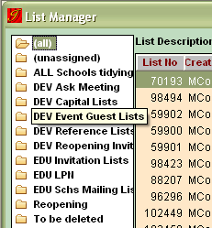
Guest lists: extractions
Recommendation: Create a folder for different Tessitura uses to store their guest lists in List Manager

Slide 8

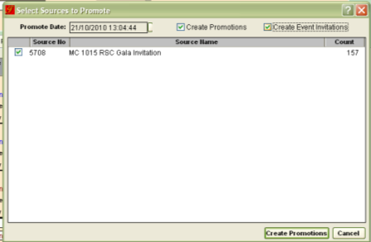
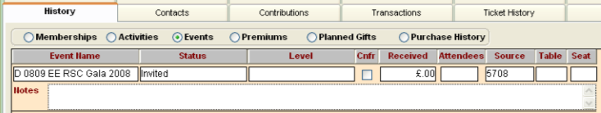
Create promotions (invitations)
Having named your guest list, create promotions and create event invitations: this will add a track to the constituent record under History > Events

Slide 9
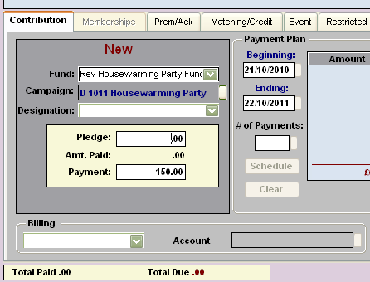
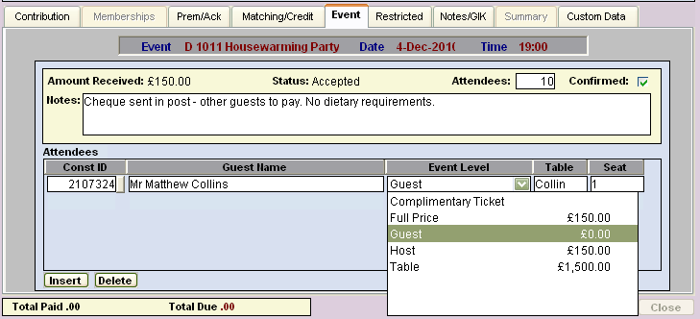
Contributions, acceptances
Processing a contribution into an event fund triggers the event tab and an acceptance status against the event.

Slide 10
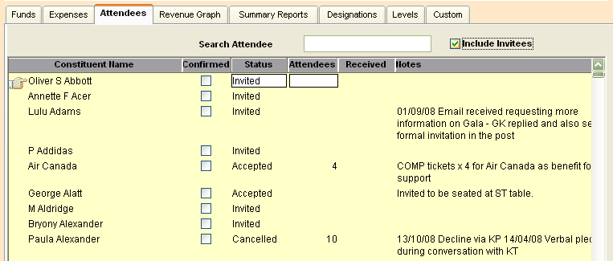
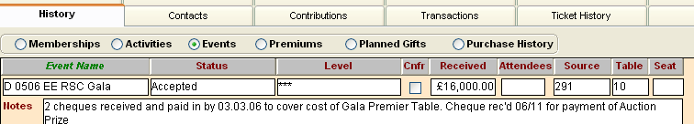
Contributions, acceptances
Manage acceptances via the Attendees tab within your Elevated Event …
…or via the constituent record:

Slide 11

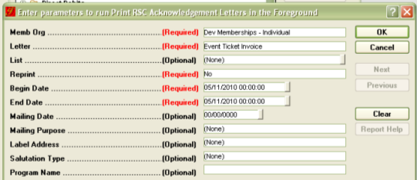
Acknowledgements, invoices
T_FORMAT_INFO = Set up the names of your acknowledgement / invoice, and the appropriate rules.
Recommendation: Name these generically “Event Invoice” / “Event Receipt” to avoid this step each time you create an Elevated Event
Run the acknowledgment report to merge the appropriate invoice / receipt

Slide 12
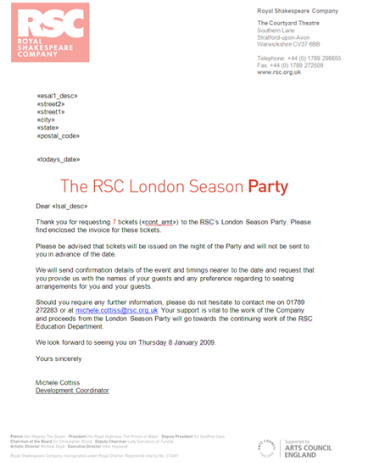
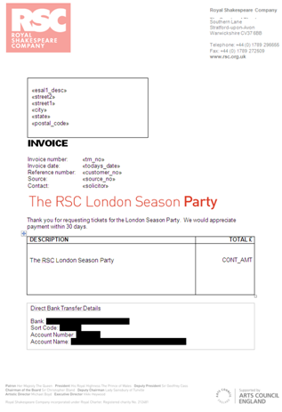
Acknowledgements, invoices

Slide 13


Reporting
Alphabetic listing for guests : can be filtered by status, list and ticket levels
Financial report which can be merged for receipts

Slide 14
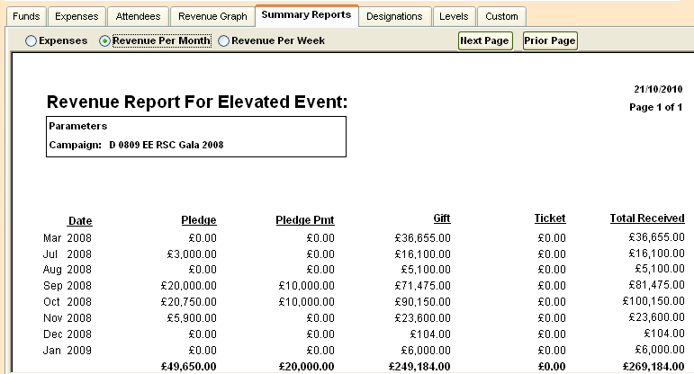
Reporting
Reporting also exists within the campaign module of the Elevated Event, e.g. month-by-month revenue:

Slide 15
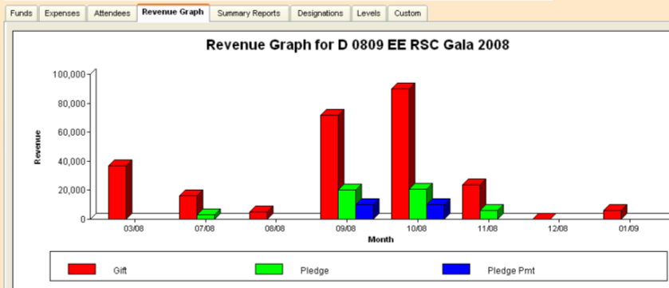
Reporting
e.g. month-by-month revenue graph.

Slide 16
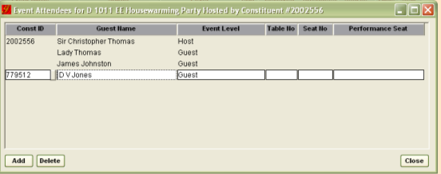

Guests of guests and tables
Guests of guests – that is those indirectly invited to the event – can be added to the table plan. Double click on the event track in the constituent record and the following pop up appears:
If a guest already has a record in the system, you can search for them through using the chiclet. This will add a “soft” event track to their record, highlighted green:
Recommendation: add guests of guests in “Associations” to the host record to ensure that information that a link exists is stored in Tessitura.

Slide 17
Guests of guests and tables
The table plan pop up can also hold details “Table No” / “Seat No” and “Performance Seat”
Recommendation: “Table No.” is alphanumeric so tables can be named according to the surname of the host of that table rather than numbered. This may make it easier when allocating late guests or filling up tables
Recommendation: The table plan pop up is a useful way of recording the names of corporate guest s whilst keeping the event history against the organisation record.

Slide 18
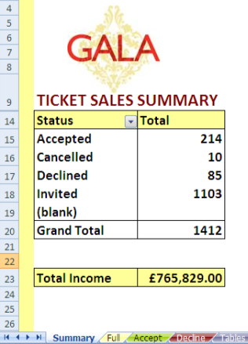
Guest names, tables, seats, performance
From the Event Listing Report we created a Macro in Excel which would sort information into all the permutations necessary for running our event – acceptances, declines, tables, complimentary guests, ticket buyers (not necessarily the same as table hosts) and donations... also colour coded…
Through pivot tables, sorting and calculating functions we were able to produce summary and detailed information
Each day the events assistant received an up-to-date excel file via a scheduled report email which was then run through the Macro.

Slide 19
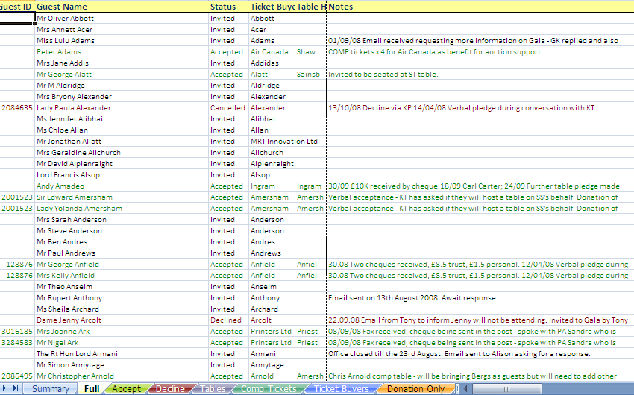
Guest names, tables, seats, performance

Slide 20
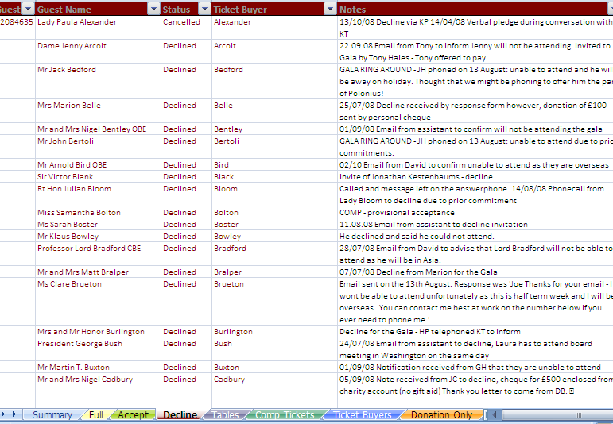
Guest names, tables, seats, performance

Slide 21
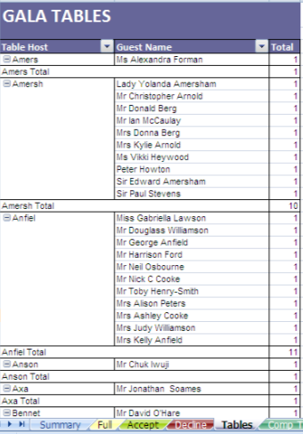
Guest names, tables, seats, performance
Pulls the “Table No” information (surname of host) and sorts into a pivot table

Slide 22
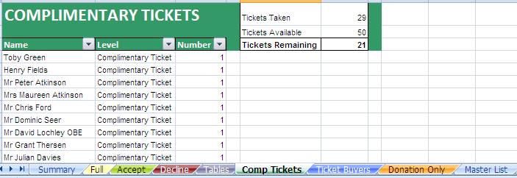
Guest names, tables, seats, performance
List guest names for £0.00 tickets and calculate the number of tickets remaining.

Slide 23
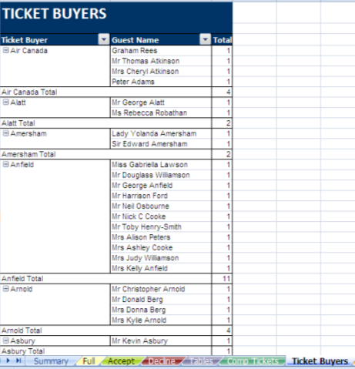
Guest names, tables, seats, performance
See who has purchased tickets on behalf of other guests (may be different to table guests)

Slide 24
Other event/activity tips and tricks
In two weeks we have a series of events to mark the reopening of the theatre – it was critical that all the right people were invited to the right events and by the right member of staff.
Using Activities, we promoted the different lists for all of the events, using the notes field to indicate who had invited each guest.
Using Output Set Builder we created elements that output information specific to each event:
Guest | Licensing Event: 7 November | Builders' Night Rehearsal: 26 November | Builders' Night: 27 November | Preview Evening: 30 November | Housewarming Party: 4 December | Take Your Seat Day: 5 December
Sir Richard Fry |  | VH |  | HP | GW
Mr Thomas Drood |  |  |  | JF |  | LP
Mrs Emily Hatton | JE |  |  |  | CK
Miss Georgia Newman | JE |  | HP

Slide 25
Elevated Events
Matthew Collins
Strategy and Planning Officer
Royal Shakespeare Company
November 2010

