Slide 1

Gift Aid Implementation
In 15 minutes
Richie Warburton
Tessitura Network
UK User Group Conference 2010

Slide 2
To Cover
What’s in the system?
  Screens
  Reports / Utilities
Setup
  System Tables
  Scope
Processing
  Viewing claimable money
  Confirming declarations
  Processing claims

Slide 3
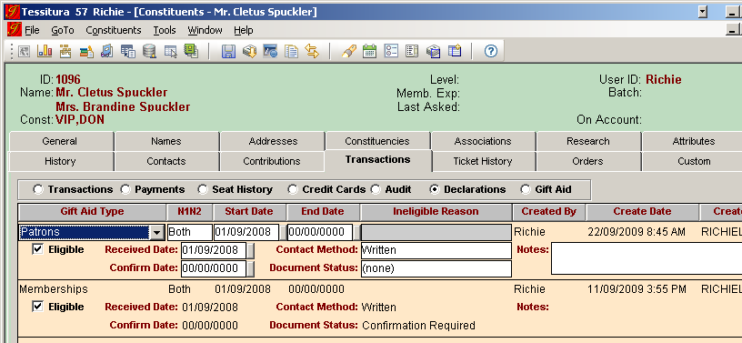
Screen - Gift Aid Declarations

Slide 4
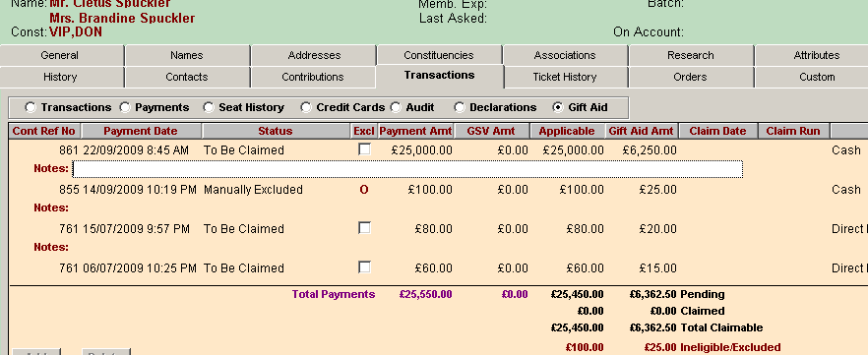
Screen – Gift Aid Payment Detail

Slide 5
Reports / Utilities
Gift Aid Payment Status
  View claimable / not eligible payments and amounts with useful filters like List / Fund
Gift Aid Declarations
  Update ‘Confirmed’ Date on declarations
  Pick desired contact method
  Useful filters
  Output to letter format or data for merge

Slide 6
Reports / Utilities
Gift Aid Claims / Gift Aid Claims R68
  Mark payments as claimed
  Output data for submission to HMRC
Gift Aid Claims Reversal
  Reverse a claim
Gift Aid Payment Update
  Update payments based on setup / scope changes
  Useful filters

Slide 7
Setup
6 Reference Tables
    T_DEFAULTS
    TR_GIFT_AID_TYPE
    TR_GIFT_AID_CONTACT_METHOD
    TR_GIFT_AID_DOCUMENT_STATUS
    TR_GIFT_AID_INELIGIBLE_REASON
    TR_GIFT_AID_RATE *(base tax rate, not claimable amount)

Slide 8

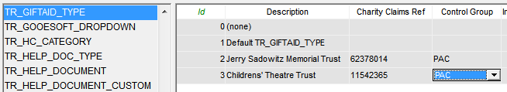
Setup
T_DEFAULTS
TR_GIFT_AID_TYPE

Slide 9
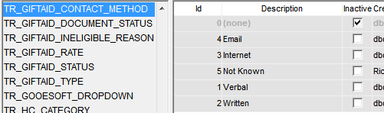
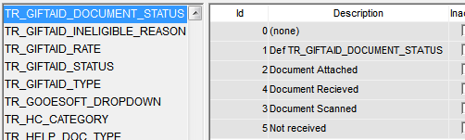
Setup
TR_GIFT_AID_CONTACT_METHOD
TR_GIFT_AID_DOCUMENT_STATUS*

Slide 10
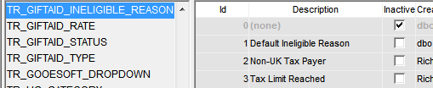

Setup
TR_GIFT_AID_INELIGIBLE_REASON
TR_GIFT_AID_RATE

Slide 11
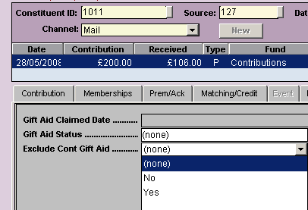
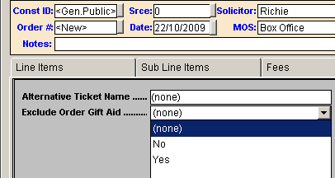
Setup
T_KEYWORD
  Ask IT to add rows as per documentation
  Adds Exclusion functionality to Orders and Contributions using a filed on the Custom tab

Slide 12
Scope
These four things must be in scope for a constituent’s payment to be eligible:
  The FUND
  The PAYMENT METHOD
  The CUSTOMER TYPE
  The CREDITEE TYPE

Slide 13
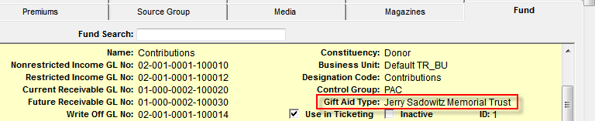
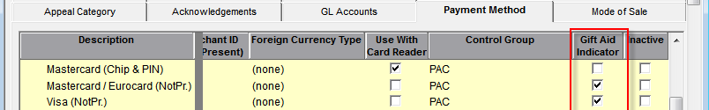
Scope
Fund
Payment Method

Slide 14
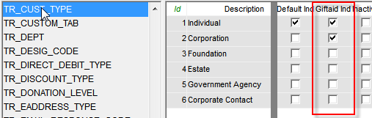
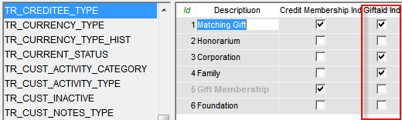
Scope
Customer Type - TR_CUST_TYPE
Creditee Type - TR_CREDITEE_TYPE

Slide 15
Processing
Add declarations to constituent records as they come in
Confirm verbal declarations regularly using Gift Aid Declaration Utility
Use Gift Aid Status Report to view money to be claimed and to highlight ways in which claims can be increased
Use Gift Aid Payment Update Utility to manage setup changes

Slide 16
Questions?

