Slide 1

Direct Debit
In a nutshell
Richie Warburton
Tessitura Network
UK User Group Conference 2010

Slide 2
To Cover
Steps to implementation
  Project Team
  Setup
  Testing
How the Direct Debit Process works
  Pledge Entry
  AUDDIS setup
  Billing Process

Slide 3
Project Team
Finance
  They’ll be running the DD billing reports and managing the DD batch
Development / Ticketing
  They'll be entering gifts and payment schedules
  They might be running Pledge Billing too.
IT
  They’ll be setting up
  They are nosey
Notes:
Accountability stems from the responsibility for processes after go live

Slide 4
Setup
System tables
  TR_BILLING_TYPE – for segregating bills and submissions
  T_FORMAT_INFO – Add a row so you can get data out
  TR_BILLING_SCHEDULE – 1st of the month? 15th? You decide

Slide 5
Setup
System tables
  TR_BILLING_TYPE – for segregating bills and submissions
  T_FORMAT_INFO – Add a row so you can get data out
  TR_BILLING_SCHEDULE – 1st of the month? 15th? - You decide
  TR_BATCH_TYPE – Create a CONTROLLED batch type
  TR_ACCOUNT_TYPE – copy DD row from documentation
  TR_DIRECT_DEBIT_TYPE – Your bank account details

Slide 6
Setup
Appeal(s)
  All DD payments will be marked with a Source Code – one for each payment run
  These source codes can live in a specially made Appeal for easy reporting (and to keep mess out of your marketing Appeals)

Slide 7



Setup
Payment Method

Slide 8
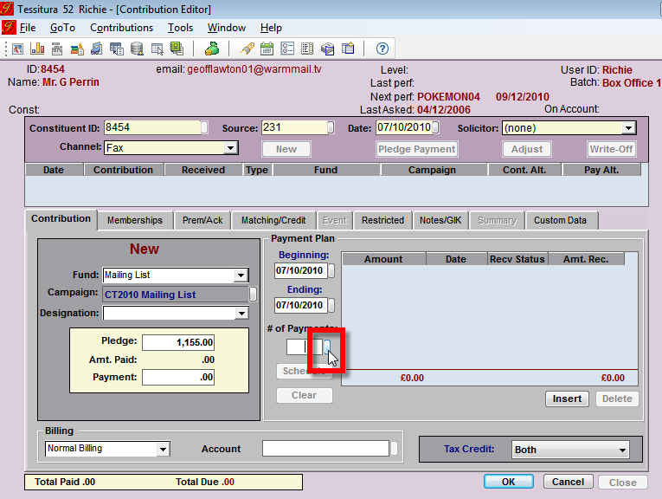
Pledge Entry
Enter as a Pledge, according to standard documented practices
Enter a Payment Schedule by clicking the
# of Payments
chicklet

Slide 9
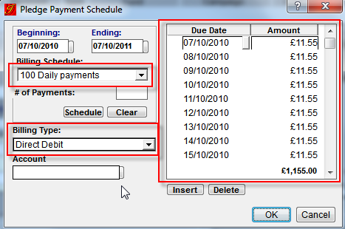
Pledge Entry
Specify DD Account and pick / edit payment schedule

Slide 10
Pledge Entry
Enter Direct Debit Account
First 2 characters | DD for paper-based instruction DE for electronic setup for AUDDIS
Next 2 | The constituents instruction number. Must be unique for that constituent- 01, 02, 03,
Next 6 | Sort Code
Next 8 | Bank Account Number (Shorter ones dealt with according to BACS documentation)
Last 1 | Account Type (according to BACS documentation not Tessitura Account Type)

Slide 11
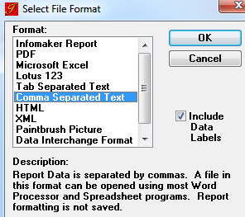
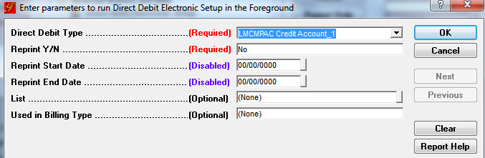
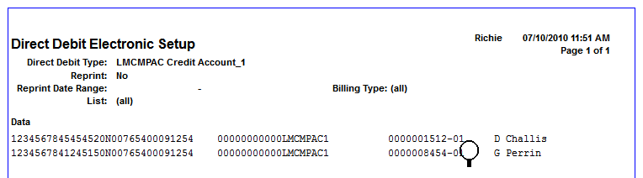
Billing Process
AUDDIS compliant Account Setup / Switch On
Direct Debit Setup Utility

Slide 12
The Setup / Billing Process
Identify due Payments in Database
Create Payment Transactions in a controlled batch and payment file
Submit payment file
Close Batch
Receive payment notification(s) from bank

Slide 13
The Setup / Billing Process
Pledge Billing Utility
Create Payment Transactions in a controlled batch and payment file
Submit payment file
Close Batch
Receive payment notification(s) from bank

Slide 14
The Setup / Billing Process
Pledge Billing Utility
Direct Debit Pledge Billing Utility
Submit payment file
Close Batch
Receive payment notification(s) from bank

Slide 15
The Setup / Billing Process
Pledge Billing Utility
Direct Debit Pledge Billing Utility
Submission Software (e.g. Albany)
Close Batch – before starting the next run!
Receive payment notification(s) from bank

Slide 16
The Setup / Billing Process
Pledge Billing Utility
Direct Debit Pledge Billing Utility
Submission Software (e.g. Albany)
Close Batch – before starting the next run!
Receive payment notification(s) from bank
CHECK – Pledge Billing Summary
CHECK – Direct Debit Processing Log

Slide 17
Reporting
Batch
    Search from Batch Administrator by Batch Type
Reprint Pledge Bills
    Save to Excel
Revenue by Source and Appeal
    Reason enough to create dedicated Appeals for billing
Submission Software reports

Slide 18
Questions

