Slide 1

ARTIFAX // EVENT
& the Tessitura Link
Friday 12 November 2010
Adam Pepper Business Development Manager, Artifax
Dominic Seabrook Account Manager, Artifax

Slide 2
Capturing the Details
Arrangement
Events
Room Rental
Documents
Emails
Images
Ticket Sales
Tasks
Checklists
Customer
Contact
Deal
Visitors
Checklists
Resources
Catering
Furniture
Staffing
Suppliers
Visio Plan
Equipment
Programme
Artists
Works

Slide 3
... so that data is only ever entered once
Maintaining Relationships with ...
Artists
Volunteers
Suppliers
Staff
Visitors
Renters

Slide 4
Utilizing Data
Extract data
Link to other software
Tessitura
Microsoft Visio
Your finance system
Reports
Quotations
Confirmation Letters
Invoices
Event Orders
Room and Resource Schedules
Staff Rosters
Statistics
Centralized archive of booking details for all staff
Feed content to your website
Populate lobby display screens

Slide 5
Working for You Every Step of the Way
Enquiry
Contract
Settlement
Check availability
Enter booking using template
Update resource requirements
Management
Enter staff quantities and skills needed
Schedule staff
Create tasks
Settlement
Export to finance system
Reporting
Programming statistics
Revenue Analysis
Costs automatically calculated
Generate contract
Produce function sheets
Update charges
Mail merges
Sale
Forecast box office sales and record the Deal
Send performance dates and times to Tessitura
View box office sales data in real time

Slide 6
What does the Tessitura/Artifax Event integration cover?
Arrangements / Production Seasons
Events / Performances
Entities /Constituents
Sales Data

Slide 7
Production elements
2-tier in Event vs. 4-tier in Tessitura
Arrangements and Events
Productions, Titles, Production Seasons and performances
One-directional, Event to Tessitura only (with exception of perf date/time)

Slide 8
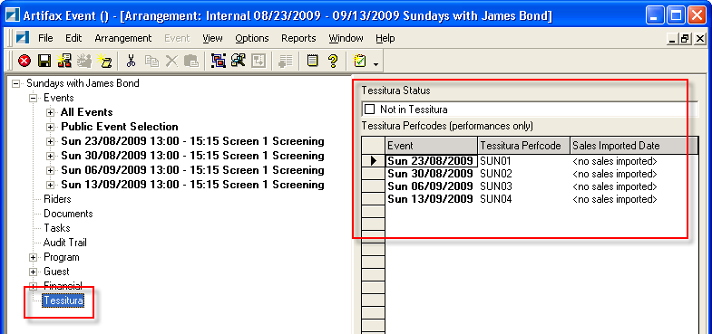
Production elements
Event export process (perf codes)

Slide 9
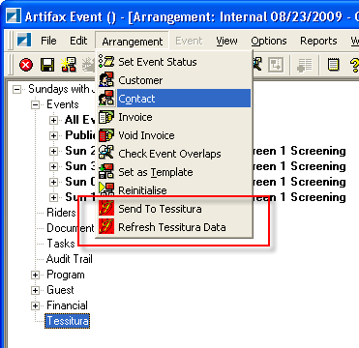
Production elements
Event export process

Slide 10
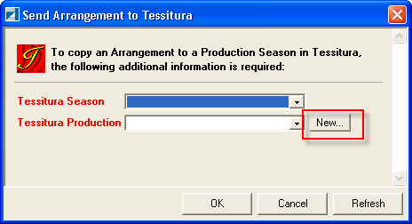
Production elements
Event export process (new prod season)

Slide 11
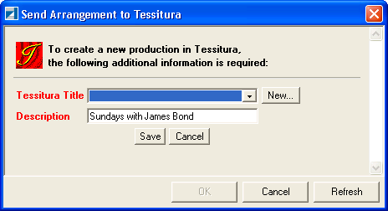
Production elements
Event export process (new production)

Slide 12
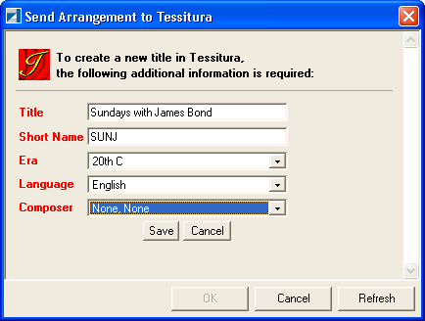
Production elements
Event export process (new title)

Slide 13
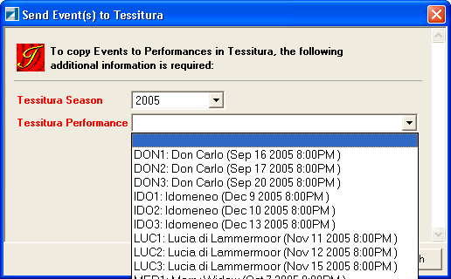
Production elements
Event export process (template performance)

Slide 14
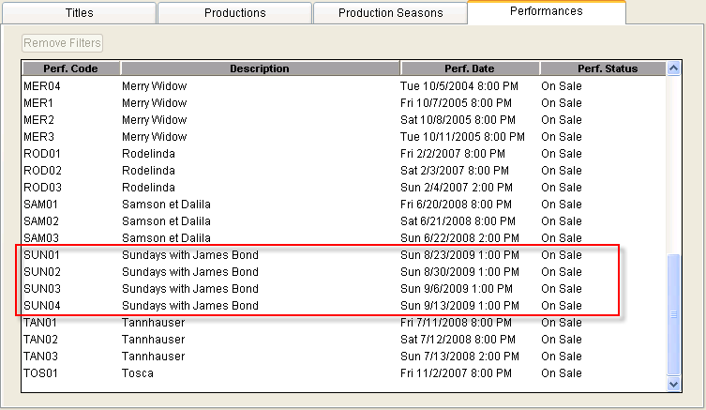
Production elements
Event export process (Tessitura)

Slide 15
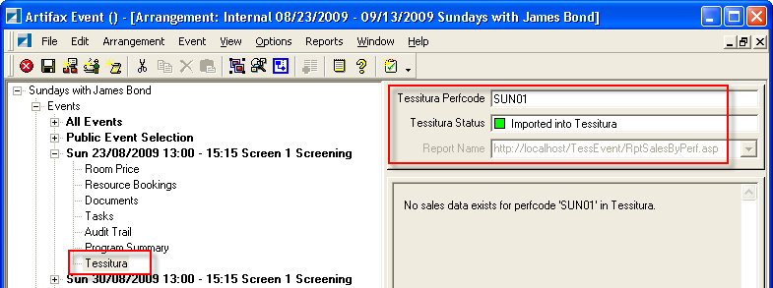
Production elements
Event export process (Event)

Slide 16
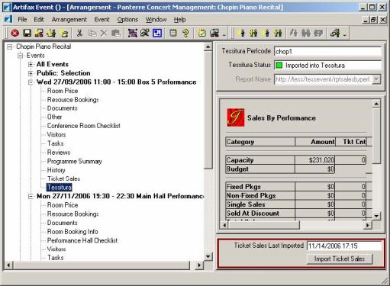
Sales data
Event exposes sales report & import:

Slide 17
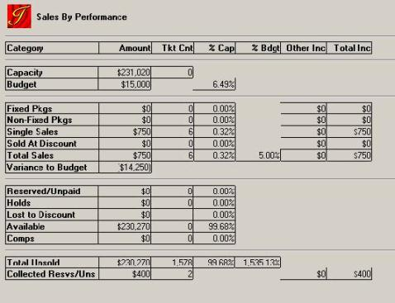
Sales data
Event exposes sales report:

Slide 18
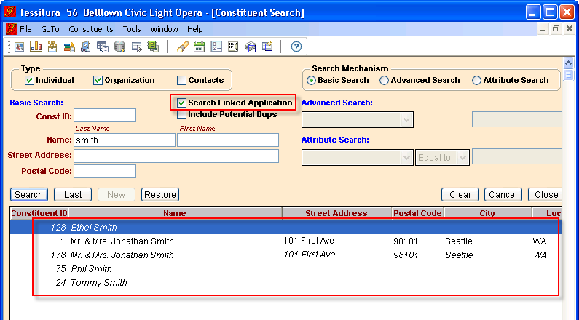
Entities/constituent search
Search both systems from within Tessitura:

Slide 19
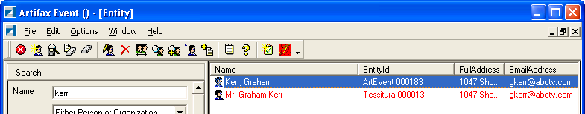
Entities/constituent search
Search both systems from within Event:

Slide 20
Entities/constituents
Bi-directional synchronization
Name & gender
Titles, Suffixes
Addresses (postal & email)
Phone numbers

Slide 21
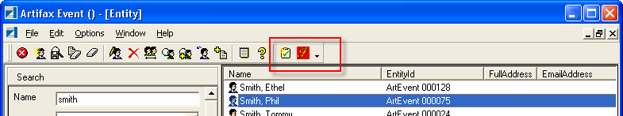
EntitIes/CONSTITUENTS
Entity Synchronization (Event)

Slide 22
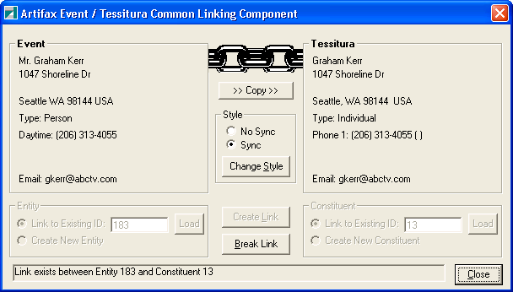
EntitIes/CONSTITUENTS
Entity Synchronization (Event & Tessitura)

Slide 23
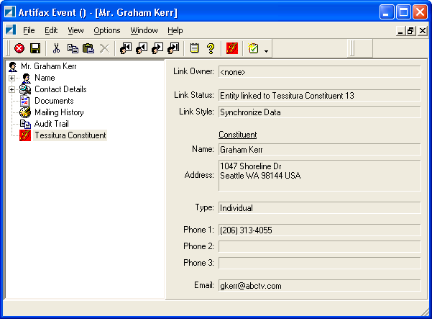
EntitIes/CONSTITUENTS
Entity Synchronization (Event & Tessitura)

Slide 24
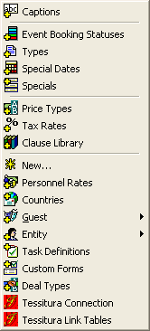
Link configuration
Additional Event setup menu items

Slide 25
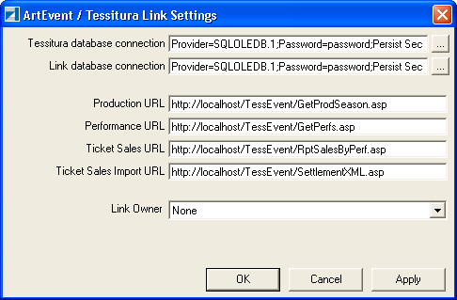
Link configuration
Database, Web Dialog locations, Link Owner

Slide 26
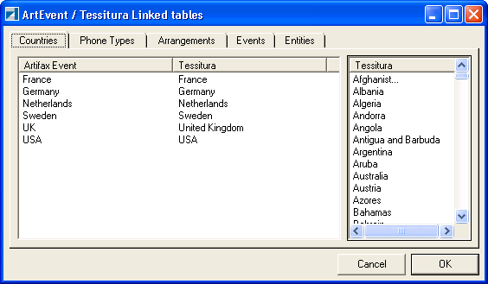
Link configuration
Data mapping

Slide 27
Additional Event plugins/modules
MessageSyncServer
MessageSync
TessituraSync

Slide 28
Additional Tessitura components
Integration Procedures (script)
Common Link component

Slide 29
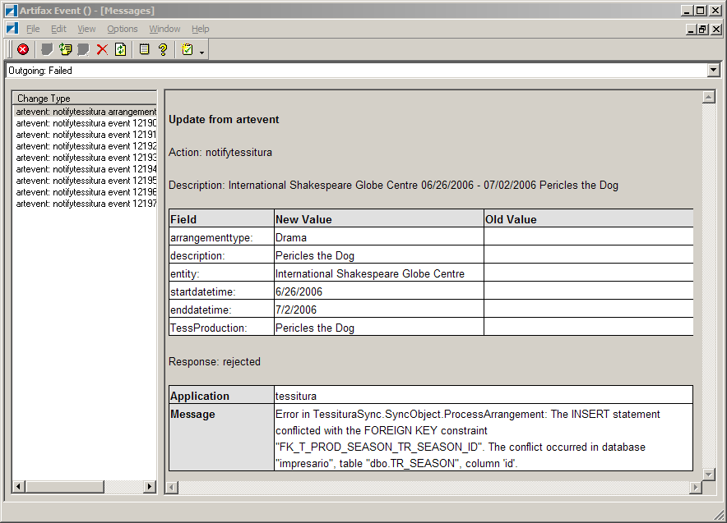
Troubleshooting
Message queue viewer:

Slide 30
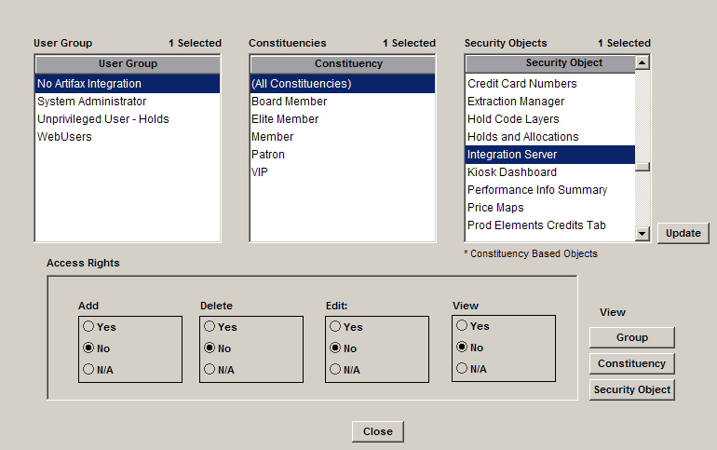
Security within Tessitura
Restrict link adds, edits, deletes and views:

Slide 31
"Our use of Artifax Event goes far beyond diary and event management; it has become the bedrock of our organisation-wide communication systems."
The Sage, Gateshead, UK
"Artifax Event is an indispensable venue management tool. Financial details are stored in the database so that performance reports can be run for any period. Operational documents are produced automatically and a database import automated throughout the summer to integrate the scheduling of the BBC Proms."
Royal Albert Hall , London, UK
“In a large theatre complex, effective coordination is crucial to success. That's where Artifax plays a key role, enabling us to monitor our spaces, maintain our client base and maximise our capacity, whilst remaining user friendly and transferable across all departments. Artifax is like another member of our team.”
Sadler’s Wells, London, UK
"We are delighted with Artifax. The product has transformed our working day and streamlined our organization. The benefits of the system are reflected in the service to our artists. Happy artists give great performances..."
Bergen International Festival, Norway
ARTIFAX creating time to think

