Slide 1
TN Express Web
Customization and administration
Mike Farr – mfarr@shawfest.com

Slide 2
Overview
Self-hosting your TNEW template
Pre-cart and checkout customizations
Shared session authentication

Slide 3
TNEW Templates
<!-- TNEW content here -->

Slide 4
Self-Hosting Your Template
Template is the skin or wrapper around TNEW
Comprised of the HTML, CSS, JavaScript and images that make up your site
Two options:
  Tessitura hosts (the easy way)
  You host (the fun way!)

Slide 5
The Easy Way (Tessitura Hosts)
You provide the template to Tessitura, they host it on their servers
Pros:
  Easiest option if you don’t meet the requirements for self-hosting
  Essentially maintenance free
Con:
  All updates must go through TASK

Slide 6
The Fun Way! (Self-Hosting)
Template files are hosted on a server that you manage
Pros:
  Full control over changes and updates to the template files
  Changes can be made at any time by you without going through Tessitura
Cons:
  Some maintenance and knowledge required
  Server outage may impact TNEW
Some requirements must be met

Slide 7
Requirements
Web server
  Connected to the internet
  With its own domain name
  Valid SSL certificate signed by a certificate authority (ie. not self-signed!)
  Separate directories for the live and QA templates
    www.shawfest.com/tnew/ and www.shawfest.com/tnew-qa/

Slide 8
Requirements met! Now what?
Make an index.html template with a TNEW content placeholder
  View source of an existing page
  Strip out the content
  Insert special <!-- TNEW content here --> placeholder

Slide 9
Template Example
<html>
<head>
<title>Shaw Festival</title>
</head>
<body>
<p>Welcome to the Shaw Festival!</p>
</body>
</html>

Slide 10
Template Example
<html>
<head>
<title>Shaw Festival</title>
</head>
<body>
<!-- TNEW content here -->
</body>
</html>

Slide 11
Requirements met! Now what?
Make an index.html template with a TNEW content placeholder
  View source of an existing page
  Strip out the content
  Insert special <!-- TNEW content here --> placeholder
  Save to the TNEW template folders on your server

Slide 12
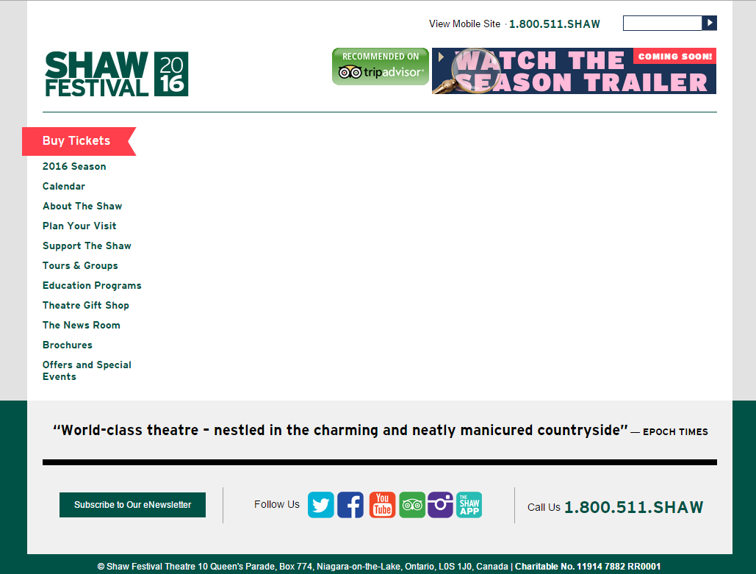
<!-- TNEW content here -->

Slide 13
Template Tips
Use secure (HTTPS), absolute URLs for images, CSS, JavaScript
Make changes to the QA template first, then copy to the live template after testing
Reference the same stylesheets that your site uses – changes will affect both sites (but be careful!)
Use a separate CSS file for TNEW-specific styles

Slide 14
Pre-Cart & Checkout Customizations
LWP_VALIDATE_CART

Slide 15
Pre-Cart & Checkout Customizations
Two areas in the purchase path that you can “hook in” to for custom processing
Checkout
  Integrated into the payment page
  Presented to the user while they are checking out
  Eg. Round-up donations, suggested contributions
Pre-Cart
  Integrated into the special precart page
  Triggered when the user adds or removes an item to/from their cart
  Two methods: Validate custom offer and execute local procedure

Slide 16
Pre-Cart Customizations
Add/Remove Item
Validation
Exists?
Execute
LWP_VALIDATE_CART
Yes
No
Display
Pre-cart
Display
Cart

Slide 17
Validations
After adding/removing an item from the cart, TNEW looks for a validation
Validations are configured in LTR_TNEW_VALIDATE_CART
Specify item type
  Single ticket
  Gift certificate
  Package
  Etc.
Specify Validation Point number – identifies section of code to run

Slide 18
LWP_VALIDATE_CART
Stored procedure provided by Tessitura. Exists in your database.
If validation is found, this procedure is executed with the entry point number specified in LTR_TNEW_VALIDATE_CART
Brains of customization
  Write SQL code to perform customization processing
    Call other stored procedures
    Insert or select data
    Call SOAP API functions
  Write HTML and JavaScript for return message
The resulting HTML (if any) is displayed on the precart.aspx page

Slide 19
Example – Assistive Listening Devices
A listening device that patrons can rent for each performance
ALDs for each theatre are set up in Tessitura as a separate production
For each applicable performance there is a corresponding ALD performance on the same date and time
Challenge: When tickets are added to the cart, find the corresponding ALD performance and give the user the option of adding ALDs to their cart

Slide 20
Example – Assistive Listening Devices
Add a Single Ticket validation to LTR_TNEW_VALIDATE_CART
Write custom SQL code in LWP_VALIDATE_CART to handle validation
  Identifies performance that user added to their cart
  Looks to see if ALD performance exists for the same theatre on the same date and time
  If ALD exists, custom HTML and JavaScript is saved as return message and presented to user
    Dropdown with button that uses jQuery to call the precart.aspx page which then calls the SOAP API to add the ALDs directly to the cart
  If there is no ALD performance, the user is taken directly to their cart

Slide 21
Example – Suggested Performances
Challenge: Present other performances that the user may be interested in based on the tickets added to the cart
Add validation to table
Write SQL code
  Identifies performance the user last added to their cart
  Checks production season for Suggested Performance content type containing production season IDs
  If suggested performances exist, write HTML to result and present to user
  If no suggestions, go straight to the cart

Slide 22
Example – Both Together!
Only one validation point
Procedure uses logic to first check for ALDs and then check for suggested performances
Also does some fancy things like saving and displaying “flash” message, saving the last production added to cart

Slide 23
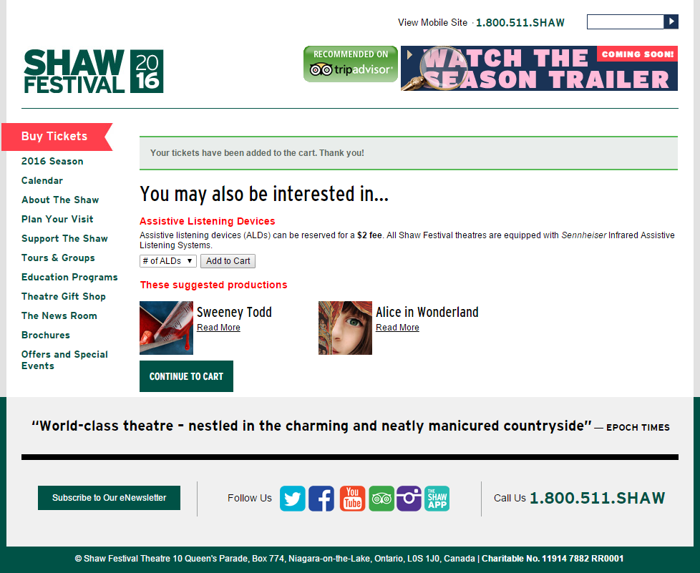
Example – Both Together!

Slide 24
Shared Session Authentication
Base64(hash|IV|CipherText)

Slide 25
What is it?
Allows you to share the user’s session between TNEW and your non-TNEW sites
  Users’s login status
  Access to cart contents
  Membership status
  Account details
  Etc.

Slide 26

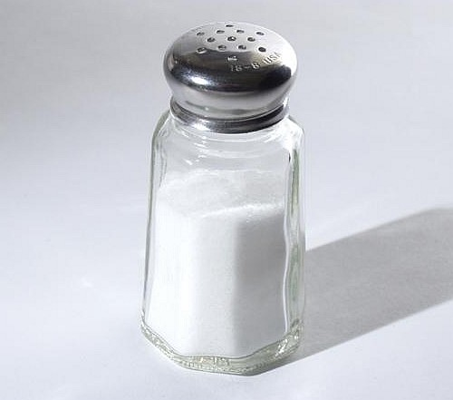


How does it work?
TNEW encrypts the user’s session information in a cookie
Details needed for decryption and encryption are provided in the admin section
Your site uses these details to access the session information, which can then be used with the Tessitura API
Details:
  Passphrase
  Salt
  Authentication key
  Iterations

Slide 27
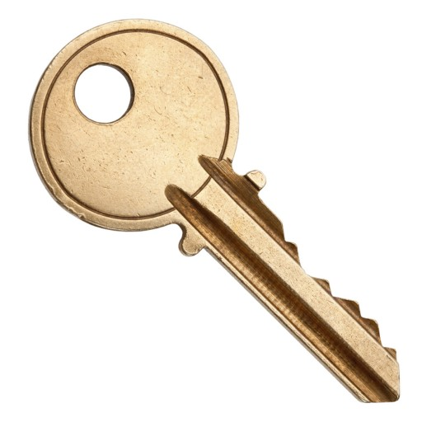
Encrypting
Use Passphrase, Salt, Iterations to make a key
(
+
)
=
*

Slide 28
Encrypting
Use the key to encrypt the session details and use the authentication key to “sign” the message
(
+
Session
Details
)
+
=
odBWWwBMBx9leq6WSLoVElsjfhGzNCxlWkuhQmEufbMaAapGRYP0ow7kp6BLwFdsaNy1NAue4ivcyg9I4nboyRee28SbMDLHURCQtpbW5kB6JlH6soHCjnyCvILaJXm0d6h6wUTIq8hnv/sf9AW86pPqiHVCBjyvxDkNFYEH6Rie2yWYFGaKTWOhgtgQNWc3

Slide 29
Decrypting
Do the same thing but in reverse

Slide 30
Examples
Personalized welcome messages
Cart content indicators
Special “Members Only” website
Custom calendar
  Buy Now links based on ranking
Brochure requests
Once a user is logged in to TNEW they will be logged in on your site

Slide 31
Thank You!
Questions?
Comments?
Ideas?

Slide 32
What’s next
Please go to Rehearsal Hall 1 (the big one upstairs)
Final wrap-up
Raffle draw!

