Slide 1

Fundraising Objectives and Revenue Management

Slide 2
What needs to be created?
Create stored procedure that generates a list of data that includes: pledge amounts and pledge scheduled payment amounts, pledge payment amounts, and gifts amounts.
Create Local table that will be used to enter objective/budget information. This table will be linked to an InfoMaker data entry object that we will add to the campaign custom tab.
  Our table has a trigger so whenever a fund is associated to a campaign it automatically gets added to the local table so the user can associate a budget amount to the new fund.
  If a fund is removed, the user will have to delete the amount from the custom tab.

Slide 3
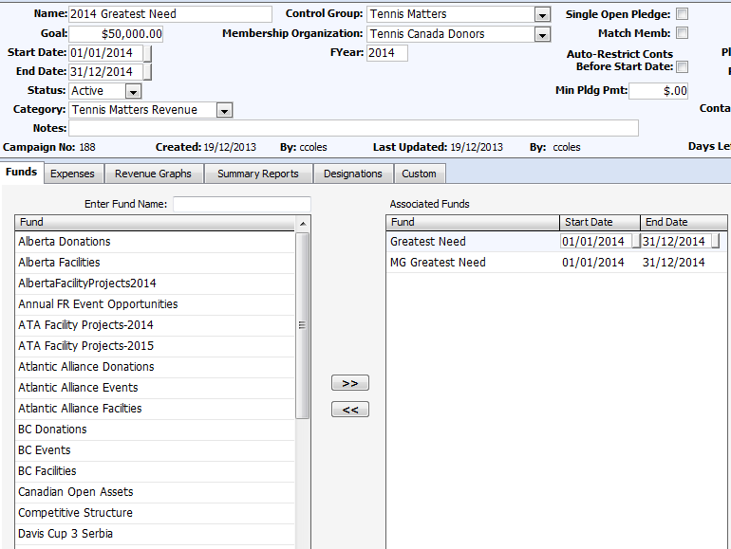

Slide 4
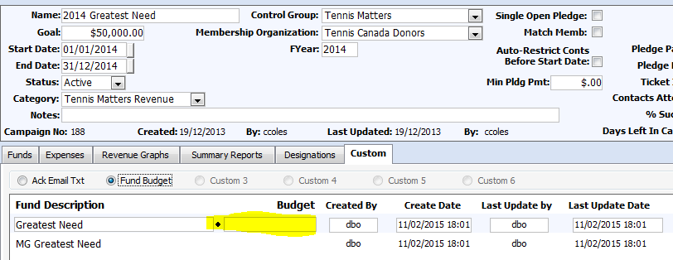

Slide 5
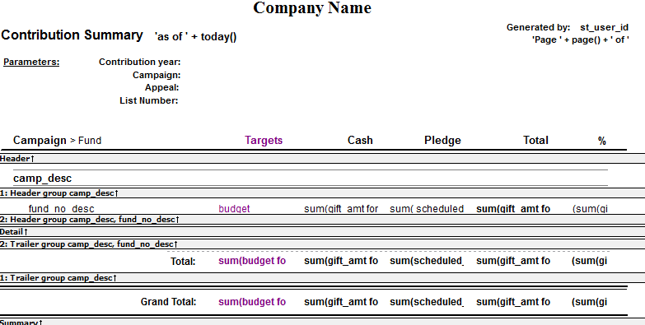
Report Creation

Slide 6


