Slide 1


We need to know more about our patrons to make better strategic decisions.
SF Patrons
Advertising
Fundraising
Group Sales
Marketing

Slide 2

Let’s ask them!
Prioritize
Retain information
Make it easy!

Slide 3
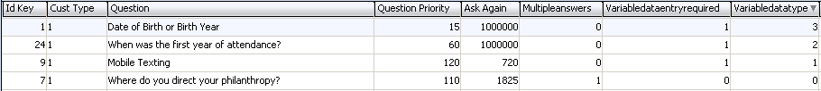
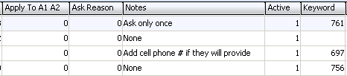

LTR_Survey_Questions
While not evident, the multipleanswers column indicates if the question should be a check box or radio button.
Variable data types include Phone, Year, Data, Text. Additional code modification is required if a variable DATA entry option is used.

Slide 4
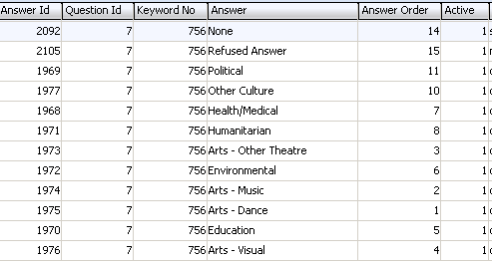
LTR_Survey_Answers
Possible answers for ID Key 7 (Question – “Where do you direct your Philanthropy”)
A

Slide 5

LV_Survey_Results
Local view ties the Question/Answer/Patron together.

Slide 6
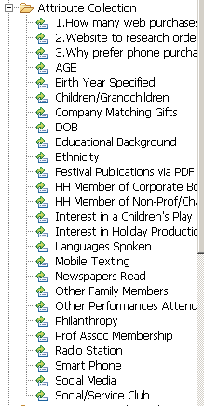

List Manager
All questions are then added to T_Keyword so that they can be queried on in List Manager and also used in Extractions

Slide 7
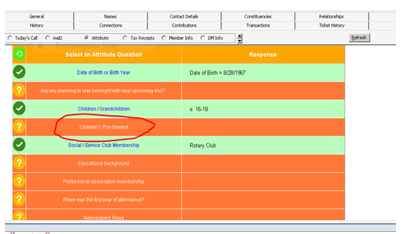
Data Collection in the Box Office

Slide 8
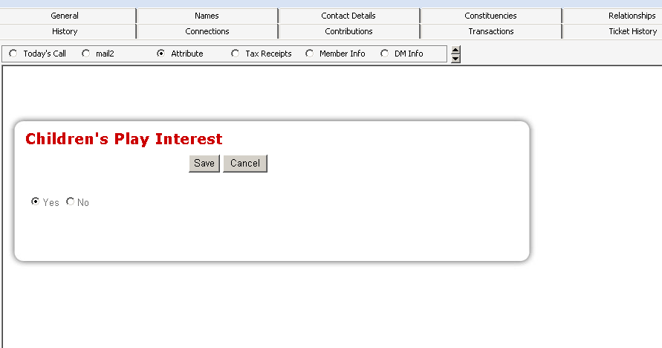
Data Collection in the Box Office

Slide 9
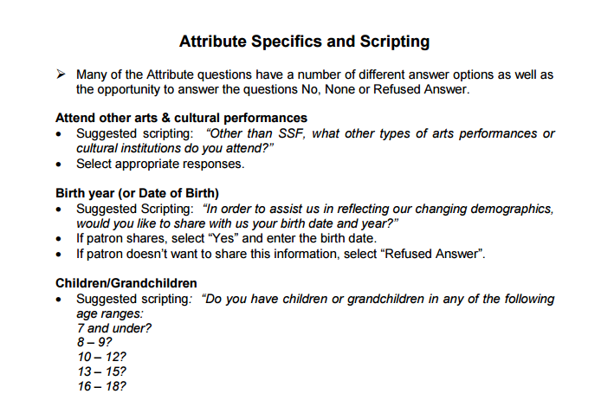
Data Collection in the Box Office

Slide 10
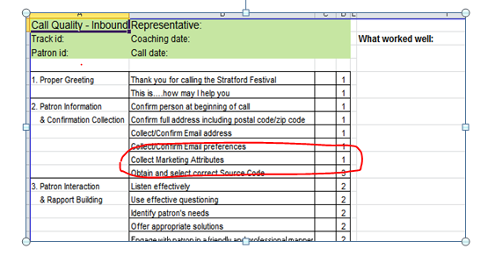
Ensuring Data Collection

Slide 11
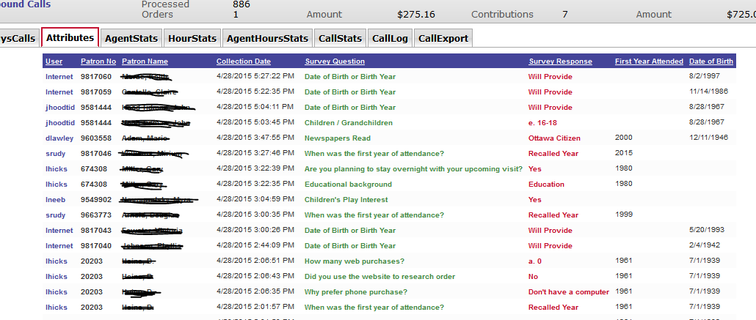
Tracking Data Collection

