Slide 1

Tessitura Interceptors
Fernando Margueirat
Kruti Shah

Slide 2

Introduction to REST Service
Uses http protocol same as web browser
Plain text requests and responses
Easy to debug using browser
Resources defined on URIs

Slide 3
HTTP Response Sample
<Constituent xmlns:i="http://www.w3.org/2001/XMLSchema-instance">
<ConstituentType>
<ConstituentGroup>
<Description>Individual</Description>
<Id>1</Id>
<Inactive>false</Inactive>
</ConstituentGroup>
<Description>Individual</Description>
<Id>1</Id>
<Inactive>false</Inactive>
</ConstituentType>
<CreateLocation>POP</CreateLocation>
<CreatedBy>webapi </CreatedBy>
<CreatedDateTime>2004-11-16T09:49:51</CreatedDateTime>
<DisplayName>Mr. Fernando Margueirat</DisplayName>
<EmarketIndicator>
<Description>Unsubscribe</Description>
<Id>5</Id>
<Inactive>false</Inactive>
</EmarketIndicator>
<FirstName>Fernando</FirstName>
<Gender i:nil="true"/>
<Id>503670</Id>
<Inactive>
<Description>Active</Description>
<Id>1</Id>
<Inactive>false</Inactive>
</Inactive>
<InactiveReason i:nil="true"/>
<LastActivityDate>2015-04-14T08:05:00</LastActivityDate>
<LastGiftDate>2009-10-21T11:23:29</LastGiftDate>
<LastName>Margueirat</LastName>
<LastTicketDate>2015-04-14T08:05:00</LastTicketDate>

Slide 4
What are Interceptors
Small programs that take a REST API request before it is processed by Tessitura (PRE) or a response before it is returned to the client (POST) and execute some action
Allows to modify behavior of Tessitura based on your business rules
PRE – change or validate the parameters of call
POST – Change Tessitura’s response

Slide 5
What are Interceptors good for?
Implement business rules that are not currently available in Tessitura
Changes have to be made on real time.

Slide 6
What are Interceptors not good for?
Customization that is available in Tessitura
Changes that could be done after that fact(e.g. nightly scripts)
Functionality that is not available in REST API
Resource intense customizations

Slide 7
Skills required to build an Interceptor
Advanced knowledge of Tessitura back end behavior
Knowledge of http protocol
Knowledge of REST framework
Knowledge of Tessitura API
.NET programming
Strongly recommended SQL programming

Slide 8
NBC Sample business case
We wanted to keep track of customer’s communication preferences for membership renewal
We ask our members what their preferred method of renewal is for donation
Email
Phone
Postal Address
In order to keep this data as clean and accurate as possible, it is extremely important that only one contact point category (phone, email address or postal address) is assigned the contact point purpose of “Preferred Donation Renewal Method”. To help with this, an interceptor letting users know that more than one contact point category is currently assigned if a second is selected.

Slide 9
Why use an Interceptor?
Need to force Tessitura to have only one contact point for preferred donation renewal method purpose (functionality not available in Tessitura)
Need to do it when customer is on phone with our call center (can’t be done after the fact)
Not resource intensive function

Slide 10
How does it works?
Intercepts call before Tessitura processes it (PRE)
Calls a SQL Stored Procedure to do validation
If OK, calls continues to Tessitura unchanged
If not OK, returns exception to application and call is never processed by Tessitura

Slide 11
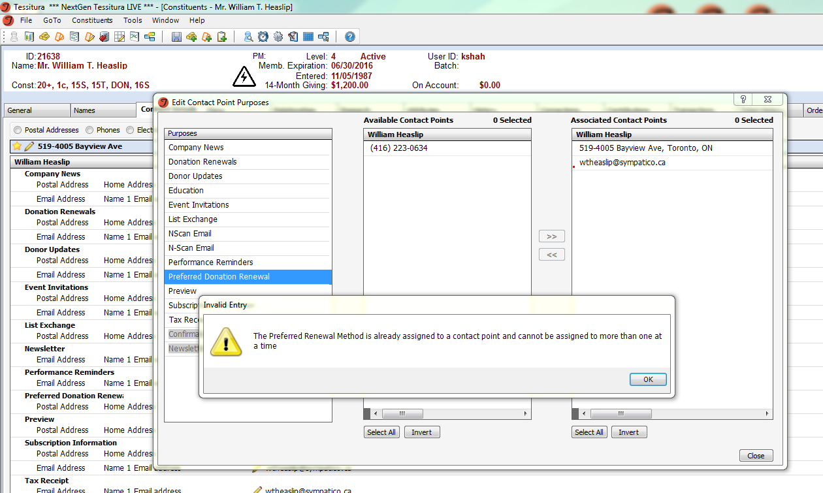
NBoC Plug-in Example

Slide 12
Conclusion
Used in the right context and circumstances, interceptors are very powerful tools to enhance Tessitura functionality
Not to be abused or it can become a nightmare to maintain

Slide 13
Resources
Tessitura Network
Real world Interceptors TLCC2014 presentation http://bit.ly/1zN4jyp
T-Cast: Creating Your First Custom Plug-in bit.ly/1puOhWJ
Tools
Rest Client plug-in for your browser
For chrome: Advanced REST Client
Firefox: RestClient
Contact Information
fmargueirat@national.ballet.ca
kshah@national.ballet.ca

