Slide 1
Philadelphia Tessitura Users Group aka Philly TUG!
Thursday, October 17, 2019
Kimmel Center for the Performing Arts

Slide 2
Agenda
Time | Session | Presenter
1:00 – 1:15 | Welcome and Tessitura Network Update | Linda Forlini, Vice President, Ticket Philadelphia Rebecca Herberson, Senior Solution Specialist, Tessitura Network
1:15 – 1:45 | Accessibility and Customer Service | Dani Rose, Training Manager and Accessibility Coordinator, Ticket Philadelphia
1:45 – 1:55 | BREAK
1:55 – 2:25 | Constituent Merge Management | Catherine LaChance-Duffy, Applications Systems Analyst / Database Administrator, ArtsPhilly
2:25 – 2:35 | BREAK
2:35 – 3:05 | Digital Membership & Philanthropic Membership Management | Anne Henry, Manager of Membership Services, Kimmel Center
3:05 – 3:15 | BREAK
3:15 – 4:15 | Breakout Discussions
4:15 – 5:00 | Tour the Kimmel Center | Kathie Cronk, Operations Manager, Special Projects, Kimmel Center
Notes:
Notes for Linda
Welcome to the Kimmel Center
Thank you to all of you for making the trip to South Broad Street to visit.
Any fun Kimmel Center facts
Notes on the Agenda; 3 presentations with a brief break between each. We’re reserving the time for discussions and follow up on the presentations to the end. Each of our presenters will be stationed throughout the room. Please join them to ask questions or engage in follow up discussion about their presentation topics. Once you’ve chosen, don’t feel like you’ve committed to a single discussion for this hour. Once you’ve had your questions answered, please feel free to quietly excuse yourself and move to another discussion. Following the discussion time, our amazing Kathie Cronk will lead the “insider” tour of the Kimmel Center.
PASS TO REBECCA

Slide 3

Tessitura User Group
Welcome
11th Hour Theatre Company
Academy of Vocal Arts
Annenberg Center for the Performing Arts
Appell Center for the Performing Arts
Bristol Riverside Theatre
EgoPo Classic Theatre
First Person Arts
Fulton Theatre
George Street Playhouse
Gettysburg Foundation
Grand Opera House
Liberty Science Center
Kimmel Center
Mason Gross School of the Arts, Rutgers
McCarter Theatre
Media Theatre for the Performing Arts
New Brunswick Performing Arts Center
Opera Philadelphia
Painted Bride Art Center
Paper Mill Playhouse
Pennsylvania Ballet
People’s Light
Philadelphia Theatre Company
Philly Pops
State Theatre New Jersey
Theatre Philadelphia
The Philadelphia Orchestra
Ticket Philadelphia
Wilma Theater
Notes:
IMPORTANT NOTE – We have provided a script with each slide in case you need some guidance on how to talk about things. You are not required to use the script – please make this personal and include your own words and experience where appropriate.
On behalf of Tessitura Network, welcome to the Philadelphia Tessitura User Group meeting! Thanks so much for coming, and huge thanks to Beth, Linda, Matt, Susan and the entire Kimmel Center staff for bringing our community together today.
I’m Rebecca Herberson and I {briefly describe role}. And I’m excited to share some brief updates from the world of Tessitura!
IF THERE ARE OTHER TN STAFFERS IN THE ROOM – Before I begin, I want to introduce my teammates……Erin Koppel, Mark Rhodes, Andy Wertner, Don Youngberg.

Slide 4


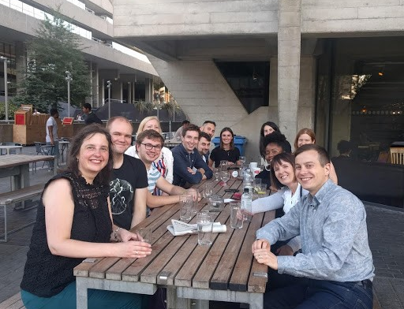


Updates from Tessitura
4 things we’re excited about
2 things you need to know
1 thing you can do today
Notes:
I want to take about 5 minutes to share with you some things we’re excited about, a few things you need to know, and some things you can do today right after this meeting.

Slide 5
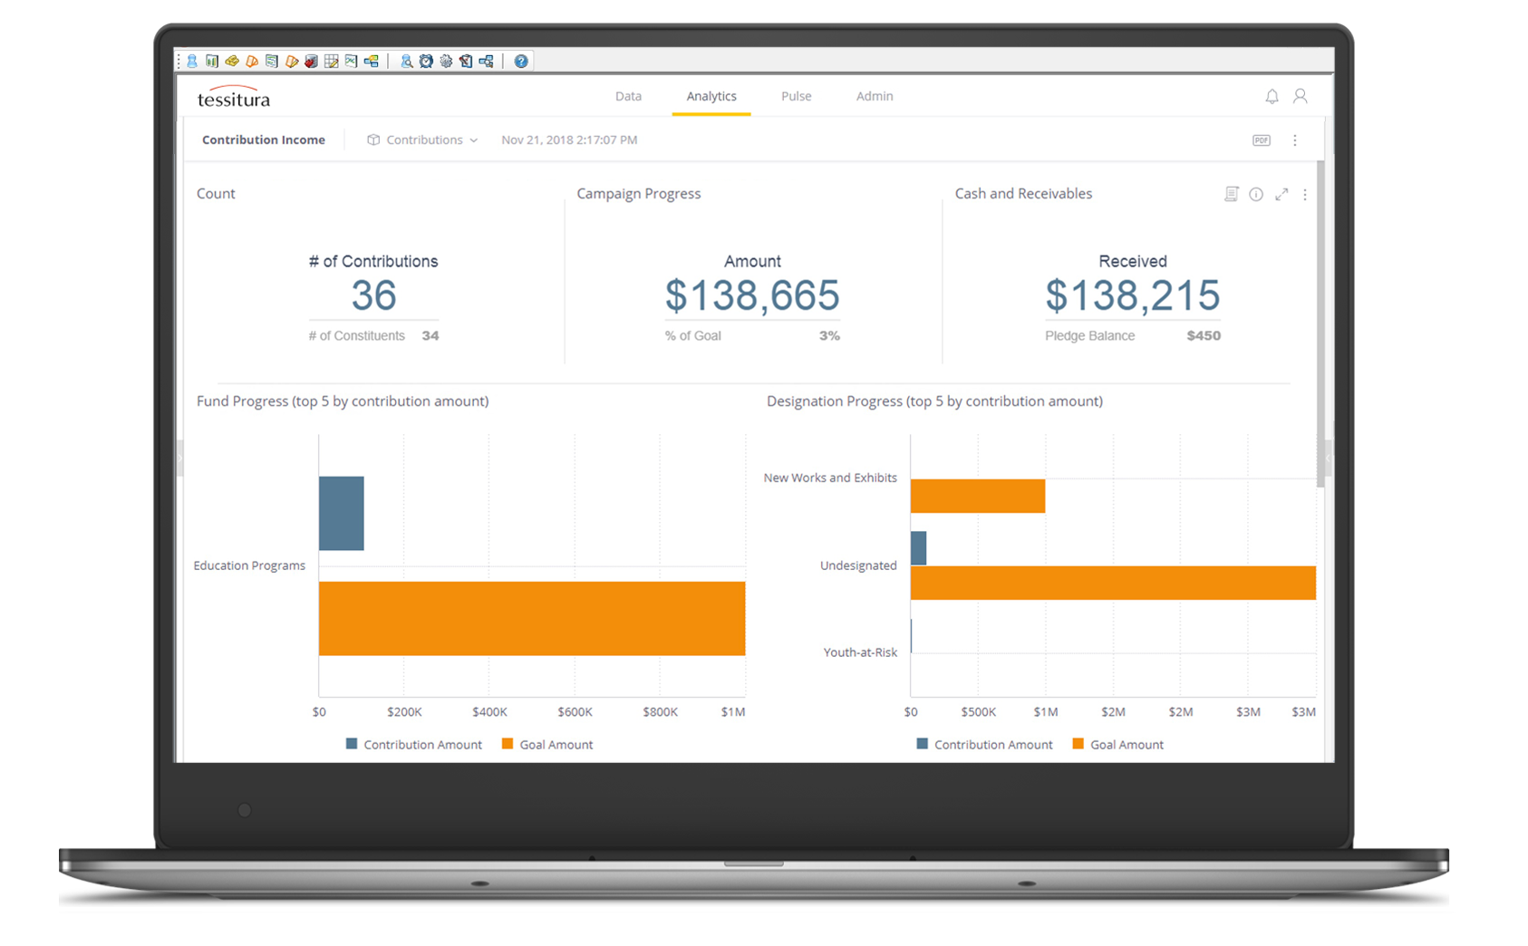
Resources to get you started
Webinars:
tessituranetwork.com
  >Support & Learning
  >Webinars
#1 Tessitura Analytics
User Groups:
TAFFY third Tuesday
TAMATO second Wednesday
tessituranetwork.com
  >My Community
  >Groups (Topical Groups)
Notes:
Tessitura Analytics is now available as part of version 15. Tessitura Analytics provides immediate and intuitive access to your most important metrics. The interactive tools allow you to tell the full story of your data, explore trends and anomalies, and track your progress against goals. This feature includes pre-built interactive dashboards, the ability to explore your data from anywhere, and personalized alerts to help you make better decisions faster.
We have training and learning opportunities coming up. We had a basic overview webinar at the end of September that is now available as a video. And on October 30, we have a more advanced training coming up. We highly encourage you to watch these as a group with others on your staff who might be interested. Visit our website to get started.
We also have two user groups to help you with Analytics. TAFFY, which stands for Tessitura Analytics for Fundraisers, meets on the third Thursday of the month. TAMATO, which stands for Tessitura Analytics for Marketing and Ticketing Operations, meets on the second Wednesday of the month.

Slide 6
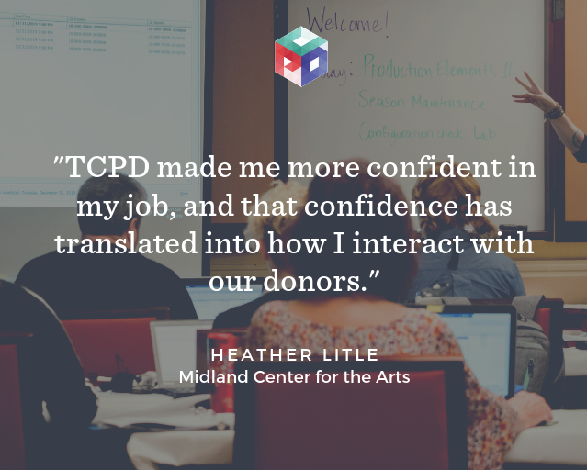
Online, quick-start options for
ticketing and fundraising
#2 Fundamentals Courses
Notes:
Did you know that Tessitura offers online courses for fundraising and ticketing? These are quick-start, 3-week courses designed to get you up to speed quickly. They start on the first Monday of each month, but we don’t offer them in December or January. So sign up by Nov 1 for the Nov 4 start date, or save the date for February 3 to expand your skill set or get started with Tessitura.

Slide 7
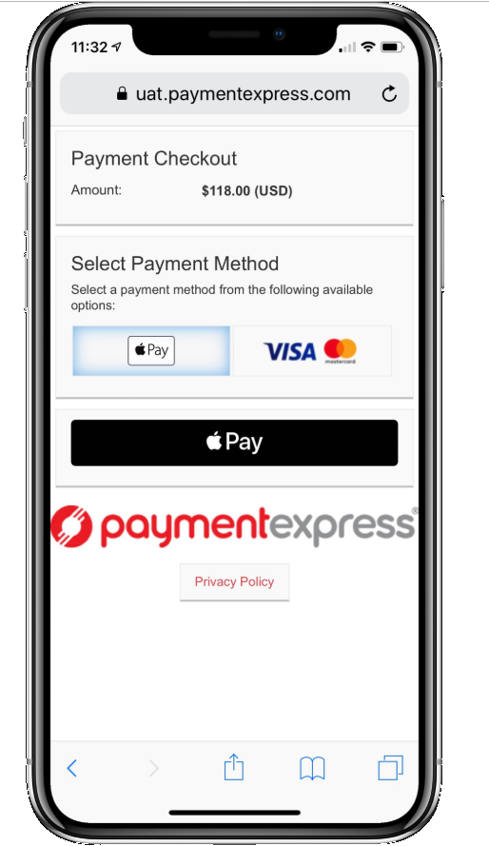
Over 200 organizations live!
Apple Pay now available!
#3 TNEW v7:
TN
Express Web
Notes:
TNEW continues to roll out new features on a regular basis. We’re excited that Apple Pay is now a payment option for TN Express Web (TNEW), making payment easy and secure on iPhone or iPad devices.
Apple Pay is available on TNEW through Windcave hosted payments. Members should contact Windcave for setup. Tessitura v15.0 or later and TNEW v7.28 are required.

Slide 8
Use Hosting Services?
Introducing the Self-Service Tool!
Now you can:
Reset your Hosting Services password
Assign and unassign physical and mobile tokens
Get started: https://selfservice.tessituranetworkramp.com
#4
Self-Service Tool
Notes:
If you use Hosting Services, you can now reset your password and assign tokens without a support ticket. Log in to RAMP to get started.

Slide 9


Things You Need to Know
T-Stats Sunset – April 2020
SOAP API Sunset – with v16 release in 2nd half of 2020
Notes:
The deadline to move off of T-Stats may seem far off, but now is the time to start planning your migration to Analytics and the REST API. Need help? Submit a support ticket, and our team will point you in the right direction.
The SOAP API will no longer function or be supported upon installation of Tessitura v16 (currently anticipated for release in the last half of 2020).

Slide 10

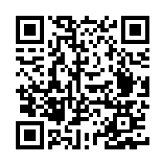
What you can do today
tessituranetwork.com/to-do
Notes:
Visit our website for your Tessitura to-do list to make sure you are getting the most out of Tessitura. Take a picture of this slide and use the short link or the QR code to sign up for your free Analytics orientation, register for webinars, start your upgrade, or explore what’s new.

Slide 11

Thank you!
www.tessituranetwork.com
Notes:
And finally, enjoy this time with your peers from the best community in the industry! Thank you for listening!

Slide 12
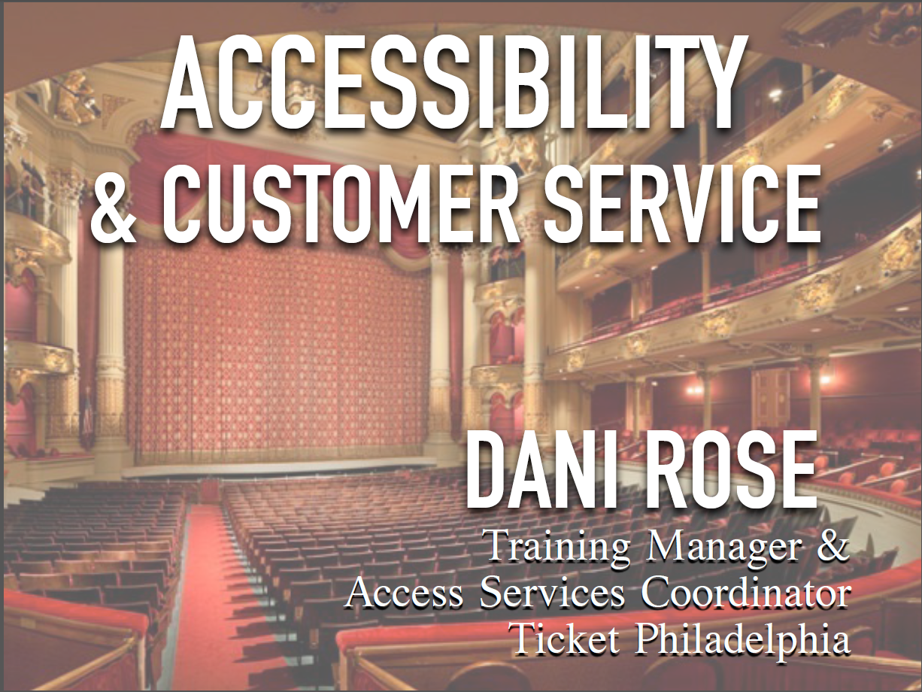

Slide 13
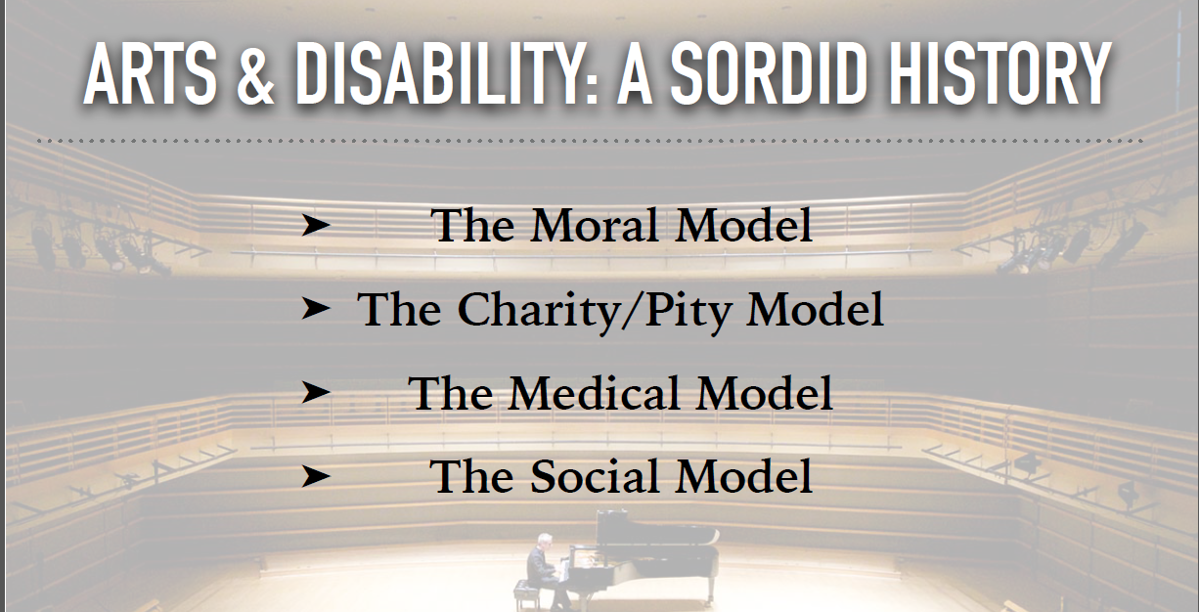

Slide 14
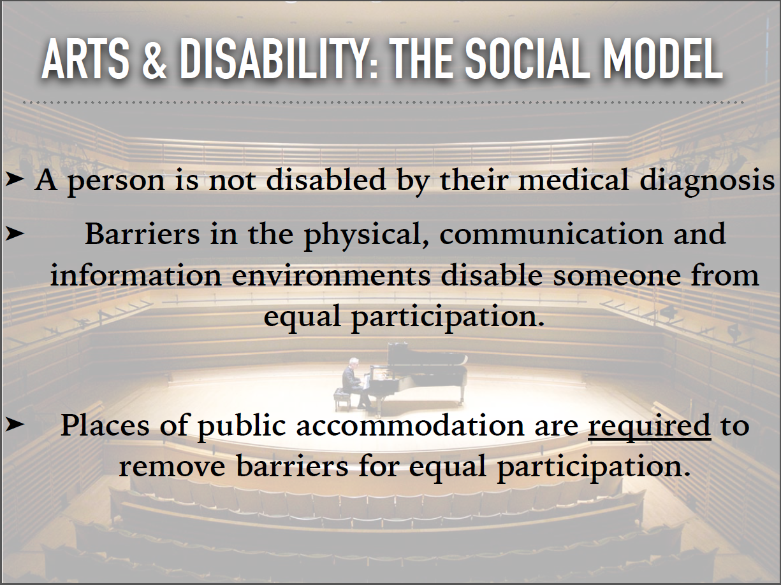

Slide 15
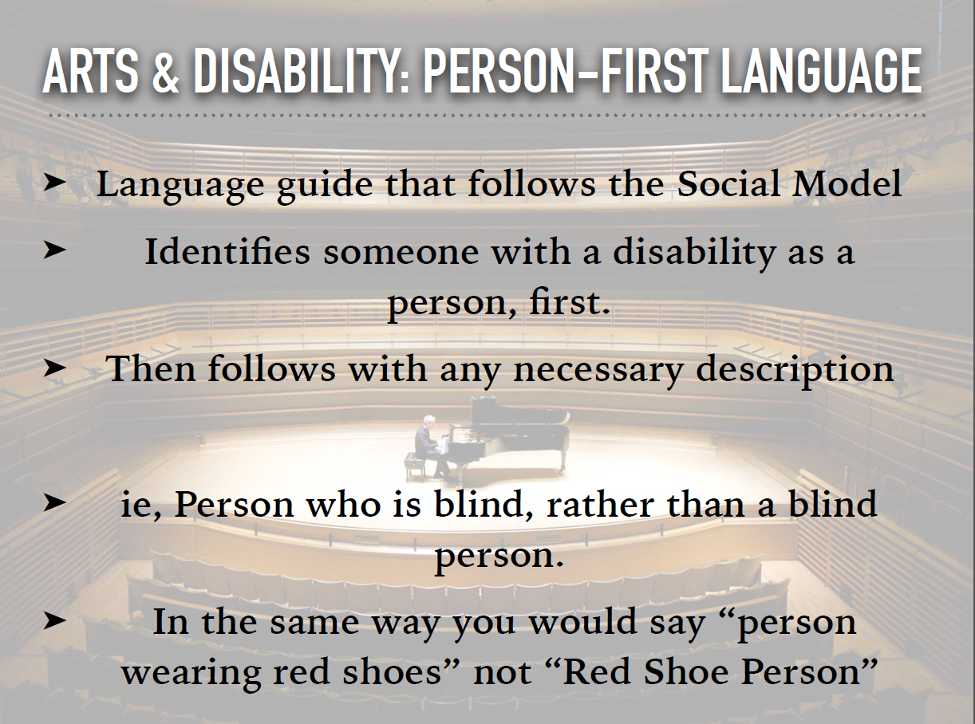

Slide 16
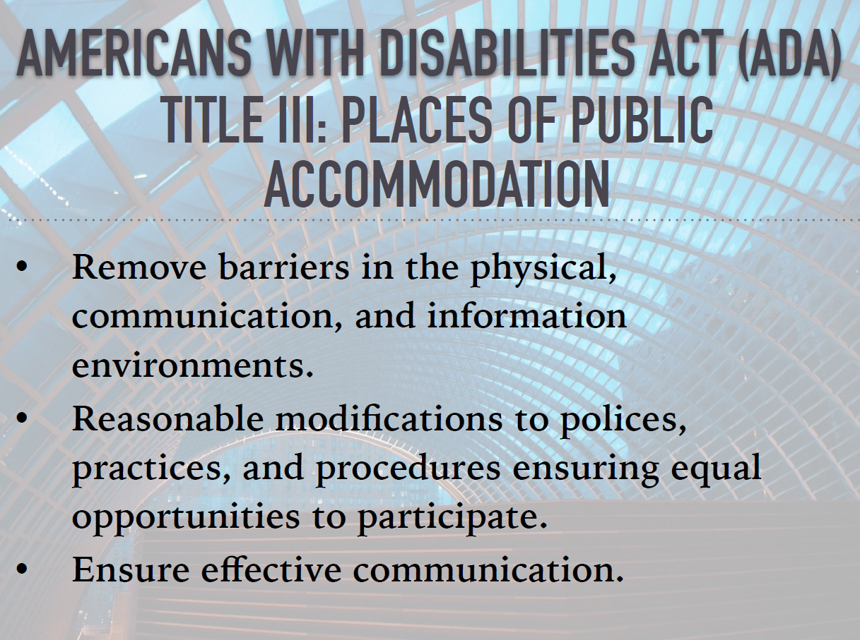

Slide 17


Slide 18
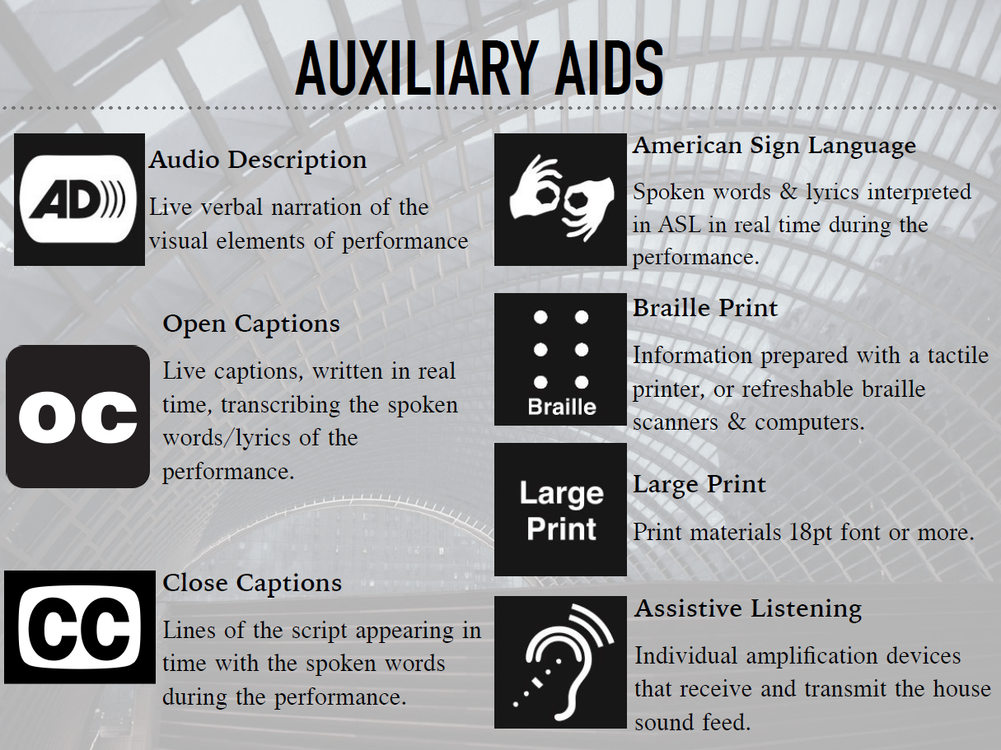

Slide 19
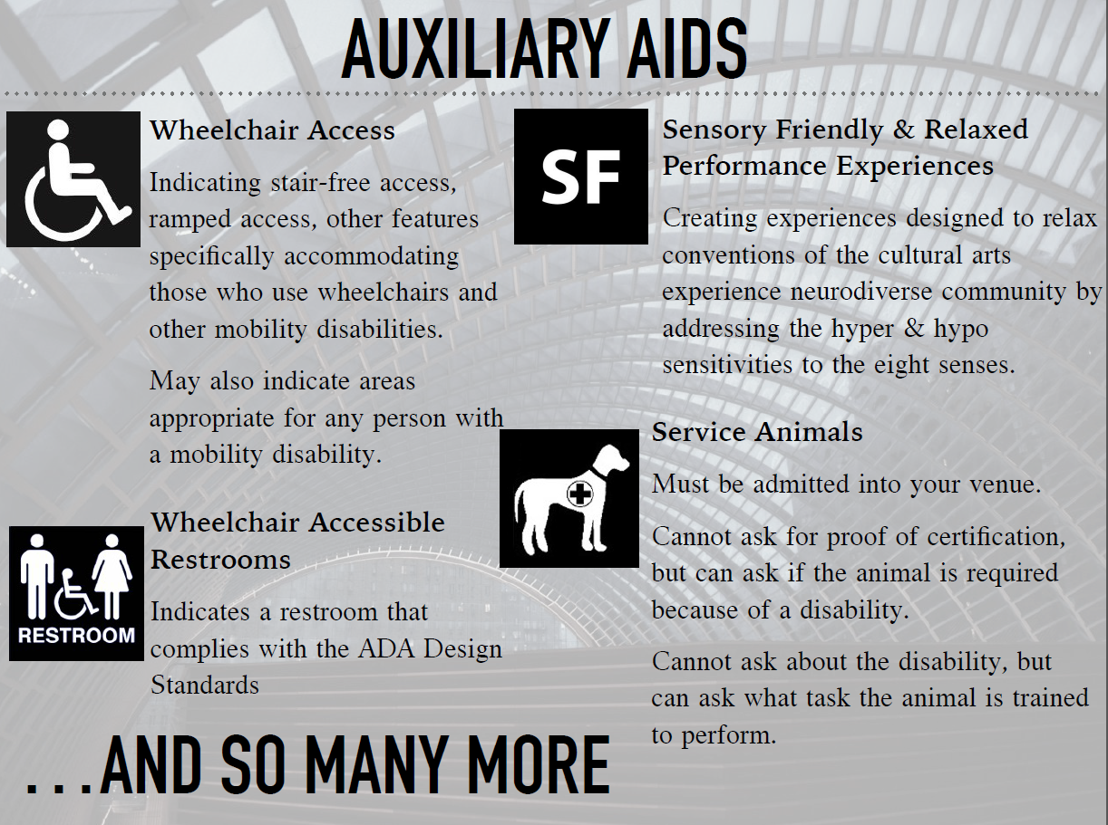

Slide 20
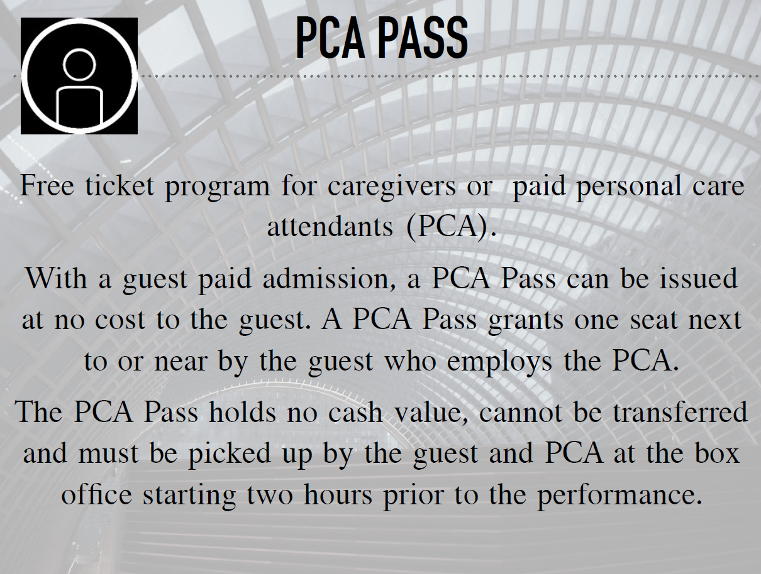

Slide 21


Slide 22
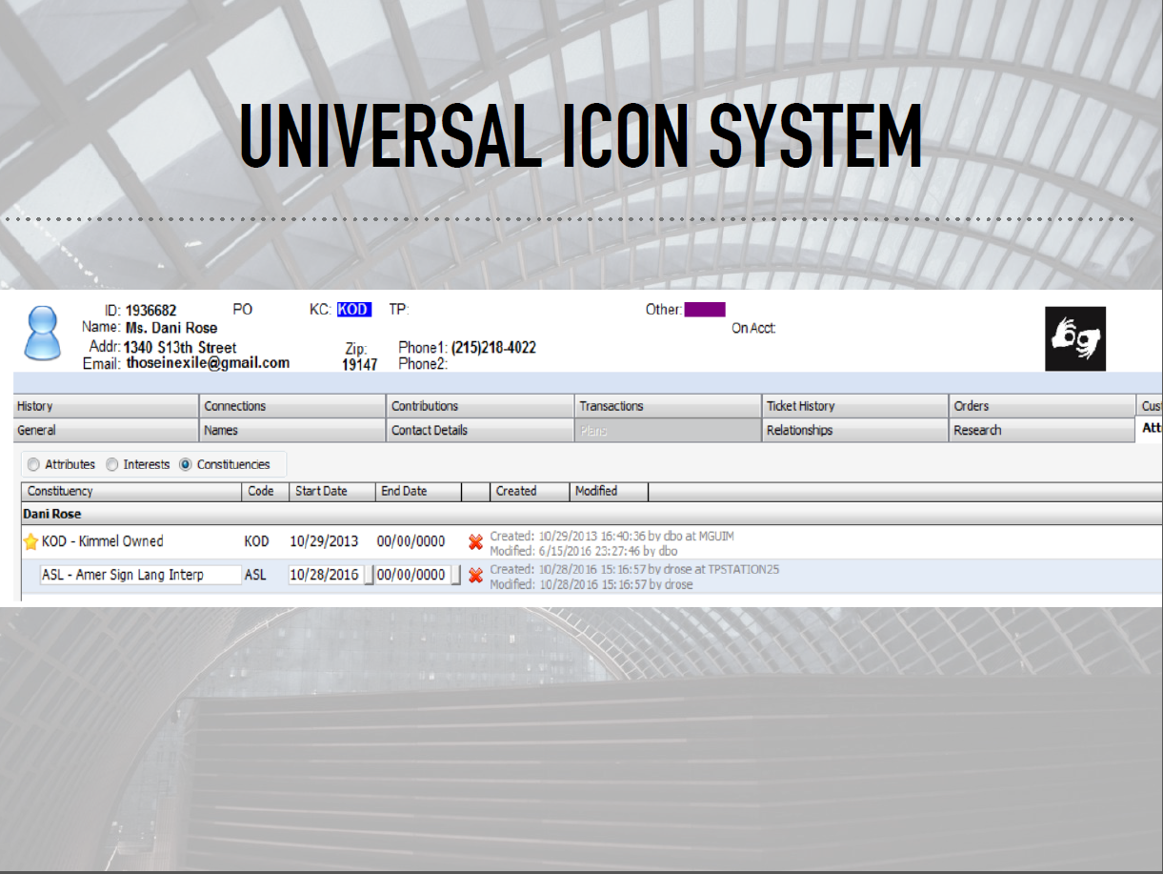

Slide 23
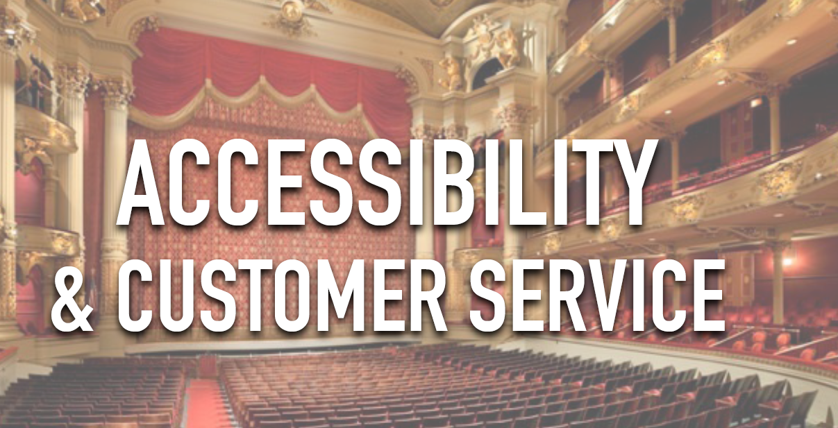

Slide 24
10 MINUTE BREAK

Slide 25
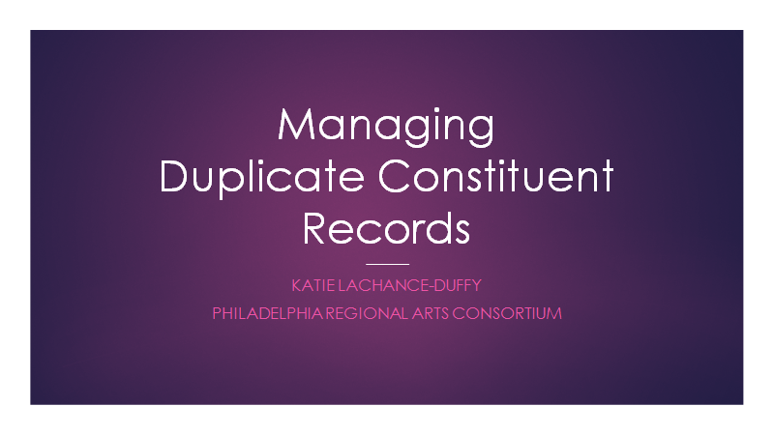

Slide 26
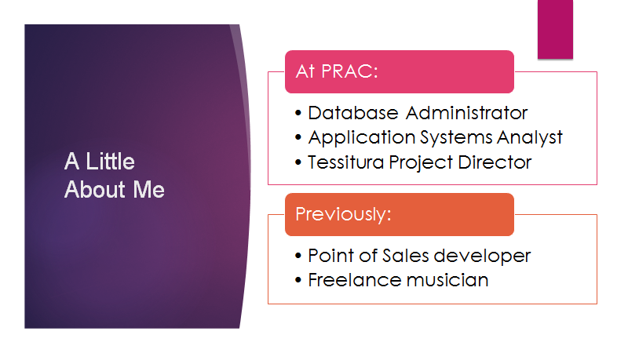
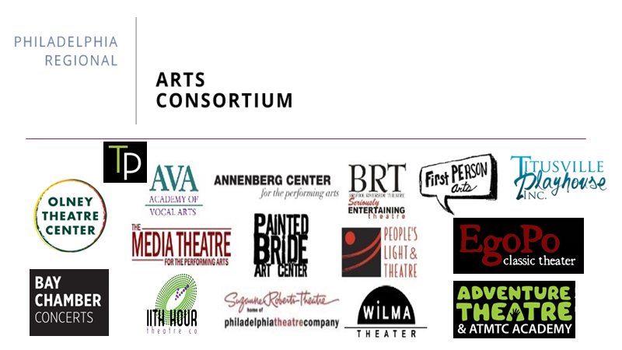

Slide 28
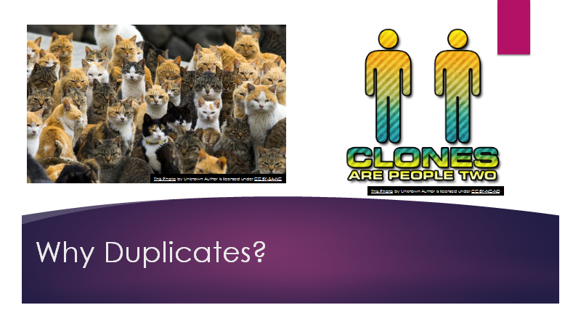

Slide 29
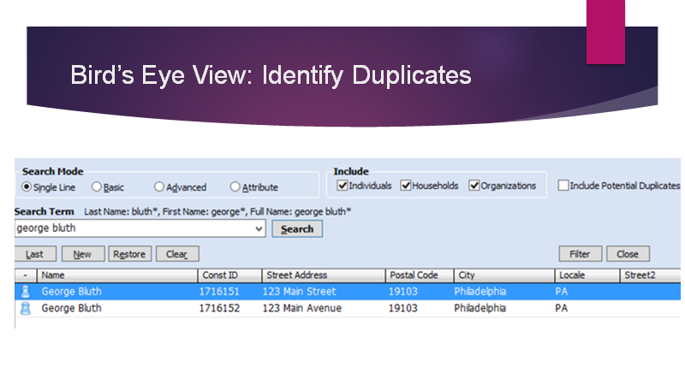

Slide 30
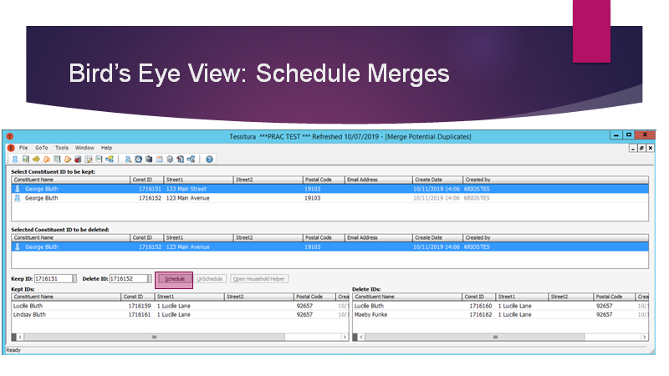

Slide 31
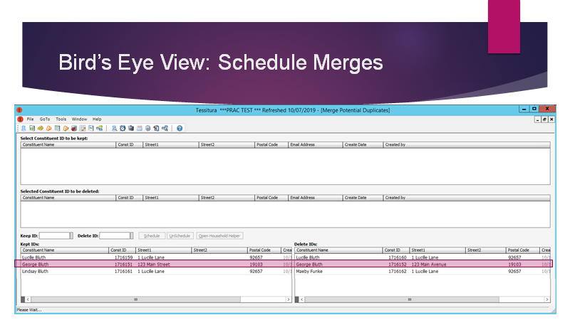

Slide 32
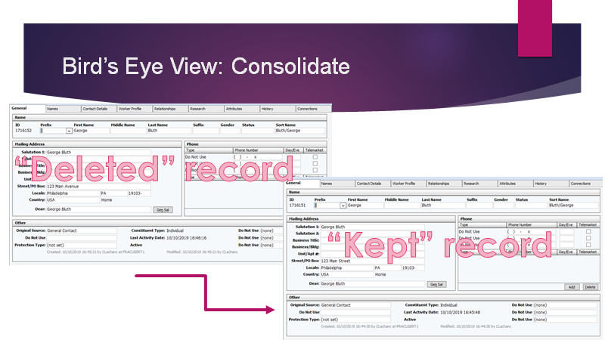

Slide 33
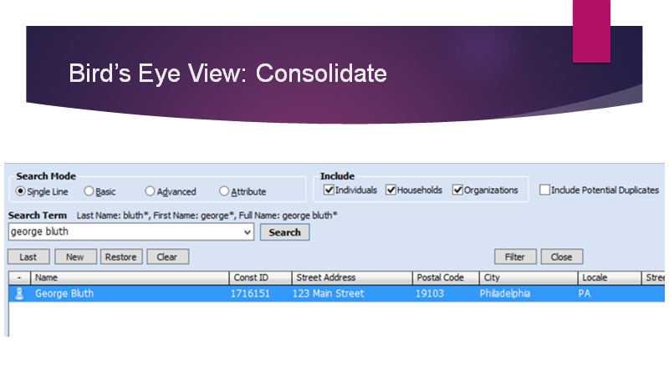

Slide 34
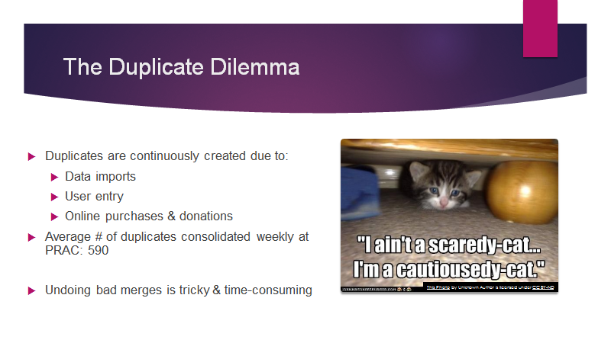

Slide 35
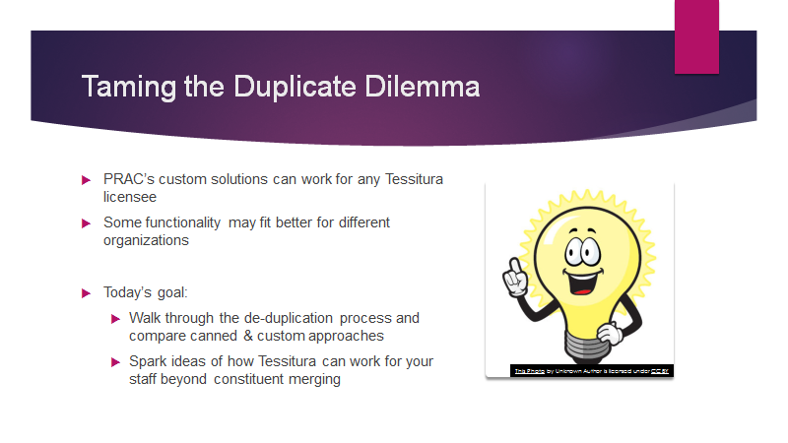

Slide 36
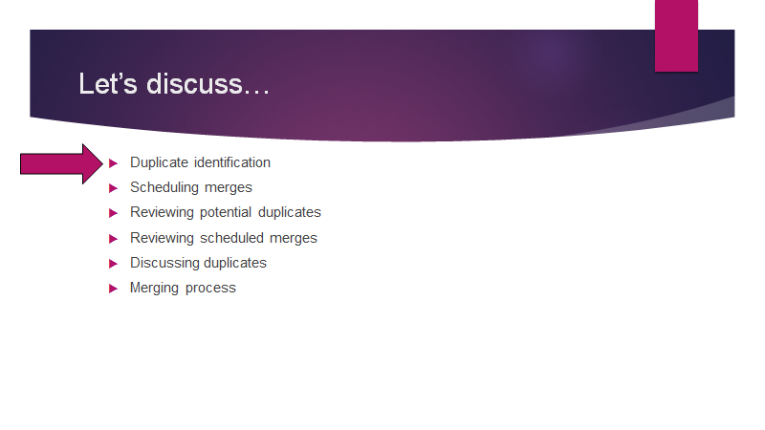

Slide 37
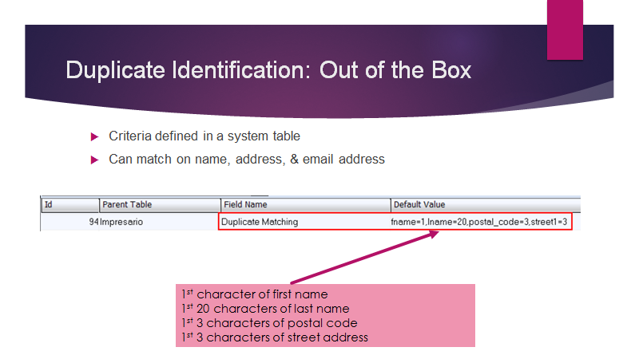

Slide 38
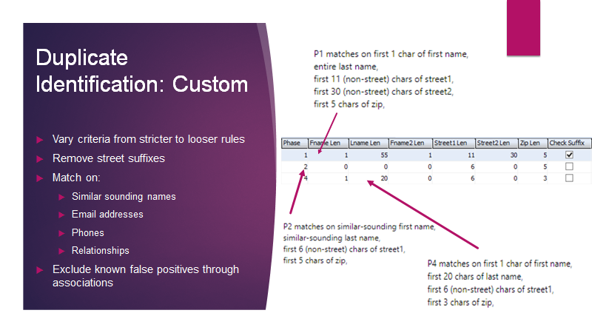

Slide 39
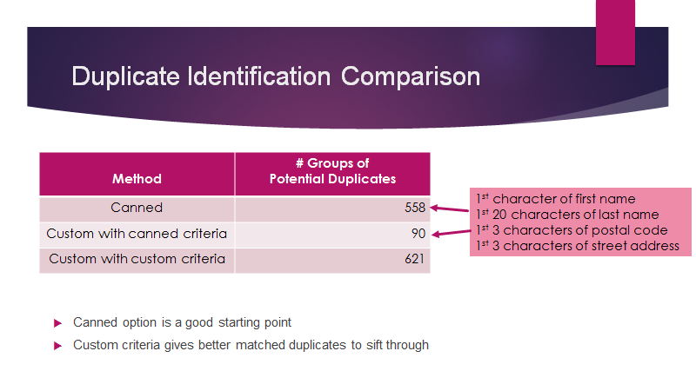

Slide 40
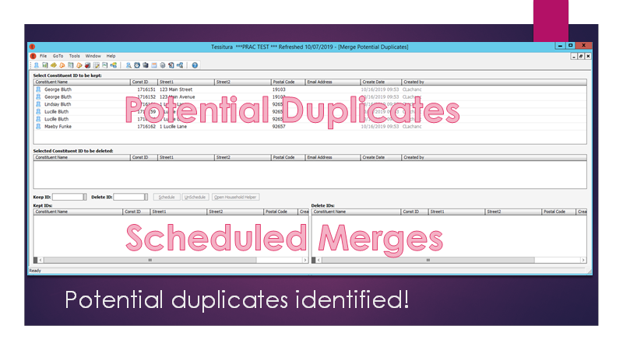

Slide 41
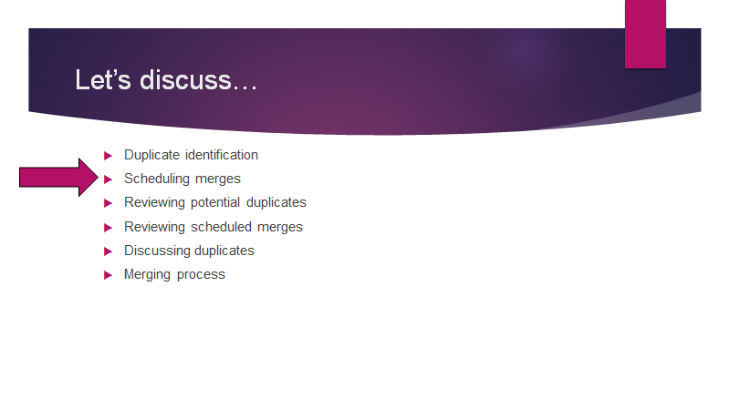

Slide 42
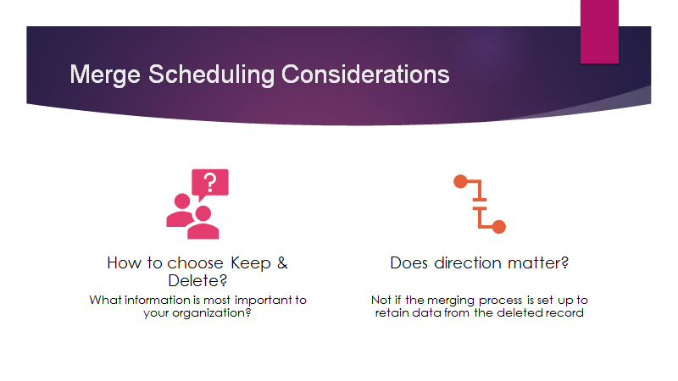

Slide 43
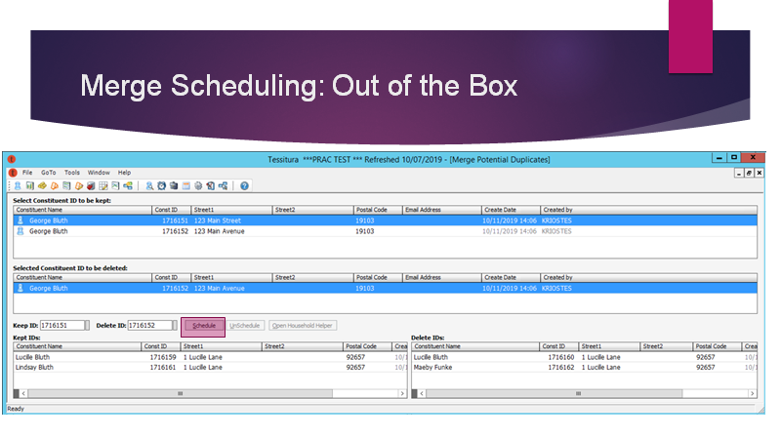

Slide 44
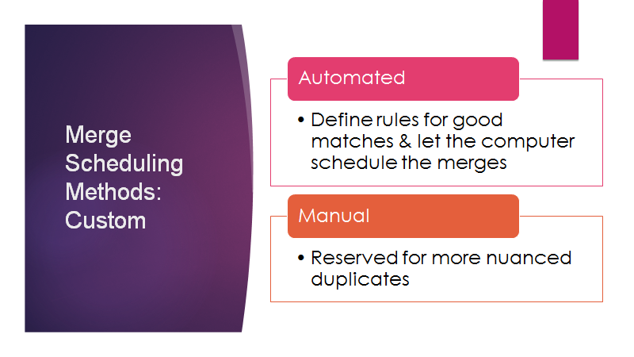

Slide 45
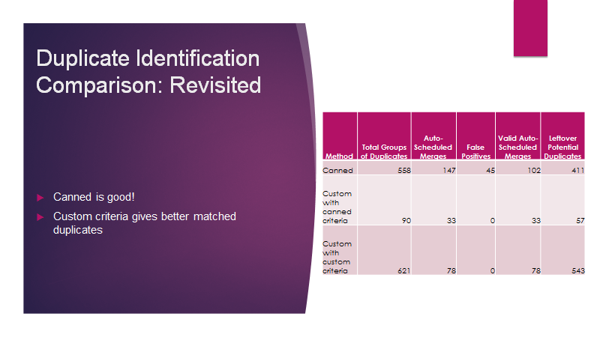

Slide 46
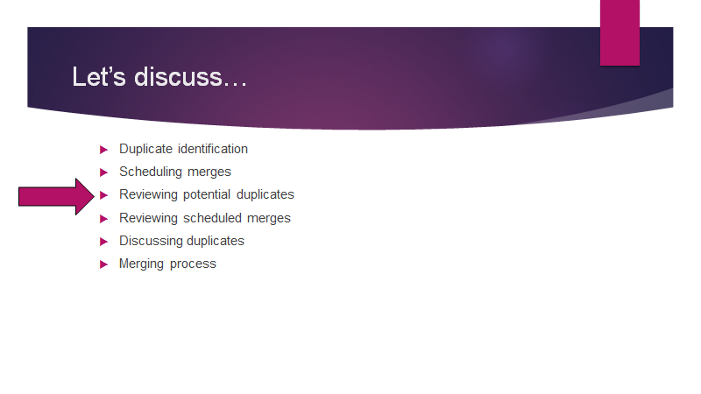

Slide 47
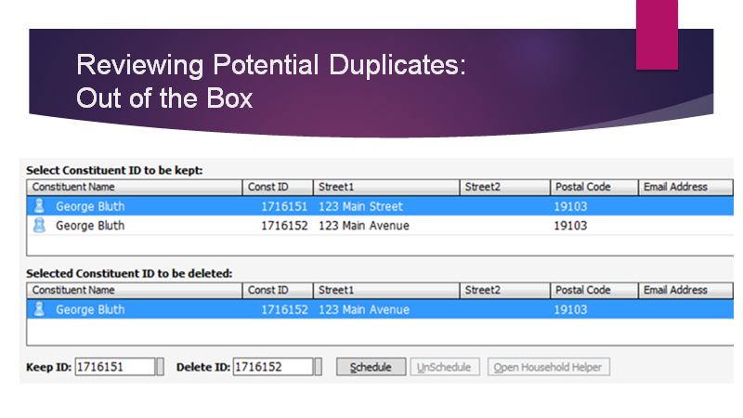

Slide 48
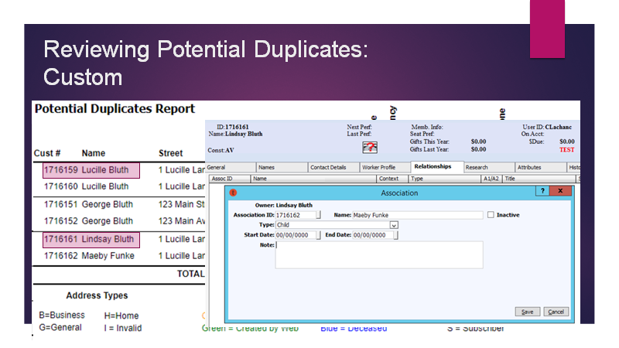

Slide 49
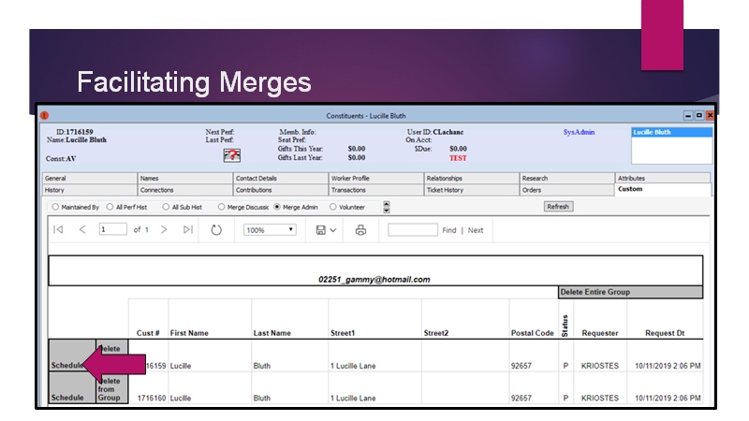

Slide 50
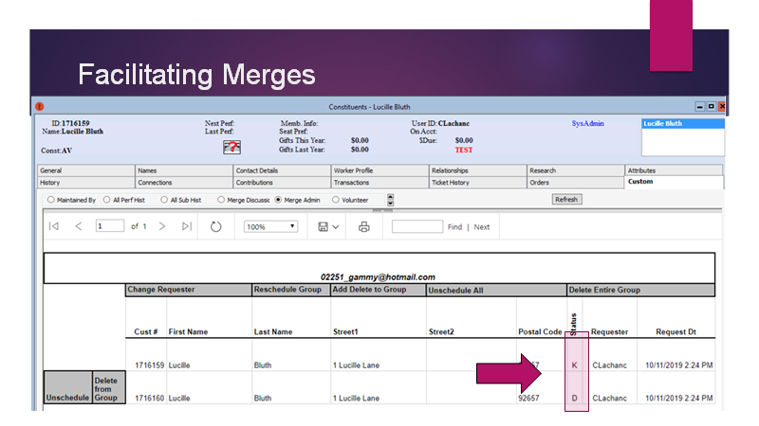

Slide 51
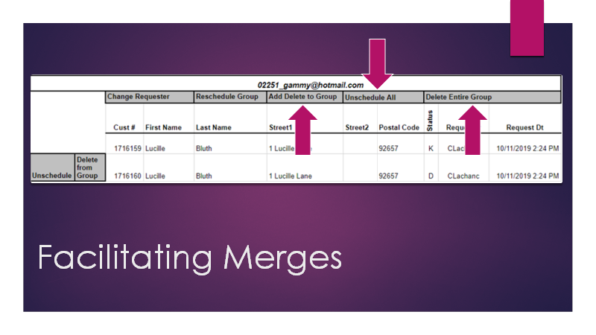

Slide 52
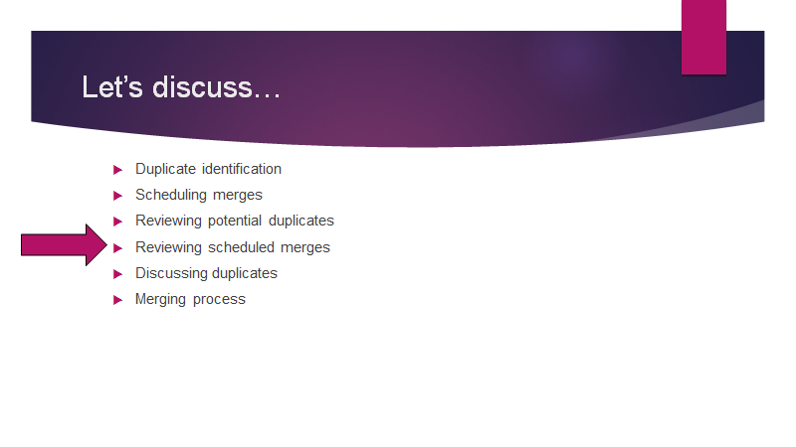

Slide 53
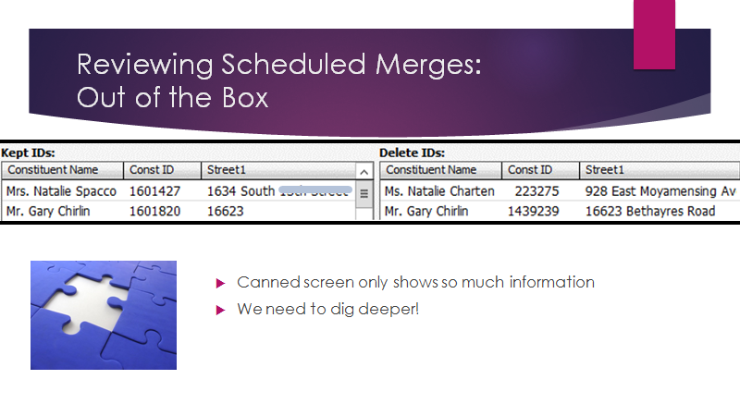

Slide 54
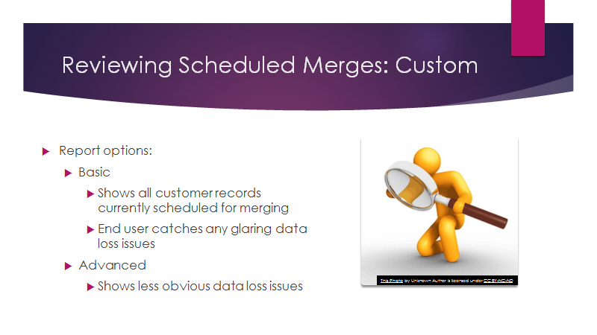

Slide 55
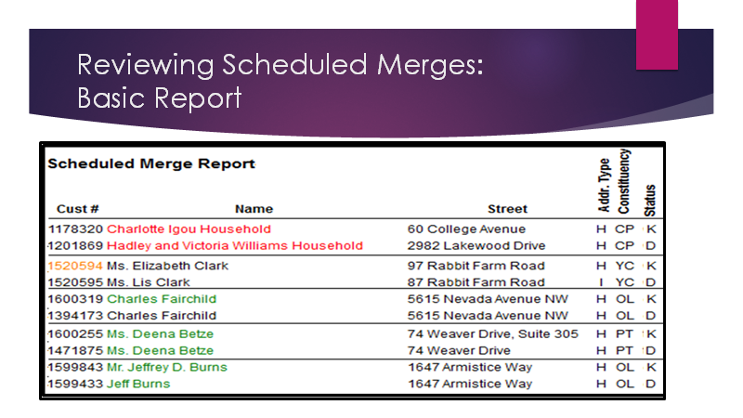

Slide 56
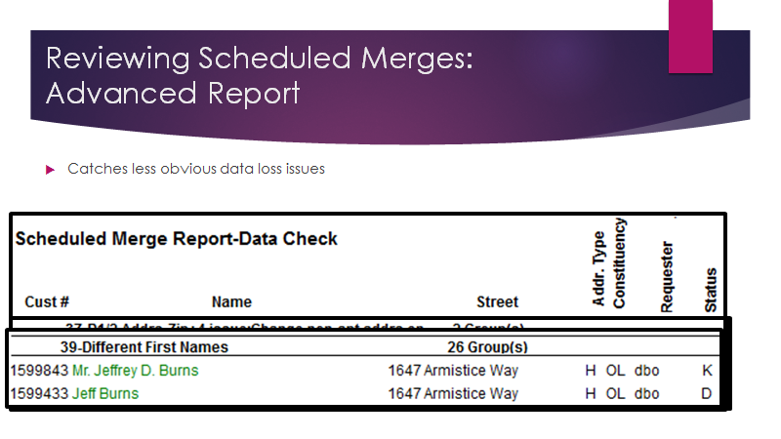

Slide 57
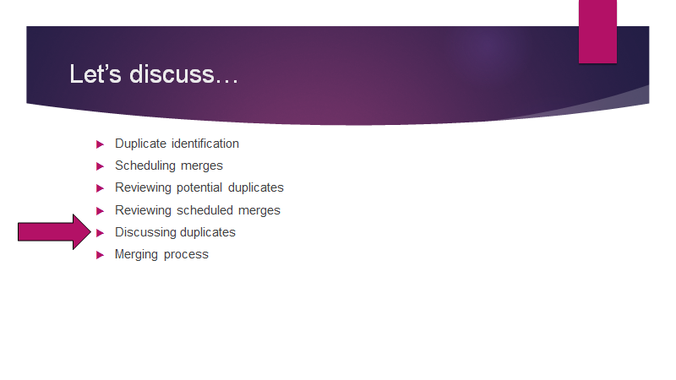

Slide 58
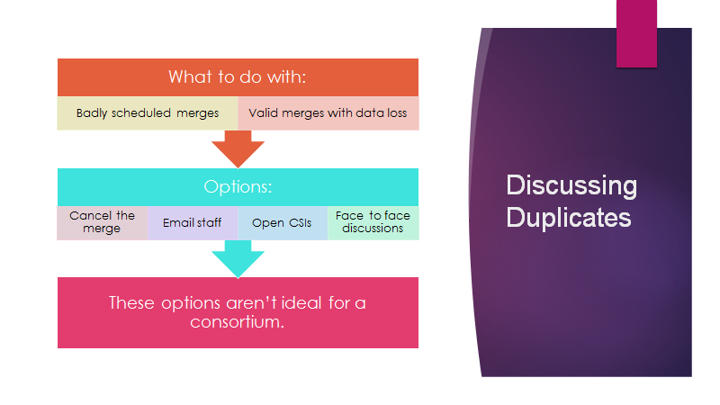

Slide 59
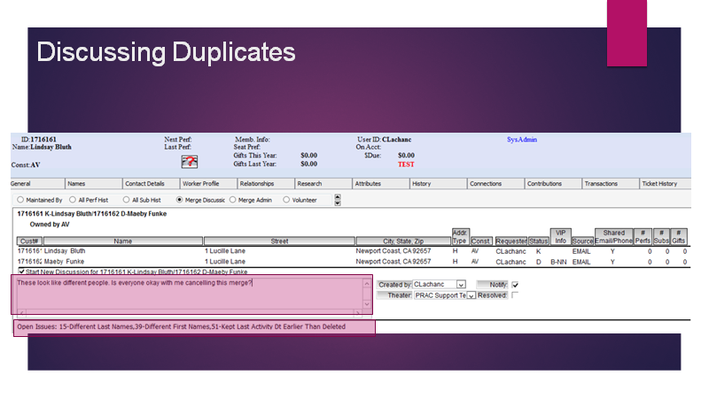

Slide 60


Slide 61


Slide 62


Slide 63


Slide 64


Slide 65


Slide 66
10 MINUTE BREAK

Slide 67


Philanthropic Memberships at the Kimmel Center
Anne Henry
Manager of Membership
ahenry@kimmelcenter.org

Slide 68
  Campus:
    Verizon Hall, a 2,500 seat concert hall
    Perlman Theater, a 650 seat theater
    Merriam Theater, a 1,800 seat proscenium theater
    Academy of Music, a 2,900 seat proscenium theater
    SEI innovation Studio, an intimate “black box” theater
    Commonwealth Plaza, a small stage for free public events
  Attendance:
    9,000 seats per night
    Over 1 million tickets sold per season to over 1,900 performances and events
    Home for eight resident companies:
      The Philadelphia Orchestra
      The Philly Pops
      The Pennsylvania Ballet
      The Chamber Orchestra of Philadelphia, PHILADANCO!
      Opera Philadelphia
      Philadelphia Chamber Music Society
      The Curtis Institute of Music
      Programming:
        Kimmel Center Presents
        Broadway
        Philadelphia Jazz and Theater Residencies.
        Creative Stages Education Programs provide free musical theater and jazz education to students K-12. We are one of the few PACs who programs are 100% free of charge and we focus solely on Title 1 schools.

Slide 69

Academy Gold Membership
2012-2013 Season:
  Donation level was $500+ with a Broadway Philadelphia Subscription
  Benefits:
    Access to the Academy of Music Ballroom one hour before curtain and during intermission
    Private Broad Street Ballroom entrance
    Early access to free coat check
    Access to private concessions for food and beverages
    Access to private restrooms
  2017-2018 Season:
  Donation level is $750+ with a Broadway Philadelphia Subscription
  New Benefits:
    A backstage tour of the Historical Academy of Music followed by a private reception.
    A complimentary Kimmel Center Souvenir Cup which can be used at all venues across the Kimmel Center Campus. It also allows saves you $2 on drinks all season long and allows you to bring your drink into the performance.

Slide 70
Retention - Have a plan!
We had a 75% retention rate from the 17-18 Season to the 18-19 Season.
    Of the people who did not renew this membership 50% did not renew their subscription.
    How did we achieve this?
    Timing of increase:
      Going to a two week subscription package
      Hamilton
    Messaging:
      We went out to our whole Academy Gold membership base at one time with the announcement regardless of renewal date. They received 2 separate letters and an email follow-up. The information was also included in their subscription renewal and in their subscriber ticket package.
      Timing of Announcement:
        We also announced it right before we had an Academy Gold performance and doubled the staff in the Ballroom to help answer questions and to listen to concerns.

Slide 71


Acquisition Strategies
Our Academy Gold membership increased 31% from the 17-18 Season to the 18-19 Season.
Targeted Email Campaigns
  3 emails leading up to the first show of the season
  Final push one week before opening night
  Promotion in all Broadway related print materials
  Promotion on Broadway related digital materials
  Targeted invite to non-members to experience the Ballroom
  Upsell Experiences
  Purchase Path Options

Slide 72

Survey your Members!
Why?
  It allows you to see which existing benefits members really value.
  Allows members to voice opinion about new or added benefits
  Engages members and allows them to feel valued
What do you do with the results?
  Use them!
    Analysis
    Promotion (Retention and Acquisition)
    Idea Generation
Implementation

Slide 73
Digital Membership Management at the Kimmel Center
Anne Henry
Manager of Membership
ahenry@kimmelcenter.org

Slide 74
Why go digital?
Philanthropic Membership Program
  Physical card rarely used
  Cost of card/letterhead
  Environmental impact
Customer Experience already digitally focused
  Online Ticket Purchases
  Online Account
  Member presales and announcements all digital

Slide 75
Implementation and Overall Strategy
1. Questions we asked ourselves:
  What did our members already do? What were the behaviors/relationship to the Kimmel Center online?
  What online tools did we already provide? What were they using?
  How do we make our member experience better?
  2. Implementation: 2 Phases (We do not use TNEW)
      Phase 1: Online Member Portal
      Phase 2: Digital Member Card

Slide 76

Phase 1: Member Portal

Slide 77

Member Portal - Features

Slide 78

Member Portal – Features Continued

Slide 79

Member Portal – Features Continued

Slide 80

Member Portal – Features Continued

Slide 81
Phase 2: Digital Member Card
Uses:
  Discounts at local restaurants/partners
  Entry into special events
  Member Perks
    Drinks at a performance
    Gift at a special event
    2. Development and Platform:
    Ability for our card to be stored and kept in Apple Wallet and Android
    Ability to access the card from the member portal
      Including a pdf for those who to be able to print a copy

Slide 82
Thank you.
Breakout Sessions
4:15PM Kimmel Center Tour

