Slide 1


Slide 2

AMY’S ADVENTURES IN ANALYTICS
Amy Welsh, Ticketing Coordinator
amy@bsstc.com.au
Been at Black Swan since February 2016
Previously used Ticketmaster (UK) and Ticketek (AU)
Used Tessitura since August 2017
Hates Maths
Notes:
For those of you who don’t know me, my name is Amy and I am the ticketing coordinator at Black Swan State Theatre Company.
I feel that it’s important to preface this presentation with the fact that I hate maths, am not that good with numbers and stopped studying maths after Year Ten as I felt I had learnt all I need to know about triangles.

Slide 3
ALL THE REPORTS!!
4 Daily Reports
4 Weekly Reports or Utilities
1 Weekly Report for Co-Producing Partner
Capacity Reports
Post-Production Reporting
Bi-Monthly Board Report Support
Yearly Membership Churn
Any Other Data as Required
Notes:
In addition to simply selling tickets, I am responsible for scheduling daily, weekly and monthly ticketing sales reports in Tessitura, database maintenance, and assisting with pre- and post- show reporting and board reports.
Black Swan is also trialling dynamic pricing, so I am looking at reporting strategies to assist with pricing decisions during live sales.

Slide 4

MY TEAM
Marketing Manager
↓
Ticketing Coordinator
↓
Ticketing Officer/s
Notes:
With the implementation of Tessitura, we went from managing one ticketing revenue stream internally to two point five. So, I also use data to track the volume of ticket sales received via our office so we can plan workflow and staffing for my team of ticketing officers.
To do this, I was previously the main, if only, T-Stats superuser at Black Swan. Not bad for someone who hates maths.

Slide 5
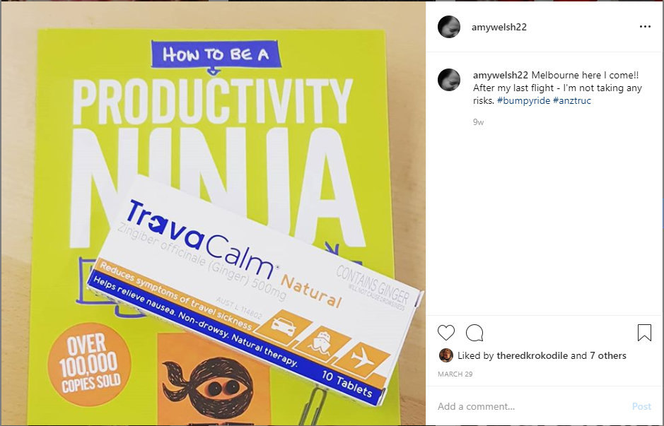
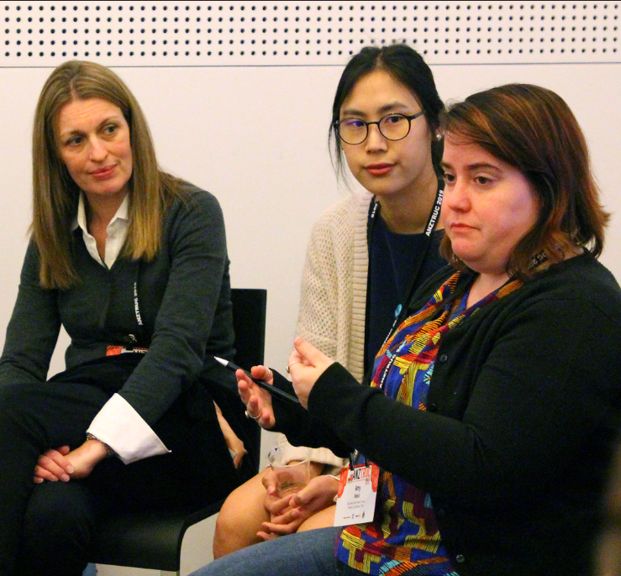
ANZTRUC 2019
Instagram
Tessitura Network
Notes:
Earlier this year, I was very lucky to travel to ANZTRUC 2019 where I attended Amalia’s presentation on championing Analytics adoption. I also undertook two hands on training sessions – Analytics for Ticketing and Analytics for Philanthropy.
I realised very quickly that Analytics would be a gamechanger – not only for myself personally, but our organisation and our ability to access data, use it to drive decision making and meet KPIs.

Slide 6
KEY CONCEPTS TO ANALYTICS
What data do I need to make help my managers make decisions?
What data to I want that I currently don’t have access to?
How can I assist staff in adopting Analytics for their teams so
I am no longer the only superuser?
Notes:
Based on Amalia’s presentation, my adoption of Analytics at Black Swan is based on the following concepts –
What data do I need to make help my managers make decisions?
What data to I want that I currently don’t have access to?
How can I assist staff in adopting Analytics for their teams so I am no longer the only superuser?

Slide 7
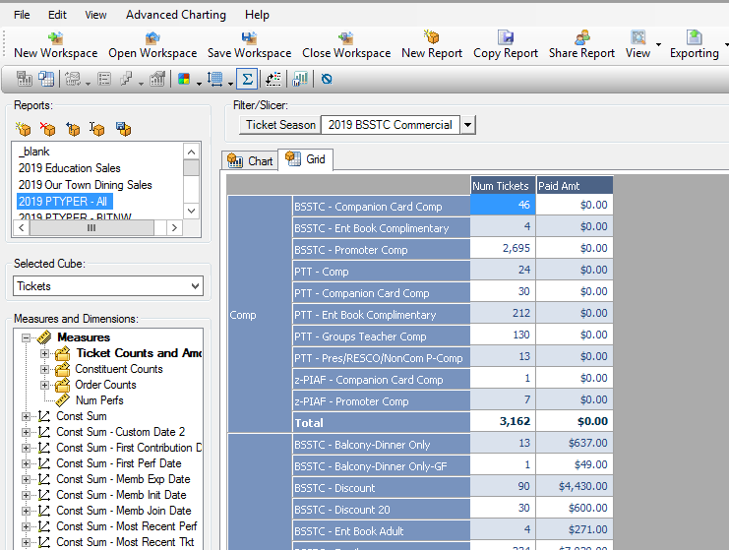
T-STATS REPORTS
Show by Source Code
Show by MOS
Show by Postcode
Show by Price Type + Price Type Category (PTYPER)
Zone by Capacity
Zone by Price Type
Single Tickets by Channel
Ticket Packages by Channel
Ticket Packages by Price Type
Average Ticket Package Price
Education/Student Sales
Notes:
So, I started with the data I am already using – pulling apart my T-Stats dashboards, emails and Excel spreadsheets to map what I currently need to help make decisions and fulfil reporting requirements.

Slide 8
REQUIRED REPORTING
PRESHOW – PRODUCTION
Net Sales To Date
Sales Target
Total Patrons (Target + To Date)
Capacity (Target + To Date)
Average Ticket Price
(Target + To Date)
Gap to Sales Target
Gap to Patron Target
+ Performance Capacity
(Dynamic Pricing)
POST-SHOW – PRODUCTION
Show by Source Code
Show by MOS
Season by MOS Comparison
Show by Price Type Category
Season by PT Category Comparison
Education Sales

Slide 9
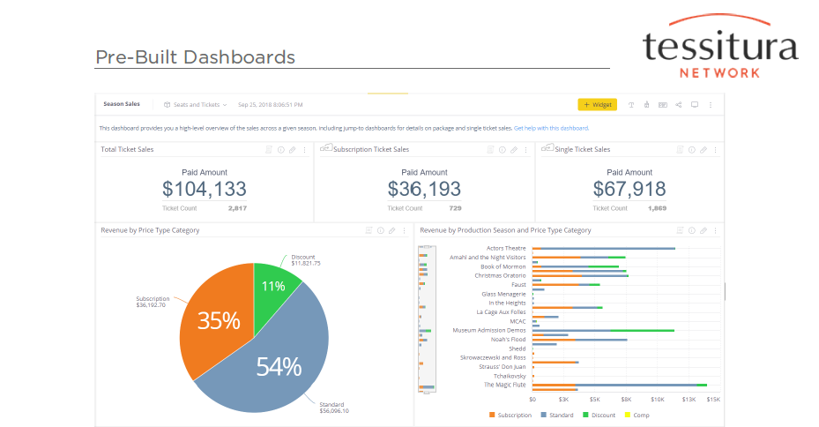
OUT OF THE BOX
DASHBOARD – SEASON SALES
Net Sales To Date ✓
Sales Target ✗ INSERT
Total Patrons (Target ✗ + To Date ✓)
Capacity (Target ✗ + To Date ✓)
Average Ticket Price (Target + To Date) ✗ INSERT
Gap to Sales Target ✗
Gap to Patron Target ✗
Performance Capacity (Dynamic Pricing) ✓
Show by Source Code ✗ INSERT
Show by MOS ✓
Season by MOS Comparison ✗ OWN BOARD?
Show by Price Type Category ✓
Season by PT Category Comparison ✗
Education Sales ✗ OWN BOARD?
Notes:
Then I started with pulling apart the ‘out of the box’ Analytics dashboards – seeing what data they contained and what I needed to add to make them fit my requirements.

Slide 10
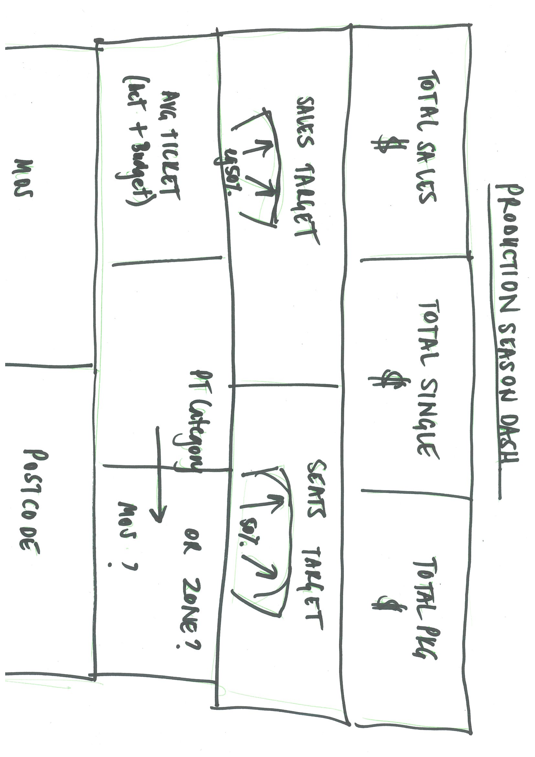
WIREFRAME
Production Information Board
Total Ticket Sales
Total Ticket Package Sales
Total Single Ticket Sales
Total Sales - Gaps to Target
Total Tickets – Gaps to Target
Average Ticket Price
Price Type Category
MOS or Channel Breakdown
Sales by Postcode
Sales by Source
Sales by Zone
Sales by Weeks Since Onsale
MOST IMPORTANT → LESS → LEAST
↓
LESS
↓
LEAST
Notes:
Based on Amalia’s advice, I created a ‘wireframe’ version of a dashboard. In this case – a ‘Production’ dashboard for each show. This is probably the most key data for myself and the marketing team, so I felt it the most critical to create and trial prior to going live in Analytics.
Key to this is prioritising also the widget layout – which data should be placed where. As noted by Amalia at ANZTRUC, your dashboard should read from left to right then up to down, with the most key information displayed in the top left corner.
Once I was relatively happy with the wireframe, I then started playing in Analytics.

Slide 11
MY DASHBOARDS
Notes:
Overall I have created four main dashboard templates to meet my reporting demands; Production Overview, Season Overview, Student or Education Sales and Ticketing Traffic.
I consider them all to be works in progress as I am given feedback from management and my own interactions with them
Some of them are missing key data e.g. sales targets.

Slide 12
TIPS AND TRICKS
Clear most pre-existing filters from an ‘out of the box’ dashboard and start from scratch
Be clear with your naming conventions
e.g. BSSTC TKT [YR] [Show]
e.g. BSSTC MKT [YR] [Show]
Experiment and Play
Pulses only work with one data source
Notes:
Found it best to clear most pre-existing filters from an ‘out of the box’ dashboard and start from scratch
Be clear with your naming conventions across the organisation – I used similar to our list manager conventions, with our organisation added.
Experiment and Play until you find what works for you and your reporting
Pulses only work with one data source in the widget. Hence the duplication of a widget at the bottom to enable pulses for Dynamic Pricing.

Slide 13
CAVEATS
We only have 18 months’ worth of data in Tessitura
If its not in Tessitura, it’s not in Analytics
We may not be able to optimise Analytics for another 1 – 3 yrs
This is only my process
My process is only beginning
Sharing is caring ☺
THANK YOU!
Notes:
Bear in mind that we currently only have 18 months’ worth of sales and production data in Tessitura
If its not in Tessitura, it’s not in Analytics. Therefore, we may not be able to absolutely optimise Analytics and transition away from using more manual data analysis forms for another 1 – 3 years.
This is only my process based on my reporting needs – your own organisation will be different
My process is only beginning – I’m still exploring with targets, widgets, jump boards, pulses, unknown data and our implementation plan.
If you use different reporting parameters or dashboards, let me know. I’d love to hear what you’re using.

