Slide 1
Special Ticketing: BAM Education
Nora Tjossem
Education Coordinator
Brooklyn Academy of Music (BAM)

Slide 2
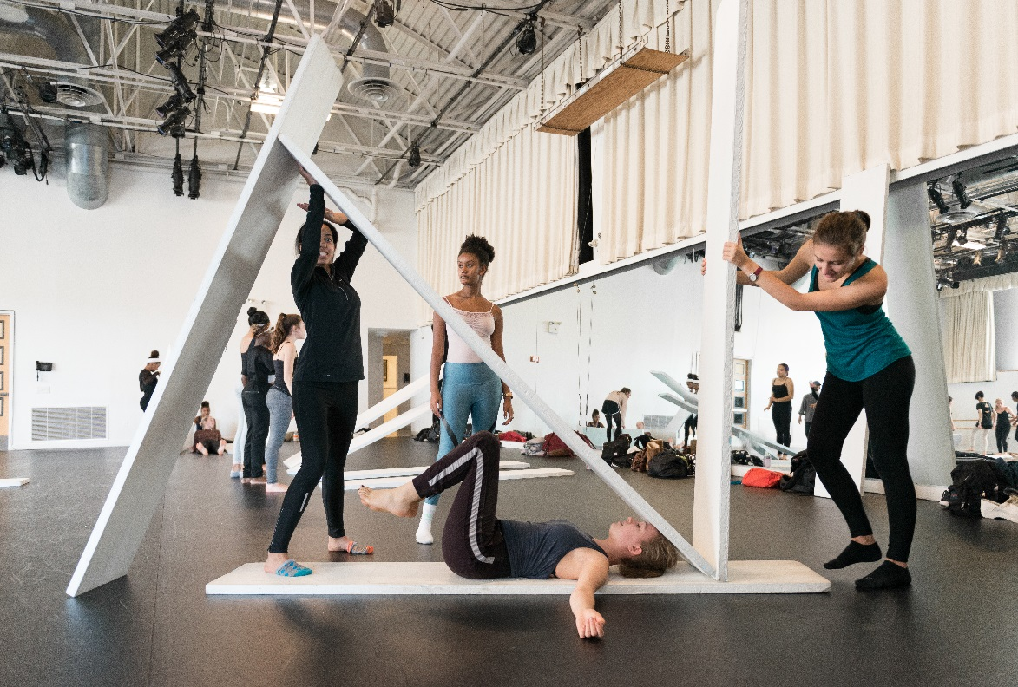
Introduction
BAM Education
Special Ticketing
TNEW
How it Works
Challenges

Slide 3
BAM Education: An overview
Family weekend programming and school-time weekday programming
FY17
  ~36,500 students, educators, families served
  180 performances/events
  1,613 workshops
  161 schools
Live performances, film screenings, workshops, residencies, after-school programs, virtual programs

Slide 4
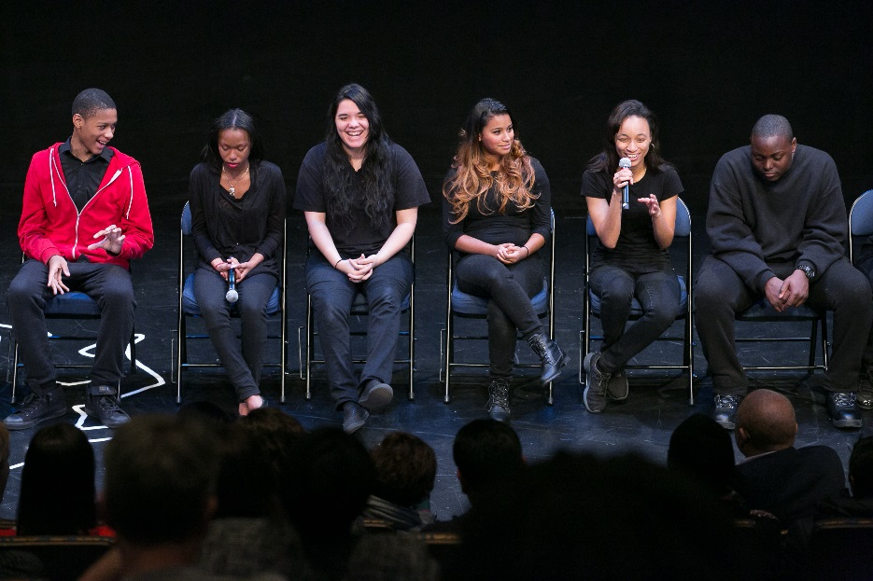
Special Ticketing: What makes us special?
Non-ticketed GA events
Large numbers of attendees
“Buy 15, get one free” chaperone policy
30-day payment policy
Payment methods
Schools, teachers, students (who owns the tickets?)
Counting groups vs. individuals

Slide 5
TNEW Project: The basics
Players
  Project Managing Consultant
  Tessitura Network Consultant (Michael Reisman)
  TNEW Implementation Specialist (Marley Wynne)
  BAM IT
  BAM Digital Media
  BAM Ticket Services
  BAM Education
Implementation, Spring-Fall 2017

Slide 6
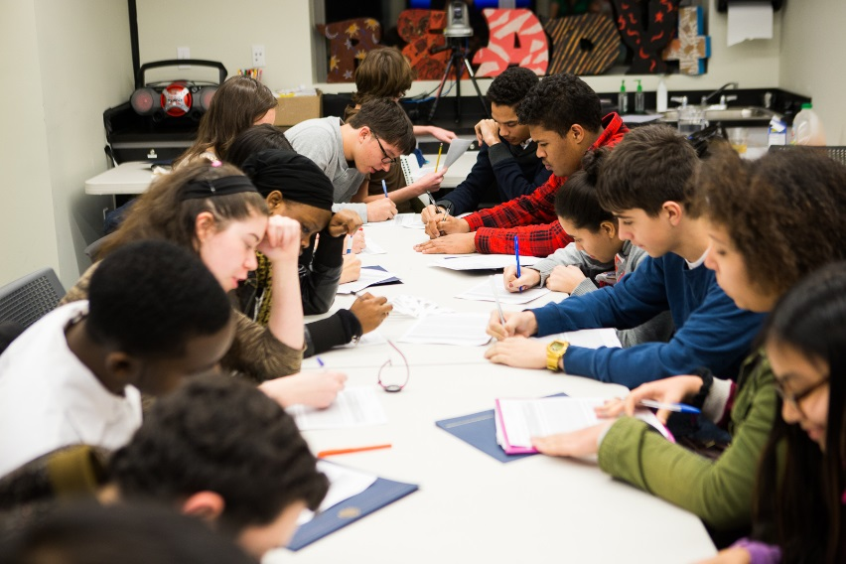
Where we started…
Live performances, screenings, residencies built in Tessitura
After-school programs, workshops not in Tessitura
Tickets assigned to teachers
Reservations came through a web form (Smartsheet) or over the phone

Slide 7
How it Works
Old Version
TNEW, 2017 AD
Teacher enters a form
Smartsheet captures “data”
Nora manually enters data into Tessitura
Nora invoices Teacher via Tessitura
Nora manually follows up with Teacher via email for payment
Nora receives payment (cash, check, cc)
Nora enters payment into Tessitura
Nora follows up with pre-show info, etc.
Teacher enters info directly into Tessitura
Tessitura sends confirmation to Teacher
Tessitura* follows up with Teacher for payment
Nora receives payment (cash, check, cc)
Nora enters payment into Tessitura
Nora follows up with pre-show info, etc.
* heads up: mass email invoicing is not easily done through Tessitura

Slide 8
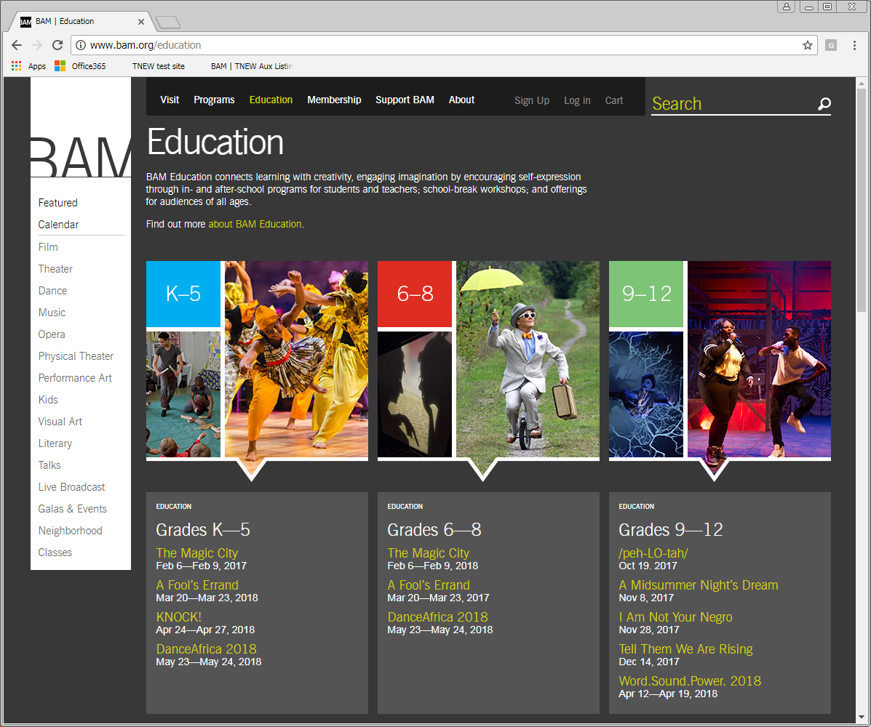
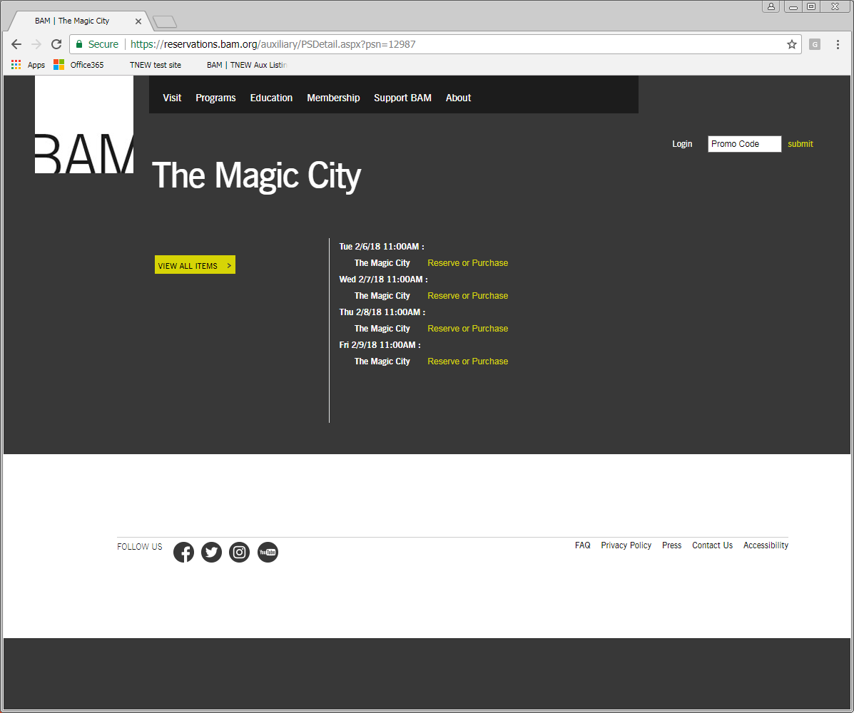
BAM.org vs. TNEW site

Slide 9
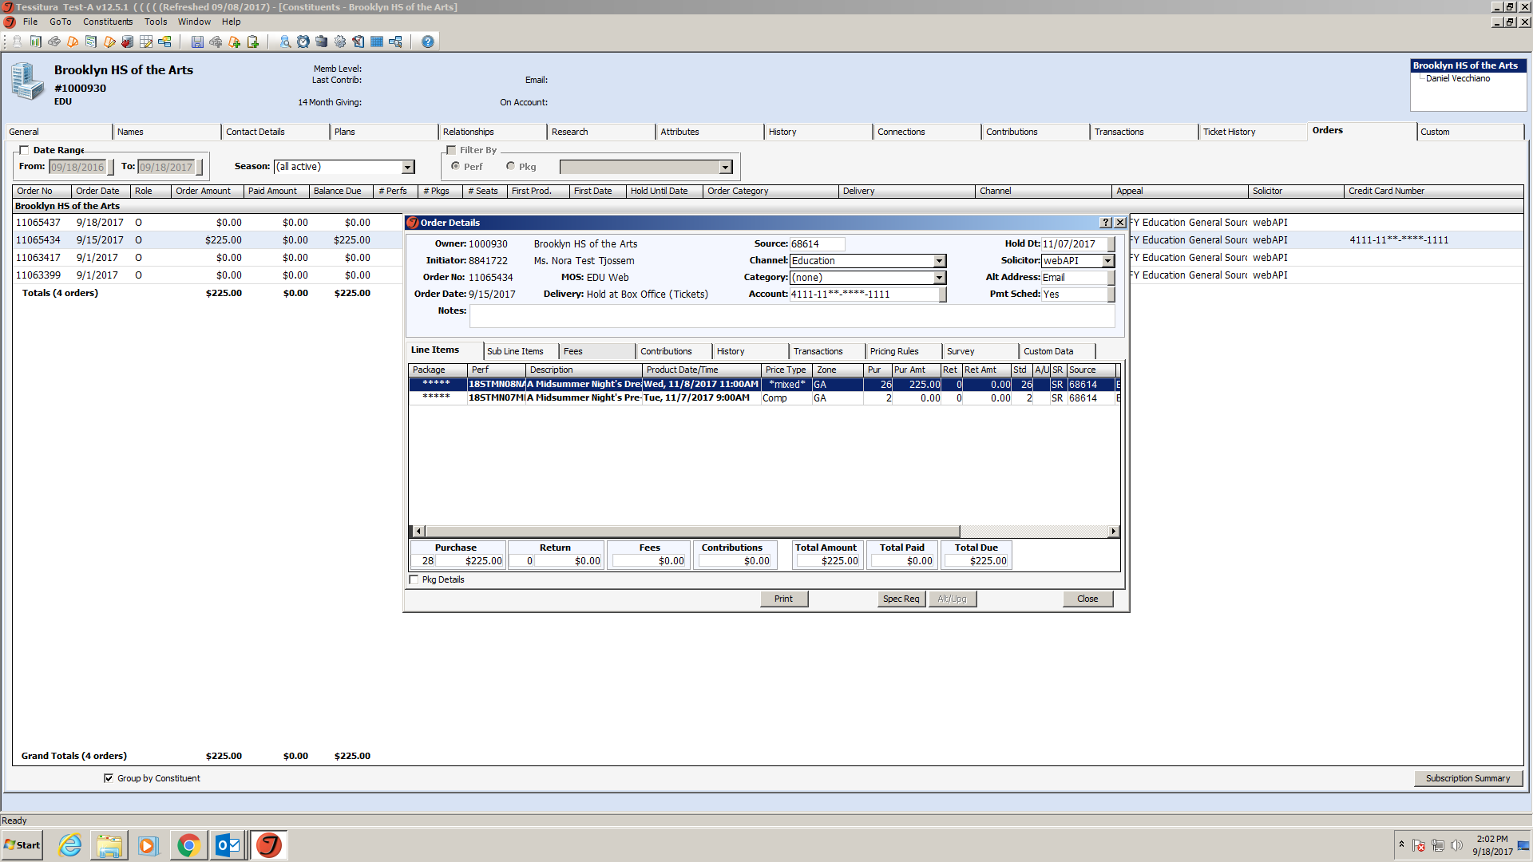
Order Owner/Initiator

Slide 10
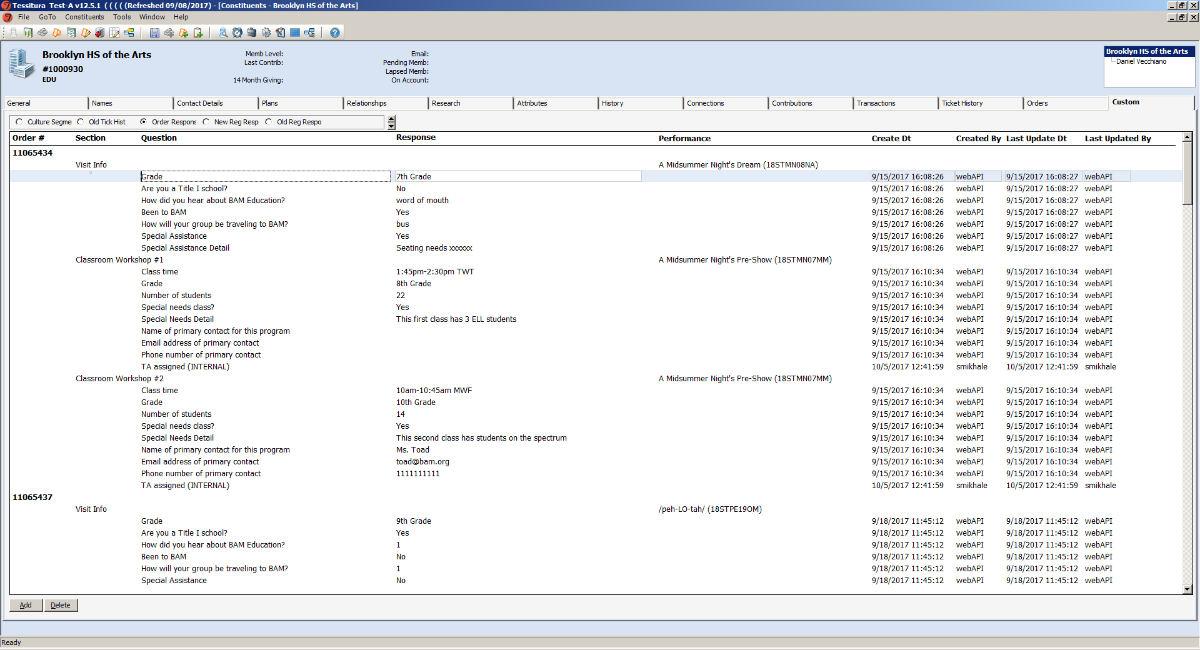
Custom Screens

Slide 11
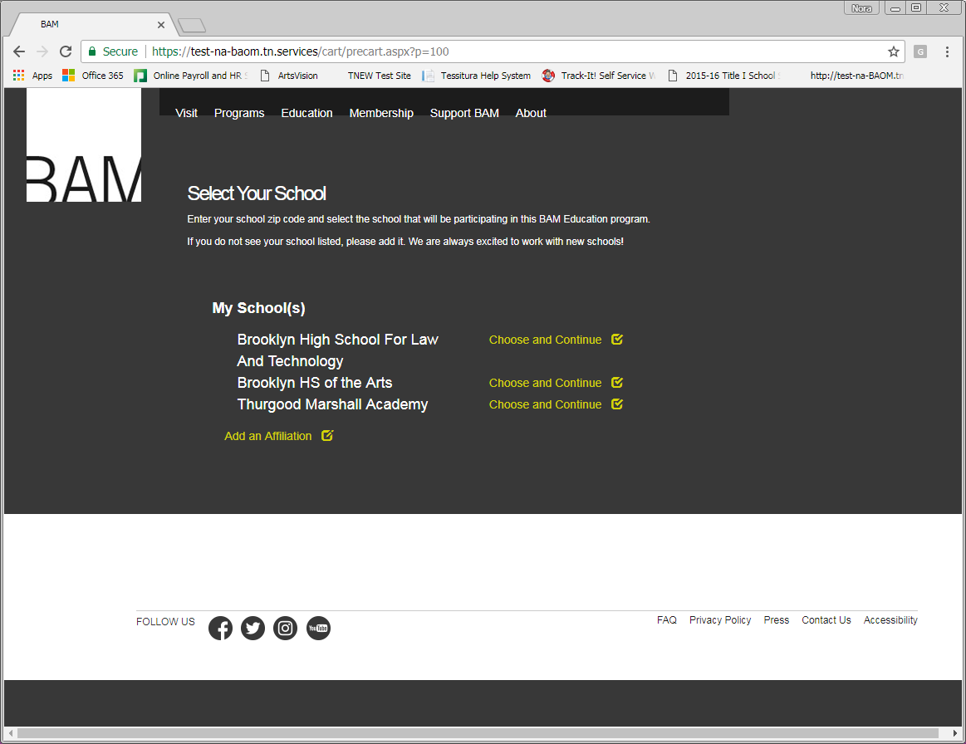
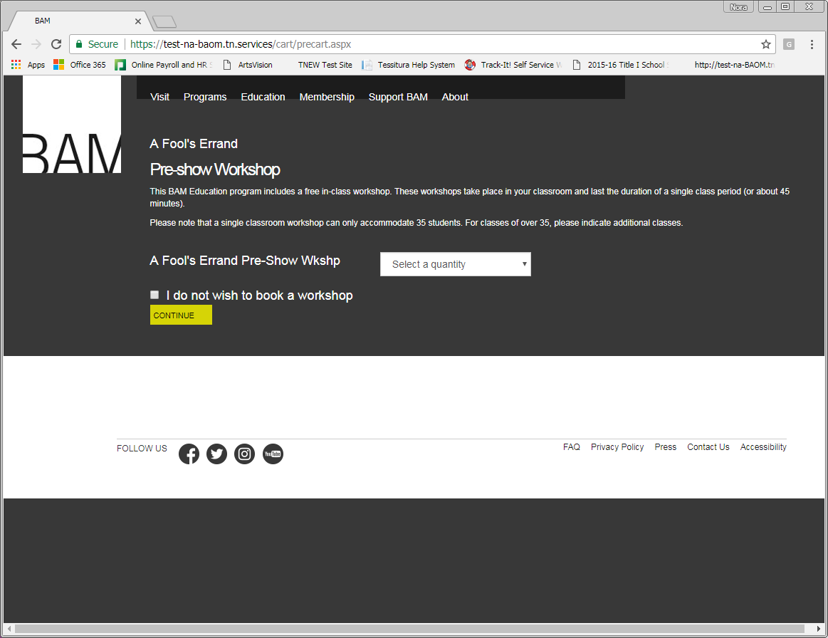
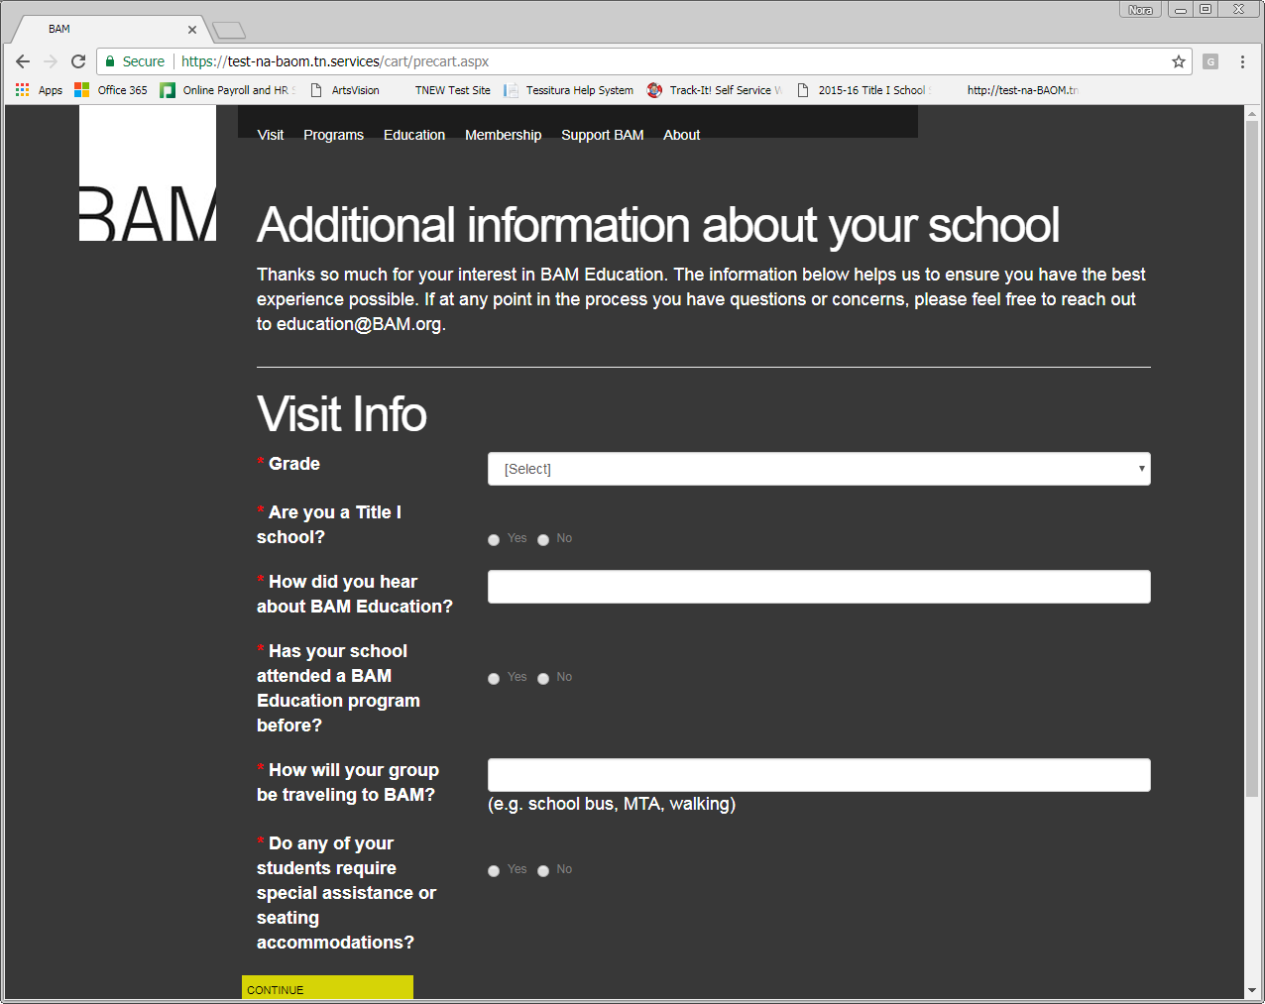
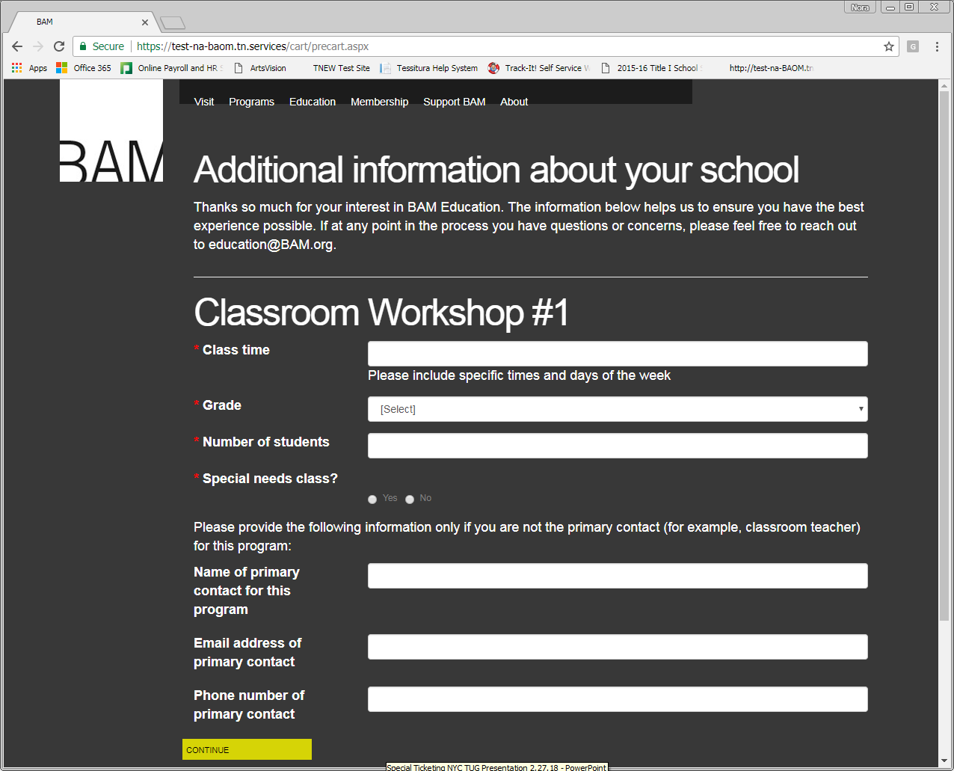
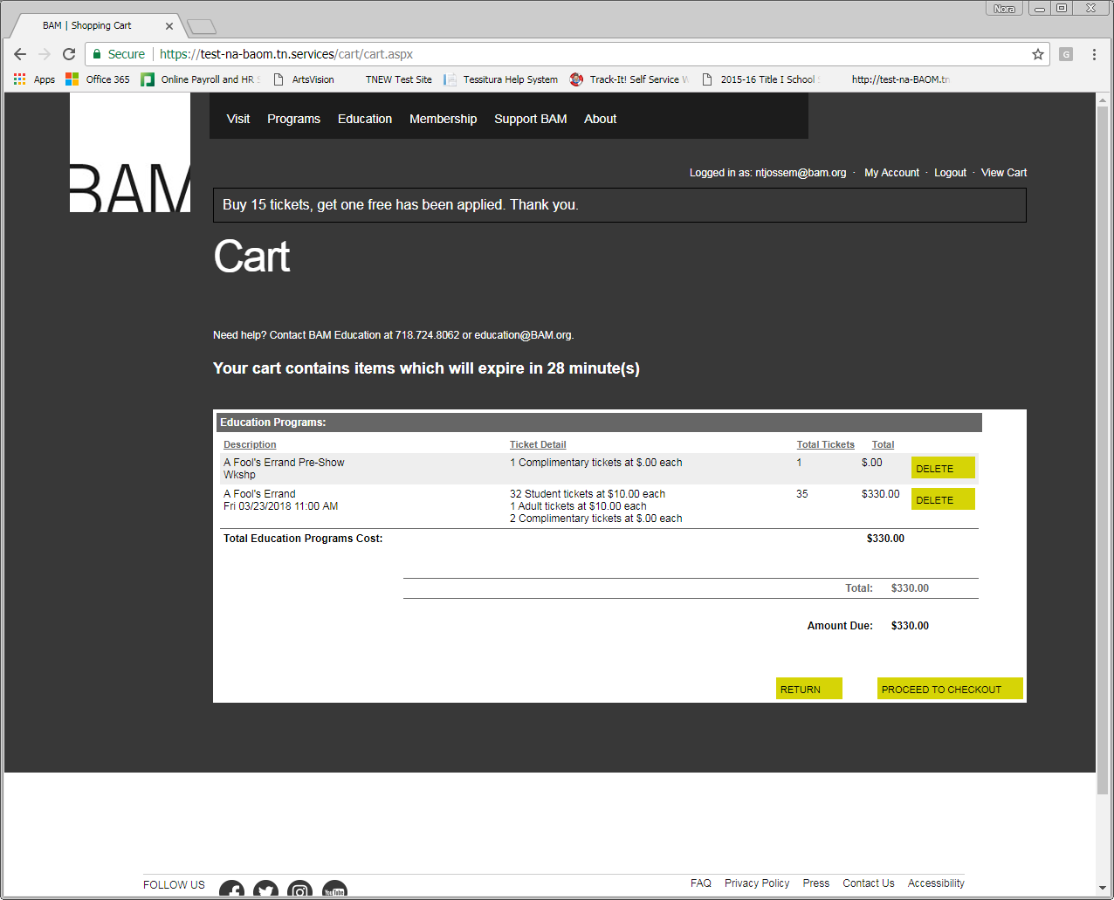
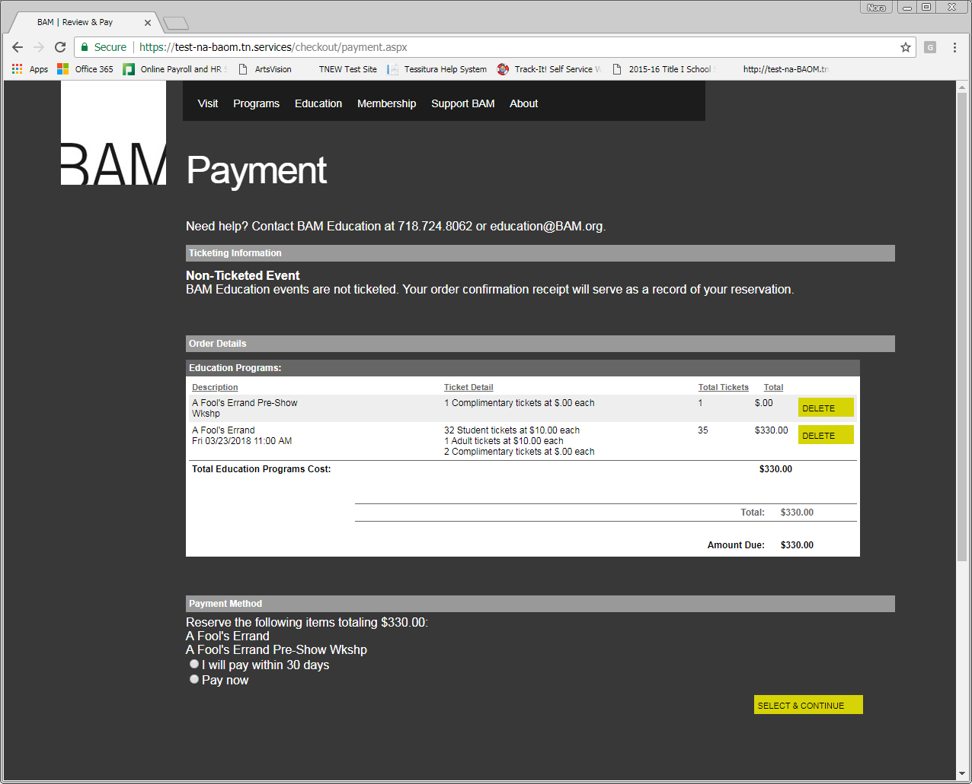
Test Site

Slide 12
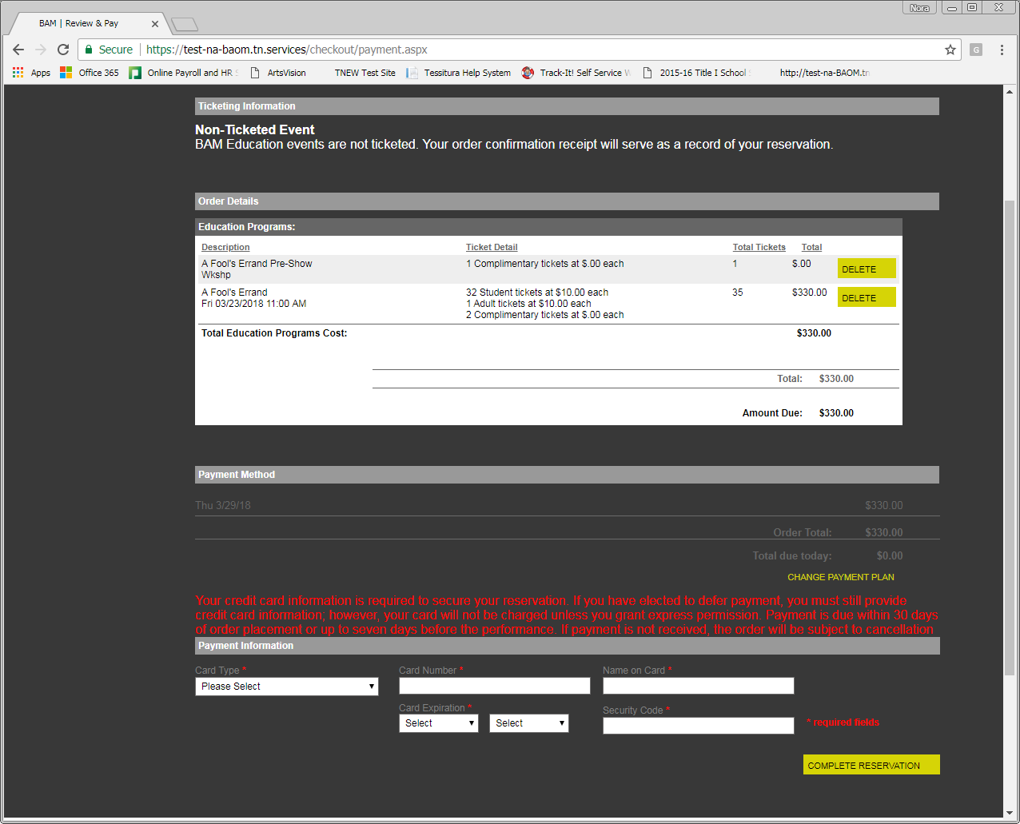
Required Credit Card

Slide 13
Challenges
Worked Around
Outstanding
Required credit card
Workflow for teaching artist assignments
Wait list and applications
Email invoicing en masse
Going live with after-school, residency programs
Lag time in reports
For the Future
Resource scheduler (v14)
Cleaner cart (TNEW v7)

Slide 14
Questions?
Nora Tjossem
Education Coordinator
Education Department
BAM (Brooklyn Academy of Music)
P: 718.724.8062
E: ntjossem@BAM.org
BAM.org/Education

