Slide 1
Membership Tracking and Reporting

Slide 2
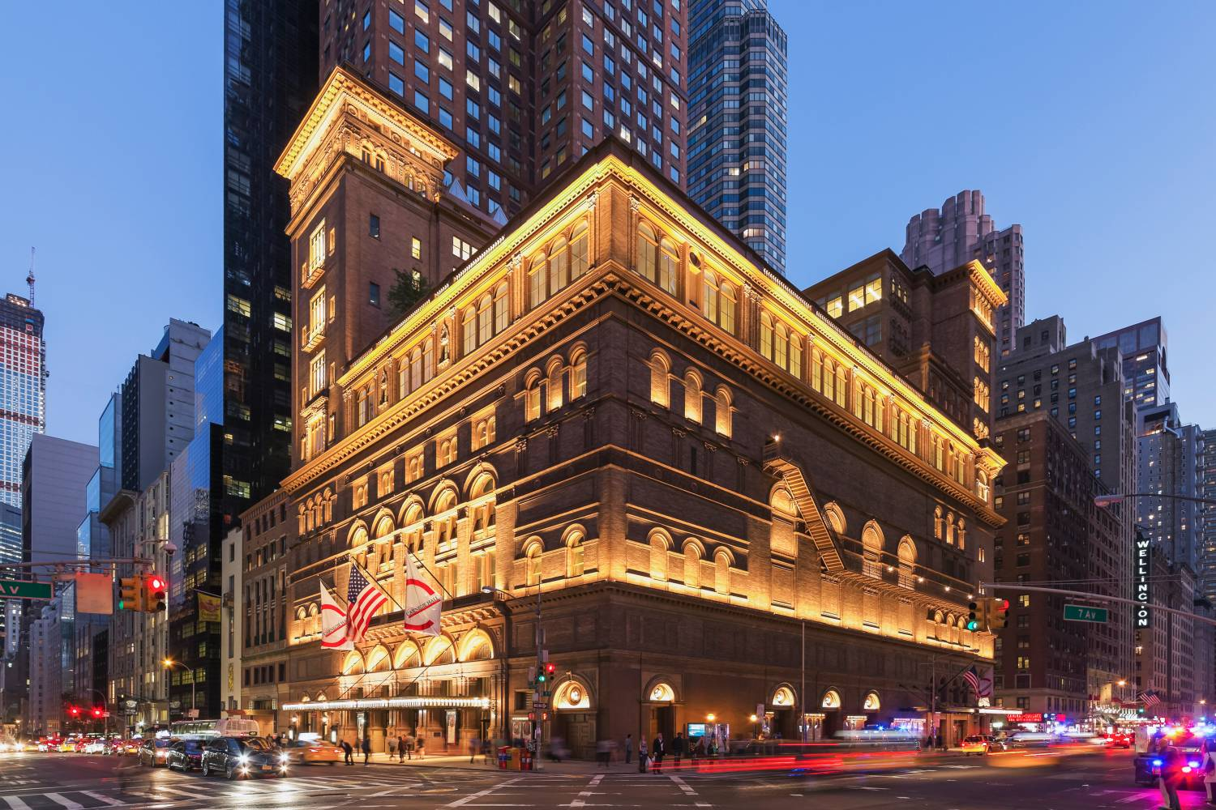
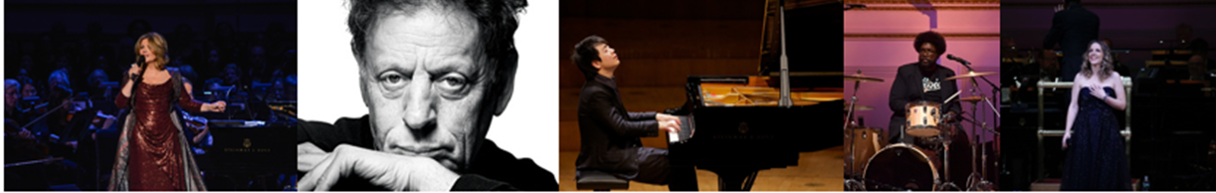
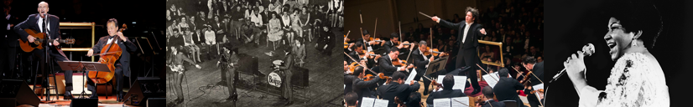
About Us
Founded in 1891 Carnegie Hall was built by philanthropist Andrew Carnegie
Carnegie Hall has 3,671 seats, divided among its three auditoriums
Carnegie Hall presents over 180 concerts a year along with 530 rental events
Genres include: Orchestras, Keyboard, Vocal, World, Pop, Rock, Jazz, Chamber and more
Our Weill Music Institute produces an extraordinary range of music education and social impact programs that reach over half a million people in New York City, across the US, and around the globe

Slide 3
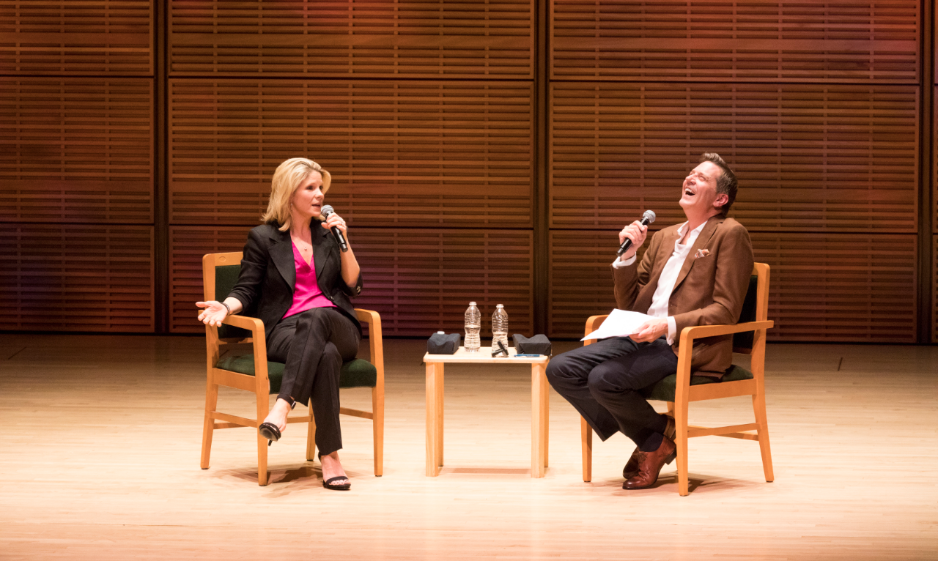
Friends
The Friends program has over 13,000 donors including:
Friends Memberships last for 1 year from the month a member joins
  7,800 Friends Members
Levels
$100 – Friend
$125 – Composer
$150 – Fellow
$300 – Associate
$600 – Supporter
$900 – Advocate
$1500 – Sustainer
  1,000 Annual Fund donors who decline benefits
  2,500 donors who give under $100
  2,000 IDNYC members
* Patron Benefits begin at $2,500

Slide 4

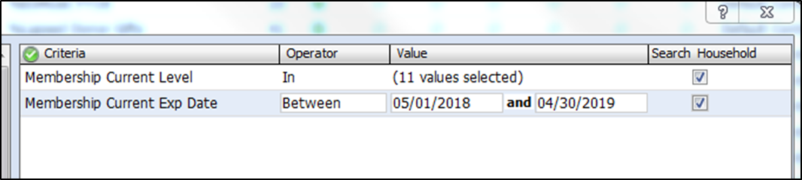
Tracking Members in Tessitura
Membership is tied to the gift that initiates it
Friend constituency
Specific membership level tied to benefits
Expiration date one year after member joins
Use lists to track number of members

Slide 5
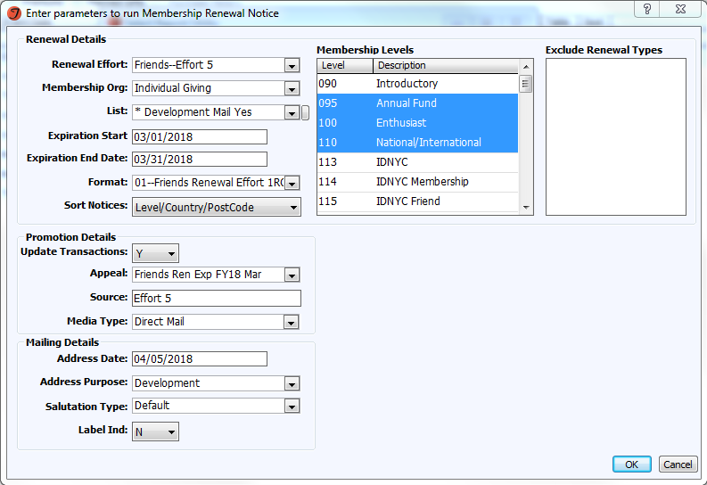
Print Acknowledgement Letters
Additional Gift Asks
Membership Renewal Notices
  5 Efforts
Membership Cycle

Slide 6
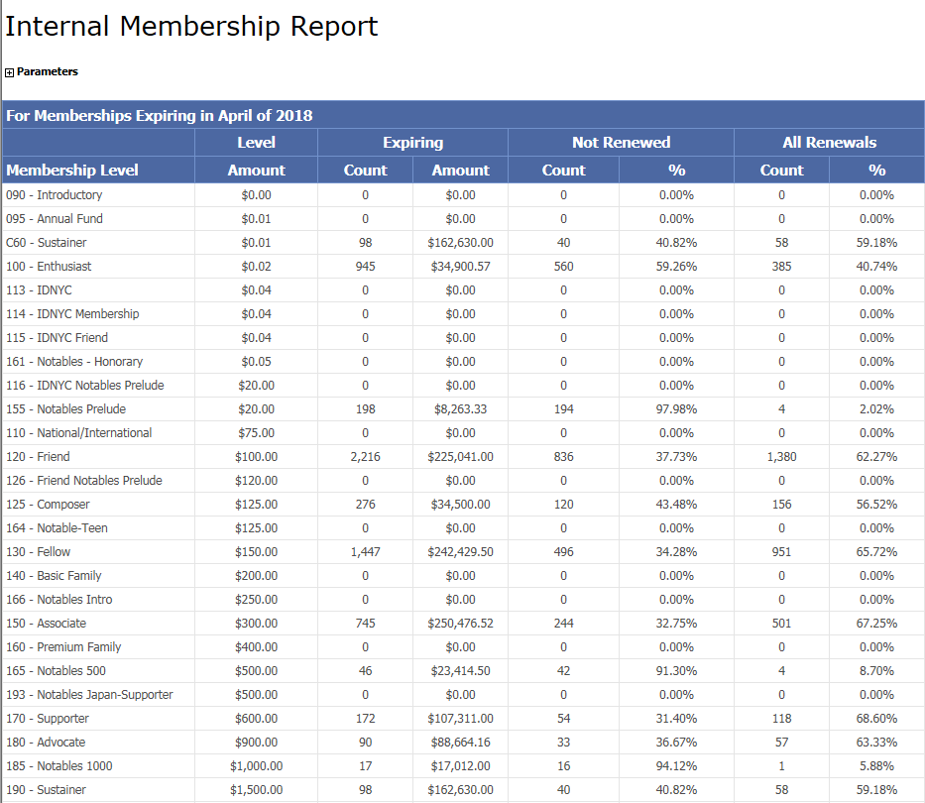
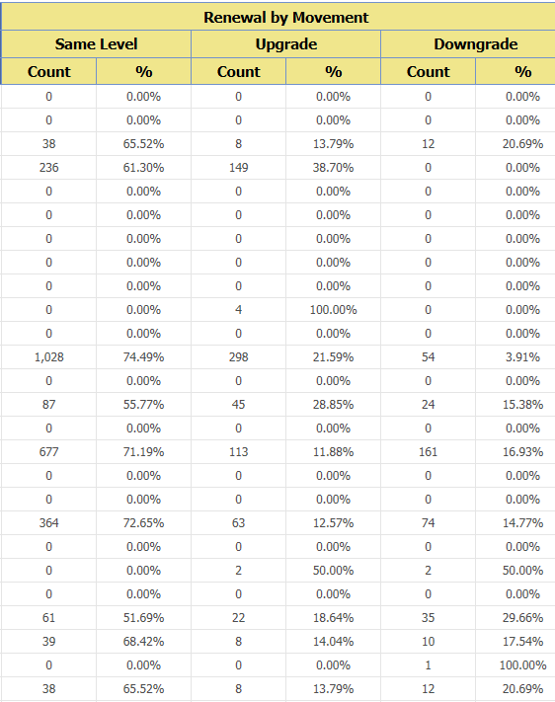
Tracking Membership Trends
Custom: Internal Membership Report
How many members renewed, upgraded, and downgraded in a given time frame

Slide 7
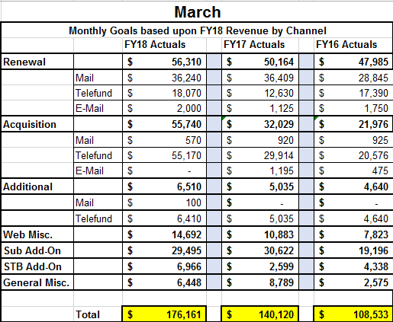
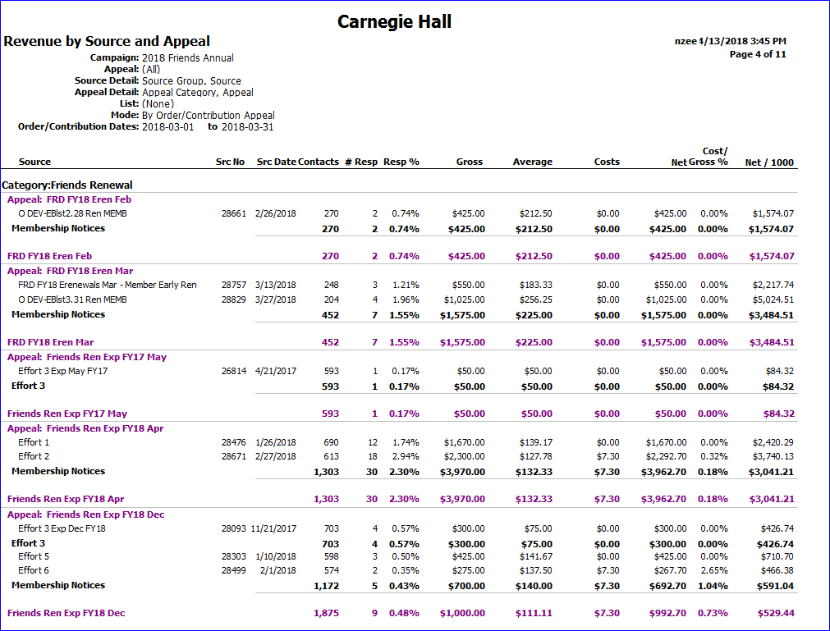
Revenue by Source and Appeal Report
Goals based on revenue
Tracks all channels and campaigns

Slide 8
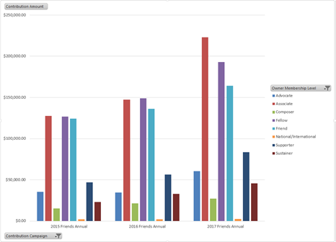
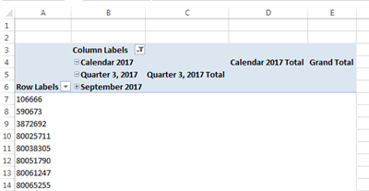
Data Cubes
Our version of T-Stats
Provides data difficult to extract from Tessitura

Slide 9
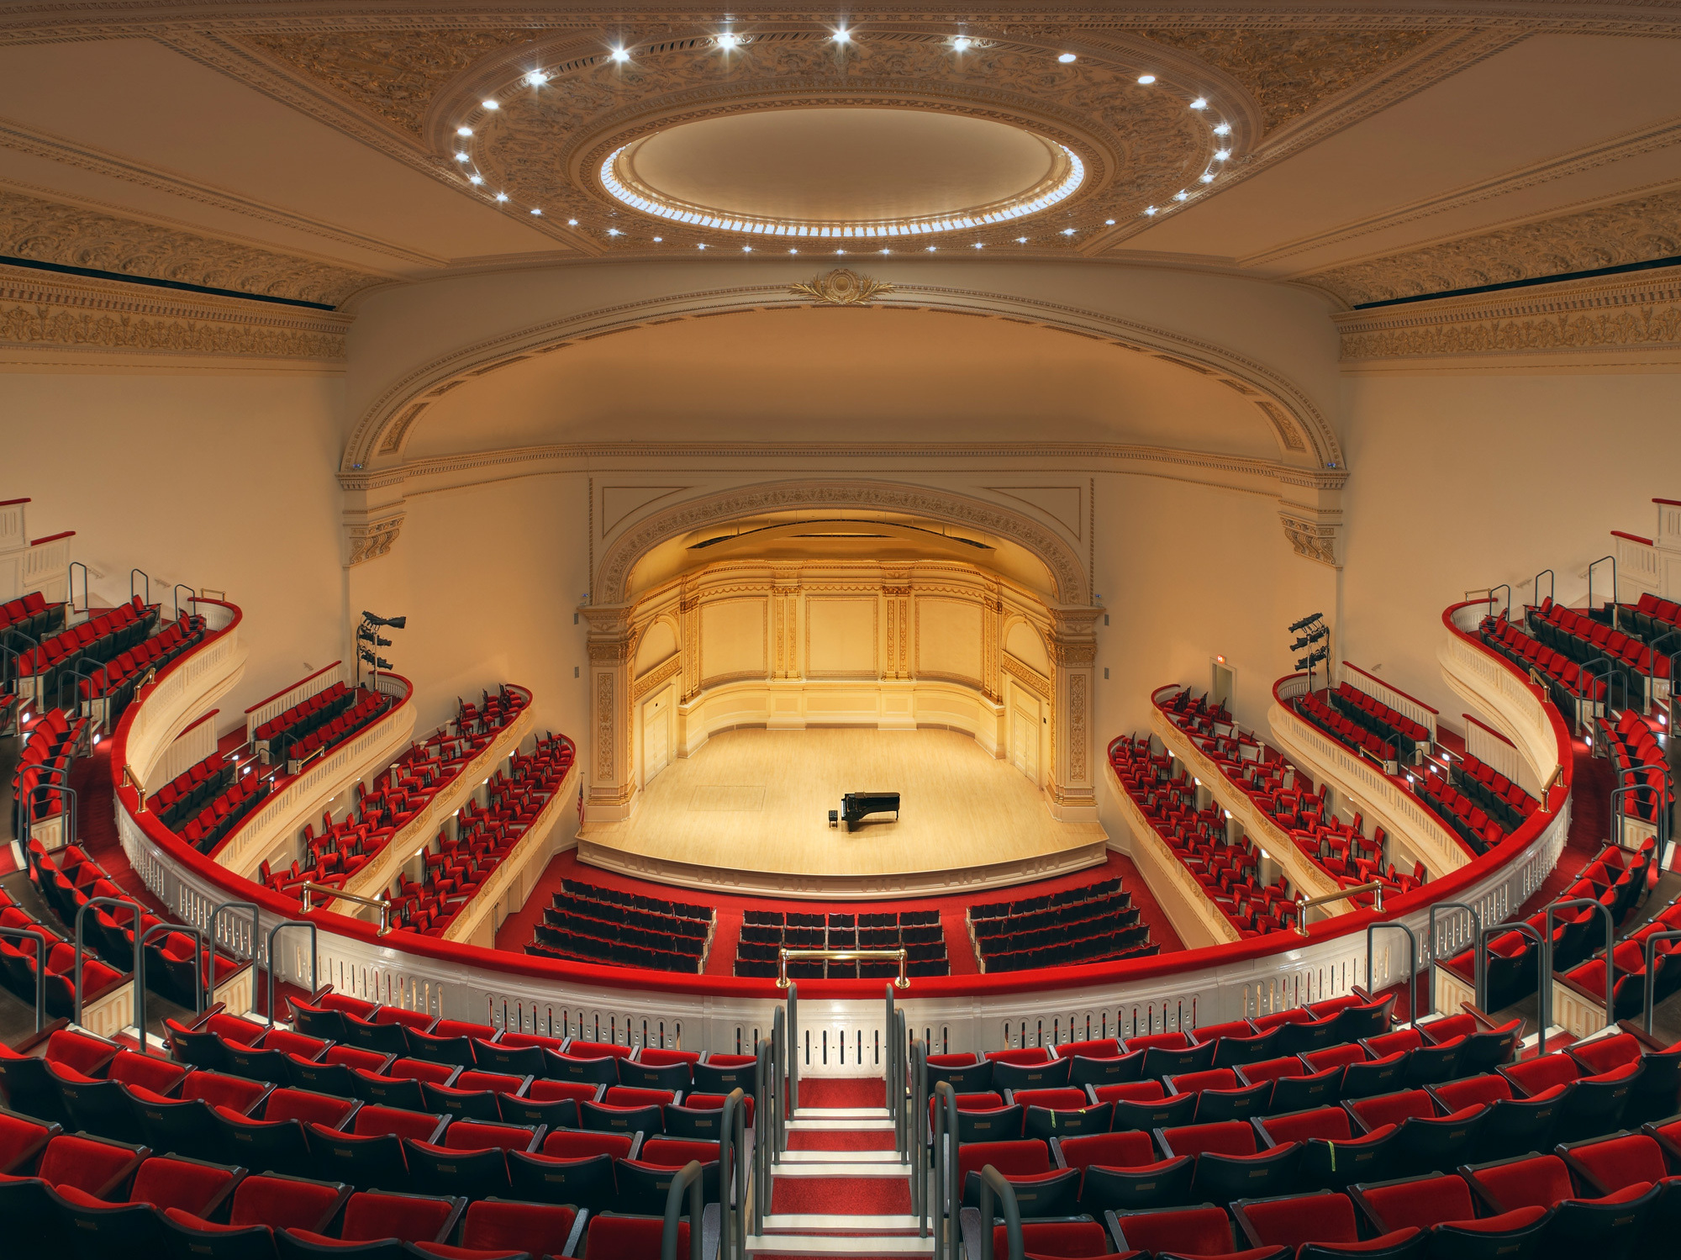
Questions?
Nicole Zee
Coordinator, Friends
nzee@carnegiehall.org

