Slide 1
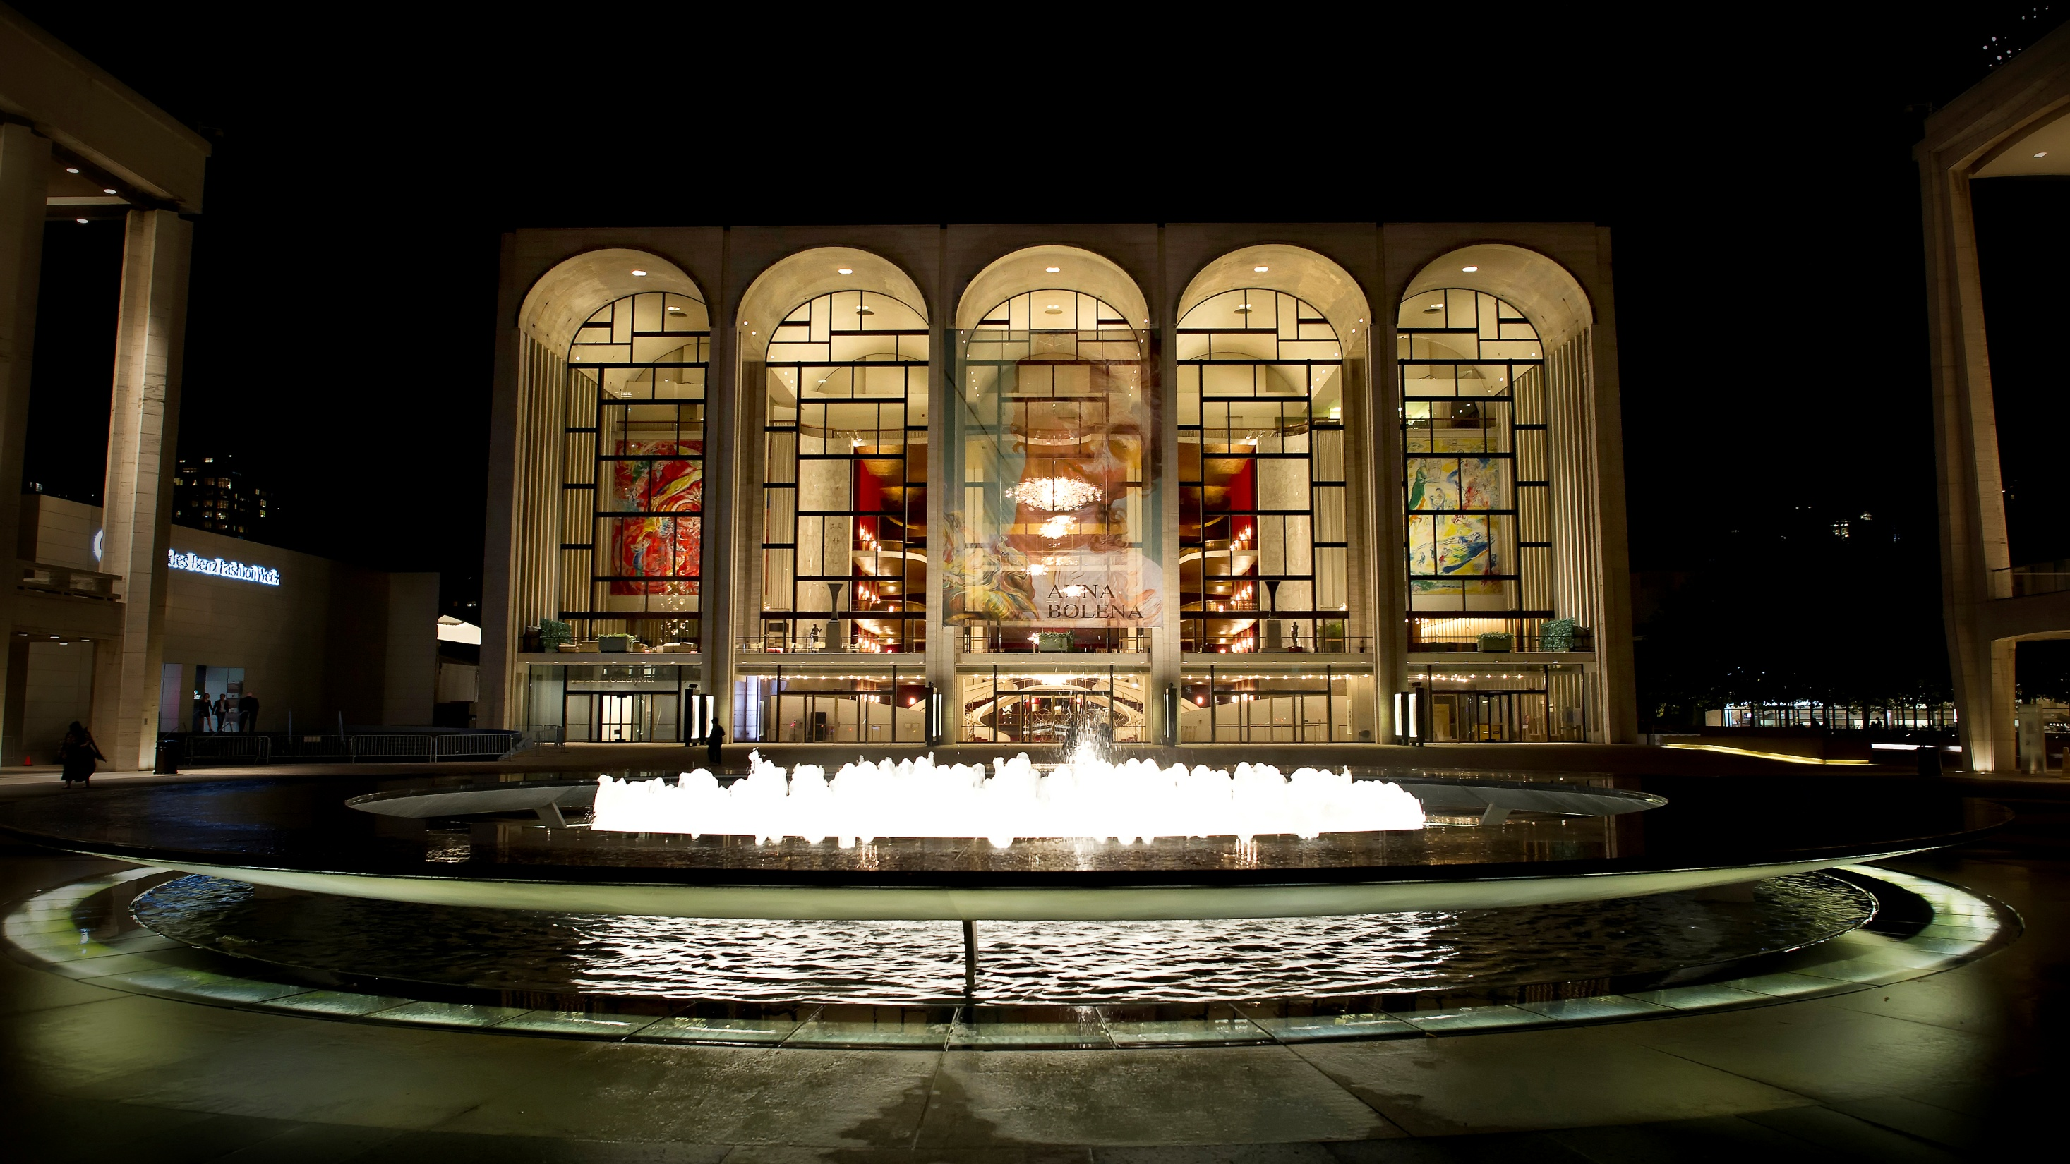

Membership at the Met
Barbra S. Lach, Director of Membership & Promotions
NYC TUG Event / April 18, 2018

Slide 2
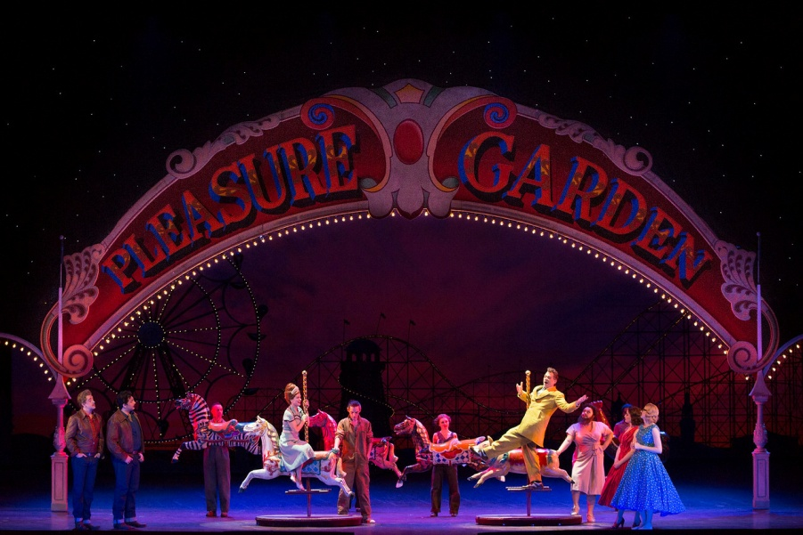
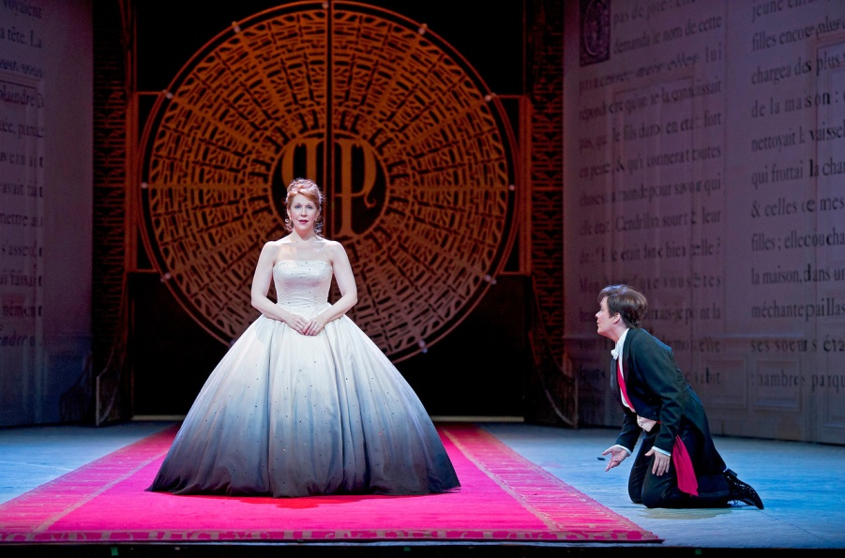
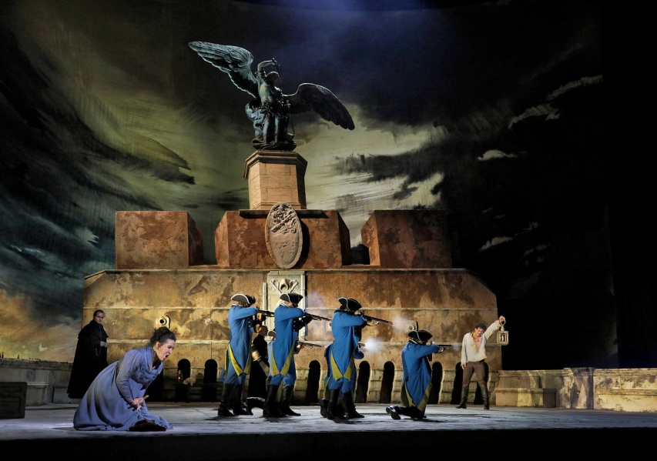

About The Metropolitan Opera
The Met’s 2017─18 season features 220 performances of 26 works, including 5 new productions.
10 Live in HD cinema transmissions at more than 2,000 theaters in over 70 countries worldwide.
In addition, the Met facilitates several public and education initiatives, such as our Summer Recital Series and our HD Live in Schools program.
Notes:
I want to share a bit of information about the Metropolitan Opera.
--The Metropolitan Opera was founded in 1883, and we celebrated our 50th anniversary at our Lincoln Center home last season.
-The current season, which runs through May 12, features 220 performances of 26 works, including five new productions.
- The Met also presented 10 Live in HD cinema presentations to more than 2,000 theaters in 70 countries around the world—the last transmission for the season will be Cendrillon on April 28.
--In addition, the Met facilitates programs that range from initiatives like our Summer Recital series in NYC parks with young artists to our HD Live in Schools programs, which are currently offered in 45 school districts in 36 states across the U.S.

Slide 3
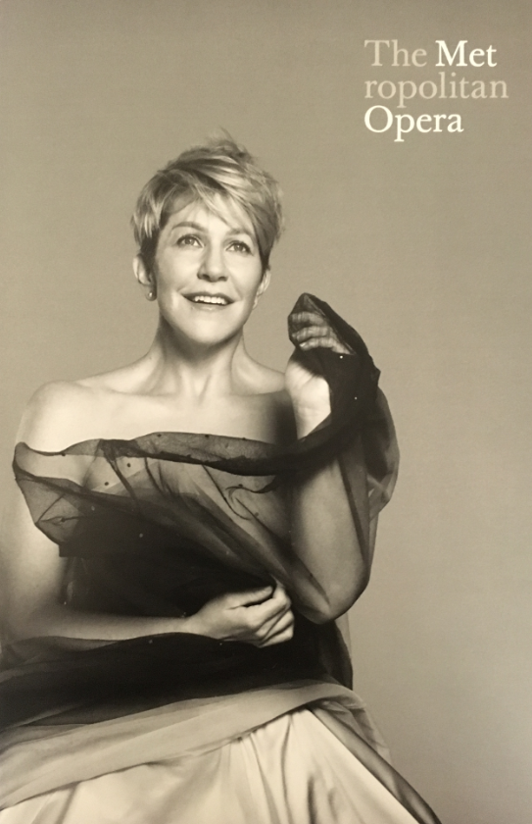
Guild Membership At A Glance
30,000+ Guild Members
Seven levels of support: $85 National level - $2,000 Benefactor level
80% renewal rate
Membership renewal is on an annual rolling basis; receive Member Guide and membership card within 2 weeks
6 membership acquisition/reinstate mailings a year, with targeted phone and email campaigns
Notes:
--We currently have more than 30,000 Guild members at the Met.
--Guild membership offers seven levels of support, beginning at the $85 National level, through the $2,000 Benefactor level. Our Patron Program begins at $2,750.
--We currently have an 80% membership renewal rate.
--Membership renewal is on an annual rolling basis, and our members receive their member guide, which includes their membership card, and information on other benefits, within two weeks of joining or renewing.
--We currently send out 6 acquisition and reinstate mailings throughout the year and we build targeted phone and email campaigns around these efforts.

Slide 4
Solicitation Strategy
Renewals: Up to 9 letters, 3 emails, plus telephone follow-up
Early renewals are incentivized.
Always encourage members to renew at the next level or higher:
Motivate members with a challenge grant.
Highlight higher level benefits in a timely manner.
Use one-time offers (i.e. ticket discounts; premiums)
Results: 44% increase in the average membership gift over 5 years
Notes:
--As far as membership renewals, our strategy includes up to 9 renewal letters, 3 e-renewals, and an ongoing phone campaign.
--We incentivize members to renew early, and in fact send them their first “early renewal” pitch two months after they join or renew.
--We always encourage members to renew at the next level or higher in all of our solicitations. How do we do this? Well there are several ways that we have done this successfully:
- We try and secure a challenge grant every year to encourage giving.
- We send solicitations promoting higher level benefits in a timely manner…for example, we build an acquisition campaign around our member on-sale periods in house and for Live in HD.
- We use one-time incentives, such as discount ticket offers or special premiums , like Met DVDs, CDs, tote bags, etc.
--Once they lapse, we continue to try and renew them at their current level or at any level.
--This strategy has worked very well for us and has helped to increase the average membership gift by 44%. In fact, our last fiscal year saw an increase in over $100,000 in membership revenue through this strategy.

Slide 5
Benefits & Touchpoints
Members enjoy a full year of benefits. All members receive Opera News magazine
$150 Supporting level and above: Priority ticketing by level at the Opera House and advance access for The Met: Live in HD cinema series.
At the $500 Donor level, members enjoy access to our Belmont Room members’ lounge.
Members at the $850 Sponsor level and above enjoy dress rehearsals.
Met Patrons ($2,750+) enjoy more behind-the-scenes access.
Notes:
--All Guild members receive exclusive benefits by level, in thanks for their support of the Met. These benefits are tailored to enhance their “Met experience”. Some examples of benefits are:
--an annual subscription to Opera News magazine.
--priority ticketing by level
--access to the Belmont Room, our members-only lounge, 45 minutes before curtain and during intermissions.
--Higher levels enjoy exclusive dress rehearsals.
--When members join our Patron Program we offer a more tailored relationship with the Met.

Slide 6
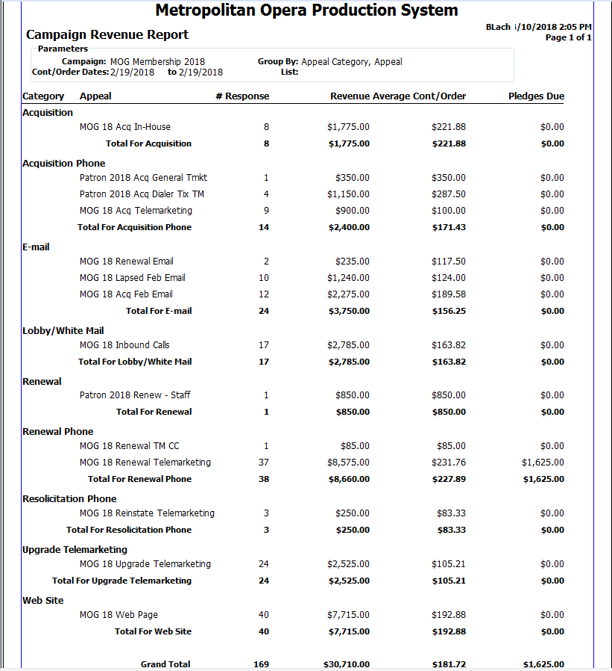
Standard Reporting
Campaign Revenue Report
Found under “Campaign & Appeal” reports
Shows revenue (pledges + gifts) from all categories reporting to one campaign by appeal by date range.
Calculates # of gifts and average gift
Notes:
--Use Tessitura to track your success…or your challenges. The data you gather will be very important in helping you to pivot and adjust your fundraising strategies.
--I’m going to go through some reports that have been very helpful to us as we track the success of our efforts. Some of them may already be reports that you are using.
--The first report is the Campaign Revenue Report.
--This report gives you a nice overview of your revenue for a unique campaign, broken down by category and appeal. It calculates # of gifts and average gift and can be pulled by any date parameter.

Slide 7
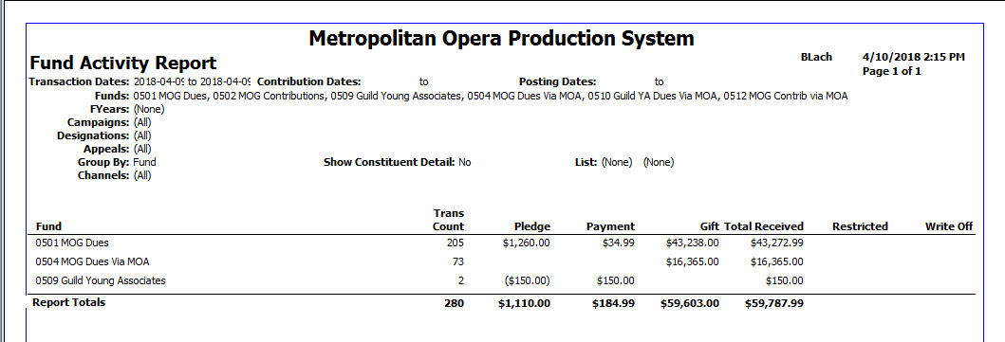
Standard Reporting
Fund Activity Report
Found under “Finance” reports
Shows revenue (pledges + payments + gifts) from specific funds by date range
Easy snapshot to show how many gifts were booked and how much we raised overall on a daily basis
Notes:
--The second report is the Fund Activity Report.
--This report will give you a quick snapshot of your revenue by fund. In this example, I am pulling to see how much revenue was brought in through the three funds that report to our membership campaign.
--The revenue is broken down by pledges, payments, and gifts.
--I use this report daily to see how much revenue has been booked.

Slide 8
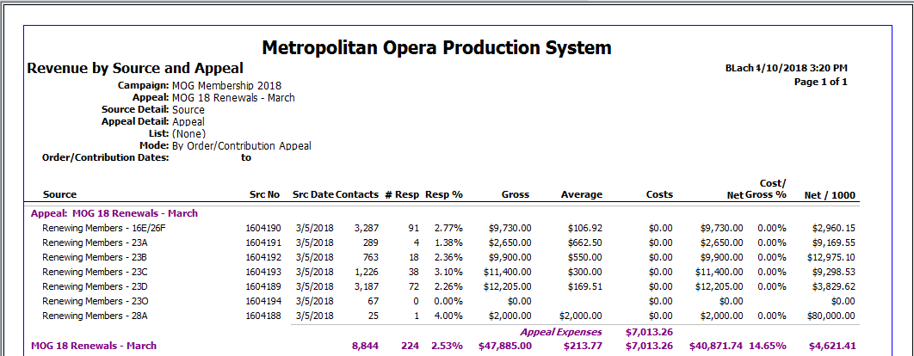
Standard Reporting
Revenue by Source & Appeal
Found under “Campaign & Appeal” reports
Shows detailed revenue for each appeal by segment
Calculates # of gifts, average gift, ROI, and presents gross vs. net revenue
Helps to identify best performing segments
Allows you to measure success of control vs. test packages
Notes:
--This is one of my favorite reports…the Revenue by Source & Appeal report, which shows detailed revenue results for our appeals by segment.
--We set up a unique appeal in Tessitura for each fundraising effort and create source codes for each segment, so we can track the productivity of that segment.
--It shows how many gifts came in through our appeal, calculates average gift, ROI, and presents gross vs. net revenue. Through this report, you can analyze which segments are your best performing prospects, as well as evaluate the success of any test segments.

Slide 9
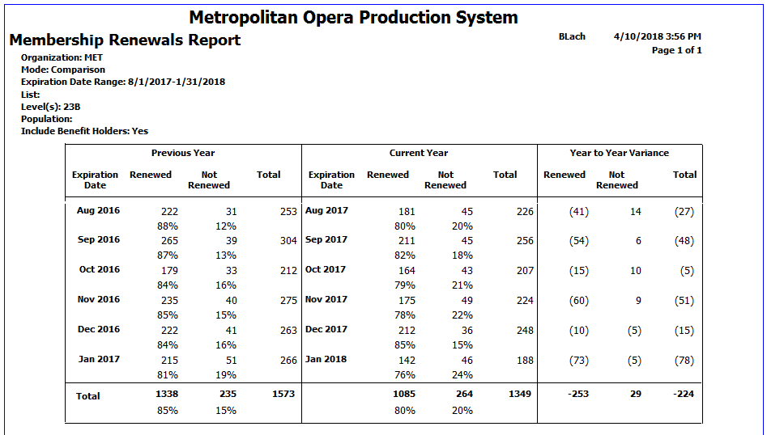
Standard Reporting
Membership Renewals Report
Found under “Membership” reports
Can be viewed in “Single”, “Comparison”, and “Years of Service” Modes and adjustable by date
Quick way to see your overall renewal rate or renewal rate by level
Shows how many members have been renewed and how many have lapsed
“Comparison” shows YTD variances and “Years of Service” assesses renewal rate by loyalty of up to 3+ years
Notes:
--The next report is the Membership Renewals Report
--It’s provides a quick way for us to see our membership renewal rate for the overall program or by membership level for a set date range. It’s also a great way to get counts, by expiration date, of members who have not yet renewed for retargeting.
--It can be viewed in three modes: “Single”, “Comparison”, and “Years of Service”
--In this example, we are looking at the “Comparison” mode, which shows the renewal rate variances by expiration month from August 1, 2017 through January 31, 2018 for our Donor level members.
--I will mention that the “Years of Service” mode is particularly helpful if you are trying to understand your “first year member” renewal rate.

Slide 10
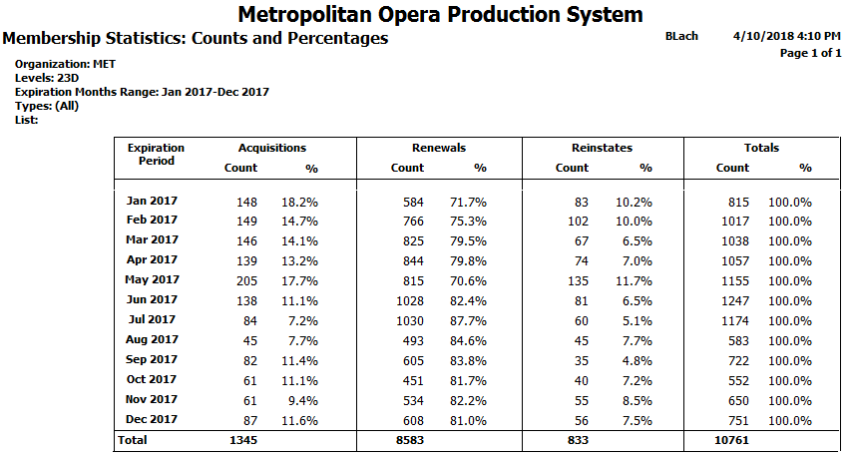
Standard Reporting
Membership Statistics: Counts & Percentages Report
Found under “Membership” reports
Details membership statistics (renewals/reinstates/acquisition) by level and counts
Variable expiration date range
Helpful in understanding the make-up of each membership level or of the overall program
Notes:
--Next up is the Membership Statistics: Counts & Percentages Report.
--This is a quick way to get some details on your membership statistics for the overall program or by level.
--In this example, I am looking specifically at our Supporting level members, with expiration dates ranging from January 2017 through December 2017. As you can see, this report breaks down how many Supporting members were acquired, renewed, and reinstated within those parameters.
--It’s quite helpful when you want to understand the make-up of your membership program overall or by level.

Slide 11
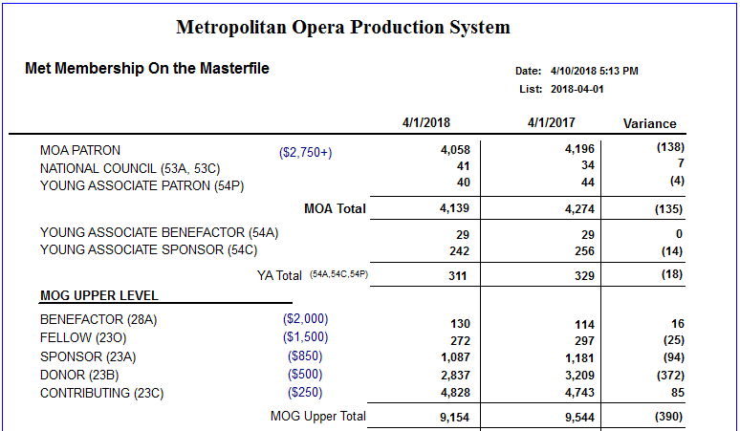
Custom Reporting
Met Membership on the Masterfile Report
Customized report that shows a snapshot comparison YTD of membership counts and variances by program and level
Notes:
--Next is a customized report we use called the Met Membership on the Masterfile.
--This report was created because we needed a quick way to look at YTD membership counts when compared to the previous fiscal year.
-- It allows us to see the variances for each program at each level and allows us to drill down and find those individuals, so that we can work on a retargeting strategy that makes sense for them.
-- In this example, I am showing the Patron, Young Associate, and Upper Guild counts.

Slide 12
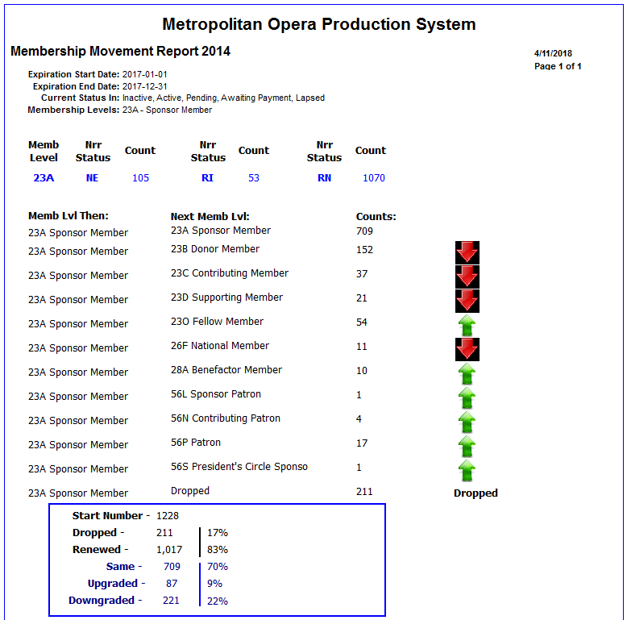
Custom Reporting
Membership Movement Report
Customized report that shows membership movement within any date range for a specific level or for multiple levels
Notes:
--Lastly is a customized Membership Movement Report.
--Although Tessitura already has a Membership Movement Report that gives numbers and percentages of renewed, lapsed/dropped, and upgraded members, we wanted to be able to specifically look at each level and summarize the movement of members at that level in a given timeframe.
--This example shows the movement of our Sponsor level members from January 2017 through December 2017. In the box below, we can quickly tell that this level had an 83% renewal rate and that we dropped 211 members from the year before.
To summarize, there are many great reports available to you in Tessitura that you can use to help track your success and better understand the challenges of your membership program.

Slide 13
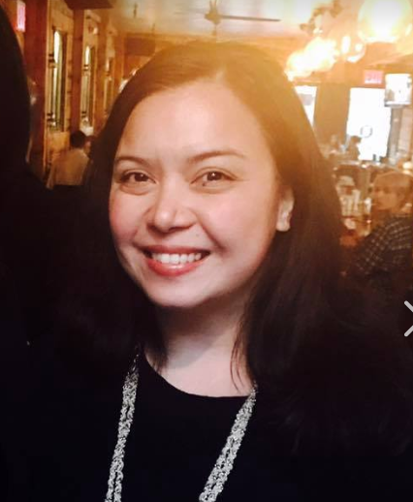
Contact Information
Barbra Lach
Director of Membership and Promotions
The Metropolitan Opera
(212) 870-4509
blach@metopera.org

