Slide 1

Kelsey Moriarty
Senior Manager, Individual Giving Programs
kmoriarty@publictheater.org

Slide 2
Individual Giving at The Public
Over 2,000 households
Over $10M annually
Young Partners
$500+
Partners
$2.5K+
Major Gifts
$25K+
Notes:
First, a quick overview of individual giving at The Public
Traditional Membership model lives with Marketing
Development handles our Young Partners, which starts at $500, Partners starting at $2,500, and Major Gifts $25K+
This totals over 2,000 households and raises over $10MM annually
-- two clicks for animation—
Today I will be focusing on our Partners Program levels up to $10,000 as we worked towards creating a way to project our fiscal year end and track on renewal and acquisition rates

Slide 3
Goals
Project contributions for Partners line ($2,500-$9,999)
Analyze renewal and acquisition rates
Track projections against budgeted goal
Streamline reports and analysis
Easily update on a monthly basis
Solution
Break out numbers by Membership Level and Expiration Date
Create renewal and acquisition goals for each month
Track actuals monthly and compare to fiscal years goals
Notes:
Here are the goals we set out with
In addition to projecting and analyzing more accurately, we wanted to streamline our reporting processes. We had different variations of reports living with multiple employees, which meant we were repeating work, pulling data more than once, and had to look at multiple reports to get the full picture
We also wanted to make sure we could update whatever we came up with monthly in less than an hour
--animation click—
We decided to look at each of these Partner levels by expiration month.
This way, we could calculate renewal and acquisition goals for each month, and more easily see how we were tracking throughout the year

Slide 4
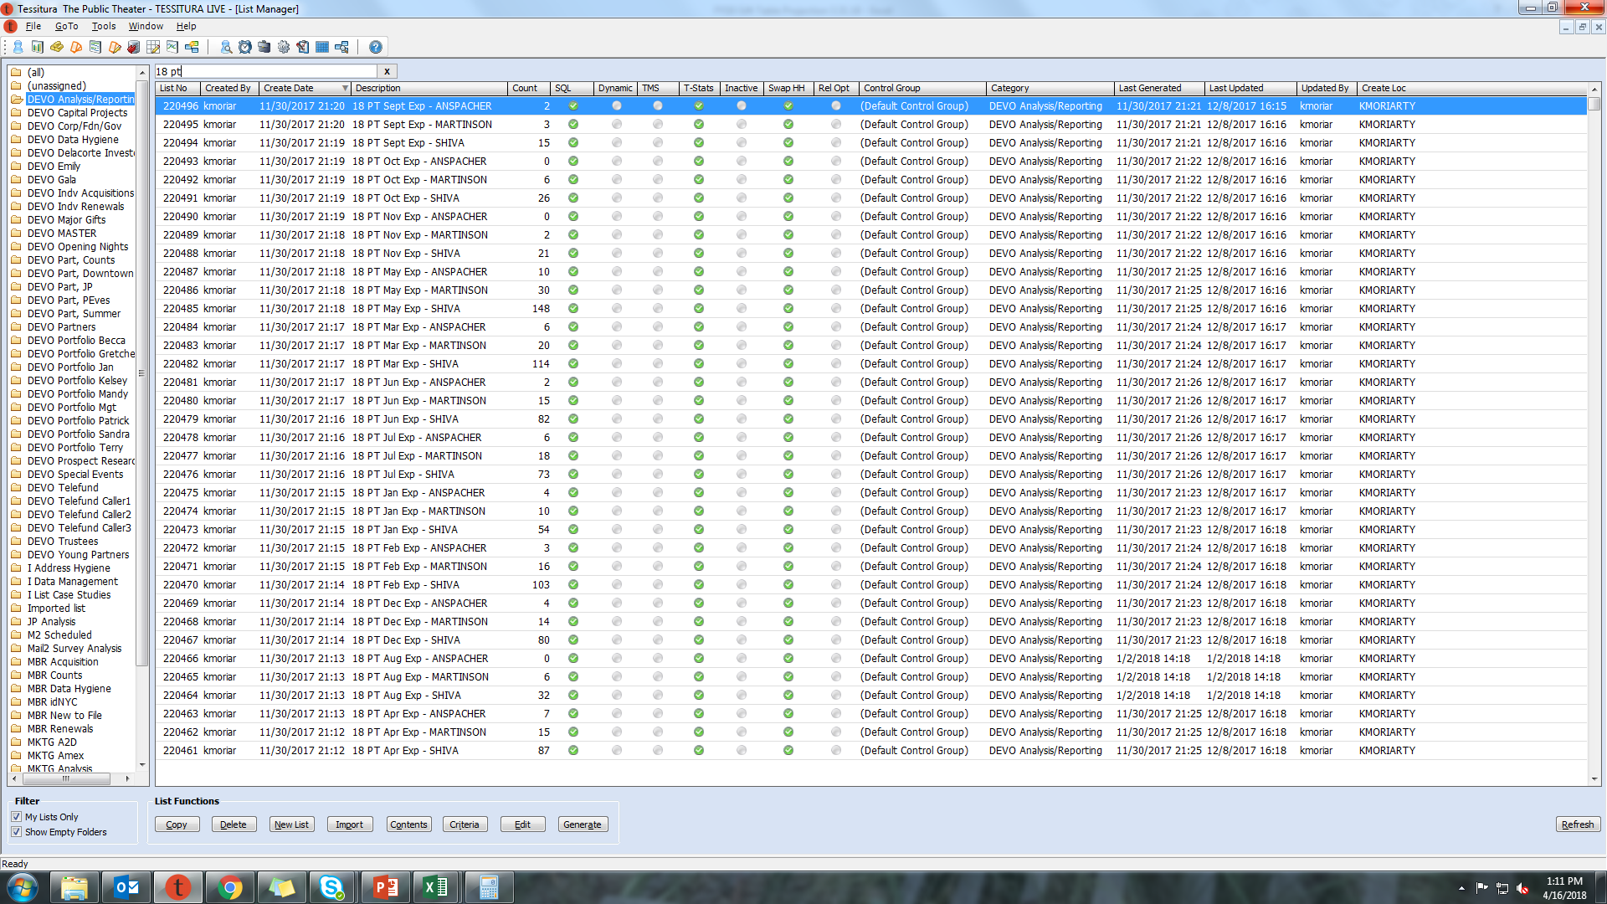
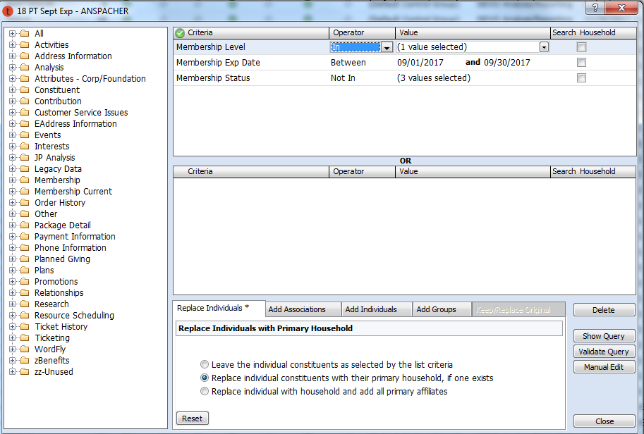
Master Lists
Create lists for each level and each expiration month
Criteria:
  Membership level
  Expiration date range
  Status not in Cancelled, Deactivated, or Suspended
Notes:
First we had to set up master lists for the year, splitting out each Partner level by expiration month
--animation click--
We used the criteria of membership level, expiration date range, and those with a status of cancelled, deactivated, suspended statuses
--animation click--
And we then have all of these lists ready to go for the year, which we will use in reports and pull into T-stats for tracking

Slide 5
 |  | Total FY17 Partners |  | 80% RN Rate |  | 25% Acqusition Goal |  | Total FY18 Goal
 |  | # Donors | $ Amt | # Donors | $ Amt | # Donors | $ Amt | # Donors | $ Amt
September | Shiva | 15 | 37,500 | 12 | 30,000 | 4 | 9,375 | 16 | 39,375
 | Martinson | 3 | 15,000 | 2 | 12,000 | 1 | 3,750 | 3 | 15,750
 | Anspacher | 2 | 15,000 | 2 | 12,000 | 1 | 3,750 | 2 | 15,750
October | Shiva | 26 | 65,000 | 21 | 52,000 | 7 | 16,250 | 27 | 68,250
 | Martinson | 6 | 30,000 | 5 | 24,000 | 2 | 7,500 | 6 | 31,500
 | Anspacher | 0 | 0 | 0 | 0 | 0 | 0 | 0 | 0
November | Shiva | 21 | 52,500 | 17 | 42,000 | 5 | 13,125 | 22 | 55,125
 | Martinson | 2 | 10,000 | 2 | 8,000 | 1 | 2,500 | 2 | 10,500
 | Anspacher | 0 | 0 | 0 | 0 | 0 | 0 | 0 | 0
December | Shiva | 80 | 200,000 | 64 | 160,000 | 20 | 50,000 | 84 | 210,000
 | Martinson | 14 | 70,000 | 11 | 56,000 | 4 | 17,500 | 15 | 73,500
 | Anspacher | 4 | 30,000 | 3 | 24,000 | 1 | 7,500 | 4 | 31,500
Janurary | Shiva | 54 | 135,000 | 43 | 108,000 | 14 | 33,750 | 57 | 141,750
 | Martinson | 10 | 50,000 | 8 | 40,000 | 3 | 12,500 | 11 | 52,500
 | Anspacher | 4 | 30,000 | 3 | 24,000 | 1 | 7,500 | 4 | 31,500
February | Shiva | 103 | 257,500 | 82 | 206,000 | 26 | 64,375 | 108 | 270,375
 | Martinson | 16 | 80,000 | 13 | 64,000 | 4 | 20,000 | 17 | 84,000
 | Anspacher | 3 | 22,500 | 2 | 18,000 | 1 | 5,625 | 3 | 23,625
March | Shiva | 114 | 285,000 | 91 | 228,000 | 29 | 71,250 | 120 | 299,250
 | Martinson | 20 | 100,000 | 16 | 80,000 | 5 | 25,000 | 21 | 105,000
 | Anspacher | 6 | 45,000 | 5 | 36,000 | 2 | 11,250 | 6 | 47,250
April | Shiva | 87 | 217,500 | 70 | 174,000 | 22 | 54,375 | 91 | 228,375
 | Martinson | 15 | 75,000 | 12 | 60,000 | 4 | 18,750 | 16 | 78,750
 | Anspacher | 7 | 52,500 | 6 | 42,000 | 2 | 13,125 | 7 | 55,125
May | Shiva | 148 | 370,000 | 118 | 296,000 | 37 | 92,500 | 155 | 388,500
 | Martinson | 30 | 150,000 | 24 | 120,000 | 8 | 37,500 | 32 | 157,500
 | Anspacher | 10 | 75,000 | 8 | 60,000 | 3 | 18,750 | 11 | 78,750
June | Shiva | 82 | 205,000 | 66 | 164,000 | 21 | 51,250 | 86 | 215,250
 | Martinson | 15 | 75,000 | 12 | 60,000 | 4 | 18,750 | 16 | 78,750
 | Anspacher | 2 | 15,000 | 2 | 12,000 | 1 | 3,750 | 2 | 15,750
July | Shiva | 73 | 182,500 | 58 | 146,000 | 18 | 45,625 | 77 | 191,625
 | Martinson | 18 | 90,000 | 14 | 72,000 | 5 | 22,500 | 19 | 94,500
 | Anspacher | 6 | 45,000 | 5 | 36,000 | 2 | 11,250 | 6 | 47,250
August | Shiva | 32 | 80,000 | 26 | 64,000 | 8 | 20,000 | 34 | 84,000
 | Martinson | 6 | 30,000 | 5 | 24,000 | 2 | 7,500 | 6 | 31,500
 | Anspacher | 0 | 0 | 0 | 0 | 0 | 0 | 0 | 0
TOTAL |  | 1,034 | $3,192,500 | 827 | $2,554,000 | 259 | $798,125 | 1,086 | $3,352,125
FY17 Actuals
FY18 Goals
From the built lists, enter last year’s actuals into excel
Calculate renewal and acquisition goals to find this year’s fiscal year goal
Notes:
One other master set up at the beginning of the year is, using the master lists we just created, calculating renewal and acquisition rate goals
The first column, Total FY17 Partners, are the numbers from those lists we just made, giving us our starting place
Historically, we have an 80% renewal rate in this line, and have a goal of 25% acquisition, since we factor in growth year over year, and both of those are calculated here, giving us our frozen FY18 goal

Slide 6
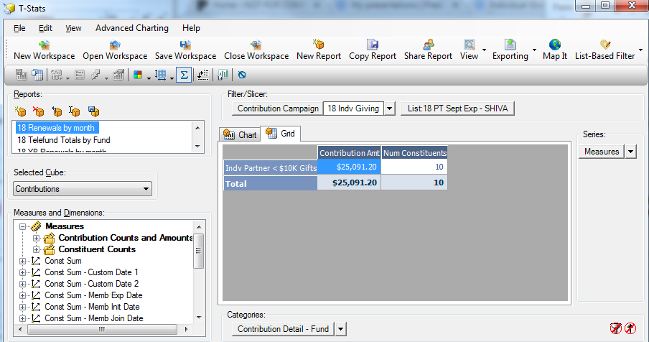
Calculating Renewals to Date
T-Stats Report
  Category = Fund
  Filter by Fiscal Year Campaign
  Measures = Contribution Amount and Number of Constituents
  List-Based Filter
    Filter by each of the month and level lists created
 |  | FY18 RN To Date |  | FY18 RN % to Date
 |  | # Donors | $ Amt | % Donors | % Amt
September | Shiva | 10 | 25,091 | 67% | 67%
 | Martinson | 0 | 0 | 0% | 0%
 | Anspacher | 2 | 10,000 | 100% | 67%
Enter into excel
Calculate renewal rate (renewed to date/last year’s actual)
Notes:
Once those master lists and numbers are set for the year, we now just have to pull in ‘to-date’ numbers every month
--animation click--
We have a simple T-Stats report looking at the fund all of these gifts are booked into, filter by this fiscal year’s campaign, and measuring number of contributions and number of constituents
--animation click—
We then filter this report by each master list we made (monthly expiration dates by level)
--two animation clicks—
And then populate our excel with those numbers
In this excel, we are also calculating the renewal rates, dividing the renewed to date numbers by last year’s actuals that we populated in the last slide

Slide 7
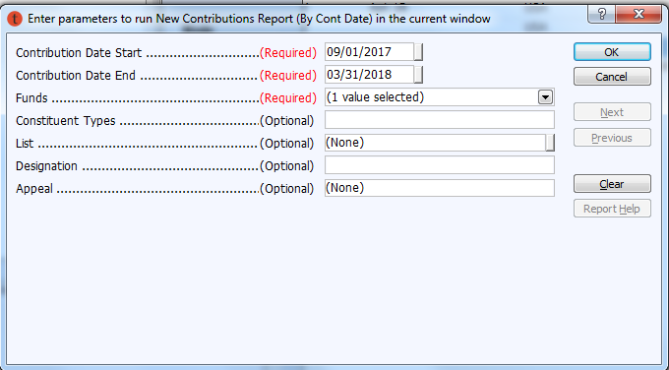
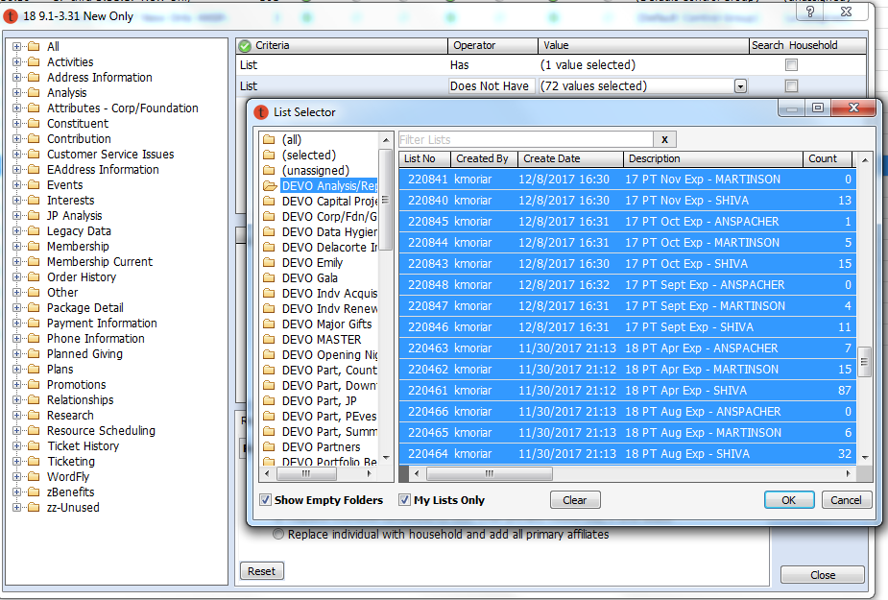
Pulling Reinstated Gifts and Acquisition
Run a new contributions report of fiscal year to date
Save report as a list
Create Acquisition list
  Criteria
    In new contributions list
    Not in master lists of last two year’s donors
    Membership Level
Create Reinstated list
  Criteria
    In new contributions list
    Not in the Acquisition list
    Membership Level
Notes:
Now that we have our renewal numbers, we move to acquisition and reinstated gifts
In order to pull these numbers, we first pull a new contributions report of the fund we are analyzing, with the fiscal year range to date, and save that report as a list
--animation click—
And then we save two lists – an acquisition list with the criteria of NOT IN the last two year’s master lists – you’ll see both 17 and 18 master lists selected here –
And a reinstated list with criteria of in our new contributions report, but not in that acquisition list just created
We create versions of each of these for each of the 3 levels we are analyzing, using Membership Level criteria

Slide 8
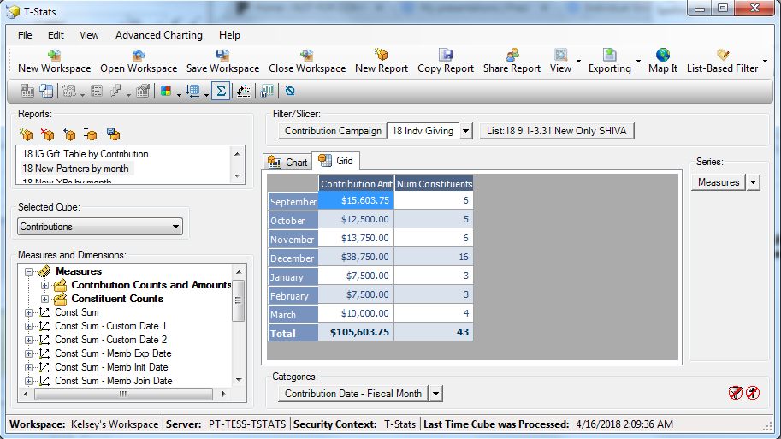
Calculating Reinstated Gifts and Acquisition
T-Stats Report
  Category = Contribution Month
  Filter by Fiscal Year Campaign
  Measures = Contribution Amount and Number of Constituents
  List-Based Filter
    Filter by each New and Reinstated list and enter into excel
Enter into excel
Calculate acquisition rate (acquisition to date/last year’s actual)
 |  | Acqusition to Date |  | Acqusition % to Date
 |  | # Donors | $ Amt | % Donors | % Amt
September | Shiva | 6 | 15,604 | 40% | 42%
 | Martinson | 1 | 5,000 | 33% | 33%
 | Anspacher | 0 | 0 | 0% | 0%
Notes:
Similarly to calculating renewals,
--animation click—
we have a simple T-Stats reporting pulling in contribution month, filtered by this year’s fiscal year campaign
--animation click—
We filter this by each of acquisition and reinstated lists we just made
--three animation clicks—
And then populate the excel with those numbers
Again, we are calculating percentages by dividing our to date numbers by the goals we initially set. To note = we set up these formulas at the beginning of the year when we’re creating our master lists, so our monthly updates we really just pulling in our to-date numbers

Slide 9
Projecting
Actuals
 |  | FY18 RN To Date |  | ReInstated to Date |  | Acqusition to Date |  | Current Projection
 |  | # Donors | $ Amt | # Donors | $ Amt | # Donors | $ Amt | # Donors | $ Amt
September | Shiva | 10 | 25,091 | 2 | 5,000 | 6 | 15,604 | 18 | 45,695 | Additional acq and renewal removed since past Sept dates
 | Martinson | 0 | 0 | 0 | 0 | 1 | 5,000 | 1 | 5,000 | Additional acq and renewal removed since past Sept dates
 | Anspacher | 2 | 10,000 | 0 | 0 | 0 | 0 | 2 | 10,000 | Additional acq and renewal removed since past Sept dates
January | Shiva | 36 | 92,272 | 4 | 10,000 | 3 | 7,500 | 50 | 125,500 | Additional acq removed since past Jan dates
 | Martinson | 5 | 20,000 | 0 | 0 | 0 | 0 | 8 | 40,000 | Additional acq removed since past Jan dates
 | Anspacher | 3 | 22,500 | 0 | 0 | 0 | 0 | 3 | 24,000 | Additional acq removed since past Jan dates
May | Shiva | 28 | 72,500 |  |  |  |  | 155 | 388,500
 | Martinson | 2 | 3,100 |  |  |  |  | 32 | 157,500
 | Anspacher | 3 | 20,038 |  |  |  |  | 11 | 78,750
Actuals + (Renewal goal – renewed to date)
Actuals + (Renewal goal – renewed to date) + Acquisition goal
Notes:
Now, after we populate the renewal, reinstated, and acquisition numbers for each month, our projections are calculated
We have three different formulas
--animation click—
1, for months that are long past, we are only summing up our actuals
--animation click—
2, for months that are just past, we are summing actuals, plus what is left to get to our 80% renewal rate goal, assuming some renewals will come in during their ‘lapsed’ period
And 3, for months we have not yet reached (reminder, these months are indicators of their expiration month, not the month of their giving) we are calculating actuals, what is left to our 80% renewal rate goal, and our 25% acquisition goal for that month

Slide 10
Macro Tables
Month | Goal $Amount | Projection $Amount | To Date $Amount | Left to Projection
September | 70,875 | 164,364 | 164,364 | -
October | 99,750 | 159,739 | 159,739 | -
November | 65,625 | 107,500 | 107,500 | -
December | 315,000 | 325,430 | 325,430 | -
January | 225,750 | 207,000 | 179,772 | 27,227
February | 378,000 | 328,600 | 293,188 | 35,412
March | 451,500 | 385,900 | 277,635 | 108,266
April | 362,250 | 362,250 | 104,250 | 258,000
May | 624,750 | 624,750 | 95,638 | 529,112
June | 309,750 | 309,743 | 28,667 | 281,076
July | 333,375 | 315,363 | 5,000 | 310,363
August | 115,500 | 71,500 | - | 71,500
Total | 3,352,125 | 3,362,138 | 1,741,181 | 1,620,957
Notes:
We then can look at some big picture tables to give us an idea of where we are
The yellow goal amount column stays frozen all year, as this is our institutional budgeted goal
The orange projection column is summing all of the calculations we just discussed, showing that we are projecting $10,000 more that budgeted
And then we have our to date and left to projection amounts for reference

Slide 11
Macro Tables
Partners to Date - Cumulative Comparison
 | FY18 Cumulative Goal | FY18 Cumulative To Date $ Amount | FY17 CumulativeTo Date $ Amount
September | 192,080 | 158,141 | 201,120
October | 263,183 | 284,812 | 276,394
November | 405,286 | 471,218 | 360,394
December | 786,804 | 882,963 | 757,192
January | 924,791 | 967,963 | 872,740
February | 1,338,208 | 1,346,173 | 1,181,728
March | 1,697,430 | 1,741,181 | 1,586,845
April | 2,145,833 |  | 1,945,637
May | 2,649,115 |  | 2,385,255
June | 2,958,603 |  | 2,717,556
July | 3,173,765 |  | 2,964,262
August | 3,352,125 |  | 3,126,512
Total | 3,352,125 | 1,741,181 | 3,126,512
Notes:
We can also look at this cumulatively.
Our goal is set up with frozen cumulative numbers
we add in actuals here based on when gifts came in rather than expiration dates
and we have last year’s cumulative amounts for reference

Slide 12
Partner Detail Tables
Partners Projection by Level
 |  | FY18 Goal |  | Current Projection |  | FY18 to Date |  | Left to Projection
Level |  | # Donors | $ Amt | # Donors | $ Amt | # Donors | $ Amt | # Donors | $ Amt
Anspacher | $ 7,500 | 46 | 346,500 | 45 | 344,873 | 29 | 199,538 | 16 | 145,335
Martinson | $ 5,000 | 163 | 813,750 | 173 | 882,017 | 93 | 458,798 | 80 | 423,218
Shiva | $ 2,500 | 877 | 2,191,875 | 842 | 2,135,249 | 431 | 1,082,845 | 412 | 1,052,404
TOTAL |  | 1,086 | 3,352,125 | 1,061 | 3,362,138 | 553 | 1,741,181 | 509 | 1,620,957
Partners Renewal Tracking
 |  | Renewal Goal (80%) |  | Renewed to Date |  | Renewed % to Date
 |  | # Donors | $ Amt | # Donors | $ Amt | # Donors | $ Amt
September |  | 16 | 54,000 | 43 | 131,260 | 56% | 45%
October |  | 26 | 76,000 | 29 | 94,739 | 113% | 115%
November |  | 18 | 50,000 | 17 | 46,250 | 86% | 85%
December |  | 78 | 240,000 | 78 | 227,180 | 84% | 74%
January |  | 54 | 172,000 | 46 | 144,772 | 71% | 68%
February |  | 98 | 288,000 | 83 | 252,588 | 77% | 77%
March |  | 112 | 344,000 | 68 | 210,735 | 61% | 58%
April |  | 87 | 276,000 | 35 | 104,250 | 0% | 0%
May |  | 150 | 476,000 | 33 | 95,638 | 0% | 0%
June |  | 79 | 236,000 | 10 | 28,667 | 0% | 0%
July |  | 78 | 254,000 | 1 | 5,000 | 0% | 0%
August |  | 45 | 172,000 | 0 | 0 | 0% | 0%
TOTAL |  | 842 | 2,638,000 | 443 | 1,341,078 | 78% | 74%
Partners Acquisition Tracking
 |  | Acqusition Goal (25%) |  | Acqusition to Date |  | % Acqusition to Date
 |  | # Donors | $ Amt | # Donors | $ Amt | # Donors | $ Amt
September |  | 5 | 16,875 | 8 | 28,104 | 41% | 42%
October |  | 8 | 23,750 | 6 | 28,104 | 18% | 43%
November |  | 6 | 15,625 | 7 | 32,500 | 39% | 38%
December |  | 25 | 75,000 | 22 | 18,750 | 33% | 34%
January |  | 17 | 53,750 | 6 | 25,000 | 17% | 17%
February |  | 31 | 90,000 | 8 | 30,600 | 20% | 19%
March |  | 35 | 107,500 | 10 | 41,900 | 15% | 15%
April |  | 27 | 86,250 | 0 | 0 | 0% | 0%
May |  | 47 | 148,750 | 0 | 0 | 0% | 0%
June |  | 25 | 73,750 | 0 | 0 | 0% | 0%
July |  | 24 | 79,375 | 0 | 0 | 0% | 0%
August |  | 14 | 53,750 | 0 | 0 | 0% | 0%
TOTAL |  | 263 | 824,375 | 67 | 204,958 | 26% | 30%
Notes:
And then finally, some more detailed tables looking at our goals and projections by level
--animation click--
Our renewal rates
--animation click--
And our acquisition rates

Slide 13
Kelsey Moriarty
Senior Manager, Individual Giving Programs
kmoriarty@publictheater.org

