Slide 1
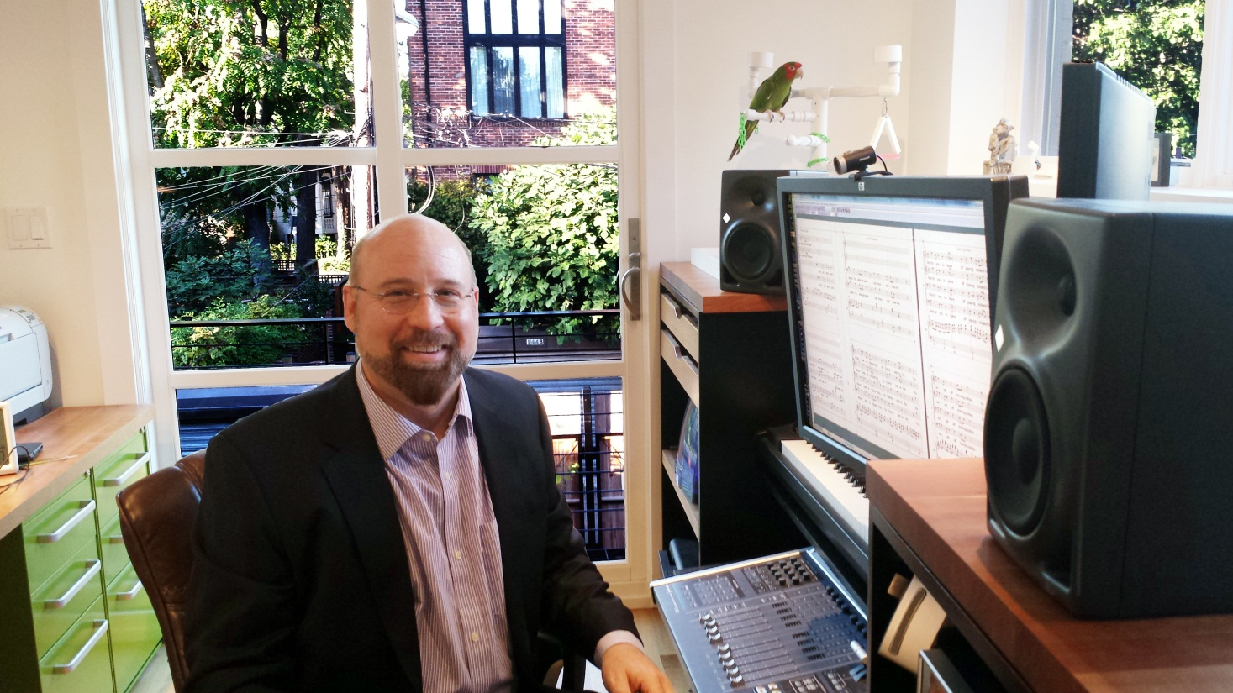
Custom Special Events
Brian Wilbur Grundstrom
Database Administrator

Slide 2
Who is BWG?
10 years Development at Brooklyn Academy of Music
6 years IT at Brooklyn Academy of Music
  Converted from PACT to Tessitura
Database Administrator at Washington National Opera for 7 years
Database Administrator at Shakespeare Theatre for 2 years
Composer of “Tessitura Mission Statement”

Slide 3
Why a new “module” for Special Events?
Need to track auxiliary information which ties into data already in Tessitura
Banish the Excel Spreadsheet
Centralize Data
Improve efficiency

Slide 4
What is the Special Events Module?
This module is designed to keep track of all information needed by special events for a gala, completely integrated within Tessitura.
Robust and easy to use in a fast paced environment
Not rock the boat - the new pivot table reports are “just like” the old excel reports

Slide 5
Primary Local Tables
LTX_EVENT_PARTY
LTX_EVENT_GUEST

Slide 6
LTX_EVENT_PARTY
holds information at the “couple” level.
For example, a company may buy a table of ten, consisting of five couples. Each “couple” is a called for our purposes a “party”, which does not necessarily indicate two people, but can be any number of people who RSVP as one, have one escort card (for table seating) and sit at the same table.
Information that is unique to the “couple” or “party” is contained in this table.
There may be many records in LTX_EVENT_PARTY that corresponding to one event record in TX_EVENT_EXTRACT (events radio button in history tab).

Slide 7
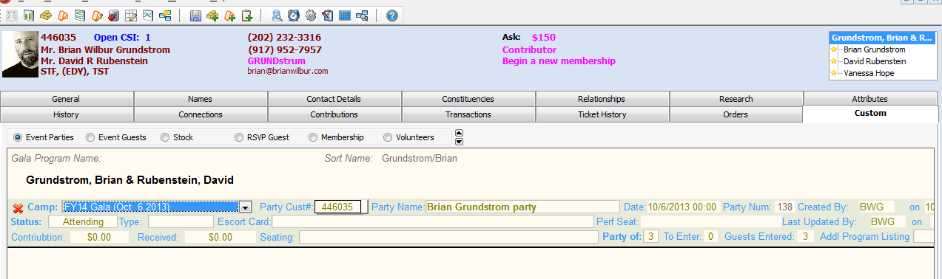
Custom Event Party Screen
There are only three required entries:
Elevated Event (Campaign)
Status
Number in Party
Everything else is auto populated or optional!
Including the guest records!

Slide 8
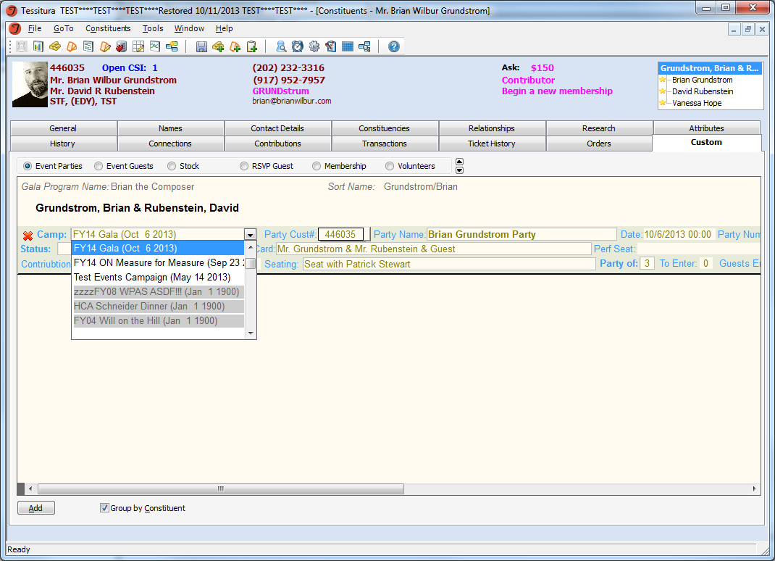
T_CAMPAIGN elevated events only

Slide 9
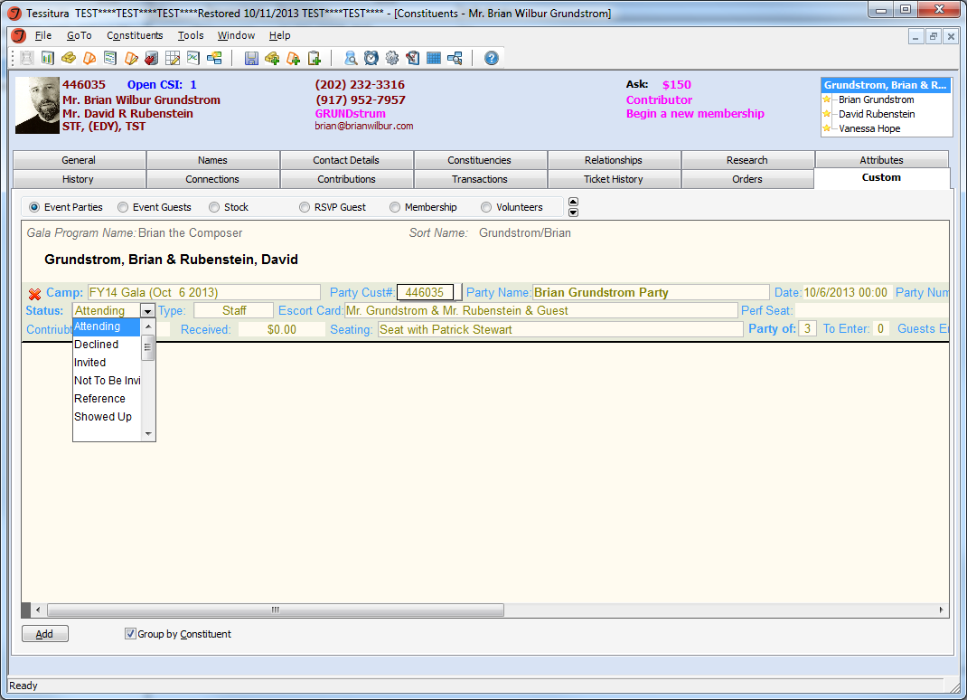
TR_INVITATION_STATUS dropdown

Slide 10
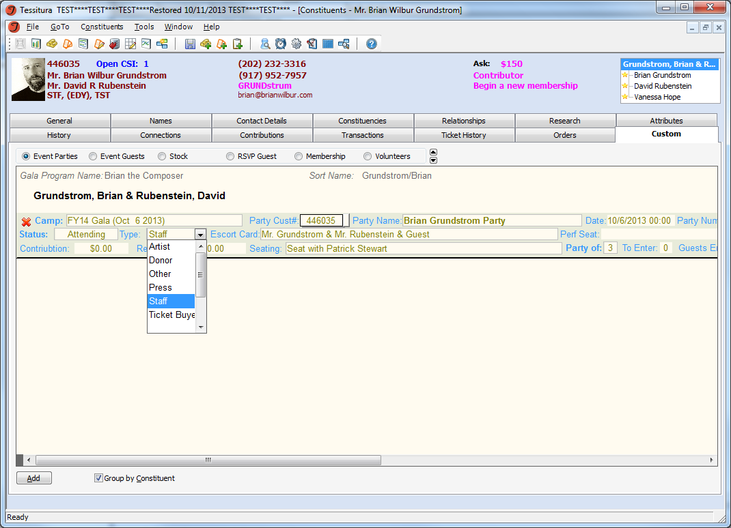
LTR_EVENT_GUEST_TYPE dropdown
Default value can be defined per campaign

Slide 11
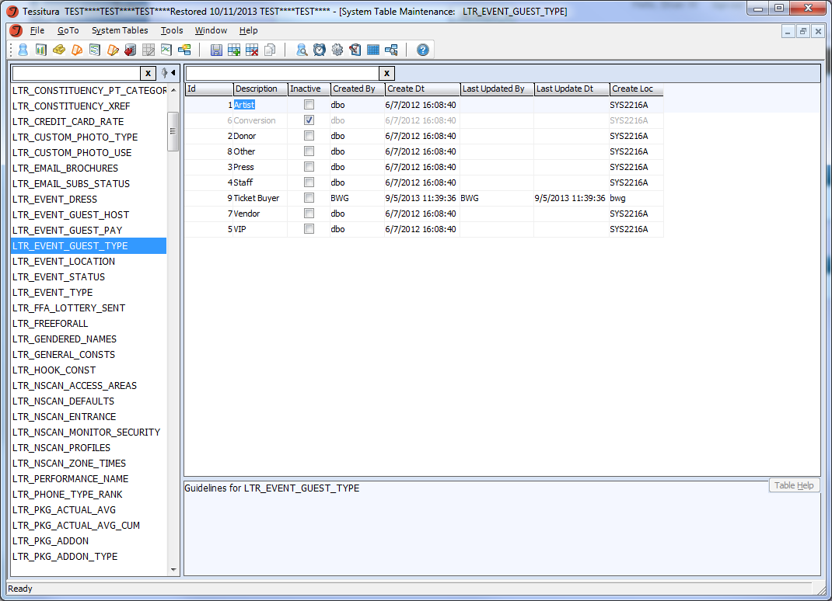

Slide 12
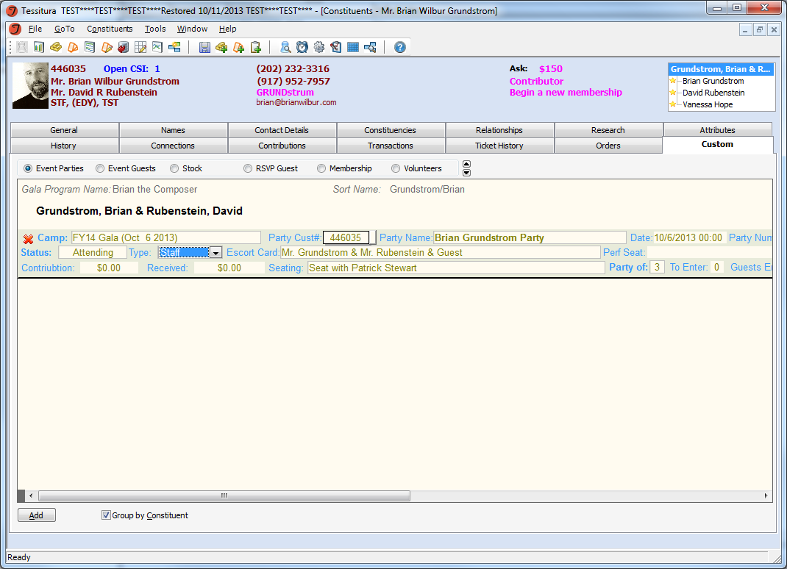
Event Parties
Program Listing
(read only/from program names)
Purchased Tickets
(read only)
Associated Contribution
(read only)
Customer No of party
(pre-populated/editable)
Seating notes
(optional)
Party name (automatic/editable)
Sort Name
(read only – from program names)

Slide 13
LTX_EVENT_GUEST
There may be many records in LTX_EVENT_GUEST that correspond to one record in LTX_EVENT_PARTY.
There is a trigger on LTX_EVENT_PARTY that automatically creates the appropriate number of guest records in LTX_EVENT_GUEST to save on data entry.
There is in turn another trigger on LTX_EVENT_GUEST that updates the event guests standard table TX_EVENT_GUEST so that canned reports will continue to function.
LTX_EVENT_GUEST contains all the information in TX_EVENT_GUEST, plus extra custom fields unique to each guest.
There is also a trigger on LTX_EVENT_PARTY which creates an event history record (TX_EVENT_EXTRACT) if one doesn’t already exist for that patron.

Slide 14
TRIGGERS
CUSTOM EVENT PARTIES
LTX_EVENT_PARTY
TG_LTX_EVENT_PARTY_INSERT
TG_EVENT_PARTY_UPDATE
TG_EVENT_PARTY_DELETE
EVENT HISTORY
TX_EVENT_EXTRACT
CUSTOM EVENT GUESTS
LTX_EVENT_GUEST
TG_LTX_EVENT_GUEST_DELETE
TG_LTX_EVENT_GUEST_INSERT
TG_LTX_EVENT_GUEST_UPDATE
EVENT GUEST
TX_EVENT_GUEST

Slide 15
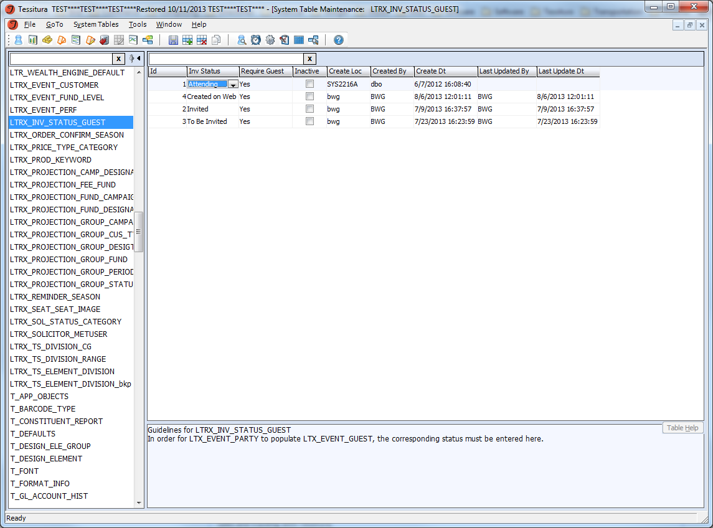
Only determined statuses will create/require guest records.

Slide 16
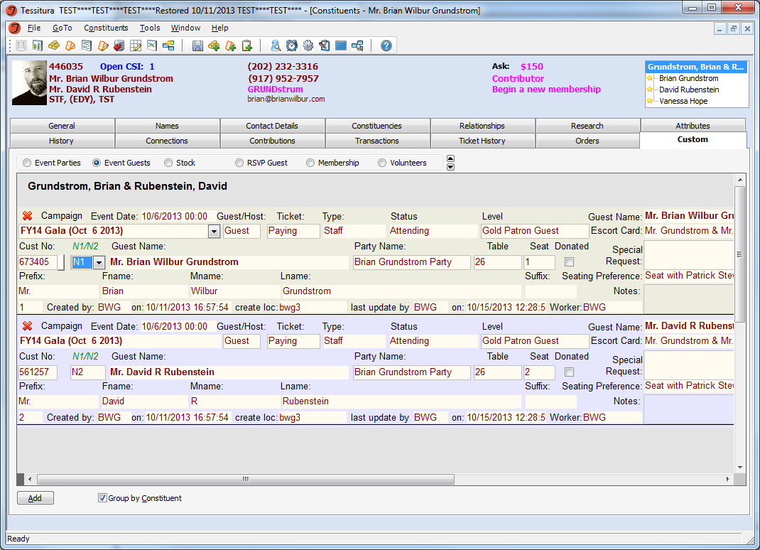

Slide 17
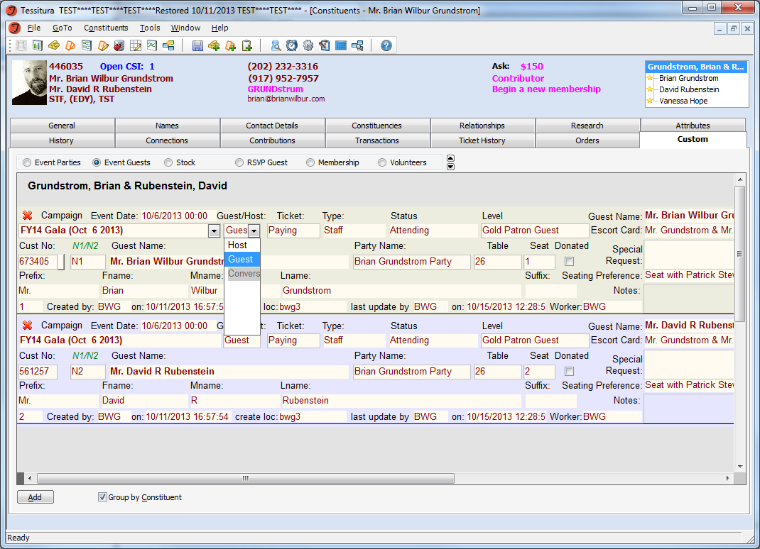

Slide 18
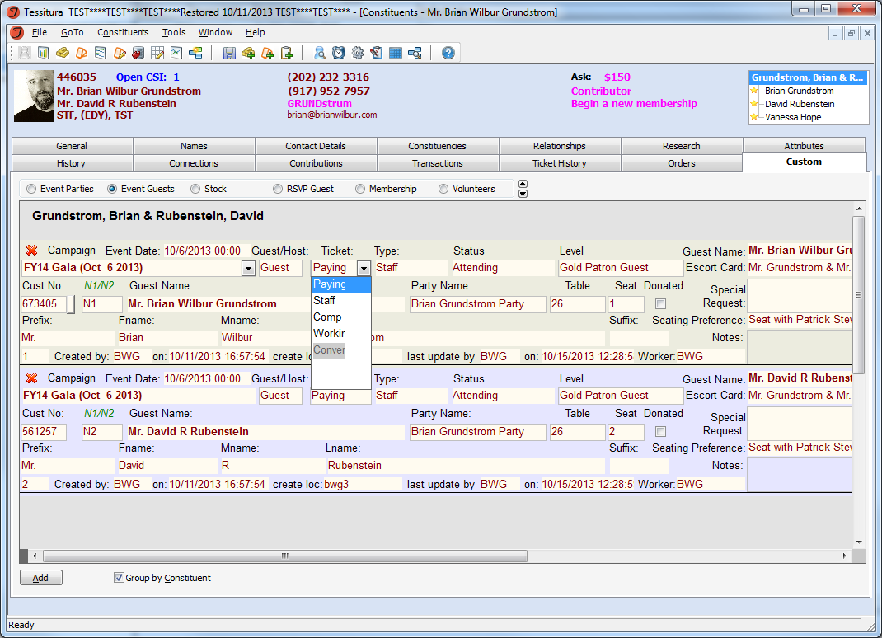

Slide 19
From Event Party

Slide 20
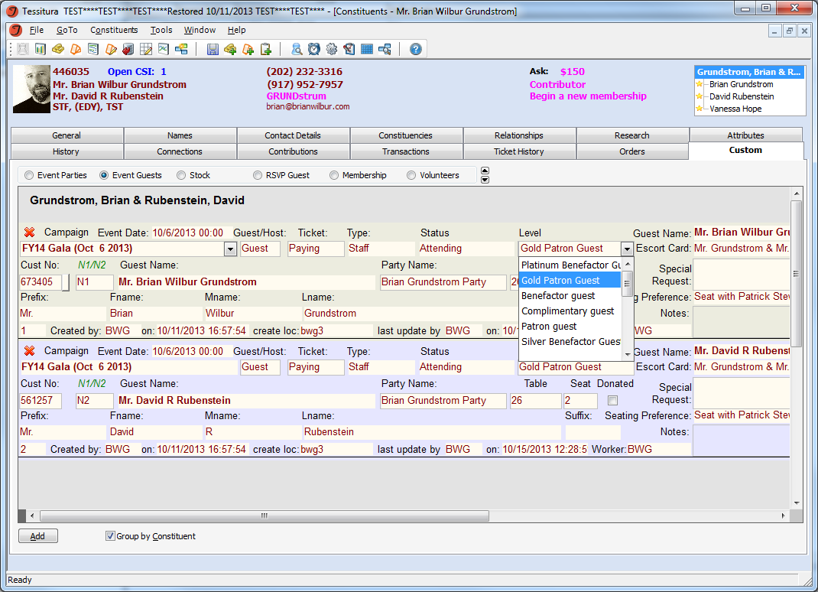

Slide 21
Customer_no and N1/N2/Other/Guest
Populate all name fields

Slide 22
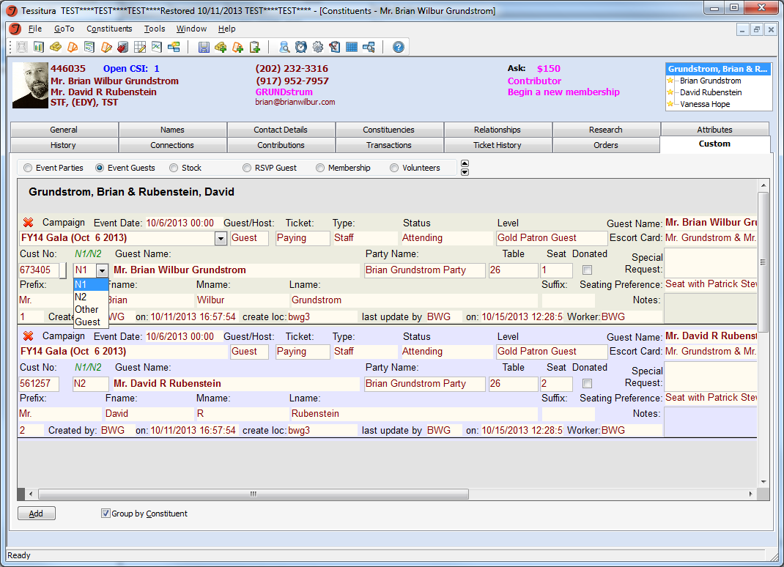

Slide 23
Clicking on customer_no will take you to that patron’s account

Slide 24
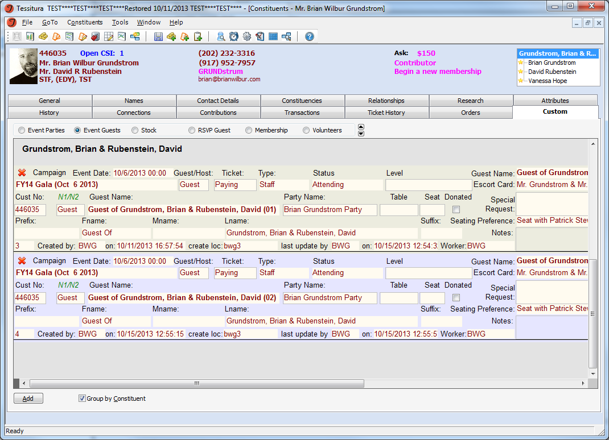
Guest creates additional “Guest of” records

Slide 25
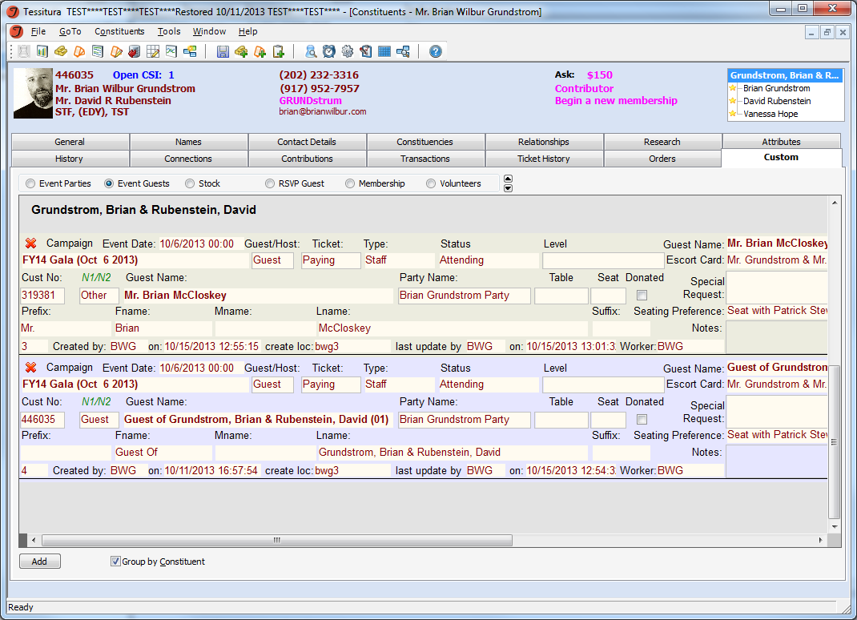
Other is used for guest other than A1 and A2.
Customer_no is always required.

Slide 26
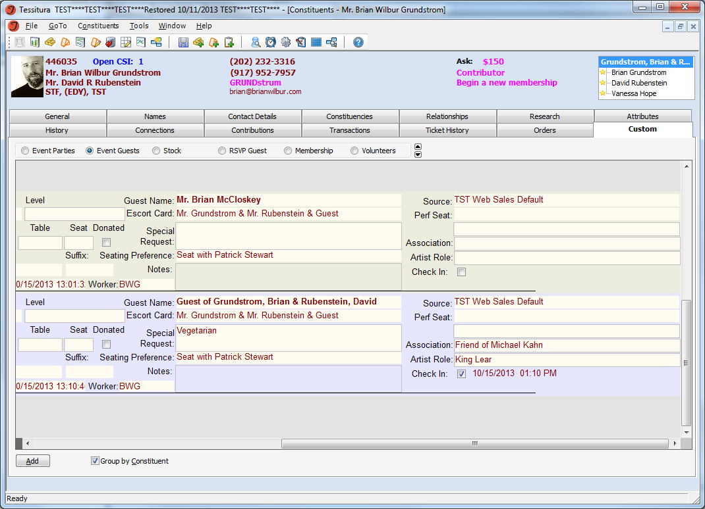
Additional Fields
Seats purchased in this account

Slide 27
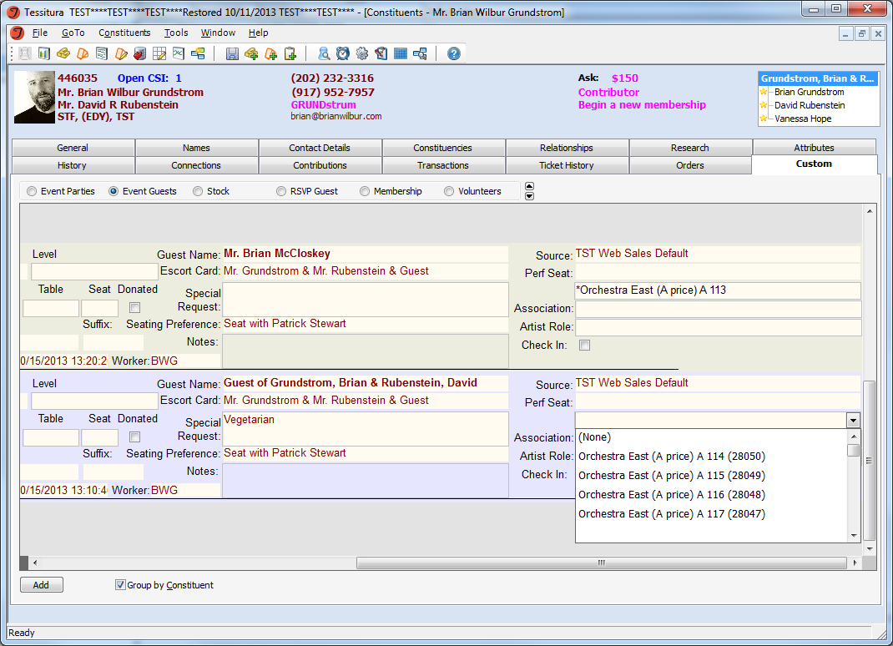
Seat Assignment
(from hold codes or tickets sold to development account)
Previously assigned tickets fall off the list

Slide 28
More Screens!!!
Constituent Custom Tab
  Parties
  Guests
  Event Attendance (an extra read-only custom “events” tab that show all events to which that patron has been a guest, similar to the highlighted green rows in the events tab)
Campaign Custom Tab
  Parties (all parties for an event)
  Guests (all guests for an event)
  Event Detail (Event setup data and summary information)
  Event Levels (Descriptions and functionality for web interaction)
  Guest Search (search criterion)
  Guest Results (display of search criterion)

Slide 29
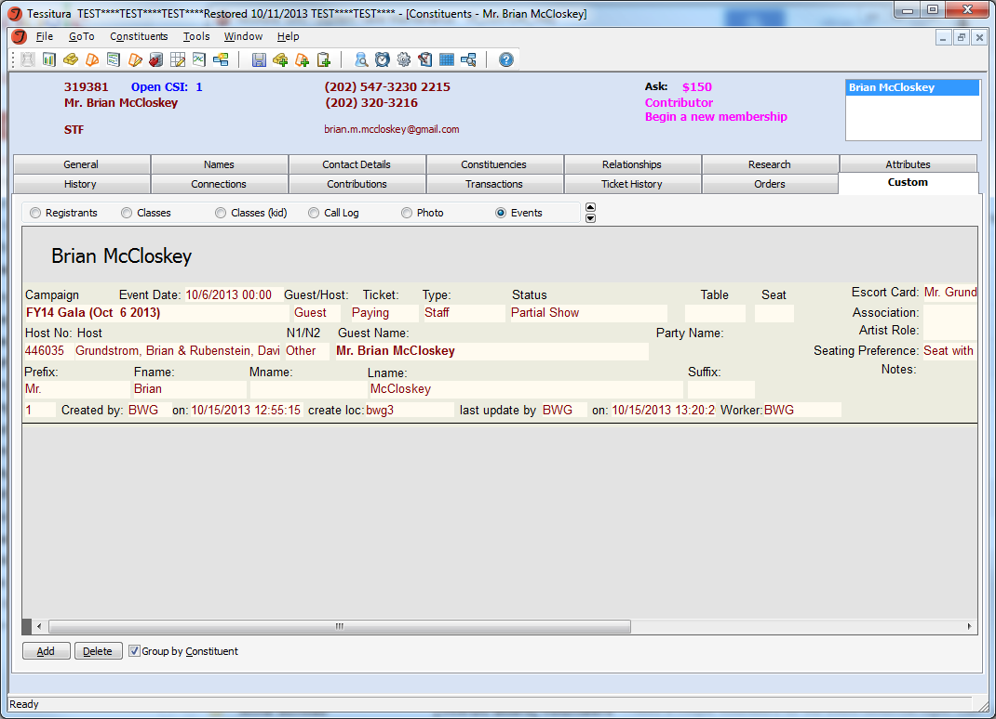
Additional screen – for events attended
(as a guest or host)

Slide 30
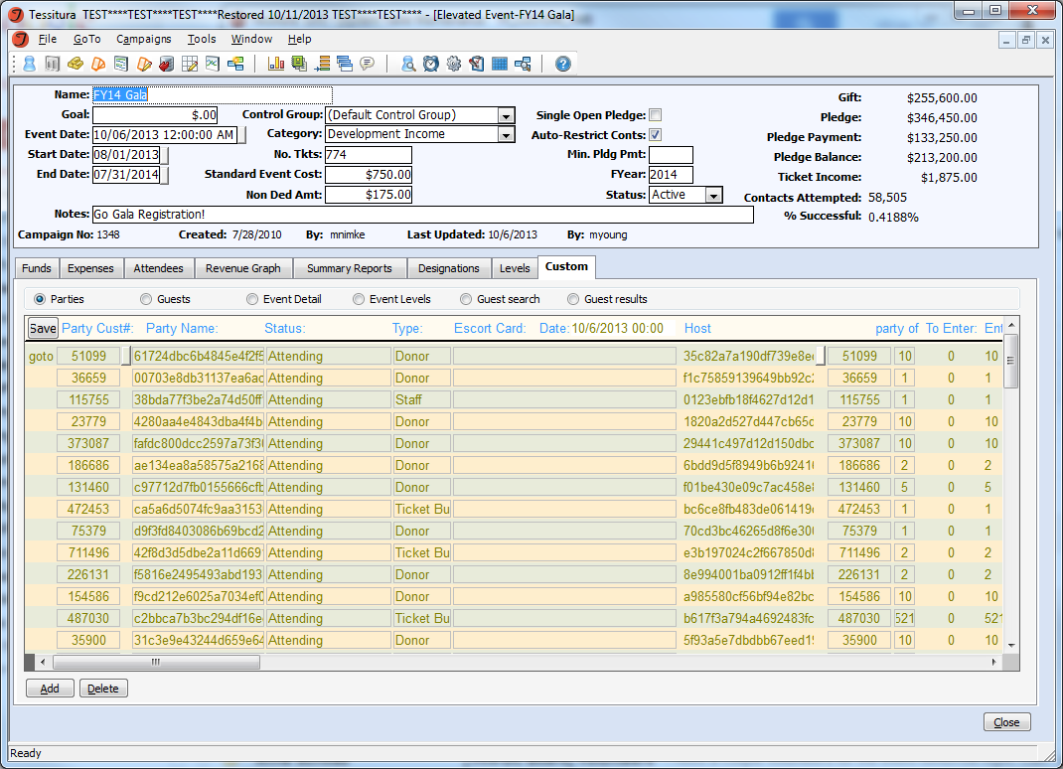

Slide 31
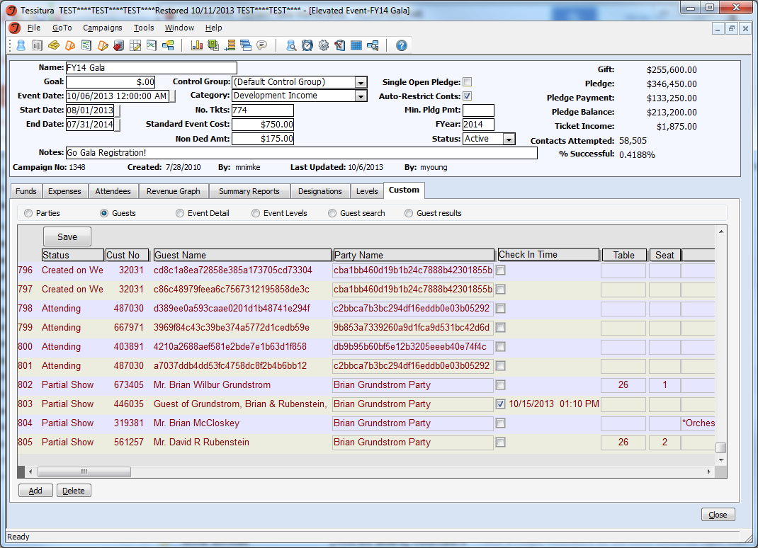

Slide 32
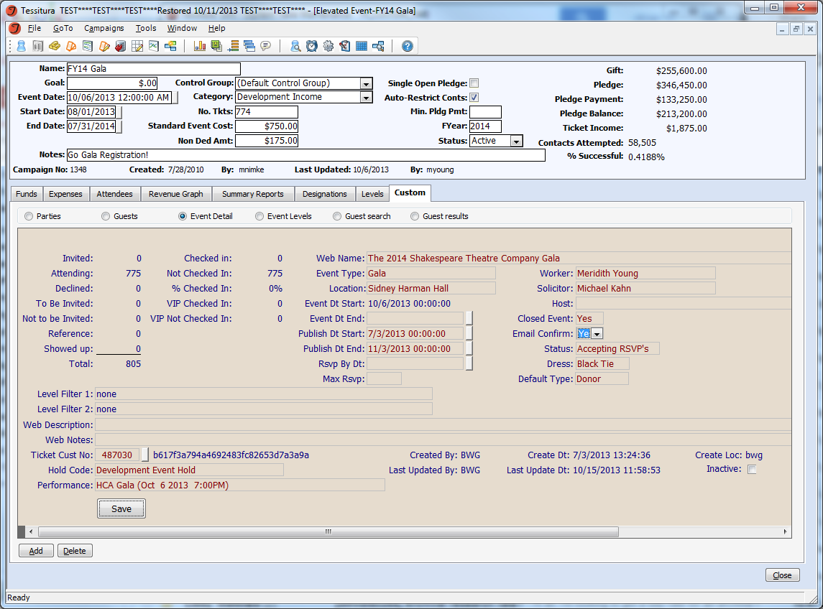
Summary Information
Filter for summary information
Web publishing information
Find seats to assign
Link to performance

Slide 33
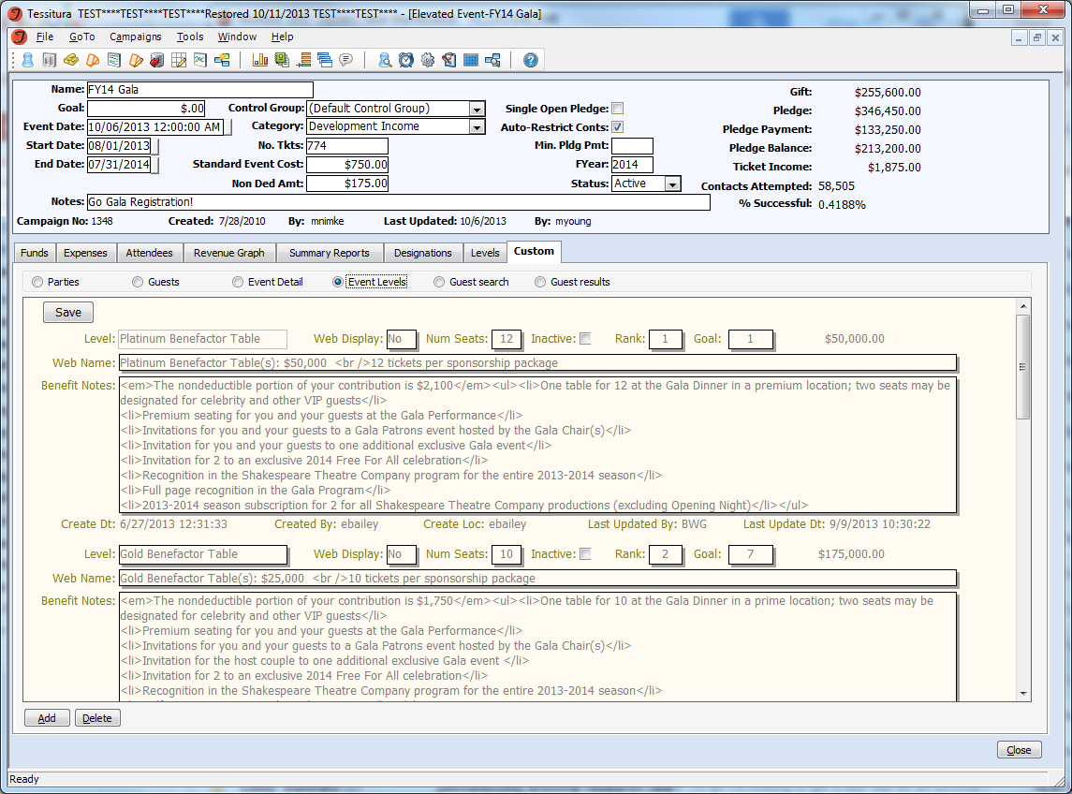
Descriptions for Web

Slide 34
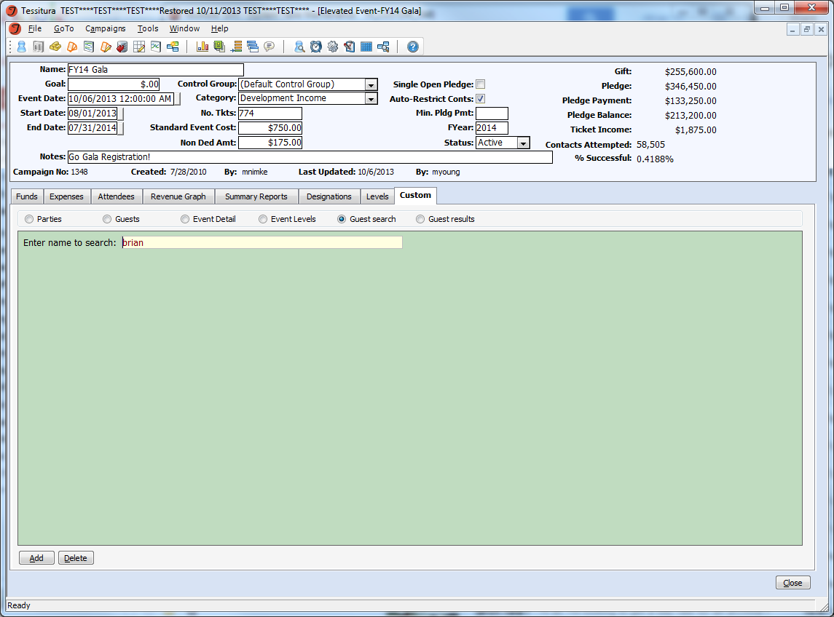

Slide 35
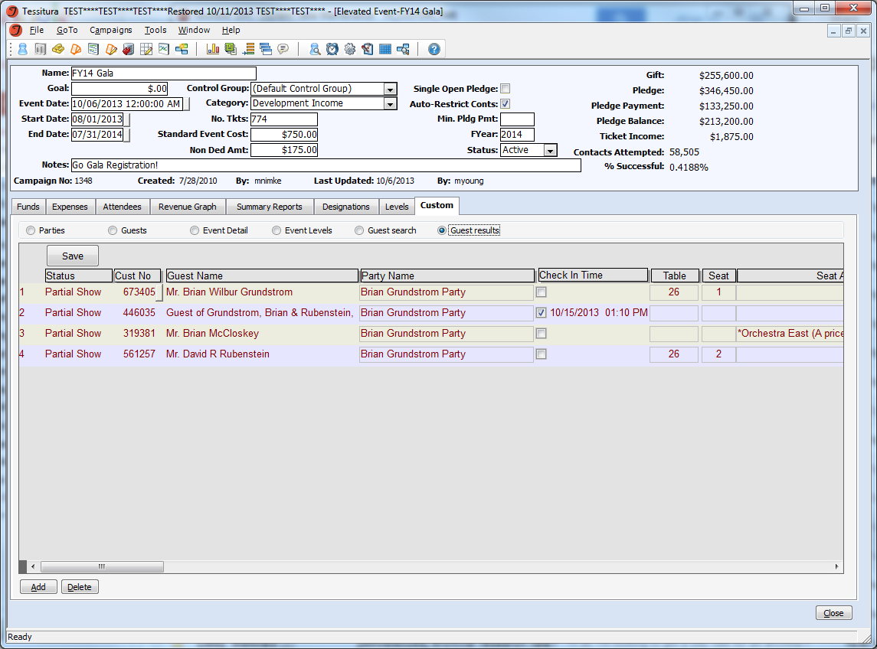

Slide 36
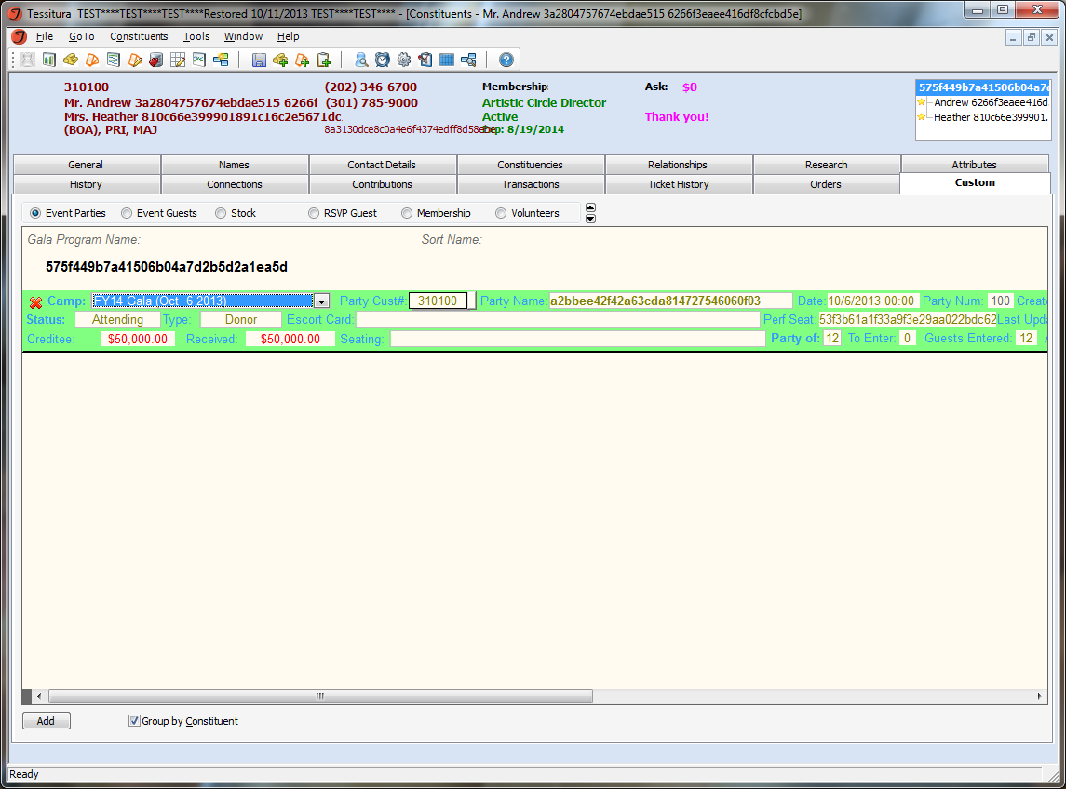
Creates an additional display only record for creditees
Clicking on “creditee” opens the creditor account.

Slide 37
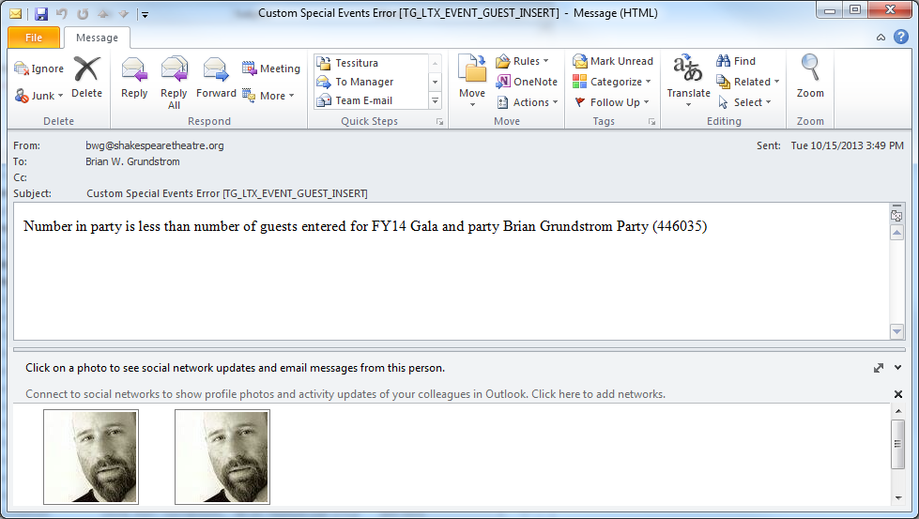
Data Consistency
Data uniformity is enforced, with error messages configurable in emails

Slide 38
Data Consistency
While the non-custom events guests are kept up to date, they need to be made read only.
Legacy data can be imported if desired

Slide 39
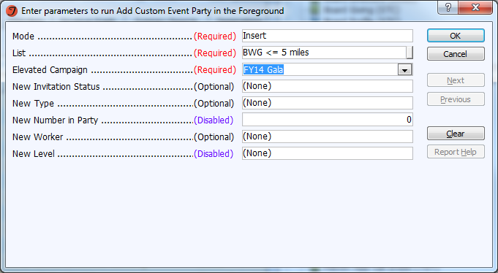
Report to add parties

Slide 40
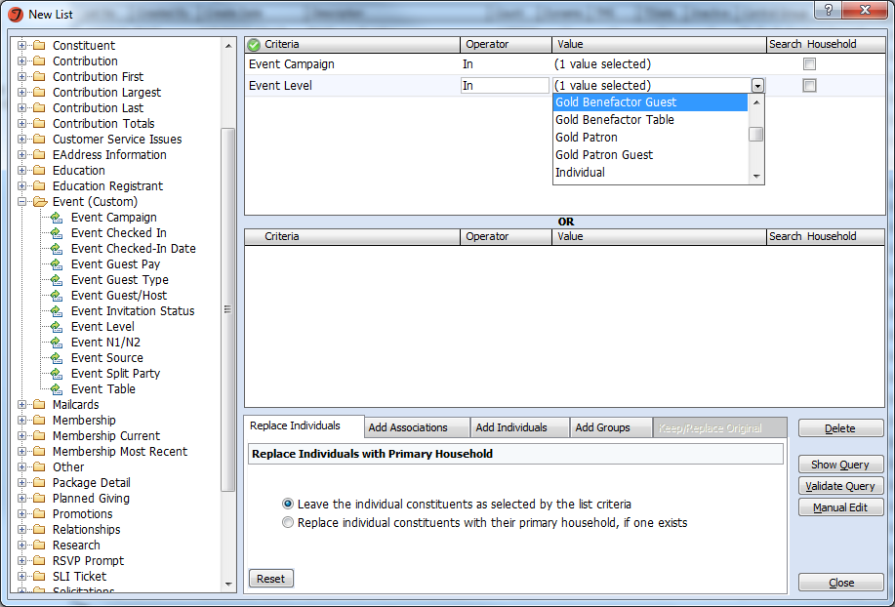
Listbuilder & Output Set builder

Slide 41
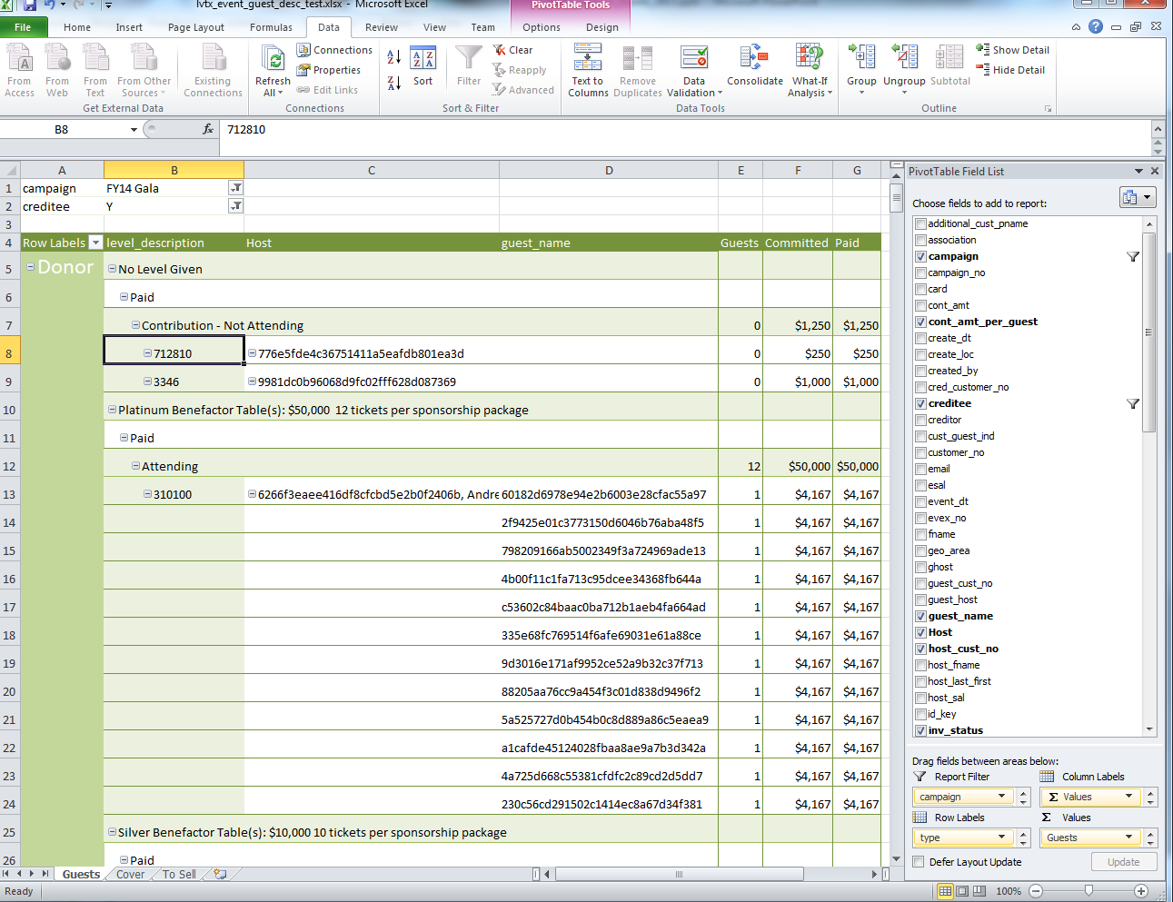
Pivot Table

Slide 42
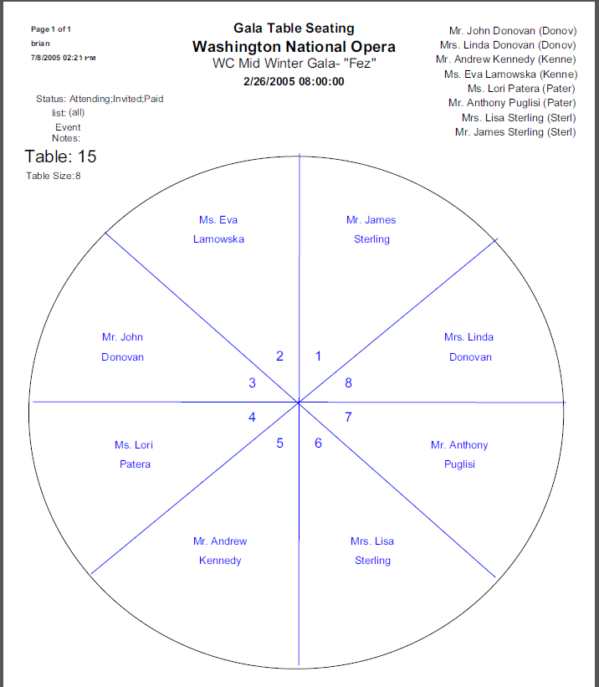

Slide 43
Custom Special Events
Brian Wilbur Grundstrom
Database Administrator

