Slide 1
ESO Flex Pass
Setup and Rollover

Slide 2




Flex Pass Outline
Build your own package
Fixed price per coupon
Subscriber benefits
Purchased in pairs with a minimum of 4

Slide 3

Setup
How does it work?

Slide 4
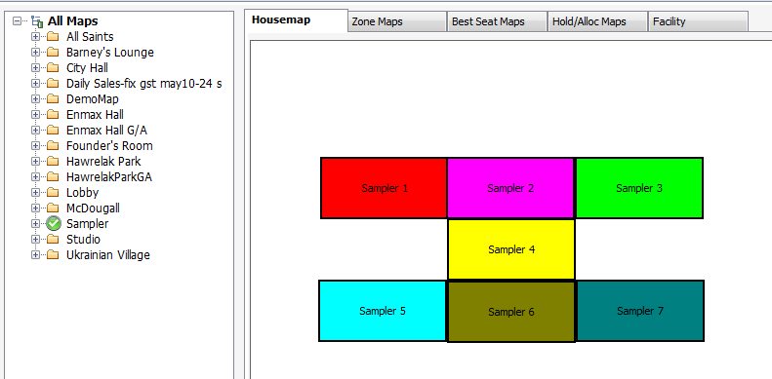
Facility Setup
Very large G/A facility

Slide 5
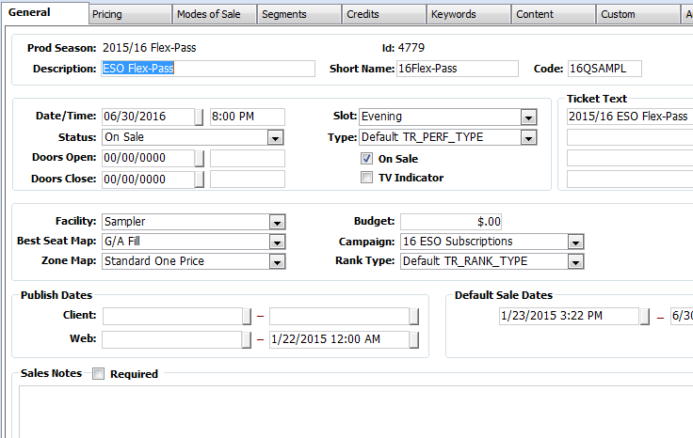
Ticketing Setup
Single “Dummy” performance

Slide 6
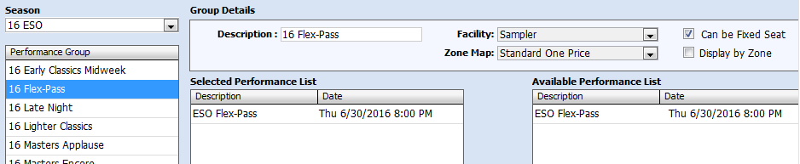
Ticketing Setup
Performance Group with single performance

Slide 7
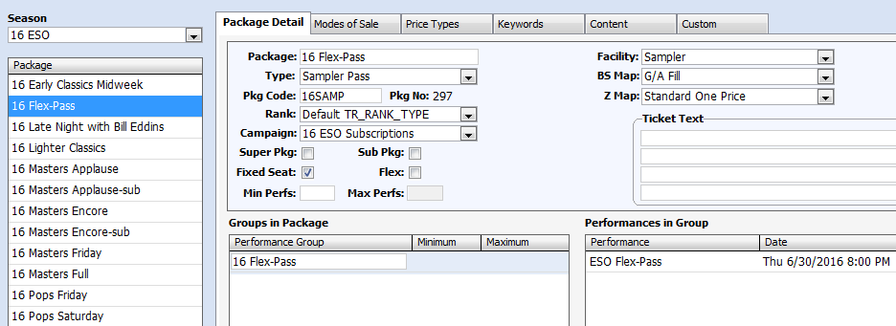
Ticketing Setup
Flex Pass package with single performance group and Fixed Seat

Slide 8
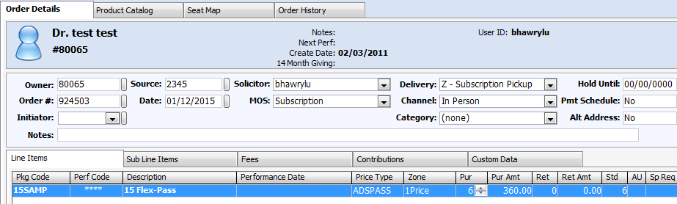
Selling Flex Passes
Package line item – number of seats indicates number of vouchers

Slide 9
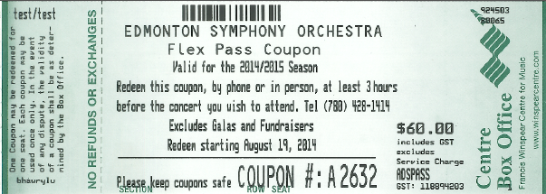
Selling Flex Passes
Printed on standard ticket stock with a Coupon Number

Slide 10

Redeeming Flex Passes

Slide 11
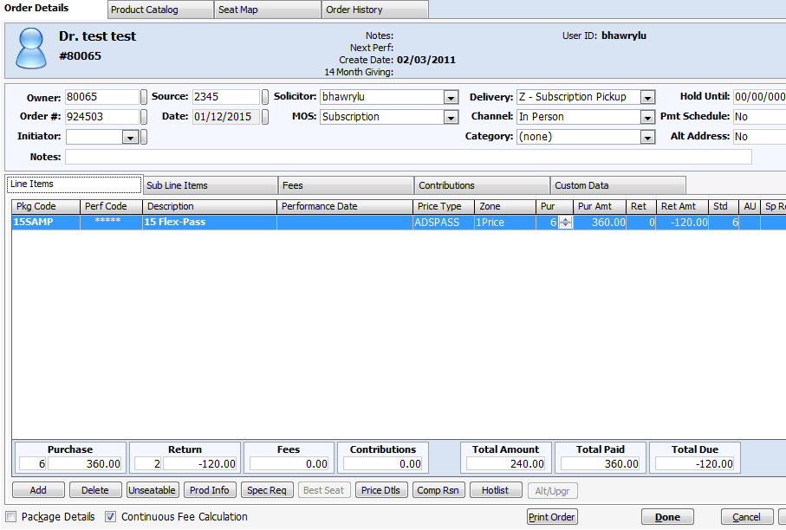
Redemption Process
Original order is loaded and appropriate seats are returned at the performance level only

Slide 12
Redemption Process
Benefits of redemption in original order and returning only performance level seats:
  Can easily see how many coupons remain
  Can see at a glance which concerts were redeemed into
  Exchange fees aren’t applied
  Base map seats remain meaning coupons can be rolled over for next season

Slide 13
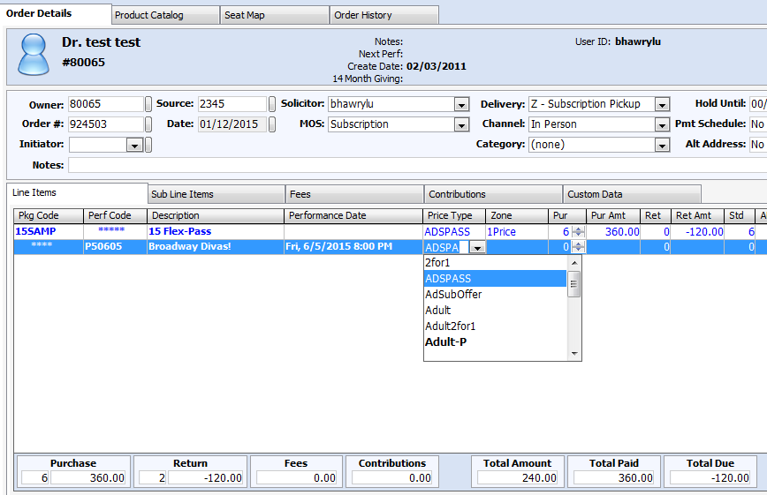
Redemption Process
Add new line item for the redemption performance and choose the appropriate price type for Flex Pass

Slide 14
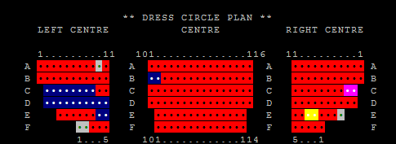
Redemption Process
Seats can be chosen from any available seat
    (even premium seats!)

Slide 15
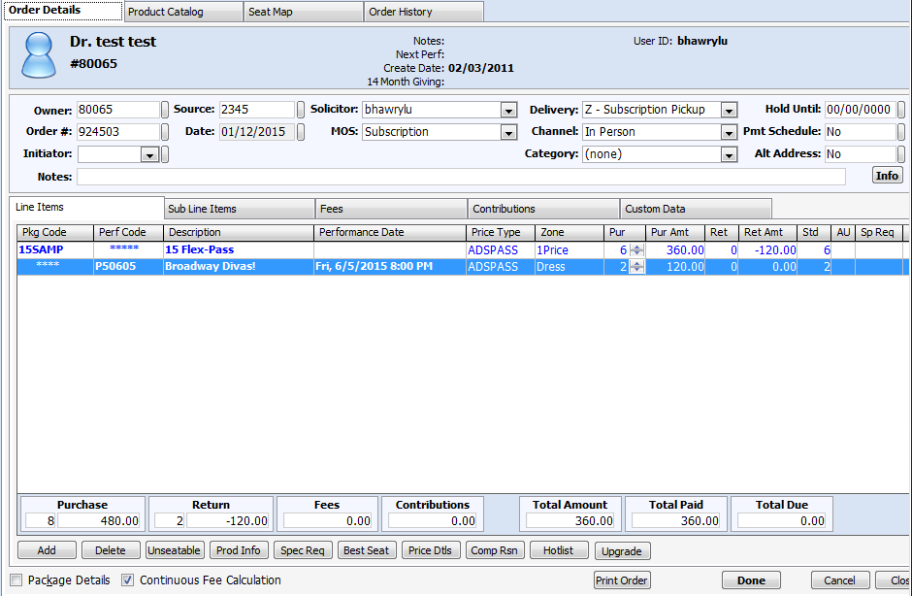
Redemption Process
The order should always balance to $0.00 if everything was exchanged properly.

Slide 16
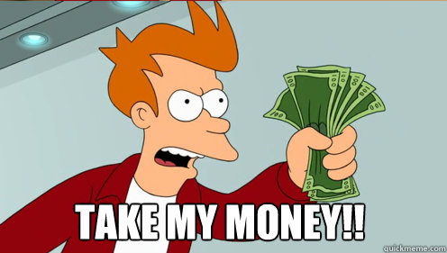
Rollover and Subscription Renewal

Slide 17
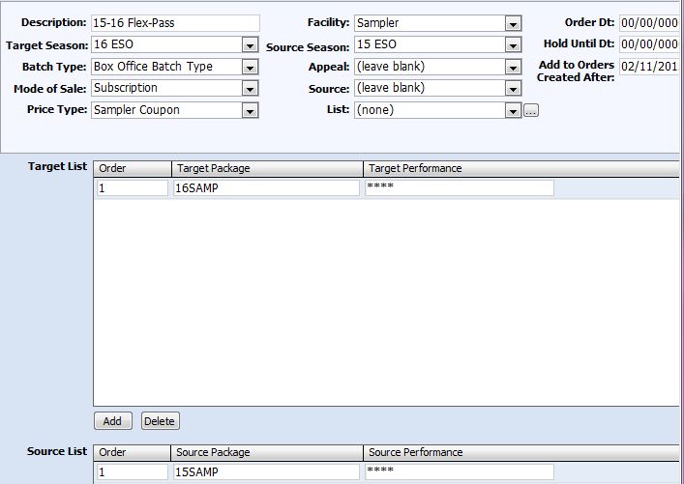
Rollover and Renewal
Super easy! Works exactly the same as a regular package.
Create a rollover set and do any required price mapping then do the roll

Slide 18
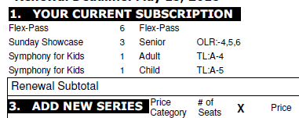
Rollover and Renewal
Custom renewal form hides “seating” data for Flex Pass and simply indicates the number of coupons

Slide 19

To Infinity and Beyond

Slide 20

Flex Passes in the Future
Easy online purchase and redemption
Better reporting and analysis

Slide 21


