Slide 1

E-TUG
April 2015 - Ticketing

Slide 2
Overview
Processing contributions in the ticket order screen
  Example 1: Ticket returns
  Example 2: Ticket exchanges
  Set-up
  Example 3: ticket amount and contribution amount in same transaction
  Set-up

Slide 3
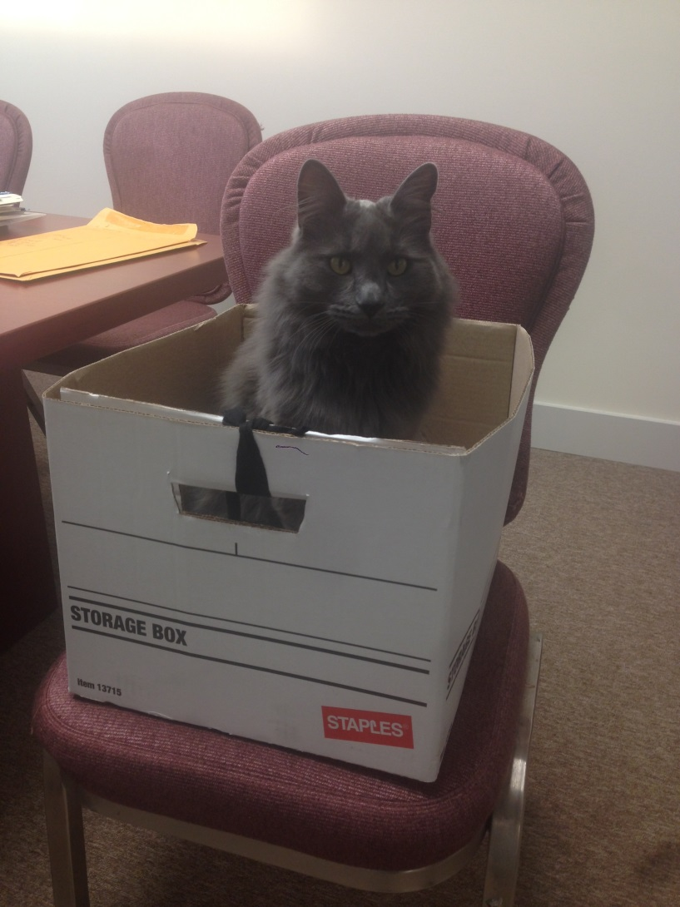
Contributions in the Ticket Order Screen
Example patron: The Director of HR for The Edmonton Opera, Mister Parker
Example 1: Mister Parker cannot use one ticket in his subscription and wants a tax receipt for the value of the ticket

Slide 4
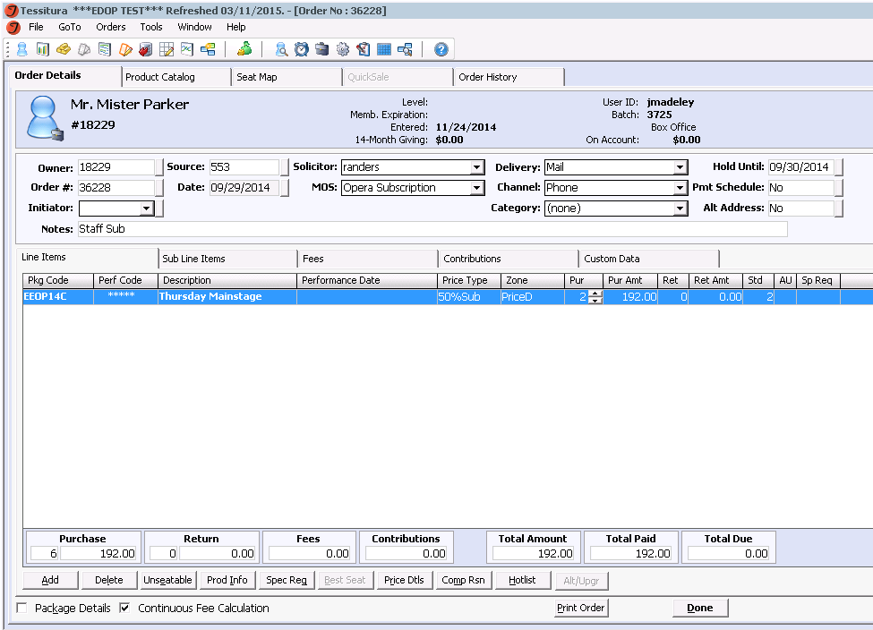
Contributions in the Ticket Order Screen – Return for a tax receipt
Note: our tickets are only able to be returned in this way if they have been printed.
In the ticket order screen, search for:
  “Parker, Mister”
  Search for the ticket order and load it

Slide 5
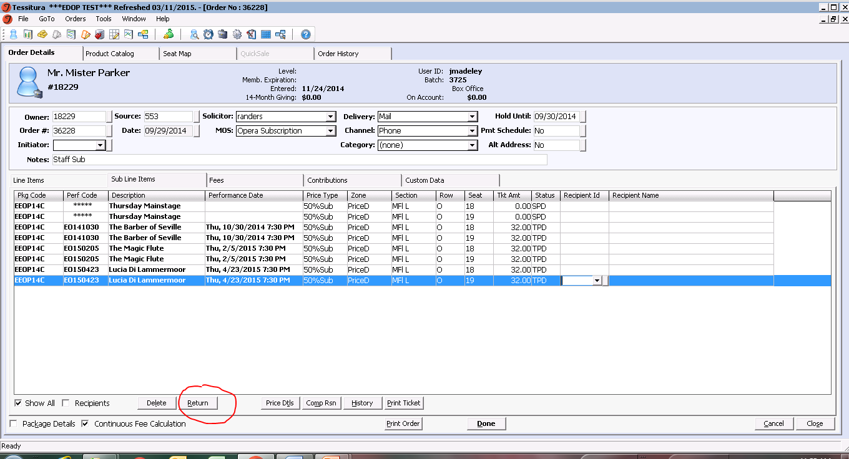
Contributions in the Ticket Order Screen – Return for a tax receipt
Click the subline item tab
Select the seat he wants to return
Click the “Return” button at the bottom of the screen

Slide 6
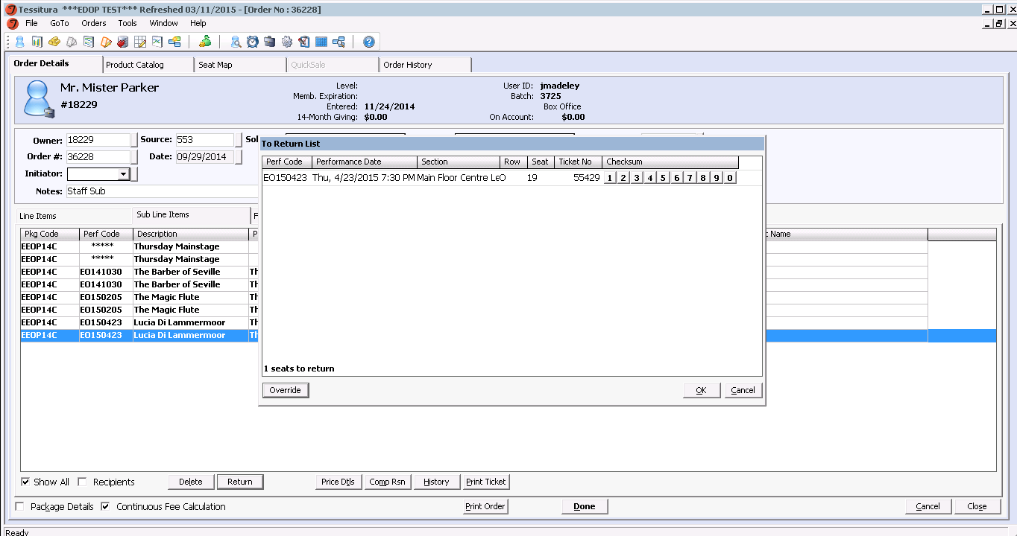
Contributions in the Ticket Order Screen – Return for a tax receipt
Confirm this is the seat you want to return and click “override” in the pop-up window

Slide 7
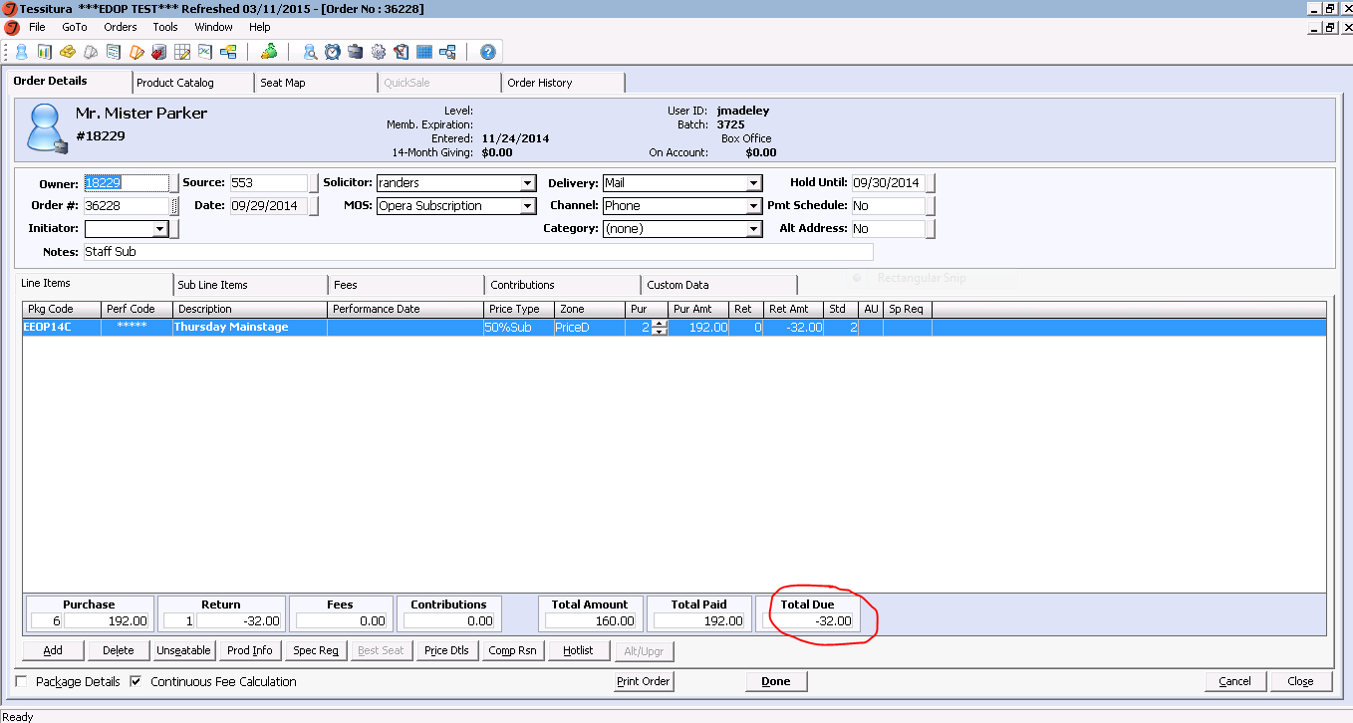
Contributions in the Ticket Order Screen – Return for a tax receipt
In the line item view, you can see that there is now a negative balance of $32
Click on the “contributions” tab

Slide 8
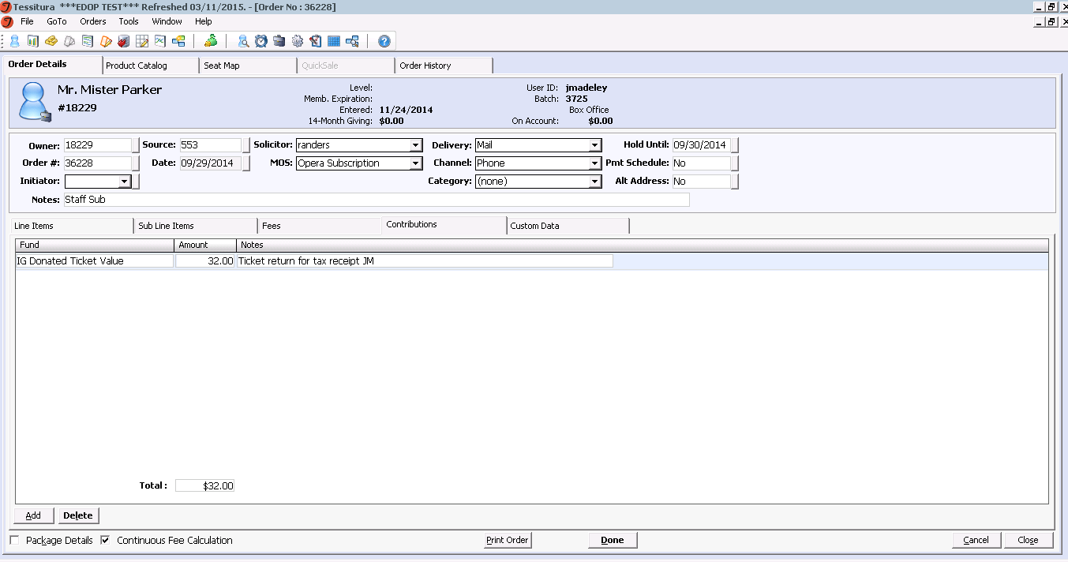
Contributions in the Ticket Order Screen – Return for a tax receipt
Click “add” at the bottom of the screen
Select the fund you want the $ to be allocated to
Enter $32
Add notes as per your internal policy
Click “done”

Slide 9
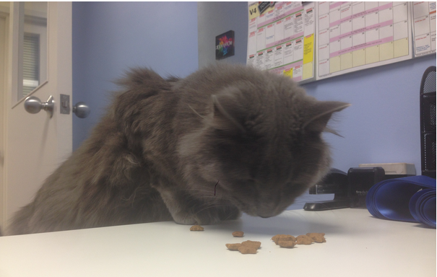
Contributions in the Ticket Order Screen – Exchange for a tax receipt
Example 2: Mister Parker cannot attend a performance in his subscription package and wants to change nights for that show. The new tickets are a lesser value and he wants a tax receipt for the difference.

Slide 10
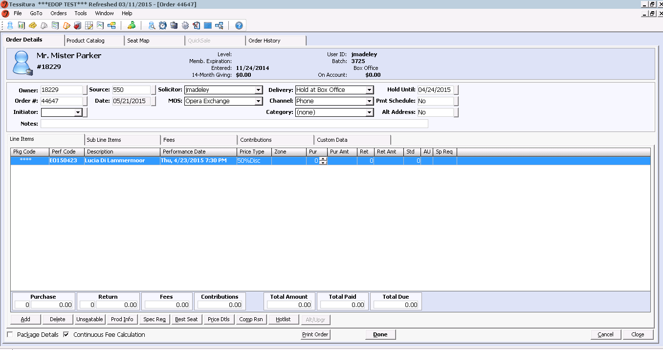
Contributions in the Ticket Order Screen – Exchange for a tax receipt
In the Exchange Mode of Sale, search for “Parker, Mister”
Select “Exchange” as the source
Click “add” and select the performance he wants to change

Slide 11
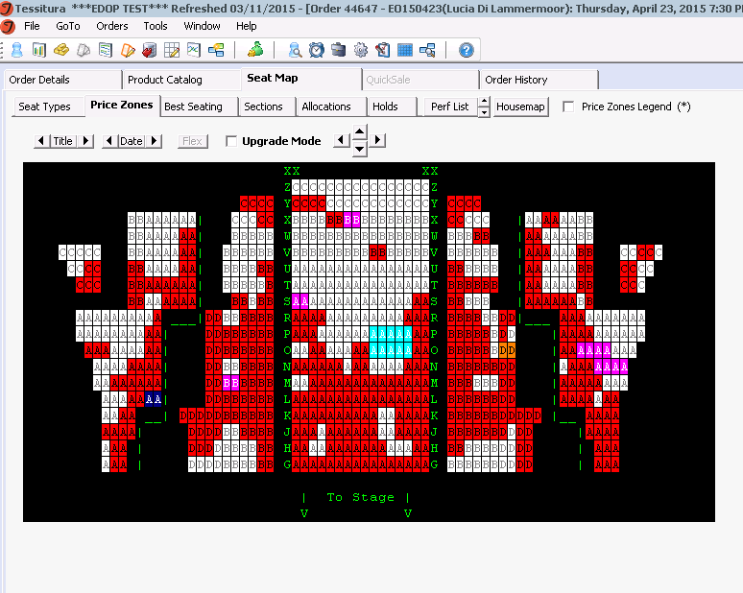
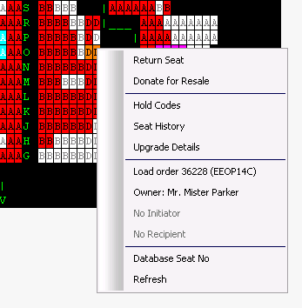
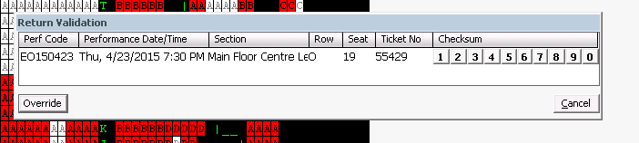
Contributions in the Ticket Order Screen – Exchange for a tax receipt
Click on the seat map and locate his tickets, displayed in orange (note: our tickets are only exchangeable if they have been printed)
Right click on the seats
In the pop up click “return seat” and then “override” to release the seat

Slide 12
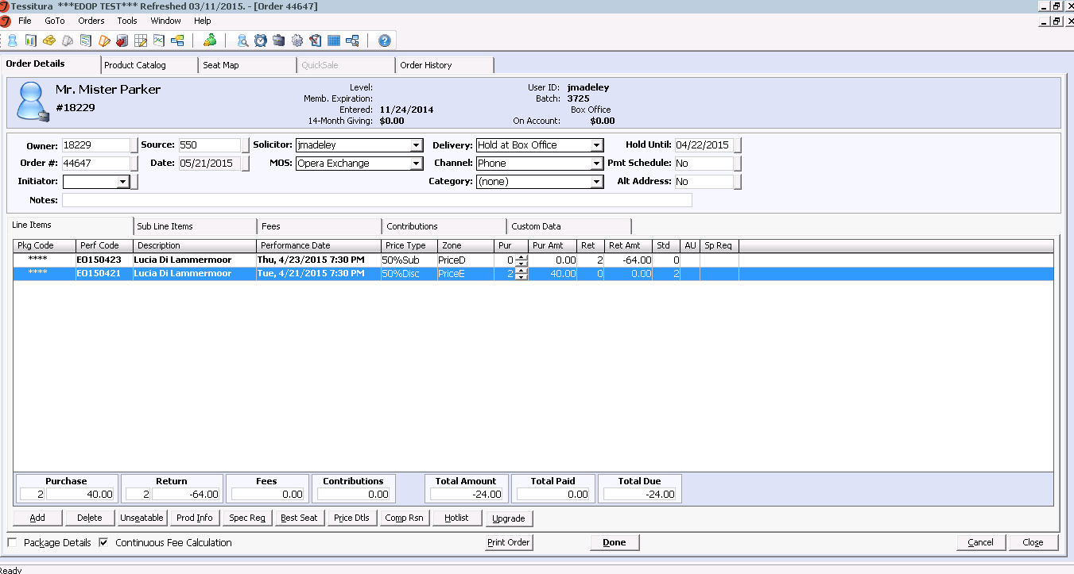
Contributions in the Ticket Order Screen – Exchange for a tax receipt
In the Line Item view, add the new seats he wants to the order
The price difference here is $24
Click on the “contribution tab”

Slide 13
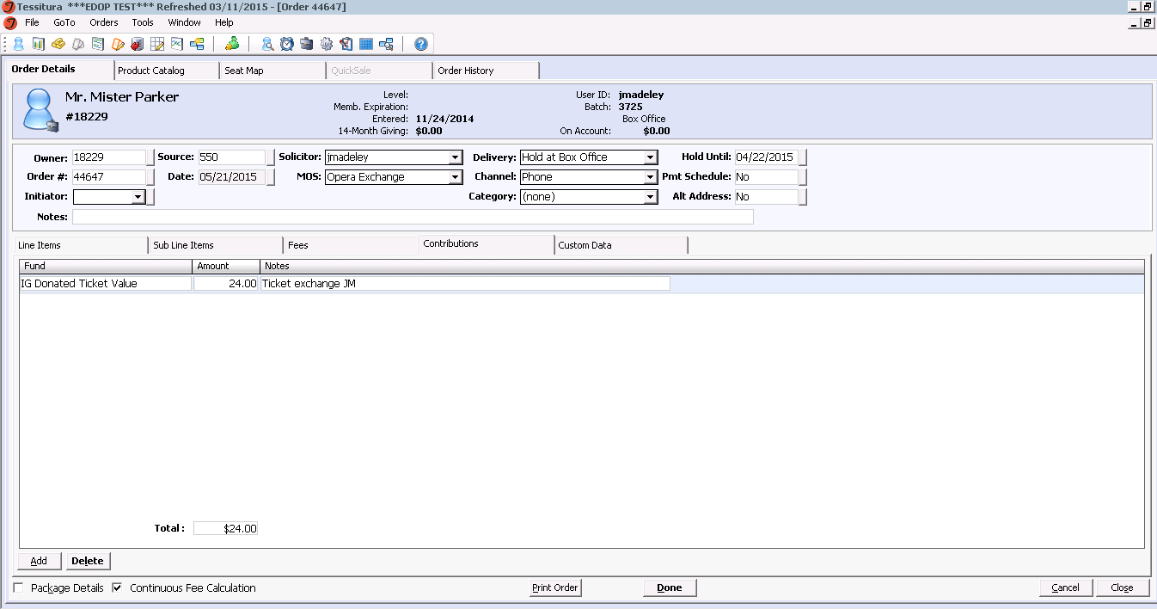
Contributions in the Ticket Order Screen – Exchange for a tax receipt
Click “add” at the bottom of the screen
Select the fund you want the $ to be allocated to (we have one populated here for the sake of simplicity and control)
Enter $24
Add notes as per your internal policy
Click “done”

Slide 14
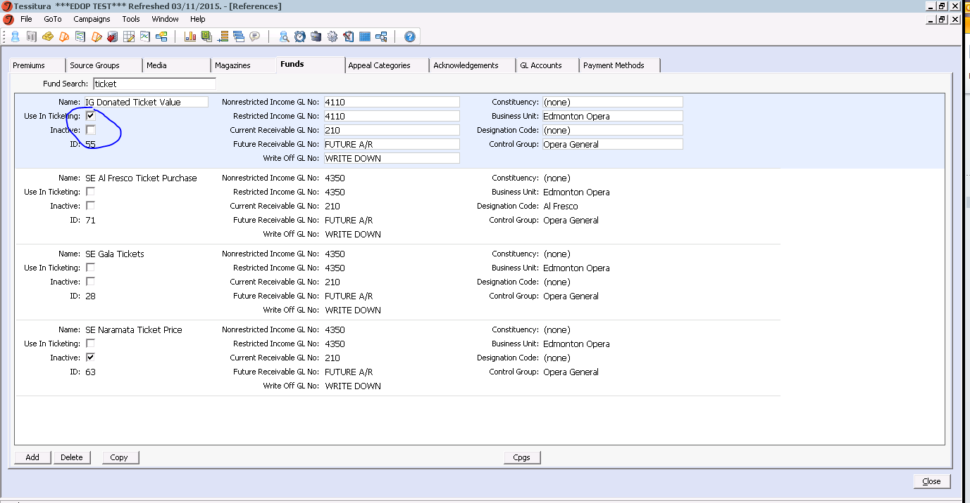
Set-up for both ticket return or exchange for a tax receipt
Go To → Campaigns → References → Funds
Search for or add the Fund you want to appear in the Contribution tab or make a new one for this purpose
Check the “use in ticketing” box
NOTE: this will make the fund available for use in all modes of sale and in all ticket orders. If you want to restrict access to this fund for certain events it may not be the best option.

Slide 15
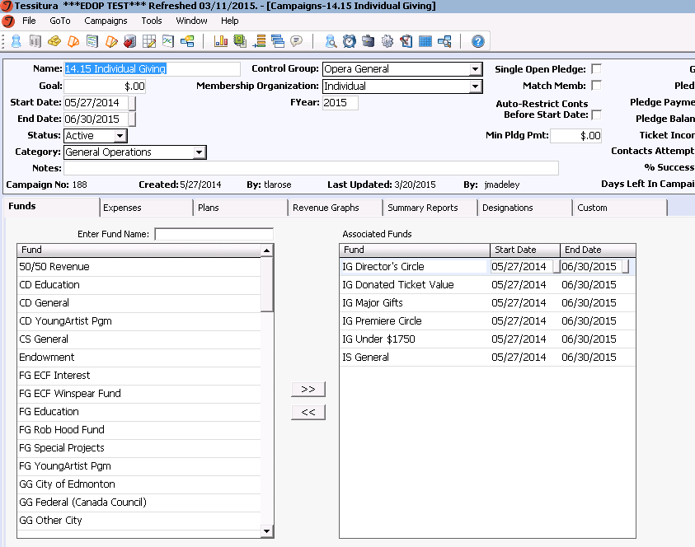
Set-up for both ticket return or exchange for a tax receipt
Go to Campaigns and associate the fund with the active Campaign you want the donation associated with, or make a new campaign for this purpose
IE our Donated Ticket Value fund is associated with the Individual Giving Campaign for the financial year.

Slide 16
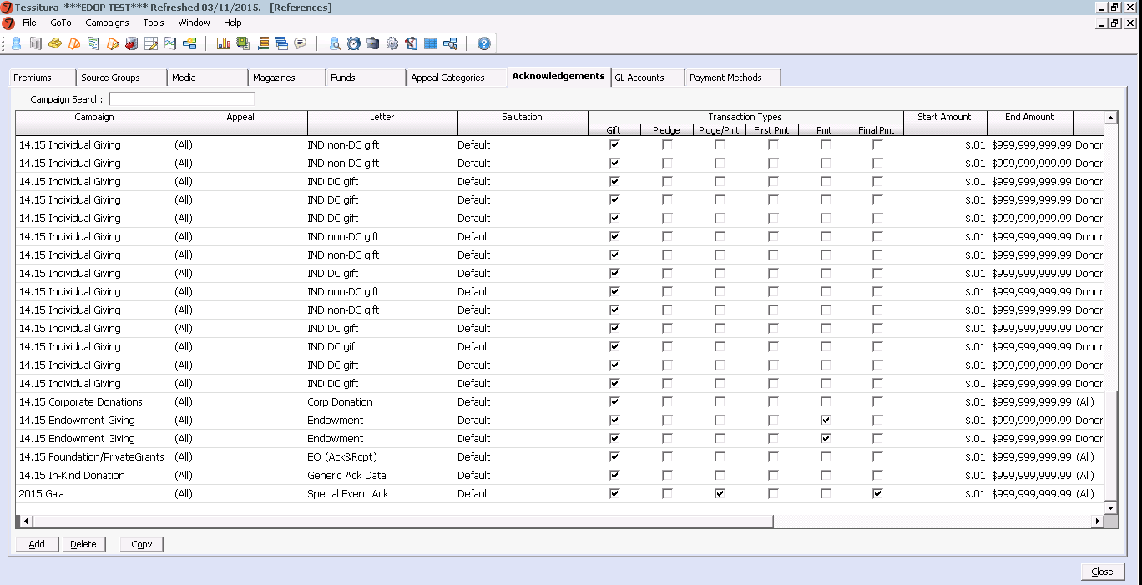
Set-up for both ticket return or exchange for a tax receipt
In Campaigns → References → Acknowledgements, create the Acknowledgement you want the fund to trigger when money is entered into that fund, and the applicable membership level
The tax receipt will generate when you run the report “Print Acknowledgement Letters” and the membership level will auto-populate depending on the set-up in the Campaigns → References → Acknowledgements screen.

Slide 17
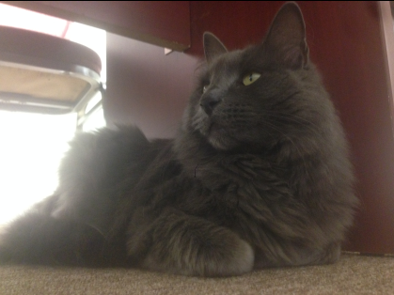
Contributions in the Ticket Order Screen – Gala Donations
Example 3: Mister Parker wants to buy a ticket for the Edmonton Opera Gala. The total ticket price he pays is $500 for 1 ticket for both the ticket price and a contribution amount he will get a tax receipt for.
Goal: to charge him for $500 in one transaction, and to process the ticket purchase and the contribution in one transaction without having to move $ around in Tessitura.

Slide 18

Contributions in the Ticket Order Screen – Opera Gala
All departments had to agree in advance of tickets going on sale what the ticket amount is and the GST, and what the value of the tax receipt will be.
For the 2015 Gala, an individual ticket was $130 and the donation amount was $370 for a total of $500

Slide 19
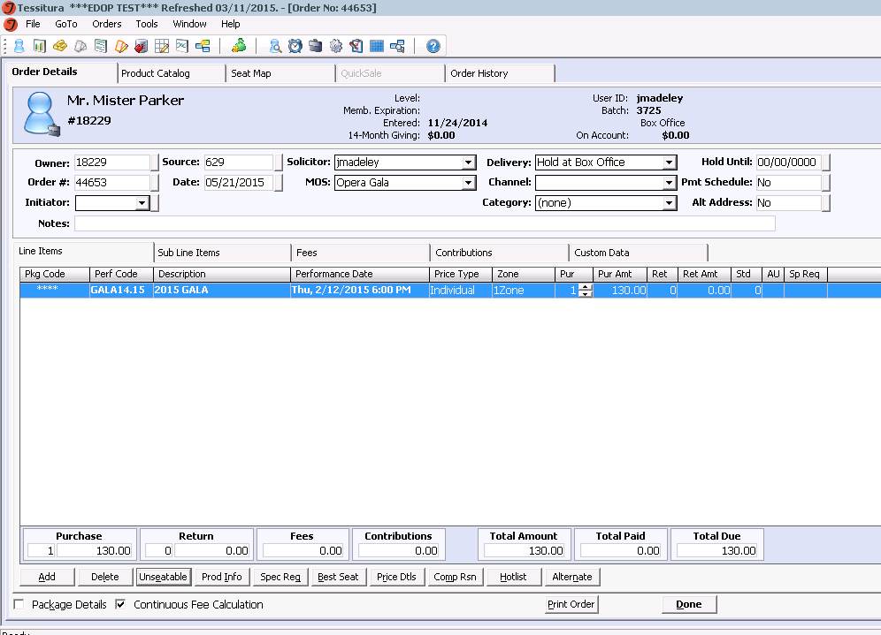
Contributions in the Ticket Order Screen – Opera Gala
In the ticket order screen search for “Parker, Mister”
Add the appeal Gala Tickets and the MOS Opera Gala
Add the performance and seat as usual

Slide 20
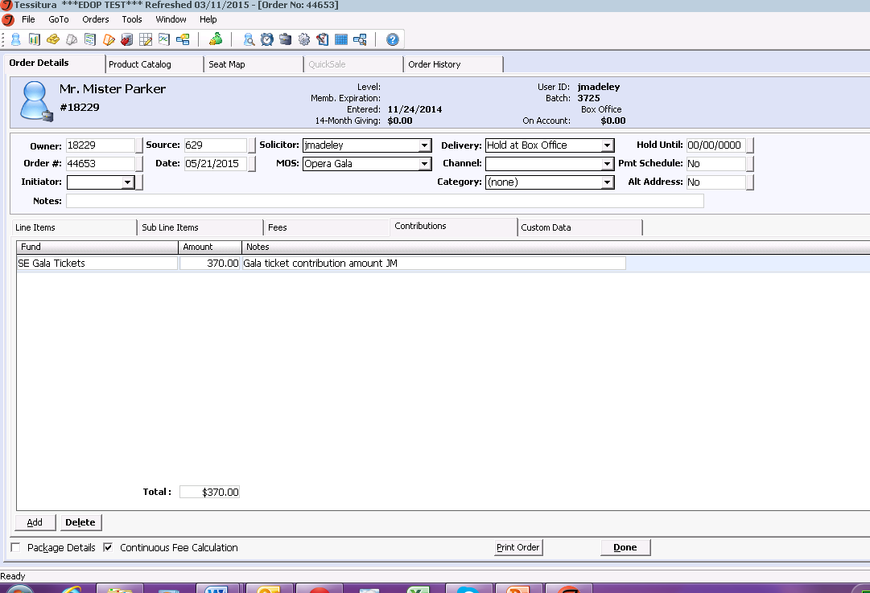
Contributions in the Ticket Order Screen – Opera Gala
Click on the Contribution tab.
Select the fund you want the money to be entered into. We used “SE Gala Tickets”
Enter $370 for the donation amount
Add notes as per your internal policy

Slide 21
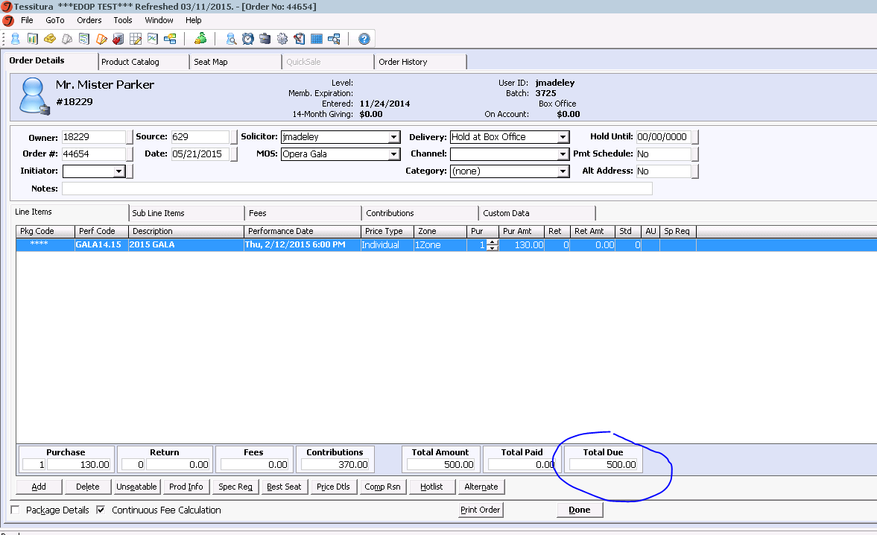
Contributions in the Ticket Order Screen – Opera Gala
Click on Line Items to double check the amount owing is correct
Pay for the order as normal
Note: Gala tickets were only sold manually. They were not set up for web sales.

Slide 22
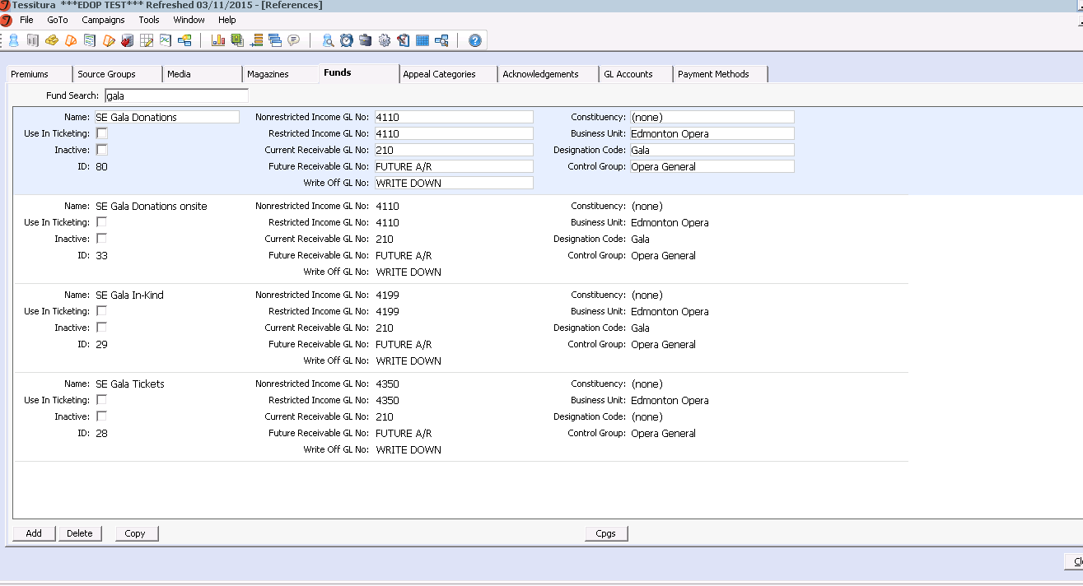
Set-up for Opera Gala tickets
Go To → Campaigns → References → Funds
Make the fund you want the revenue to go into.
I didn’t want these funds to be available for all ticket orders so the “use in ticketing” box is not checked

Slide 23
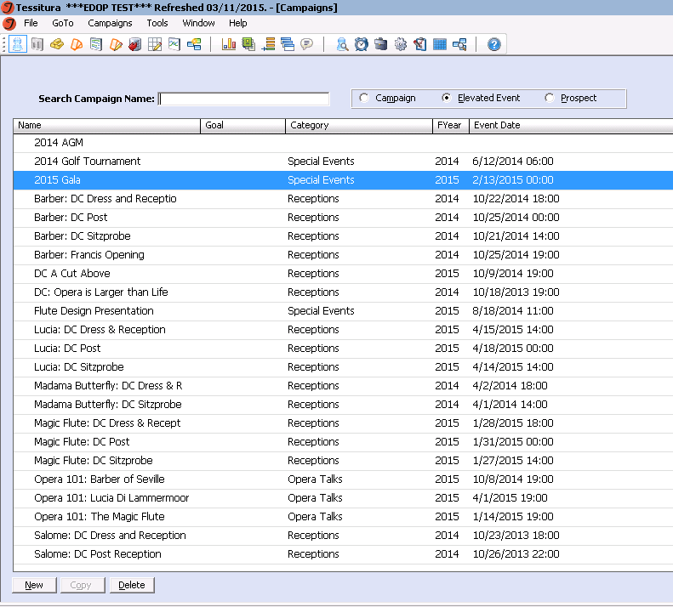
Set-up for Opera Gala tickets
The Gala is actually an Elevated Event in Campaigns

Slide 24
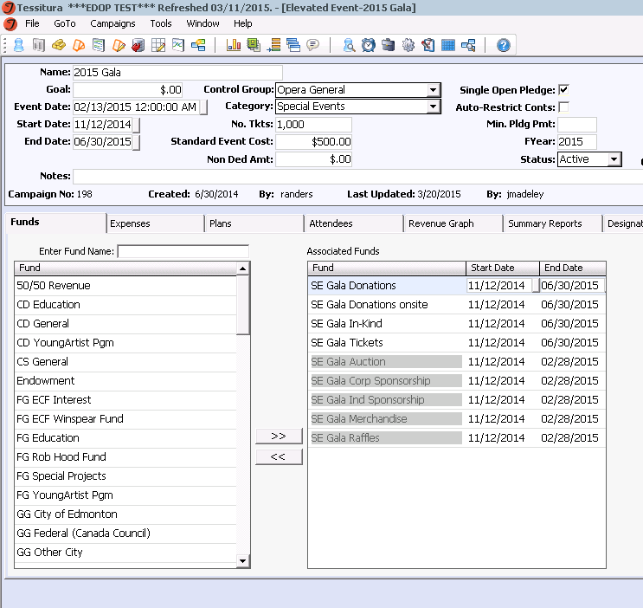
Set-up for Opera Gala tickets
The header is filled out much like a Campaign
Here the funds you want to see in the contribution tab of the ticket order screen are associated with the event. These funds will not appear on other performances that are not affiliated with the elevated event.
Here, you can also track expenses, plans, and see a revenue graph for this event.

Slide 25
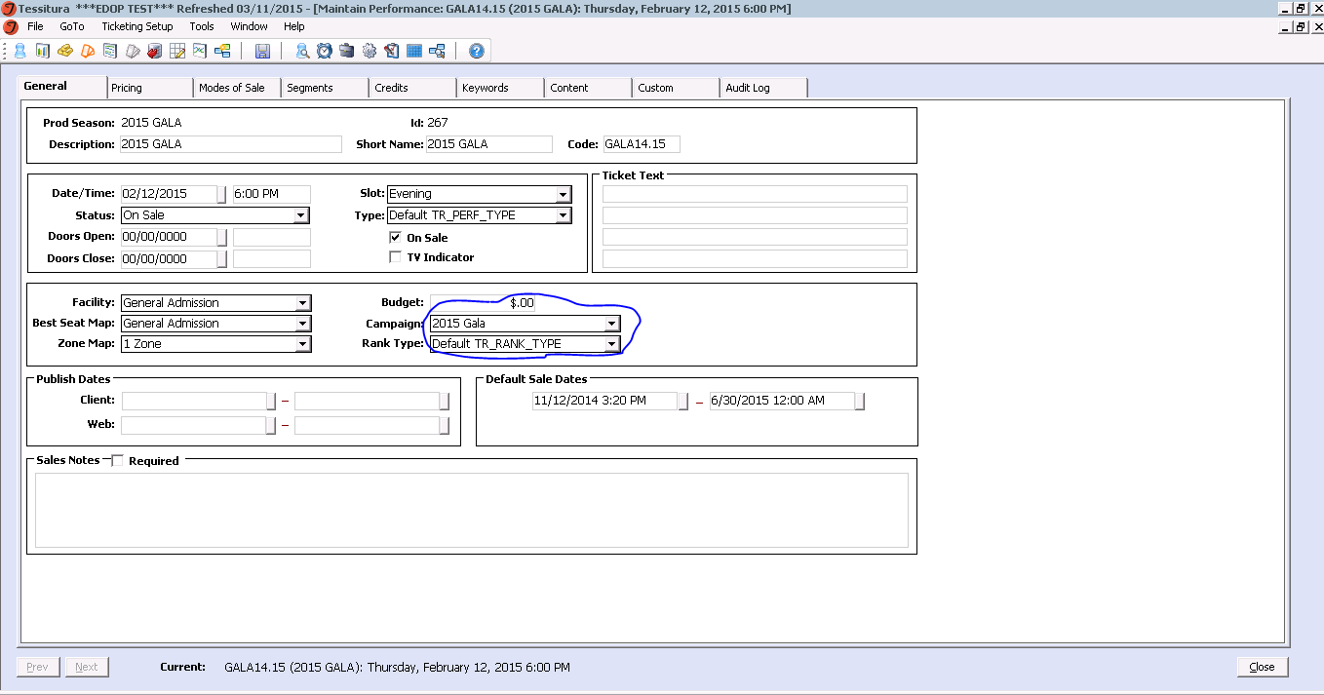
Set-up for Opera Gala tickets
Start building your ticket as usual in ticketing setup
At the performance level, in the campaign field, select your elevated event.

Slide 26
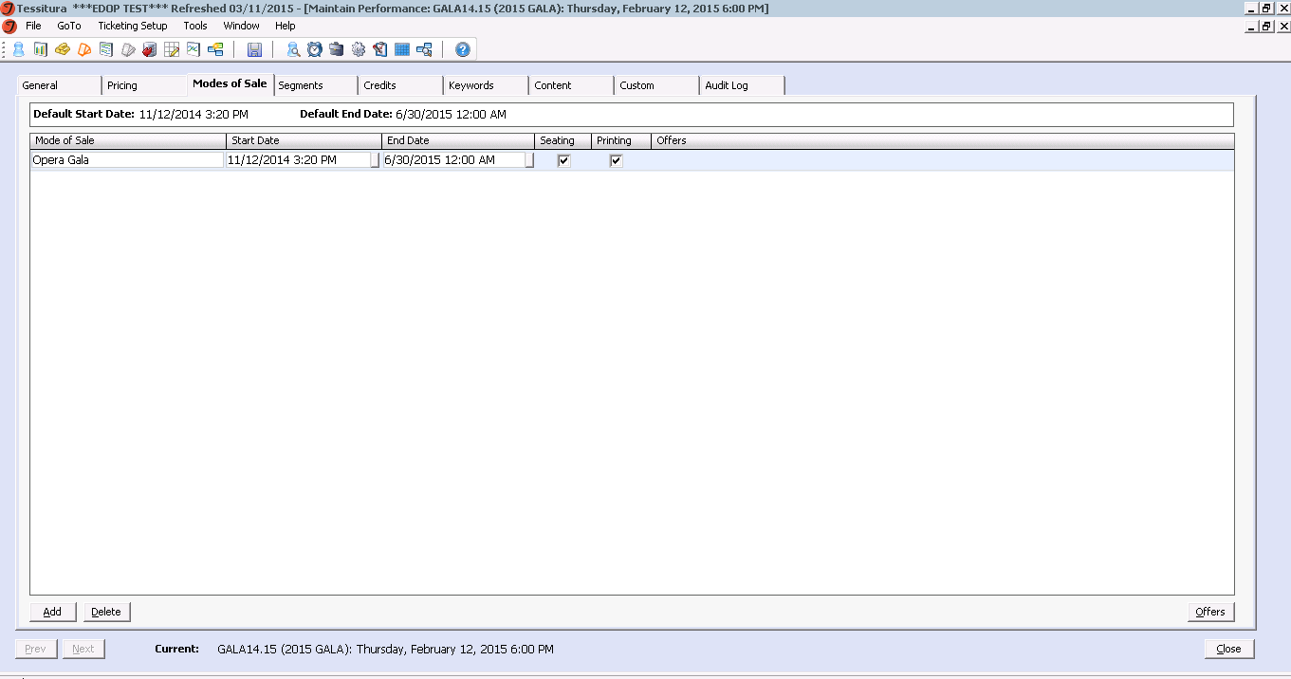
Set-up for Opera Gala tickets
I wanted the Gala tickets to be controlled so I only gave the tickets one mode of sale

Slide 27
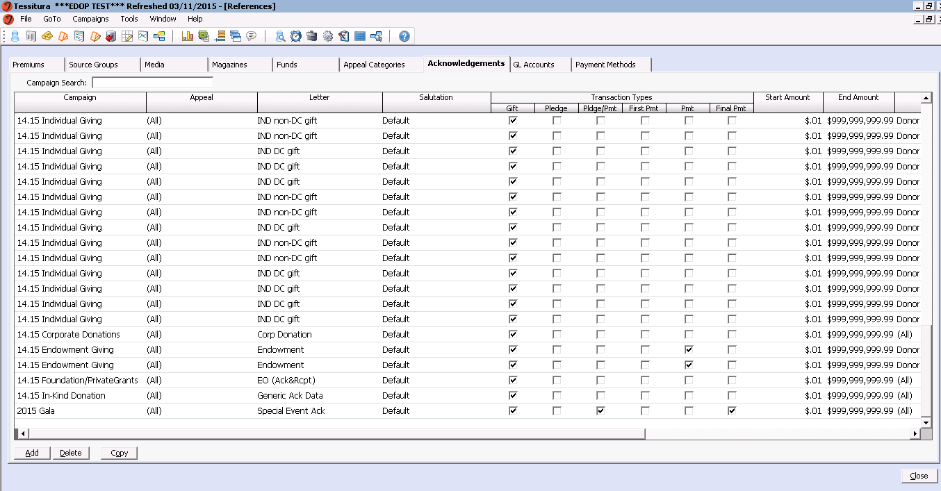
Set-up for Opera Gala tickets
In Campaigns → References → Acknowledgements, create the Acknowledgement you want the fund to trigger when money is entered into that fund, and the applicable membership level
The tax receipt will generate when you run the report “Print Acknowledgement Letters” and the membership level will auto-populate depending on the set-up in the Campaigns → References → Acknowledgements screen.

