Slide 1


CUSTOM REPORTING TIPS AND TRICKS
Liz Blake – Dallas Zoo

Slide 2
INTRODUCTION
Personal Background with Tessitura
Nearly a decade working with the system at multiple venues – AT&T Performing Arts Center, the Perot Museum of Nature and Science, and the Dallas Zoo.
Over five years as a System Administrator at the Dallas Zoo.
Have led the creation of more than a dozen custom reports and utilities to improve efficiency at the Zoo.
Relevant Dallas Zoo Background
​110-acre open-air, general admission venue with approximately 1 million visitors each year.
Thousands of donations are received annually to support the Zoo’s mission of Engaging People & Saving Wildlife.
We have roughly 22,000 members. Currently, memberships are sold through ticketing using the ‘Memberships as Product Add-On’.
The Dallas Zoo converted to Tessitura in October 2017 and works with Tessitura Extended Services for custom reporting needs.

Slide 3
I’ve heard all the potential drawbacks…
No in-house SQL report writer.
Worried about seeing errors following updates.
No documentation for reference on Tessitura Network site.
A custom report is “too expensive” to have built.
HESITANT ABOUT A CUSTOM ANYTHING?

Slide 4
REASONS FOR CUSTOM REPORTING THAT CAN OUTWEIGH THE NEGATIVES
Organizations that have customizations may not be able to use canned reporting fully.
STAFF RESOURCES
CUSTOMER SERVICE
Processes may need to be streamlined to improve the guest experience.
TIME RESTRICTIONS
Timelines do not allow for a slower turnaround but compiling and cleaning data is required.
Custom reporting can easily combine information from different modules (contributions, ticketing, etc.) on demand.
CUSTOM SETUP
IMPROVED ACCURACY
Recurring tasks that utilize too many staff hours cost the organization more money over time.

Slide 5
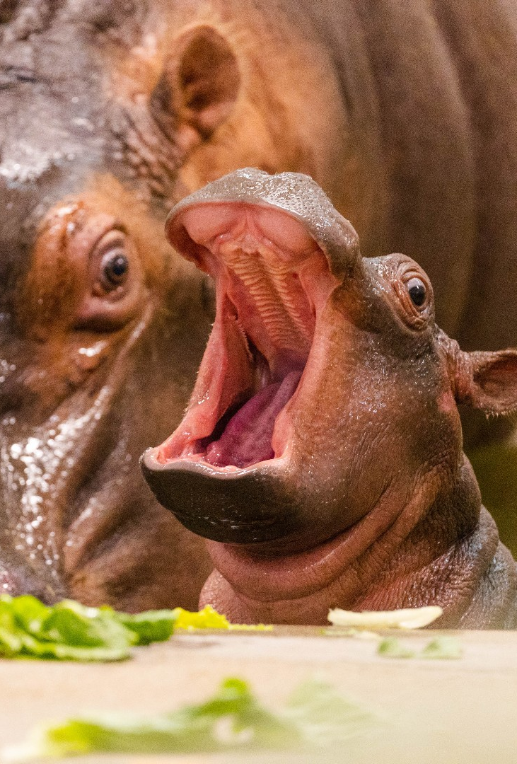
STORY TIME WITH LIZ
Once upon a time… kidding (mostly)
Back in 2017, the Dallas Zoo was one of the first organizations from the Zoos and Aquariums sector to start using Tessitura. The unique ticketing and tracking needs of the zoo meant that customizations were a must at implementation. That also meant that custom reporting would be needed. After my first few meetings with Tessitura Extended Services, I began to notice there was a lot of back and forth about how we wanted to use reporting without much progress on the actual report. That is when I realized that while I couldn’t write the SQL, I could streamline the communications with Extended Services by asking the same questions internally before we submit requests.

Slide 6
HOW TO GET STARTED
IDENTIFY PROCESS
CONSULT INTERNALLY
OUTLINE REPORT
Keeping in mind the pros that could outweigh the cons of custom reporting, look for areas that need streamlining.
Once a process that would benefit from custom reporting has been identified, check in with the report writer to ensure that your idea is feasible.
Meet with the people currently involved with the process and go through the steps together.
Pinpoint the steps that can be eliminated or expedited with the desired report.
Ask “Is there anything missing from the current process?”
Compile the information into an outline for the report writer.
The outline provides the context needed for the consultant to give a more accurate estimate of the time it will take to create.
This guides the testing and revisions reducing the back-and-forth questions.

Slide 7
OUTLINE BASICS
Summary
Summarize how the report will be used in the organization. This gives context to the request that will reduce follow up questions.
Parameters
List any parameters needed to identify the constituents included in the report or modify the output format. Note if a field is required and how the parameter information is entered.
Output
Describe how the rows should be output – one row per constituent, one row per order, etc. List the columns needed and define how the information should appear if necessary.
Additions
Note any additional report requirements such as a summary section, any needed suppressions, or making columns sortable.

Slide 8
Once the request is submitted, the report writer will let you know when the initial draft of the report is available for review.
This is when the real fun begins – TESTING TIME!!

Slide 9
Have one main point of contact to answer any follow up questions from the report writer. Too many people responding can lead to contradicting instructions and use more of the consultant’s time.
Test the report with real-world scenarios whenever possible.
Don’t be afraid to change things as you go through testing and discover additional functionality or reporting needs.
Be patient. The report won’t be perfect the first time. Expect multiple rounds of testing and revisions.
REVISING AND TESTING TIPS

Slide 10
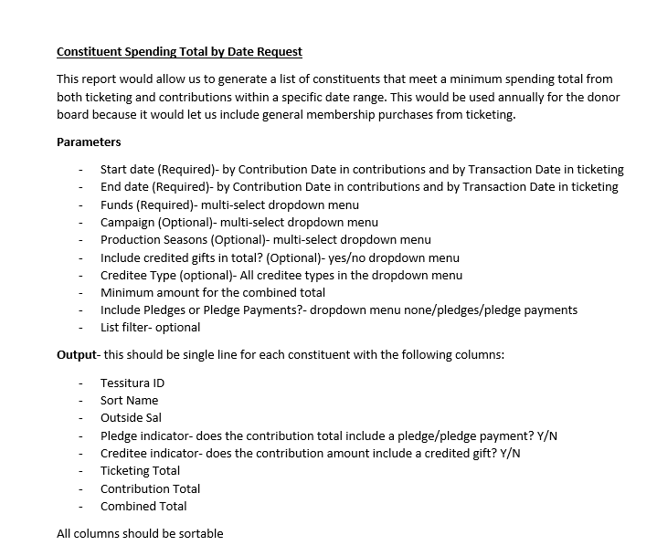
EXAMPLE REPORT
REQUEST
The goal of this request was to improve the process for creating the annual Donor Board display.
Remember that this is just the starting point. Changes will happen in the testing phase.

Slide 11
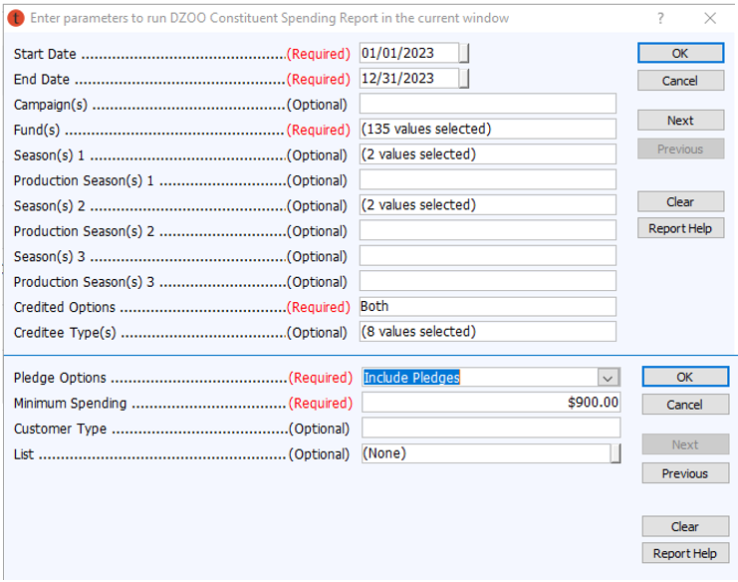
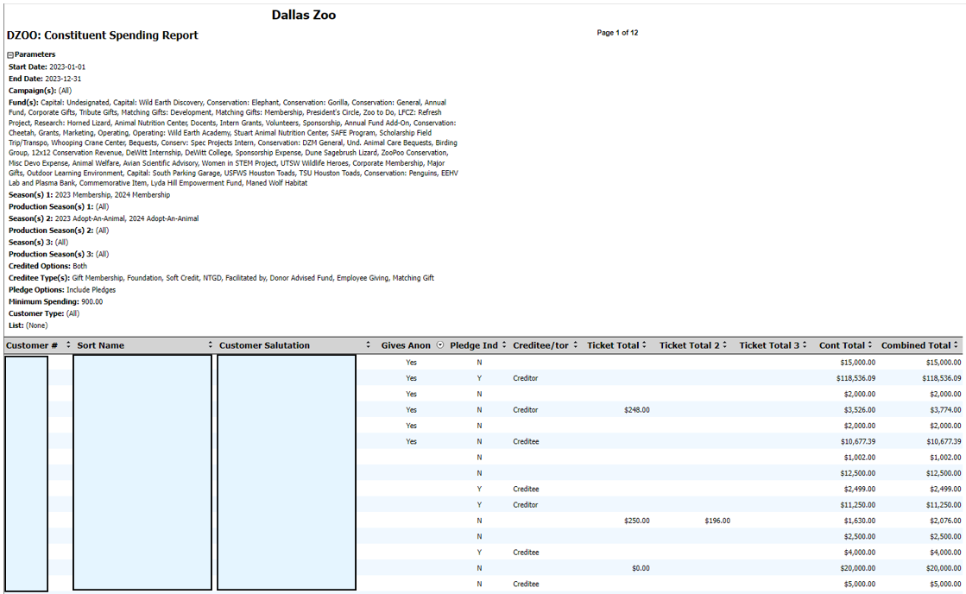
FINAL REPORT
PARAMETERS
OUTPUT

Slide 12
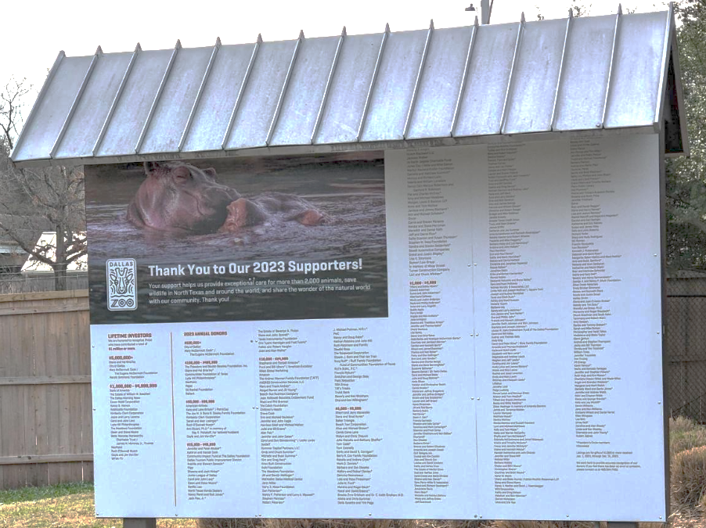
RESULTS
This year’s donor board list was able to be pulled from Tessitura and reviewed to send to marketing in less than two weeks.
Fewer edits needed to be made during the design review by the Marketing and Advancement Teams.
Staff and Board member feedback on this year’s process was overwhelmingly (if not entirely) positive.
The total number of staff hours spent has been reduced by more than 85% compared to before the report’s creation.

Slide 13
Use the native functionality of Tessitura whenever possible.
Custom reporting will not fix poor data entry. Cleaning data could be the solution to your problem or could be required for a custom report to work.
When possible, start with an already existing report. It is usually easier for the report writer to add columns or parameters than it is to create a report from scratch
Always add a “List Filter” parameter. You will need it at some point.
For utilities that make system updates, always request a “Review Mode” parameter.
FINAL TIPS

Slide 14
SUMMARY
Despite the potential expense, when approached thoughtfully, custom reporting can not only improve workflow and the guest experience but can also save your organization money.

Slide 15
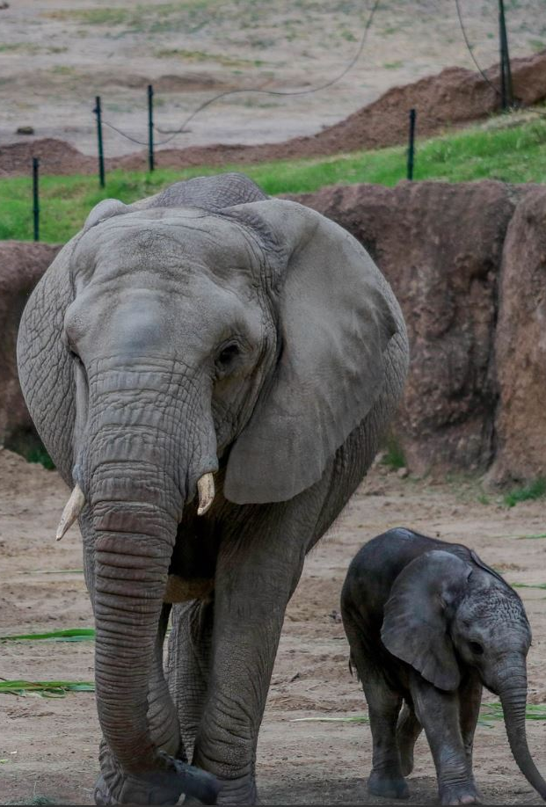
THANK YOU
Liz Blake
liz.blake@dallaszoo.com

