Slide 1
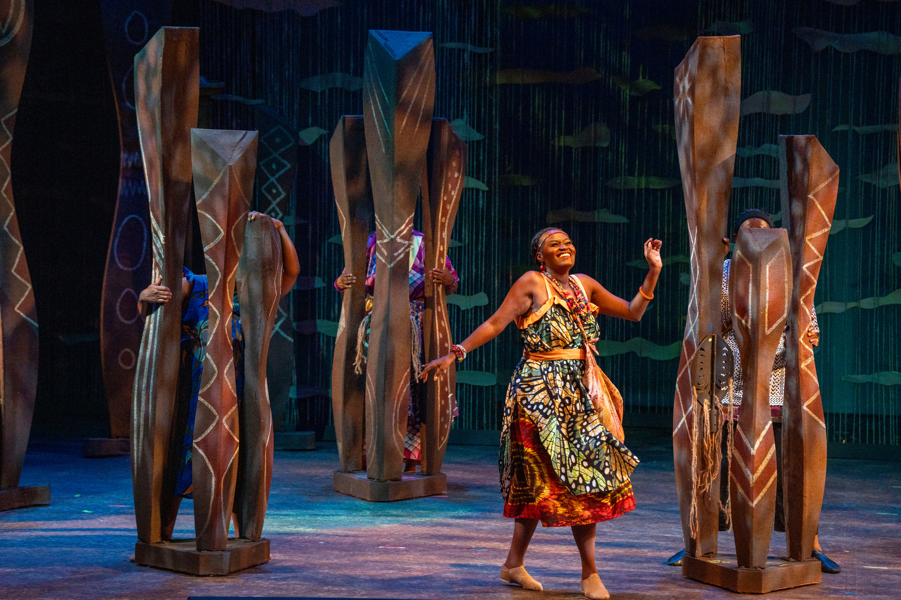

ADJUSTING TO A DYNAMIC PRICING MODEL
Presented by Mallory Coulter, Dir of Mktg

Slide 2

Background
40 Years of Static Pricing
A Year of Change
Low Turnover & Steady Prices
The TYA Challenge

Slide 3

TELLING THE STORY OF DCT TO DCT
WINNING OVER INTERNAL STAKEHOLDERS

Slide 4

Deep Data Diving
Understanding current buying patterns is key to finding your new starting point. We utilized extractions and the Performance Sales Summary by Price Type report to build the data set for our show forecasts and buyer modeling.
The Starting Point

Slide 5
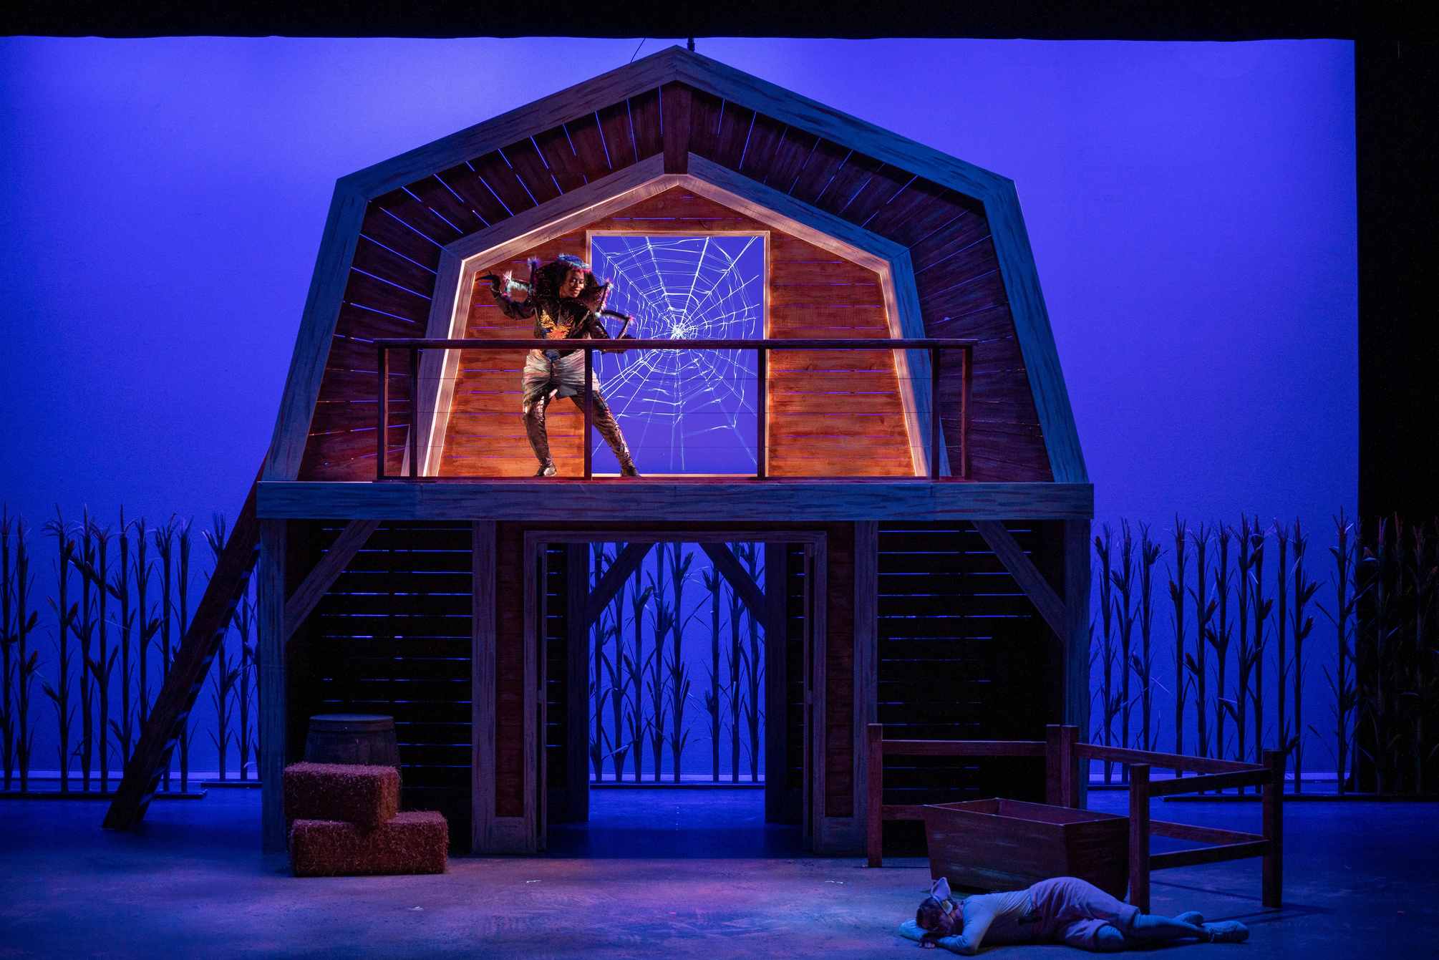
IMPLEMENTATION

Slide 6
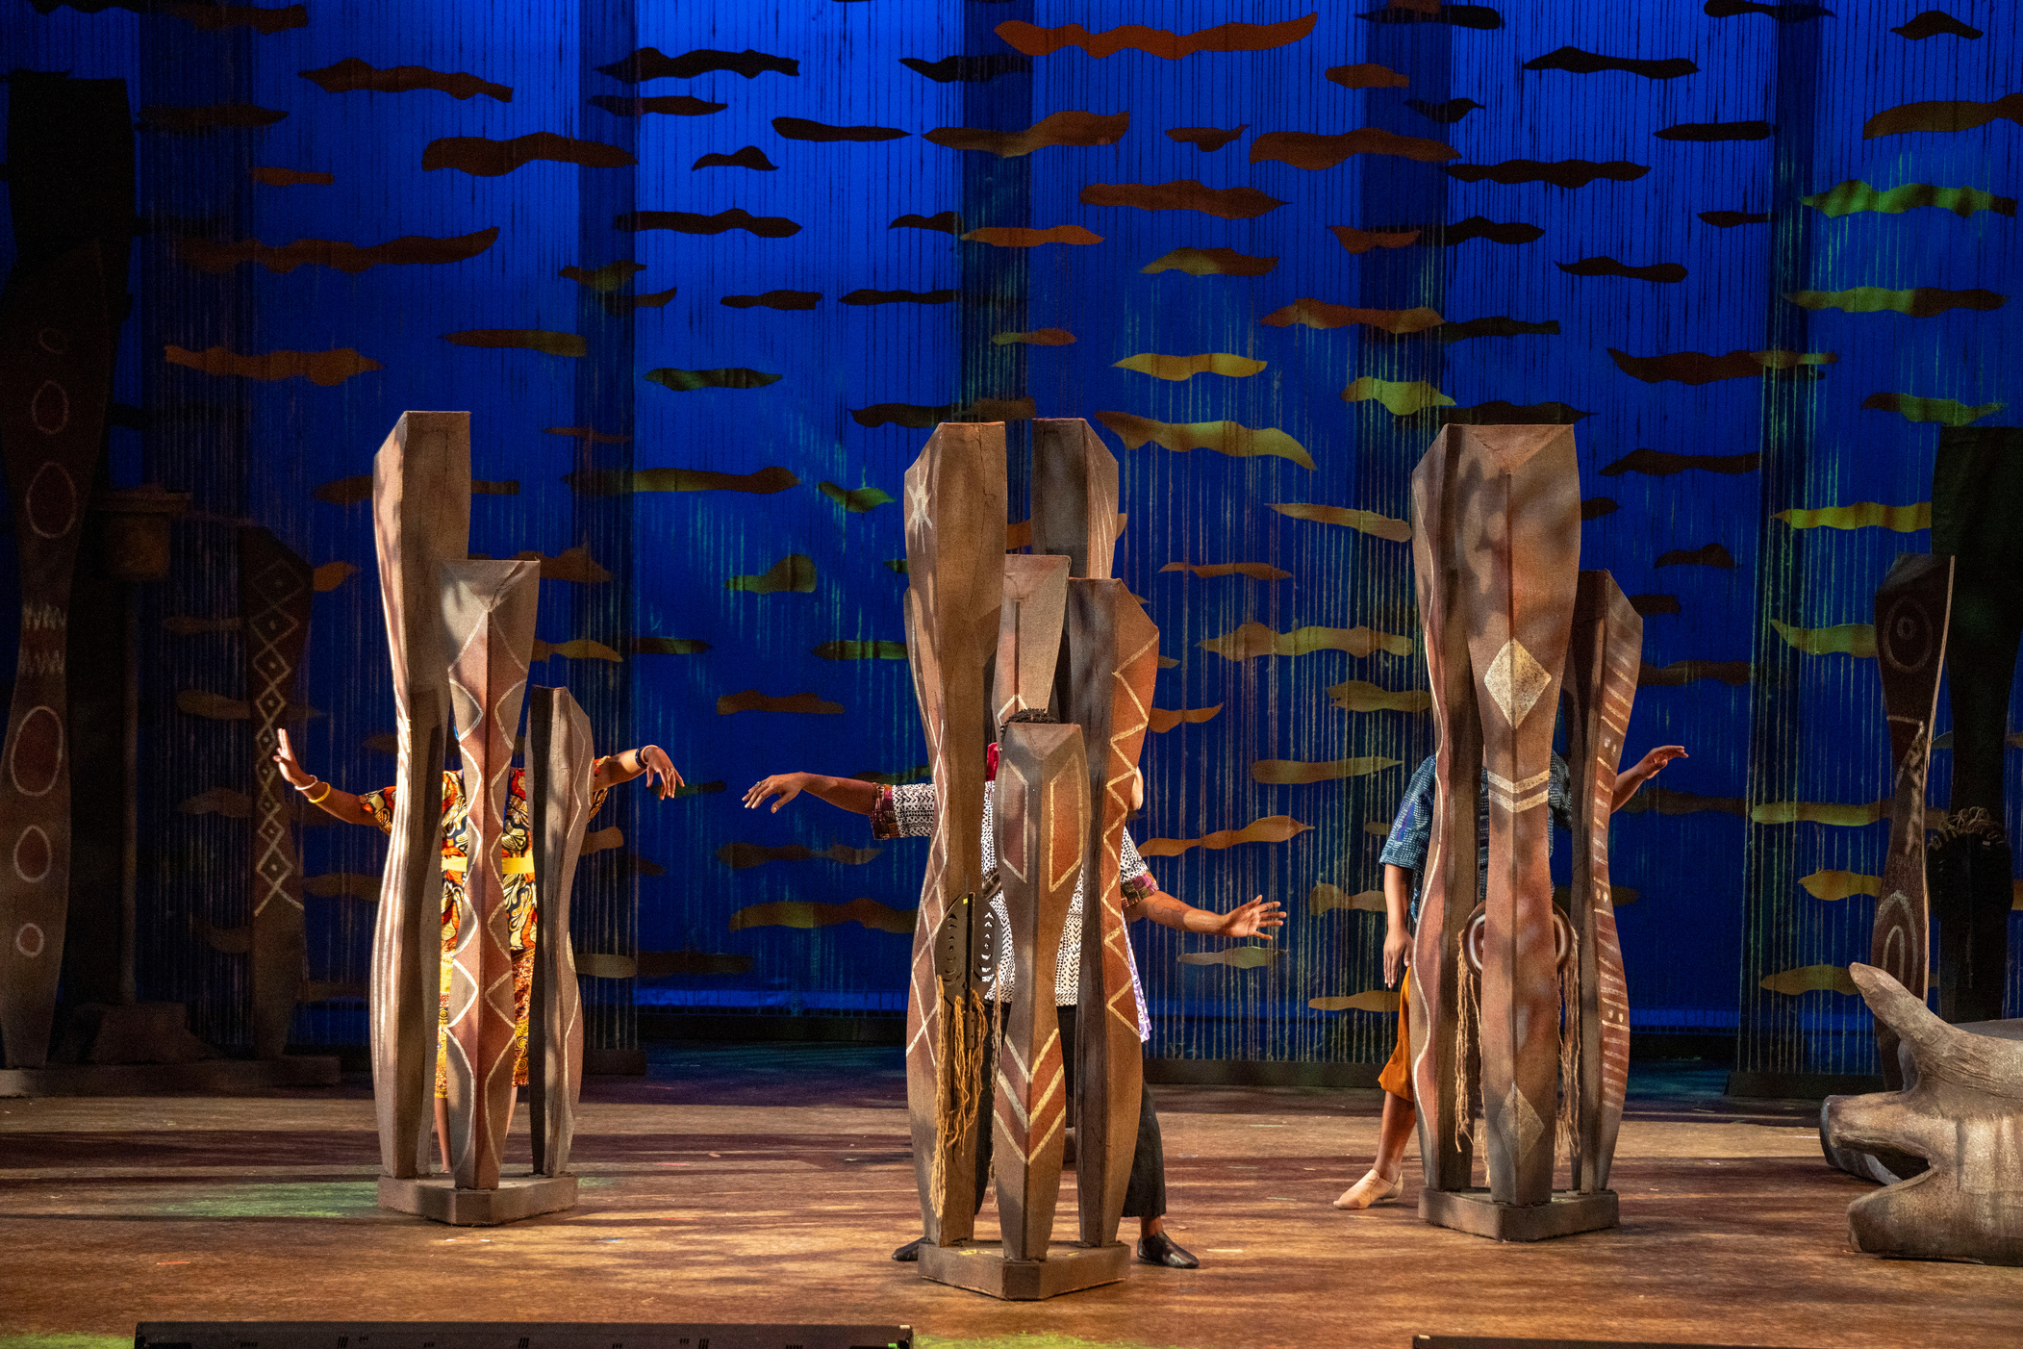
COMMUNICATION
Ensuring non-ticketing staff are well educated on new protocols.
REASSURANCE
The front line staff should know they are supported as patrons are encountering this change.
PROCESS AND DOCUMENT
Utilizing Tessitura functionality that was new to DCT allowed for a smooth transition that ensured leadership was aware of patron response.
Preparing the Box Office

Slide 7
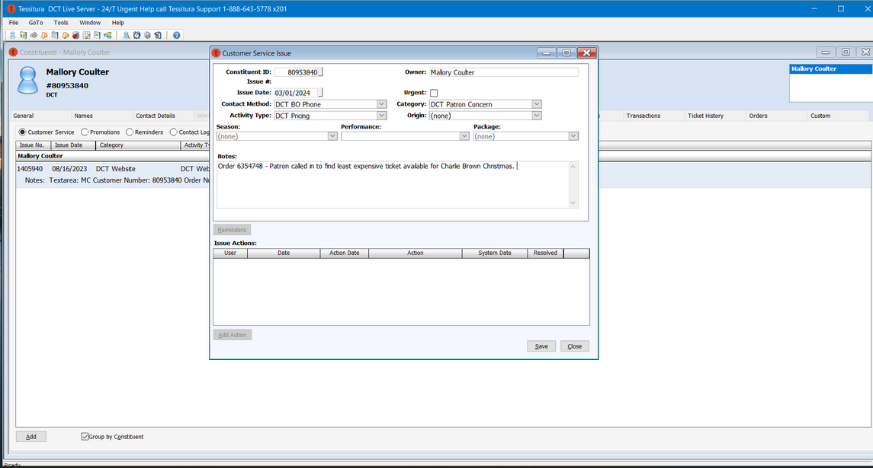
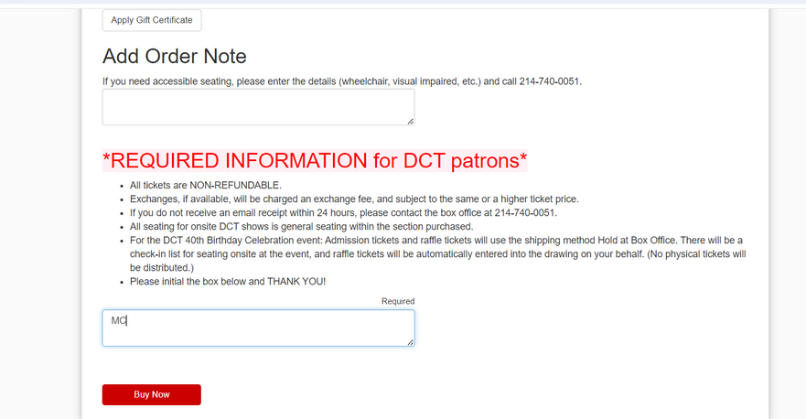
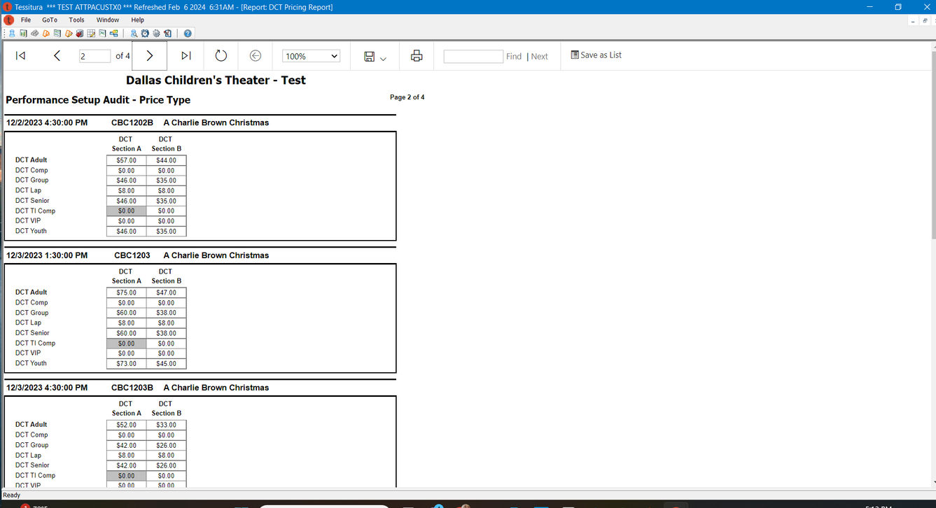
CSI ENTRY
TNEW
REPORTING
DCT implemented new CSI protocols to track patron feedback
Additional language and disclosures were added to the purchase path
A custom report was built to allow the box office team to quickly identify specific price availability
THE TOOLKIT

Slide 8

CSI Entry
Organizing Patron Feedback
New Contact Methods, Categories & Activity Types that were specific to patron feedback about pricing were created to track response.

Slide 9
TNEW Updates
Patrons are now required to initial to acknowledge potential price differences in ticket exchanges.

Slide 10
Updated Reporting
A custom report now enables the box office to quickly scan for the lowest price or a specific price point a patron has requested.

Slide 11
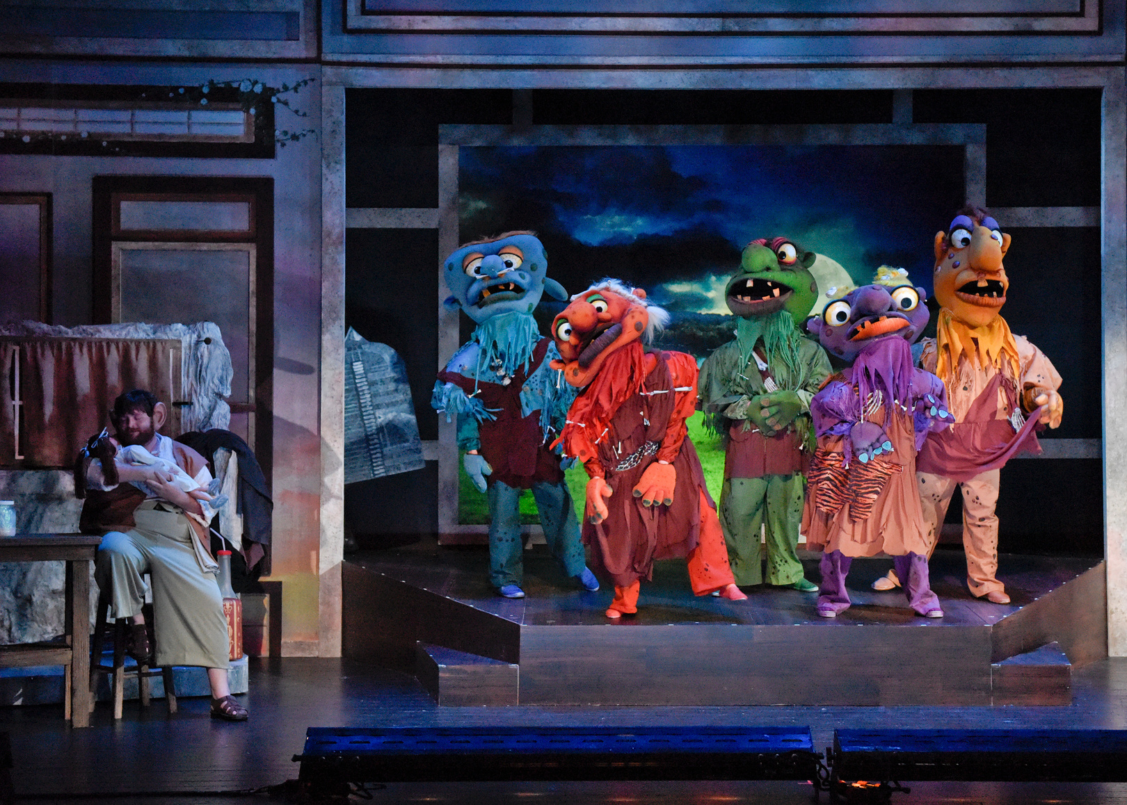

Increased Revenue
Better Houses
Responsive pricing has allowed us to fill in less popular performance times, creating fuller houses for our late matinees
DCT was able to quickly increase YOY ticket income, nearly doubling the previous year’s Holiday revenue
Fundraising Education
Lower No Show Rates
Speaking more directly to our patrons about the financial realities of the performing arts sector has opened up new opportunities for giving and donor cultivation
Our no show rates have decreased substantially and our late arrivals have decreased as patrons now perceive the value of their tickets differently
RESULTS

Slide 12
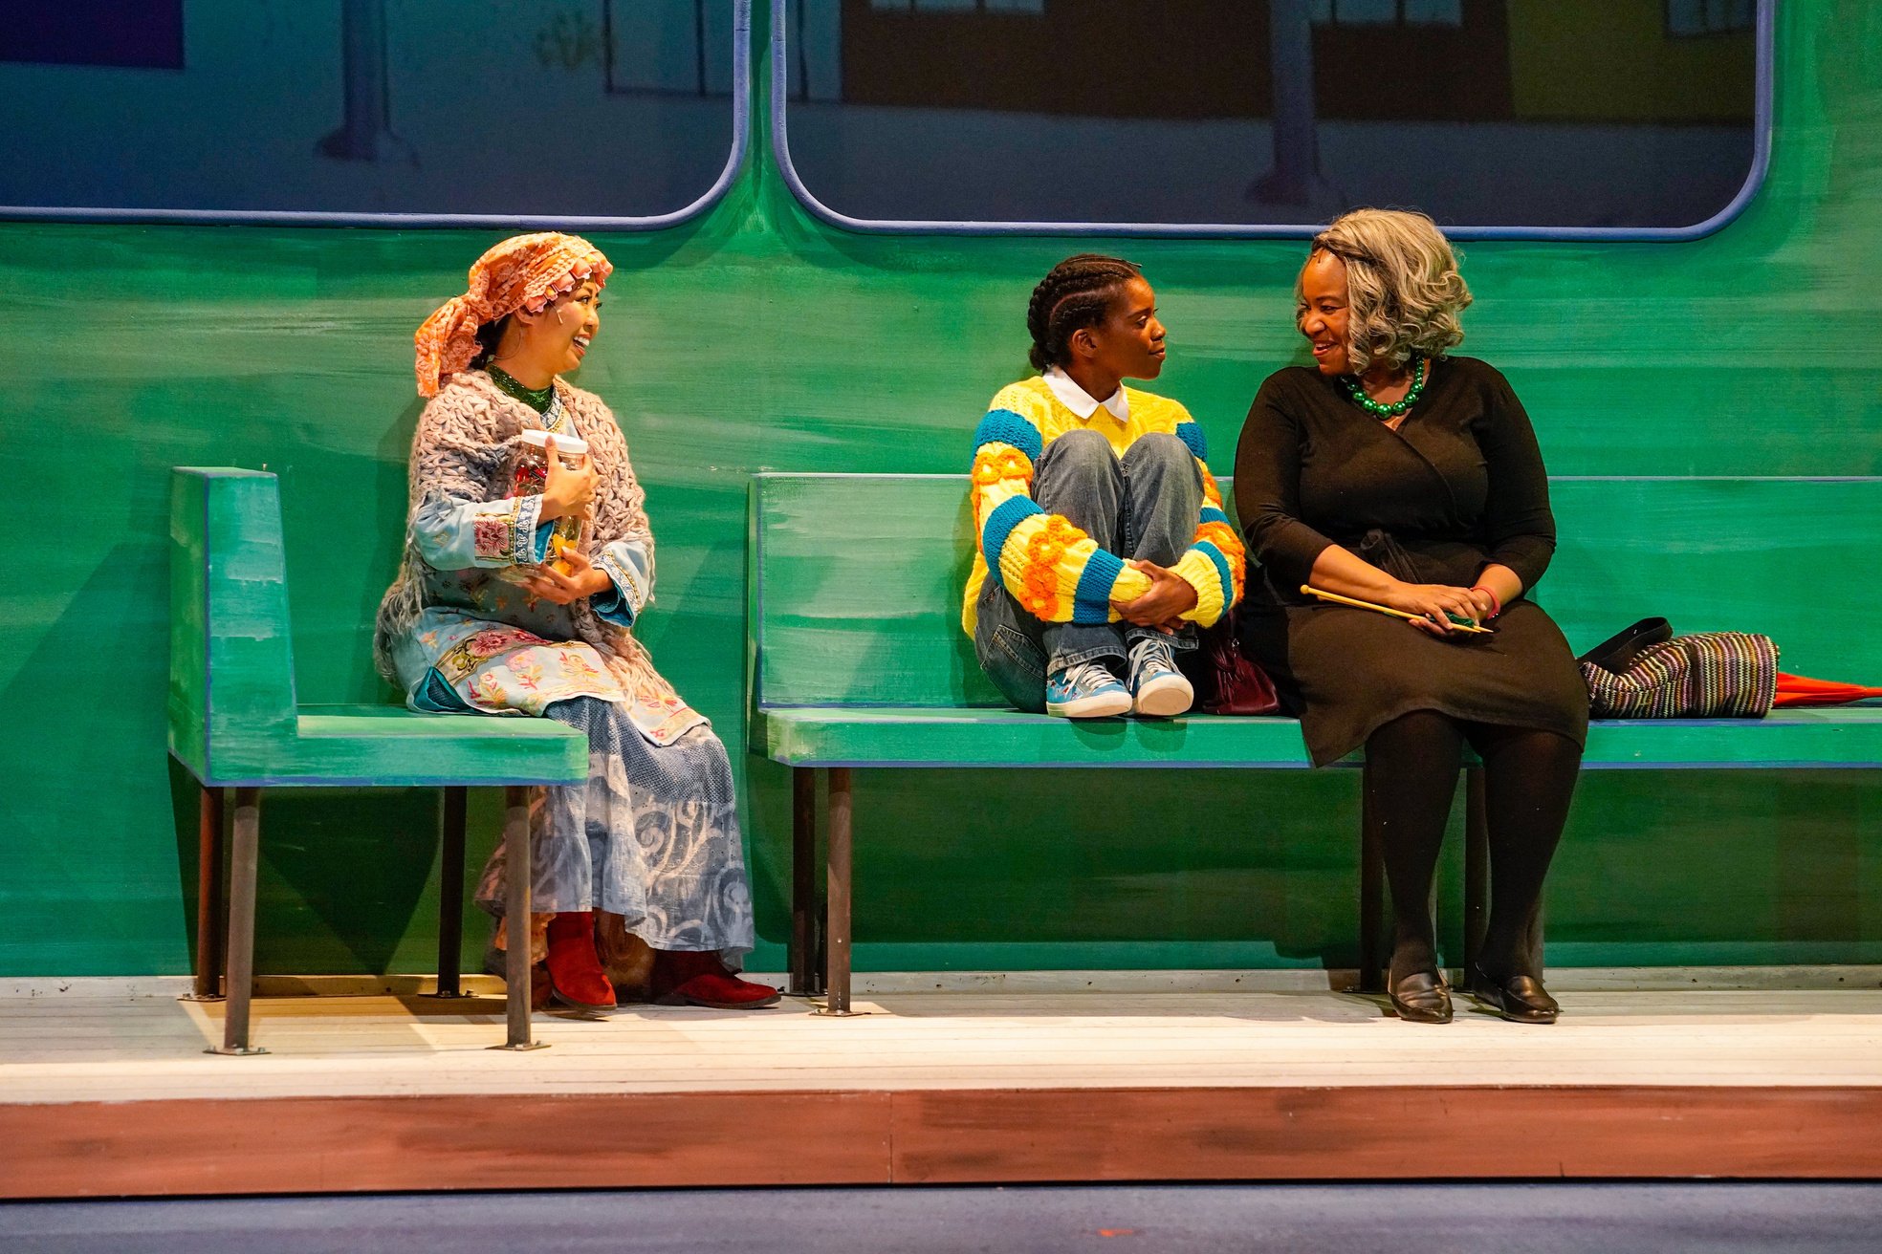
SUCCESS AND CHALLENGES
DCT’s utilization of a dynamic pricing strategy had the unintended consequence of broadening Tessitura utilization. Continuing to enhance our reporting and tracking metrics will only increase the effectiveness of our pricing strategy.

