Slide 1



Slide 2
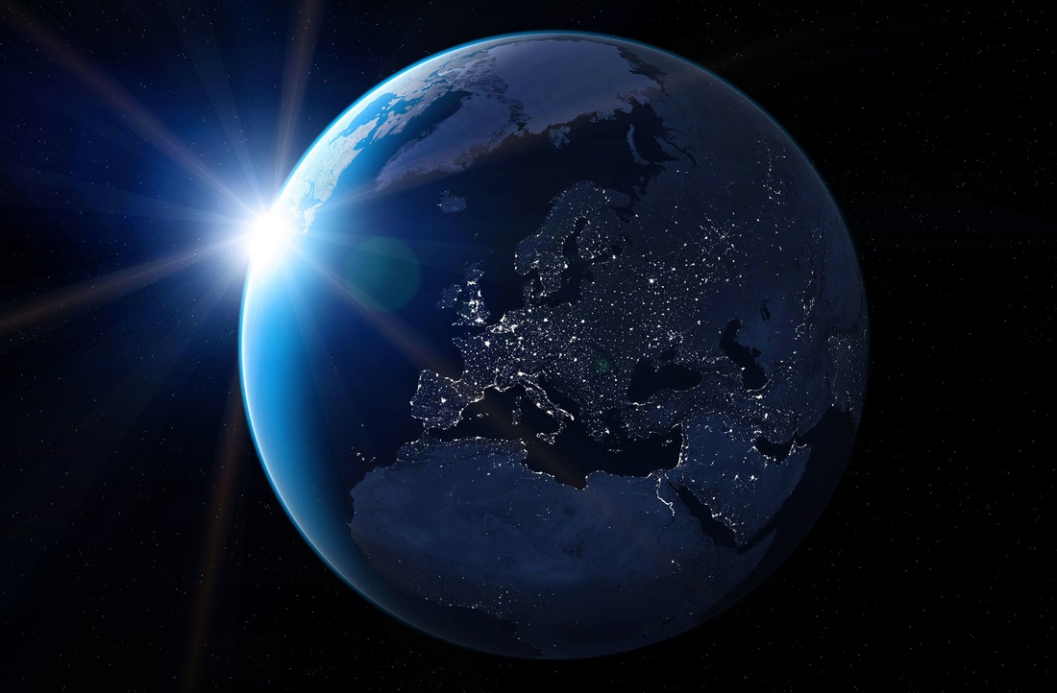
Our Purpose
We enable companies to grow their social, cultural and economic impact in the world.
Notes:
But ultimately everything we do comes down to one common driver, and that's our purpose. It's our why -- why Lifeblue exists; the reason we get up in the morning and do what we do.
Even if we are building websites, creating the next content management system, transforming a business, or hell even mining the next bitcoin, we should do it under this common purpose.

Slide 3
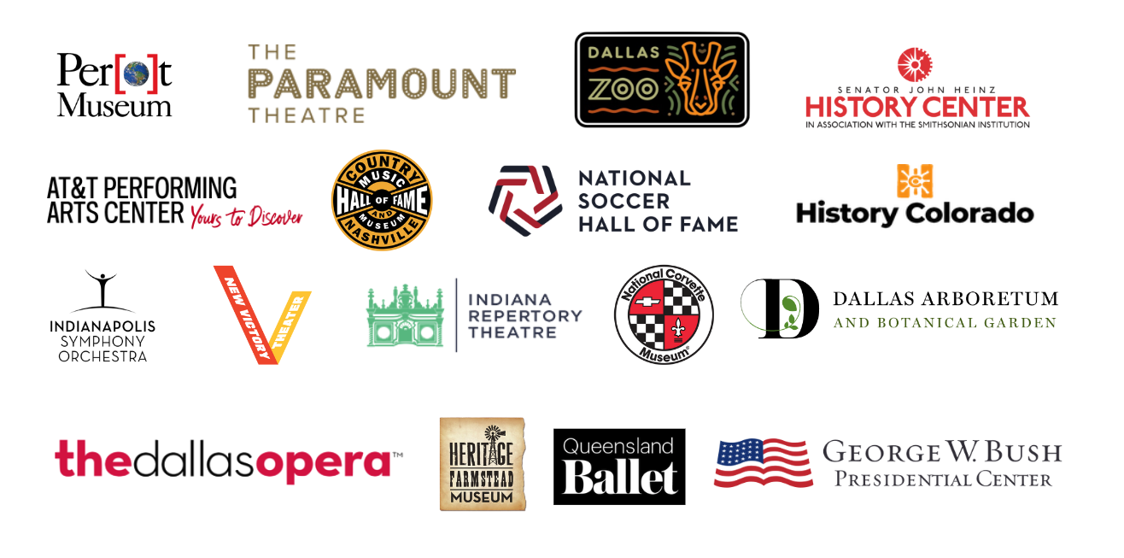
Just a Few Folks We Call Friends
Notes:
Add legacy Texas; city of hope

Slide 4
THE LANDSCAPE

Slide 5

ALL ABOUT ME
ACTUALLY IT EVEN DOUBLED DOWN, AND IS NOW IN HYPER SPEED
PERSONALIZATION AND CUSTOMIZATION

Slide 6
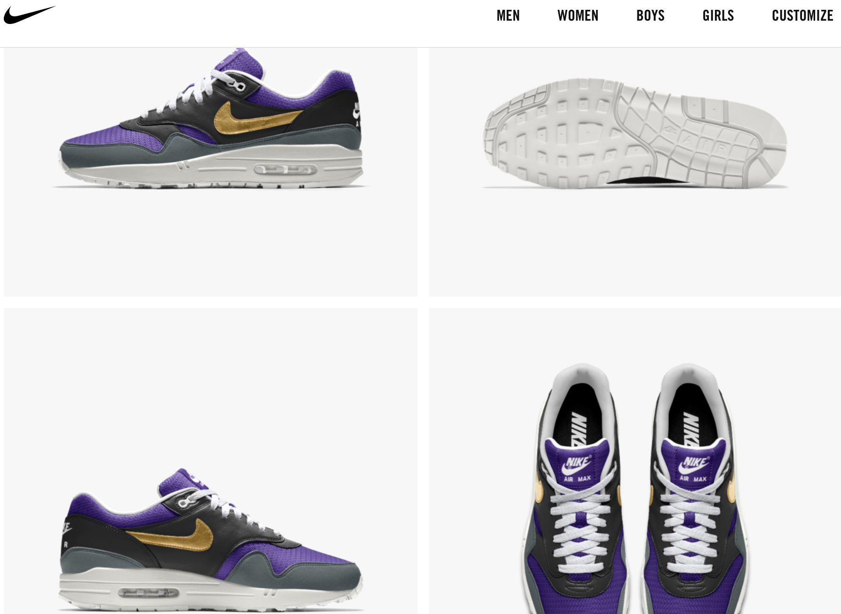
BRANDS THAT EMBRACE ME ARE WINNING
REALIZING MY NEEDS AND PUTTING THEM FIRST IS THE RECIPE TO BUSINESS SUCCESS

Slide 7



WHAT DOES THIS MEAN TO YOU
You must keep up with consumer expectations that come from user-first models that deliver better experiences.

Slide 8
Overcoming Reality
2.4
Average times someone visits the same cultural institution in a lifetime.

Slide 9
EVERYTHING IS AN
EXPERIENCE

Slide 10
EXPERIENCE
IS EVERYTHING

Slide 11
LIFEBLUE
GUIDE TO
THE FUTURE
AND BY FUTURE WE MEAN PRESENT

Slide 12
Know Your Customers
Step 1

Slide 13


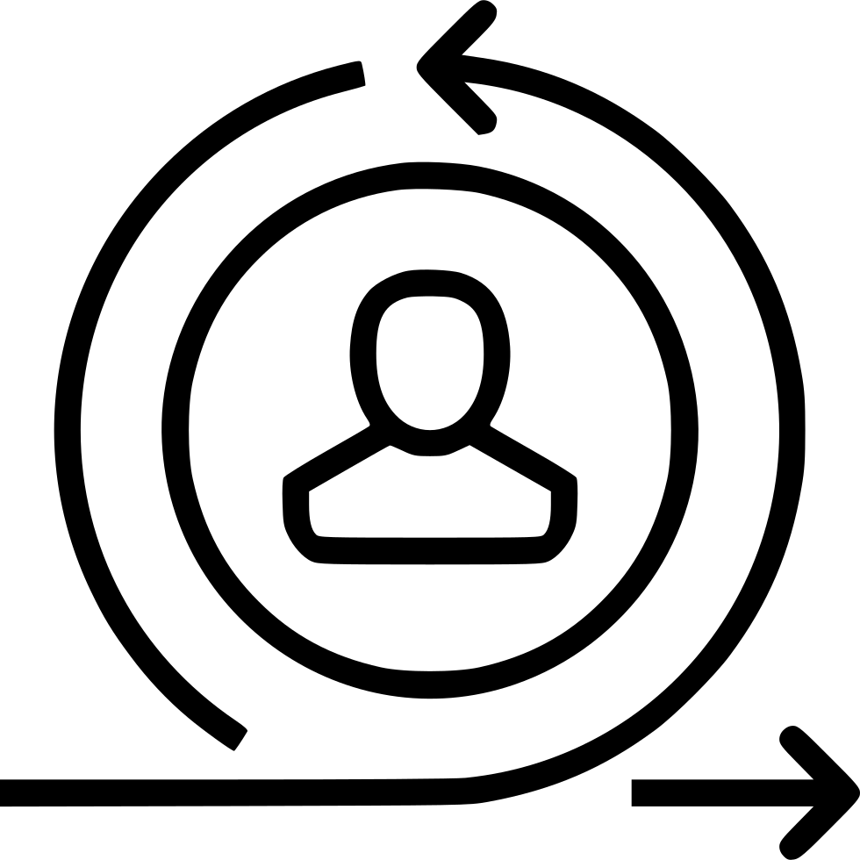

SERVING THE MASSES TO SURFACE THE FEW
. PERSONALIZED FAN ENRICHMENT LEADS TO INCREASED REVENUE AND ENGAGEMENT FOR ORGANIZATIONS.
Connections
Affluent
Neighbors
Returning vs. New

Slide 14
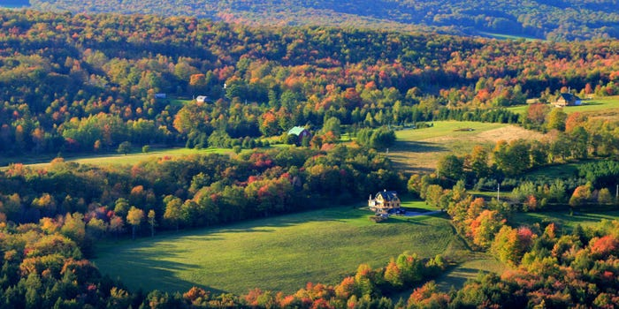
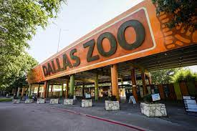

PLACESHIFTING
FROM THE SUBURBAN SPRAWL TO WORK FROM ANYWHERE
Notes:
Maybe felt even more, the movement from cities, how do you get fans to come to events in your area

Slide 15
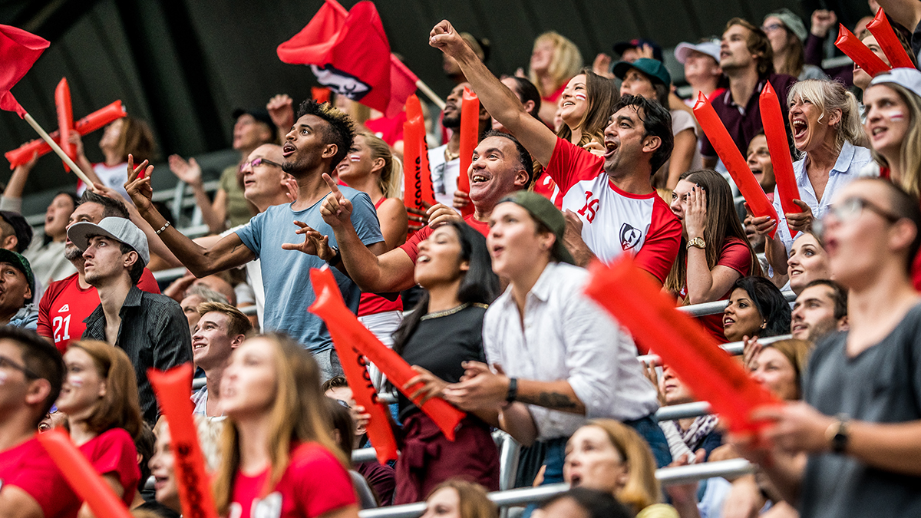
BE IN THE MOMENT
PLANNING AHEAD
Today
Tomorrow
This Weekend
Average amount of time before an event a person plans.
Notes:
How far in advance does an average person plan?

Slide 16
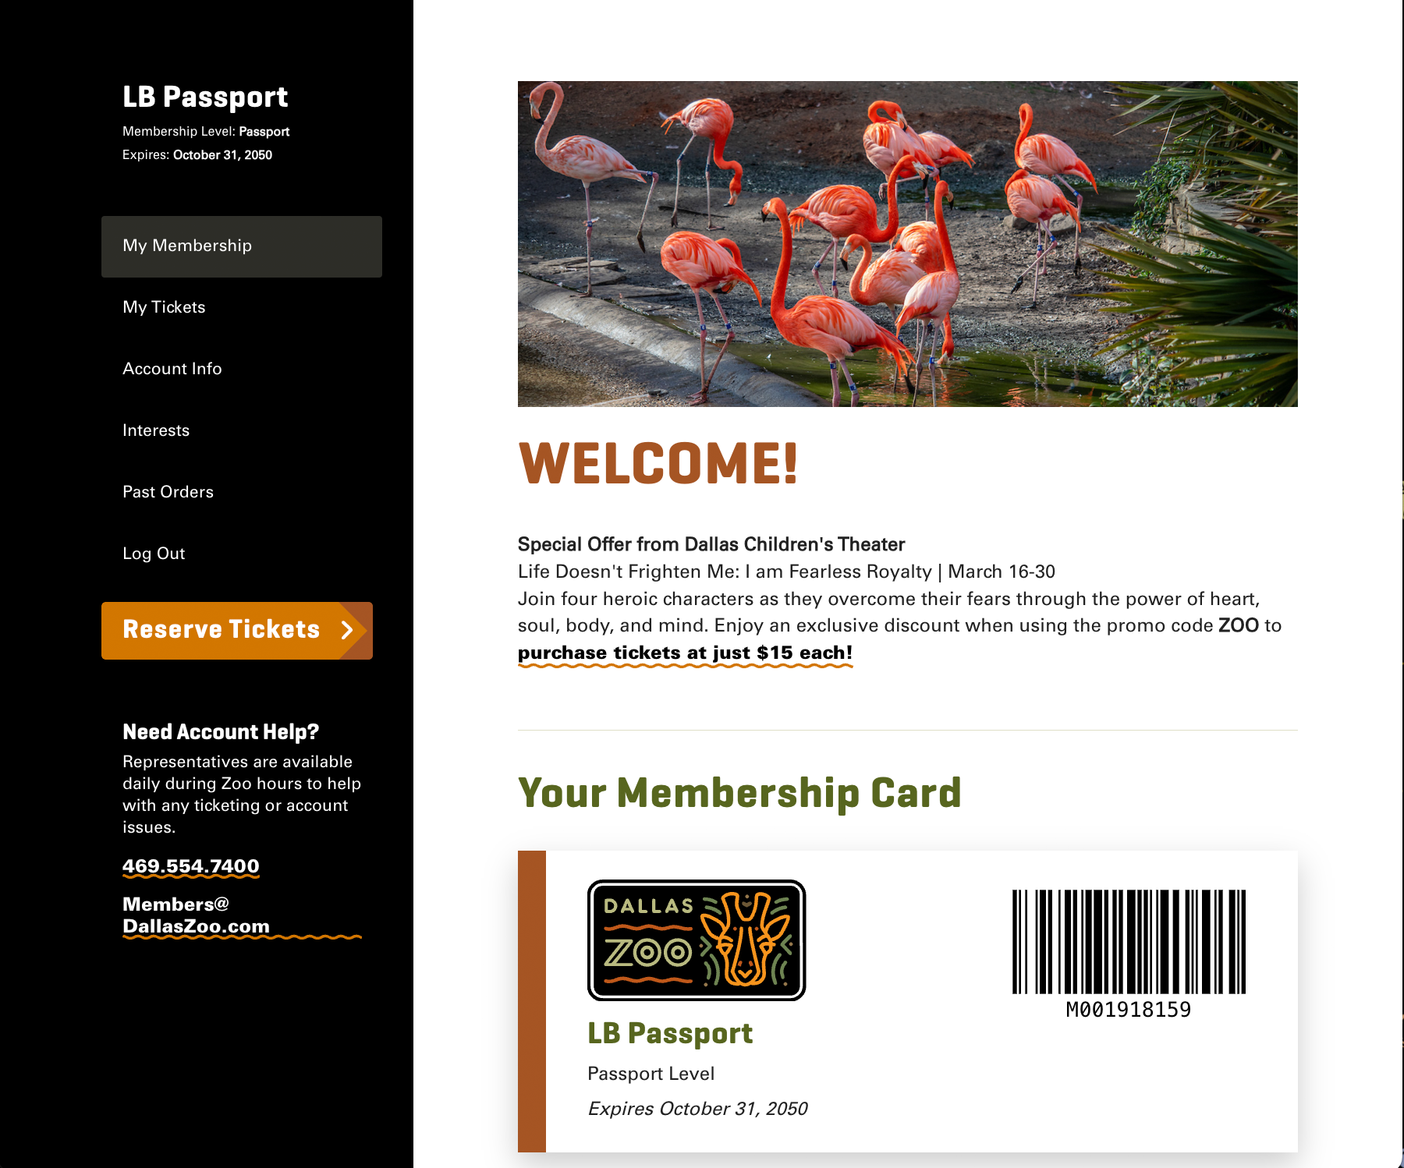
PERSONALIZE THEIR EXPERIENCE
HARNESS THE POWER OF DIGITAL FOR YOUR ULTIMATE GAIN

Slide 17
Make Friendship Soup
Step 2

Slide 18
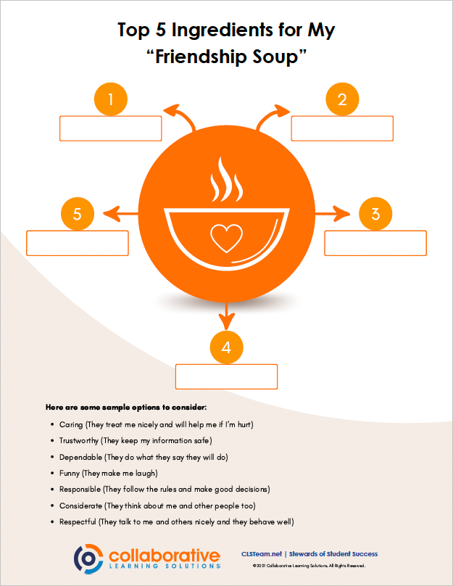
Notes:
Has anyone ever done improv comedy?
At our company we actually used to have an improv comedy club come and teach us for a day, the art and science of improv comedy. And there are two parlells that jump out to me about what the last 2 years has taught us and what we have come to know in our society today.
Improv is all about embracing the moment, never anticipating what was going to happen next, and listening before reacting, and they tell you the more chaotic it is, the more you just have to go with it.

Slide 19
SPEED MATTERS
CONSUMERS ARE VERY GENEROUS IN STICKING WITH IT
SPEED SCORE
# OF CLICKS
F
16
Average time for server and system to react is over 12 seconds. You should try and be under 3 seconds.
Average clicks to get to a transaction. With modern devices, you should strive for less than 6.

Slide 20
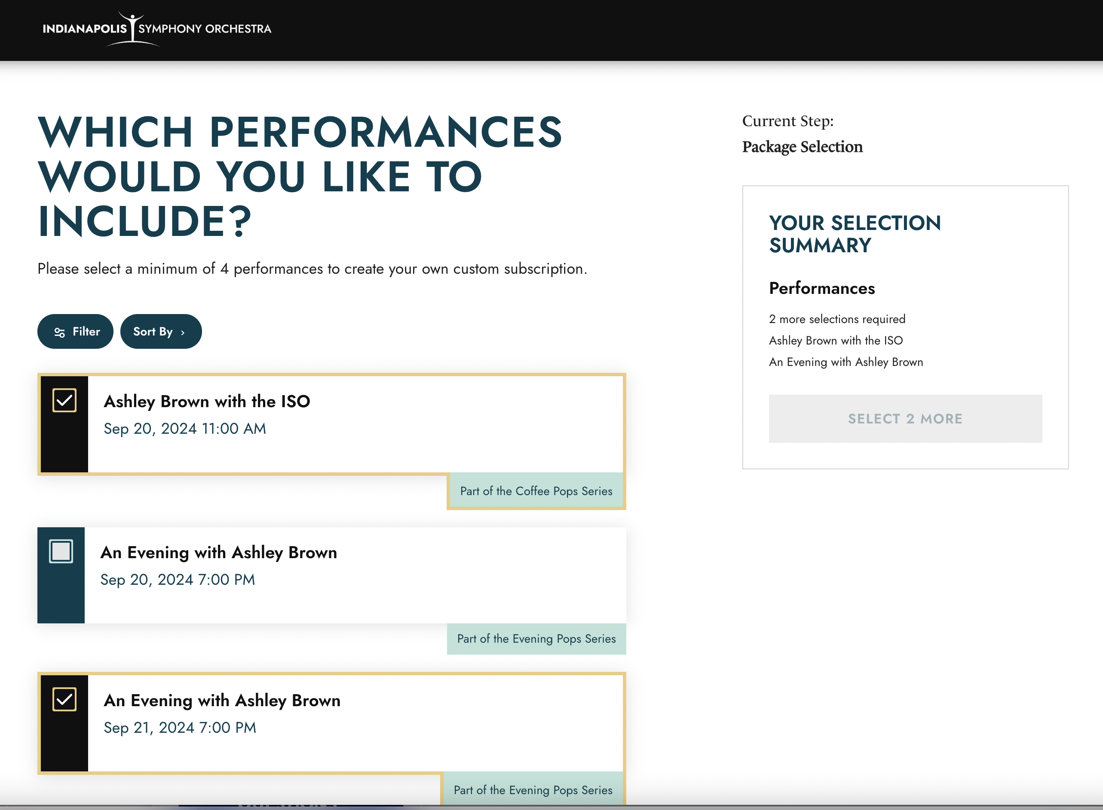
A FRIEND LISTENS AND REACTS
BEING FLEXIBLE IS KEY

Slide 21
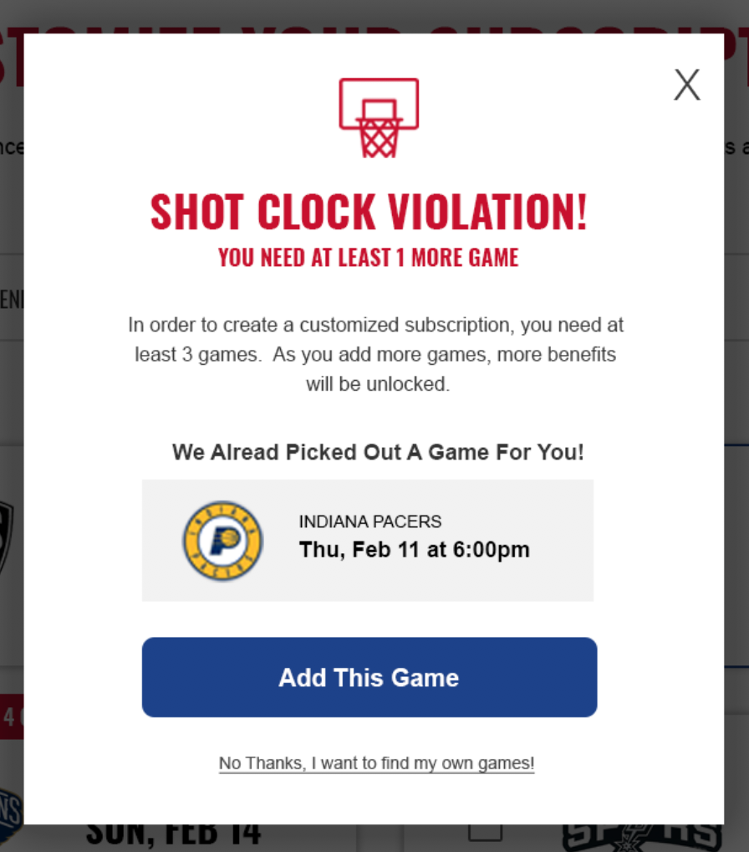
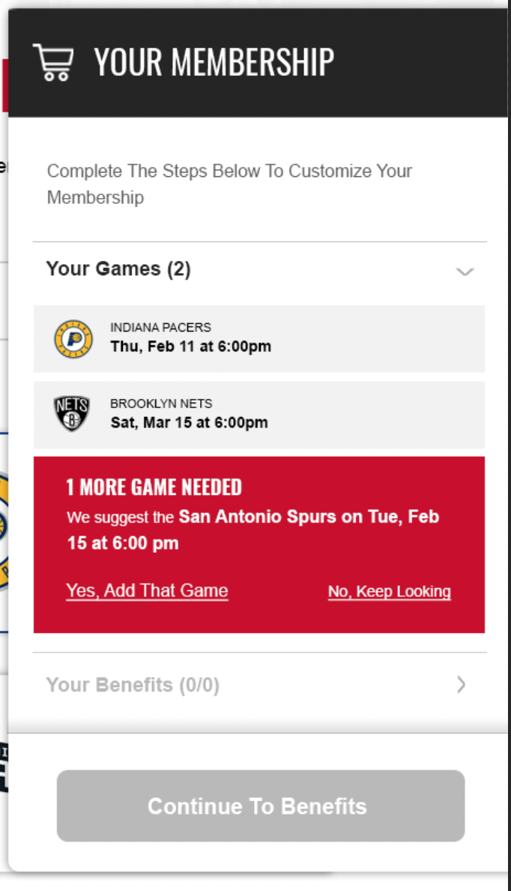
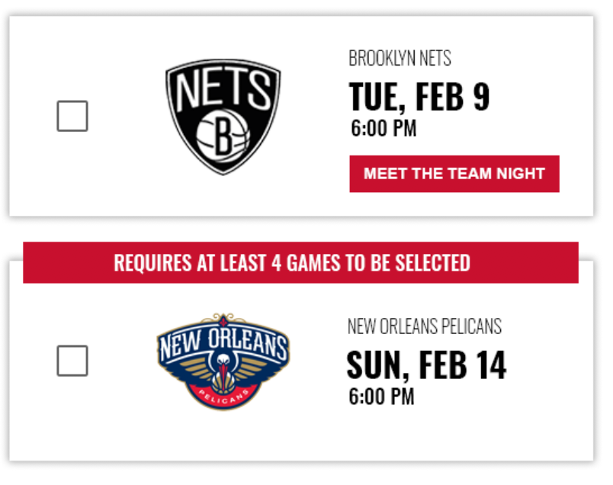
BE THEIR GUIDE
DIGITAL LEADS TO LESS INTERATION BUT CAN STILL BE THEIR WHEN THEY NEED YOU
60%
Of fans take smart recommendations

Slide 22
Create Experiences
People Will Love
Step 3

Slide 23
WHAT’S AN EXPERIENCE WORTH
DATA THAT MATTERS
66%
Care more about the experience than the price or value.
Notes:
Skews even more with net new buyers

Slide 24
WHAT’S AN EXPERIENCE WORTH
DATA THAT MATTERS
Consumers are willing to pay
20%
more for a great experience

Slide 25
Your competition is the last best experience your customer had.
Notes:
So what are some great experiences you’ve seen?

Slide 26
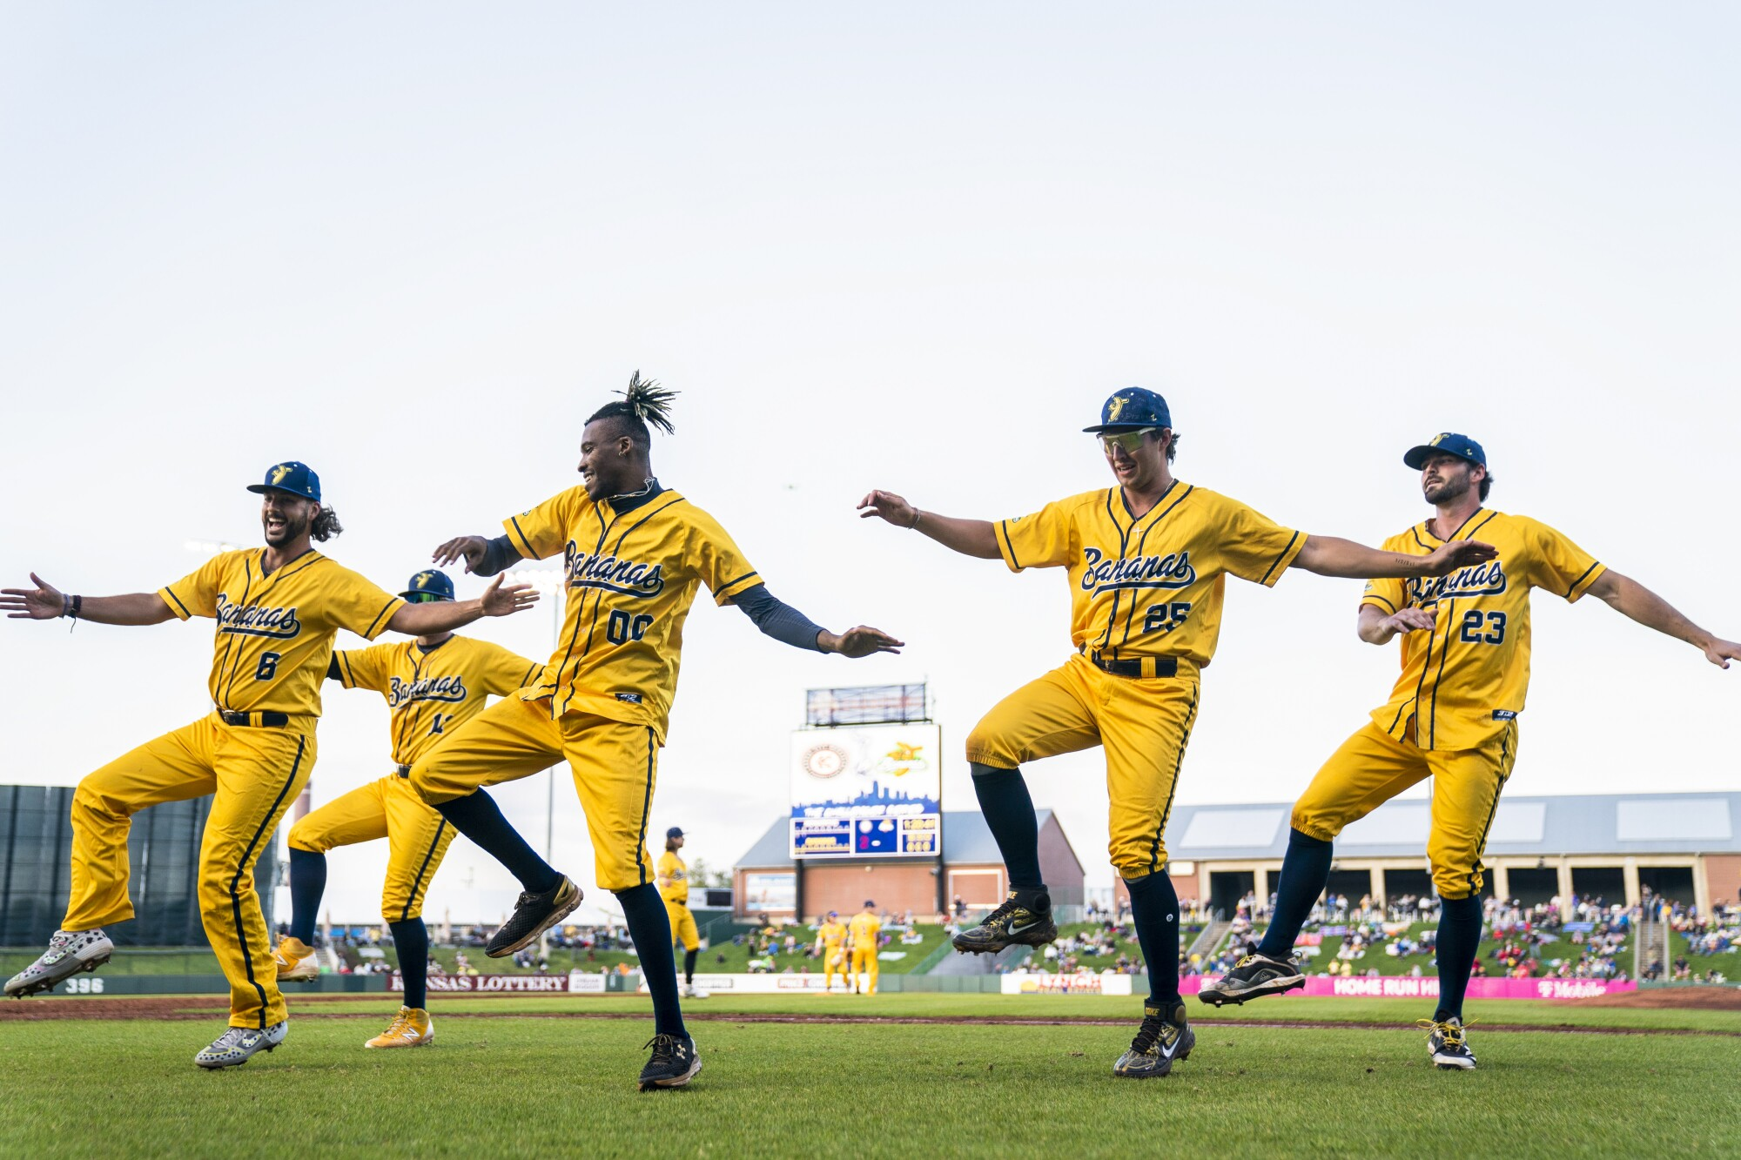

Slide 27
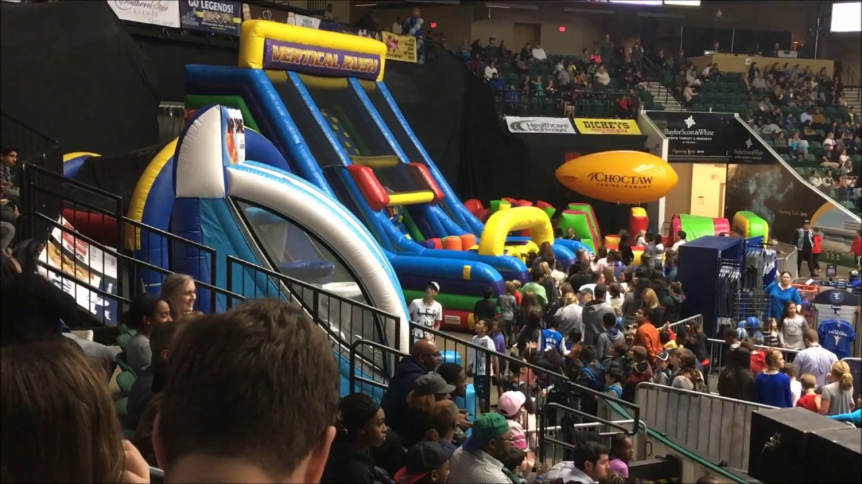

Slide 28
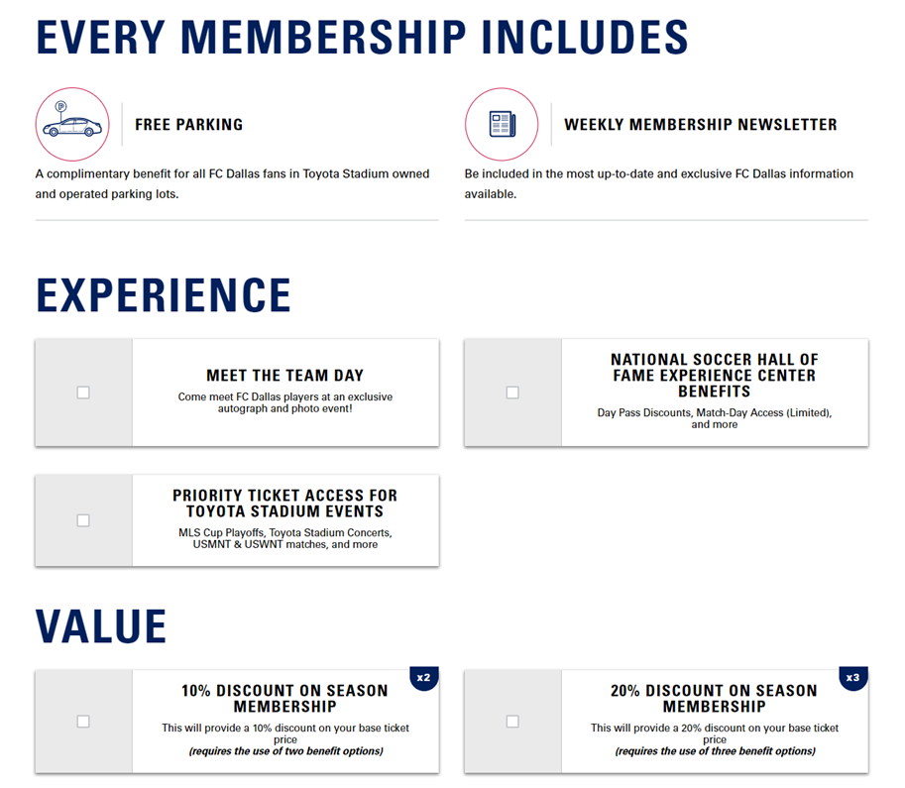
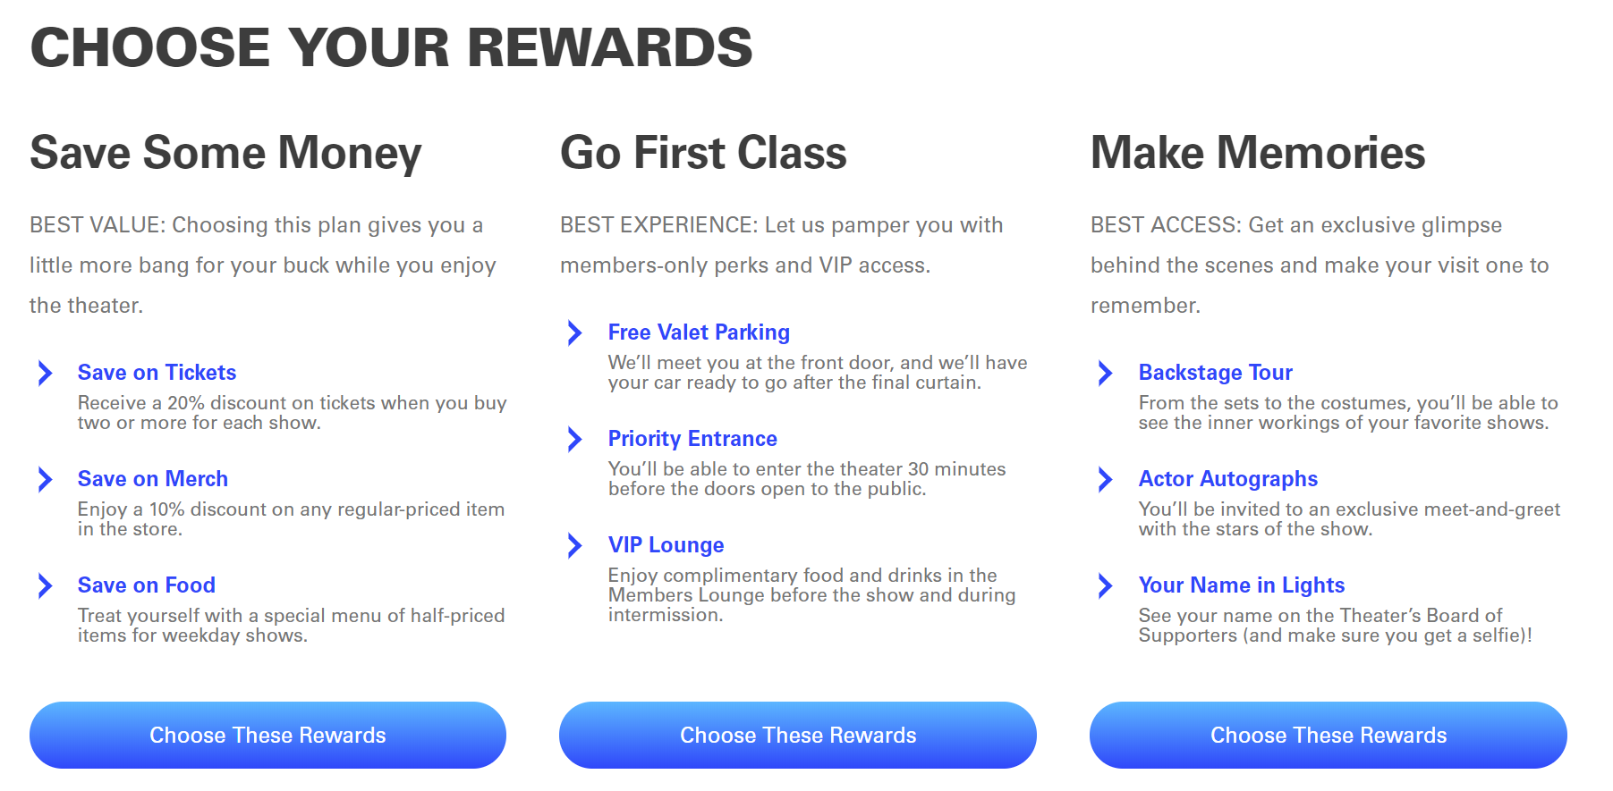
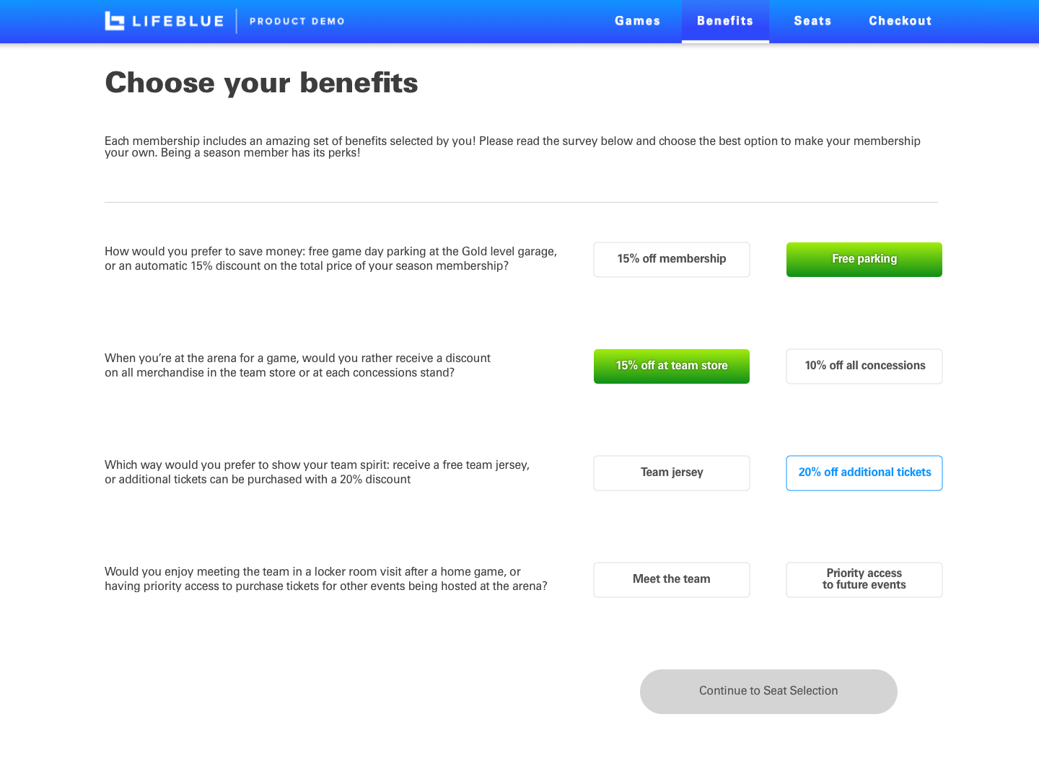
WHAT DO YOU CARE ABOUT THE MOST?
FROM VALUE BUYERS TO EXCLUSIVE ACCESS
Notes:
Number one thing people pick, experiences

Slide 29
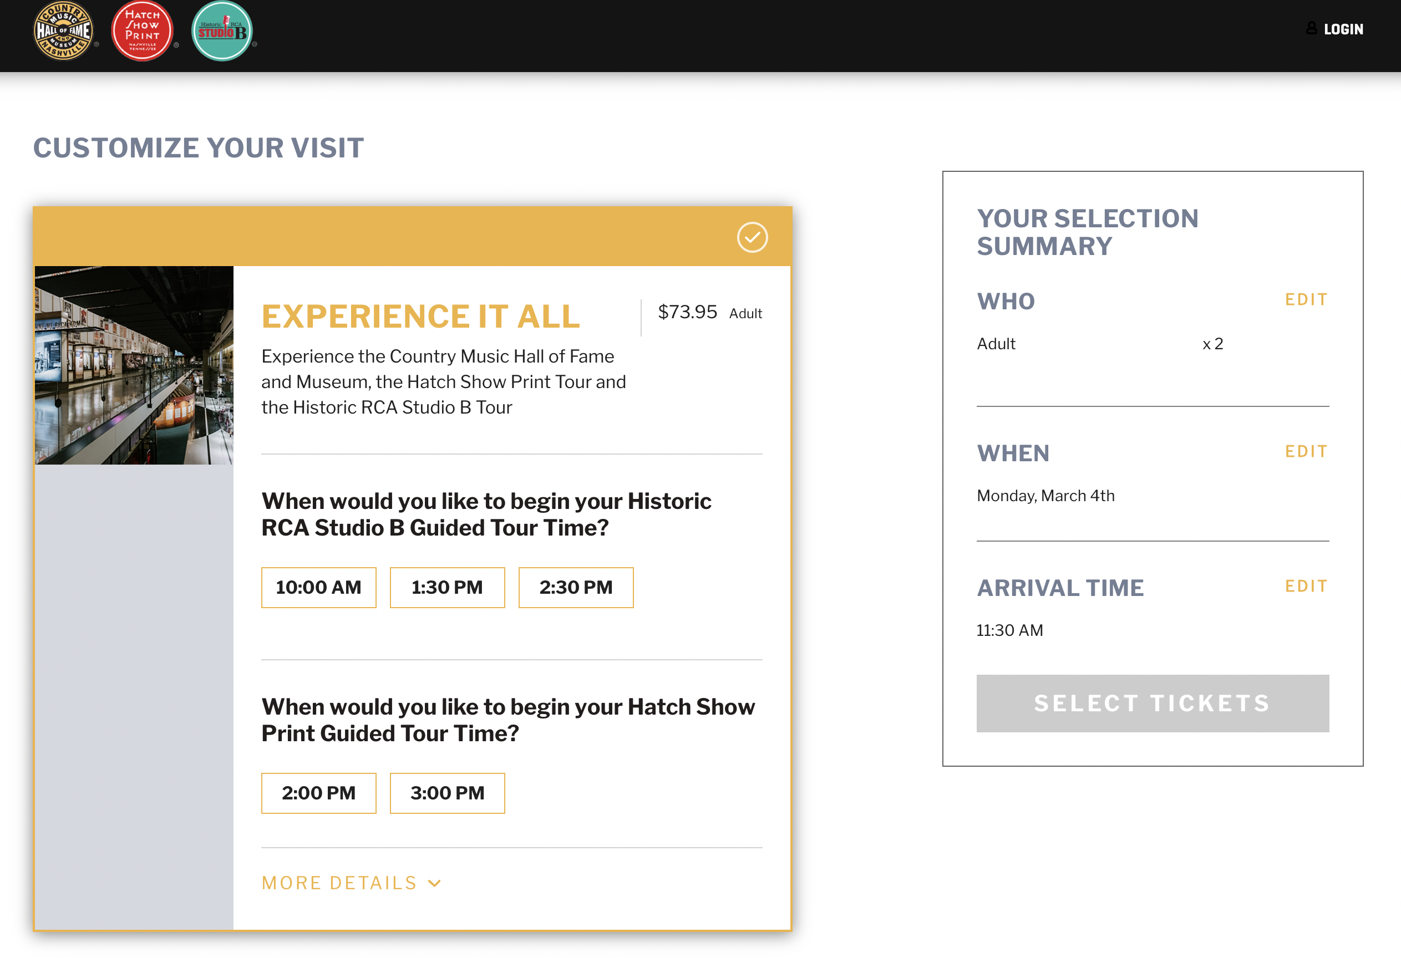
ADD-ONS CREATE ENGAGEMENT
AND INCREASED REVENUE

Slide 30
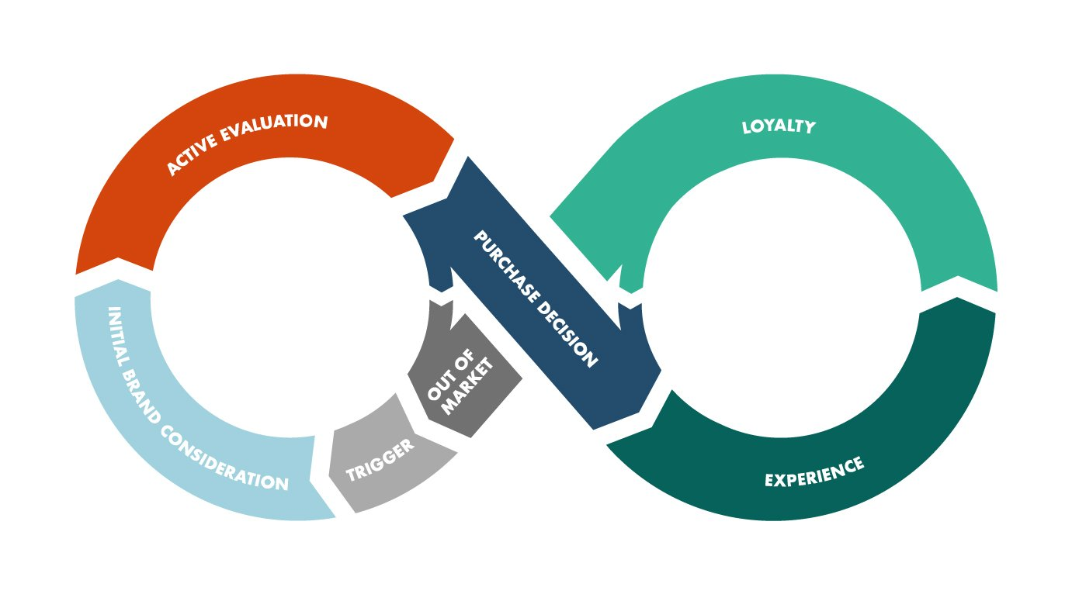
CUSTOMER JOURNEY
WHEN DOES THEIR EXPERIENCE BEGIN?
Notes:
Has anyone ever done a customer journey exercise?
If so, when did that journey start and when did it end?
We’ve seen some pretty amazing things on the tours, I’ve spent time with many of you all this last few days and so much is around what can we take back to apply in stadium, in experience, while the fan is there… but what are you doing before, during and after?

Slide 31

CUSTOMER JOURNEY
WHEN DOES THEIR EXPERIENCE BEGIN?
Notes:
Has anyone ever done a customer journey exercise?
If so, when did that journey start and when did it end? If not, just think about

Slide 32
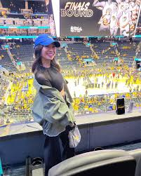
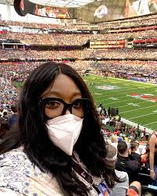
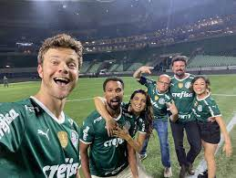
CUSTOMER JOURNEY
WHEN DOES THEIR EXPERIENCE END?
Notes:
It ends as the share their experience with others.

Slide 33
QUESTIONS
WELCOME

