Slide 1
Lists and Extractions
In/ Not In
vs
Has/ Does Not Have

Slide 2
What is the Difference?
In/ Not In
Has/ Does Not Have
Works with your other Criteria if they are in the same table
Must also be in the same row in said table
Evaluates Independently
Does not have to be in the same row

Slide 3
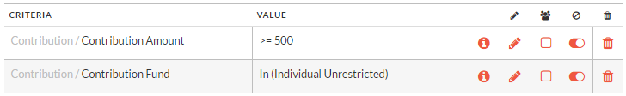
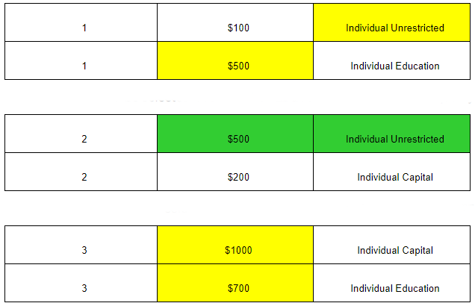
In/ Not In

Slide 4
What is the Difference?
In/ Not In
Has/ Does Not Have
Works with your other Criteria if they are in the same table
Must also be in the same row in said table
Evaluates Independently
Does not have to be in the same row

Slide 5
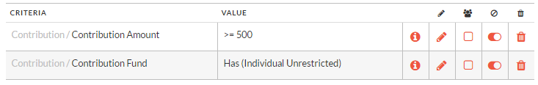
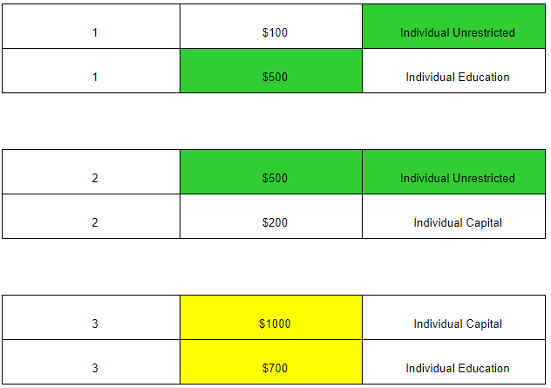
Has/ Does Not Have

Slide 6

What makes all this work?
SQL
List is a SQL Query
In and Not In are both operators in SQL
Has and Does Not Have is the Exists condition

Slide 7
SQL Code
IN
Has
SELECT DISTINCT a.customer_no
FROM V_CUSTOMER_WITH_PRIMARY_GROUP AS a WITH (NOLOCK)
INNER JOIN
(SELECT a1.customer_no
FROM vs_contribution_with_initiator AS a1 WITH (NOLOCK)
WHERE a1.cont_amt >= 500
AND a1.fund_no IN (1)) AS e
ON e.customer_no = a.customer_no
WHERE a.inactive = 1
SELECT DISTINCT a.customer_no
FROM V_CUSTOMER_WITH_PRIMARY_GROUP AS a WITH (NOLOCK)
INNER JOIN
(SELECT a1.customer_no
FROM vs_contribution_with_initiator AS a1 WITH (NOLOCK)
WHERE a1.cont_amt >= 500) AS e
ON e.customer_no = a.customer_no
WHERE a.inactive = 1
AND EXISTS (SELECT *
FROM vs_contribution_with_initiator WITH (NOLOCK)
WHERE a.customer_no = vs_contribution_with_initiator.customer_no
AND vs_contribution_with_initiator.fund_no IN (1))

Slide 8
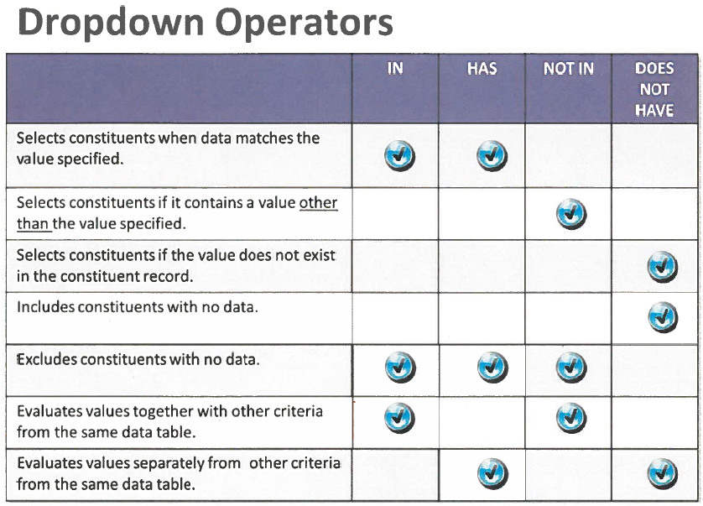
In/ Not In vs
Has/ Does Not Have

