Slide 1

Traci McKinney – Director of Ticketing Services
Dallas Theater Center

Slide 2
5-Minute Tessitura
Pricing Rules
Dallas Theater Center

Slide 3
What Are Pricing Rules?
Pricing rules are used to trigger automatic price changes and deliver messages based on selected order, product, and constituent criteria.
NOTE: Pricing Rules do not necessarily replace Offers on the web. Offers are still used to hide Price Types, display discount pricing before an item is added to the cart, limit seats per order, and prompt a Mode of Sale change on the web.
Dallas Theater Center

Slide 4
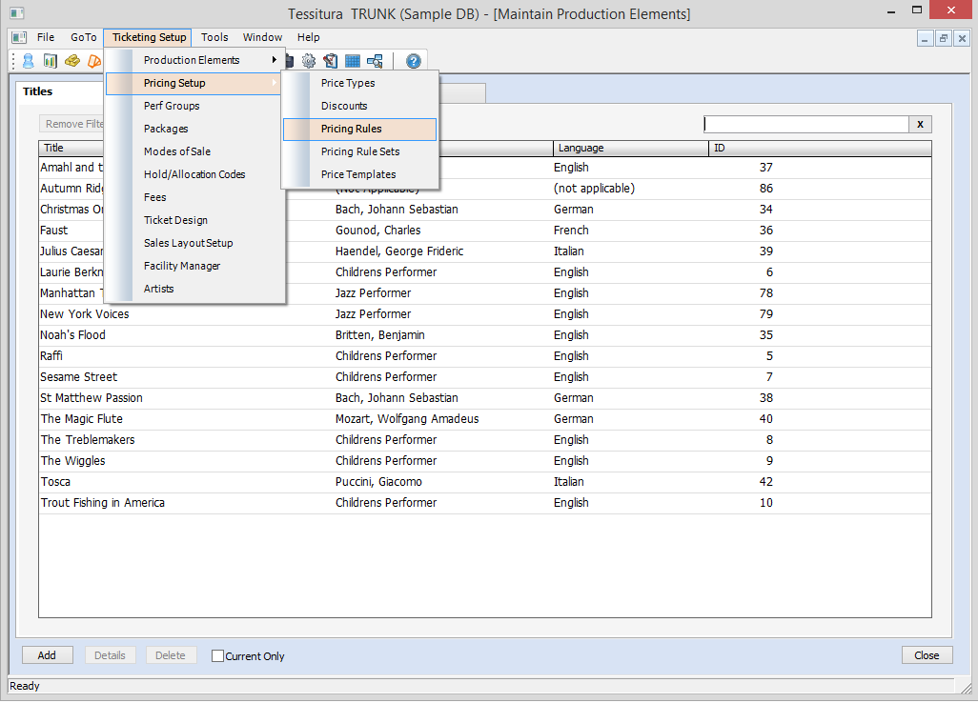
Where Can I Find Pricing Rules?
Dallas Theater Center

Slide 5
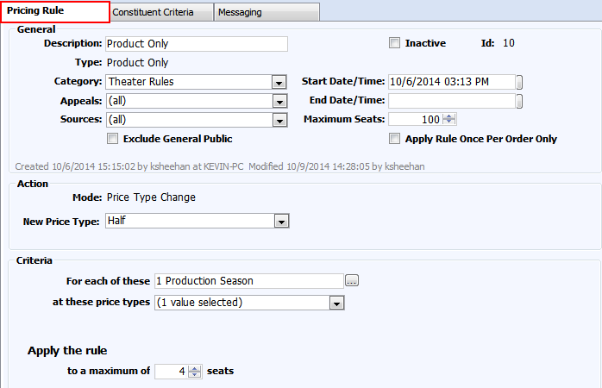
Pricing Rule Setup – Pricing Rule Tab
Dallas Theater Center

Slide 6
Types of Pricing Rules
Product Only (for basic discounts)
Seat Volume (group discounts)
Multiple Price Type (family discounts)
Product Volume (for bundling or faux-packages)
Add On (i.e. Subscriber discounts)
Buy One Get One (buy something get something)
Message Only (displays a message to box office/customer)
Dallas Theater Center

Slide 7
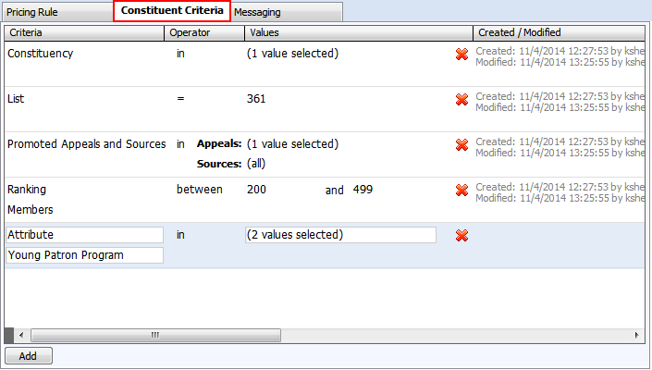
Pricing Rule Setup – Constituent Criteria Tab
Dallas Theater Center

Slide 8
Types of Rule Criteria
Product Criteria (what they’re buying)
Constituent Criteria (who is buying)
  Attribute
  Constituency
  List/Exclusion List
  Promoted Appeal/Source
  Ranking
Dallas Theater Center

Slide 9
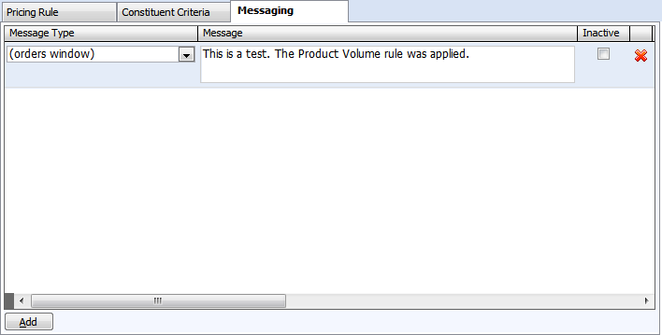
Pricing Rule Setup – Messaging Tab
Dallas Theater Center

Slide 10
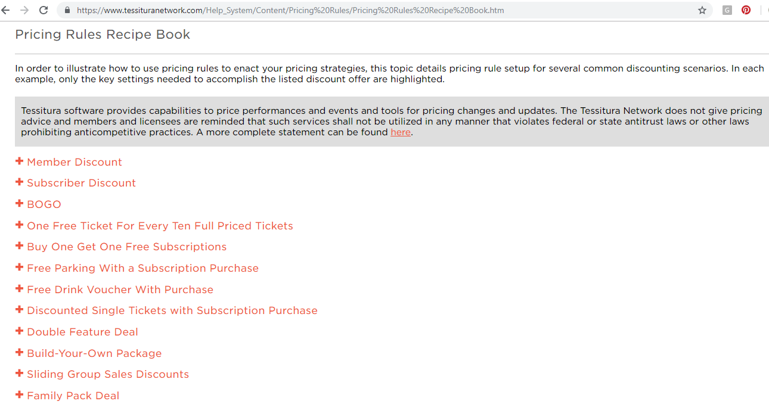
Pricing Rules Recipe Book
Dallas Theater Center

Slide 11
Inside the Recipe Book
A Little More Advanced…
Buy 1 Regular Ticket Get Up to
5 Free Child Tickets
(Buy 1 Get 1-5 Free)
Dallas Theater Center

Slide 12
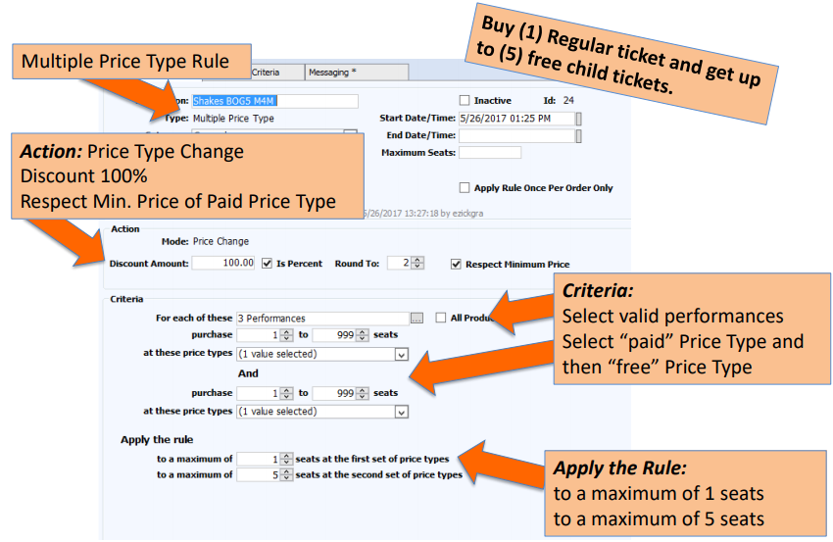
Dallas Theater Center
Courtesy of Debartolo Performing Arts Center

Slide 13
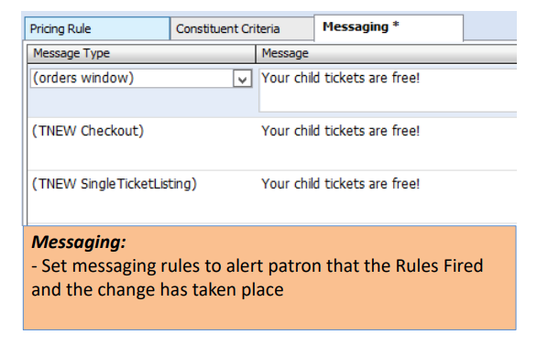
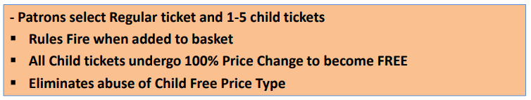
Courtesy of Debartolo Performing Arts Center
Dallas Theater Center
Notes:
Museum of Science Boston
My favorite thing about Tessitura so far is pricing rules. We have probably 30 pricing rules in place in the system now, doing a variety of things. Our member discounted pricing online is triggered through pricing rules. We have internal buy-out pricing and external buy-out pricing. We have message rules that help reinforce sales instructions for particularly tricky products that have a lot of steps. We have an offer for a particular corporate sponsor for discounted membership vouchers that they're using as part of a community program that's triggered when the owner or initiator on the order is that company.

Slide 14
Inside the Recipe Book
More Fun Uses:
Attribute-Based Messaging
Dallas Theater Center

Slide 15
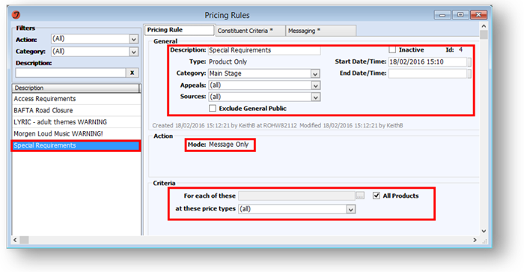
Dallas Theater Center
Courtesy of Royal Opera House

Slide 16
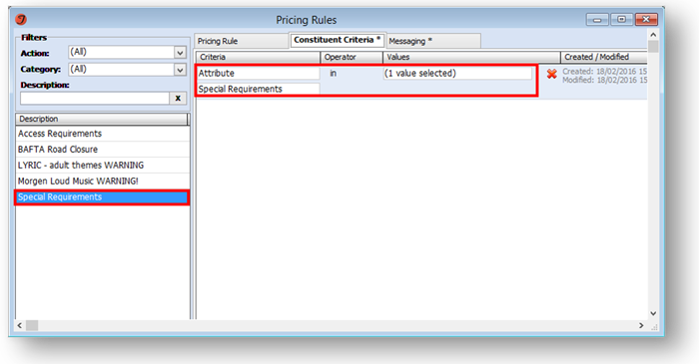
Dallas Theater Center
Courtesy of Royal Opera House

Slide 17
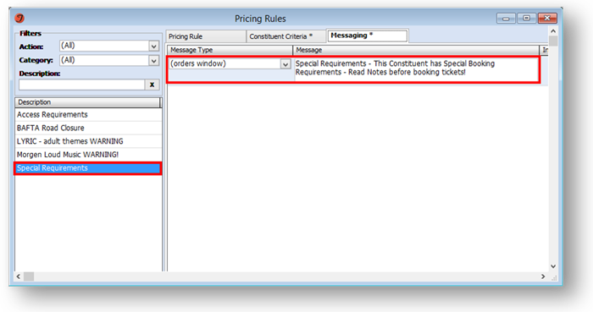
Dallas Theater Center
Courtesy of Royal Opera House

Slide 18
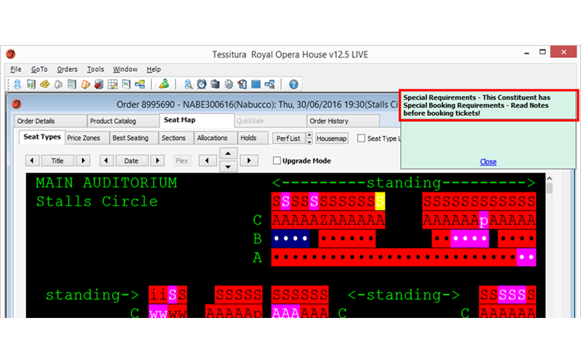
Dallas Theater Center
Courtesy of Royal Opera House

Slide 19
Pricing Rules
Thank you!
Traci McKinney
Director of Ticketing Services
Traci.Mckinney@dallastheatercenter.org

