Slide 1
Plans
Campaign, Designation, and fund must match the same plan items for a contribution to post properly.
When a contribution is posted before the plan is setup, the contribution amount will not populate automatically in the plan.

Slide 2
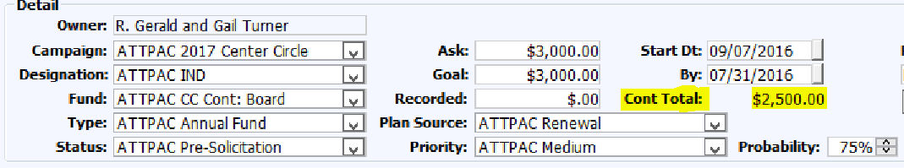
Plan Detail to Contribution Data

Slide 3
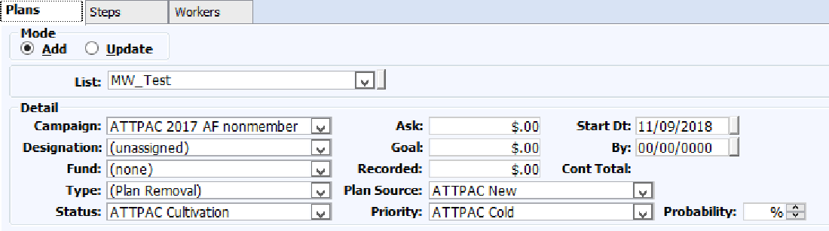
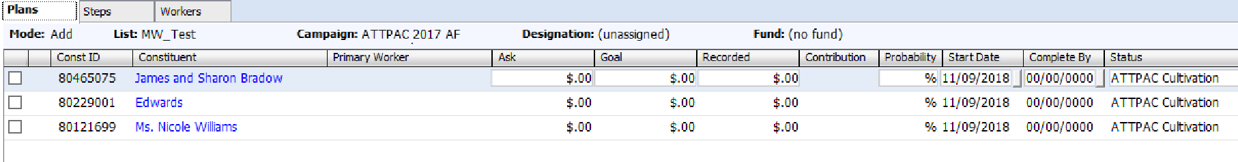
Plan Maintenance
Bulk Plan Insert
Editable Detail

Slide 4
Plan Hacks and Strategy
Campaign Goal field should match the sum of all plan goal amounts for that same campaign.
Create a House Account to assign all gifts under a specific dollar amount to a single plan. This allows all miscellaneous gifts to roll up to your total goal without creating individual plans for all of your smaller gifts. [Requires a custom utility]
Populate plans based on last year's contribution in bulk. [Requires custom utility]
Use a custom report to find all gifts that are not assigned to a plan.

Slide 5
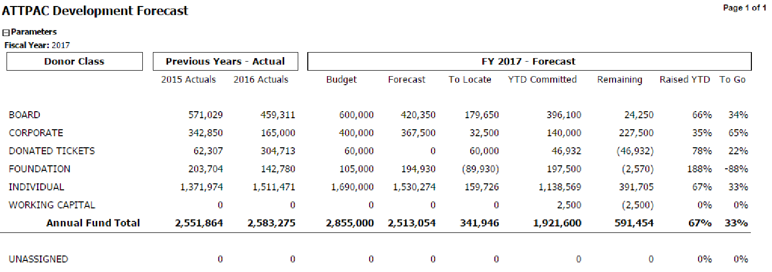
Plan Hacks and Strategy ( continued )
Example of Plan management report to budget.

