Slide 1


USING PRICING RULES
FOR A SPECIAL DONATION ASK

Slide 2

Find a way to ask Nutcracker buyers for a special 60th Anniversary donation
Challenge
Notes:
Last year, Ballet Austin celebrated the 60th Anniversary of The Nutcracker. In honor of the anniversary, we asked prospective/lower level donors to consider a donation of $160.
We wanted to find a way to ask both existing donors and potential donors for the ask as part of the purchase path. We used our customization in the single ticket purchase path to ask those who we had identified as prospects, but we also wanted a way to ask those who either weren’t identified or were new.

Slide 3
Use a pricing rule message in the purchase path for the ask
Idea/Solution
Notes:
We decided to test using a pricing rule message in the purchase path for the ask.

Slide 4
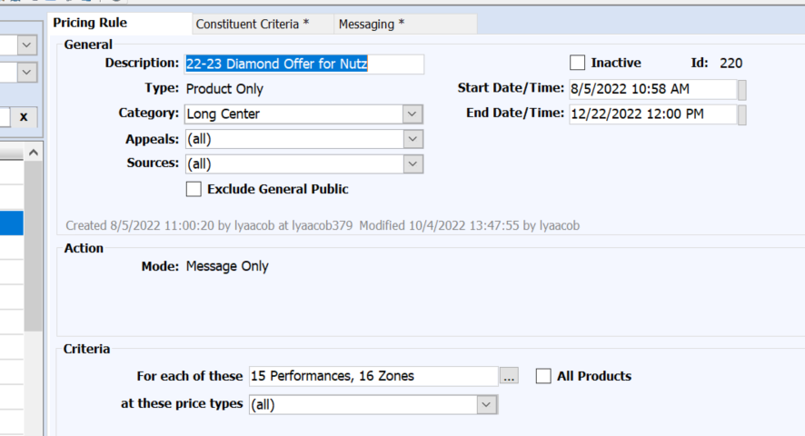
PRICING RULE SET-UP
Notes:
We set this up to show for anyone purchasing any of the Nutcracker performances in any price type.

Slide 5
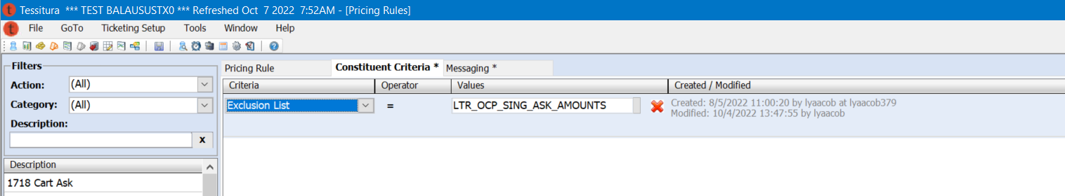
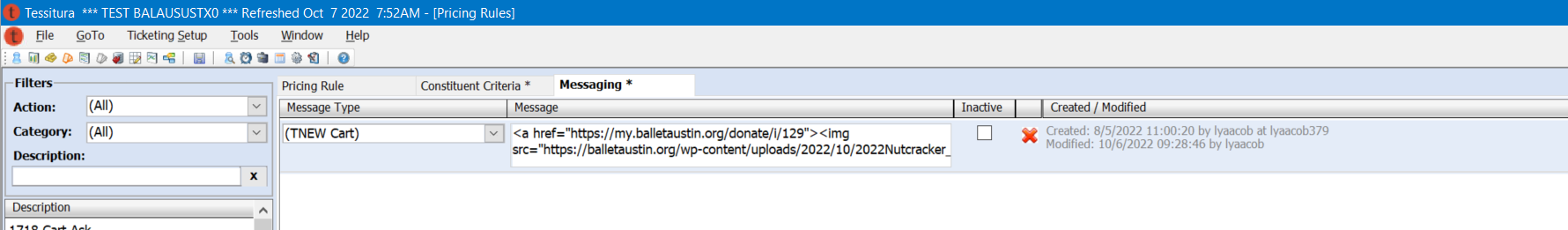
PRICING RULE SET-UP
Notes:
Since we do have a custom purchase path ask as well, we didn’t want people to be asked twice, so we used an exclusion list with a dynamic list of those in that custom ask table to make sure people weren’t receiving two asks.
We chose to have this as a cart ask, and we used HTML to insert an image for the ask.

Slide 6
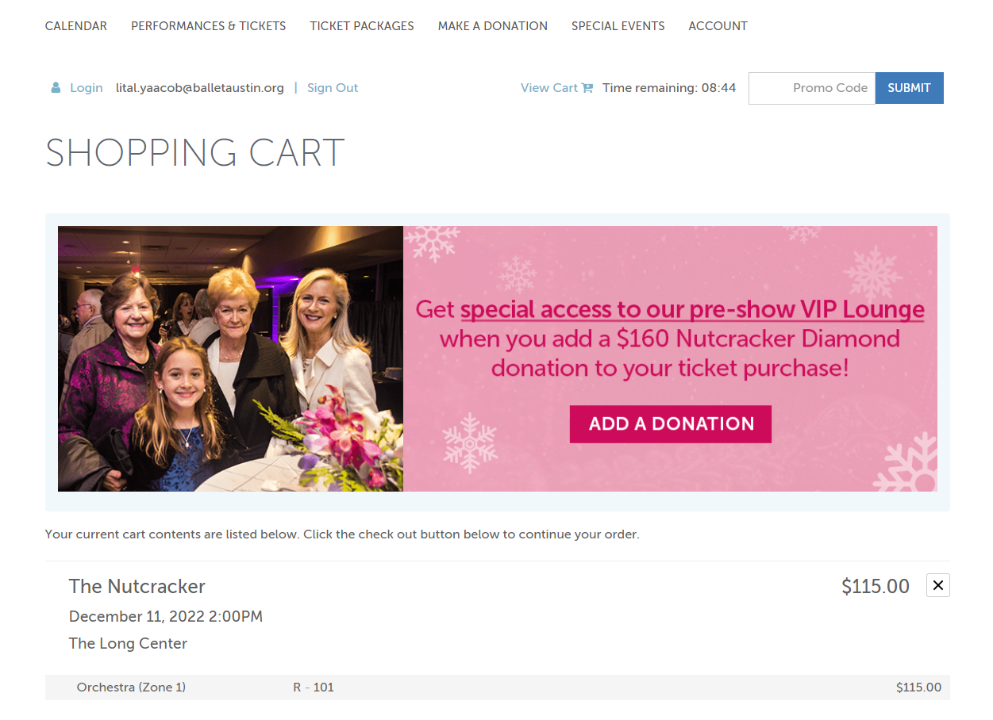
PRICING RULE ON TNEW
Notes:
Here is what the ask looked like on TNEW

Slide 7
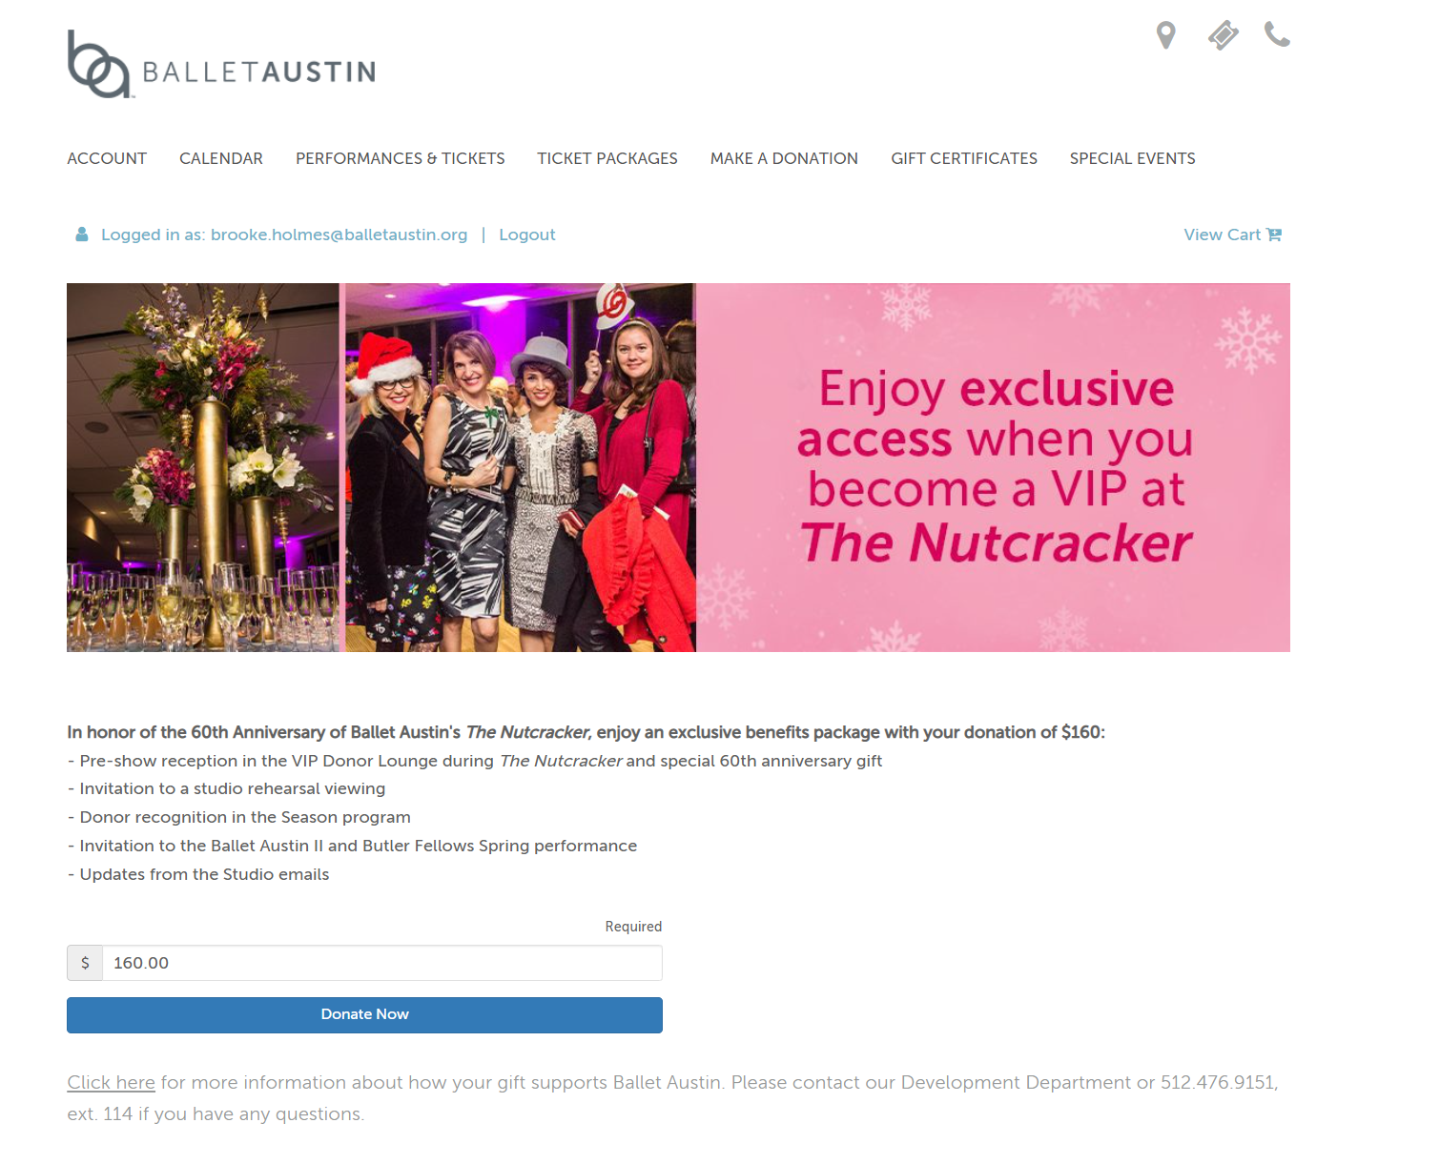
PRICING RULE ON TNEW
Notes:
We linked the image to an individual giving page under our contribute 2 TNEW page so we could have an image specific to this donation ask. If someone added the donation here, it added it to their cart and took them to the check out page.

Slide 8
9 new $160 donors directly through pricing rule ask
More response received from follow-up email to ticket buyers closer to the show
Results
Notes:
We weren’t sure how this type of ask would perform. It yielded 9 new $160, so while the response was not big, I do think it’s worth trying something like this again. It puts the information in front of them and counts as an impression. We did have a much larger response when we sent an email out to ticket buyers about the additional donation. I don’t think seeing it in the purchase path hurts!

