Slide 1
#tlcc2013
Quick and Beautiful Acknowledgements
Lather, Rinse, Repeat!
Presenters
Nick Barnett, Tessitura Network
Barbara Mazer Gross, Tessitura Network

Slide 2

Goal:
Reduce acknowledgement processing time!

Slide 3
Myths of Why Acks Take So Long
I have to save to Excel and create a mail merge each time!
I have to reformat things in Excel, like dates, because Tessitura pulls them out wrong!
I have to manually tweak each letter to get the content right!
I mean, I know how to do a mail merge…

Slide 4
Myths of Why Acks Take So Long
I have to save to Excel and create a mail merge each time!
I have to reformat things in Excel, like dates, because Tessitura pulls them out wrong!
I have to manually tweak each letter to get the content right!
I mean, I know how to do a mail merge…
BUSTED!

Slide 5
Quick and Beautiful Acknowledgements
Building a mail merge template
Switches and field codes
  Date formatting
  Numeric formatting
  Formulas
  Text formatting
  Conditional formatting
Advanced acknowledgement rules

Slide 6
Building a mail merge template & merging from Tessitura

Slide 7
Save time:
Create a mail merge template that you can reuse
Save more time:
Merge your letters from Tessitura, don’t save to Excel

Slide 8
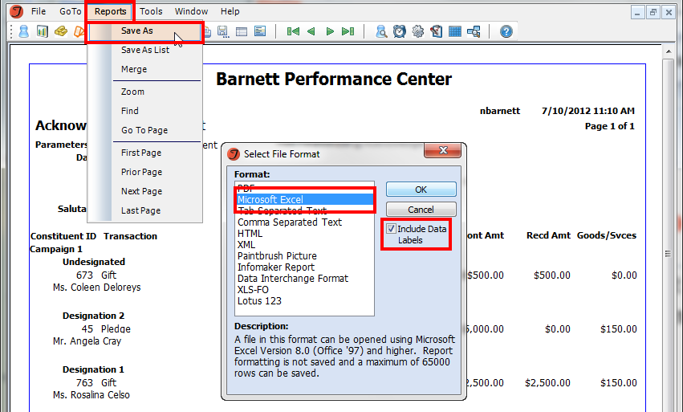
Building a mail merge template
1. Run the Print Ack Letters report and save as Excel (include data labels)

Slide 9
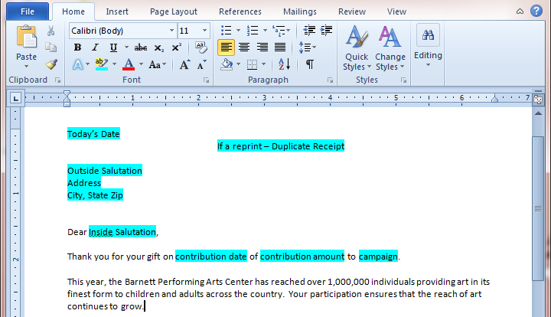
Building a mail merge template
2. In MS Word, compose letter, indicating where merge fields will go

Slide 10
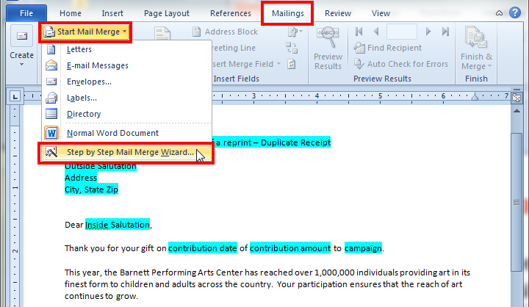
Building a mail merge template
3. Select Start Mail Merge, then Step by Step Wizard

Slide 11

Building a mail merge template
4. Follow the Wizard through step 4
  Step 1 – Select document type: Letter
  Step 2 – Use the current document
  Step 3 – Browse to select an existing list (select your Excel export of the Ack report)
  Step 4 – Insert appropriate merge fields to replace place holders

Slide 12

Building a mail merge template
5. Save the word document following step 4 – this will save your merge template so that you can merge into it in the future without having to go through this whole process each time

Slide 13
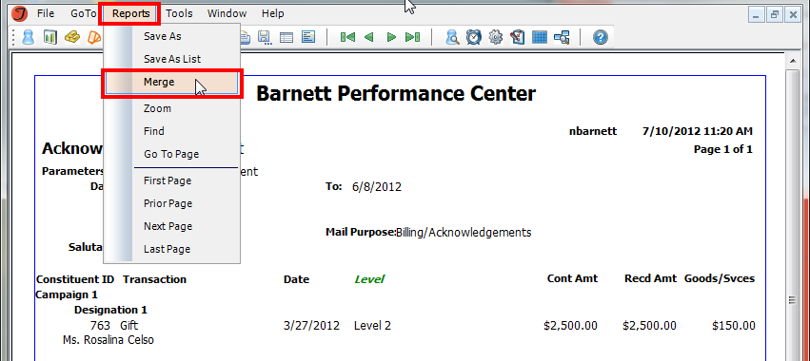
Building a mail merge template
6. Test your template by running the Print Ack Letters report and merging into your template from Tessitura

Slide 14
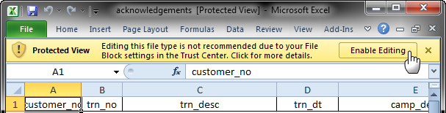
Mail merge warning!!
Computer settings may download files (like the Excel file) in a Protected Mode preventing editing. Make sure that this mode is off or that you have enabled editing in the Excel file.

Slide 15
Microsoft switches and field codes

Slide 16
Save time:
Let the merge do the editing and clean up for you – no need to save and edit in Excel!

Slide 17
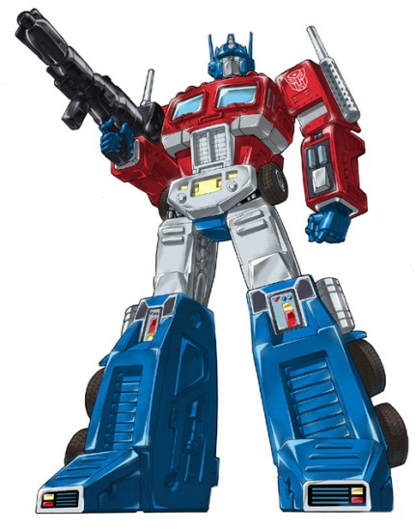
Switches and Field Codes
Within a merge field, you can dictate formatting changes
If you make these changes in your template, you only have to do it once (instead of every time you merge)

Slide 18


Switches and Field Codes
Press ALT+F9 to expose the underlying merge field text and to add in formatting

Slide 19
Switches and Field Codes
Press ALT+F9 to expose the underlying merge field text and to add in formatting
  Normal merge field:
  Merge detail revealed with ALT+F9:
  Merge field edited with formatting switch:

Slide 20
Switches and Field Codes
Press ALT+F9 to expose the underlying merge field text and to add in formatting
  Normal merge field:
  Merge detail revealed with ALT+F9:
  Merge field edited with formatting switch:
This is the
Switch!

Slide 21
Date Formatting
Issue: Dates in Tessitura include a time stamp (e.g., 06/30/2012 00:00:000), which you don’t want to include in your letters
Issue: You want to format dates formally (e.g., June 30, 2012) and you are editing the format in Excel before merging

Slide 22
Date Formatting: \@
\@ “M/D/YYYY”
\@ “MM/DD/YYYY”
\@ “MMMM D, YYYY”
6/30/2012
06/30/2012
June 30, 2012

Slide 23
Numeric Formatting
Issue: For money, the decimal doesn’t merge when the amount is a whole number (e.g., 100 instead of 100.00)
Issue: For large values, a comma doesn’t merge (e.g., 1000 instead of 1,000)

Slide 24
Numeric Formatting: \#
\# $#,##0.00
$1,000.00

Slide 25
Formula Formatting
Issue: You want to display the tax deductible value of a contribution, but the non-tax deductible value is part of the data set
Solution: Use a formula to subtract the goods and services value from the contribution amount (Cont-GS=Deductible)

Slide 26
Formulas: +, -
= (Mfield – Mfield)
$750.00

Slide 27
Text Formatting
Issue: The capitalization used in Tessitura isn’t always the capitalization we want in our letters
  We use caps, but the merge is mid sentence
  We use all lower case, but the merge should be in title case
  We use all lower case, but the merge is at the start of a sentence

Slide 28
Text Formatting: \*
\* LOWER
\* CAPS
\* FIRSTCAP
lower case
Title Case
Sentence case

Slide 29
Conditional Formatting
Issue: The text required depends on what the value in the data set is
  If decline benefits, display “you have declined benefits and this gift is fully tax deductible”
  If duplicate receipt, display “Duplicate Receipt Copy”

Slide 30
Conditional Formatting: If
IF Mfield=X “Display” “”
Display
If this is true…
…then display this...
…if not, display this.

Slide 31
Conditional Formatting
Issue: The text required depends on what the value in the data set is
  I want to display member benefits based on the person’s level
  I want to display specific text based on the fund donated towards
  I don’t want a million letter types, but I want a million different letters

Slide 32
Conditional Formatting: Include Text
INCLUDETEXT “c:\\filename.docx”
You can merge text from another document
Use your Ack merge field to determine which file you want to pull the text from
Just name your files based on your data

Slide 33
Advanced acknowledgement rules

Slide 34
Save time:
Now that you know how to minimize the number of Ack types you need, new Ack types and rules can save you time!

Slide 35
Tessitura Acknowledgement Rules
Although the goal is to minimize the number of Ack types and rules, sometimes having a few can actually save you time
The rules can account for some things that the data set cannot

Slide 36
Credited contributions
Issue: For credited gifts you always edit or manually create letters so the donor gets a tax receipt that identifies the gift is in honor of someone else AND the creditee gets an acknowledgement identifying the donor
Solution: Have different letter types and use Creditee Indicator rules

Slide 37
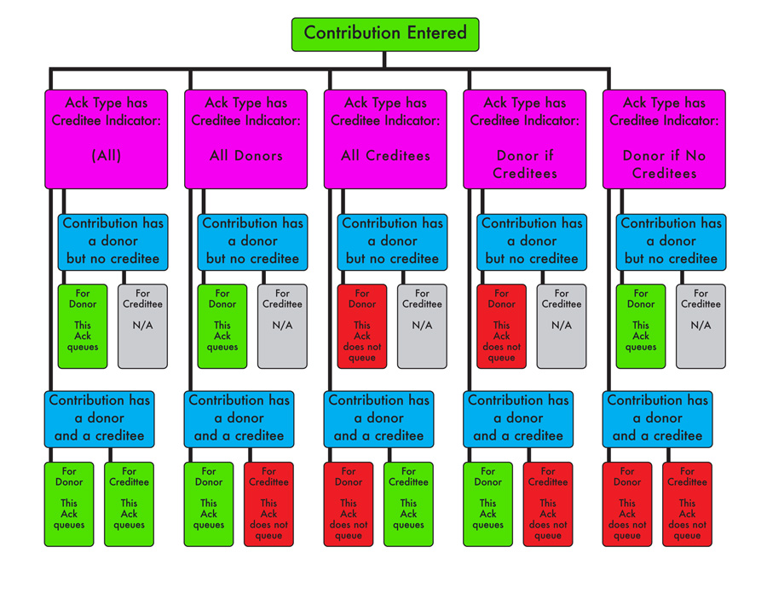

Slide 38
Credited contributions
If credited gifts:
  All Donors/Donor if Creditees:
  All Creditees:
Creditor info
Creditee info
Creditee info
Creditor info

Slide 39
NRR contributions
Issue: Membership NRR information is not included in data set, but is needed for your acknowledgements (e.g., new member welcome packets, renewal packets, etc.)
Solution: Have different letter types and use NRR Status rules

Slide 40
Transaction types
Issue: Confusion around the Transaction Types

Slide 41
Transaction types
Gift: New contribution paid in full at the time of entry
Pledge: New contribution where no payment is made at the time of entry
Pldge/Pmt: New contribution where partial payment is made at the time of entry and leaving partial payment still due

Slide 42
Transaction types
First Pmt: The first payment towards an existing pledge where no dollars have yet been received
Pmt: Any payment between the first payment and the final payment on an existing pledge
Final Pmt: The payment that completes the balance on an existing pledge.

Slide 43
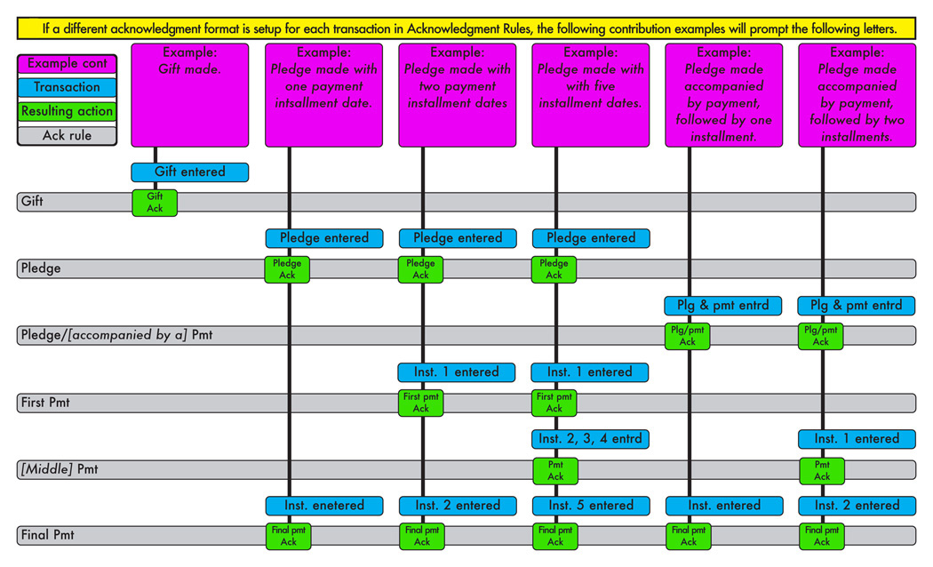

Slide 44
Additional reference materials
Microsoft Word Field References
  http://office.microsoft.com/en-us/word-help/CH006104723.aspx?CTT=97
Tessitura Documentation – Acknowledgments
  http://www.tessituranetwork.com/PDFs/Contribution_Acknowledgements_and_Premiums.pdf
Tessitura Recorded Webinar – Acknowledgements
  http://www.tessituranetwork.com/network/Learning/Webinars%20Archive/Development/Acknowledgements.aspx
Tessitura T-Cast – Merging Tessitura Data
  http://www.tessituranetwork.com/network/Learning/Webinars%20Archive/Development/Merging%20Tess%20Data%20tcast.aspx

Slide 45



Quick and Beautiful Acknowledgements
Please ask for a microphone and introduce yourself when you are ready to speak.
#tlcc2013
What are your takeaways?

Slide 46

Conference Evaluation
arriving in your inbox tomorrow
Yay!
I’ve got ideas!
Heads up!
I was thinking..

Slide 47
Where do we go from here …
Networking Break is next, thanks to our sponsor:
  KlearSky
Next session is at 10:45
  Our last TLCC2013 sessions…
All these PowerPoints?
  Posted soon in the Conference Archive

