Slide 1

Demand Based Pricing
A case study from
The Australian Ballet
ANZTRUC
Thursday 23 February 2012
Amalia Hordern
CRM Manager
The Australian Ballet

Slide 2

Overview
Background on DBP implementation
Major considerations
Phase 1 – per production
Phase 2 – per performance
What’s next?

Slide 3

The challenge
To unlock revenue opportunities within our existing performance footprint without alienating loyal audiences through significant, across the board price increases

Slide 4

Our structure
Subscription based program
Audience comprises 57% subscribers
Renewable seating
Loyal subscriber base
Mixture of full length and mixed bill repertoire
Notes:
Our organisation
Subscription based program in Melbourne and Sydney, in addition to single seasons in other major cities
Subscribers make up approximately 50% of our attendees and the majority of these subscribe into renewable seats
We value our very loyal subscriber base – over 35% have been with us for over 15 years
Mixture of blockbuster (traditional, narrative) and mixed bill repertoire (heritage and new works)

Slide 5

Our situation
Schedule limits –company and venues
Restrictive subscription footprint
Limited unsold capacity
Diminishing per capita ticket yield
Notes:
The Australian Ballet’s situation
We can’t add performances – no venue availability and company is at capacity, inherent costs in this anyway
Current subscription footprint does not allow much flexibility in scheduling - we can’t increase the number of blockbuster performances and reduce the more challenging works
We are in the fortunate position that our productions will often sell out towards the end of the season – but this may leave us with unsold capacity in early performances
Most significantly, as popularity for a production increases and capacity decreases our per ticket yield exponentially diminishes – we are making increasingly less money for a ticket that is in great demand (graph)

Slide 6


Slide 7

Traditional pricing strategies
Premium performances
Discounted previews
Price zoning
Concessions
Demand based pricing
Dynamic based on real time market demand
Notes:
History
DBP not a new concept – most companies, venues and productions have for many years employed pricing strategies to reflect or manipulate demand. Premium prices for Friday and Saturday evening performances or heavily discounted previews, for example. Even price zoning and concession ticketing is predicated on demand. Slide 5
The difference with demand based pricing as we employ it is its dynamic aspect – pricing is directly related to real-time market demand

Slide 8

The desired outcomes
Revenue maximisation
Encourage early booking
Increase perception of demand
Remodel customer buying behaviour
Refine marketing communications
Notes:
The desired outcomes
Revenue management – are revenues maximised for each seat sold?
Encourage early booking
Increased perception of demand – a ‘hot ticket’ mentality
Ultimately remodelling customer behaviour
Enables directing resources away from reminding our regular audiences to activities which enrich their experience and the acquisition of new customers

Slide 9
Major considerations
Resourcing
Tessitura build and reporting
Clear communication strategy
  in print
  online
  in person
Support from venue partners
What price will the market bare?
Notes:
Major considerations
Operational aspects – resourcing, Tessitura pricing build
Reporting and settlement
Clear communication strategy
In print – all prices on all collateral now shown as a range, eg tickets from $33
Online – pricing tables needed to be easily updated on the fly
In person – customer services staff needed strong buy in to the strategy in order to feel confident in explaining the pricing structure to customers
Requires support from our venue partners
What price will the market bear?

Slide 10

Phase 1
Per production demand based pricing
Sydney and Melbourne seasons
Stable entry point
Exemption on subscription tickets
2011 Model
$5 price increase for each 5% of paid capacity - based on production sales
Notes:
Phase 1 – per production demand based pricing, 2011
Sydney and Melbourne seasons only
The model - at each 5% increment of paid capacity over 60%, the ticket price increased by $5
Stable entry point – our D Reserve ticket price is not dynamic, allows an accessible entry point in every performance
Exemption on subscription tickets (package tix plus additional through the year)

Slide 11

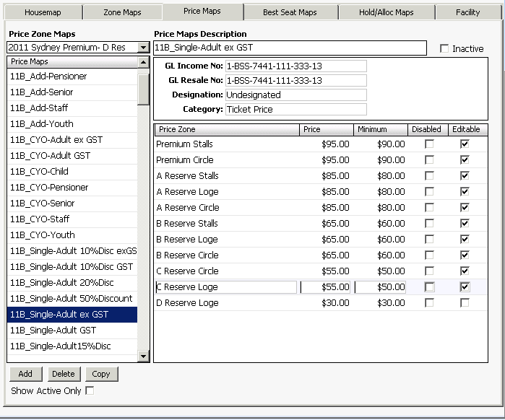

Slide 12
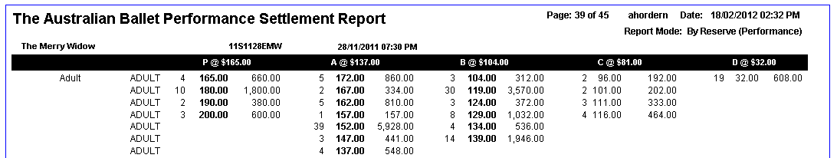

Slide 13

Phase 1 results
The Merry Widow, Sydney
Seven increments
Season increase of $35
No negative feedback
15-Feb | 18-Feb | 10-Mar | 11-Nov | 15-Nov | 18-Nov | 22-Nov
60% | 65% | 70% | 75% | 80% | 85% | 90%
Additional 12% single ticket revenue
Notes:
Phase 1 results
Six of the eleven seasons presented were subject to demand based pricing
The Merry Widow in Sydney as an example – price was bumped twice in February immediately following the GP on sale, once in March, then four times in November in the lead up to and during the season (table)
Adult A Reserve ticket went from $137 at on sale to $172 at end of season – seven bumps, $35 increase
No negative feedback from customers
Revenue impact on The Merry Widow Sydney of an additional $130,140.00

Slide 14
Phase 1 results
2011 overall
Six of eleven productions
Additional revenue between 4% and 12%
Total additional revenue over 8%
Notes:
Of the six productions subject to DBP, additional revenue ranged from $28,000.00 to $169,000.00
2011 total additional revenue attributed to DBP over $722,000.00
Analysis
Great revenue result but was this really managing demand and maximising our inventory?
While this structure tacitly penalised late bookers, it did not actively encourage sales into performances with higher available capacity
In analysing our 2012 results we saw that the production capacity figures often vary wildly from what is represented on a per performance basis

Slide 15
The Merry Widow Sydney – performance capacity trends
Overall |  | Thur |  | Fr |  | Sat |  | Sat |  | Mon |  | Tues |  | Wed |  | Wed |  | Thur |  | Fri |  | Sat |  | Sat |  | Mon |  | Tues |  | Wed |  | Thur |  | Fri |  | Sat |  | Sat |  | Mon
Notes:
Analysis
Great revenue result but was this really managing demand and maximising our inventory?
While this structure tacitly penalised late bookers, it did not actively encourage sales into performances with higher available capacity
In analysing our 2012 results we saw that the production capacity figures often vary wildly from what is represented on a per performance basis
Graph indicating The Merry Widow Sydney – some are lower than the average but many are higher, suggesting lost revenue opportunities

Slide 16
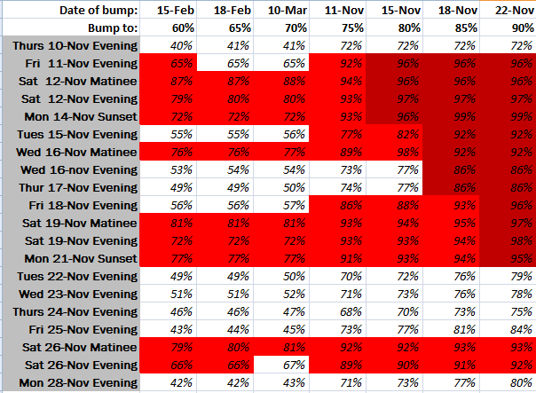
Notes:
To show this another way, this table indicates where individual performances were at the date of 2011 price bumps Slide 15
We determined that dynamically adjusting prices based on performance capacity will encourage sales into less popular performance days/times by allowing a broader range of entry price points across the season
Additionally, revenue opportunities further maximised – analysis on The Merry Widow Sydney suggests a conservative estimate on $42,000.00 additional ticket revenue
Furthermore, strong selling individual performances in seasons which might not otherwise hit our 60% threshold can be dynamically priced

Slide 17
Phase 2
Per performance demand based pricing
Monitoring and performance maintenance
Move to a 10%/$10 demand model
Modelling suggests just under 190 adjustments
More than ever, venue support vital
Communication refinement
Notes:
Phase 2 – per performance demand based pricing, 2012
The major considerations were intensified in moving to a per performance model – in particular resourcing for monitoring and performance maintenance
Where in 2011 The Merry Widow in Sydney saw seven adjustments, modelling on the per performance structure blew this out to approximately 120 adjustments
Decision to move to a 10%/$10 demand model
Modelling based on the 2011 performance year suggests just under 190 adjustments will be required in 2012 for our Sydney season
This is significant but tends to be focussed in the immediate lead up to a season
More than ever, the support of our venues vital to our ability to implement!
Communication strategies required refinement – as the dynamic nature of pricing becomes more apparent to customers
Online – somewhat nervous as web usability testing we carried out in 2009 told us clear communication of price was important to our customers
Move to indicating price ranges in our online tables (show before and after screen shots) Slide 17
Detailed messaging for our sales staff –

Slide 18
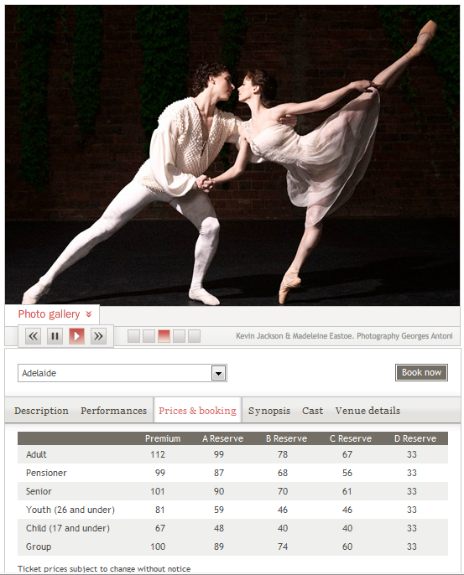

Slide 19
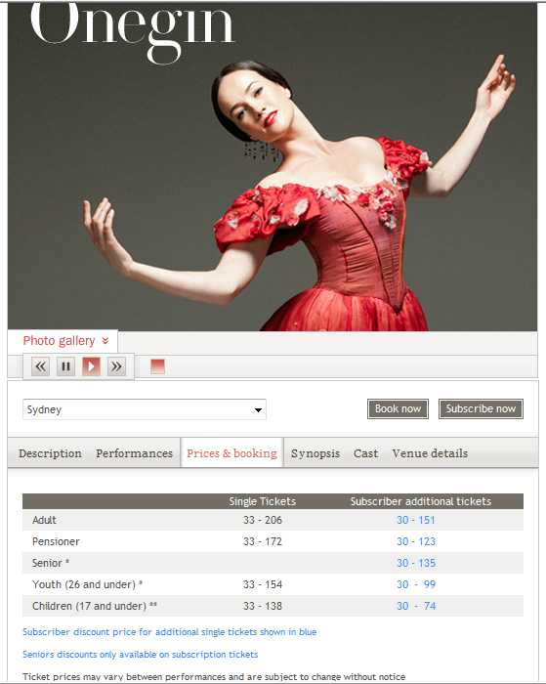

Slide 20
Key messages for our sales staff
TAB operates in a demand situation
Buy now to secure the best price
Reiterate prices are subject to change
Notes:
Detailed messaging for our sales staff – regularly updated online ‘cheat sheets’ outlining prices per performance (screen shot example) Slide 18
TAB operates in a demand situation Slide 19
prices do vary between performances
the price today is $xx but may increase the performance fills
encourage locking in the sale to secure the quoted price
reiterate prices are subject to change

Slide 21
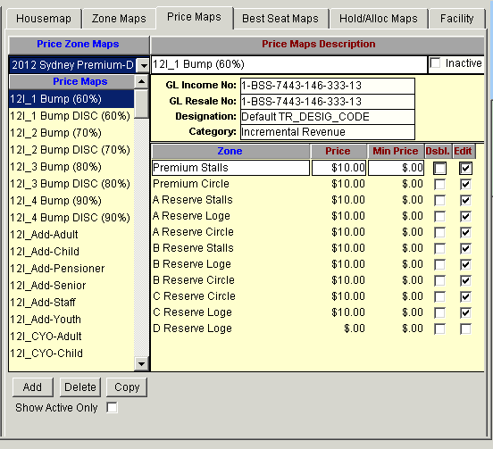
Notes:
Move from simply adjusting the Price Map, to creating layered Price Maps (screen shot) Slide 20
Maps are built with a Price Map Category of Incremental Revenue to allow this detail to be split out via custom reporting

Slide 22
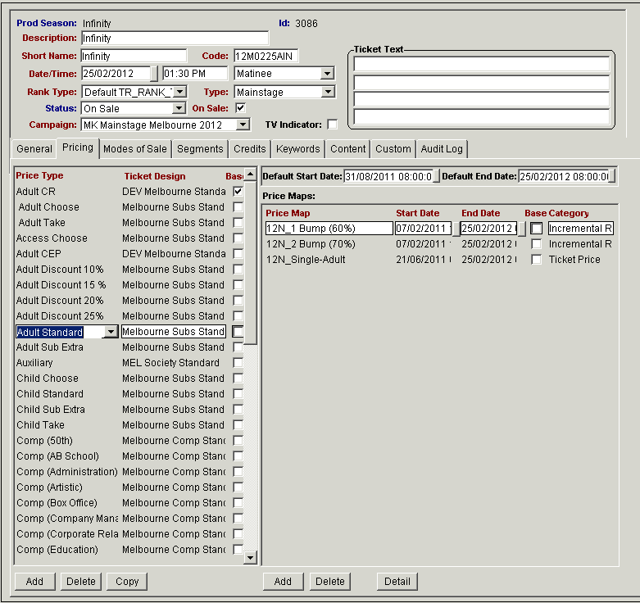
Notes:
Adjusted through Production Elements > Performances – an extra map is added for each $10 increment, start dates indicate when the increment was added

Slide 23
Has it worked?
Revenue certainly – but customer behaviour?
Sydney season of Graeme Murphy’s Romeo & Juliet – sold out prior to opening
2012 Sydney general public on sale demonstrated 23% increase on 2011
Notes:
Has DBP worked in influencing customer behaviour?
Hard to say
What we do know is our Sydney season of Graeme Murphy’s Romeo & Juliet sold out **** before it opened in late November 2011
Our 2012 Sydney general public on sale earlier this month saw a 23% increase on 2011 in the number of tickets sold that first day

Slide 24
What’s next?
Extended nationally
Opportunities for seasons otherwise below the threshold
Per price zone for optimal revenue maximisation opportunities – but not just yet!
Experimental rescaling
Revenue Management Application – reliant on regular order imports
How do we communicate our pricing strategies into the future?

Slide 25

Key considerations
A structured model important but value is in flexibility
Clear communication strategy
Support of venue partners
Maintain accessible pricing points
Consider in a loyalty framework

Slide 26
Demand Based Pricing
A case study from
The Australian Ballet
Amalia Hordern
CRM Manager
The Australian Ballet
amaliah@australianballet.com.au

