Slide 1

AUSTRALIA & NEW ZEALAND TESSITURA REGIONAL USERS CONFERENCE 2011
ANZTRUC
WELCOME

Slide 2

Conference partner

Slide 3










Sponsors supporters

Slide 4

AUSTRALIA & NEW ZEALAND TESSITURA REGIONAL USERS CONFERENCE
MONDAY 21 FEBRUARY GENERAL SESSION #1
NEXT GENERATION UPDATE
PRESENTER:
ANDREW RECINOS (Tessitura)

Slide 5
Tessitura Next Generation Update
Monday, 21 February, 2011
Andrew Recinos
Tessitura Next Generation
Product Member

Slide 6
If you are just joining us….
Tessitura Next Generation Project:
  Multi-year, member-mandated initiative to evolve the Tessitura application from the best in the industry today, to the best in the future
  Project governed by Board Steering Committee
  Membership represented by Member Advisory Committee and Epic Story Committees
  Product development is happening now, by Tessitura development staff in US, and ThoughtWorks staff in India

Slide 7
If you are just joining us….
Goals of the NextGen Project
  Add major new and enhanced functionality to help meet the current and future business needs of the users
  Make the application more flexible and interoperable by adding a robust “services layer” to the existing product
  Revisit the overall Tessitura user interface after the first two goals are met

Slide 8
If you are just joining us….
What NextGen means to you
  Starting with Version 11, you will start to see major new annual functional additions to Tessitura, both through the front end and “under the hood”
  These new functionalities are the direct result of licensee feedback and input
  The annual upgrade process is going to be more involved during this period
  The NextGen project is moving from visioning to reality…

Slide 9
Agenda

Slide 10
Agenda
Roadmap Survey Results
Version 11 Release Vision
First Look at Version 11
Timeline
Preparing for Version 11
Q&A

Slide 11
Functionality Roadmap
Survey Recap

Slide 12
Functionality Roadmap Survey Recap
August 2010 - TLCC:
  We debuted list of 14 major new or enhanced functionalities we proposed adding as part of NextGen
  In series of MAC, user, and staff sessions at Conference, discussed ranking, adding and removing items from the Functionality Roadmap

Slide 13
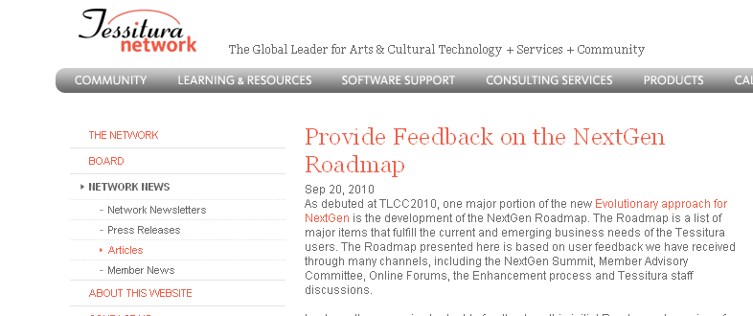
Functionality Roadmap Survey Recap
September – October 2010
  Received more Roadmap feedback via on-line survey on Tessitura website

Slide 14
Functionality Roadmap Survey Recap
Compiled Results:
  Eight of the original 14 still in the top 14
  Six new items were more popular than the original 14:
    End User Customizable Reports
    Enhanced Gift Card/Payment Processing
    Improved Security Model and Administration
    Flexibility in Package Set-up
    Support for non-ticketed Education Outreach/Workshops
    Enhanced workflow around Patron Interactions

Slide 15
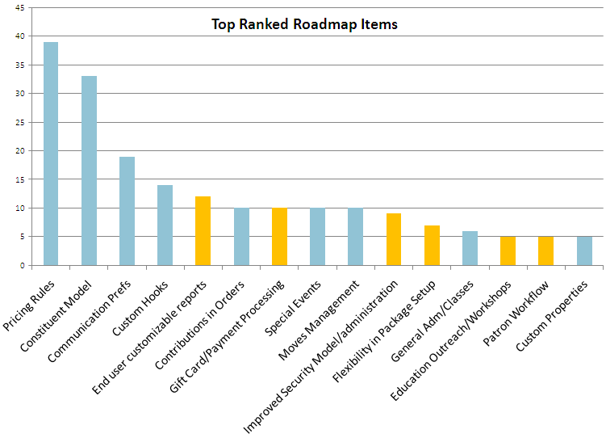

Slide 16
Functionality Roadmap Survey Recap
Two of the Top 5 are planned for Version 11:
  New Constituent Relationship Model
  Custom Hooks

Slide 17
Version 11 Vision

Slide 18
Version 11 Vision
Add to the existing Tessitura application:
  New Constituent Relationship Model
  First New Services Layer
  Custom Hooks
  Upgraded User Interface
  New Credit Card Server (possibly)

Slide 19
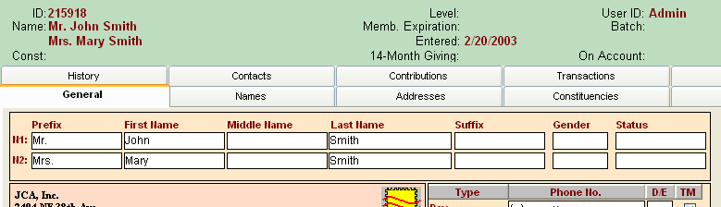
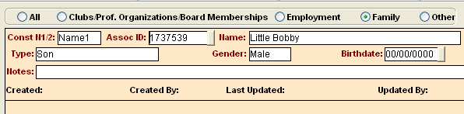
New Constituent Relationship Model
Seeks to addresses the limitations of “Name2”

Slide 20
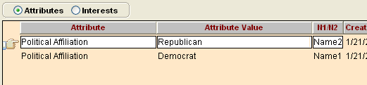
New Constituent Relationship Model
Seeks to addresses the limitations of “Name2”

Slide 21
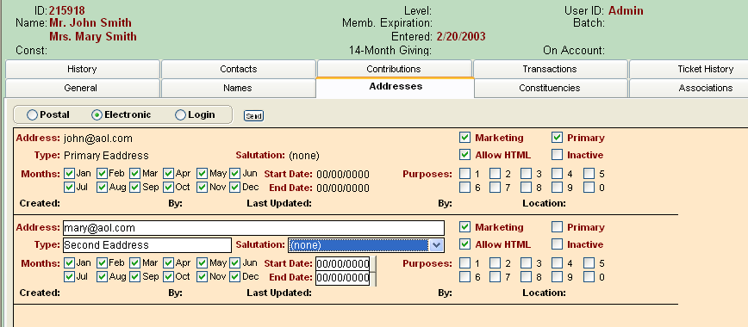
New Constituent Relationship Model
Seeks to addresses the limitations of “Name2”

Slide 22
New Constituent Relationship Model
Families can now be reflected as equal members of a group, rather than Name1+Name2+some associations
Creates new accounts for former Name1s and Name2s
Allows for each member of a family to have their own specific emails, phones, etc.
Still retains ability for household to be treated as a single entity

Slide 23
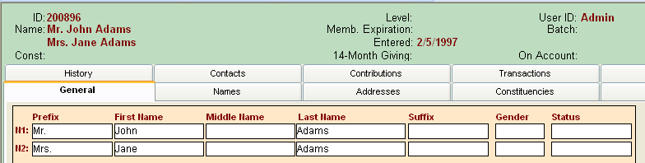
New Constituent Relationship model
How this will look in the application:
Version 10:

Slide 24
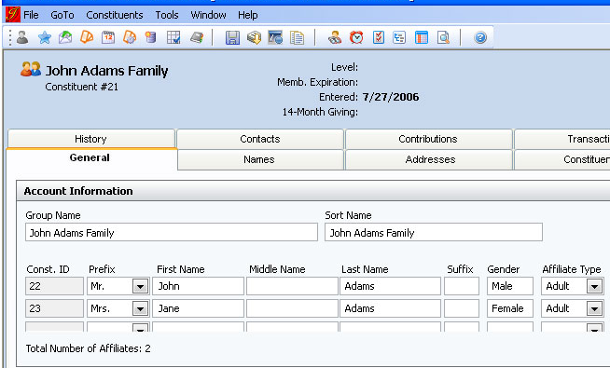
New Constituent Relationship model
How this will look in the application:
Version 11:

Slide 25
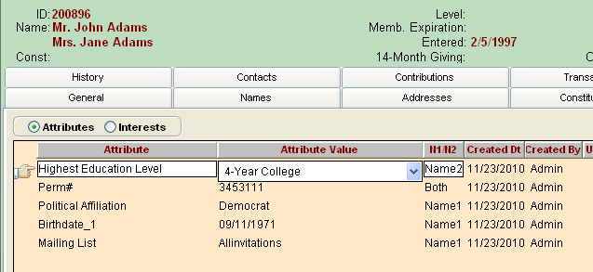
New Constituent Relationship model
How this will look in the application:
Version 10:

Slide 26
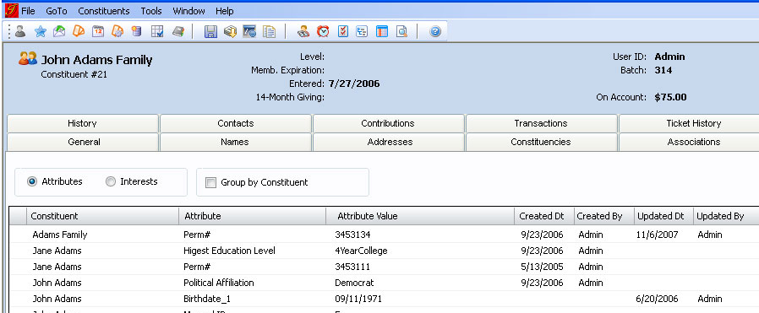
New Constituent Relationship model
How this will look in the application:
Version 11:

Slide 27
New Constituent Relationship model
Other features:
  List Manager, Extractions, Output Set Builder and Account Merges are all being enhanced to work with new model
  Control Groups functionality will continue to restrict data as it does today

Slide 28
New Services Layer
Modern Software Design Best Practice
Takes much of the business logic out of the database and user interface and puts it into a more portable code base
Allows much more of Tessitura functionality to be available on the web
For Version 11, much of the constituent business logic will happen (for the first time) in the services layer
The rest of the services layer will roll out in subsequent upgrades

Slide 29
Custom Hooks
Services Layer enables Custom “Hooks”, essentially a very flexible way to intercept actions between the user application and the database
Only available where there are services
Requires basic knowledge of a .NET language (such as VB.NET), we will include samples and helper utilities
Example 1 – You could write a hook to add a Constituency when a child is added to a family
Example 2 – You could write a hook to send an email to the Development Director when someone has the “Major Donor” constituency added to their account.

Slide 30
Updated User Interface
Required to support New Constituent Model
Opportunity to provide a more current look and feel
Considered an interim update, will revisit overall User Interface paradigm later in the project

Slide 31
Showcase

Slide 32
Version 11 Timeline

Slide 33

Version 11 Timeline
March 2011: Incomplete version to Sandbox (sample data) for MAC and interested users
April 2011: Sandbox for web developers
June 2011: Start Alpha testing with select MAC volunteers
July 2011: Start BETA testing with selected users
October 2011: General release of v11
Upgrade deadline will be at least 6 months after General Release

Slide 34
Preparing for Version 11

Slide 35
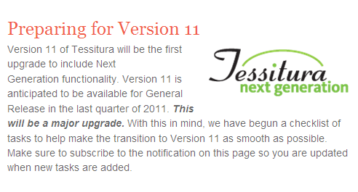
How you can prepare starting now
New page on tessituranetwork.com:
  From Homepage to NextGen Page
  Choose “Preparing for Version 11”
Frequently update check-list of tasks to ensure a smooth transition

Slide 36
Technical Considerations

Slide 37
Technical Considerations
SQL Server 2008
SQL Server Reporting Services
IIS 7, .NET 4.0
Gateway Server will have more workload
Much more detail at technical break-out session

Slide 38
Version 11:
Business Considerations

Slide 39
Training and Documentation
New Constituent Model will change all aspects of Constituent Functionality, from adding and editing Constituents, to Lists, Extractions and Merges
  We will provide documentation and learning materials to explain new functionality and give a translation from Version 10 to Version 11
  TLCC 2011 will have many opportunities to learn about Version 11 changes
Plan to release documentation as it is completed, in advance of upgrade

Slide 40
Upgrade Decisions
New Constituent Model will require adding new constituents and changing existing ones
NextGen team is working on scripting necessary to do this. Will include variety of organization-specific decisions.
Too early to discuss these items yet, but as we have them solidified, will get documentation out as it will require business/technical discussion.

Slide 41
Version 11:
Customization/Website Considerations

Slide 42
Customization Considerations
The Data Model is changing:
Associations table (TX_XREF) is being replaced with two new tables
  We will provide a view to replicate the existing TX_XREF
Name2 is going away
  We will provide views where possible to give backward compatibility for former Name2 functionality, to help ease transition.

Slide 43
Customization Considerations
Where there are other data model changes we will work to provide bridge between v10 and v11
As part of upgrade, we will provide audit reporting to identify custom SQL code that should be reviewed due to data model changes
Post-upgrade, we hope and anticipate that the new data model changes get worked into future customizations so that organizations take advantage of the many benefits of the new model

Slide 44
Customization Summary
Our goal for customizations in the upgrade to v11:
  Majority of your customizations will be unaffected
  Where the data model requires a change to a customization, in general, we anticipate a fairly simple change such as swapping out an existing table or view with a new view that provides backward compatibility
  It is still possible, based on your custom code, that more extensive changes to custom work may be required.
  Regardless, we anticipate being able to help you identify where customizations will need your review

Slide 45
Website Considerations
Very cognizant of need to impact website functionality as little as possible
Have arrived at an initial plan to keep existing API functional in Version 11, even with the change in data model.
During testing in April and May, we will confirm this plan and keep community posted on progress.
Version 11 will include a number of robust new services that work in the new model, providing the opportunity for organizations to take advantage of the new model if desired.

Slide 46
Wanna Learn More?

Slide 47
NextGen at ANZTRUC2011
In-depth with Constituent Model changes in V 11
  1:30 – 2:30 Today
Tech Review of Version 11
  (with Ron Wilson via Webex)
  2:30 – 3:30 Today
People to Corner about NextGen
  Jack Rubin
  Dale Bradbury
  Anna Wessely
  (Me)

Slide 48
Q&A

Slide 49
Thank you!

Slide 50
AUSTRALIA & NEW ZEALAND TESSITURA REGIONAL USERS CONFERENCE
MONDAY 21 FEBRUARY WHAT’S NEXT
MORNING TEA
MTC THEATRE LEVEL 1 FOYER
11.00AM-11.30AM

