Slide 1

AUSTRALIA & NEW ZEALAND TESSITURA REGIONAL USERS CONFERENCE
TUESDAY 22 FEBRUARY BREAKOUT SESSION #6
TESSITURA MAGIC
PRESENTER:
KIM LEE (SOH) & Friends

Slide 2
Tessitura
Magic
ANZTRUC
Style
UCSS Reset Users Password

Slide 3
What is it and why is it magic?
A Utility run from the Tessitura client
Allows a manager to reset a users password, without needing access to the Tessitura Security module.
Its secure, the temporary password is emailed only to the user, not the manger.
A temporary password is generated, which allows the user change their password to something they will remember at logon.
Saves time for users, managers and Tessitura administrators .

Slide 4
The scenario….
User: I can’t access Tessitura, its not accepting my password
Manager: Do you know what your password is?
User: I think so, but its my first shift in two weeks, so then again maybe I don’t.
Manager: Let me reset that for you…….

Slide 5
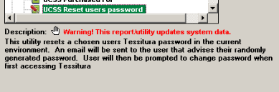
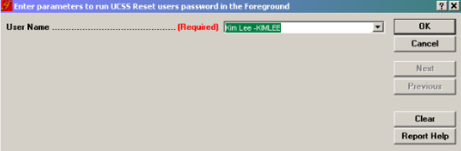
How does it work?
Manager locates the UCSS Reset users password Utility, in Reports & Utilities
Selects the user from the drop down and clicks OK

Slide 6
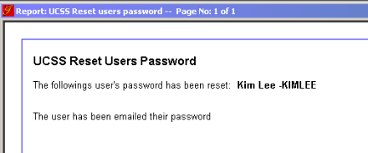
How does it work?

Slide 7
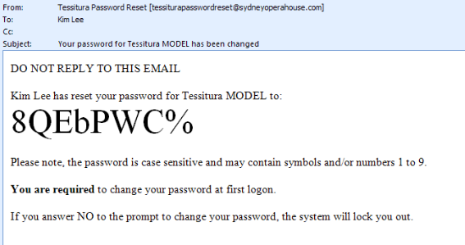
How does it work?
The user receives an email with a temporary password

Slide 8
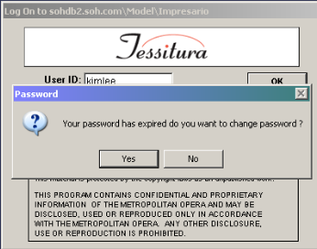
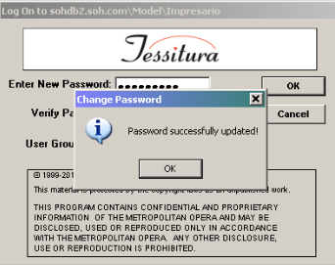
How does it work?
  The user logs in with temporary password supplied in the email (they can even copy + paste!), and is prompted to change their password
  Password updated! User has successfully logged into Tessitura without a call to Helpdesk/Tessitura System Administrator

Slide 9
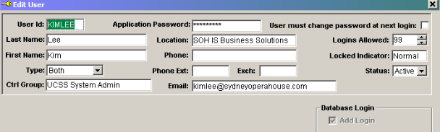
Setup – email addresses
In Tessitura Security, every ‘human’ user needs to have an email address
Shared email addresses like ‘boxoffice@organisation.com.au’ can be used, but are less secure.

Slide 10
Setup – who can reset who?
    Users who are allocated as Managers of a User Group in Tessitura Security can reset passwords for all users who have that User Group as their Default.
      Users may already be Managers of a User Group for the purpose of closing Batches and assigning Ticklers.
  A local table exists where User Groups can be defined as being able to reset passwords for users in other User Groups. Only the Tessitura System Administrator can edit this table.

Slide 11
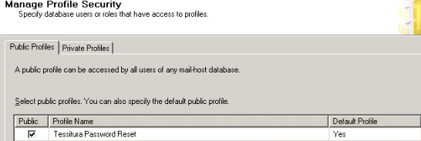
Setup – Database Mail
  Setup Database Mail on your database server - other Tessitura features such as emailed scheduled reports can use Database Mail so this may already be setup on your server
    Plenty of online resources for Database Mail setup
      http://technet.microsoft.com/en-us/library/ms175951.aspx
      Ensure Public Profile is ticked and Default Profile is set to YES

Slide 12
Setup – the pieces
  Stored Procedure – contains details of your servers, uses sql to generate random password, controls email layout (html), sends email via DB Mail
  View – controls drop down in report i.e. who can reset who
  Local Reference Table – feeds data into view above
  Infomaker object - report
  Report Setup – to add to Tessitura reports menu. Defines the report and the parameters.

Slide 13
Where can I get it?
  Tessitura Shared Reports on TASK – written by Warren Evans, Royal Shakespeare Company UK
    What we changed:
      Changed view to allow Managers of Users to reset passwords, as well as User Groups mapped in Local Reference table.
      Added into the SP and the email WHO ran the reset password report
      Got rid of zero (confusion with o) and added symbols to randomly generated password
      Added logic report can be run from Production and Test systems, and email identifies which system password was reset for.

Slide 14
“This report saves time for the end user and also relieves the helpdesk of an irritating task. It’s especially useful for users who return to the office after a period of leave/absence – the main circumstance where users frequently forget their passwords!”
AUSTRALIAN CHAMBER ORCHESTRA

Slide 15
“This report has allowed us to be more responsive - it's immediate and confidential. It doesn't involve too many "additional" people or time, and allows department managers with access to be autonomous.”
OPERA AUSTRALIA

Slide 16
“We use the utility about once a week (three times a day on the first week back from holiday). It’s perfect for the infrequent Tessitura users who never remember their passwords.”
BELL SHAKESPEARE

Slide 17

“This report is great especially on weekends as it saves us from having to wake up the IT person at 8:30am on Saturday mornings!”
SYDNEY OPERA HOUSE

Slide 18
Q & A

Slide 19
TESSITURA MAGIC
ANZTRUC STYLE

Slide 20
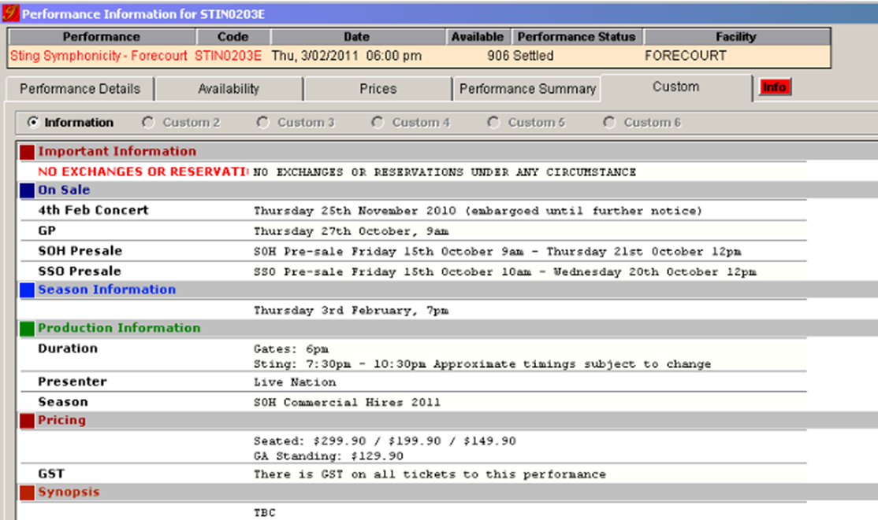
Product Information Module – Sydney Opera House
Through a series of custom screens this utility allows for a more structured and secure means of providing production information. It frees up the limited functionality currently utilised via the “Synopsis” tab in “Productions”. We also have a Report that allows Product Category elements to be copied from one Production Season to another.

Slide 21
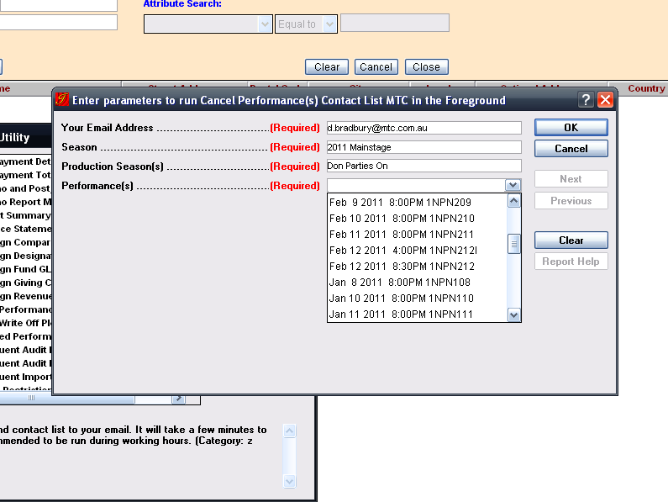
Cancelled Performance Report – Melbourne Theatre Company
Allows constituent details to be separated into the relevant contact modes for ease of instigating sms and eblast advice in the case of cancelled performances.

Slide 22
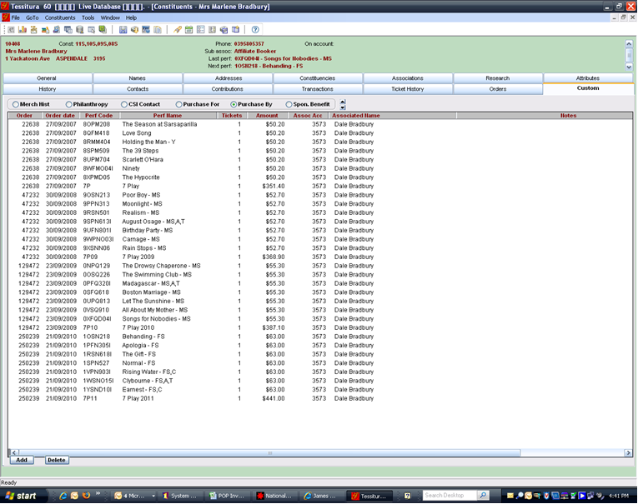
Special Request – Melbourne Theatre Company
When a line item in an order is special requested to another constituent a “ghosting” of the purchase is retained in the custom screen.

Slide 23
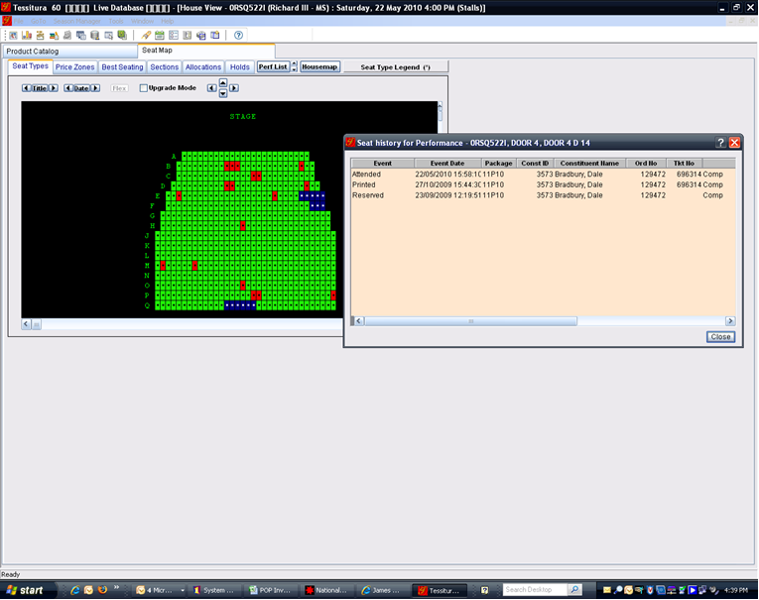
Access Control – Melbourne Theatre Company
By using access control we can tell who attended their booked performance. Great for following up any issues.

Slide 24
The Australian Ballet

Slide 25
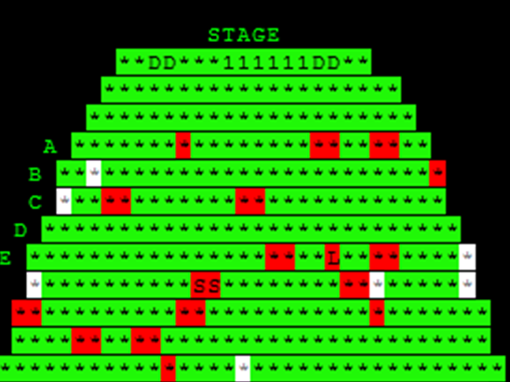
Order Import Utility – Melbourne Theatre Company
By using order import utility we can see exactly which seats have been sold by Ticketmaster to our MTC Theatre events.

Slide 26
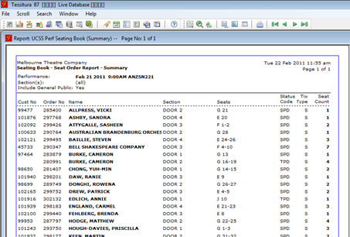
UCSS Perf Seating Book – Melbourne Theatre Company from SOH
Similar to the Performance Seating Book Report except it groups seating by section and seats.

Slide 27
Q & A

Slide 28
AUSTRALIA & NEW ZEALAND TESSITURA REGIONAL USERS CONFERENCE
Tuesday 22 FEBRUARY WHAT’S NEXT
Conference conclusion
lawler
2.30PM-3.00PM

