Slide 1

AUSTRALIA & NEW ZEALAND TESSITURA REGIONAL USERS CONFERENCE
TUESDAY 22 FEBRUARY BREAKOUT SESSION #5
List/extractions workshop
PRESENTER:
Anna wessely (tessitura)

Slide 2
Is Anybody Out There?
Advanced Lists and Extractions
Presenter: Anna Wessely

Slide 3
Your Host:
Anna E. Wessely
Manager Asia Pacific/ Senior Application Specialist
awessely@tessituranetwork.com

Slide 4
The Plan
Extraction Set Quickie Overview
When/why use an extraction
Examples of uses
  Complex List: Elevated Event Invitation
  Dynamic Copy: Call Sheets for Telefunding
  Segmented List: CYO Subscription Renewal & Acquisition

Slide 5
Extractions Overview
What is an extraction set?
Hierarchical discrete grouping of lists (segments); can generate output directly to a file, automatically promote segments, and/or be saved as a list.

Slide 6
Components of an Extraction
Header – contains source and appeal details
Body – contains Segments which are the discrete list elements

Slide 7

Extraction Header
For extraction which will be promoted directly from the extraction the header contains the default source and appeal data.
Sample Resultant Source Code

Slide 8
Extraction Body
Segments
  Discrete list of lists
  If generated counts are listed
  Settings for suppressions, random options, download numbers
  Appeal/Source details supersede default settings in header

Slide 9
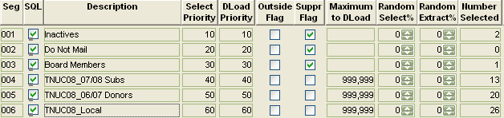
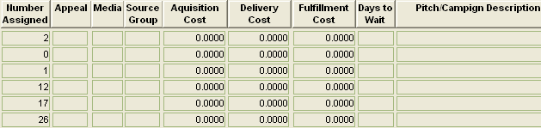
Screenshot of Extraction Body

Slide 10
Criteria Sets for Segments
Segment criteria managed in the criteria set window
  Accessed by double-clicking on Segment
  Criteria tree, operators, and values same List Manager
  Inactive accounts NOT excluded implicitly in Extraction Sets
Don’t Worry: During this class we will be looking at different uses of criteria, and criteria set functionality.

Slide 11
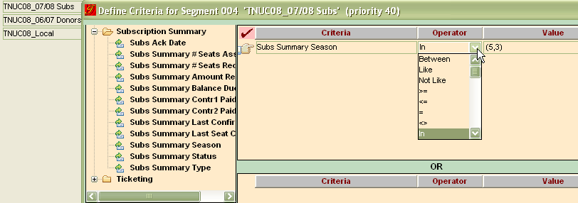
Screenshot of criteria set window in Extraction Manager

Slide 12
Suppressions
Finite groupings excluded from subsequent segment selections
Suppressions use positive logic in the criteria set window

Slide 13
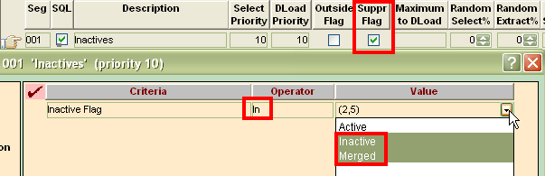
Screenshot of Suppression criteria set window

Slide 14
When to Use Extraction Sets
Complexity of Selection or Check your ANDs and ORs at the door
Look at the definition of the pull to evaluate complexity
If the selection can not be contained in a single list extraction sets may be appropriate

Slide 15
Complexity of Selection or Check your ANDs and ORs at the door
Samples:
Definition | Result
Active Constituents (const) Purchased Magic Flute (MF) for Nov 9 | List
Active const Purchased MF Nov 9 OR 11 | List
Active Const Purchased MF Nov 9 OR 11 OR 17 OR Noah’s Flood on Sept 14 OR 15 | Extraction
Active Const Purchased MF Nov 9 OR 11 AND Donors of >= $60 in the last 6 months AND NOT Opt outs AND NOT Board members AND NOT donors over $20,000 | Extraction

Slide 16
Segmentation used for Advanced Analysis
Segments can be used for testing different messaging, media, groupings, demographics against expected responses
Develops advanced profile of the constituent’s communication behavior

Slide 17
Constituent Selection Process
Segment Definition
Define and Order the Segments

Slide 18
Constituent Selection Process
Original Order
Identified Selected Suppression Final
Yes
No
No
No

Slide 19
Constituent Selection Process
Different Order
Identified Selected Suppression Final
Yes
No
No
No

Slide 20
Constituent Selection Process
Final Selection Comparison
Single Ticket Buyers
  2500 (52%)
  1700 (35%)
Lapsed Subscribers
  1400 (29%)
  950 (20%)
Local Metropolitan Area
  900 (19%)
  2150 (45%)

Slide 21
Automatic Promotion Example
We are going to be sending out a segmented renewal and acquisition mailing for a CYO subscription season in an effort to evaluate which segments are viable.

Slide 22
Desired Results
A segmented list to track response to the mailing.
Randomly selected test segments for mixed media.
Tracking response vs. cost for each segment
Assignment of different appeal details for test segments

Slide 23
Why Use Extractions for this Example?
% random selection and download for generating test segments
Using source details at the Segment level allows segments within the same extraction to have different features
Ability to analyse and re-order Segments prior to selection allows for finer tuning of the segmentation

Slide 24
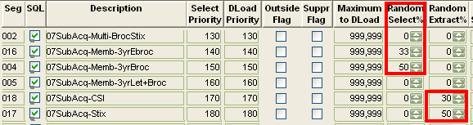
This Example Uses
Random Selection and
Random Extraction
Random Select % - Selecting a random percentage of constituents
Random Extract % - Downloading a random percentage of constituents
The Power of Segmentation

Slide 25

Random Select %
Allows selection of a random percent of selectable accounts
Accounts which are suppressed are not considered in the calculation
Reflected in the Count Report

Slide 26

Random Extract %
Allows download of a random percent of selected accounts
Similar to the “maximum to download” field – will only include a portion of selected constituents in the output file
Count report reflects the total available not the total to be downloaded

Slide 27
Suppressions
Standard Suppressions
  Inactive
  Do Not Mail
  Media
Renewal exception attribute

Slide 28
Selections for Standard Brochure
Renewals
  Full Play Package Subs
  Partial Play Package
  Mini Package

Slide 29
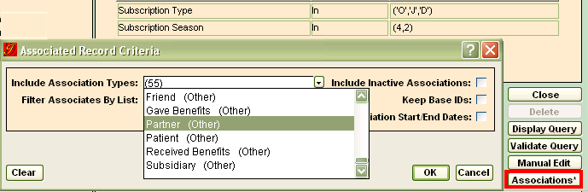
Selections for Standard Brochure
Subscriber Partners for Renewing Subscribers

Slide 30
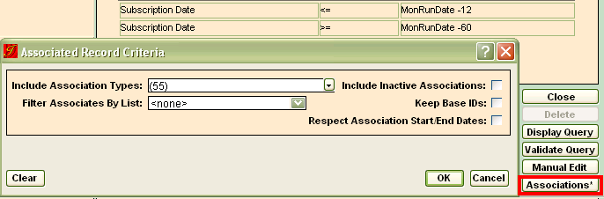
Selections for Standard Brochure
Reinstatement
  2 and 3 year Lapsed Subscribers
  4 and 5 year Lapsed Subscribers
  Lapsed Subscriber Partners

Slide 31

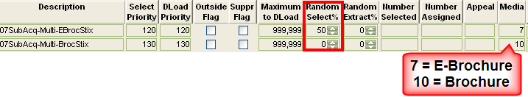
Random Selection Test Segment –Ticket Buyers
Acquisition: multi-year ticket buyers in last 3 years
  50% will receive an e-brochure
    1st segment has Random Select % of 50
  50% will receive the subscription brochure
    2nd segment has Random Select % of 0
The Power of Segmentation

Slide 32
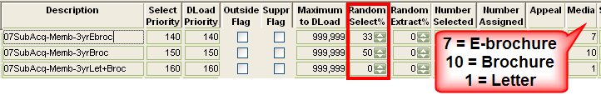
Random Selection Test Segment - Members
Acquisition: Renewing Members in the last 3 years
  1/3 will receive an e-brochure
    1st segment (33%) 1/3 of initial selection
  1/3 will receive the subscription brochure
    2nd segment (50%) ½ of available constituents; less 1/3 selected in 1st segment
  1/3 will receive a personalized letter and brochure
    3rd segment (0%) remainder of available constituents; 1/3 the original total
The Power of Segmentation

Slide 33
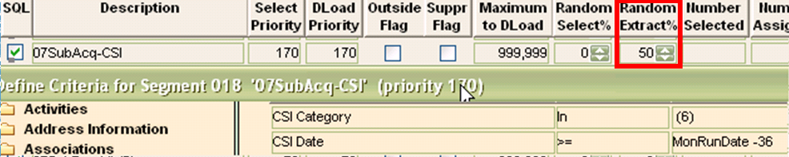
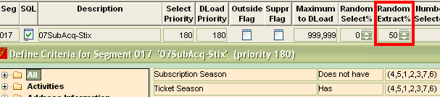
Random Extraction Test
Acquisition
  Download 50% of constituents who requested Information in the last 3 years
  Download 50% of single ticket buyers in the last 3 years
The Power of Segmentation

Slide 34
Check the order
Use count reports and suppression report to test the order of the segments
Adjust select priority to update Segment order

Slide 35
Extract Constituents
Promote Segments
Use Output Set to include data for suggested contribution
Include source code on response mechanism for ease of tracking
Setup promotion codes for the web

Slide 36
Bonus time
Using Criteria Selection and Manual Edit to get desired results
Tracking success of segments using reports

Slide 37

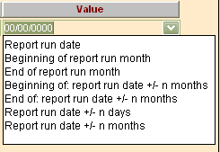

Extraction Specific Suppressions Using Dynamic Dates
Foundation and Capital Donors (w/i last year)
Recent Donors (w/i 4 months)
Contacted by phone recently (w/i last 4 weeks)
Poor response to calls within the last year
The Power of Dynamic Selection

Slide 38

Inline Suppression
Filter Selections Below Suppression
Acquisition Segments – select only accounts for non-members
Suppress Members using inline suppression

Slide 39
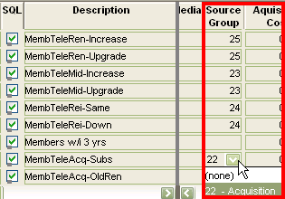
Edit Appeal Details at the Segment Level
For each segment set the Source Group
  Segment appeal details supersede header details

Slide 40
Email Desired Results
A list of eaddresses for likely respondents
Suppression of unlikely respondents as there is a per piece cost
Source codes for each segment so responses are tracked

Slide 41
Suppressed Segment
Using Promotion Data & Manual Edit
Hard bounce since last email address update
  This Suppression uses:
  Graphical Edit – Create the basic structure query
  Manual Edit – Modify existing SQL query in Criteria Set
  Validate Query – Check SQL Syntax

Slide 42

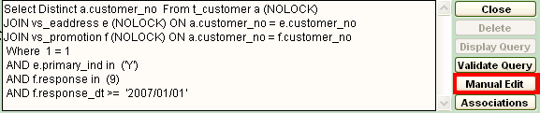
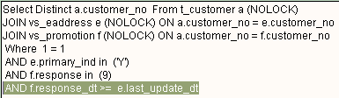
Suppressed Segment
Using Promotion Data & Manual Edit
Graphical Edit – Create the basic structure query
Manual Edit – Modify SQL query in Criteria Set
Original
Final

Slide 43
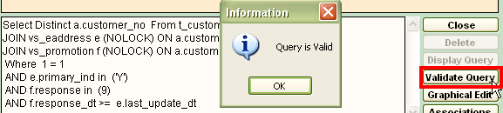
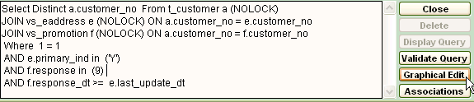
Suppressed Segments
Hard bounce since last email address update
Validate Query – to validate SQL syntax
Skip Graphical Edit Button; Returns to graphical interface loses changes

Slide 44
Response Tracking
Campaign Appeal Expense Report compares response with expense
Lists and extractions can be used to track household response counts
Fund Activity Report can track fund movement for the appeal

Slide 45
Extraction and List Resources
Introducing: T-Class Series
  Basic Concepts of Lists and Extractions
  Criteria and Criteria Sets
  Extractions
  All accessible on the website: http://www.tessituranetwork.com/network/Learning/E-Learning/Lists%20and%20Extractions.aspx
  Broken into individual lessons so you just review a single lesson (like In, Not In, Has, and Does Not Have)

Slide 46
Extraction and List Resources
Documentation
  Access through the help system
  And Website: http://www.tessituranetwork.com/en/network/Learning/Documentation/Extractions%20and%20Lists.aspx
Consulting
  Provide training and advice
  consulting@tessituranetwork.com

Slide 47

Advanced Lists and Extractions

Slide 48
AUSTRALIA & NEW ZEALAND TESSITURA REGIONAL USERS CONFERENCE
Tuesday 22 FEBRUARY WHAT’S NEXT
LUNCH & SPONSOR LAB
MRC SALON
12.30PM-1.30PM

Slide 49
AUSTRALIA & NEW ZEALAND TESSITURA REGIONAL USERS CONFERENCE
Tuesday 22 FEBRUARY BREAKOUT SESSION #6
1.30pm-2.30pm
MOBILE/FUTURE TECHNOLOGY (PRESENTATION), MTC VIP SQUARE
PHILANTHROPY ROUNDTABLE (DISCUSSION), MRC VIP (WILLIAMS)
TESS ORGANISATION WIDE (DISCUSSION), MTC VIP LONG
TESSITURA MAGIC ANZTRUC STYLE (USER PRES), MTC LAWLER
APPEALS VS SOURCES (WORKSHOP), MRC REHEARSAL ROOM

