Slide 1

AUSTRALIA & NEW ZEALAND TESSITURA REGIONAL USERS CONFERENCE
TUESDAY 22 FEBRUARY BREAKOUT SESSION #4
Revenue management application workshop
presenter:
Andrew recinos (tessitura)

Slide 2
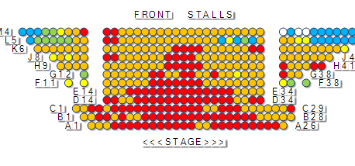
ANZTRUC
Revenue Management Application
Workshop
Andrew Recinos
JCA

Slide 3
Today’s Agenda
Background
Revenue Management in the Arts
Product Demonstration
Q&A

Slide 4
Some Background…

Slide 5
About The Pricing Institute
Partnership of consultants, founded 2008
Worked with more than 200 arts and cultural organizations worldwide
Minimum 200% Return On Investment on evaluated projects
Current and Recent Tessitura Clients include:
  Glyndebourne Festival Opera (UK)
  Philadelphia Orchestra (USA)
  Stratford Shakespeare Festival (Canada)
  Sydney Opera House (Australia)

Slide 6
About JCA
Consulting and Product Development company focused on the Non Profit market
Certified Tessitura implementation consultants since 2002
Develop, support and maintain T-Stats for 108 Tessitura organizations
Leader in Non Profit Business Intelligence

Slide 7
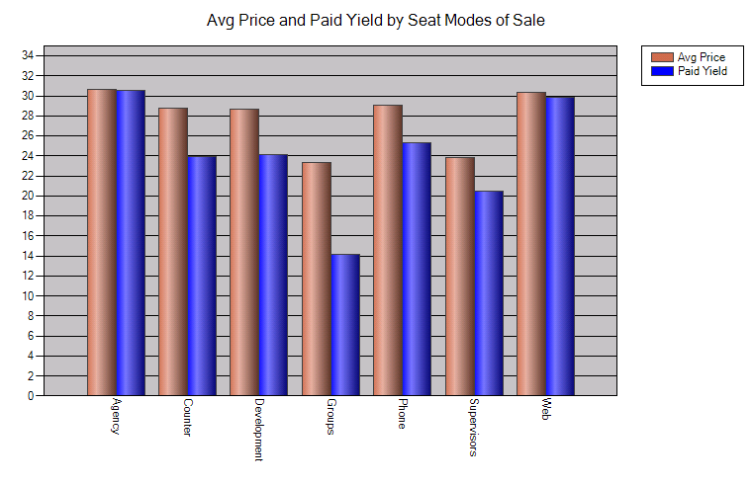
A Collaboration
JCA and The Pricing Institute first worked together in developing the Seats Cube in T-Stats v2.0…

Slide 8
Introducing….
JCA and The Pricing Institute now introduce the Revenue Management Application
Incorporating The Pricing Institute’s proven methodologies into a single user-friendly application that uses your Tessitura data

Slide 9
Revenue Management Success Stories
from Tessitura Network Members
Producing Theatre Company, with a star appearing in a three week run of a new play, raised prices, eliminated discounts and made US$50,000 in additional revenue
Performing Arts Organization rescaled house, applied dynamic pricing to their most popular performances and added US$145,000 in additional revenue in the first half of the season alone.

Slide 10
What is Revenue Management?

Slide 11
“Revenue Management ensures that companies will sell the right product
to the right customer at the right time
for the right price”
-- Robert Cross

Slide 12
Revenue Management techniques
we had in mind when developing the RMA

Slide 13
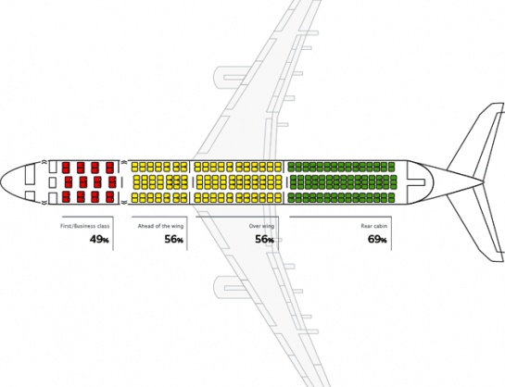
Revenue Management Techniques
Inventory Control

Slide 14
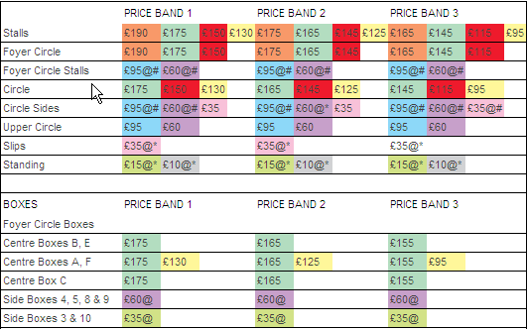
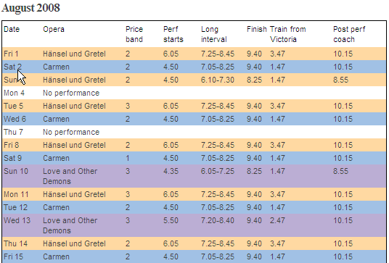
Revenue Management Techniques
Variable Pricing by Performance

Slide 15

Revenue Management Techniques
Strategic Discounting. Monitor and control:
  Discount rate
  Applicability
  Availability
RM objectives can also be achieved through: Subscription Design, Dynamic Groups Management, and other sales promotion initiatives.

Slide 16
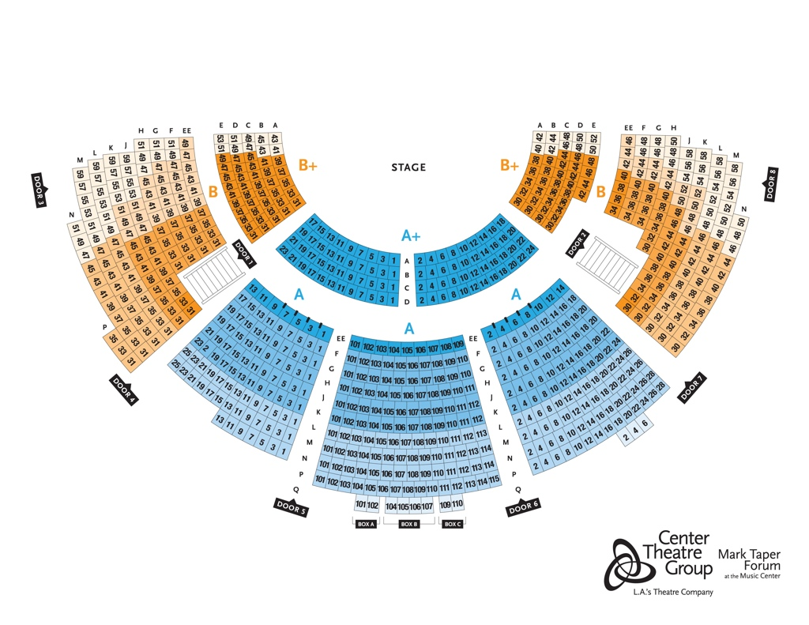
Revenue Management Techniques
Premium Pricing
  Value-add
  Leveraging upgrades/ donations

Slide 17
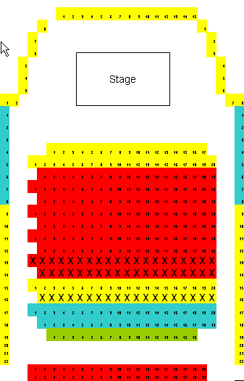
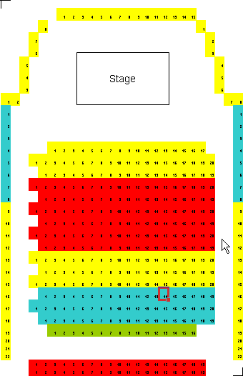
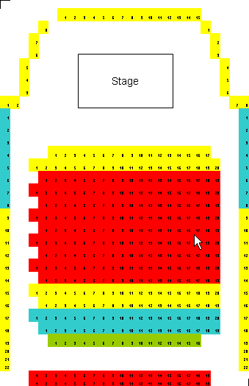
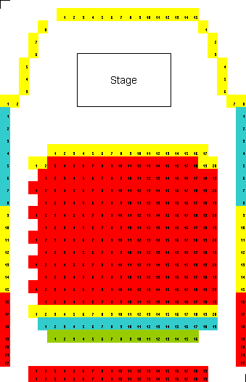
Revenue Management Techniques
Variable Scaling
Variable Adjustable Scaling

Slide 18
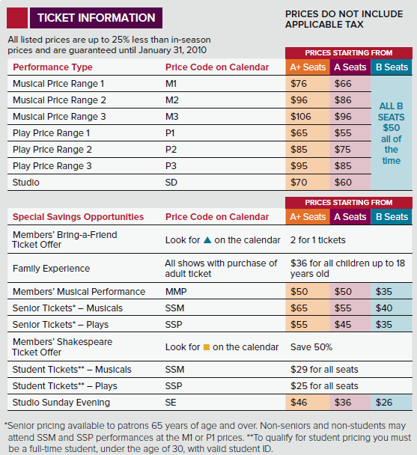
Revenue Management Techniques
Dynamic Price Management

Slide 19

Revenue Management Techniques
Inventory Control
Variable Pricing by Performance
Strategic Discounting
Variable Scaling
Premium Pricing
Dynamic Pricing

Slide 20
We already DO Revenue Management
The main opportunity is to
MANAGE it better

Slide 21
The Revenue Management Application Features
25+ Pricing and Analysis Charts and Reports
The Pricing Institute Hot Seat Index ™
Reports on your Tessitura sales data
  via T-Stats Data Warehouse
Ability to filter and group performances on the fly
Ability to aggregate performance averages and percentages across a group
Works with Consortiums

Slide 22
Let’s Have a Look…

Slide 23
Training and Consultancy Included with RMA
RMA provides powerful analytics for those that can interpret it
These are new concepts, metrics, terminology
To ensure you get the most out of the RMA included with license is
  Comprehensive User Documentation
  RMA Recipe Book
  16 hours of Consultancy with The Pricing Institute each year

Slide 24
Pricing
We install
Unlimited licenses per organization
Documentation
Upgrades
Includes Training and Consulting
Tessitura Tier | Annual Subscription
A | US$6,000
B | US$6,000
C | US$6,000
D | US$9,000
E | US$9,000
F | US$9,000
G | US$12,000
H | US$15,000
I | US$18,000

Slide 25
Contact us!
rma@thepricinginstitute.com
rma@jcainc.com
011.888.446.4588 ext. 318

Slide 26
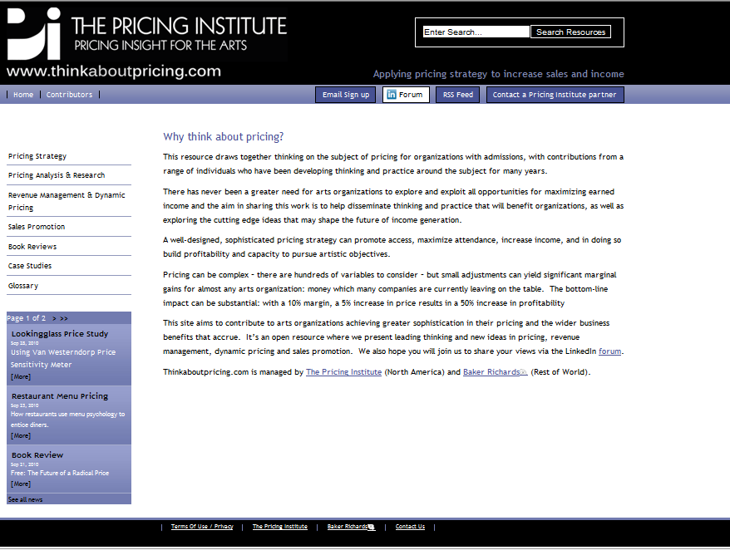
www.thinkaboutpricing.com
Discussion forum on LinkedIn

Slide 27
Q&A

Slide 28
Contact us!
rma@thepricinginstitute.com
rma@jcainc.com
888.446.4588 ext. 318

Slide 29
AUSTRALIA & NEW ZEALAND TESSITURA REGIONAL USERS CONFERENCE
Tuesday 22 FEBRUARY WHAT’S NEXT
Morning tea
Mtc level 1 foyer 10.00aM-10.30aM
Pci compliance
(GENERAL SESSION)
LAWLER 10.30aM – 11.30aM

