Slide 1

AUSTRALIA & NEW ZEALAND TESSITURA REGIONAL USERS CONFERENCE
MONDAY 21 FEBRUARY BREAKOUT SESSION #3
NON-TRADITIONAL PERFORMANCE
PRESENTERS:
KYLIE ANANIA & Natasha purkiss (SSO)
Kim jacobs (soh)

Slide 2


Working Harmoniously
getting box office and development on the same page

Slide 3
Introduction
events
charity requests
holds
Notes:
Word of Introduction:
Natasha box office operations manager
& Kylie P&PA E
Worked together at SSO for 4 years
Have implemented some things through tess that make communication btwen BO and DEV smoother

Slide 4
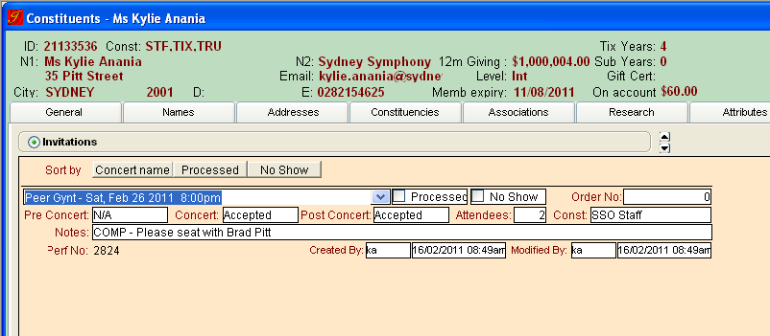
events
Notes:
3 kinds of events
Free non concert related
Non free non concert related
Concert related
Talk through the fields
Concert is a drop down populated by the upcoming season in date order
Process is for BO to tick when done
No show we go back after
Order No populates when the tickets are processed
Const = sso staff/donor/sponsor etc
Notes is used for communicating with BO

Slide 5
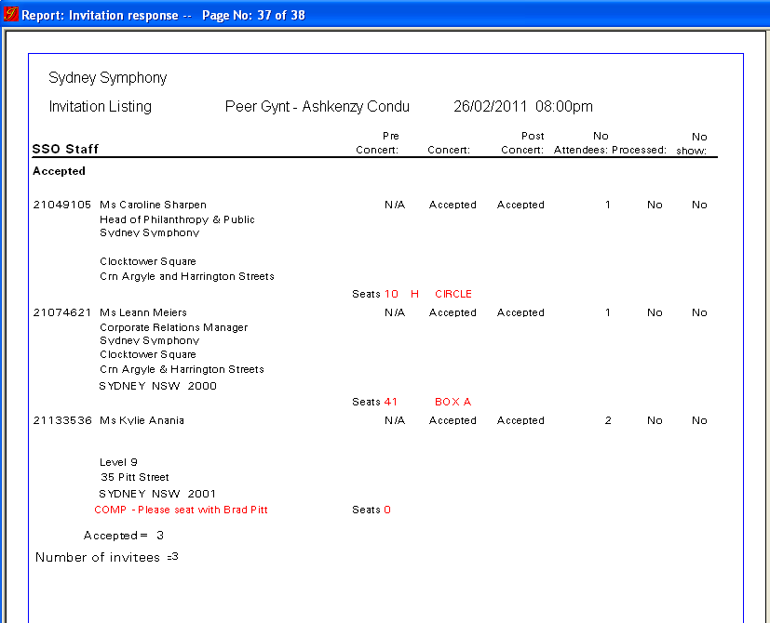
events
Notes:
When there is an event on BO pulls this report regularly and anyone with “accepted” gets a ticket processed
The report shows where guests are sitting and any nots for BO comes up in Red
If it were a patron who was paying the note would say PAY – Charge AMEX exp 09/2001 etc
If it were a sponsor it would say “internal Billing”
Can use for specific seating requirements ect
For those who don’t like looking at tessitura reports – very easily saved as excel and there are address details on the excel too – so if you wanted to send a thank you letter to everyone who came or something you could very easily
When there is an event on we Schedule an excel to be emailed to BO to book in the tickets
**makes it easy for them to copy & Paste id no & read the notes

Slide 6
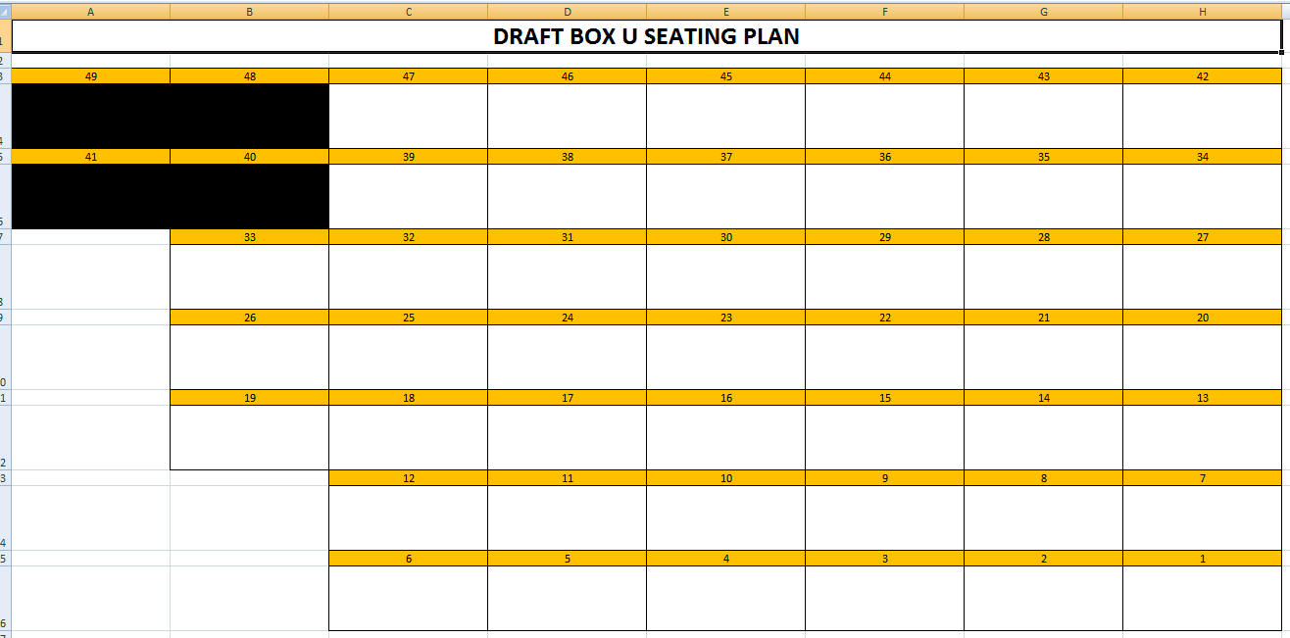
events
Notes:
Clever excel programming
MD fills out in pensile
BO allocates the seats accordingly

Slide 7
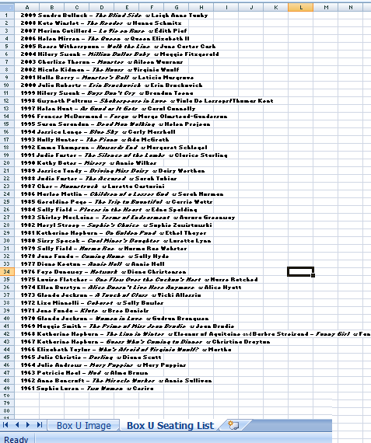
events
Notes:
Then we pull our report and pull the people sitting in box U in order
And copy it into this spreadsheet

Slide 8
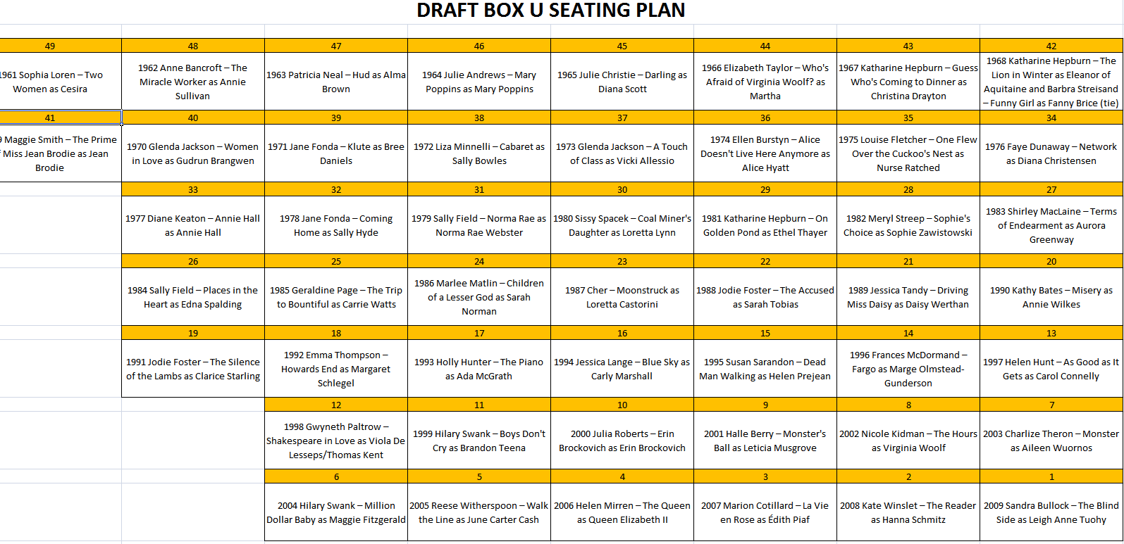
events
Notes:
And it populates the other page like this

Slide 9
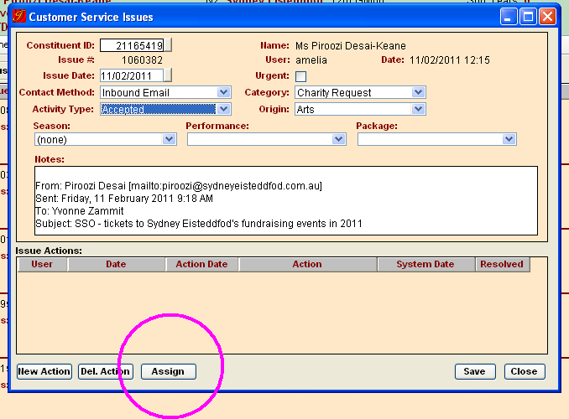
charity requests
Notes:
PHIL enters CSI and
Assigns it to BO
They print the voucher and close the tickler

Slide 10
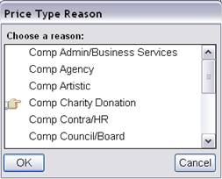
charity requests
Notes:
We have a price type reason to see what concerts people areredeeming charity vouchers for..

Slide 11
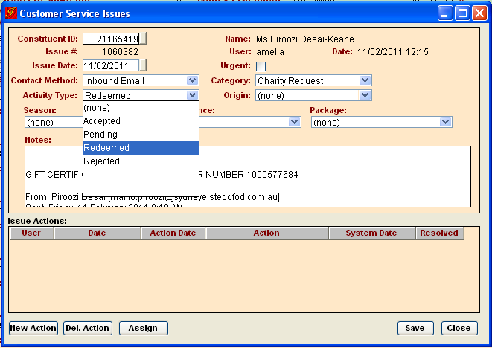
charity requests
Notes:
Activity type changed to redeemed
And the order no it was redeemed under entered into CSI

Slide 12
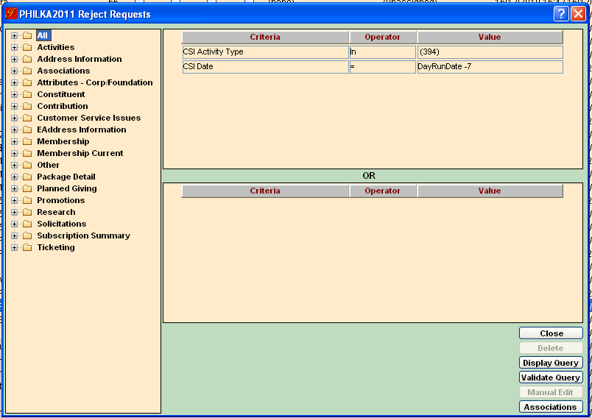
charity requests
Notes:
REJECT
Activity type = (394) Reject
List that gathers anyone with that CSI -7 days (or however regularly you do it)
Merge the output with a standard Reject letter

Slide 13
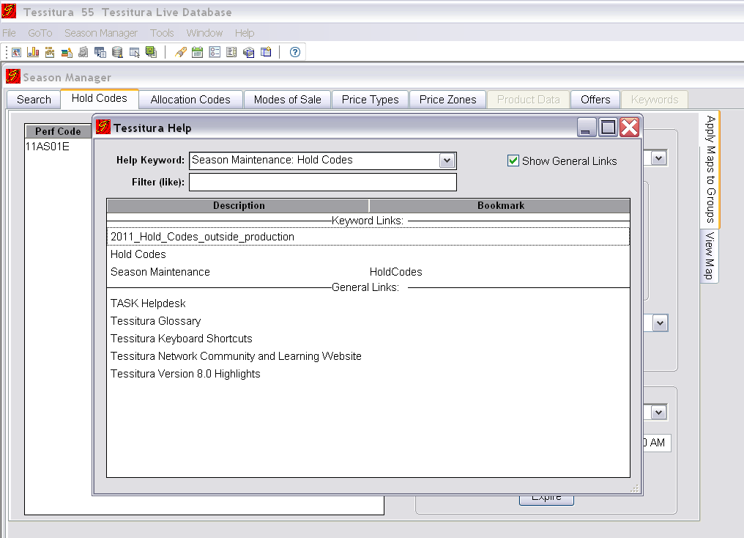
holds

Slide 14
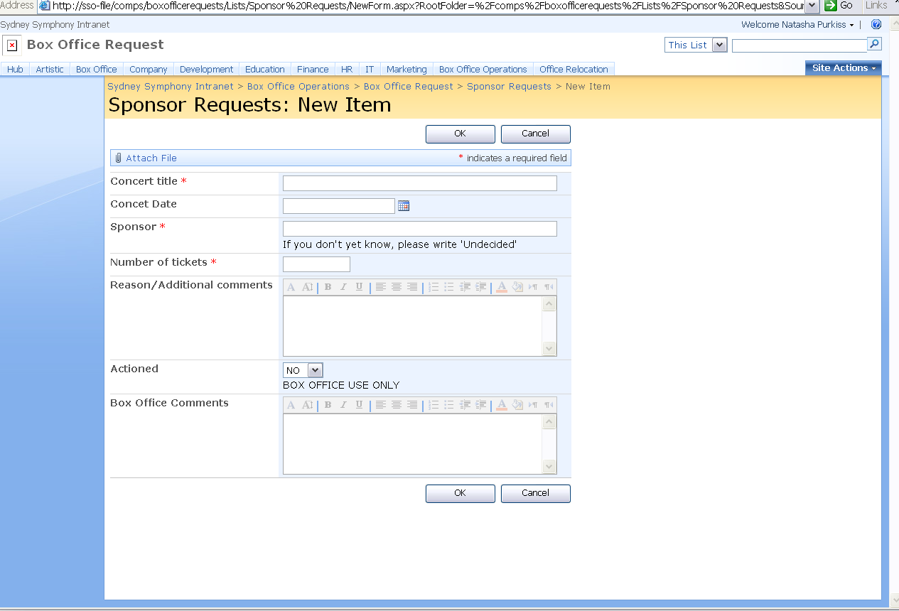
holds

Slide 15
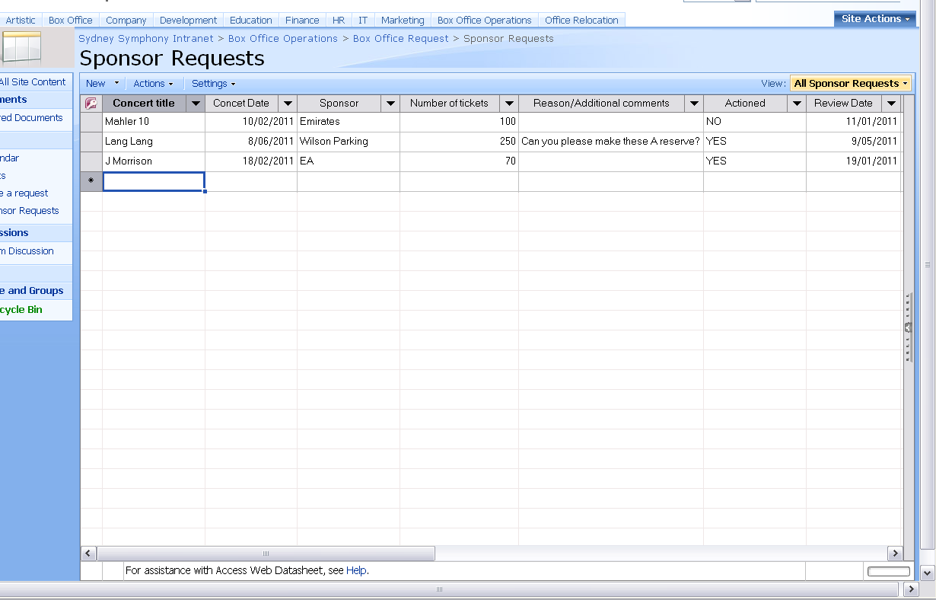
holds

Slide 16
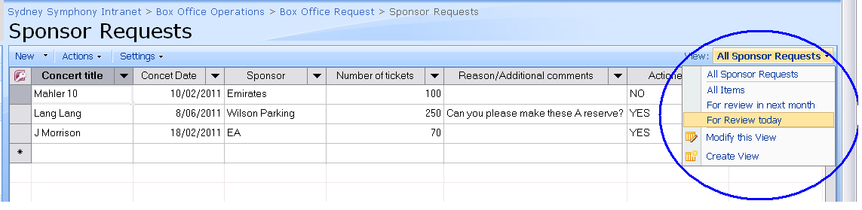
holds

Slide 17
thank you... any questions?
Natasha Purkiss |Manager of Box Office Operations
natasha.purkiss@sydneysymphony.com
Kylie Anania |Philanthropy & Public Affairs Executive
kylie.anania@sydneysymphony.com
Notes:
The GST Problem

Slide 18
ANZTRUC 2011
Sydney Opera House Tourism
Managing Tours with timed entry in Tessitura

Slide 19
Introduction
Sydney Opera House is a major tourism destination as well as a busy performing arts centre.
Approximately 320,000 people take a tour every year, creating revenue of over $7m.
85% of our customers are international travellers, with the bulk of domestic business coming from interstate – mainly from Victoria and Queensland.
Tourism revenue provides a significant contribution (nett profit), back to Sydney Opera House that is invested in performing arts and community.

Slide 21
Guided Tours operate 363 days a year, and are offered in six languages:
17 Public Tours in English (up to 35 per day in peak season)
Up to 20 Group Tours in English during the peak Cruise Ship season
16 Tours in Mandarin (up to 30 tours during Chinese New Year)
8 Tours in Japanese
7 Tours in Korean
3 tours a week in French and German

Slide 22
When Tessitura was first introduced, the challenge was how to represent all this in the most efficient and user-friendly method.
Our first attempt was to create a new event for every tour, however this was unwieldy for the user due to the volume of tours operated on a daily basis and it became immediately apparent that this would use an enormous amount of server space. The other problem that was encountered was that the performance dropdown took in excess of one minute to load for each new transaction, and consequently the Product Catalogue had a massive amount of information to sift through.
Given that the average time for each transaction to sell a tour is approximately 30 seconds this was unacceptably, not to mention frustratingly, slow.
With the configuration that was finally decided upon, only one item per tour type populated the Product Catalogue. This used up far less space on the server and kept the number of items seen for each day in the Product Catalogue down to a manageable number.

Slide 23
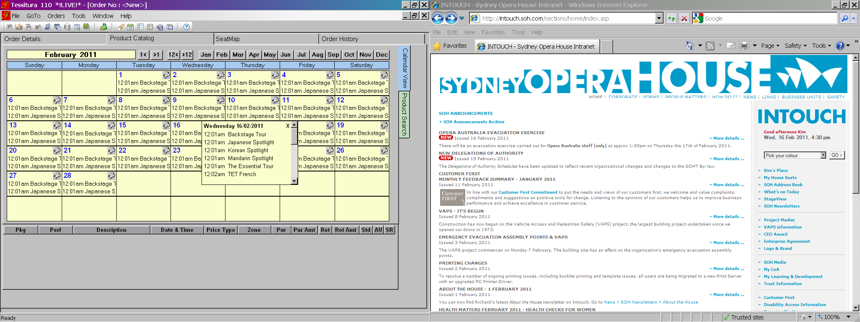

Slide 24
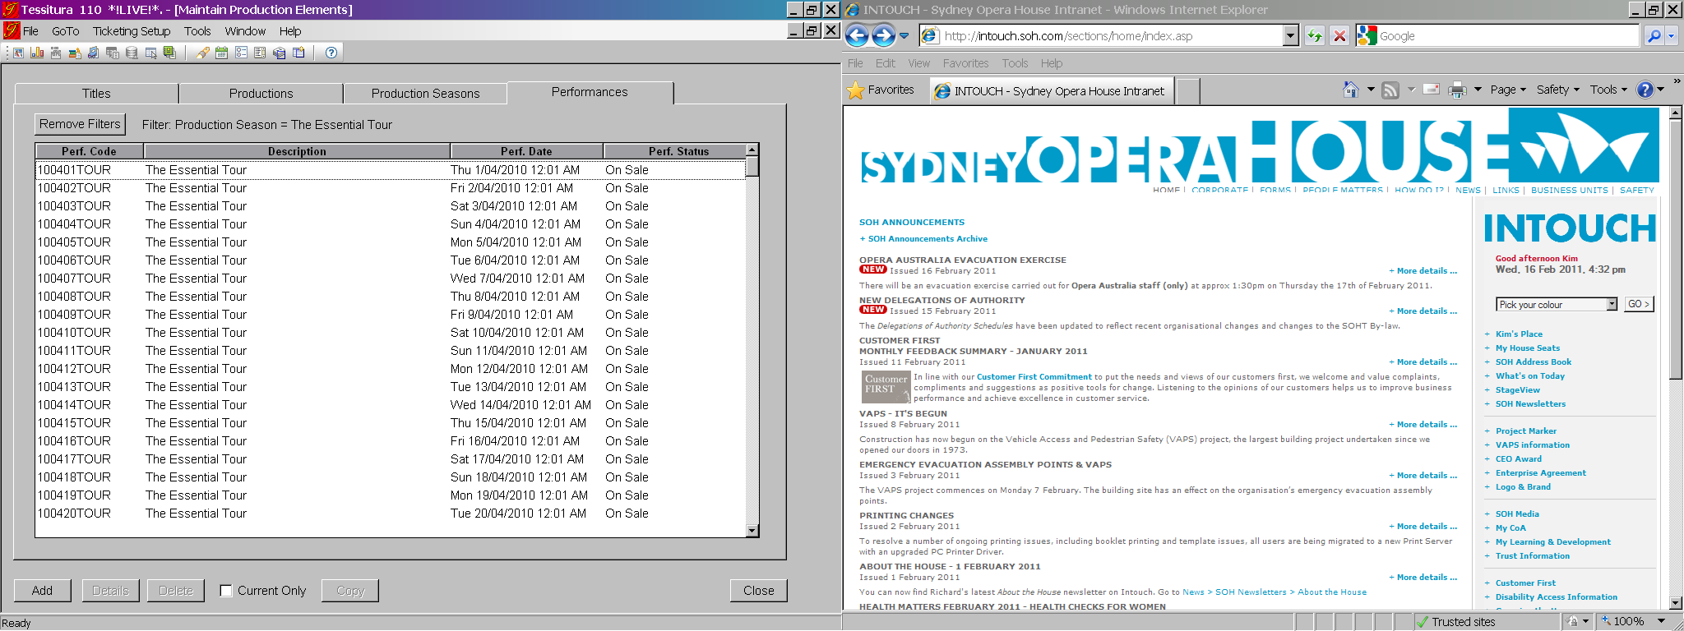
Tessitura Set Up
Each different type of tour has its own Seat Map – one event per day

Slide 25
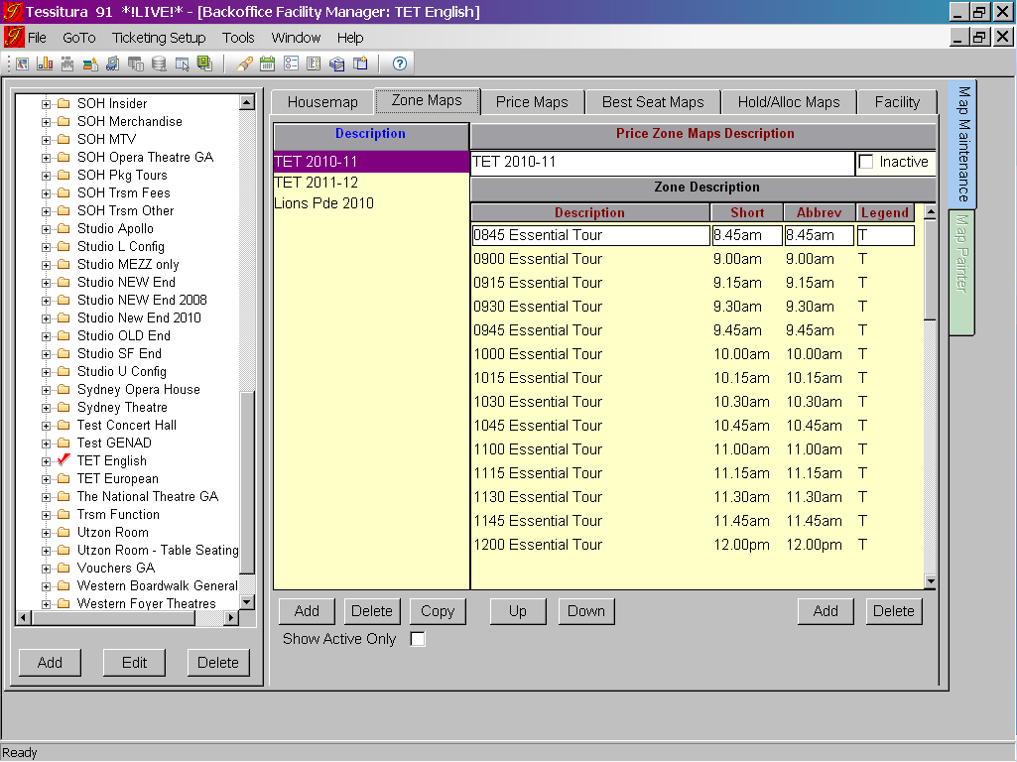
Each tour time is represented by a Zone, with a set number of seats available for each tour

Slide 26
Tour times (Zones) are named in conjunction with the Zone Map so that the time of the tour is printed on the ticket issued. The ticket is formatted to suit Tourism needs with the tour time (zone) being the most prominent information.
We even have a little bit of space on the stub for advertising.

Slide 27
Inventory Management
Control of tour times available for sale is done with Hold Codes which are applied to each seat map and are reviewed as part of our Inventory Management process.
Tour times that are held on “Contingency” have a “C” Hold Code applied. These times can be opened as required for extra tours by Operations.
Tours are available for sale on our website. To ensure that we retain a portion of each scheduled tour for walk up customers, a W (Web Hold) code is applied. A “Web Release” Hold Map is applied daily to release the web hold codes. Operations supervisors check each morning to release or apply additional Hold Codes as required for daily tour operations. Tours Desk staff can clearly see which tours are open for sale.
Inventory management is monitored throughout the day by Operations and tours are added or closed as business demand requires.

Slide 28
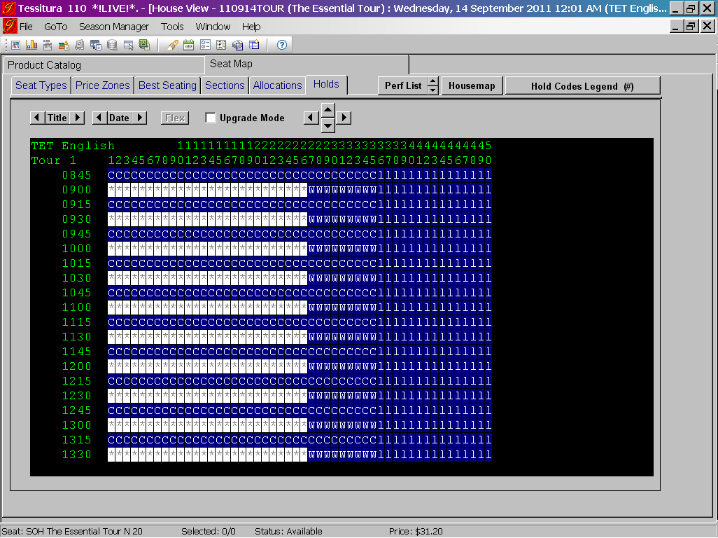

Slide 29
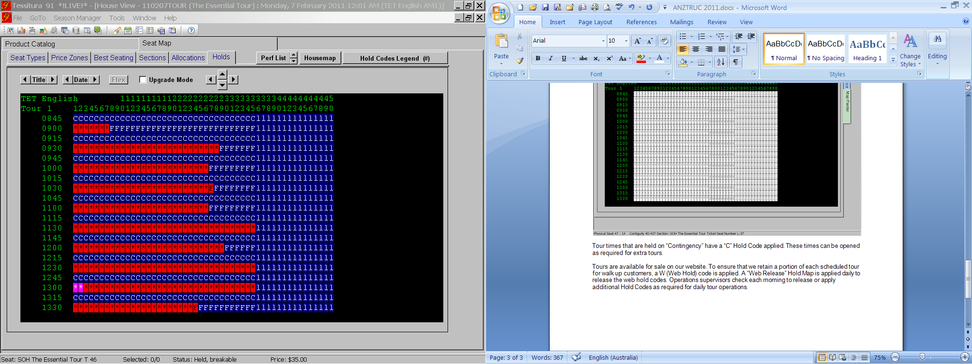
Information on the tours sold is also utilised by our Tour Guides and our AV Support person. Headset equipment is prepared for each tour and staff need to know how many to have ready for each group. This information is also provided to the tour guide, who counts the number of customers on their tour before departing. We apply another hold code (F) to signify that the tour has been closed for sale.

Slide 30
Planning ahead to determine best use of our tour guide staff and availability of access to each of our theatres is monitored in conjunction with planned performances, rehearsals and events.
Where we encounter a period of time where both our main theatres – the Concert Hall and the Opera Theatre – are unavailable, Hold Codes are applied (H) to represent that there are no Main Theatre available. This restricts sales from being made online and is also used by Reservations who look after Agent Group Sales.
Tours may still be booked by our Reservations Team however this hold code allows us to inform companies that their tour will not see the larger theatres, and a decision can be made by the tour company on whether they still wish to book for that time.

Slide 31
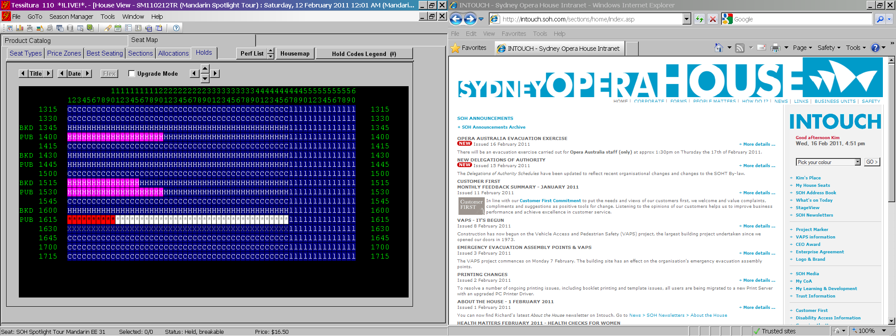

Slide 32
Part of inventory management also encompasses rostering to tour guides. There is a set schedule for public tours, Asian Language tours, French and German tours that are run daily. These are easily rostered as there are few changes.
Group Bookings are ad-hoc and the number of guides required on any given day varies. The shift start times and length of shifts are dependant on the tour times booked. A single guide taking a one hour group tour requires a 30 minute turn-around to prepare for the next group. Each guide can take three groups over a 4 ½ hour shift, with groups booked at 90 minute intervals. The Reservations Team uses this pattern to enter bookings for group tours.
Hold codes are applied at the time the roster is finalised (usually two weeks out) to indicate to the Reservations Team which Group Booking tour times have been closed where there is no guide rostered, and which are still available to be booked.

Slide 33
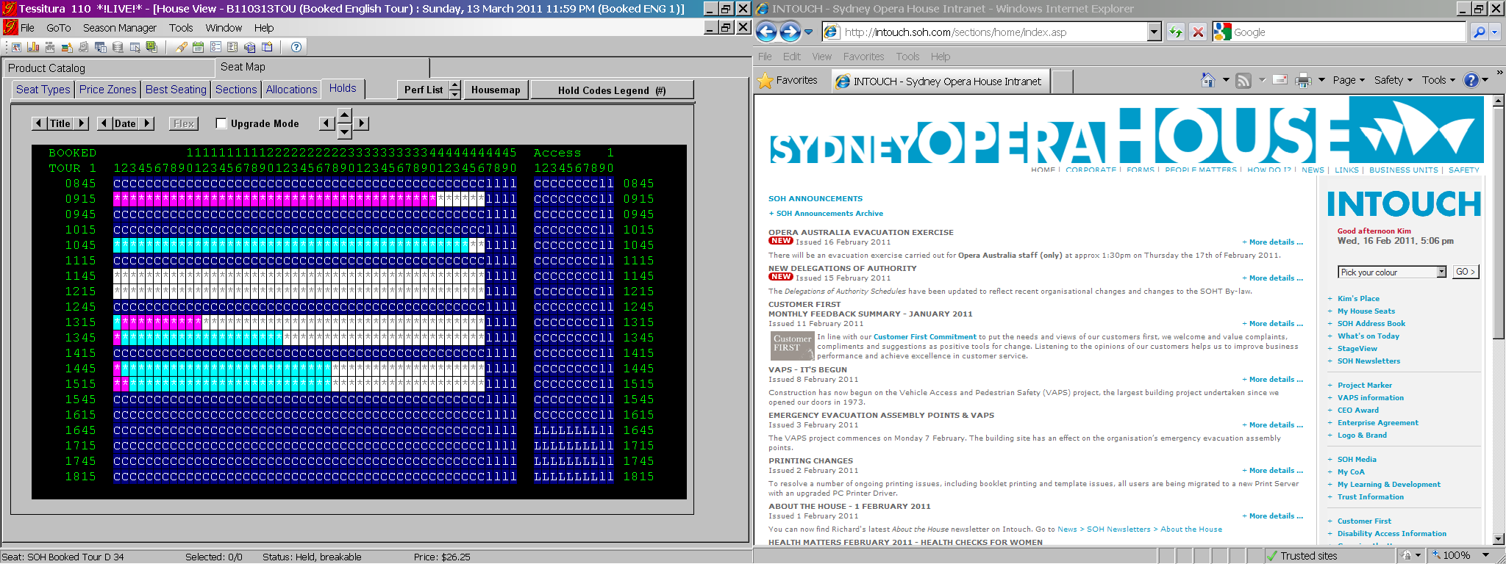
Rigid control of inventory allows us to operate efficiently and control labour costs, ensuring that we utilise our guides for the optimum number of tours each shift. Using the booking pattern as a template, Operations are able to determine, at roster time, how many guides are required each day to service the number of group bookings in the system.

Slide 34
Looking to the Future
We are currently working on a number of projects which will make business processes more efficient, save on resources and satisfy our customers’ needs in an increasingly technological environment.
These measures include streamlining the way we send confirmations and invoices to customers by use of emailed confirmations and invoices, and allowing industry agents the ability to make their own group bookings online through a dedicated portal that will give them access to their own specific price types.

Slide 35
Kim Jacobs
KJacobs@sydneyoperahouse.com
Tourism Reservations Supervisor
T +61 (0)2 9250 7915 F +61 (0)2 9250 7096 M +61 (0)413 498 310
Tourism Reservations - for all Bookings
Tourism@sydneyoperahouse.com
T +61 (0)2 9250 7250 F +61 (0)2 9250 7096

Slide 36
Q & A

Slide 37
AUSTRALIA & NEW ZEALAND TESSITURA REGIONAL USERS CONFERENCE
MONDAY 21 FEBRUARY WHAT’S NEXT
AFTERNOON TEA
MRC SALON 3.30PM-4.00PM
SOCIAL MEDIA
(GENERAL SESSION)
LAWLER 4.00PM – 5.PM

