Slide 1

AUSTRALIA & NEW ZEALAND TESSITURA REGIONAL USERS CONFERENCE
MONDAY 21 FEBRUARY BREAKOUT SESSION #3
NEXT GEN BREAKOUT #2
PRESENTER:
ANDREW RECINOS (Tessitura)

Slide 2

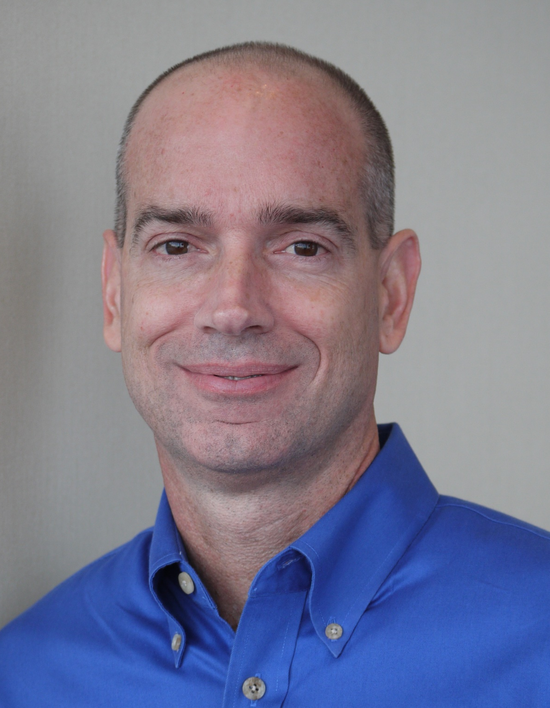
Tessitura Next Generation
Technical Session
Monday, 21 February, 2011
Andrew Recinos
Ron Wilson
(via Phone)

Slide 3
Agenda

Slide 4
Agenda
Review of Product Development work to date
Version 11 Upgrade Technical Considerations
Version 11 Data Model Changes
Q&A

Slide 5
Development Review
(Sept 2010 – Feb 2011)

Slide 6
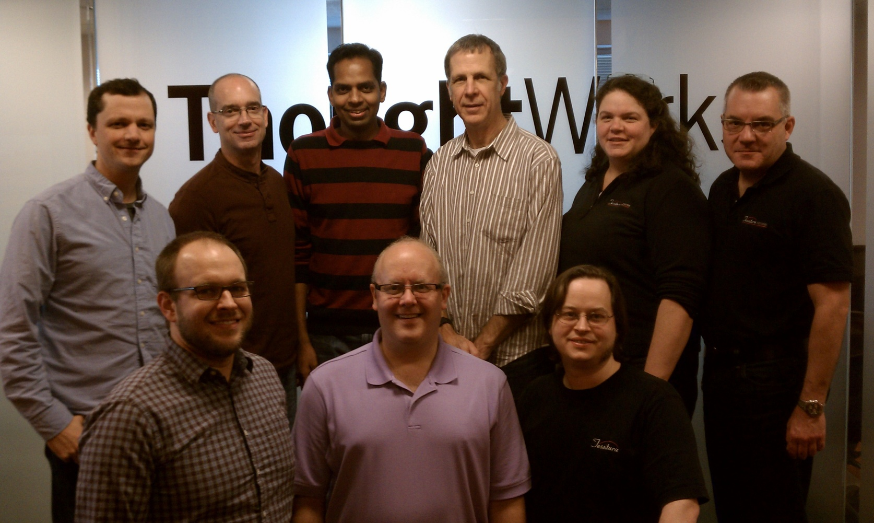
The Team - Shimoga
Andrew Recinos, Ron Wilson, Ravi Ranjan, Chuck Reif, Anna Wessely, Steven Bras
Ryan Creps, Rob Pedersen, Mark Rhodes

Slide 7
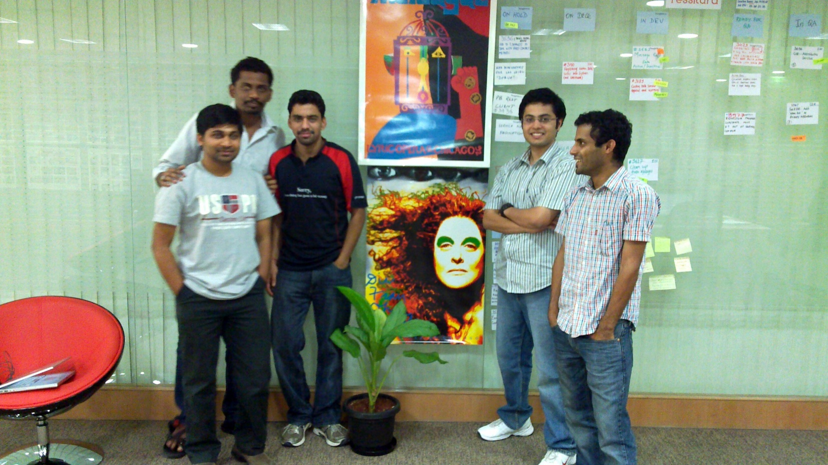
The Team - Vegas
Hari B (Dev), Mahadev Prased (Dev), Chethan Prakash (Dev), Ankur Bhatia (Dev Lead),
Harsha Maya (QA), Suresh Jaydev (QA/BA – not shown)

Slide 8
Development Activity
Completed first 12 iterations under the Evolutionary development approach, with very positive results.
Migrated previously developed REST service framework to work with existing Impresario database.
  DB access, logging, auditing, OAuth security, control groups, custom data
Began creating REST service exposures for basic constituent information using the new constituent model.
As supporting services were completed, created/updated Tessitura client UI to use the new design patterns and services layer where appropriate.

Slide 9
Development Activity
Constituent model areas covered so far:
  Constituent Search (Including new Single Line Search)
  General Tab (Create, Read, Update Individuals and Groups)
  Addresses
  Salutations
  Aliases
  Relationships (Affiliations and Associations)
  Phones (Services and partial UI)
  Emails (Services only)
  Logins (Services only)
  Constituencies (Services only)
  Attributes (Services only)

Slide 10
Development Activity
Extended Constituent Model to List Manager
Extended Constituent Model to Output Set Builder
Created service exposure for System Tables
Admin Dashboard for services
Started applying new UI design to other areas beyond the Constituent Module
Foundational work on new Credit Card Server (Payment Gateway Server)
Configure Sandbox Environment

Slide 11
On Deck…
Continue Constituent Module services and UI work
Extend new Constituent model to Extractions, Reports
Enhanced security model for external access to SSRS reports
Continue work on new Credit Card Server
Begin work on application upgrade and data migration process
Refine Sandbox Environment and prep for opening it up for users

Slide 12
Version 11 Upgrade
Technical Considerations

Slide 15
V11 Service Layer
Made up of multiple individual services
  REST Services:
    ConstituentService – Main constituent data
    ReferenceDataService – Shared system data
    DataService – Custom data
  Supporting Services:
    Dashboard – Administrative tools and monitor of REST services
    InternalRESTClient – Internal use only. Helper service for desktop client.
    TessituraSSRSProxy – (preliminary) Provides custom security authentication for external report access.

Slide 16
V11 Service Layer
Flexible deployment options:
  Existing Web API and V11 Services on single server but in separate web sites.
  Separation of internal and external traffic.
    Existing Web API and V11 Services on one server for external web
    V11 Services on another server for internal desktop client
  And many other variations based on business need

Slide 17
Technical Installation Requirements
SQL Server 2008 or 2008R2 with Reporting Services required
Determine best V11 Service Layer deployment option for your organization
IIS7.0 (Windows 2008) or IIS7.5 (Windows 2008R2 - Recommended) and .NetFramework 4.0 required for any server running V11 Services
SSL certificate for any server/web site running V11 Services in secure mode.
Potentially a .NetFramework 4.0 requirement on individual workstations

Slide 18
Version 11:
Data Model Changes

Slide 19
Data Model Changes: Constituent
The Data Model is changing in order to:
  Remove Name2
  Add individual accounts for household members:
Version 10
Customer_no | fname | lname | fname2 | lname2
4 | John | Adams | Jane | Adams
Version 11
Customer_no | fname | lname
4 |  | John and Jane Adams
5 | John | Adams
6 | Jane | Adams

Slide 20
Data Model Changes: Constituent
This will only be for accounts with a Name2 value. Single name accounts will not change.
Version 10
Customer_no | fname | lname | fname2 | lname2
4 | Bob | Smith
Version 11
Customer_no | fname | lname
4 | Bob | Smith

Slide 21
Data Model Changes: Constituent
Rows that are flagged with the N1/N2 Indicator (such as Constituencies, Attributes and Solicitations) will be moved to the associated new account:
Version 10
Customer_no | Name | N1/N2 Ind | Attribute | Attribute Value
4 | John and Jane Adams | Name2 | Birth date | Nov 23, 1967
Version 11
Customer_no | Name | Attribute | Attribute Value
6 | Jane Adams | Birth date | Nov 23, 1967

Slide 22
Data Model Changes: Constituent
Where possible will provide backward-compatible views that replicate existing N1/N2 data model

Slide 23
Data Model Changes: Relationships
A “primary” affiliation will be added between the original household account and the new individual accounts to tie them together:
Version 10
(Doesn’t Exist)
Version 11
Group Customer_no | Group Name | Affiliation Type | Affiliate Customer_no | Affiliate Name
4 | Adams Family | Adult Member | 5 | John Adams
4 | Adams Family | Adult Member | 6 | Jane Adams

Slide 24
Data Model Changes: Relationships
Version 10:
  TX_XREF
  TR_XREF_TYPE
Version 11:
  T_AFFILIATION
  T_ASSOCIATION
  TR_AFFILIATION_TYPE, TR_ASSOCIATION_TYPE, TR_RELATIONSHIP_TYPE
  TX_XREF View to replicate TX_XREF and TR_XREF_TYPE (planned)

Slide 25
Customization Considerations
Where there are other data model changes we will work to provide bridge between v10 and v11
As part of upgrade, we will provide audit reporting to identify custom SQL code that should be reviewed due to data model changes
Post-upgrade, we hope and anticipate that the new data model changes get worked into future customizations so that organizations take advantage of the many benefits of the new model

Slide 26
Q&A

Slide 27
AUSTRALIA & NEW ZEALAND TESSITURA REGIONAL USERS CONFERENCE
MONDAY 21 FEBRUARY WHAT’S NEXT
AFTERNOON TEA
MRC SALON 3.30PM-4.00PM
SOCIAL MEDIA
(GENERAL SESSION)
LAWLER 4.00PM – 5.PM

