Slide 1

AUSTRALIA & NEW ZEALAND TESSITURA REGIONAL USERS CONFERENCE
MONDAY 21 FEBRUARY BREAKOUT SESSION #2
SOLICITATIONS, CONTACTS & INVOICING
PRESENTERS:
KYLIE ANANIA (SSO)
SUSAN LERNER & MELISSA HARTY (TAB)
PETER NELSON (soh)

Slide 2


Getting Sponsorship Onto Tess
From a “Power Users” Point of View

Slide 3
Introduction
the process of getting sponsorship onto Tessitura
what we had & what we have for 6 key sponsorship functions
Notes:
Word of Introduction:
Philanthropy At SSO (have been 4 years)
Part of my role there is to set up Tess architecture – may have seen pres last conference
Helping sponsorship get into tess
Power user but not System Tables etc
I will present them as if we do them – but many of these projects are still a WIP

Slide 4
the process
start at the end
talk to Power Users
work with Tessitura
Fit Tessitura to what you do - don’t fit what you do to Tessitura
Notes:
*6 areas of sponsorship activity in tess as an opportunity to overall the whole Sponsorship interaction with tess
At sso we recognise that we have made an investment in Tess and we may as well use it to the fullest
There were a number of problems from across the company with getting the right info out of SPO and for the team as well
We recognised that tessitura was the solution to our problems so this is how we worked it out
Made sponsorship use tess for all the areas where they interact with others and we found they began to use it for themselves to interact with eachother
pen and piece of paper
START AT THE END
- Talked through what information they want in their reports
TALK TO POWER USERS
– how could we create a totally integrated sponsorship architecture that would work achieve the needs of the whole company
Lengthy discussions with accounts ie. General Ledger
Talk to marketing and Box Office – cos its no good if the system works for you & not them
Talk with events team about how to identify Current sponsors & key contacts
we got tessitura in to help us with this translation
designed the following system for us…

Slide 5
6 key functions
contacts
invoicing
logo acknowledgements
benefits
prospecting
contracts
Notes:
6 key areas
I should mention also that SPO events are in Tess but there is a whole session on that

Slide 6
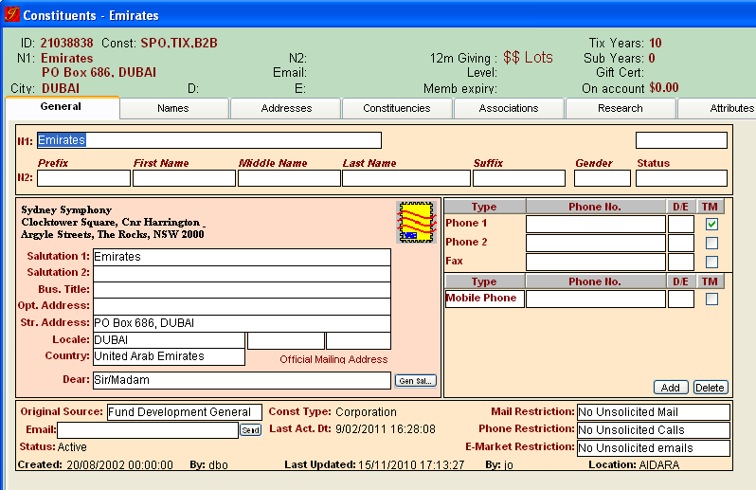
contacts
Notes:
*Contacts
SPON team liked spreadsheets cos simple to update :
Contacts
CEOs etc
Problem cos:
cross company event – made them update it every year
ticketing
No “Salutation 2” on this account – this is a business rule
The Cash from the sponsorship sits against this ID and you can see what is due and what is paid by clicking on the “Contributions” tab
Any ticketing allocation sits against this account (not a contact’s account) so that you can easily see what is being used.
We built some custom reports and did some training to make sure they could access the exact contact info they needed – and they know who to go to if they need something tweaked…

Slide 7
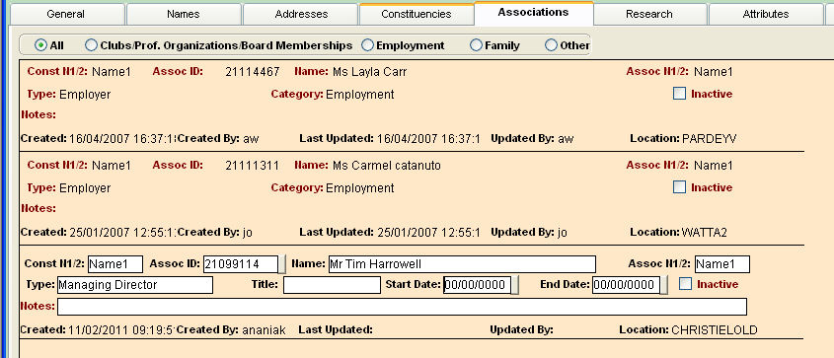
contacts
Notes:
Business rules determine when we use what “type”
Employees are associated with this account
MD has a separate association
If someone leaves the company we remove the association
Makes pulling lists of contacts very easy
… Problem
Invoices have to go to someone…

Slide 8
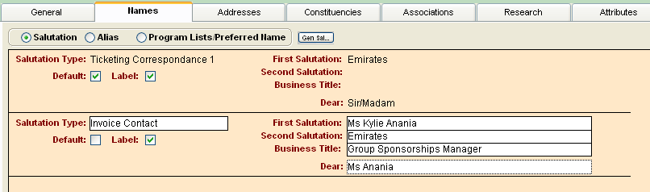
invoices
Notes:
Invoices used to come out of accoutns…
SPON team liked cos :
They didn’t have to do it
Problem cos:
They didn’t really know when things went out or were due
No ability to report in a quick and meaningful way
These problems created enough impetus across various departments for sponsorship to get on tess
Invoice contact

Slide 9
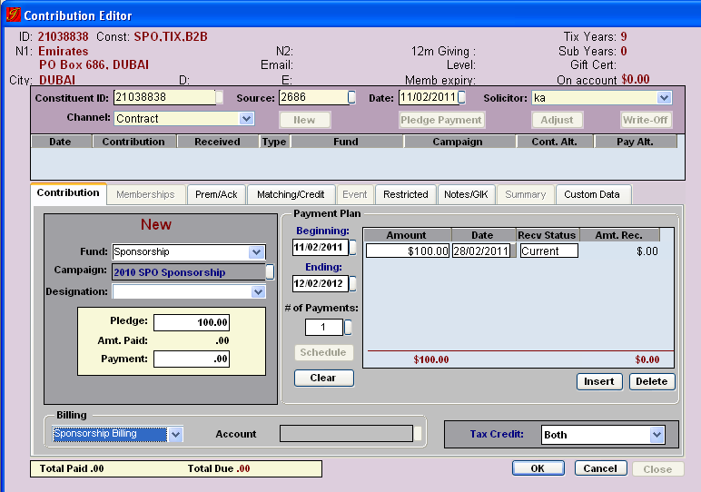
invoices
Notes:
Talk about solicitator = name on invoice at the end
For report at the end
Due date
Sponsorship billing
Repeat steps for GST fund
Come back in and pay it off as a normal pledge
then we merge the ACK report with a receipt letter template we have…

Slide 10
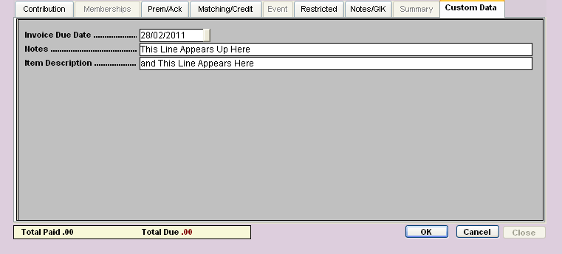
invoices
Notes:
Custom part This is the info that merges with the report that we can send out

Slide 11
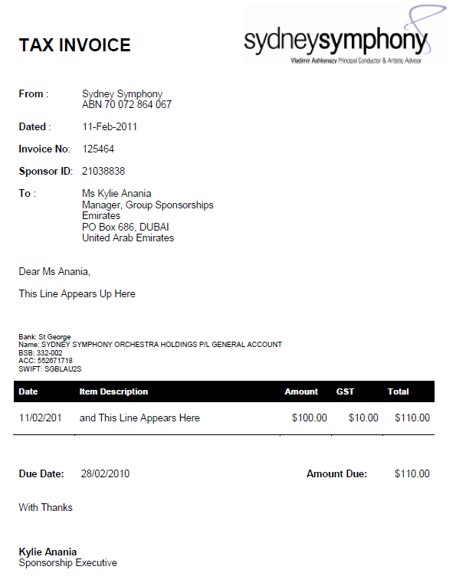
Notes:
Voila my invoice
Invoice report that we schedule and send to Head and team to track weekly what is due, what is out there etc

Slide 12
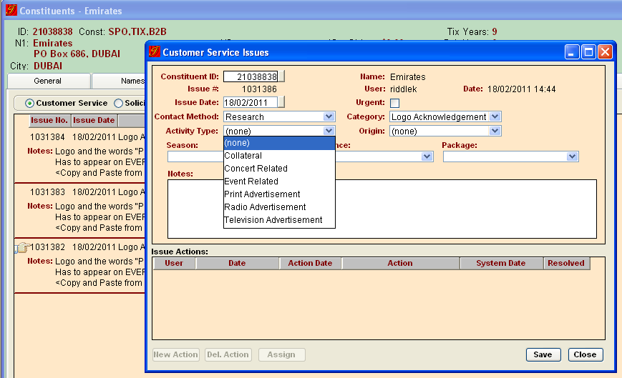
logo acknowledgement

Slide 13
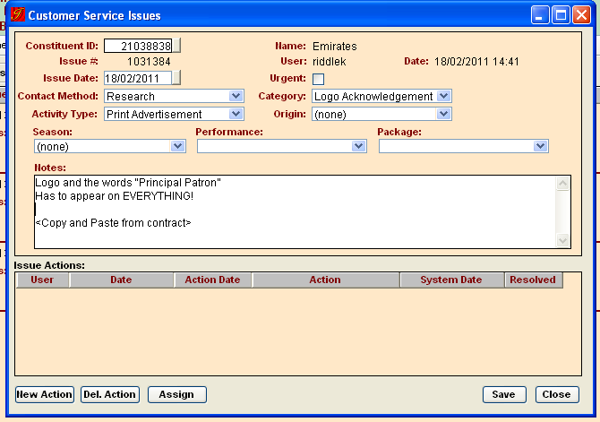
logo acknowledgement

Slide 14
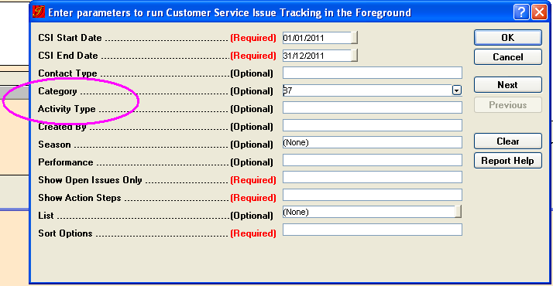
logo acknowledgement

Slide 15
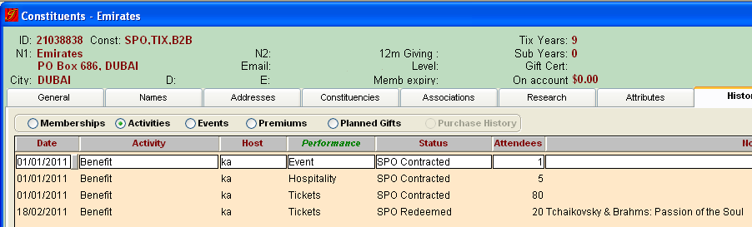
benefits
Notes:
New project
Date – is 1 Jan or the date of when the benefit was redeemed
Host is the worker responsible for that sponsor
Performance is not a drop down so we have business rules about what to enter (makes reporting more meaningful and more sort-able)
Status is either contracted or redeemed (thought it was a nicer word than “used”
Attendees we have business rules for how to enter meaningful number (for eg emirates is entitled to 80 tickets each year and they have used 20)
We add a line when something is redeemed

Slide 16
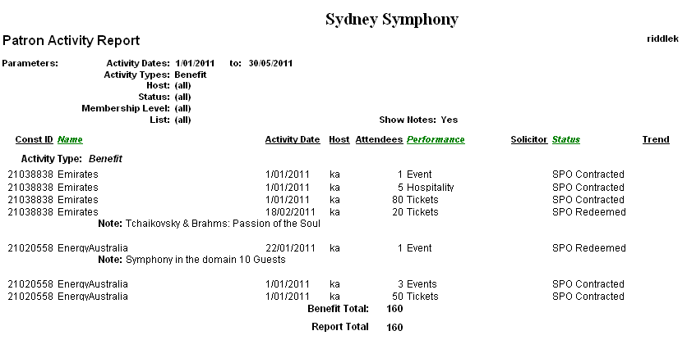
benefits
Notes:
Can pull by date range
Can filter out benefits that have been redeemed or only look at redeemed benefits
You may want this report only by the “host” or worker…

Slide 17

prospecting
Notes:
Won’t tal
*Pipeline
Rows got deleted
New Spreadsheets each year – (wouldn’t necessarily go back and look…)
= historical data disappeared
k about cos there is another presentation

Slide 18
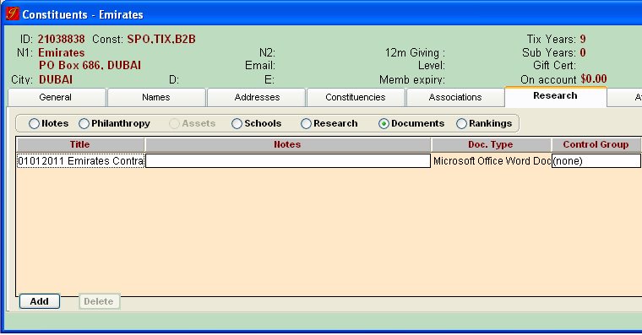
contracts

Slide 19
what we have
business rules for managing contacts
invoices processed though customisation of the contribution module
logo & acknowledgment rules that anyone can access and check up on
benefits tracked in tessitura
historic tracking of a prospects process
a copy of contracts easily accessible on a sponsor’s record
Notes:
Entirely integrated sponsorship tessitura strategy

Slide 20
what we have
Sponsorship Function | Tessitura Tool Used
Contacts | Associations & Business Rules
Invoicing | Contribution Module & Custom Reports
Benefits | Activities
Logo Acknowledgement | CSI
Pipeline | Solicitations
Contracts | Documents
Notes:
business rules for managing contacts
invoices processed though customisation of the contribution module
logo & acknowledgment rules that anyone can access and check up on
benefits tracked in tessitura
historic tracking of a prospects process
a copy of contracts easily accessible on a sponsor’s record

Slide 21
thank you... any questions?
Kylie Anania |Philanthropy & Public Affairs Executive
Sydney Symphony
kylie.anania@sydneysymphony.com
02 8215 4625

Slide 22


Solicitations
Presented by:
Susan Learner and Melissa Harty

Slide 23
Presentation Outline
Individual moves through the Solicitations module.
Manage Solicitations & Solicitation Tasks en mass.
Reports – Solicitation Tracking (customisation).

Slide 24
Moves Management Background
Major
Gift
Donor
Subscriber

Slide 25
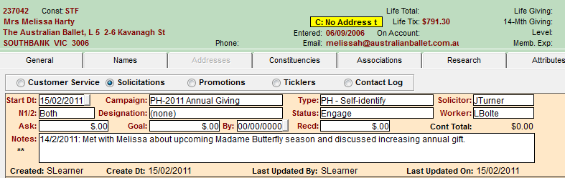
Individual Moves Management
How to enter Solicitations
For every patron contact
Go to desired Constituent record.
Click on Contacts tab (mid left).
Click Solicitations radio button.

Slide 26
Individual Moves Management
Click Add button
Fill in each field
(see below for Solicitation Types and Solicitation Status).

Slide 27
Individual Moves Management
Contribution Total: automatically populated when a transaction takes place.
Notes: Enter a Solicitation Note as required – date first dd/mm/yyyy, initials next. NB: Most recent notes at the top from 1 January 2011.
Close screen and click yes to save changes.

Slide 28
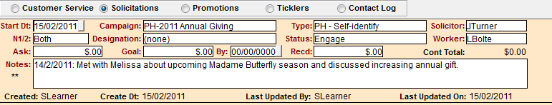
Individual Moves Management
How to enter Solicitation Tasks
For every action/next move
Go to desired Constituent record.
Click on Contacts tab (mid left).
Click Solicitations radio button.
On Solicitation record already created, double click on space below “Notes” when magnifying glass appears.

Slide 29
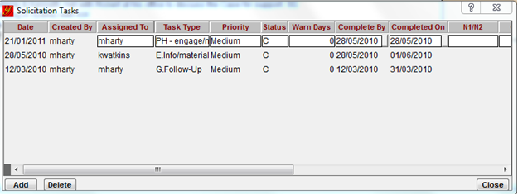
Individual Moves Management
Click Add button.
Fill in each field (see below for Solicitation Task Types).
Status
C = Complete
N = New
R = Re-assigned

Slide 30
Individual Moves Management
The next time the record is opened “**” will appear in the space below Notes.

Slide 31
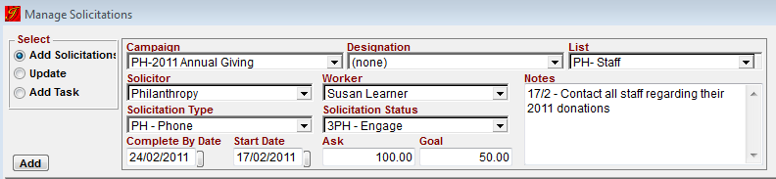
Manage Solicitations en mass
Go to menu and select Campaigns
Campaigns menu and Solicitations
Fill in each field per below:
Select Add

Slide 32
Manage Solicitations en mass
Using the buttons in the bottom left hand corner:
Click ‘Select All’
(you can manually edit each constituent or some records if you wish).
Save at the bottom right hand side of the screen.

Slide 33
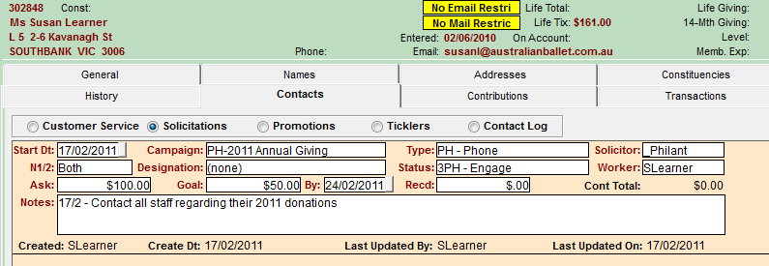
Manage Solicitations en mass
Each or all of your selected constituents will now have the relevant Solicitation record added.

Slide 34
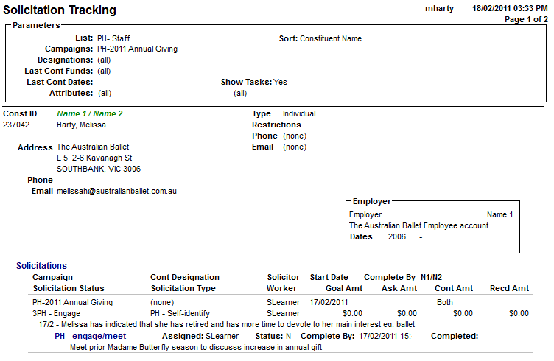
Solicitation Tracking Report – Customisation
Remove Address, Phone, E-mail, Employer and Membership boxes.
Show Const ID, Name with the options of showing Task, Task Notes and Task priority as well as Solicitation Notes.

Slide 35
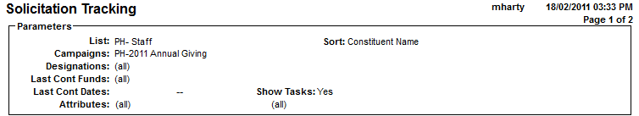
Solicitation Tracking Report – Customisation
Customise Parameters to make the List an optional field.
Add a Notes filter (similar to Show Tasks).
Add a Solicitation Task priority filter – High, Medium and Low.

Slide 36
Thank You
Questions?
Contact details:
susanl@australianballet.com.au
melissah@australianballet.com.au

Slide 37
Corporate Partnerships Invoicing
Peter Nelson
Business Analyst

Slide 38
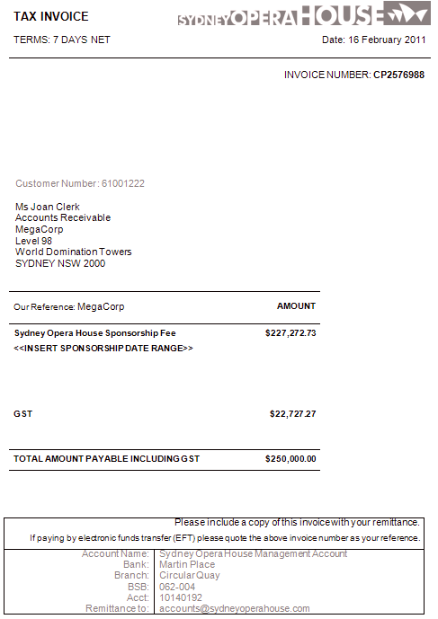
Corporate Partnerships Invoicing
PROJECT REQUIREMENTS
  Move all Invoice handling from SUN Finance system into Tessitura
  Tessitura posting to distribute directly to required SUN Accounts structure
  Process needs to handle Cash, Contra, Royalty and Reimbursable related transactions
  Produce an Invoice document in all scenarios, including where no actual payment is required (ie Contra).

Slide 39
Corporate Partnerships Invoicing
SETUP
  GLs
  Funds
  Campaigns
  Sponsor-specific Payment Methods
  Acknowledgements

Slide 40
Corporate Partnerships Invoicing
Setup – GLs for FUNDS
  Three tier code: Account-Cost Centre-Project
  Example: 60234-C0043-PJ070
  Cost Centre indicates Cash/Contra status
  Project indicates specific Sponsor
GLs used in Contra FUNDS (Credit)
5003X-C0043-PJXXX-N / Description: SOH Contra Fund <sponsorname>
Account code may vary dependent on type of Contra
GLs used in Cash FUNDS (Credit)
Uses Balance Sheet account

Slide 41
Corporate Partnerships Invoicing
Setup – GLs for PAYMENT METHODS
For use in Payment Methods (Debit)
These GLs may be used either in the “offset” of a Contra ‘contribution’,
or to purchase tickets or other items through Ticketing.
The Account code indicates the nature of the debit.
These examples cover
Hospitality
Entertainment (usually used for ticket purchases)
Reimbursements (recovering the cost of events initially borne internally).

Slide 42
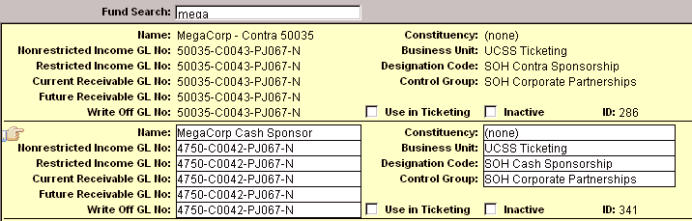
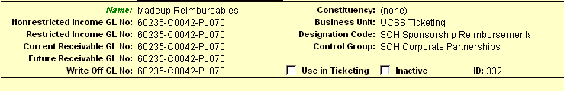
Corporate Partnerships Invoicing
Setup – FUNDS
Funds are setup for each scenario where an Invoice may be required.

Slide 43

Corporate Partnerships Invoicing
Setup – PAYMENT METHODS
Payment Methods are setup for each scenario where purchases or “offset”
Invoicing may be required.
Tends to follow a consistent pattern of Account codes, although structure allows for
one-off requirements.
Referencing the Account code in the ‘description’ of the Payment Method
allows for easier selection of the correct code combination during processing.

Slide 44
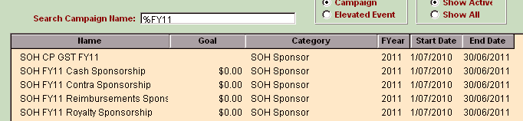
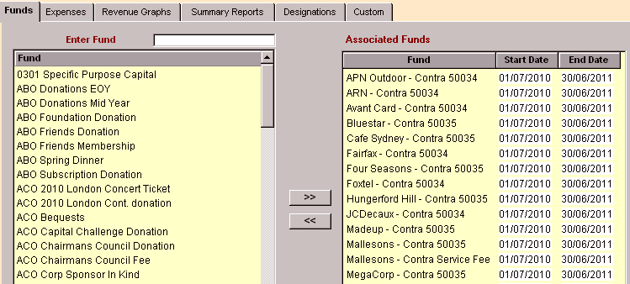
Corporate Partnerships Invoicing
Setup – CAMPAIGNS
One Campaign per FY for each Sponsorship type, including one GST Fund and Campaign

Slide 45
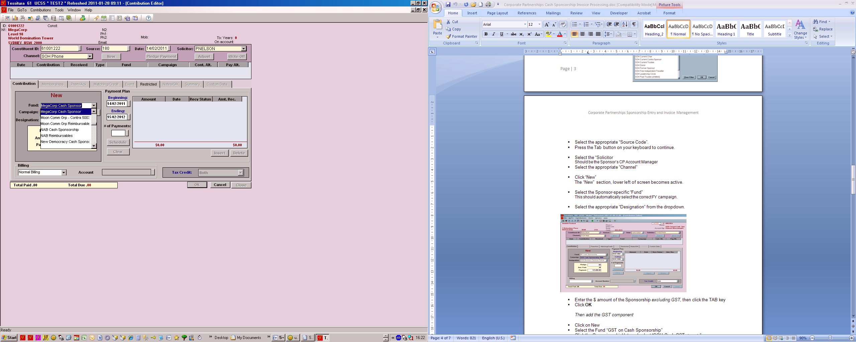

Corporate Partnerships Invoicing
PROCESSING – Cash Invoice
Processed in two steps
Firstly adding the value ex-GST to the Sponsor-specific Cash Fund
Then adding a “New” Contribution to the GST Fund
For an accumulated total …

Slide 46
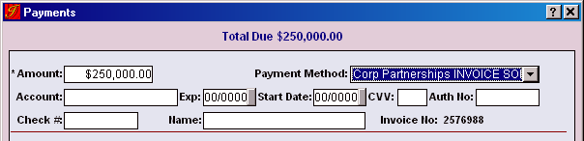
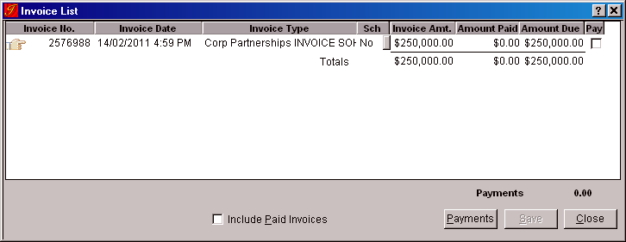
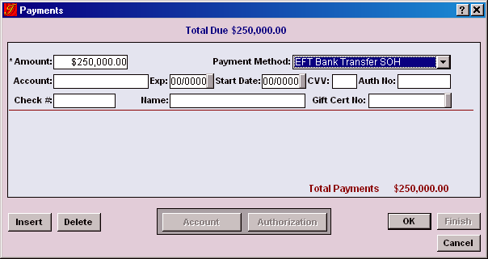
Corporate Partnerships Invoicing
PROCESSING – Cash Invoice
Paid using specific Corporate Partnerships “Invoice” Payment Method
Then Invoice paid off when sponsor sends fund at later date

Slide 47


Corporate Partnerships Invoicing
CONTRA PROCESSING
The Credit is processed as a ‘Contribution’, using the sponsor-specific Contra Fund, plus the Contra GST Fund.
The offset Debit is controlled by the Payment Method.
The Payment Method needs to be both Sponsor (Project Code) and Account specific.

Slide 48
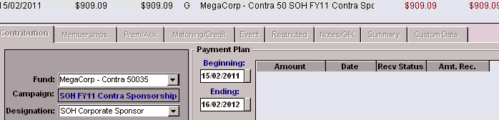
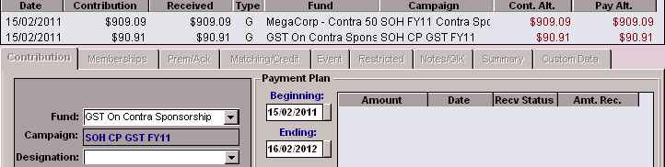
Corporate Partnerships Invoicing
PROCESSING Contra Invoice
Part 1 the Contribution
The Contribution is processed using the same method as a Cash contribution, selecting the required Contra Fund
Then the Contra GST Fund is added

Slide 49
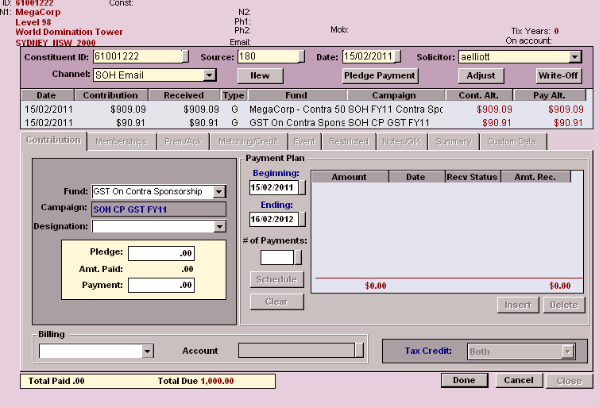

Corporate Partnerships Invoicing
PROCESSING Contra Invoice
Part 2 The Payment
As no actual payment is required the Invoice Payment Method is not used
The Payment Method referencing the specific “Offset” Account
and sponsor is selected and the Contribution paid off immediately.

Slide 50
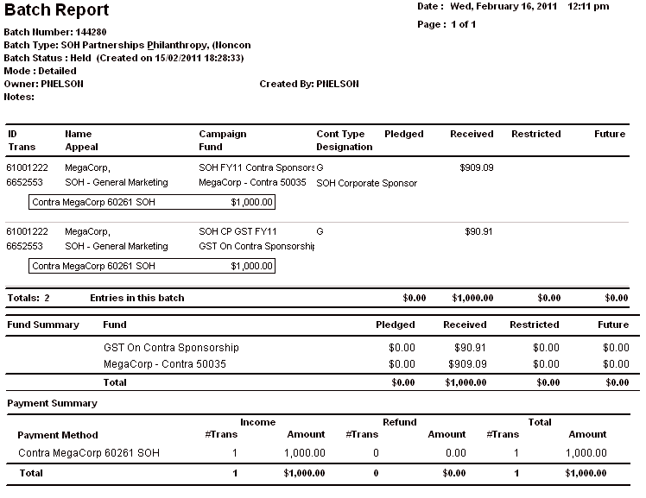
Corporate Partnerships Invoicing
POSTING
Both side of the transaction handled in single Contribution

Slide 51
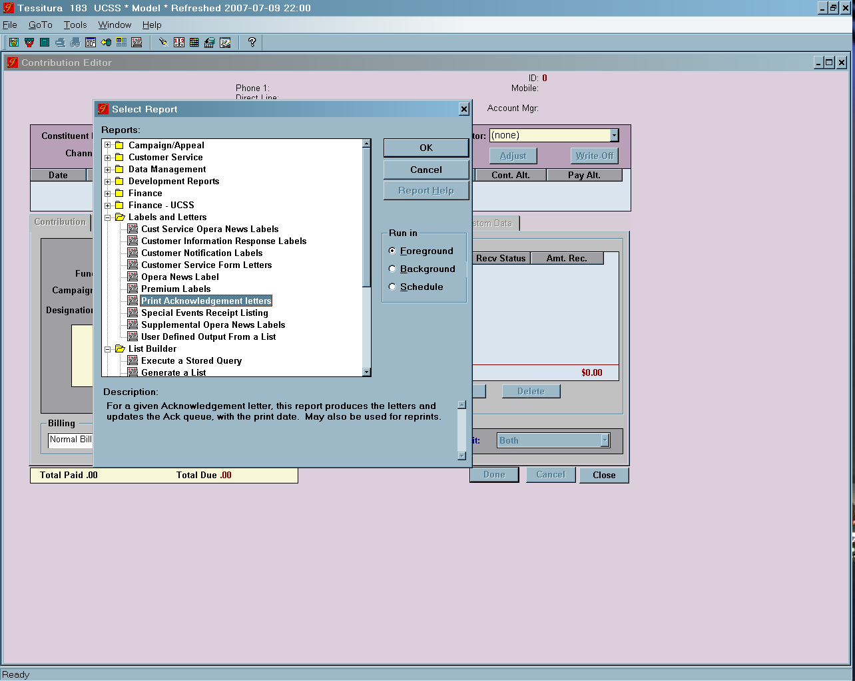
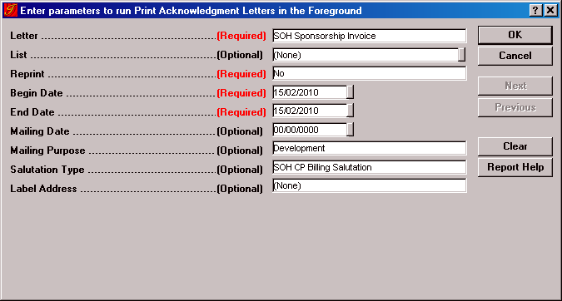
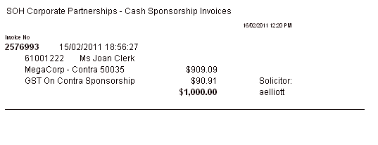
Corporate Partnerships Invoicing
PRODUCING THE INVOICE
Run the report “Print Acknowledgement Letters”
Then “Merge” results to a Word Template ….

Slide 52
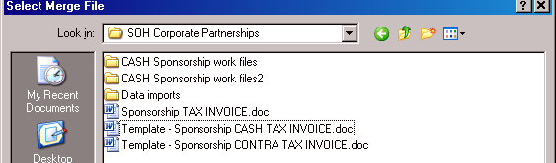
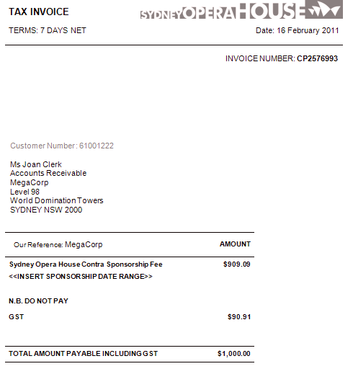
Corporate Partnerships Invoicing
INVOICE - Merge to Template
On Cash Invoice this is the actual Invoice number
On Contra Invoice this is a dummy number
based on the Payment number

Slide 53

Thanks
Peter Nelson
Business Analyst
pnelson@sydneyoperahouse.com

Slide 54
Q & A

Slide 55
AUSTRALIA & NEW ZEALAND TESSITURA REGIONAL USERS CONFERENCE
MONDAY 21 FEBRUARY BREAKOUT SESSION #3
2.30PM-3.30PM
FINANCE ROUNDTABLE (DISCUSSION), MTC VIP LONG
DATA SEGMENTATION (USER PRES), MRC BOARDROOM
TICKETING ROUNDTABLE (DISCUSSION), MRC VIP (WILLIAMS)
NEXT GEN BREAKOUT#2 (PRESENTATION), MTC LAWLER
NON-TRADITIONAL PERFORMANCES (USER PRES), MTC VIP SQUARE

