Slide 1
Elevated Events w/Tessitura
YAY!!!!!!
(I hope ☺ )
Crystal Love
High Museum Atlanta Wine Auction

Slide 2
High Museum Atlanta Wine Auction
In 2016 we will be celebrating our 24th anniversary
Have numerous events throughout the year, with the majority happening during “Wine Auction Week”
Event Highlights:
  Kick-Off Party: 100 pp, September 2015 (Paperless Post)
  Top Bidders Dinner: 100 pp, January 2016 (EE)
  Tasting Seminars, Ladies & Gentleman’s Lunch, Trade Tasting: Various sizes, week of Wine Auction (Eventbrite)
  Toque & Cork Dinners: 24 Dinners, 24-30 people per dinner, March 31, 2016 (EE)
  Friday Fete: 700 pp, April 1, 2016 (EE)
  Friday Fete After-Party: 100 pp, April 1, 2016 (Eventbrite)
  Vintners Reception & Live Auction: 1000 pp, April 2, 2016 (EE)
Wine Auction & Elevated Events (EE)
  We use Elevated Events to keep track of and manage our largest Wine Auction Events
  Through custom reports we are able to track guests, keep updated on RSVP numbers, create excel spreadsheets to use for mailings, tax letters and nametags

Slide 3
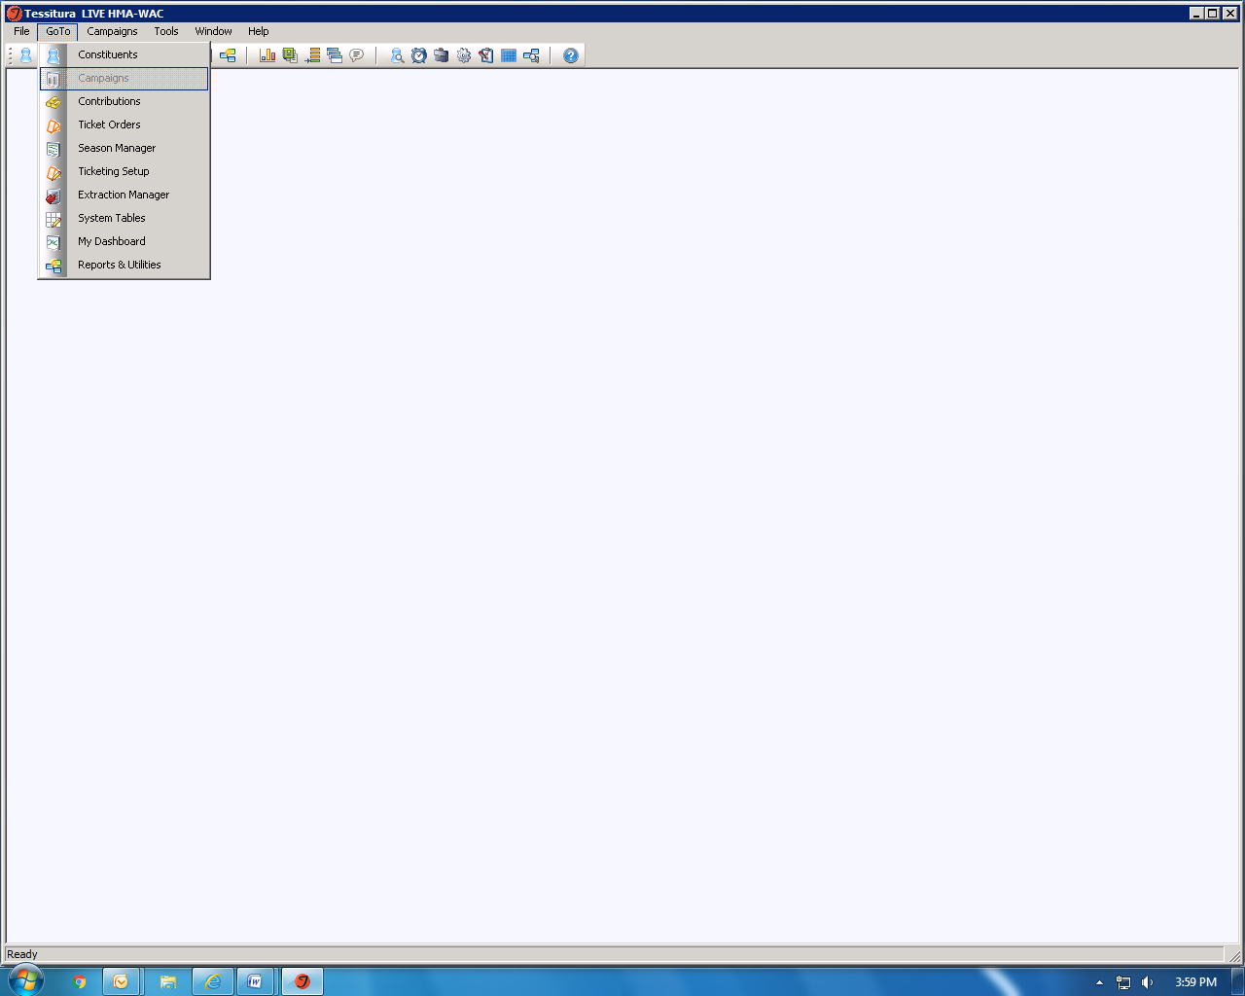

Slide 4
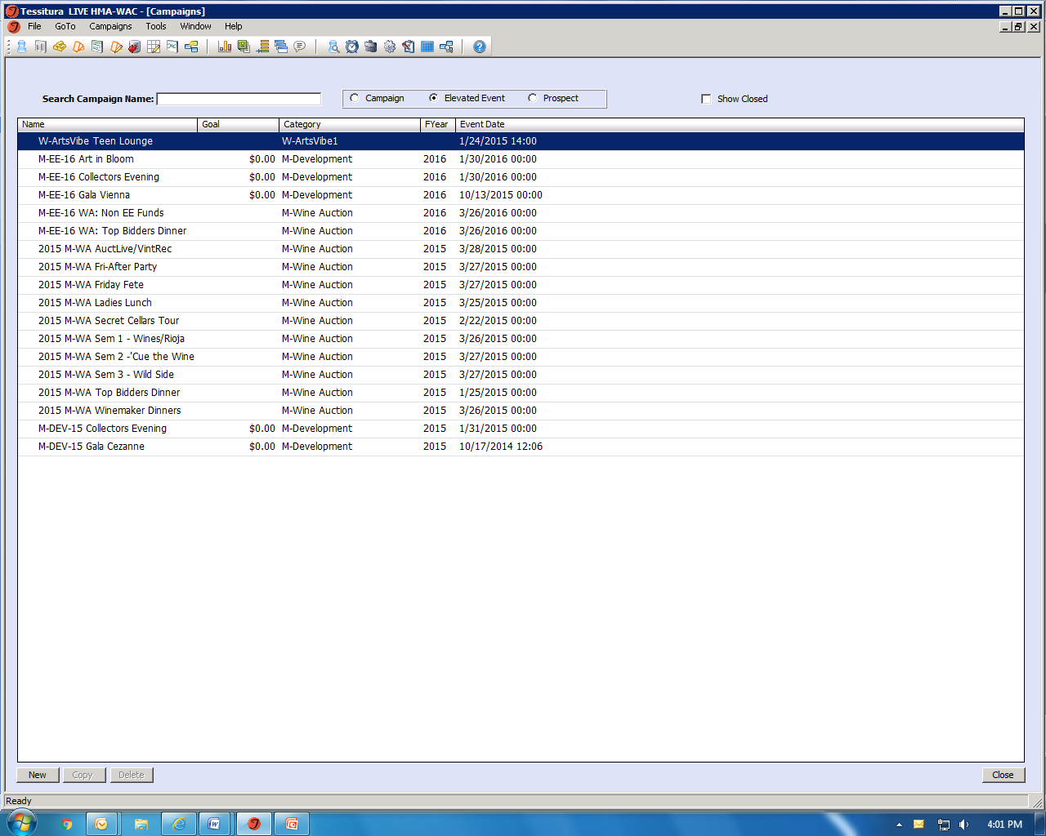

Slide 5
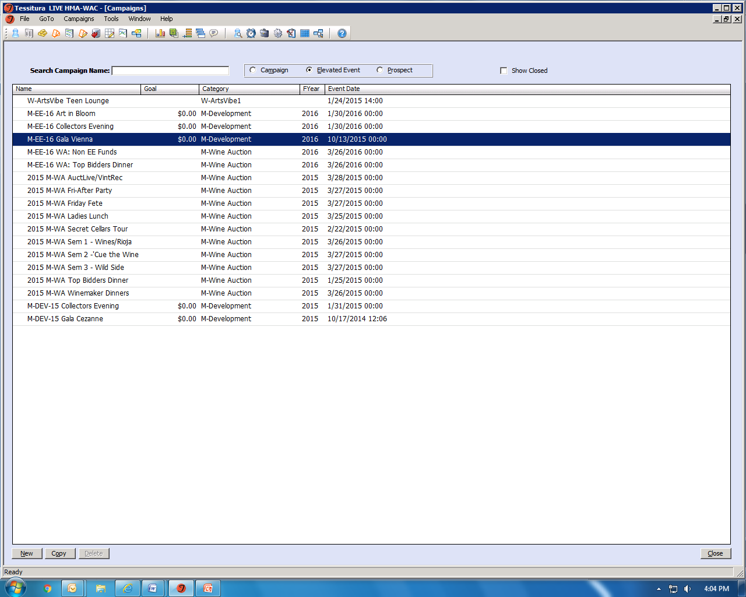

Slide 6
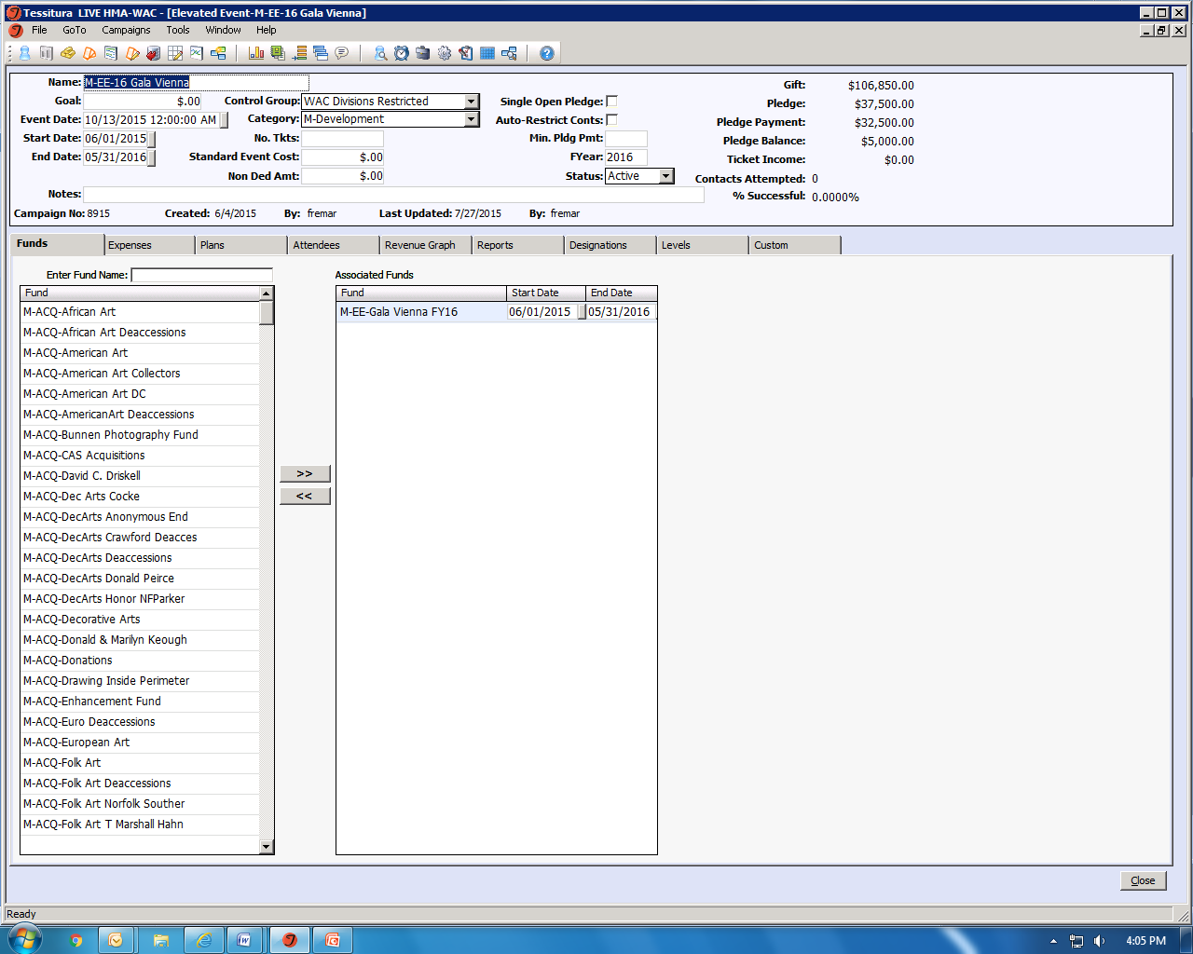

Slide 7
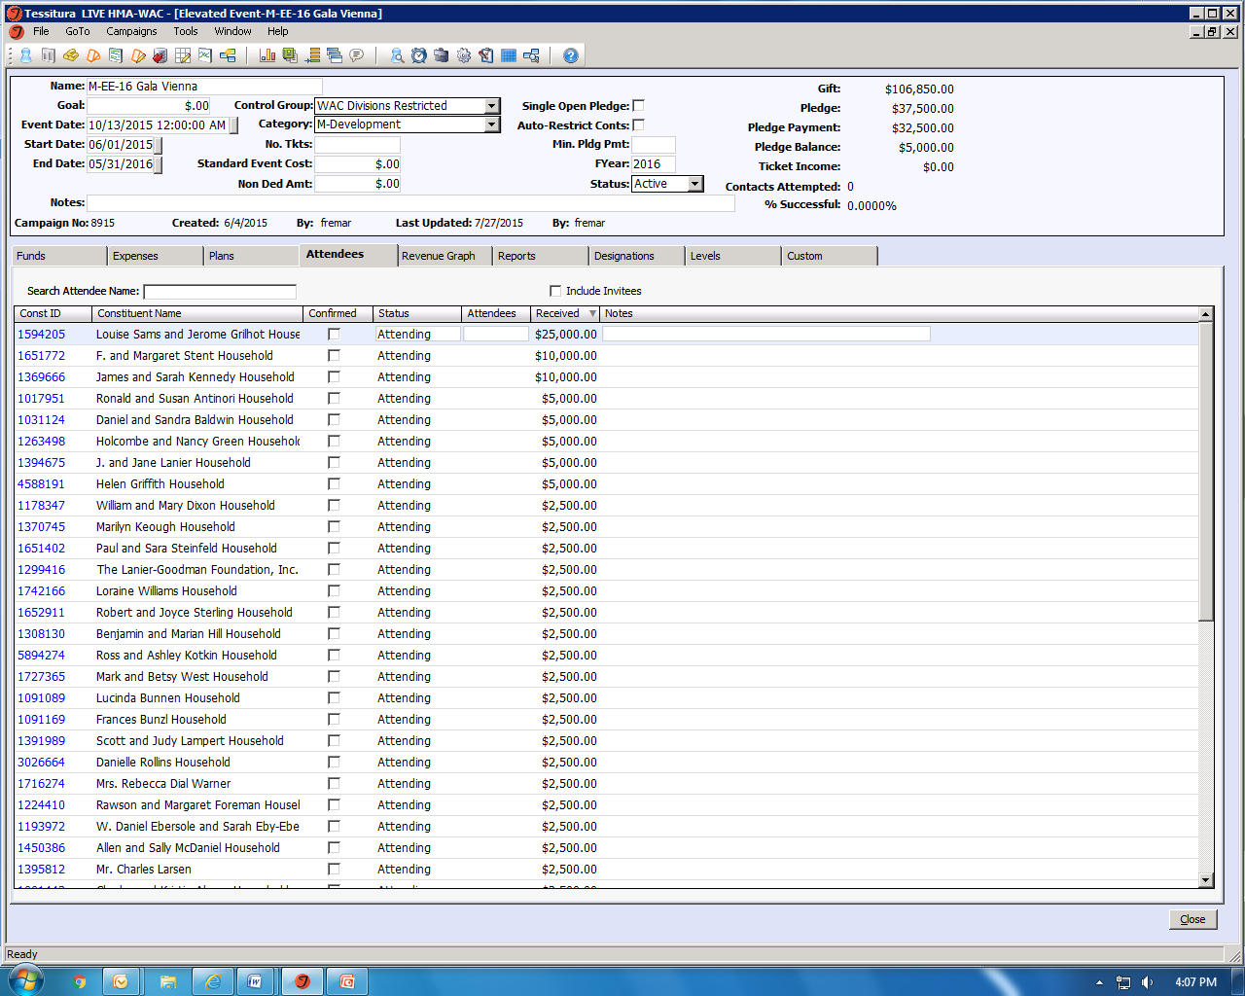

Slide 8
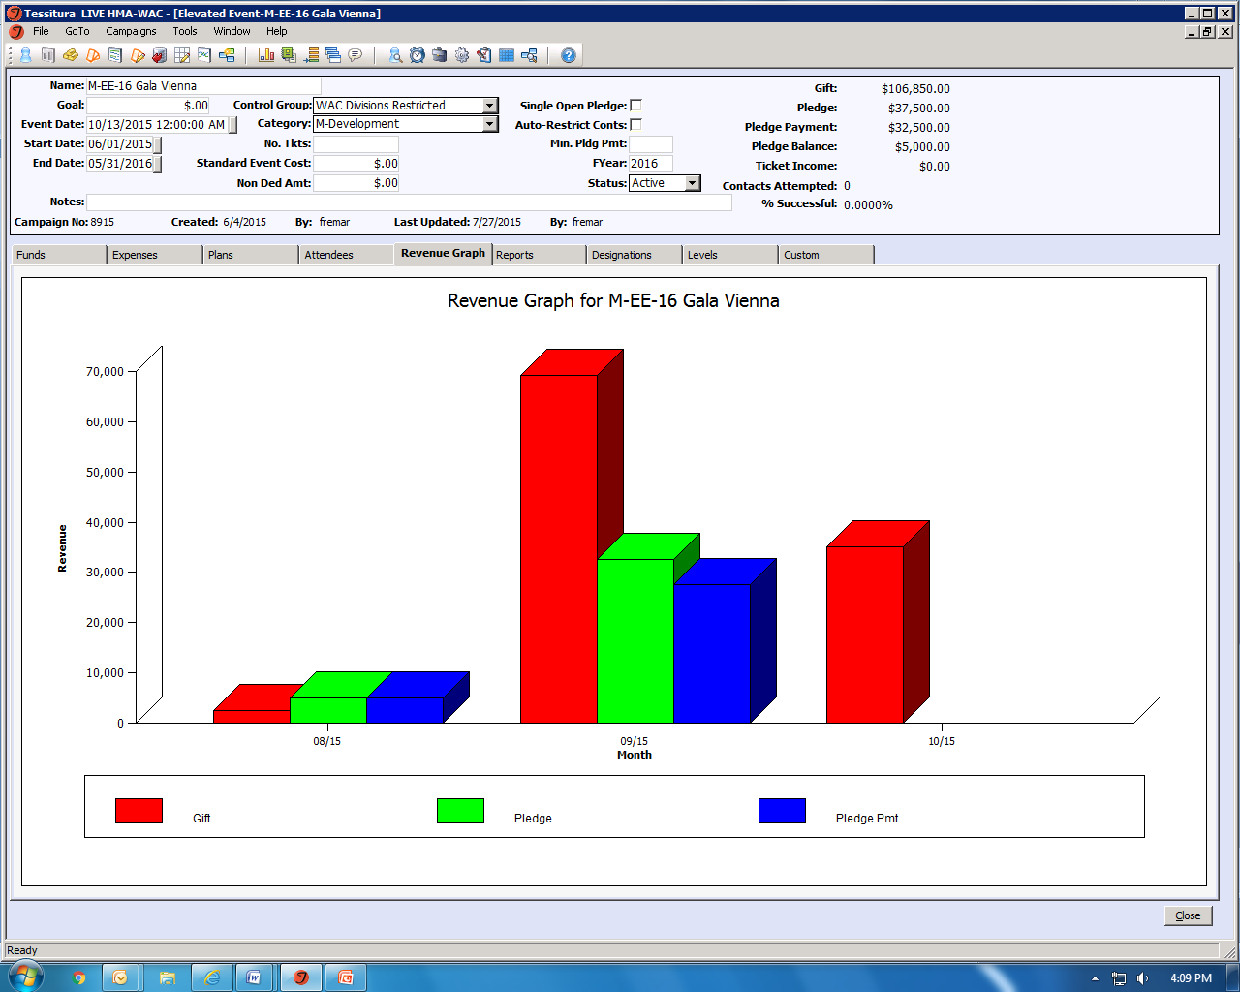

Slide 9
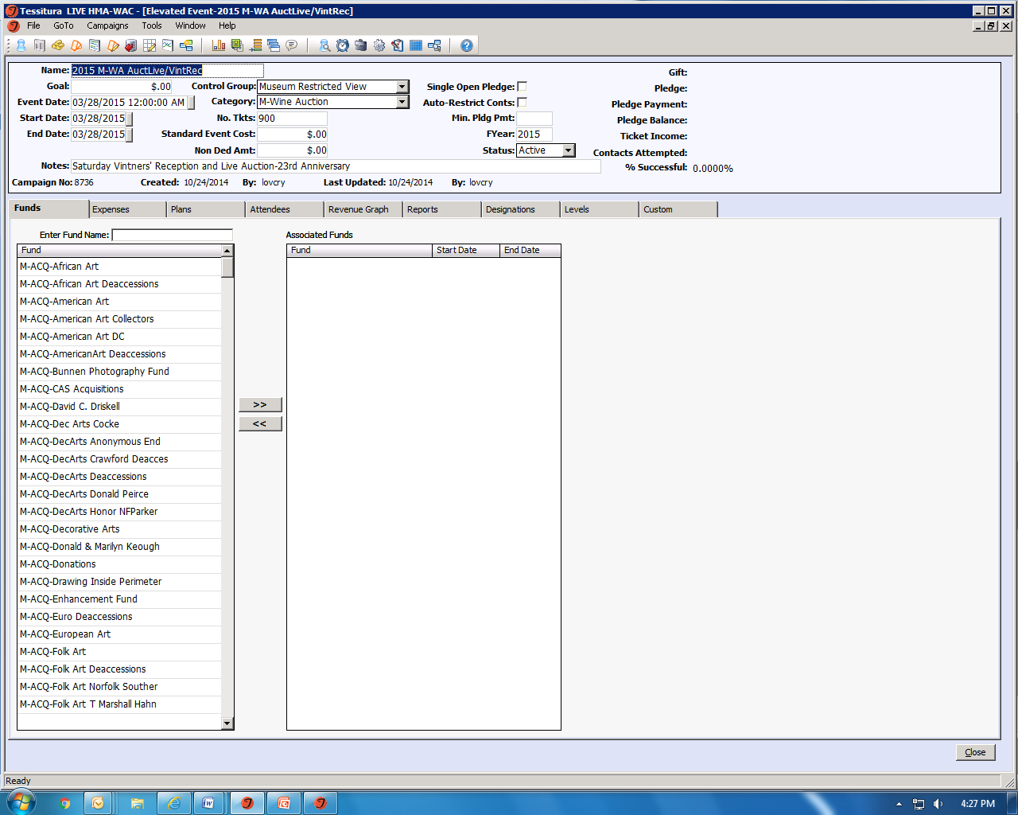

Slide 10
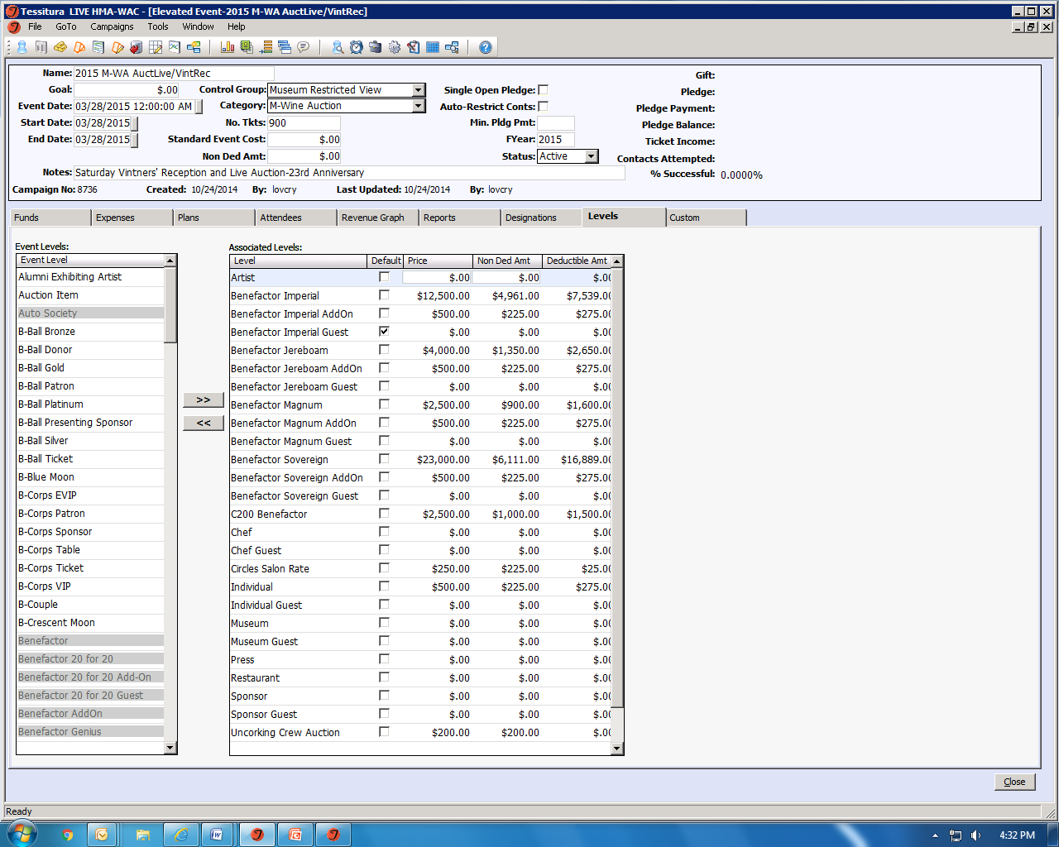

Slide 11
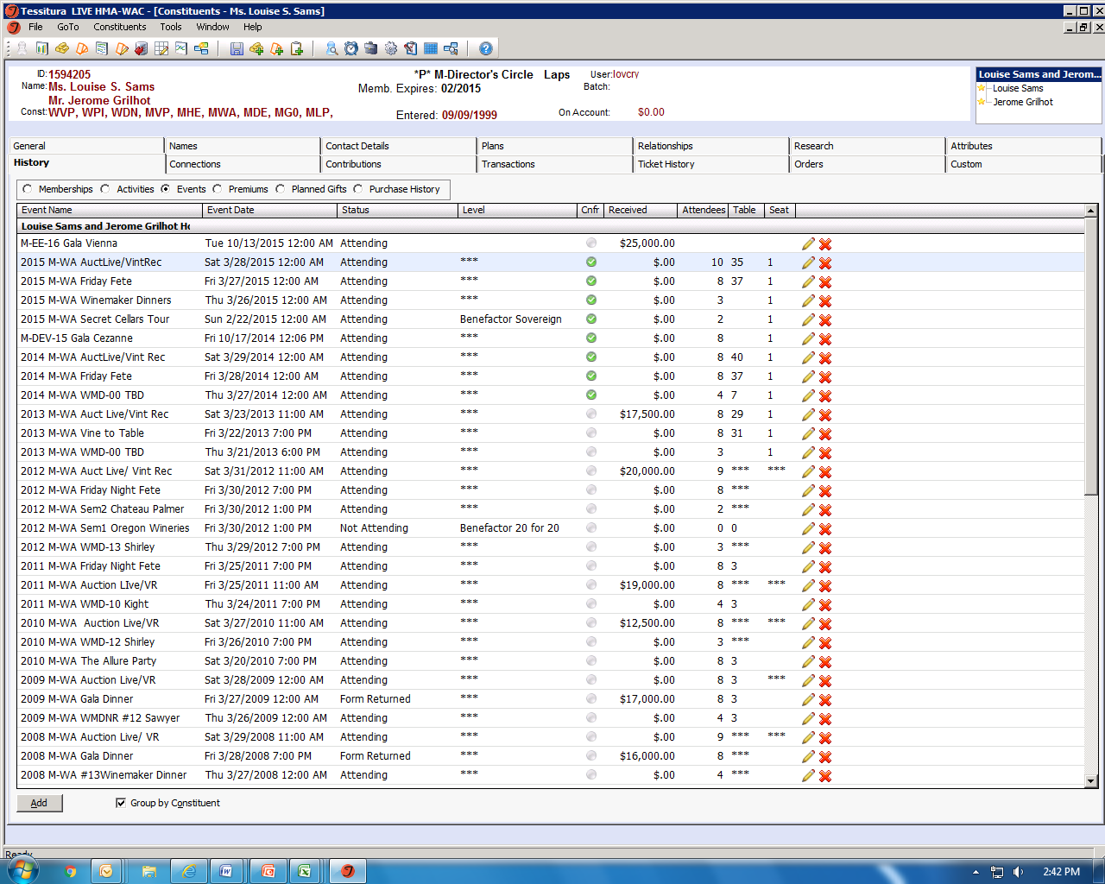

Slide 12
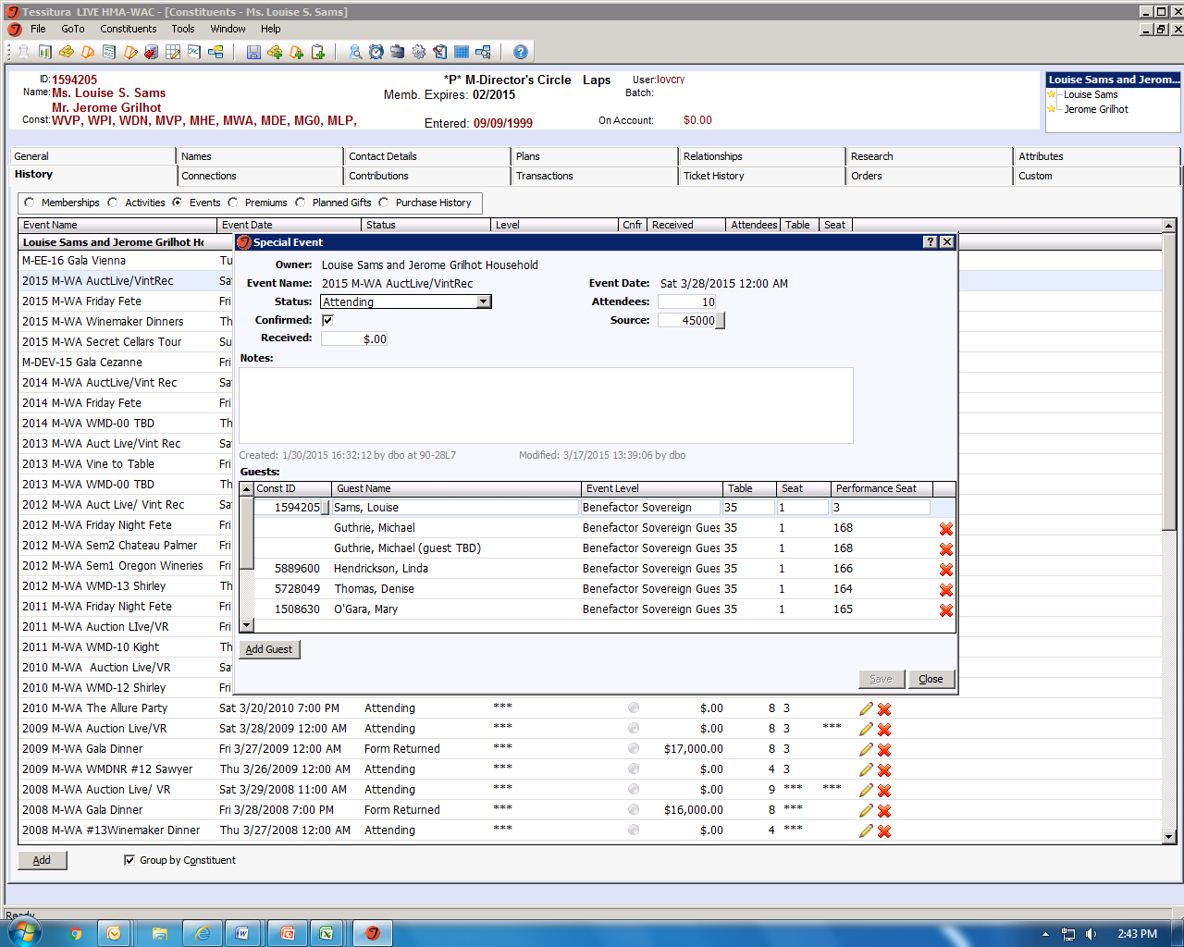

Slide 13
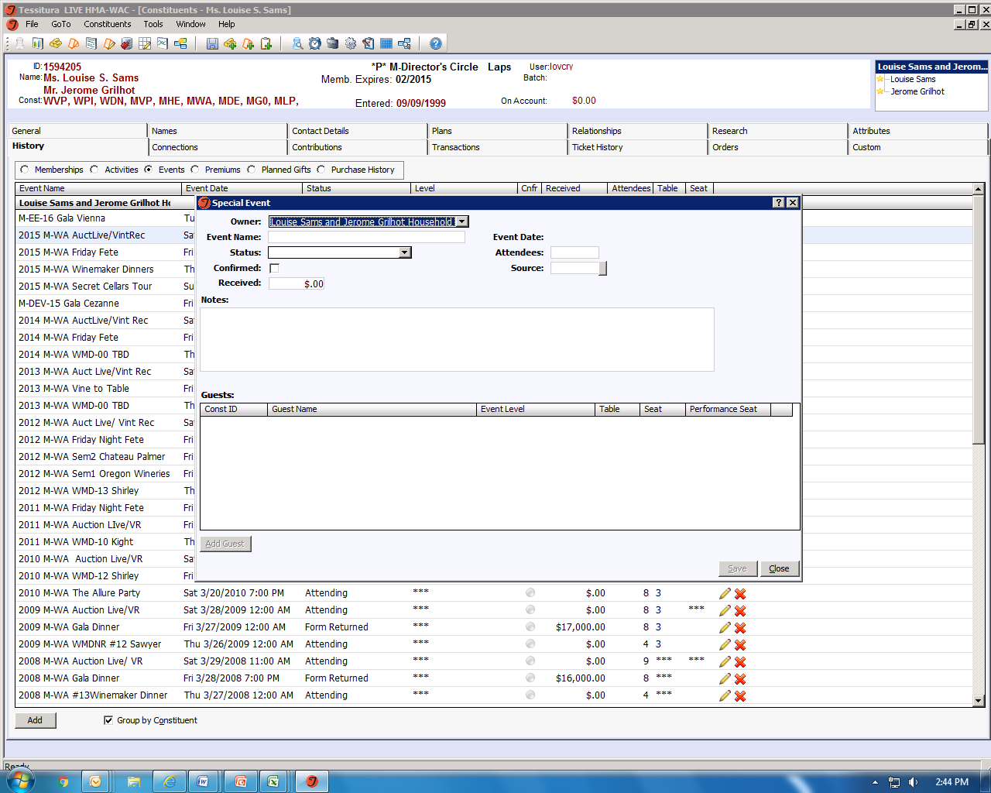

Slide 14
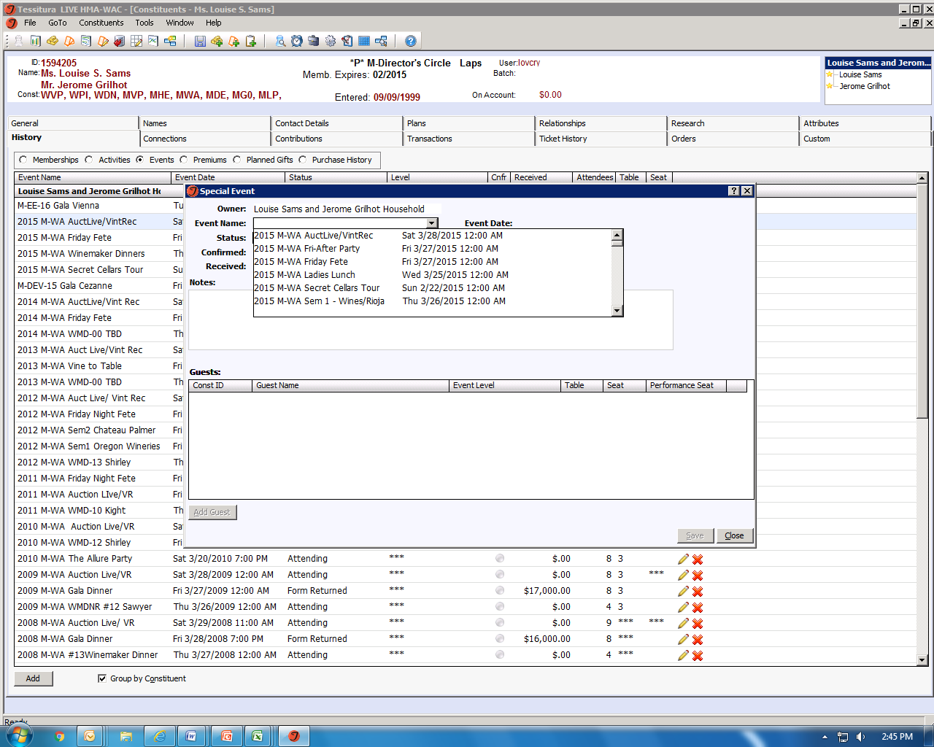

Slide 15
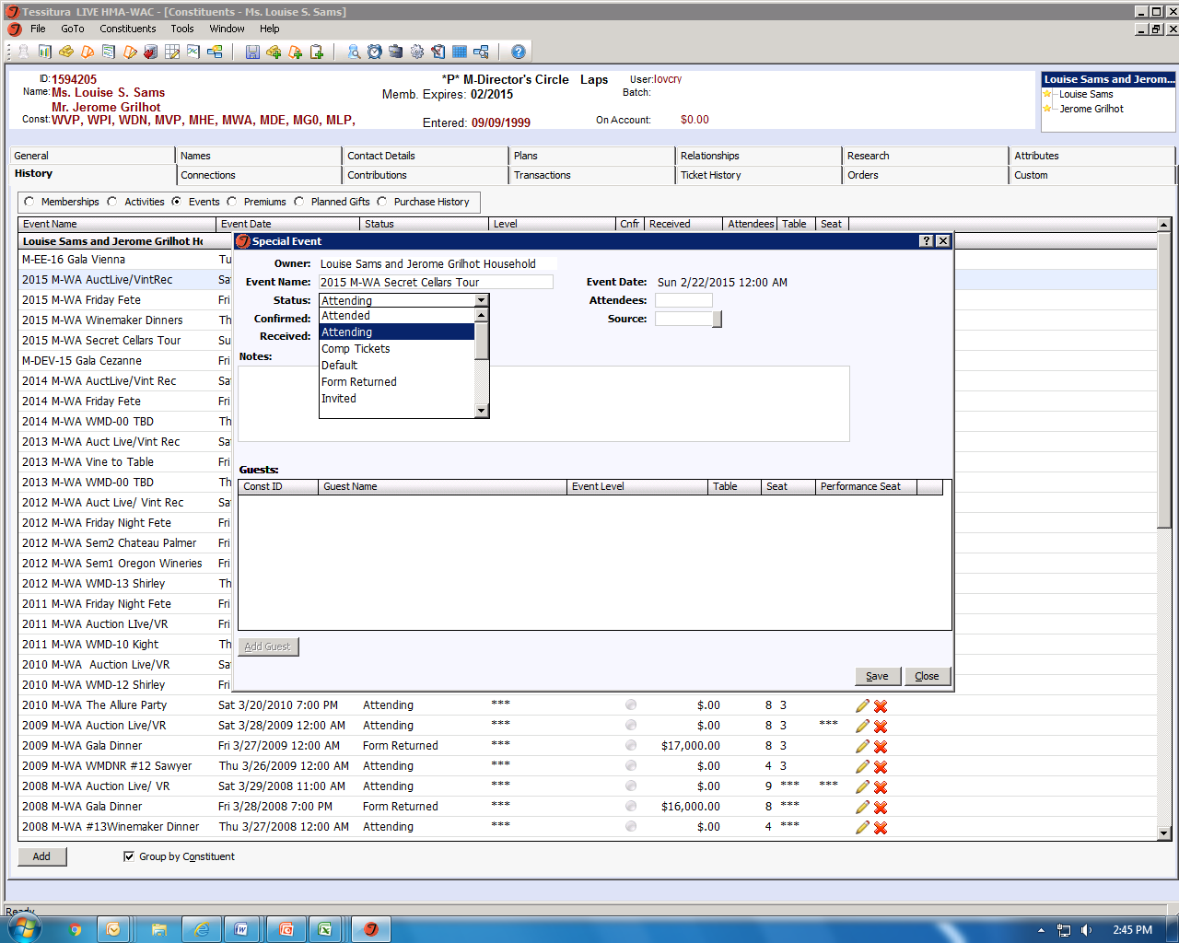

Slide 16
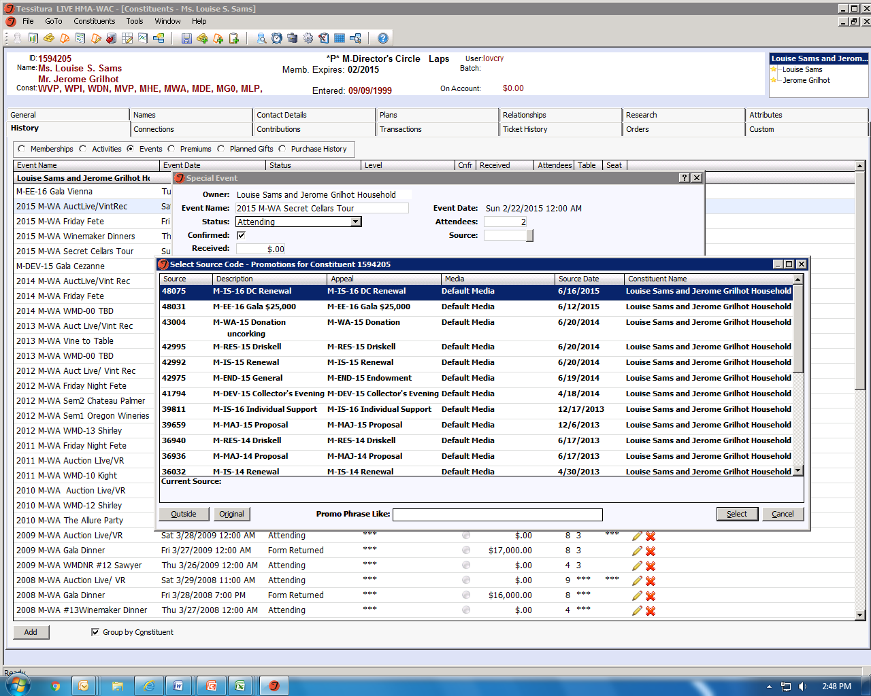

Slide 17
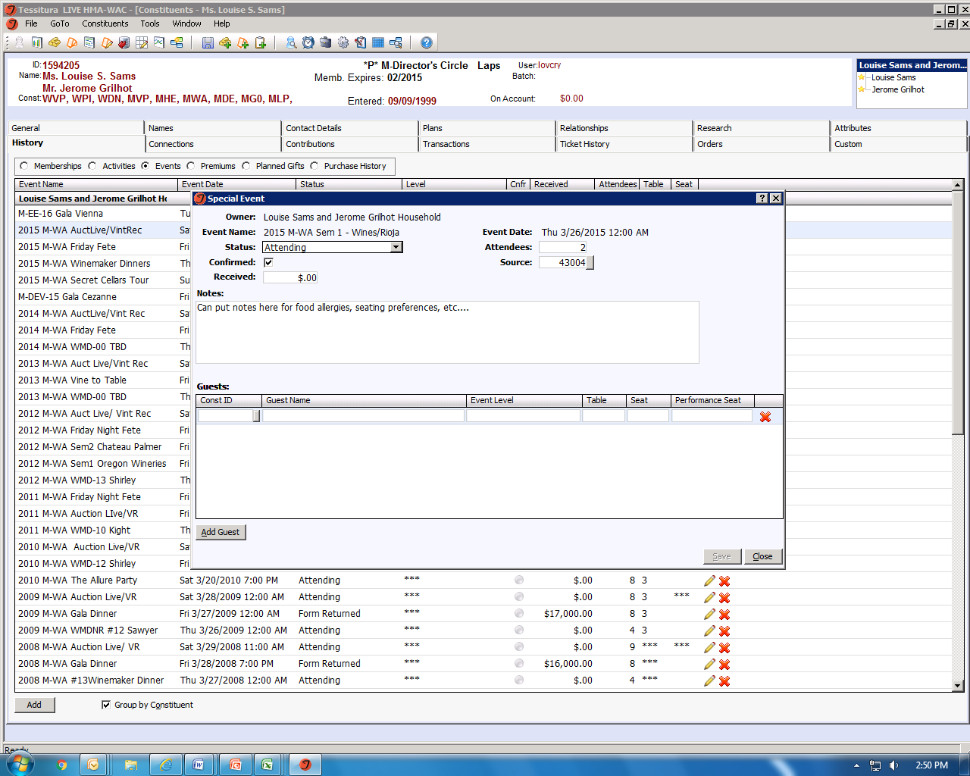

Slide 18
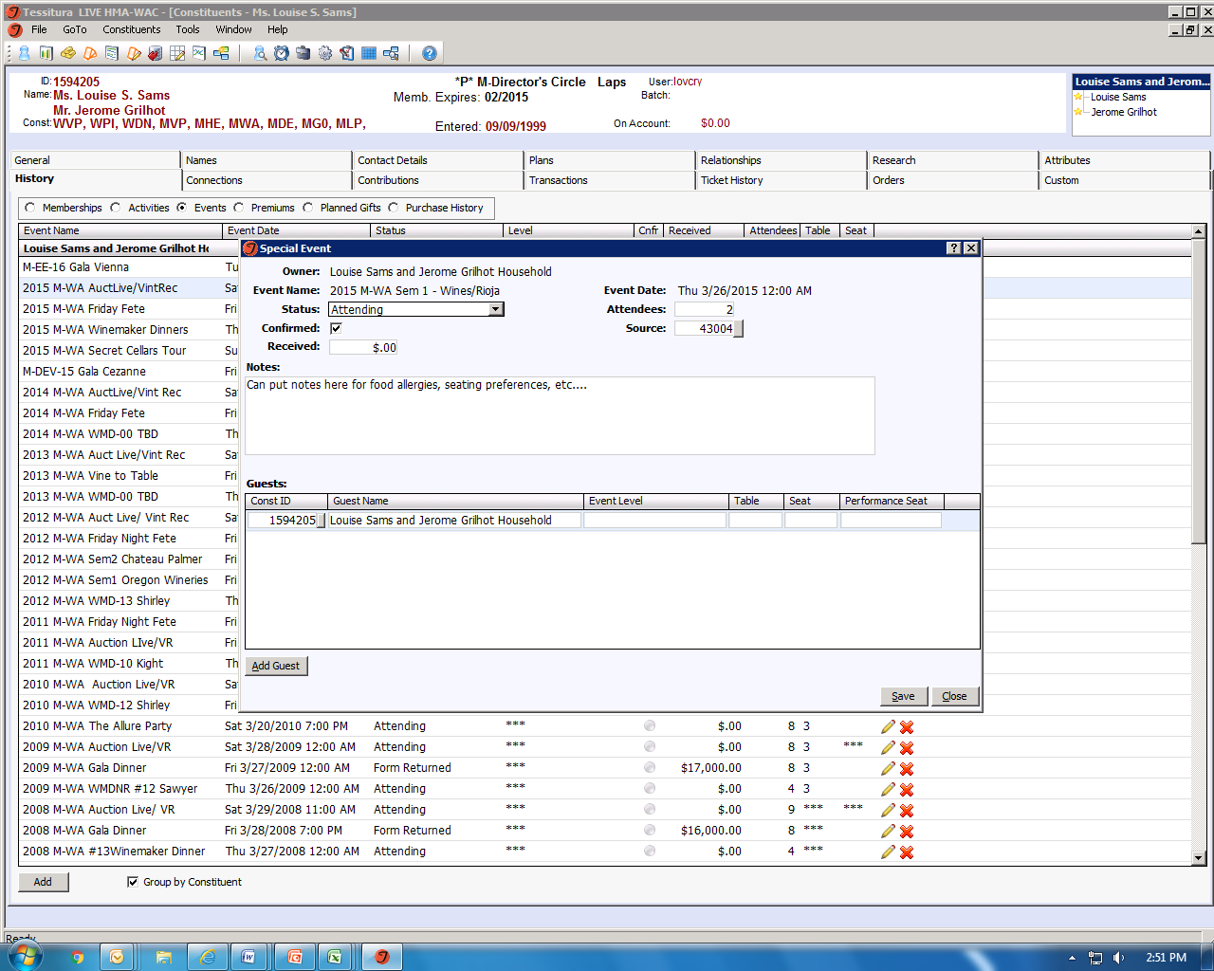

Slide 19
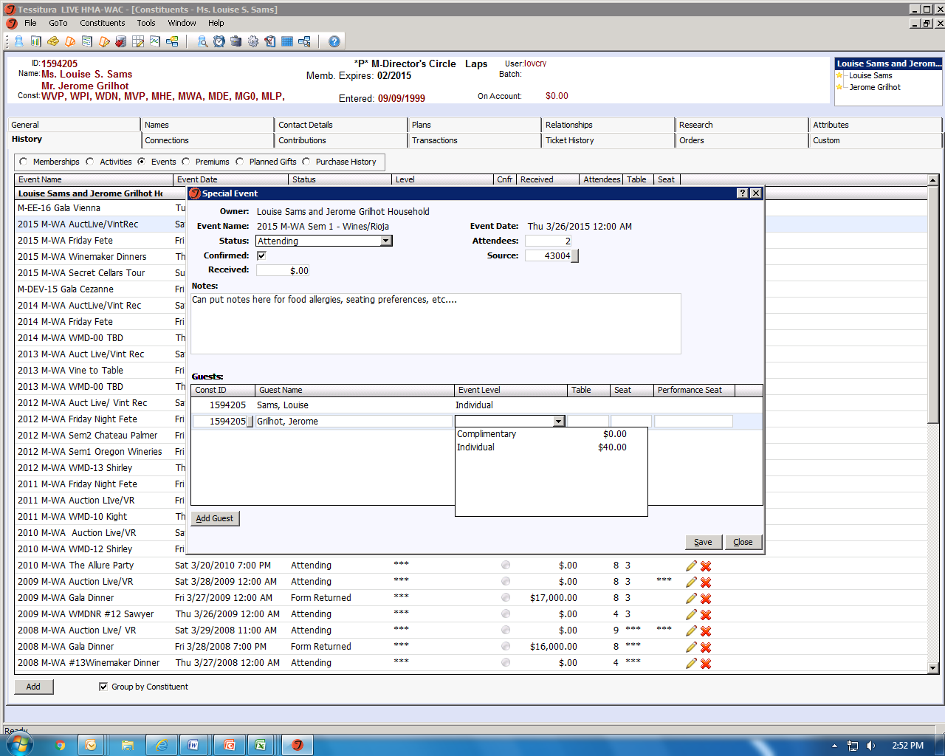

Slide 20
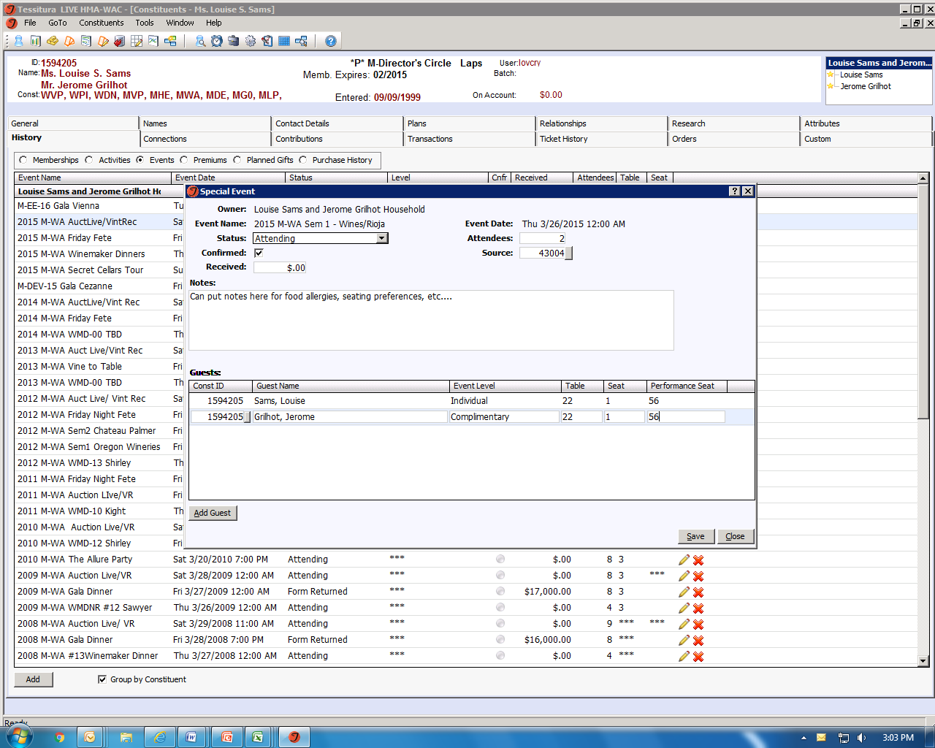

Slide 21
Elevated Events Reports
Go To → Reports & Utilities → Elevated Events
Custom: EE – Registration Lists by Alpha (Example A)
Registration List of everyone registered for event
Gives you a total Guest count at the bottom if you put a “1” in the “seat” column
Guest Names, Table number, Host name, Tess ID, Level, Padle #
Can pull by “Alpha” or “Alpha Grouped By Host” (Example B)
Can also include Notes section from guest registration (Example C)
Save to excel, manipulate as needed (Reports → Save as → Excel)
Custom: EE – Registration Lists by Table (Example D)
Registration List of everyone registered for event
Gives you a total Guest count for each table section if you put a “1” in the “seat” column
Guest Names, Table number, Host name, Tess ID, Level, Padle #
Can also include Notes section from guest registration
Table “998” and “999” gives you guests who are registered but not assigned to a table (Example E)
Save to excel, manipulate as needed (Reports → Save as → Excel)
Paddle Packet labels / Custom: EE –Paddle Packets (Example F)
Cannot save as excel, formatted to fit Avery label 5163/5663
Custom: EE – Event Confirmations (guest) (Example G) / Custom: EE – Event Confirmations (host) (Example H)
Nothing shows up initially, have to save as excel to see data (Reports → Save as → Excel)
What we use to send confirmations of rsvp’d events and number of people
Custom: EE – Confirmation w/tax amounts (Example I)
Nothing shows up initially, have to save as excel to see data (Reports → Save as → Excel)
What we use to send confirmations of rsvp’d events and number of people

Slide 22
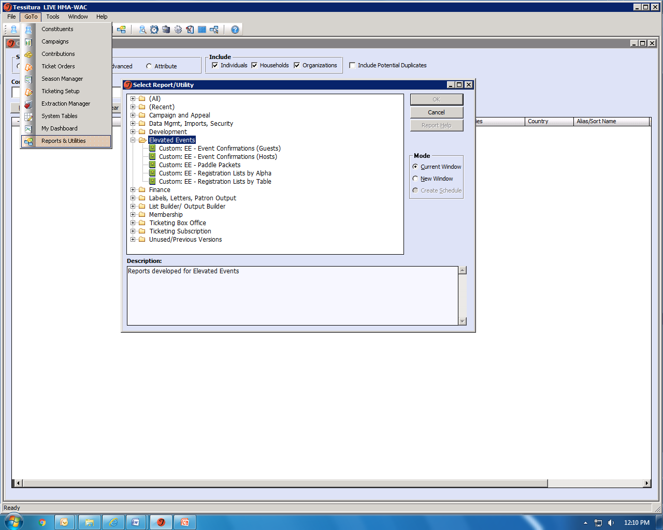

Slide 23
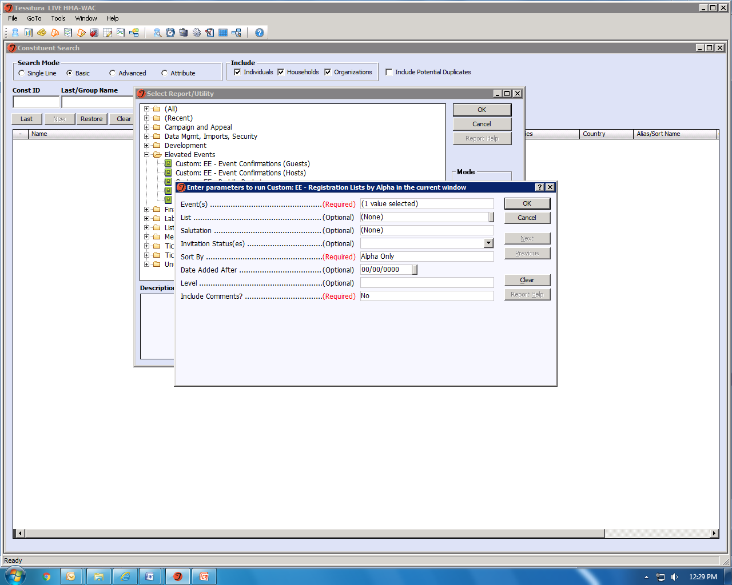

Slide 24
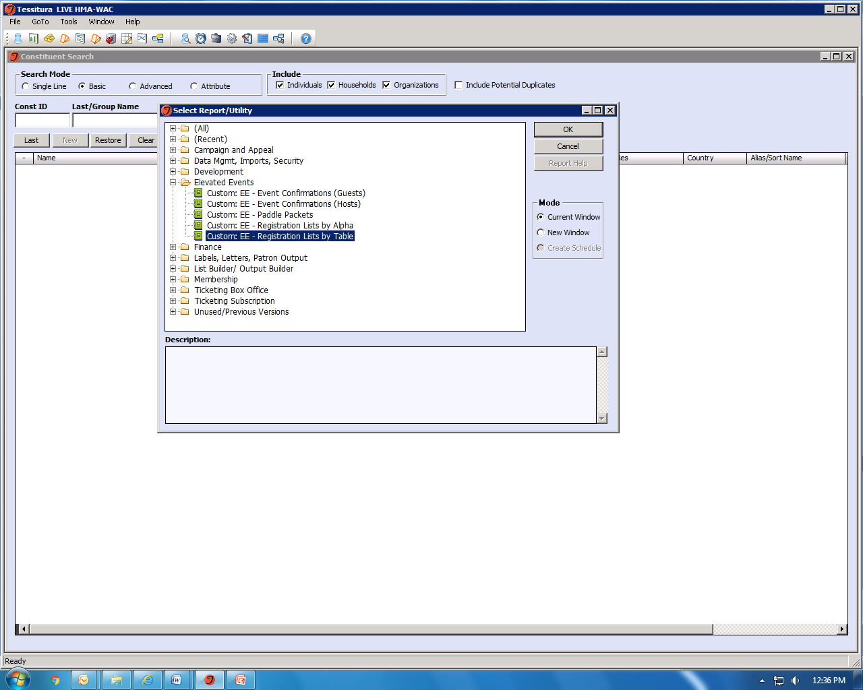

Slide 25


Slide 26
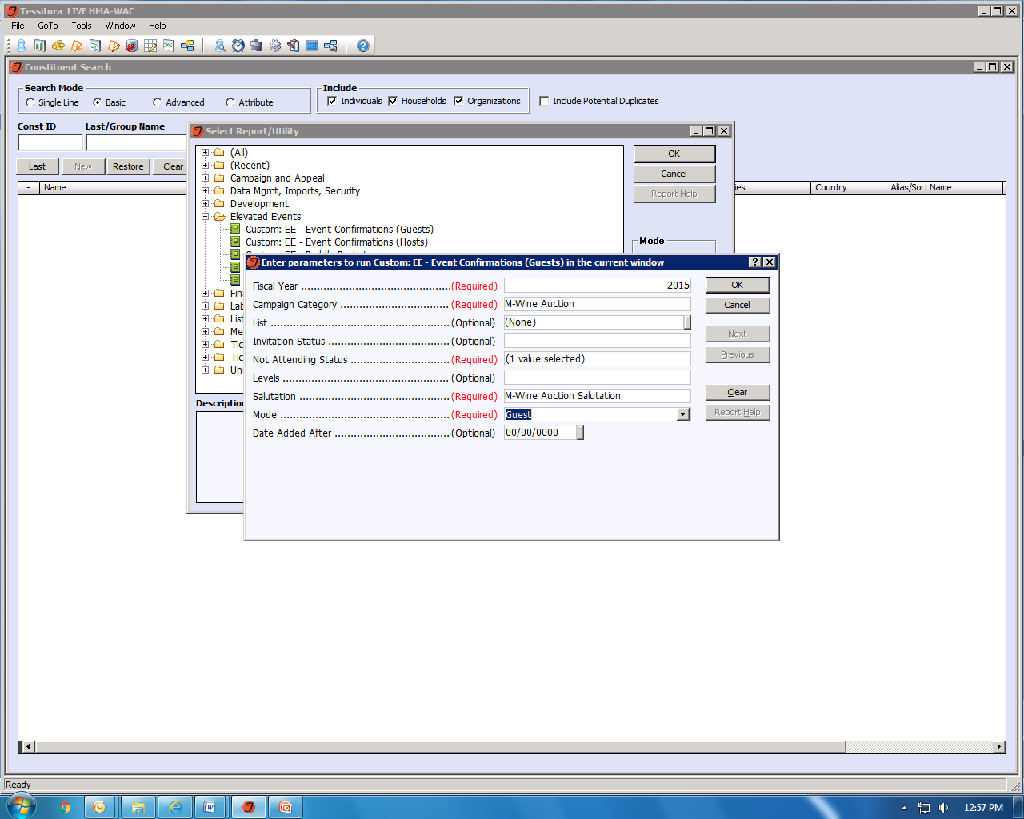

Slide 27
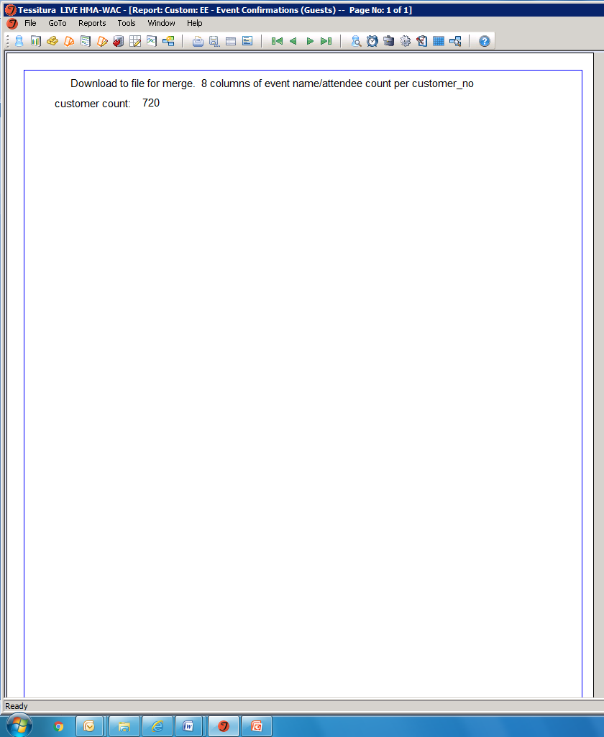

Slide 28
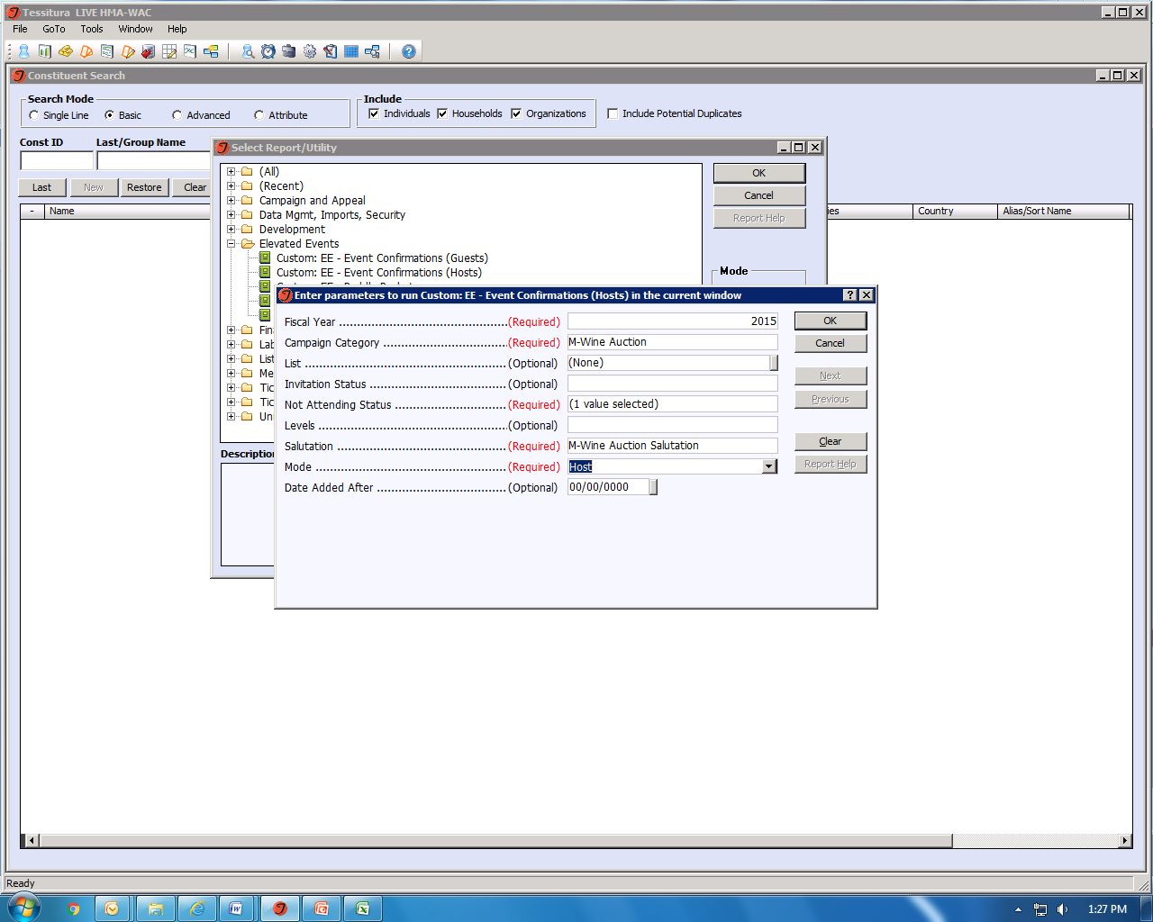

Slide 29
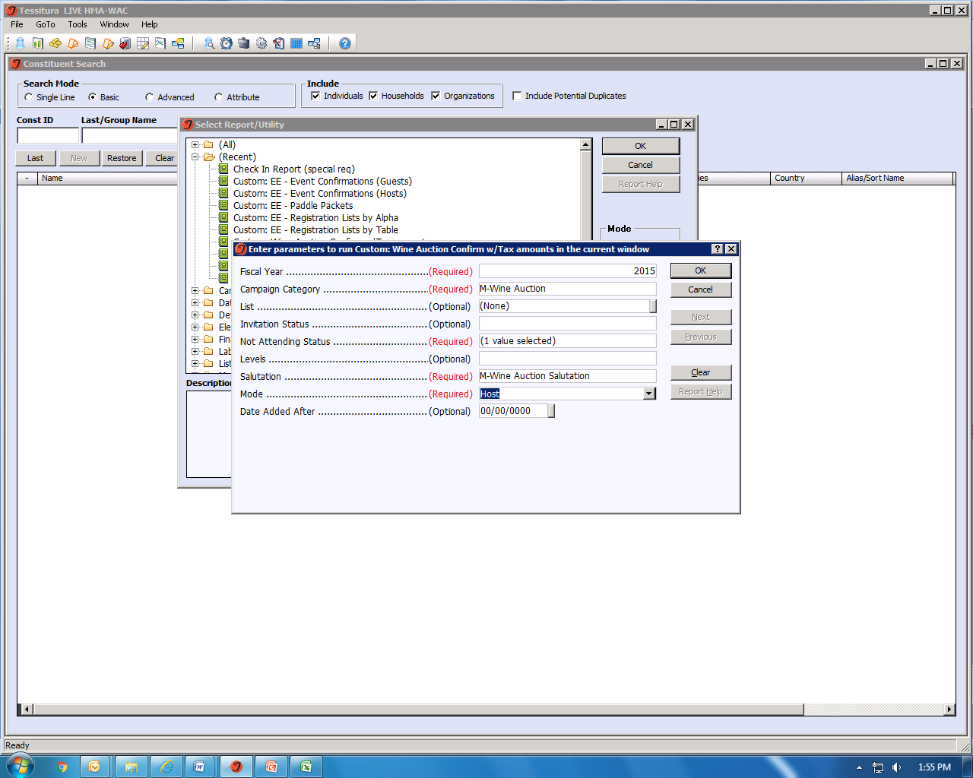

Slide 30
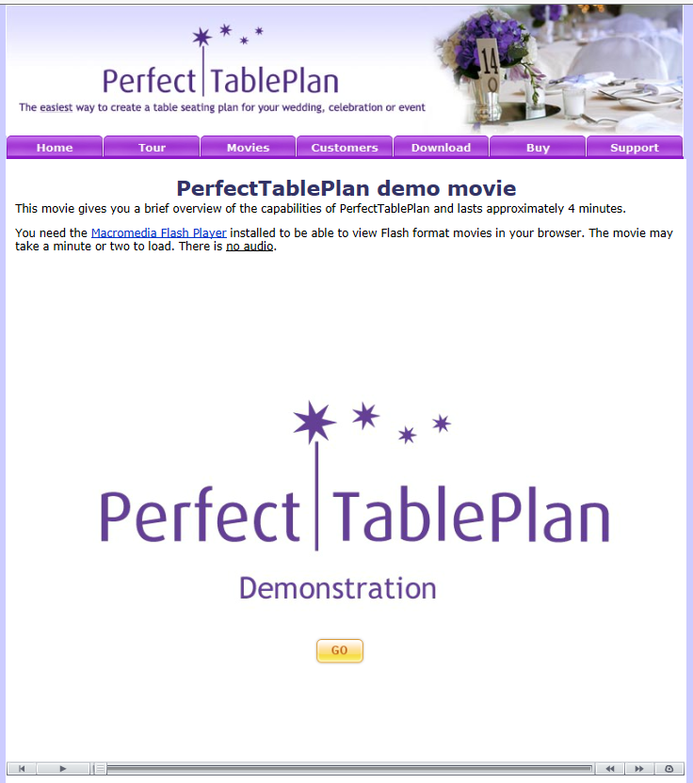
Perfect Table perfecttableplan.com

Slide 31
Questions?

Slide 32
Crystal Love
High Museum Atlanta Wine Auction
(404)733-5307
Crystal.love@woodruffcenter.org

