Slide 1
Intro to Tstats

Slide 2

What is T-Stats?
From the Network: “T-Stats™ is the Network’s comprehensive business intelligence solution and allows you to easily and quickly explore your organization’s data in very flexible ways. T-Stats allows a savvy, functionally-capable, but non-technical Tessitura end-user to browse the data and create their own reports in seconds in order to do analysis, track successes, uncover opportunities and much more.”
Notes:
T-Stats™ is the Network’s comprehensive business intelligence solution that allows you to easily and quickly explore your organization’s data in very flexible ways. T-Stats allows a savvy, functionally-capable, but non-technical Tessitura end-user (that’s you) to browse the data and create their own reports in seconds in order to do analysis, track successes, uncover opportunities and much more.
In layman’s terms- it’s a lifesaver.

Slide 3
How do I get it??
Tegan Ketchie
Business Process Manager
Tegan.Ketchie@woodruffcenter.org
Notes:
Everyone needs a life saver, so how do you get one?
Email Tegan Ketchie, of course. She will be compiling a list of requests to send to IT of those who want (or NEED) T-Stats.

Slide 4
What is T-Stats, really?
Contributions
Memberships
Packages
Tickets
Seats
Notes:
T-stats is an easy to use data analysis system of five different data cubes – or segments of data from the Tessitura database. The five cubes are contributions, memberships, packages, tickets, and seats. I have heard rumor of an Education cube and a Woodruff cube headed our way.
The best part – you can’t break it! The data is live as of yesterday, so you are not messing with

Slide 5
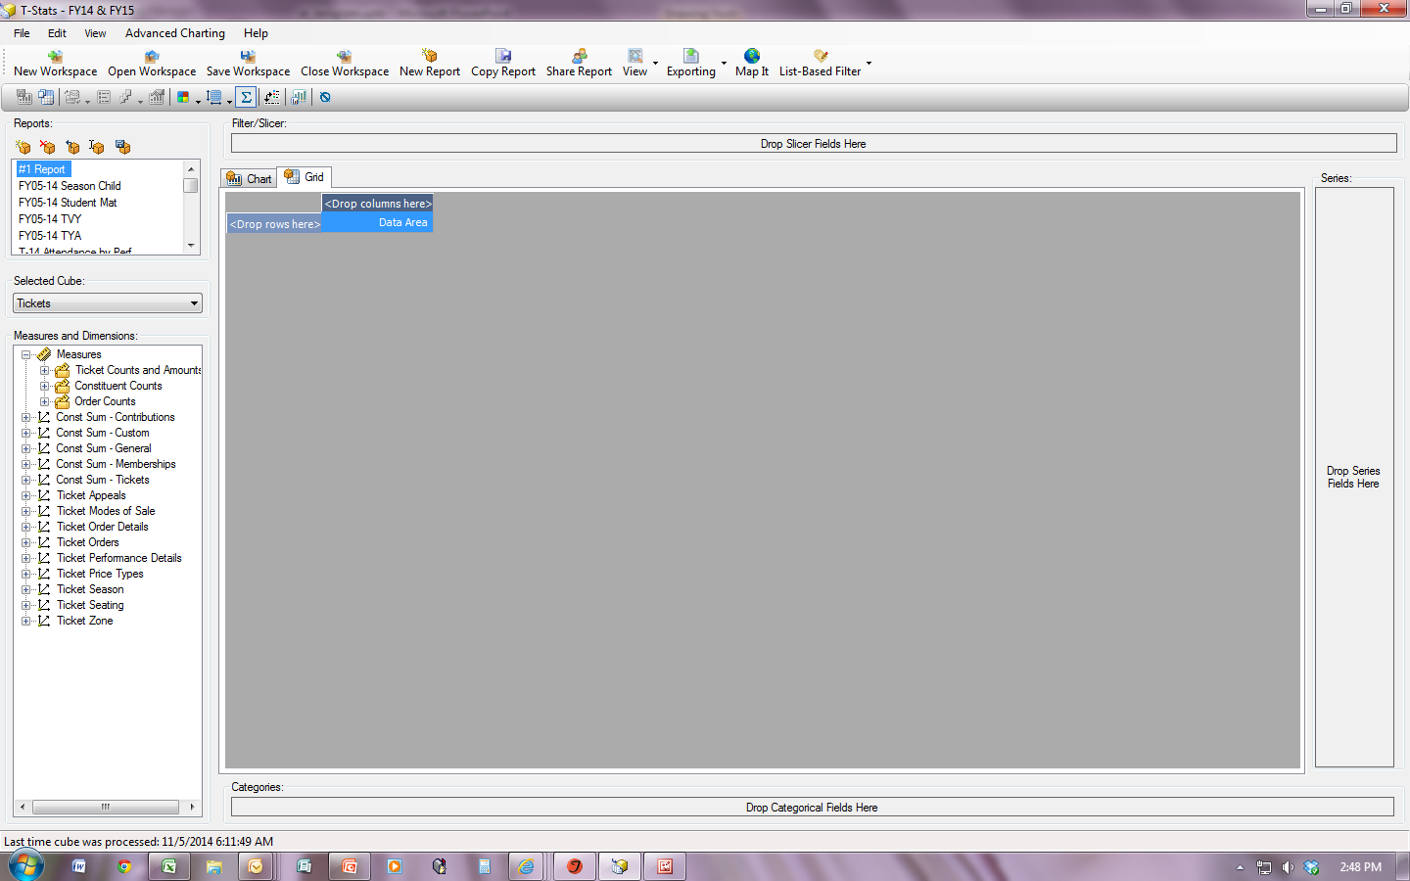
Vocabulary Break!
Vocab Break!
Measure: Item of data that can be counted
Dimension: Groups of items being counted.
Category: Horizontal Axis; Can be a measure or a dimension.
Series: Vertical Axis; Can be a measure or a dimension
Notes:
A few quick vocab words before we get started. This is your workspace within your workspace there are Measures & Dimensions; Categories and Series. (CLICK)
Measure: Item of data that can be counted – number of tickets, number of constituents, etc. (CLICK)
Dimension: Groups of items being counted. - A particular show in a season, the price types of tickets sold, what seating sections, etc. (CLICK)
Category: Horizontal Axis; Can be a measure or a dimension. (CLICK)
Series: Vertical Axis; Can be a measure or a dimension(CLICK)
Filter/Slicer: It is exactly what you think. You can add a list directly from Tessitura to filter on, or you can slice & dice your data anyway you want. (CLICK)
Also, one quick tip – your workspace will default open to the first report. I have a blank report saved as #1 Report. With it being blank T-Stats isn’t trying to pull data in, so it opens faster.

Slide 6
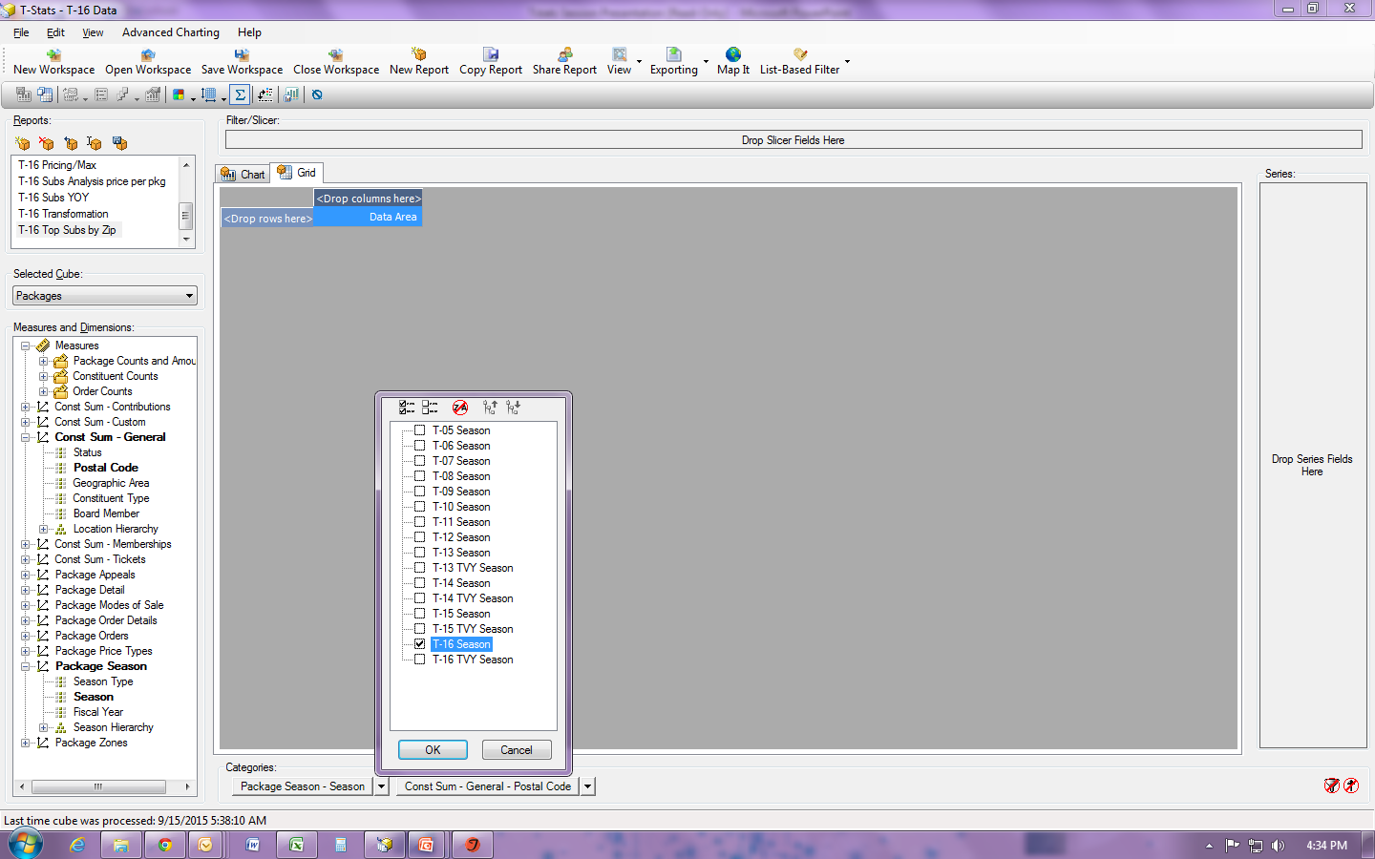
What zip codes should we be targeting for a season ticket mailing?
Notes:
So let’s look at a relatively easy one. I am wondering what zip codes I should be targeting for my season ticket brochure. Certainly, I could just mail to everyone on our list, but that is tens of thousands of people and a ton of money in postage. So let’s look at WHERE my current season ticket holders are most likely to live. With that knowledge I can easily pull a list in Tessitura of single ticket holders who live in the same area and would be more likely to purchase a season ticket package.
First I will start by adding a new report, and I will immediately re-name it – otherwise it will just stay as Report 1 (or two or three, and that won’t help me identify it later). Next, I will choose the cube that best pertains to what I am doing. Since I am looking for season ticket holders, that would be my packages cube.
A word to the wise, start with your dimensions and filters first. If you start with the measures, as you add the dimensions and filters it will automatically start pulling the data for you and you will have to wait for it to retrieve your data before you can add the next dimension or filter.
From my Dimensions I am going to add the season I am looking for: T-16 Season, and from the Constituent Summary area the postal code.

Slide 7
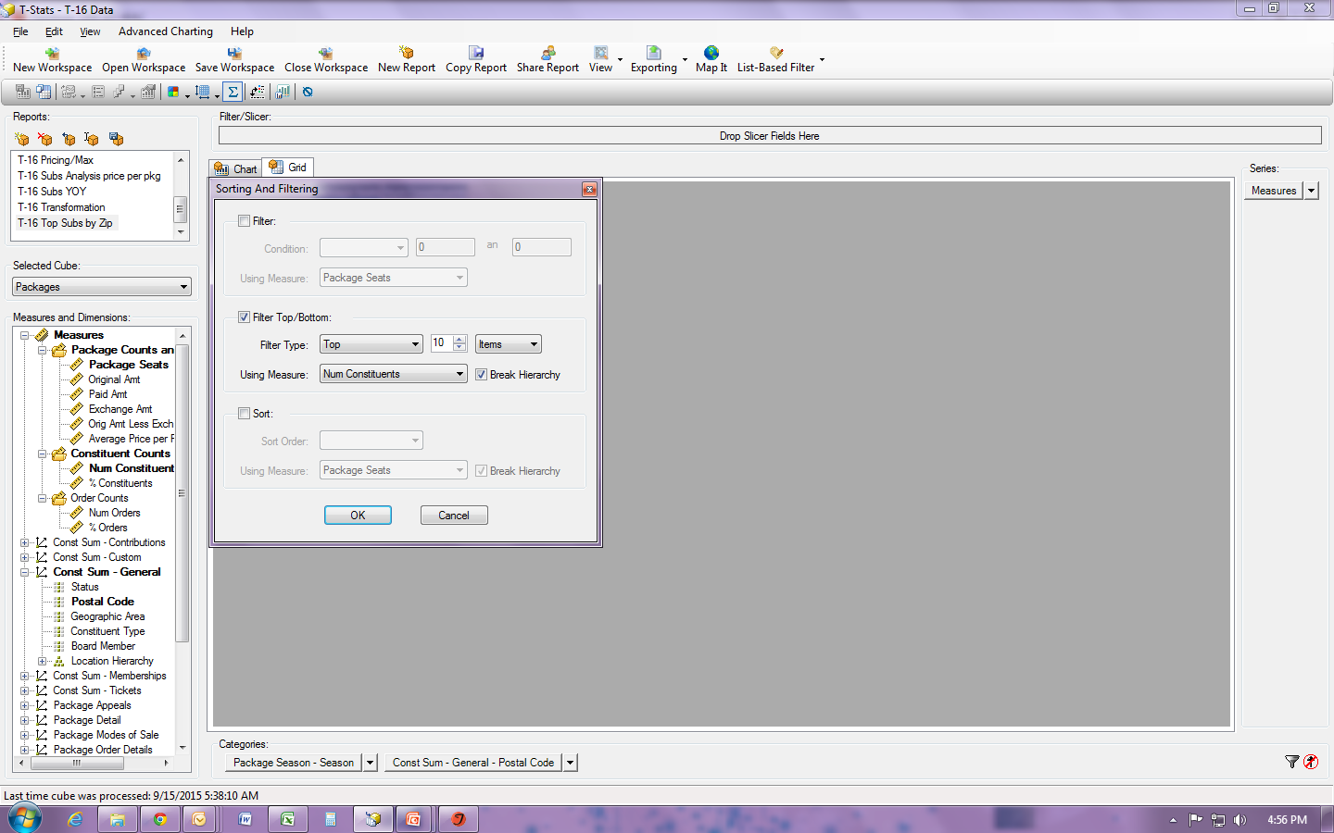
Slice it and Dice it!
Notes:
Next I will click on the red Sort/Filter icons in the bottom right corner so I can ask for just the top 10 zip codes by the number constituents who purchased season tickets in that zip code.

Slide 8
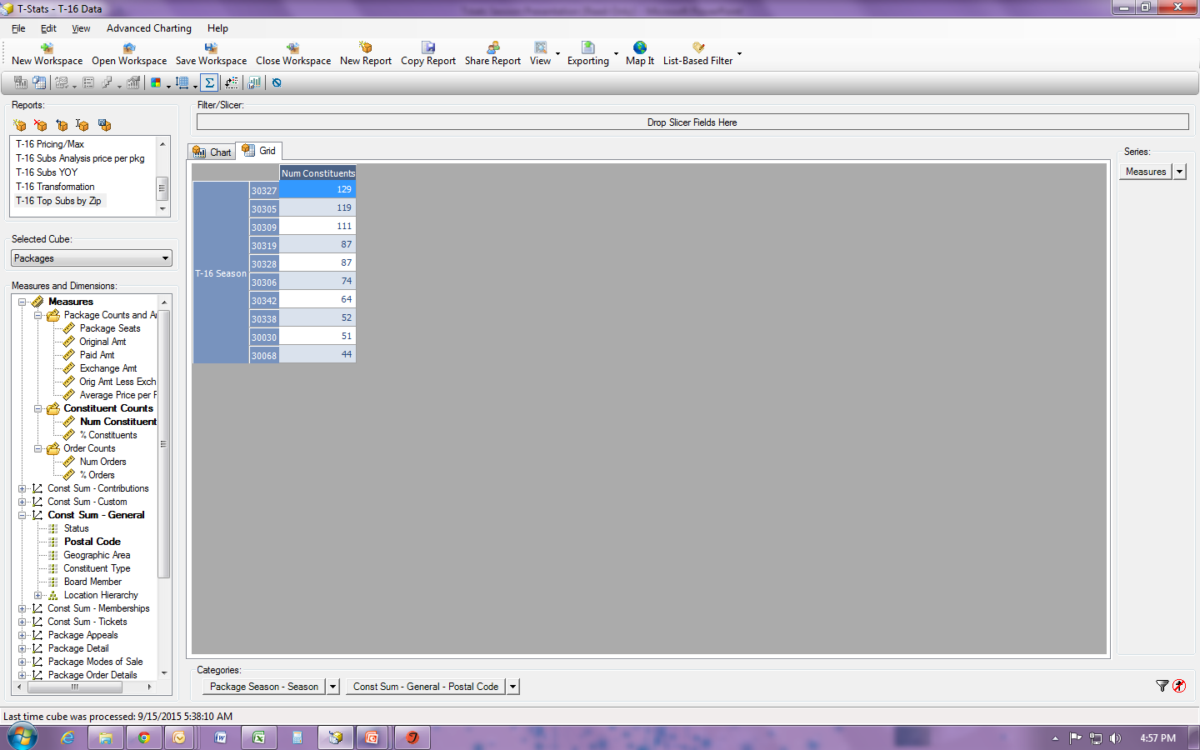
Measure it!
Notes:
Finally I can drag and drop my measures into place and boom! Now I have it.
But wouldn’t it be super if I could see on a map where those zip codes are in proximity to the theatre itself, like a heat map… (click) T-Stats for the win!!!! I just click the map it button and….(CLICK)

Slide 9
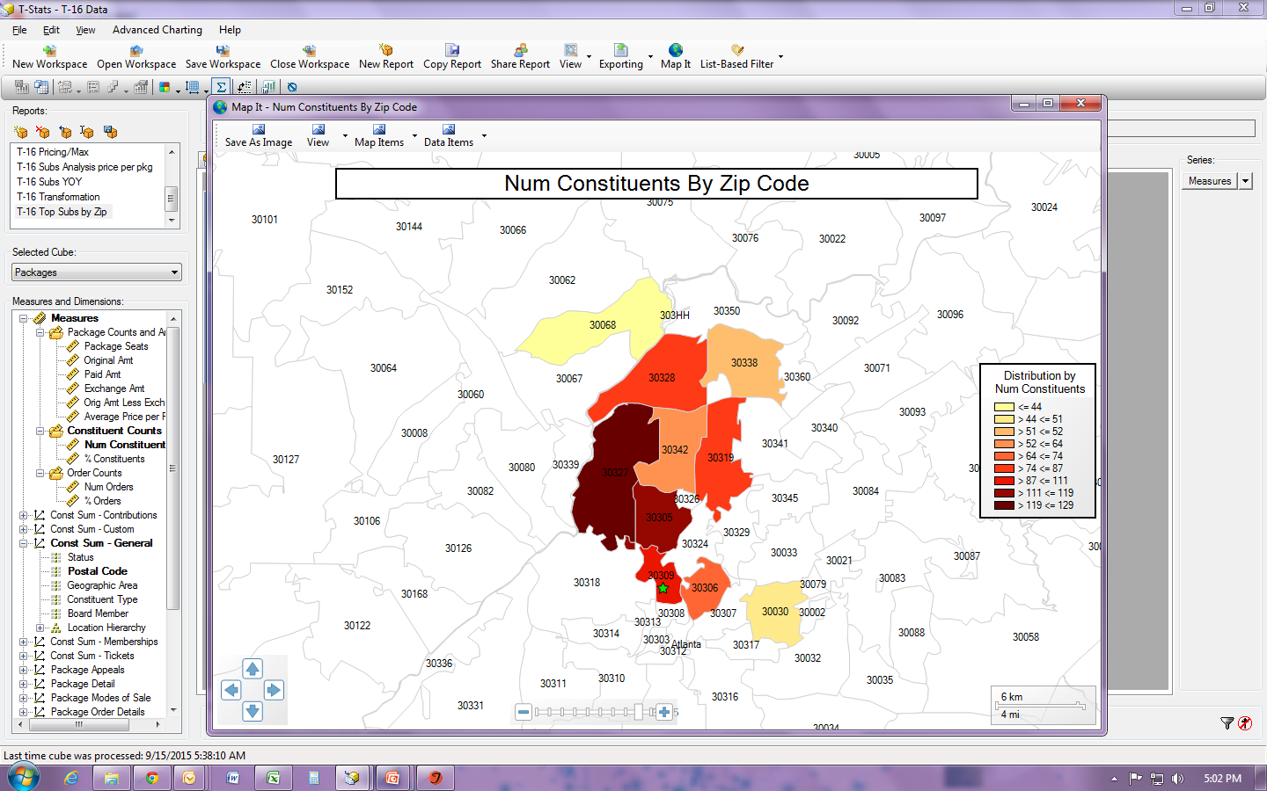
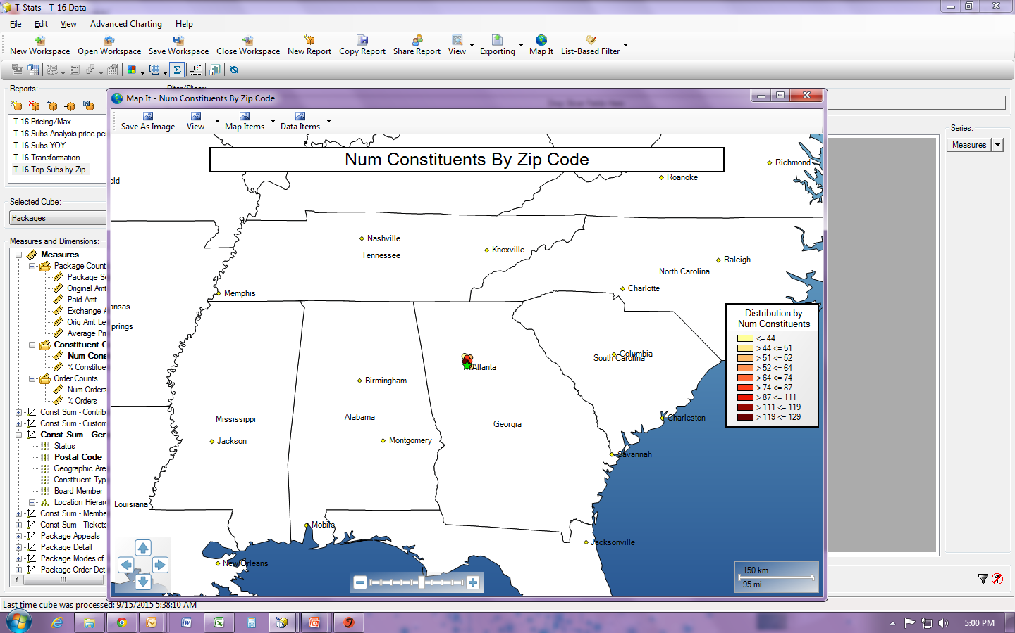
MAP IT!!!
Notes:
WHAT??? This is the worst??? This doesn’t tell me anything, other than a bunch of dots on a map clustered around Atlanta.
With some zoom action and a quick double click to get the zip code outlines. (CLICK) Much better. We are the little green star in the center. So the majority of our top 10 zip codes are located directly north of us. Now I can go back into Tessitura and pull a list of people to target using just these top 10 zip codes.

Slide 10
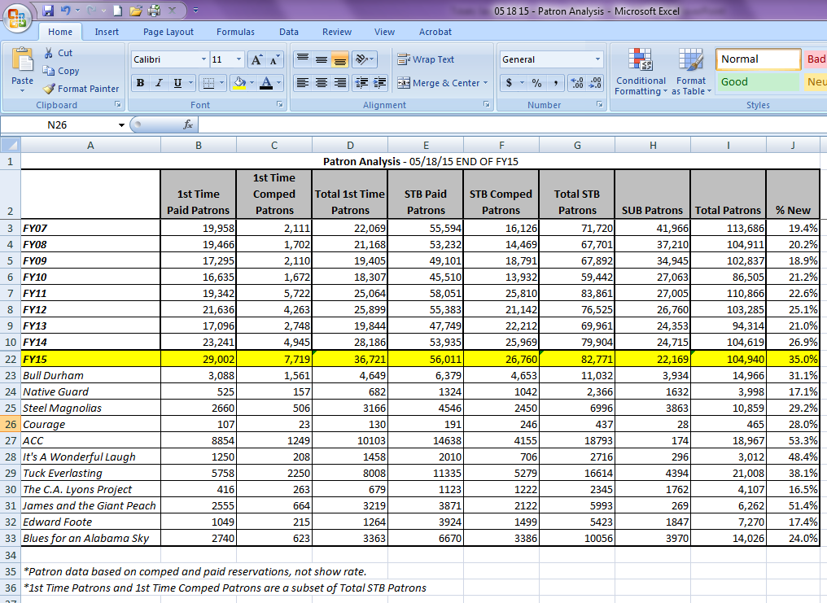
Patron Analysis
Notes:
At the end of each production I have a patron analysis report that I have to fill out and send to our Senior Staff . It looks like this (CLICK). Certainly, there are reports in Tessitura that will give me this data, but I will have to run those reports a a number of times with different parameters to get all of this info. T-Stats can show me all of the data with just a few tweaks here and there.

Slide 11
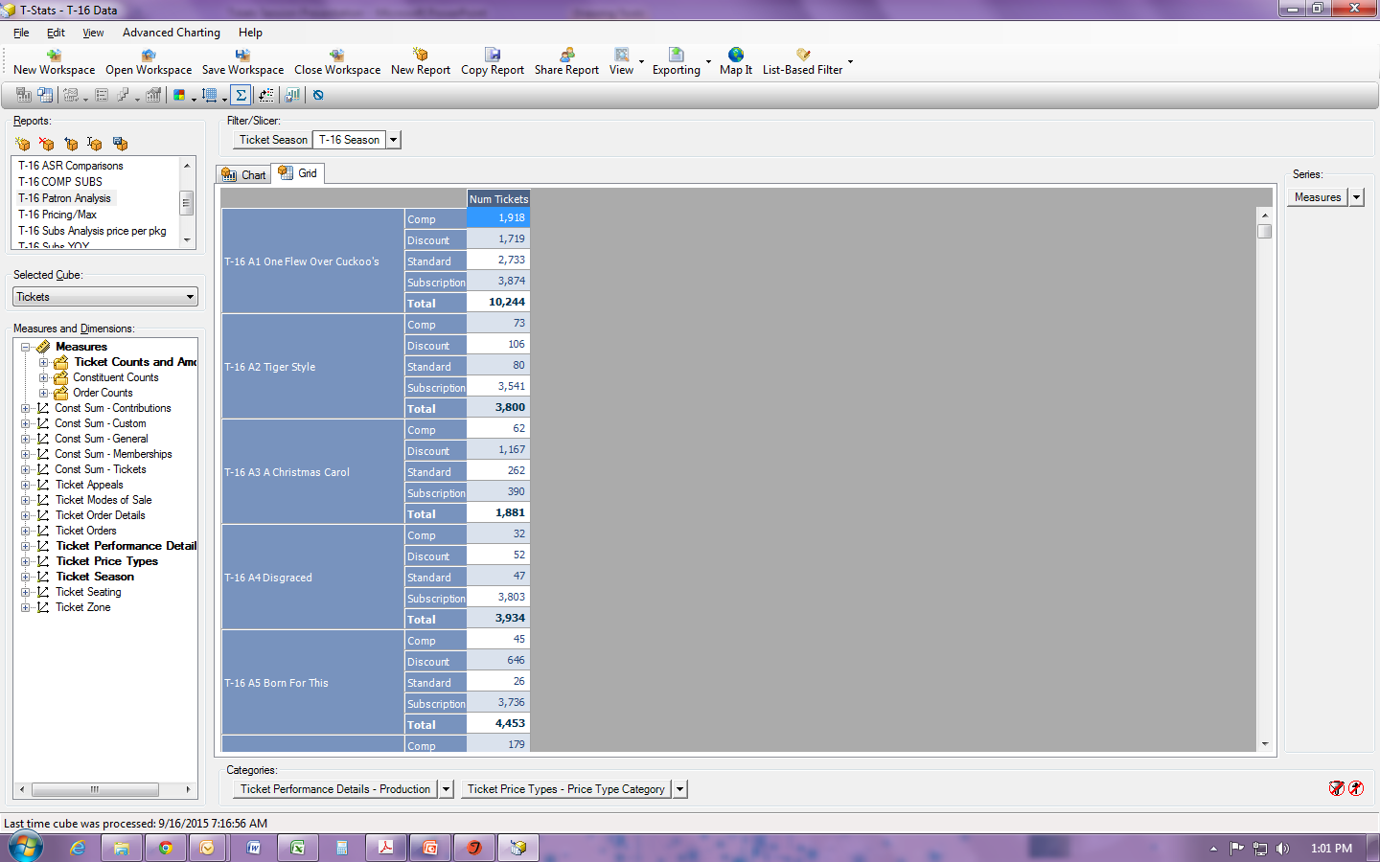
T-Stats Patron Analysis
Notes:
The set up in Tstats is very simple: I start by putting my season in my Filter/Slicer. My categories are Tix Perf Details by Production and Tix Price Types by price type category. In my measures I want to know the number of tickets.
As it stands this gives me half of what I need. But if we go back and look at the patron analysis, The Powers That Be want to know who were first timers. For that I need to add another filter, this one will be based on a list out of Tessitura.

Slide 12
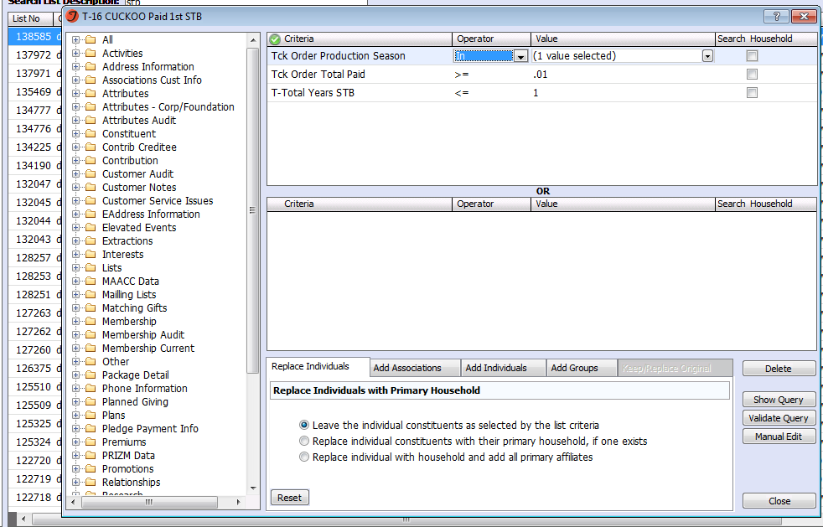
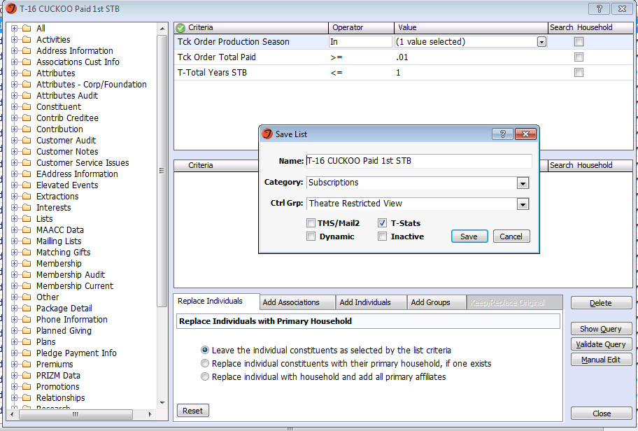
Filter: By List
Notes:
So I build the list I am looking for: Tix Order Production Season = Cuckoo’s Nest; Tic Order total paid >/= .01, and the Attribute T-Total Years STB </= 1. When saving the list, be sure to check the Tstats check box.
Now heading back to T-Stats

Slide 13
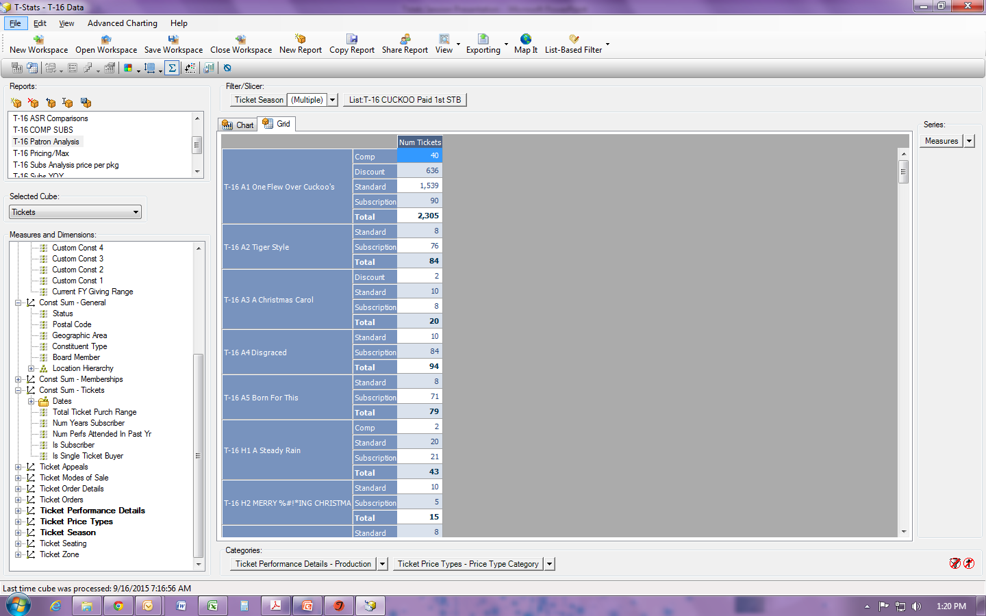
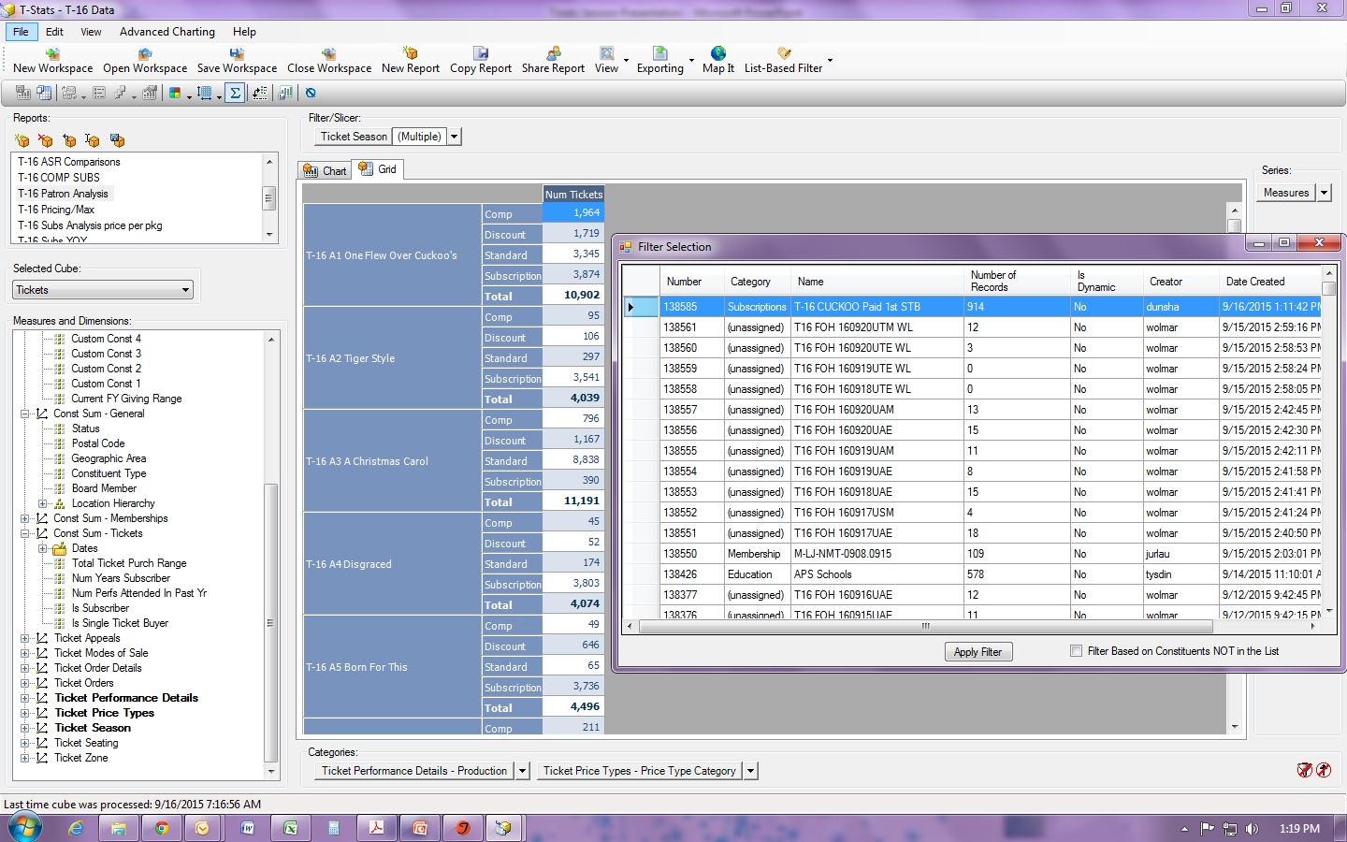
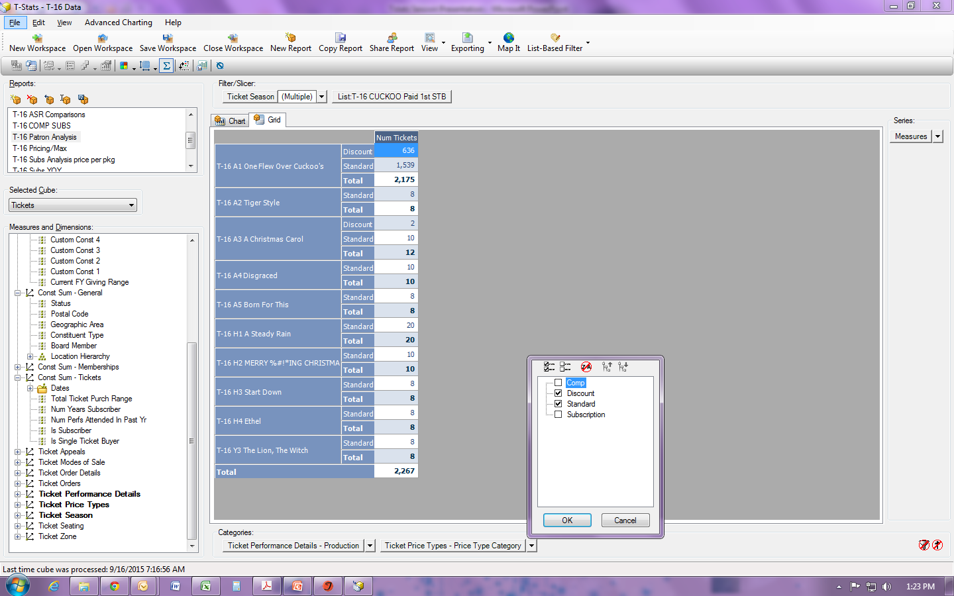
Filter: By List
Notes:
Now back in Tstats I apply that list as a filter by choosing the list based filter option and applying it. (CLICK)
Now you can see my total # tickets dropped from over 10K to 2300. So I can either add the discount and standard numbers together or (CLICK) I can simply uncheck the comp and subs price type category to get the total number of PAID first time STB.
I do the same thing all over again for first time COMP patrons – starting with building my list in Tess and applying it as a filter.

Slide 14
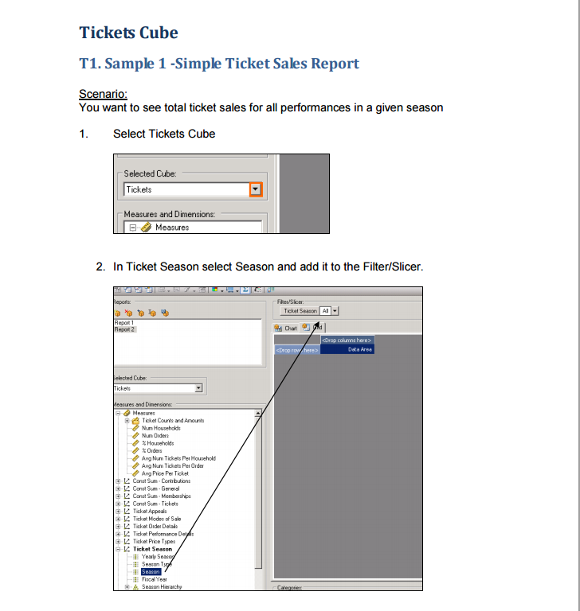
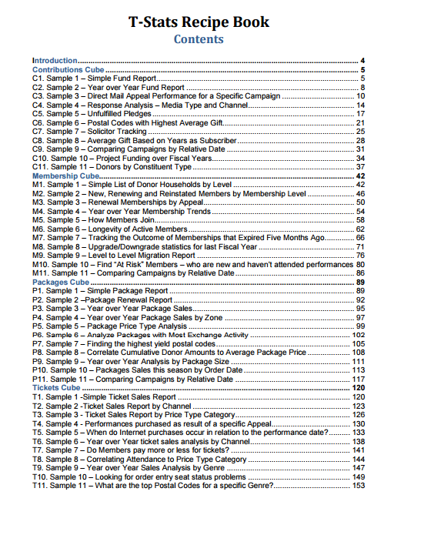
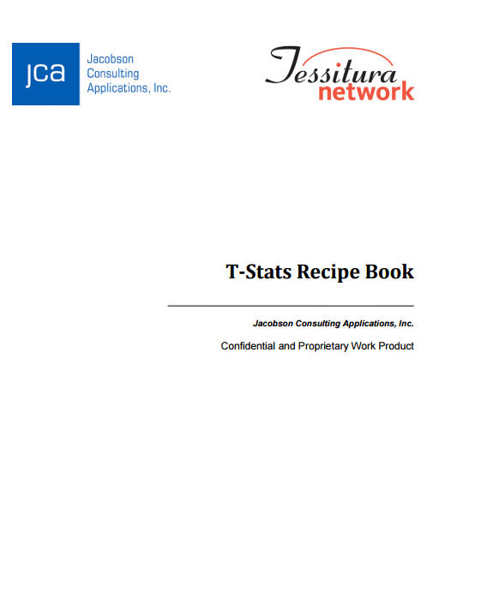
Cooking with T-Stats
www.tessituranetwork.com/network/Learning/Documentation
Notes:
As we all know, Tessitura Network is a great resource for pretty much every question you have. That holds true for T-Stats as well- Behold the T-Stats recipe book located in the documentation help system on
The recipe book is the place to start learning. It is a step by step guide for reports you can create in each data cube. The recipe book will give you different scenarios and show you which measures and dimensions to use and where to put them. Tegan will be putting a link to the recipe book under Training Resources on the intranet for WAC employees.

Slide 15
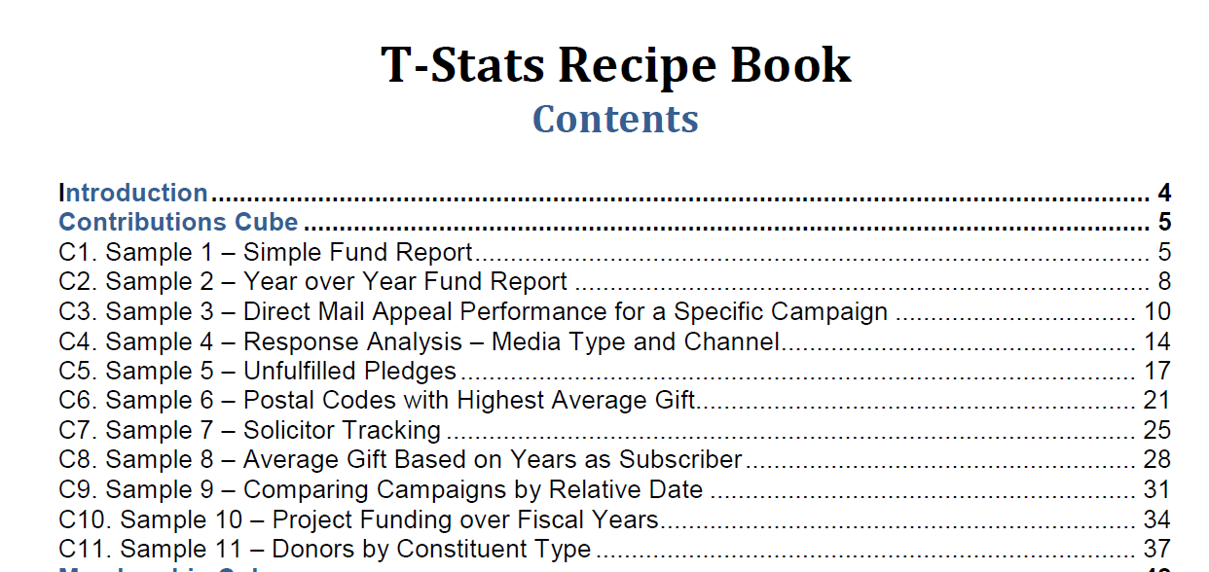
Recipe Book - Contributions
Notes:
There is an awesome recipe book with tons of report examples for T-stats. We’re going to look at a couple of these, but I’ve changed the Year over Year Fund Report to show you a slightly different version. Instead of a Year over Year Report, we’ll look at a Year over Year Report by Month. The best thing about T-Stats is that you can easily modify the criteria to get a completely different view of the same data.

Slide 16
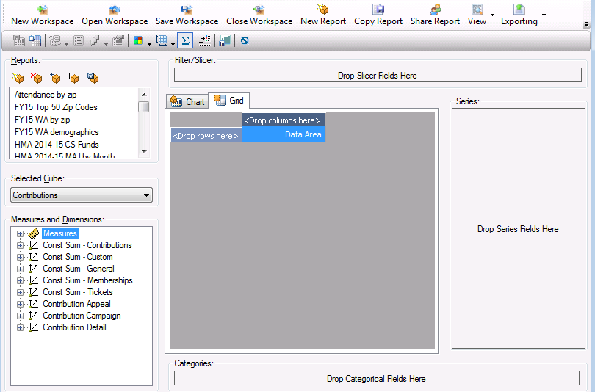
Year Over Year by Month
Notes:
Let’s review the report screen. The top left area houses your previously created reports. You can create new report, delete reports, copy reports, etc.. You can choose, Contributions, Memberships, Packages, Seats, and Tickets, in the Cube. Make sure you are in the right cube for the data that you are looking for. You’ll use the Measures and Dimensions to build your report. It takes a bit of trial and error, but recreating reports in the Recipe book is how I learned everything I know about T-Stats! The Measure will usually go in the Series section. The dimensions usually go in either the Categories section or the Filter/Slicer section, though I have used them in Measures. The Series and Category sections will show on your report. Any dimensions that you put in the Filter/Slicer section will filter the data, but the dimensions do not appear on the report visually.

Slide 17
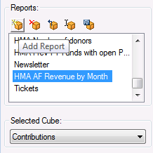
Year Over Year by Month
Notes:
First, we’ll look at the different areas and then you’ll see how the report comes together. Click the Add Report button to add a new report and then remember to choose the appropriate cube! If you start building a Contribution report in the Membership cube, you’ll have to start over when you switch to the Contribution cube. Make sure you are in the correct cube!

Slide 18
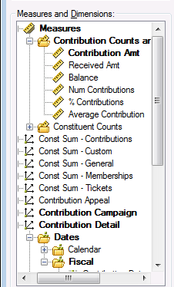
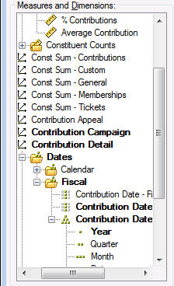
Year Over Year by Month
Notes:
For the Year over Year by Month report, we’ll need the Contribution Amt in the Measures and the Year which is hidden way down in the Contribution Detail folder. We’ll put both of these in the Series section.

Slide 19
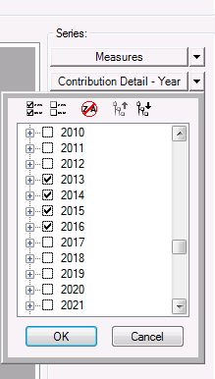
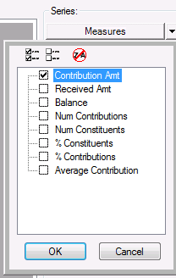
Year Over Year by Month
Notes:
Once you choose the criteria, you can then choose the dropdown to choose which fiscal years and Measures you want to appear on your report.

Slide 20
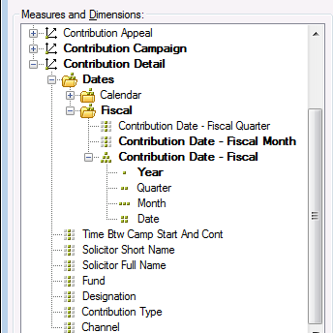
Year Over Year by Month
Notes:
Next, we want the Contribution date – Fiscal Month to put in the Categories section.

Slide 21
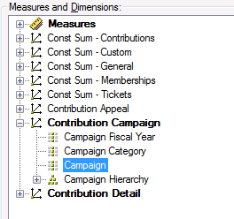
Year Over Year by Month
Notes:
Next, we’ll choose the Campaign Dimension and put this in the Filter/Slicer Section. We do want to be able to filter by Campaign, but we don’t need to see this detail on our report.

Slide 22
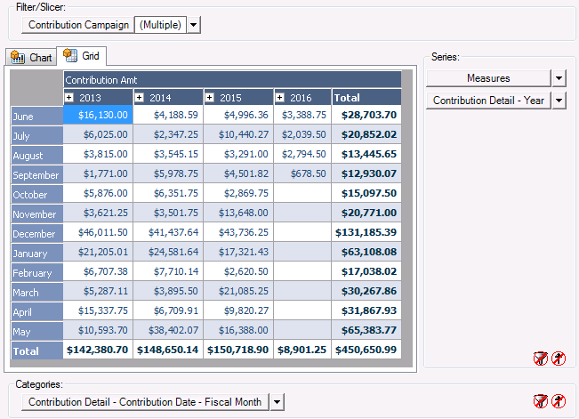
Year Over Year by Month
Notes:
And here we have the report! We see the total for the campaigns that we have chosen by month and by fiscal year. This would be great to use in budgeting or to see how you are doing compared to previous years.

Slide 23
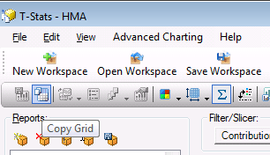
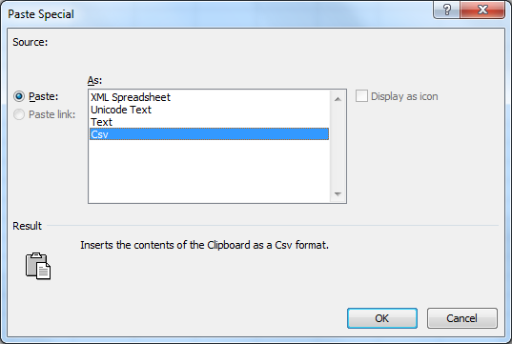
Year Over Year by Month
Notes:
Choose this button to copy your report so that you can paste it into excel if you need to create a report to email or analyze it further. You’ll need to do a right click paste special and choose csv when you paste it into Excel if you want to do any calculations with the data.

Slide 24
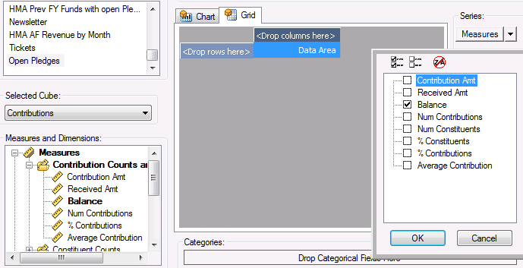
Unfulfilled Pledges
Notes:
Now, let’s look at Unfulfilled Pledges. We’ll walk through this with the full screen view. First, select the Balance Measure and move it to the Series. The Balance will already be chosen for you in the dropdown, but you can choose more than one if you want.

Slide 25
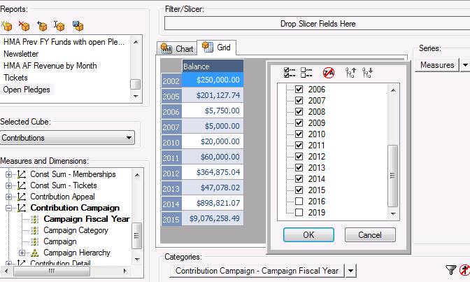
Unfulfilled Pledges
Notes:
Next, we’ll put the Campaign Fiscal year in the Categories section. Then, in the dropdown, we’ll choose the fiscal years we want. I chose everything except the current and future years.

Slide 26
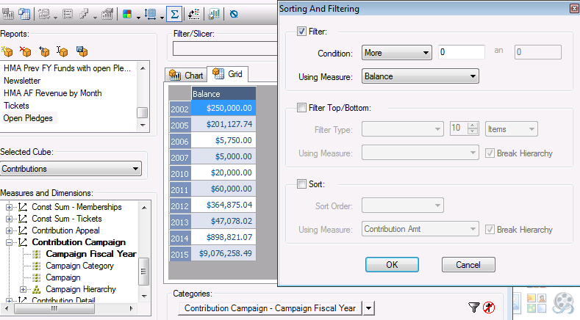
Unfulfilled Pledges
Notes:
Next, we’ll filter further by choosing the Sorting and Filtering button at the lower right. We want to see any balance greater than 0 so we’ll choose the Condition “more” with a value of “0” and the Measure of “Balance”. That’s it! Our report is done. We have Balances due by Fiscal year. If you wanted more detail, you could add Campaign, Fund, Appeal, etc. to the Categories to break it down further.

Slide 27
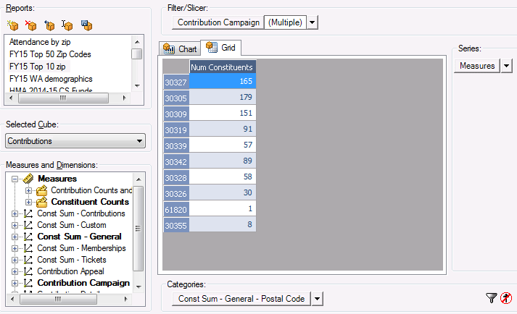
Top 10 Zip codes by Constituent
Notes:
Now, Let’s look at the top 10 zip codes by Constituent. Let’s work backwards this time. Here is the finished report.

Slide 28
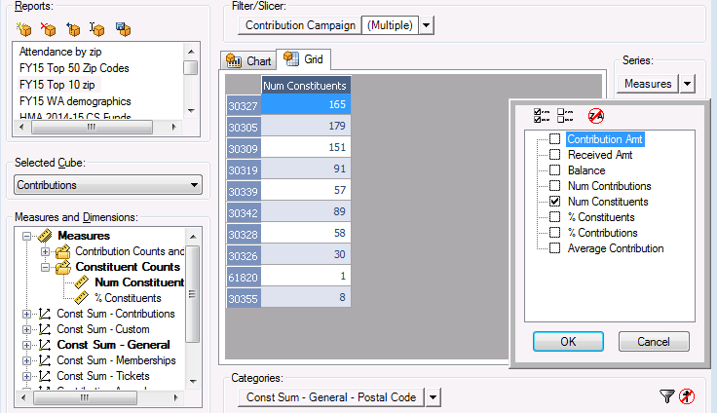
Top 10 Zipcodes by Constituent
Notes:
And this is how we made the report. We put the Num Constituents in the Series.

Slide 29
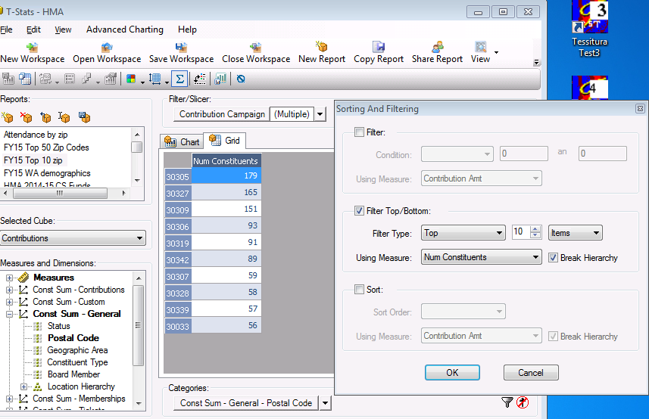
Top 10 Zipcodes by Constituent
Notes:
Then we put the postal code in the Categories section. With the Sorting and Filtering button, we filtered for the Top 10 Items using the Num Constituents.

Slide 30
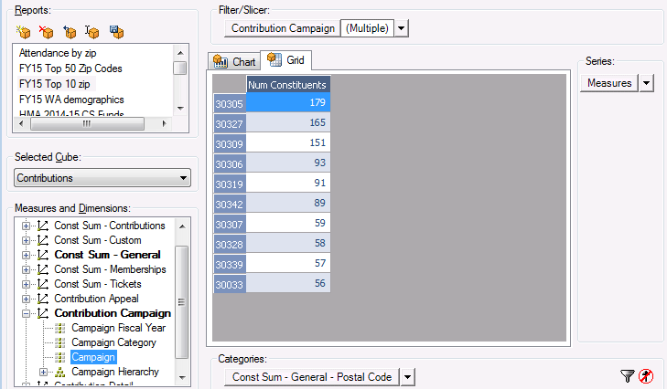
Top 10 Zipcodes by Constituent
Notes:
And we also filtered by Campaign because we were only interested in a few campaigns, not all of them. From here, you could map it, copy it to Excel, or change any of the criteria if the report output wasn’t what you thought.

Slide 31
Contact Us!
Shana Orr
Alliance Theater
Ticketing & Patron Services Manager
404-733-4760
shana.orr@woodruffcenter.org
Mark Frey
Woodruff Arts Center
Database & Analytics Manager
404-733-4277
mark.frey@woodruffcenter.org

