Slide 1
Ticketing Tips and Tricks
Presenter
Danielle Hicks

Slide 2
Constituent Record Tabs
Constituent Record tab | Radio buttons/features
General tab | Made up of Name, Mailing List, Phone and Other
Names tab | Radio buttons: Salutations, Aliases, Program names
Contact Details tab | Radio buttons: Postal Addresses, Phones, Electronic Addresses, Contact Point Purposes, Login
Plans tab | Radio buttons: Plans Portfolio, Worker Setup
Relationships tab | Add and Edit Affiliations and Associations
Research tab | Radio buttons: Notes, Philanthropy, Assets, Schools, Research, Documents, Rankings
Attributes tab | Radio buttons: Attributes, Interests, Constituencies
History tab | Radio buttons: Membership, Activities, Events, Premiums
Connections tab | Radio buttons: Customer Service, Promotions, Reminders, Contact Log
Contribution tab | Shows contribution detail
Transactions tab | Radio buttons: Transactions, Payments, Seat History, Credit Card, Audit
Ticket History tab | Radio buttons: Ticket History, Package History
Orders tab | Shows order details and subscription summary

Slide 3
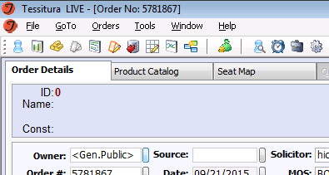
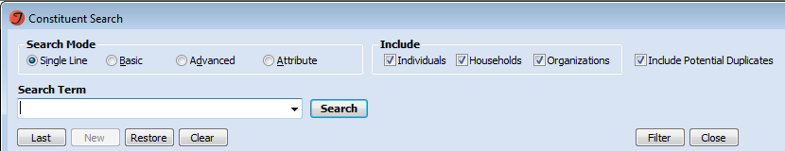
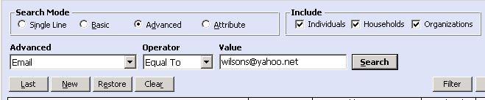
Search Options
One consolidated search bar
All search elements in one place

Slide 4
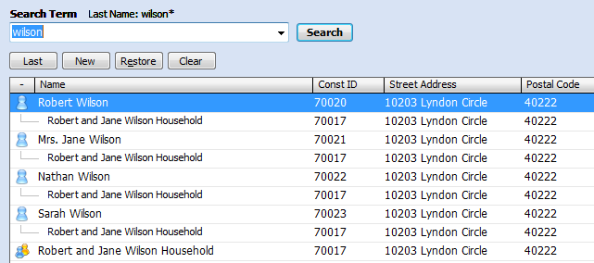
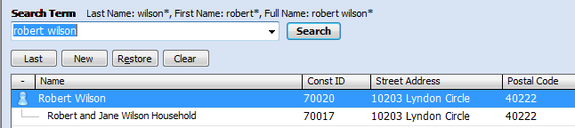
Single Line Search Examples (1)

Slide 5
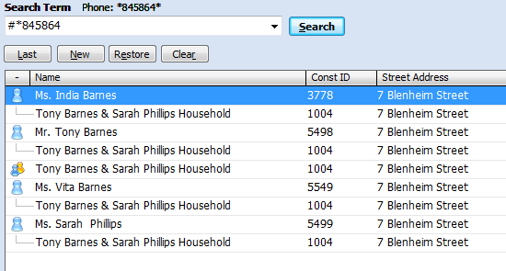
Single Line Search Examples (2)
#phone number
email@email.com

Slide 6

Single Line Caveats
Number by itself is always a constituent ID
Name and number is always last name/postal code
Can’t search for info in “street1” or “street2”
Can’t search by postal code alone

Slide 7

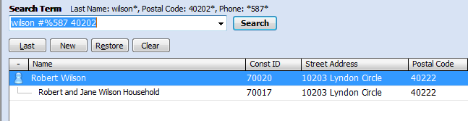
Single Line Tricks
Multiple criteria
  Can use phone, name, email,
  postal code in any combination
  Can use * or % wildcard in searches
  Search “memory” – last 15 searches

Slide 8
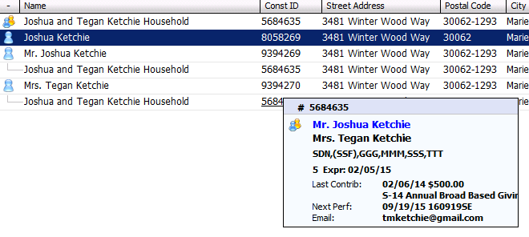
Pop Up Headers

Slide 9
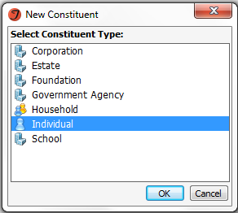



Constituent Types
Constituent Type determines:
  Account format
  Default Salutation
  Format
  Default Address Type

Slide 10

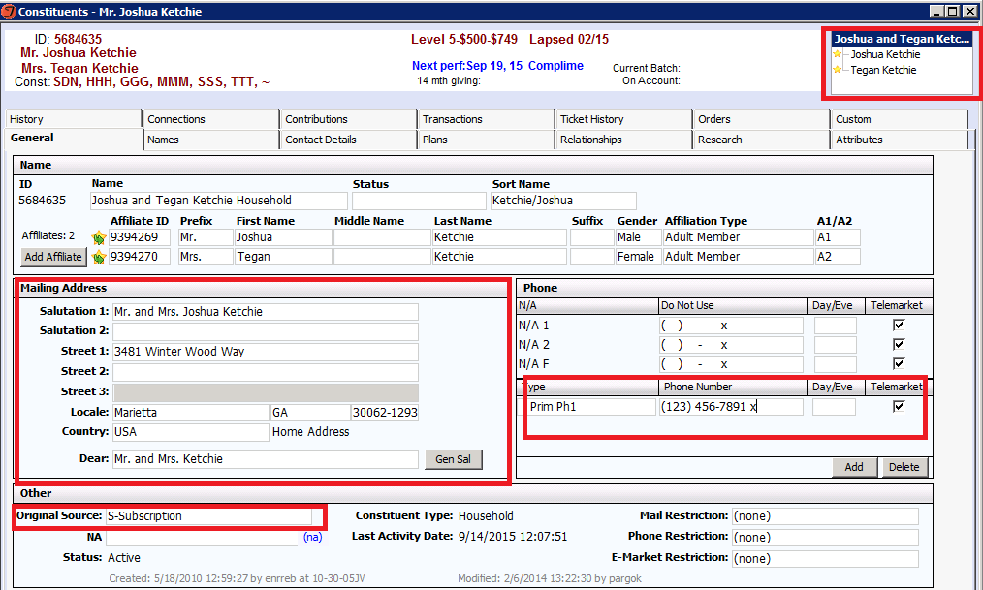
New Household Record

Slide 11
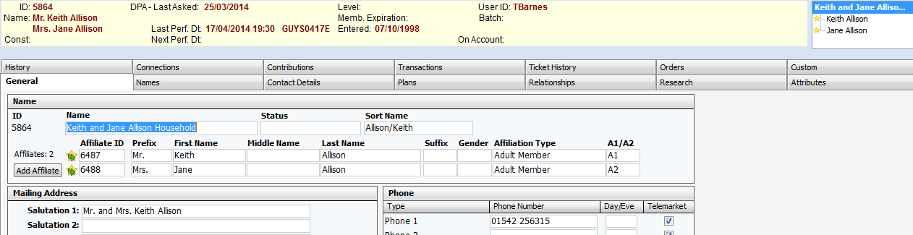
New Household Record
A1/A2 affiliate names are used to build household name, sort name and salutation

Slide 12
New Household Record
Primary contact data for new affiliate records is inherited from the household
  Address, phone and email
If creating a household from an existing affiliate record, information can be moved to the household or new household info can be entered

Slide 13
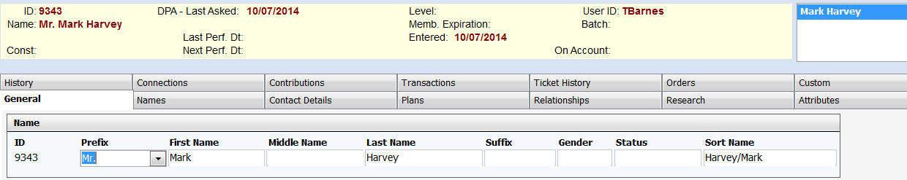
Save Your Work
Click the Save icon in the Toolbar
Switch tabs and continue data entry

Slide 14
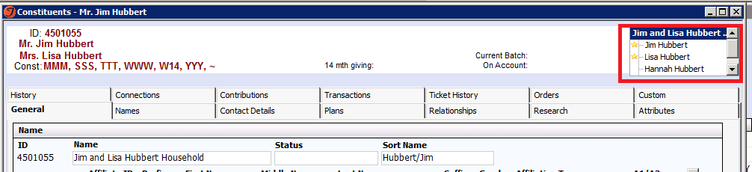
Constituent Navigator
Displays a tree of the group and all affiliated individuals
Clicking on any constituent opens the selected record
The A1/A2 constituents are listed first
Remaining affiliates are listed alphabetically by Sort Name

Slide 15
What is an Affiliation?
Affiliations link household and organization constituent records (i.e. groups) with individual constituent records, such as linking spouses and children to a shared household record and linking employees to an employer organization record.

Slide 16

Primary Affiliations
Between individuals and households; between individuals and organizations
Indicated with a star (in households)
Individuals can only be part of ONE household

Slide 17
What is an Association?
Associations track relationships between constituents in the same constituent category (i.e. individual to individual or group to group), such as grandparent/grandchild relationships, friend relationships, and seat partner relationships.

Slide 18
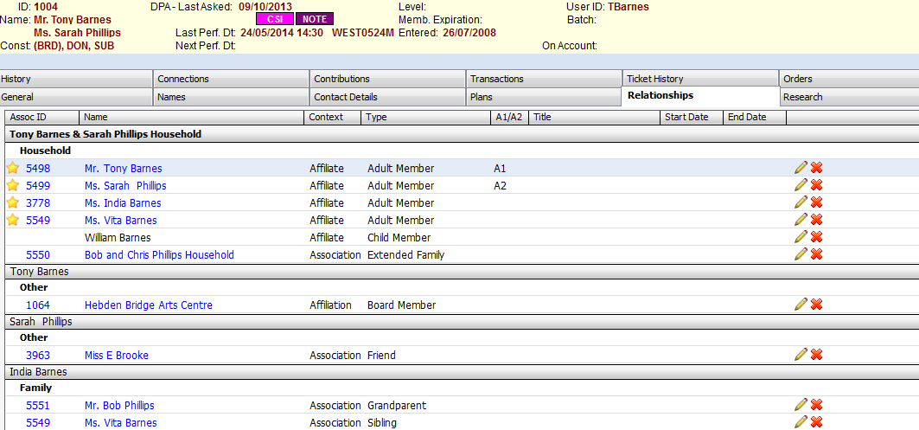
Relationships Tab: Associations
Two relationship types – Associations and Affiliations
Associations = Helpful for the: “I always sit with…” “I share a subscription with…”

Slide 19
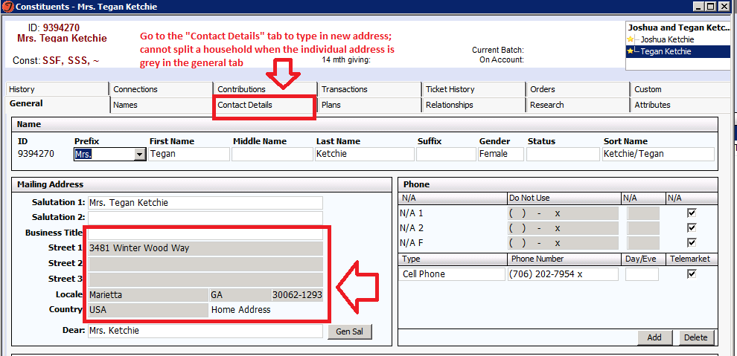
Inherited Data & Divorce

Slide 20
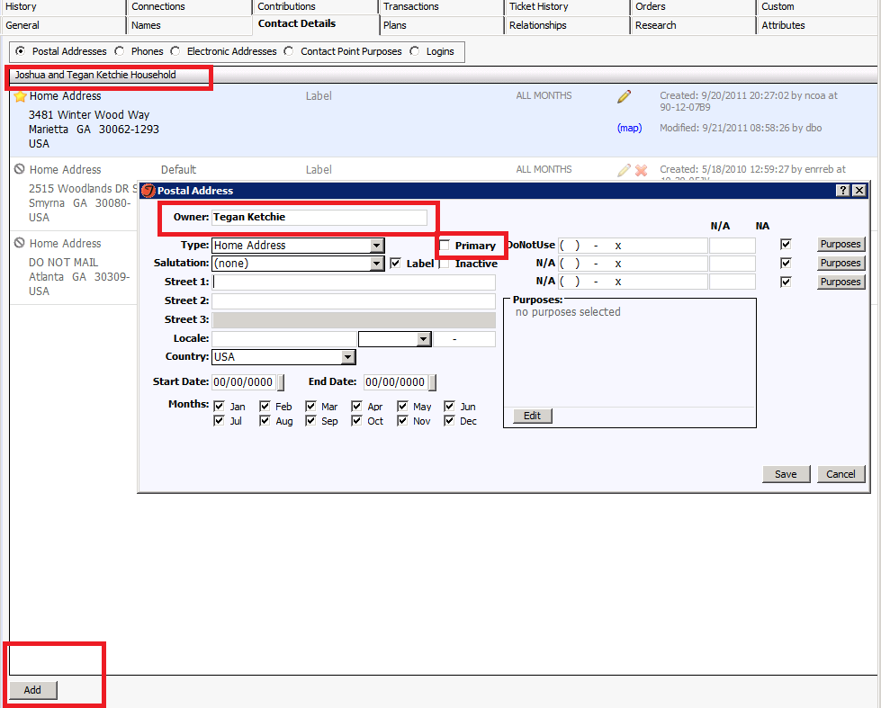
Where to Update Address if Splitting Household

Slide 21
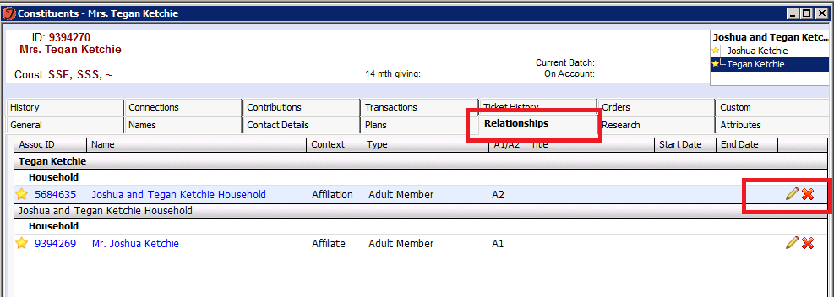
Delete Relationship

Slide 22
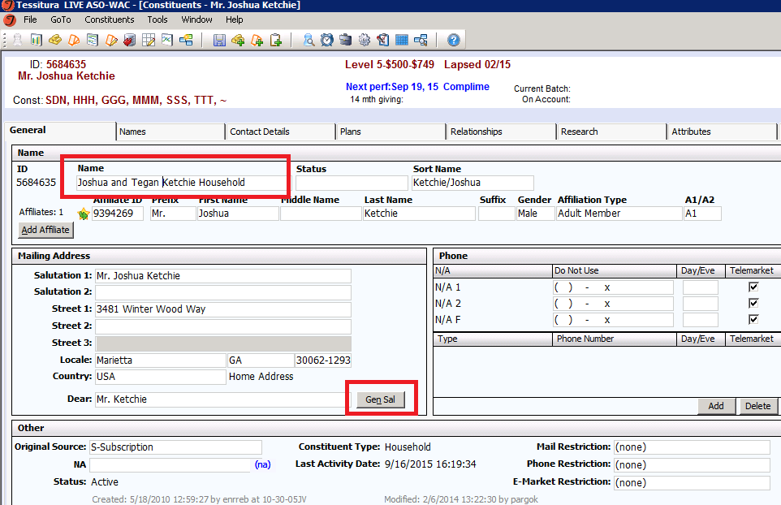
Remember to update “Gen Sal” on Household

Slide 23
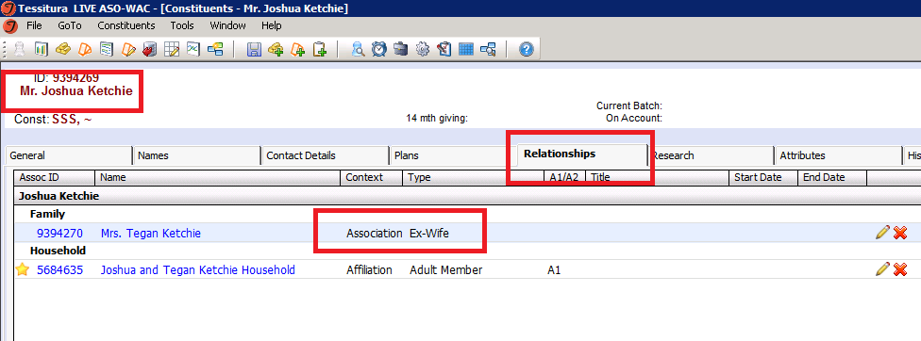
Help Others Think Before Merging: Add the Ex-Spouse as an association!

Slide 24
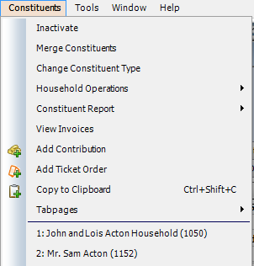
Constituents Menu
Available whenever a constituent record is open
Contains reports and tools to be used on constituent records

Slide 25

Change Constituent Type

Slide 26
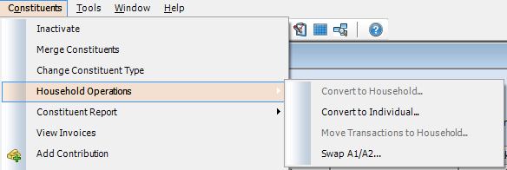
Change Constituent Type
To change an individual to a household, and vice versa, use the Household Operations menu option instead
Swap A1/A2 – Useful For Salutations

Slide 27
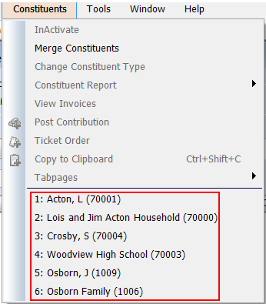
Constituent Memory in Menu
Last six accessed records are held in memory
Click on name or type number to open record

Slide 28
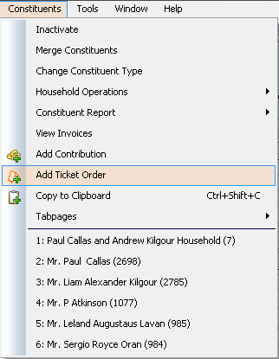
Add Ticket Order

Slide 29
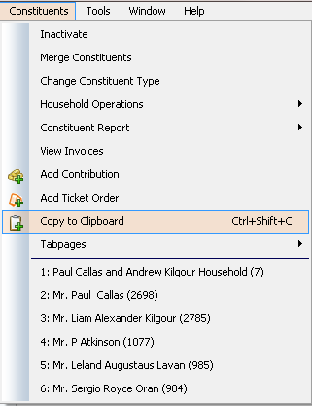
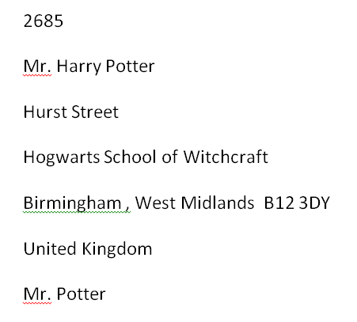
Copy to Clip Board

Slide 30
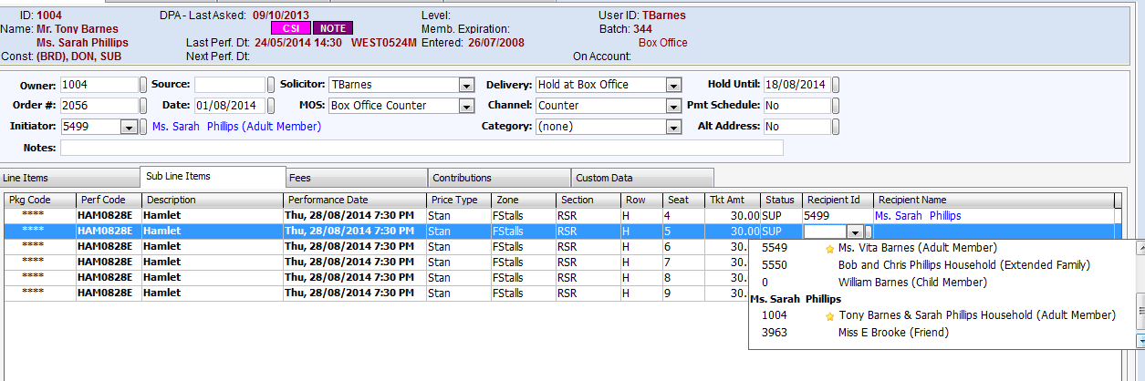
V12 Owner, Initiator, Recipient

Slide 31
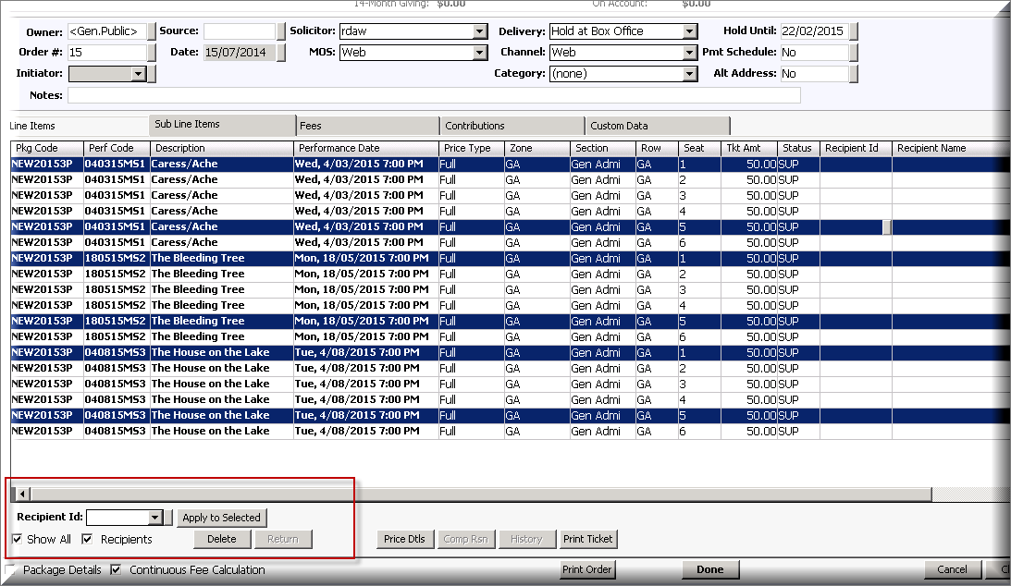
Multiple Recipients?

Slide 32
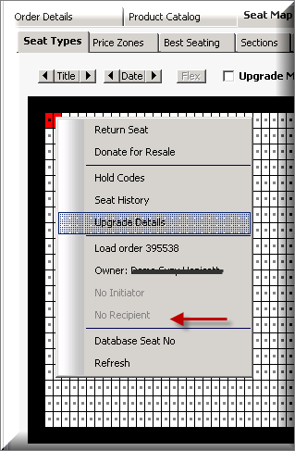
Checking Recipients on Seatmap
Right click over a seat
and instantly you have the:
  Owner
  Initiator: Really helpful for shared subscribers
  Recipient

Slide 33
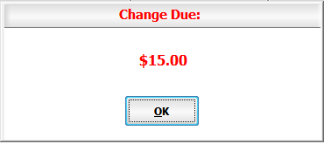
Amount Tendered for Cash
Enter tendered amount for cash payments
Calculate change due
Works in Payment Details and QuickSale
Amount tendered stored in the system

Slide 34
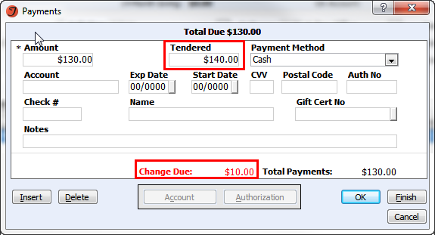
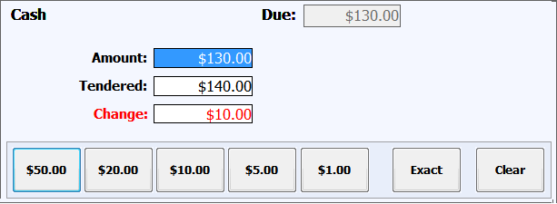
Amount Tendered for Cash

Slide 35
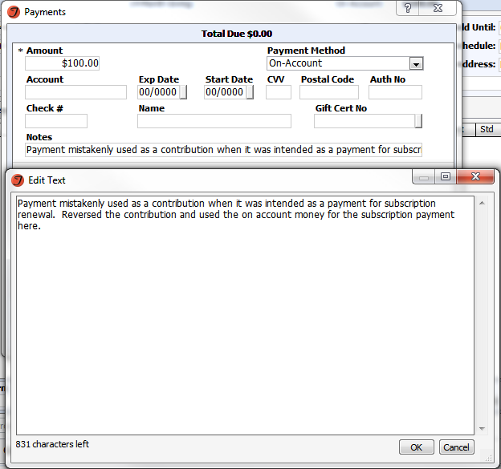
Notes Field added to Payments
Allows you to see payment notes without having to open the actual order

Slide 36
Tools Menu Functions – No need to stop what you are doing
Constituent Search
  Open the search window and constituent record from anywhere in the application (CTRL+T)
CSIs
  Enter a CSI from anywhere in the application

Slide 37
From the keyboard Basic Sale Sequence
Add a line item - Alt+A
Move from one field to the next - TAB
Perf/Pkg Code – know thy formula
Best Seat - Alt+B
Payment - Ctrl+P
Type in payment method
Finish - Alt+F

Slide 38
Completing an order
Finish – Alt+F from Payment window
  Saves/validates order
  Prints tickets
Done – Alt+D

Slide 39
Lassoing Seats
Reserve Available
  Allows reserving in blocks
  Reserve all selected seats – Leave # seats blank on line item (LI)
  Enter # seats on LI and get only number of seats specified
Release locked to release the seats just selected

Slide 40

SeatMap – Performance Scrolling
Previous Perf by Title – T+←
Next Perf by Title – T+→
Return to Line Items – Ctrl+L

Slide 41
The Hunter
Customer calls in looking for anything going the week of x
Navigate the calendar
Review availability
Scan seat map for best seats among several performances

Slide 42

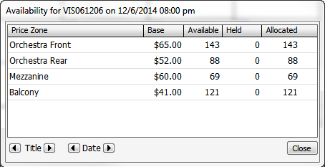
Product Catalog
Product Search - Ctrl+R
  Gross Avail – Show/Sort by availability
Availability Window
  Shift+Click on Zone
    Adds to cart
    Selects the zone
    Navigates to zone in SeatMap
  Scroll By Title or Date

Slide 43
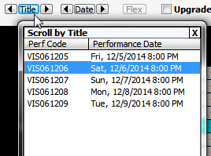
SeatMap – Performance Scrolling
Prev/Next Perf Dt – D+←/→
Prev/Next Perf Date w/i facility – D+Shift+ ←/→
  Or Shift+Click on date arrow buttons
Pick from a list Pop-Up
  (don’t forget window expands)

Slide 44

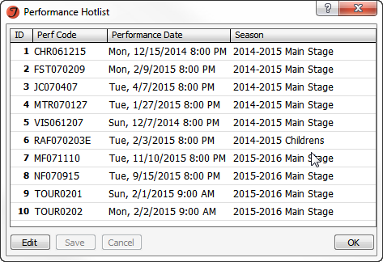

The Hot List – not just for People Magazine anymore
User configurable list of top 10 perfs to sell
Hotlist window - Alt+H
Select hotlist item - 0-9

Slide 45
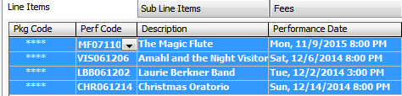
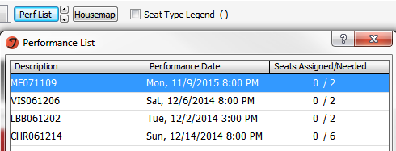
Seating Multiple Performances
Multi-Select line items
  Select ad hoc LIs - Ctrl+Click
  Select range of LIs - Shift+Click
  Invert selection - Shift+Alt+Click
  Select/Clear all - Ctrl+Shift+Click
Best Seat
or Use Perf List to scroll through LIs

Slide 46
Adding Fees
In the Fees tab on the Order Screen click the Add button at the bottom or Alt+A
Choose appropriate fee (W-Misc) Override to whatever amount

