Slide 1

Education & Tessitura
Atlanta Tessitura User Group
Mini- Conference September 21, 2015

Slide 2
Individuals &
Households
NEW! Consortium wide
Attribute for KIDS !!!

Slide 3
Individuals &
Households
What information is already in the system and where is it?

Slide 4
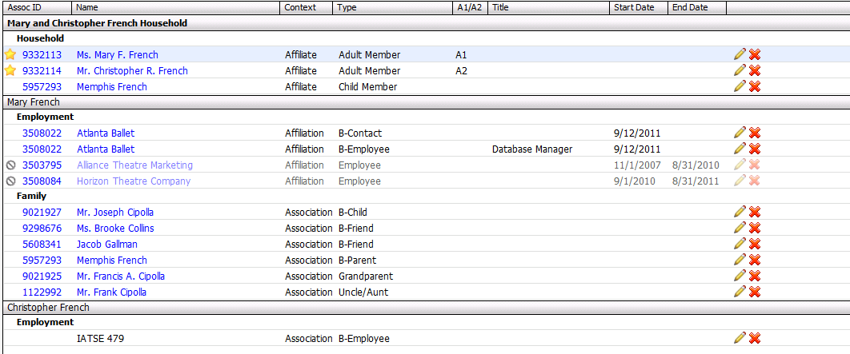
Individuals & Households

Slide 5
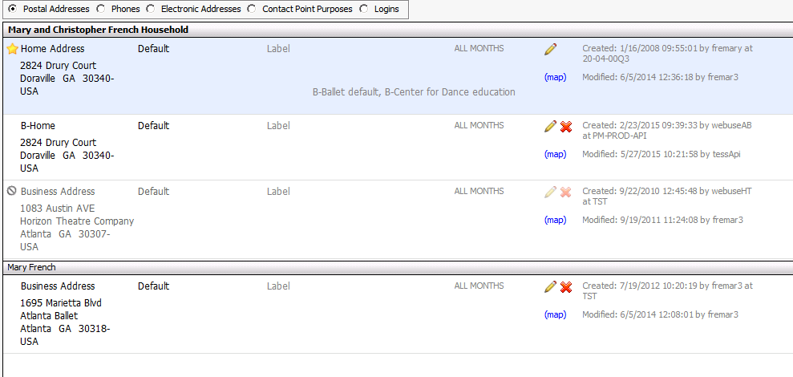
Individuals & Households

Slide 6
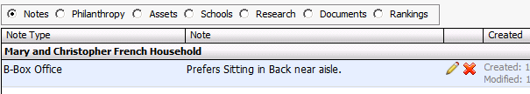
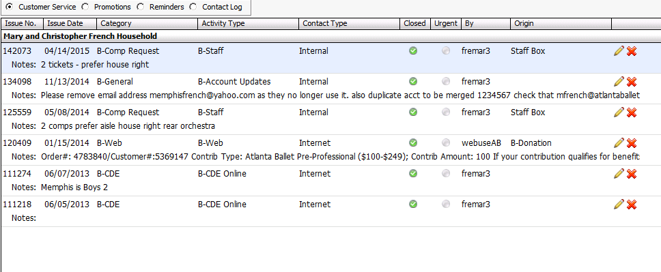
Individuals & Households

Slide 7
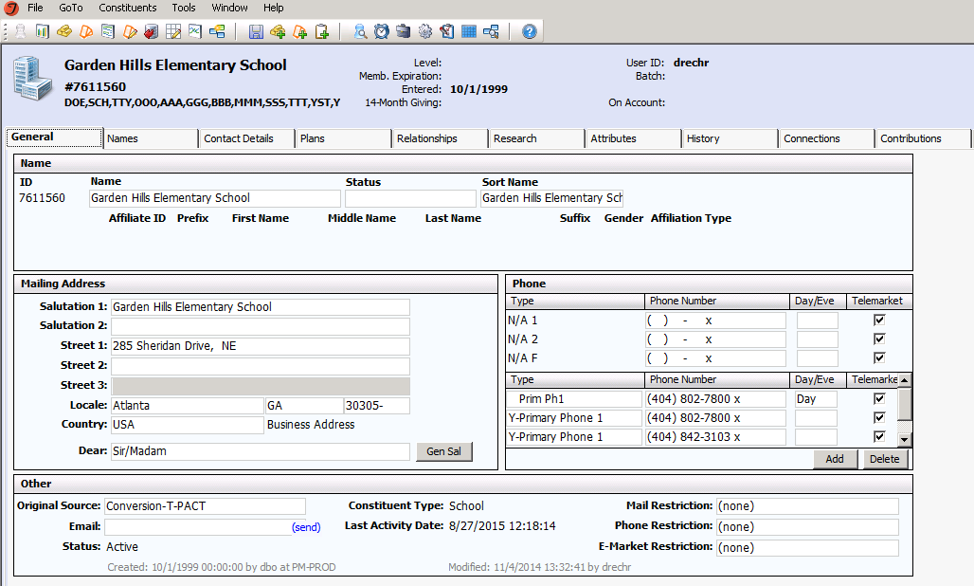
School Records
What is already in Tessitura?

Slide 8
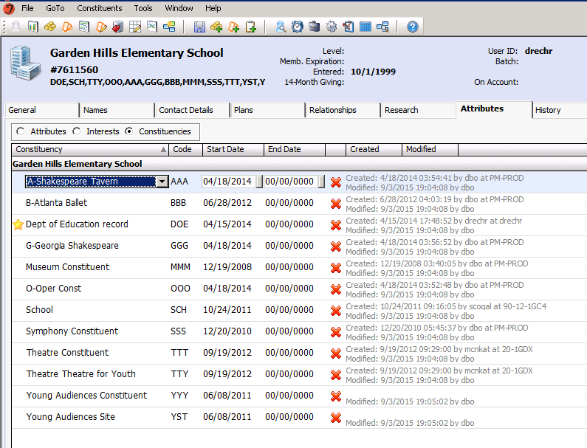
Constituencies

Slide 9
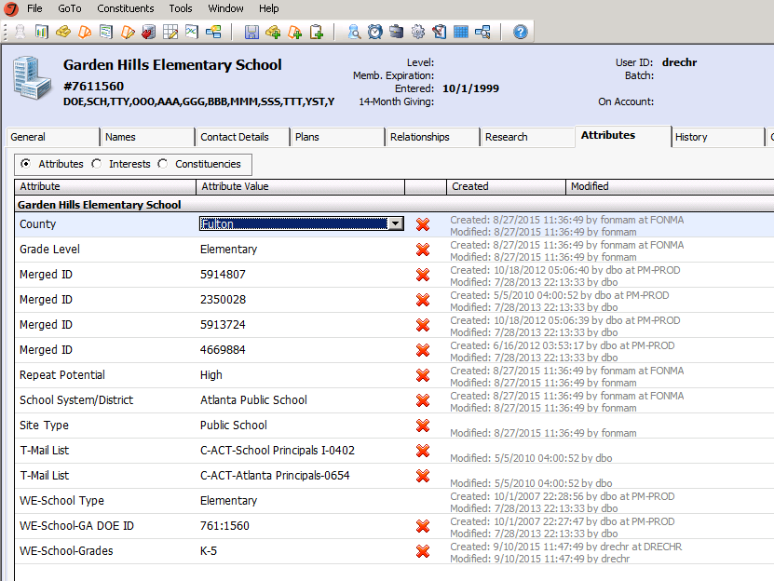
Attributes

Slide 10
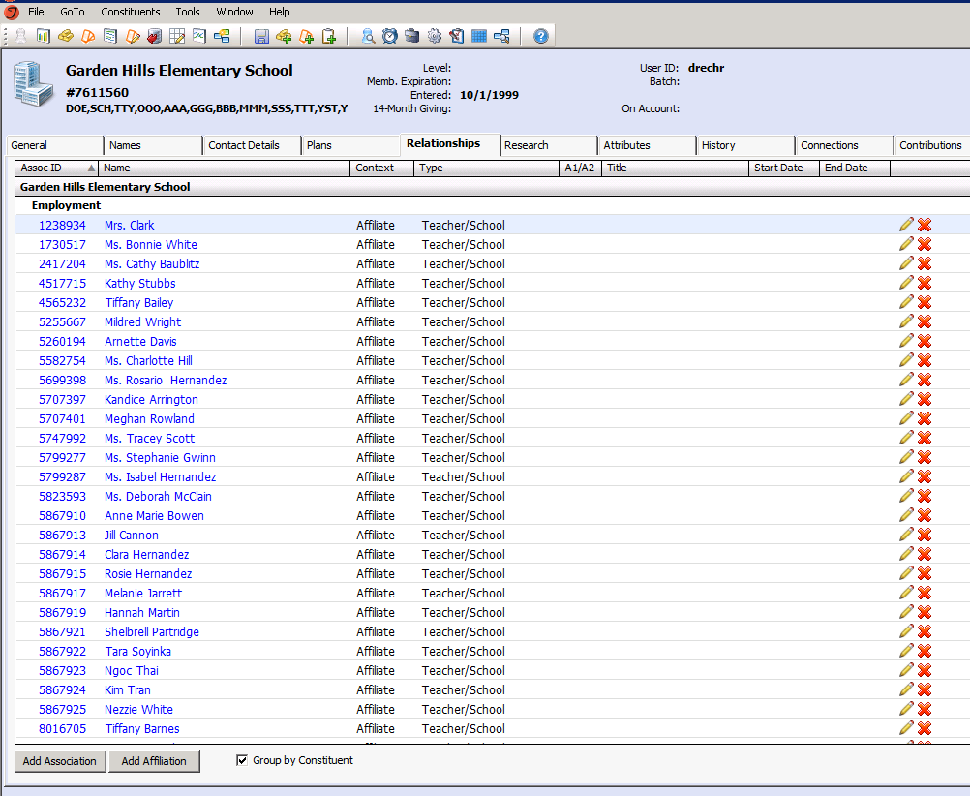
Relationships Tab

Slide 11
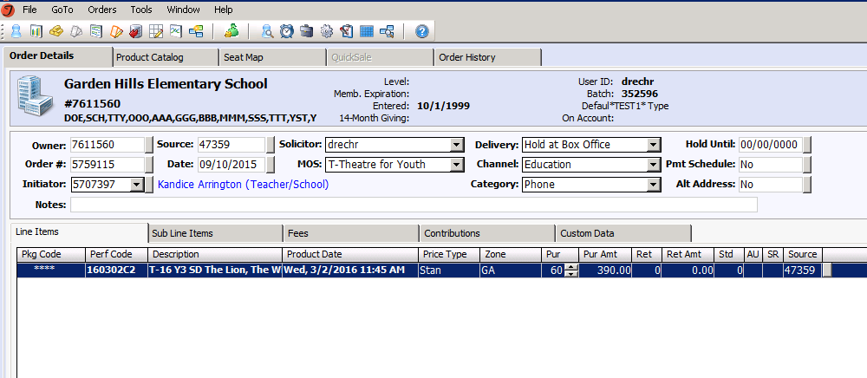
Orders

Slide 12
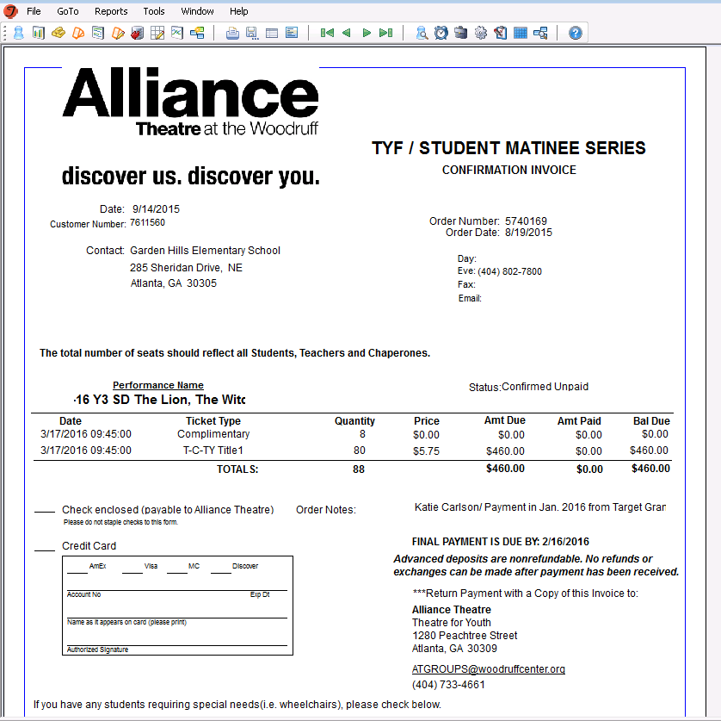
Invoices

Slide 13
Reporting
How many patrons are coming to the School Day Matinee for A Christmas Carol?
How much $ did we make?
Who is paid vs. unpaid?

Slide 14
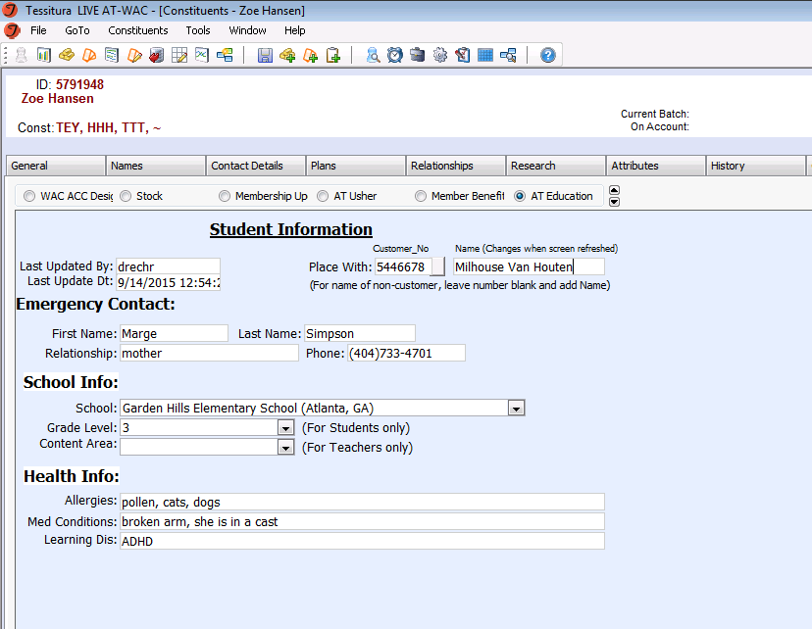
Bonus!

