Slide 1
Atlanta Tessitura User Group
(T.U.G.) Mini-Conference
September 21, 2015

Slide 2

Introducing:

Slide 3
T.H.U.G.s
(Tessitura Houston User Group)
Notes:
What’s a TUG? Who’s got a TUG? Houston has one – and they call themselves “THUG” – we’ve got one – but we happen to all live together

Slide 4




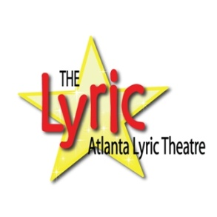






Atlanta Tessitura User Group
(ATL TUG)
Notes:
What’s a TUG? Who’s got a TUG? Houston has one – and they call themselves “THUG” – we’ve got one – but we happen to all live together

Slide 5

Oh yeah! And….

Slide 6
Many Thanks
Our session presenters today:
  Christina Dresser (Alliance Theatre)
  Mary French (Atlanta Ballet)
  Mark Frey (Woodruff Arts Center)
  Danielle Hicks (Woodruff Arts Center)
  Jim Hubbert (Alliance Theatre)
  Shana Orr (Alliance Theatre)
Ushers
  LaWanda Green (Horizon Theatre)
  EB Hooyer (Aurora Theatre)
  Rachel Jorgensen (Atlanta Opera)
  Mary Alice-Nichols (Alliance Theatre)
  Shana Orr (Alliance Theatre)
  Valerie Thomas (Woodruff Arts Center)
  Jennifer Williford (Woodruff Arts Center)
Our Conference Sponsor(s):
Woodruff Arts Center Leadership

Slide 7
Noel Barnes, CFO
Woodruff Arts Center

Slide 8

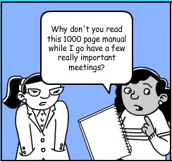
Your Training Experience

Slide 9
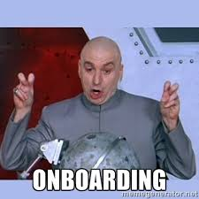
Your Training Experience

Slide 10
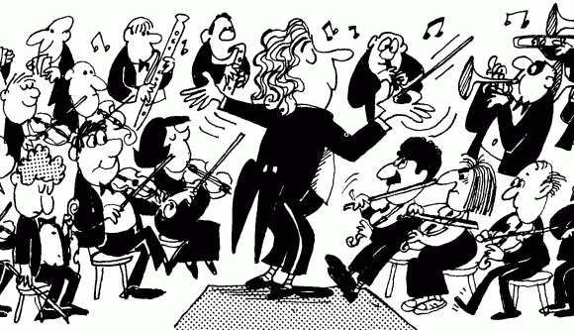
Who am I?
Tegan
Jim
Hubbert
Rebecca Abernathy

Slide 11
What is Tessitura?
Why Tessitura?

Slide 12
Tessitura Mythbusters
True Or False?

Slide 13
TRUE OR FALSE??
Tessitura can’t keep track of the number of board meetings your board members have attended over the last year

Slide 14
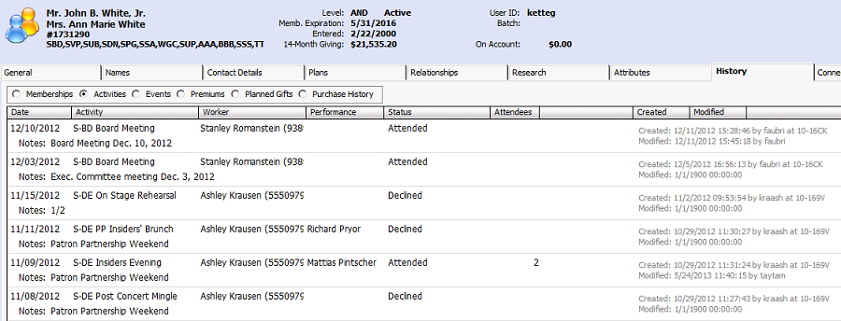
TRUE OR FALSE??
FALSE
You can track and update attendance activity using the activities tab

Slide 15
TRUE OR FALSE??
Tessitura can integrate with the web to allow individuals to log on to your website to sign up for volunteer shifts

Slide 16
TRUE OR FALSE??
TRUE!
The Alliance Theatre has harnessed the power of Tessitura to keep them from having to manage an usher calendar manually!

Slide 17
TRUE OR FALSE??
Tessitura can’t be used to manage a private dining room with reservations

Slide 18
TRUE OR FALSE??
FALSE
The Symphony uses Tessitura to track and charge reservations for the Robert Shaw Room (private donor lounge)

Slide 19
TRUE OR FALSE??
Tessitura can automatically change the price of a ticket based on number of seats left in the house

Slide 20
TRUE OR FALSE??
TRUE
Dynamic pricing allows you to change prices based on availability and/or time until showtime

Slide 21
Mini-Magic
From Planet Tessitura

Slide 22
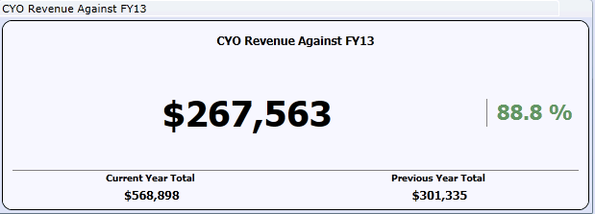
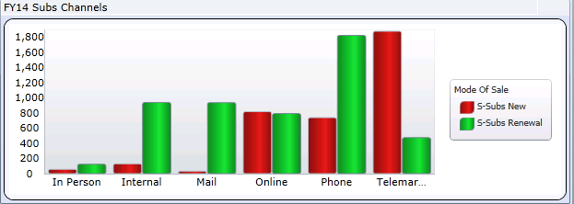
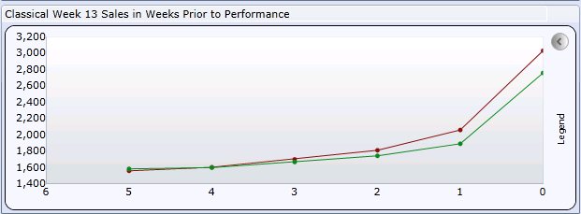
Dashboards

Slide 23
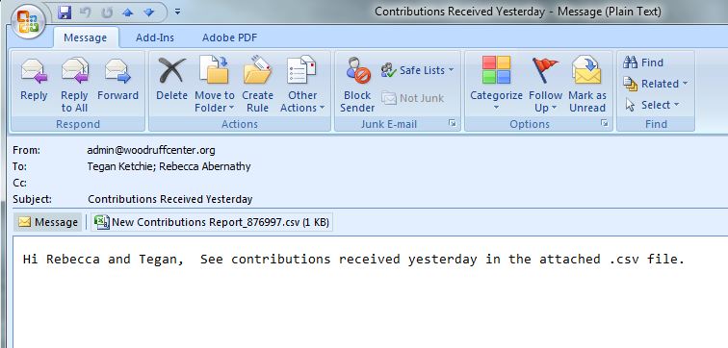
Schedule Report Utility
To learn more, attend the Reporting session today at 11:00 AM in the Event Room – led by Mary French (Atlanta Ballet) and Mark Frey (Woodruff Arts Center)!

Slide 24
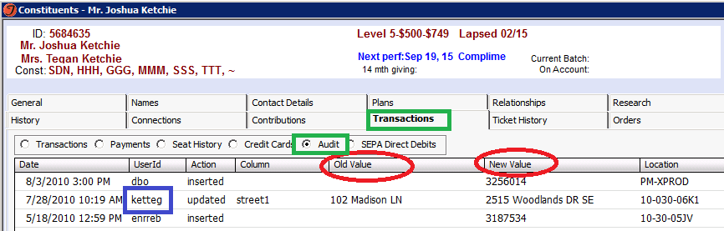
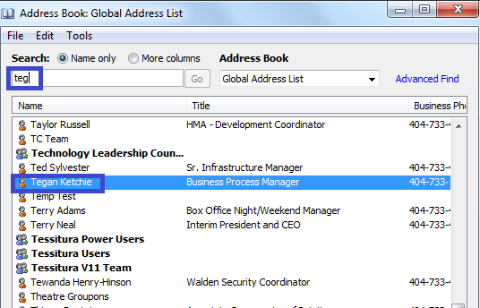
Whodunit?

Slide 25
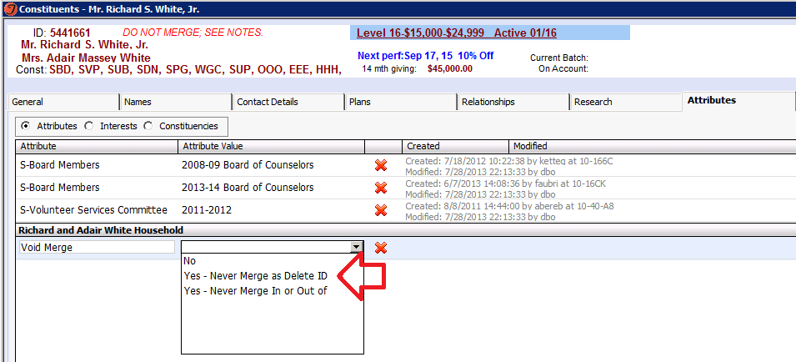
Do NOT MERGE!! Attribute

Slide 26
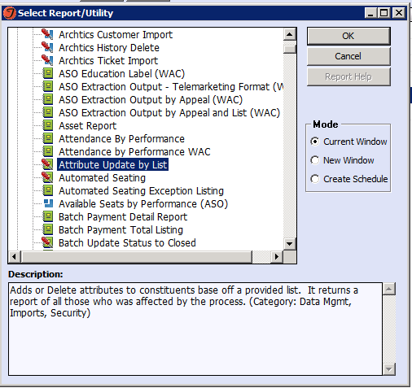
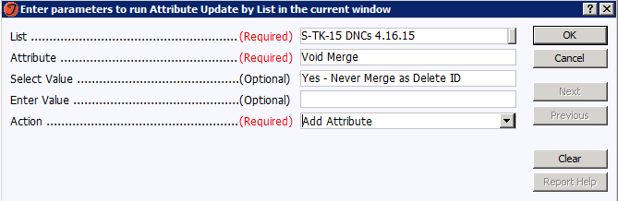
Do NOT MERGE!!! Attribute
Try this at home: Immediately.
How you ask?:

Slide 27
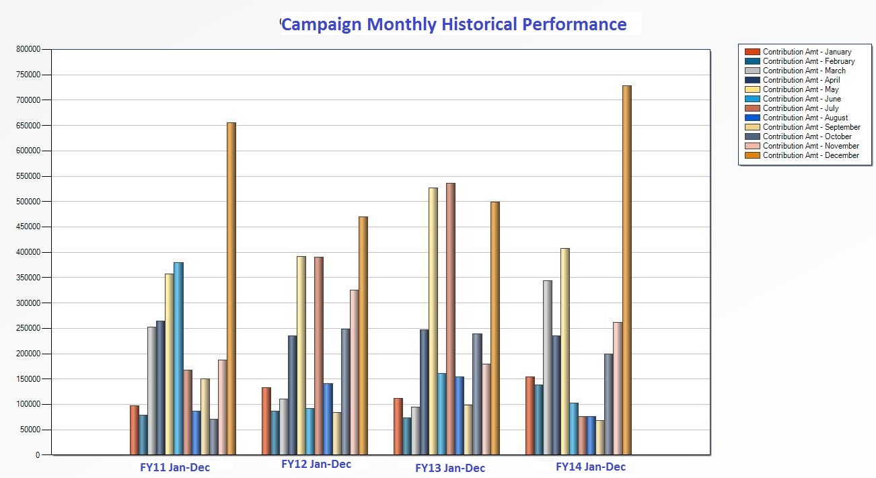
T-Stats for Projections

Slide 28
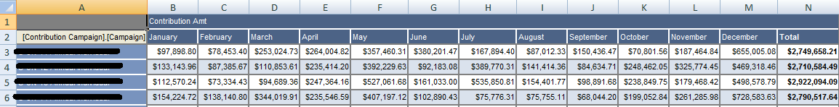
T-Stats for Projections
Want to know more about T-Stats? Join Shana Orr (Alliance Theatre) and Mark Frey (Woodruff Arts Center) in Center Space at 1:00!

Slide 29
Woodruff-Hosted Training Plan
Fall 2015

Slide 30
TessiCore: Getting data OUT
Tessitura 101
9/28/15
List Building & Output Sets
Development
Marketing
Basic Reporting
Development
Marketing
10/7/15
10/5/15
Memberships? Other? Education?
11/5/15
10/28/15
10/19/15
Memberships? Other? Education?
11/9/15
10/14/15
T-Stats Lab
Extractions
Lab
10/12/15
11/11/15
10/26/15
11/16/15
11/2/15
Finance

Slide 31
TessTalks
  Dashboards: What do we want and how do we want to see it?
  Custom report creation: How do we ask?
  New System Tools: Who’s on 1st? (example: Advancement and Plans / Portfolios)
  What’s a Power User?
    Per Current (2010) Tessitura Policies and Procedures Manual:

Slide 32
Power User Roles & Responsibilities
Representing their respective member organization in all policies and procedures discussions and ultimate decisions.
Assembling a team to test each Tessitura upgrade and implementation to ensure that no negative impact is felt by the member organization.
Communications to all Tessitura users within the member organization of any planned upgrades, downtimes etc.
Recommend and develop improvements in the use of Tessitura across all member organizations. These should include but not be limited to processes, training, tools, and reports.
Develop member specific training and policies and implement across the member organization.

Slide 33
TessTalks
Your Ideas Here:

Slide 34
TessituraNOW
For quick questions: Call me! Or the gurus!
5-Minute Tessitura
  5-Minute Videos
  GOAL: 5-Minute Solutions for 5-Minute Problems
    Problem specific, organized by department, fully searchable
    Ie. “How do I merge a constituent?” as opposed to “Tessitura 101”

Slide 35
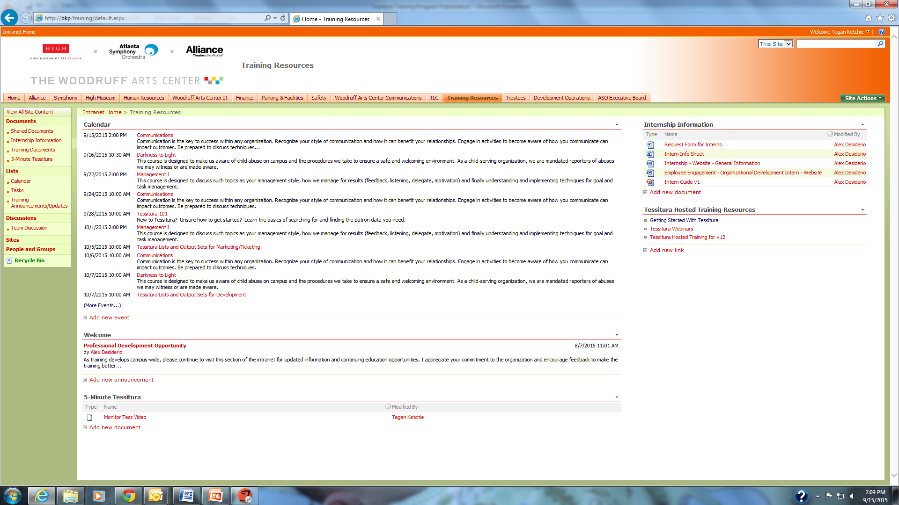
Intranet Training Resources (WAC users)
Search capacity
Calendar of Training Events (includes HR training)
5-Minute Videos

Slide 36
TessituraNOW
Tessitura Tuesdays: For extra 1:1 training and consulting help
  9 AM -12 PM Tuesdays
    Tegan Ketchie (tegan.ketchie@woodruffcenter.org or 404-733-4595)
      New Hire Training (not covered by TessiCore)
      One-on-one lab sessions
      Process Consulting: Need something, have no idea how to make it happen?
    Tessitura User Group Outlook Group
      Monthly calendar invites and resource documents
Announcing our Social Chairs!
  Christina Dresser and Mark Frey: 1st Monday of the month, details TBA

Slide 37
2015-2016 Tessitura Training Program
Where will you go NEXT?
TessTalks
TessiCore
TessituraNOW

Slide 38
Where WILL you go next?
11:00 AM – 12:00 PM | Breakout Session 1
Center Space, 1st floor | Tessitura 101 (Tegan Ketchie)
 | New to Tessitura New to your role and don’t know where to find information Just curious to know if you’re missing out on what kind of information already lives in the database
Events Room, 2nd floor | Basic Reports (Mark Frey / Mary French)
 | Intermediate to advanced users of Tessitura Finance, Development, Marketing staff where big picture reports are more relevant than viewing individual constituent data
Conference Room A&B, 2nd floor | Ticketing Tips and Tricks (Danielle Hicks)
 | Should have experience making a ticket sale in Tessitura Early intermediate class

Slide 39
Where to Next?
12:00 PM – 1:00 PM
  Lunch in Gallery 1280

Slide 40
Where to Next?
1:00 PM – 2:00 PM | Breakout Session 2
Events Room, 2nd floor | Basic List Building and Extractions (Tegan Ketchie / Jim Hubbert)
 | Intermediate class designed with beginning users in mind Marketing & development specific: for users more interested in building contact lists to interact with specific groups of people
Center Space, 1st floor | Cooking with T-Stats (Shana Orr / Mark Frey)
 | Designed for all users: Marketing, Development, Finance For users more interested in “big data”: Board reports, forecasting, campaign progress
Conference Room A&B, 2nd floor | Education Data & Tessitura (Christina Dresser / Mary French)
 | Education-specific: geared towards any user working with school or student groups

Slide 41
Happy Learning!

