Slide 1

Mix, Food & Mingle
Notes:
So How has it been tonight?
Thank everyone who has come.
Particular thanks to:
Jacob Strauss (BAM)
Food
Susan Bishop (BAM)

Slide 2
Business Meeting
Notes:
So How has it been tonight?
Thank eveyone who has come.
Particular thanks to:
Chuck Buchanan (92nd Street Y)
James Boncek (Carnegie Hall)
Susan Biship (BAM)

Slide 3
Thank You!
Notes:
Content:
Jacob Straus (BAM)
Marisa Perry (Roundabout)
Jamie O’Brian (New 42)
Site:
Jamie O’Brian and New 42
Food:
BAM (Susan Bishop)

Slide 4
A Common Desire
“NYC TUG is a group of Tessitura users interested in sharing information and insights in order to improve the way we all use the Tessitura database.
We meet every four to six weeks for a great presentation and networking.
I almost always learn something to make my job easier, either from the formal presentation or the informal talks.
Plus...the meetings are FUN!” – Anonymous

Slide 5
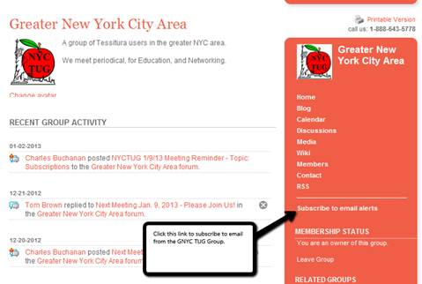
Keeping in Touch
Meetings Posted on Tessitura Network web site group for the Greater NYC Tessitura Users Group
Please Subscribe to email alerts
Encourage your Coworkers to do the same.

Slide 6
Upcoming Meetings
Dates | Content | Content Planners | Location | Food
6/5 | Email and the Arts: Upgrading Your Digital Strategy with the Resources You've Got | Jacob, Marisa Jamie | New 42nd Street | BAM
7/14 OR 7/15 | TLCC 2013 - NYC TUG Dinner Out in SF | Chuck Buchanan | TBD | Yes TBD
7/18 Breakfast | TLCC 2013 - International TUGs get together | Tessitura Network | TBD | TLCC 2013
August 2013 | A Month Off. See you in September | None | None | None

Slide 7
Preliminary Next Season
Dates | Content | Content Planners | Location | Food
September ’13 | NYC TUG Unconference II (TLCC 2013 in review) | TBD | TBD | TBD
October ’13 |  | TBD | TBD | TBD
November ’13 | Ticketing | TBD | TBD | TBD
December ‘13 | Social Event | TBD | TBD | TBD
January ‘14

Slide 8
See you at: TLCC 2013

Slide 9
EMAIL AND THE ARTS: Upgrading Your Digital Strategy with the Resources You've Got

Slide 10
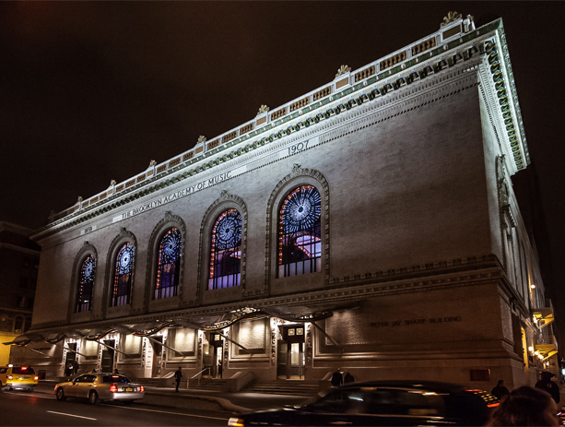
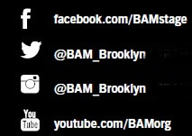
Jacob Strauss
Digital Marketing Manager
BAM (Brooklyn Academy of Music)
jstrauss@BAM.org

Slide 11
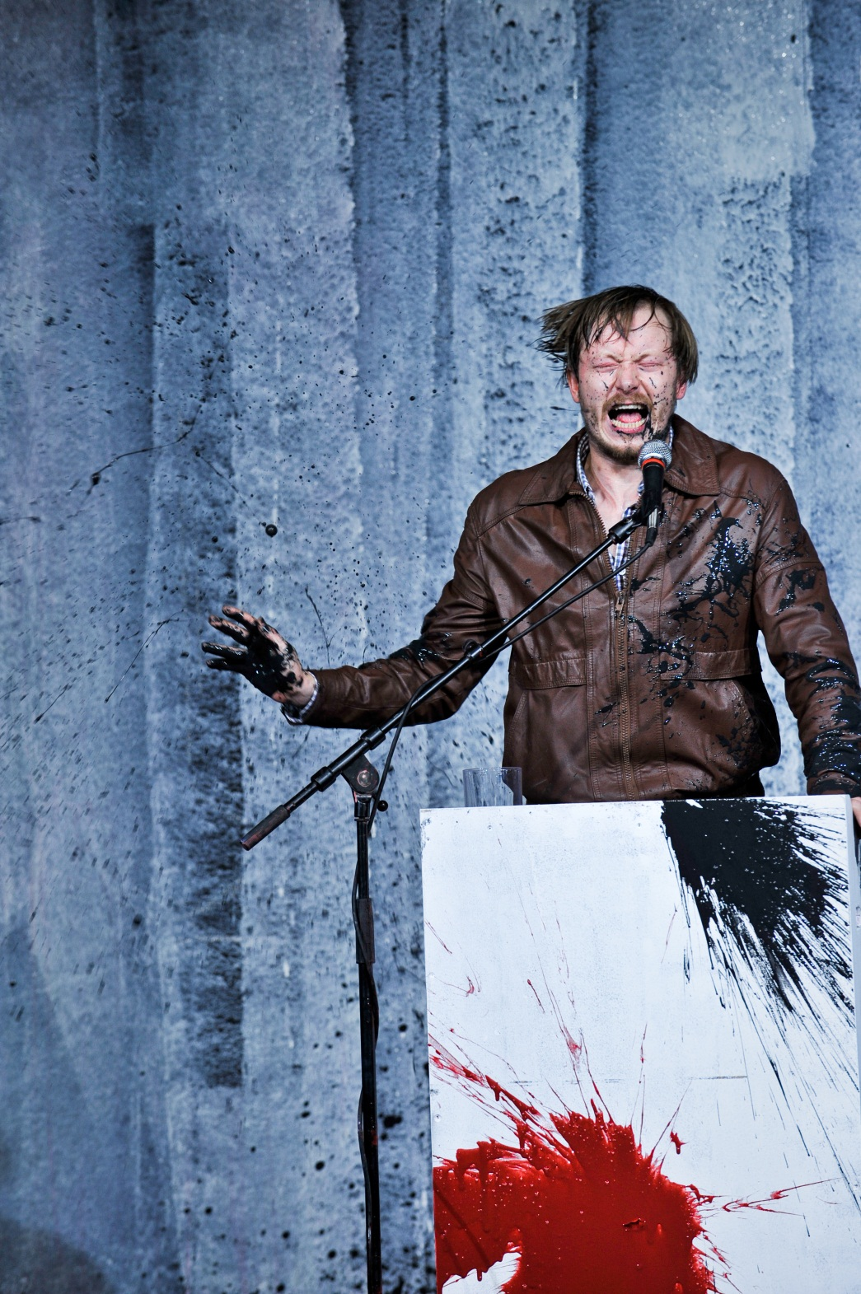
EMAIL STATS
140K email subscribers
13 million emails sent in 2012
70% of members receiving email
More departments are turning to email
Notes:
25% of our active 560K database

Slide 12

2002—2004 Custom built solution 2004—2011 ExactTarget 2011—today WordFly
BAM EMAILS … THROUGHOUT TIME
Notes:
Custom Built Solution: all hard coded/hard to update
ExactTarget: third party ESP/very big company now/build emails in Dreamweaver then upload a separate list each time

Slide 13

EMAIL PROCESS
Starts with a ticket in…
Notes:
Unfuddle is actually more for software development, but we’re using it to track email and image projects across departments.
Others out there like basecamp

Slide 14
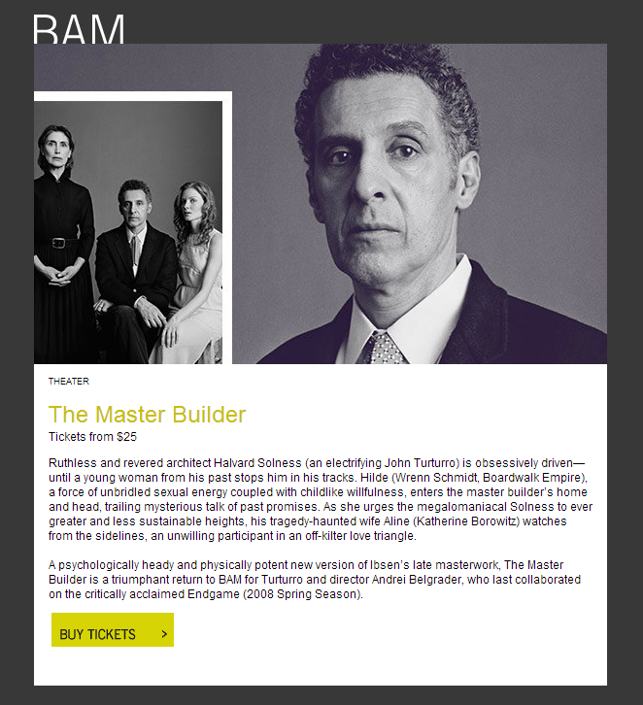

Slide 15
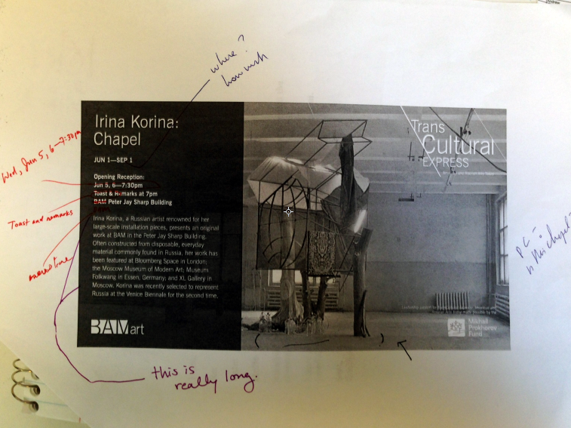
EMAIL PROCESS
Notes:
Unfuddle is actually more for software development, but we’re using it to track email and image projects across departments.
Others out there like basecamp

Slide 16
EMAIL PROCESS
Notes:
Don’t do paper routings for emails. Doesn’t really make sense when you think about it (that’s not how anyone will actually experience them.
Outlook public folder routing system – available to pretty much anyone on Outlook

Slide 17
EMAIL PROCESS
Email Creative Brief
What’s the 1-second takeaway?
Who is the target audience?
How do you want them to feel? What’s the tone?
What do you want the target to commit to?
Notes:
Unfuddle is actually more for software development, but we’re using it to track email and image projects across departments.
Others out there like basecamp

Slide 18
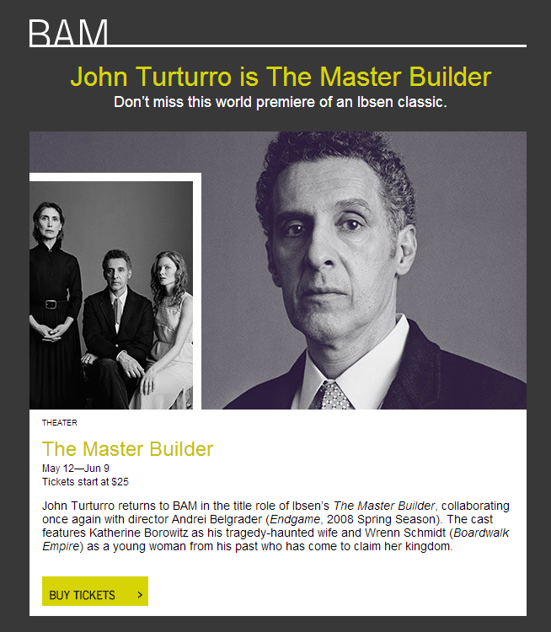

Slide 19
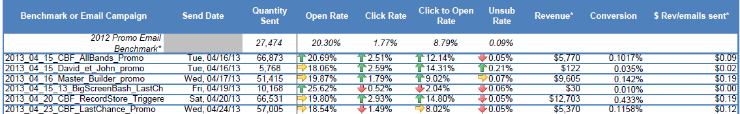
Analytics and Reporting
Open Rate
Click Rate
Click to Open Rate
Revenue
Conversion
$ Revenue / # emails sent

Slide 20
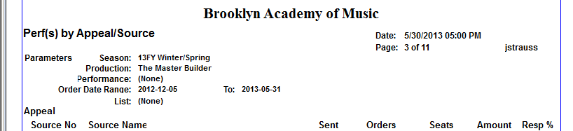
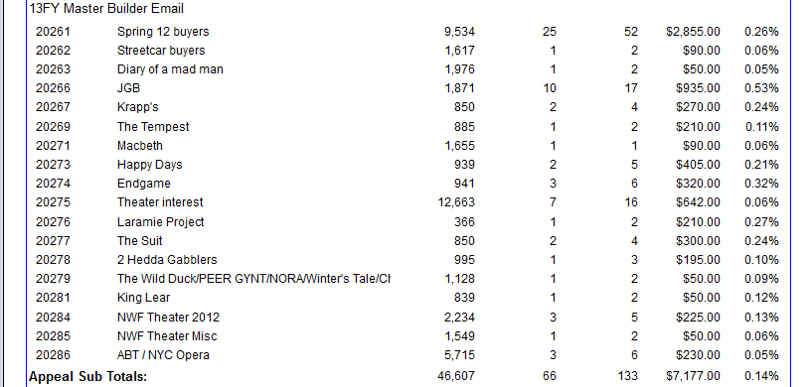

Slide 21
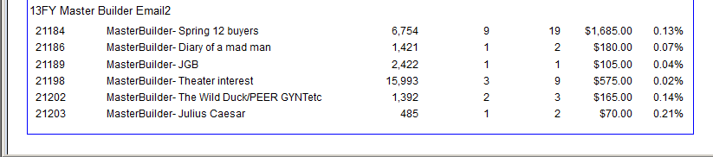

Slide 22
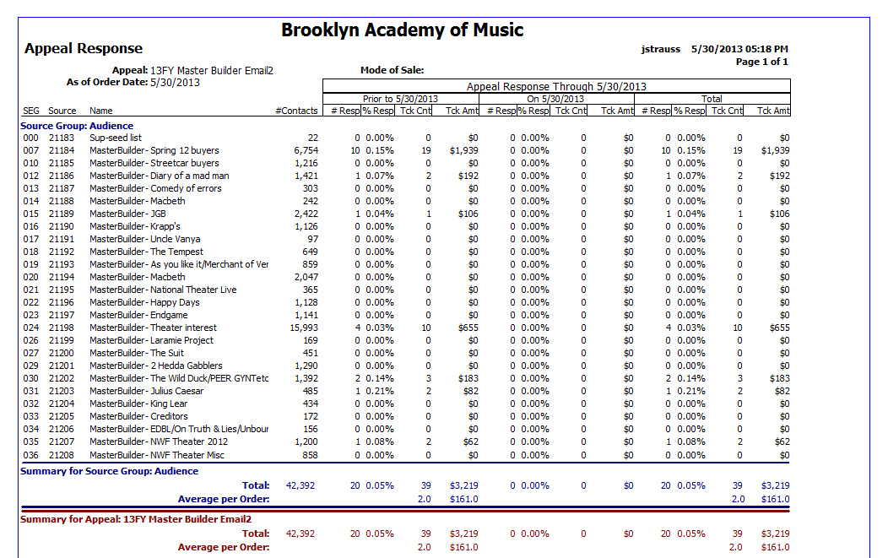
Appeal Response Report

Slide 23
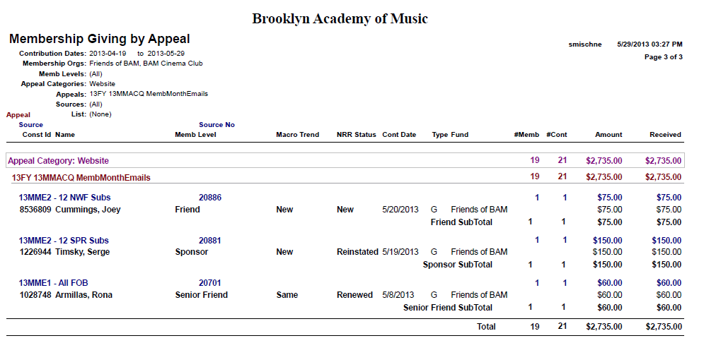
Giving by Appeal Report

Slide 24
THANK YOU
Questions?
Jacob Strauss
Digital Marketing Manager
BAM (Brooklyn Academy of Music)
jstrauss@BAM.org

Slide 25

EMAIL AND THE ARTS
Upgrading Your Digital Strategy with the Resources You've Got

Slide 26
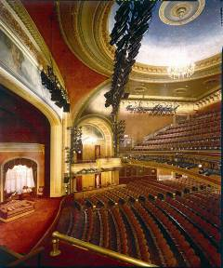
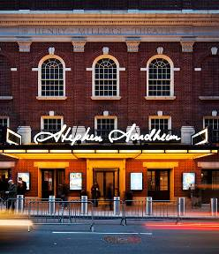
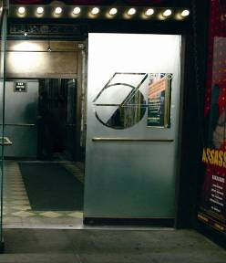
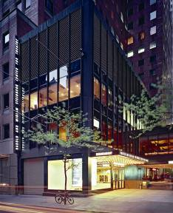
ABOUT ROUNDABOUT
Who We Are
Not-for-profit Broadway theatre company, specializing in classic revivals and new works by established and emerging writers.
Email and the Arts: Upgrading Your Digital Strategy with the Resources You've Got
Notes:
Founded in 1965
Home to 5 theatres: 1 Black Box, 1 Off-Broadway, and 3 Broadway Theatres including the infamous Studio 54 and the SST, Bway’s first Green theatre

Slide 27
ABOUT ROUNDABOUT
A Quick Look at Numbers
7-10 Productions Each Season
Over 750,000 Theatre-goers Annually
14,000 Subscriber Households
10,000 Donor Households
Over 255,000 current email addresses in our system
62% of Subscribers receive email
70% of Donors receive email
Email and the Arts: Upgrading Your Digital Strategy with the Resources You've Got

Slide 28
EMAIL STRATEGY
Marketing
Most emails are facilitated through the Marketing Department
Marketing send out 25-35 emails a week, including:
Pre- and Post-show Emails
Monthly E-Newsletters (5)
Special Show Offers
HIPTIX Communications (E-Newsletters and Offers)
Transaction emails will soon be sent via WordFly as well
Email and the Arts: Upgrading Your Digital Strategy with the Resources You've Got

Slide 29
EMAIL STRATEGY
Development
Development provides content for all Marketing emails (sponsors, promotions, institutional information)
Development also sends out 2-3 dedicated emails for each of our annual appeals
1-2 Informative Emails
1 Dedicated “Ask” Email
Average of $50K annually raised via email alone
Email and the Arts: Upgrading Your Digital Strategy with the Resources You've Got

Slide 30
EMAIL STRATEGY
Working Together
Scheduling via Google Calendars
Hardcopy and Digital Routing
WordFly Custom Tab in Tessitura
Email and the Arts: Upgrading Your Digital Strategy with the Resources You've Got

Slide 31
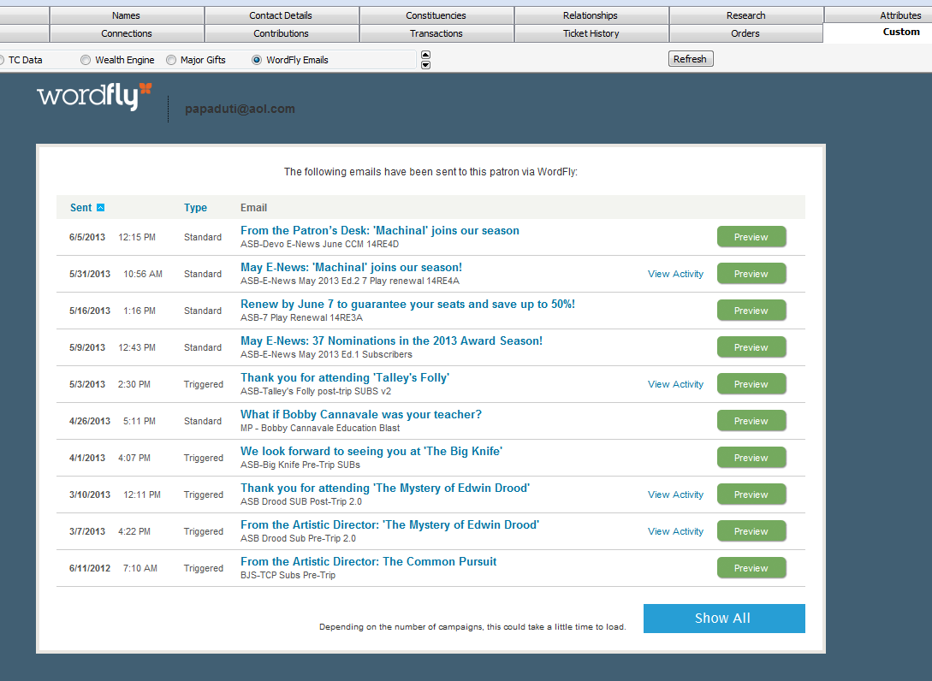
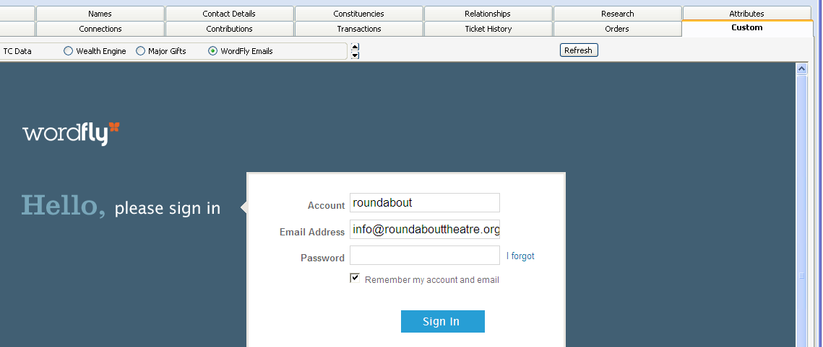
EMAIL STRATEGY
WordFly Custom Tab
Email and the Arts: Upgrading Your Digital Strategy with the Resources You've Got

Slide 32
EMAIL STRATEGY
Working Together
Scheduling via Google Calendars
Routing
WordFly Custom Tab in Tessitura
Standard Templates
Email and the Arts: Upgrading Your Digital Strategy with the Resources You've Got

Slide 33
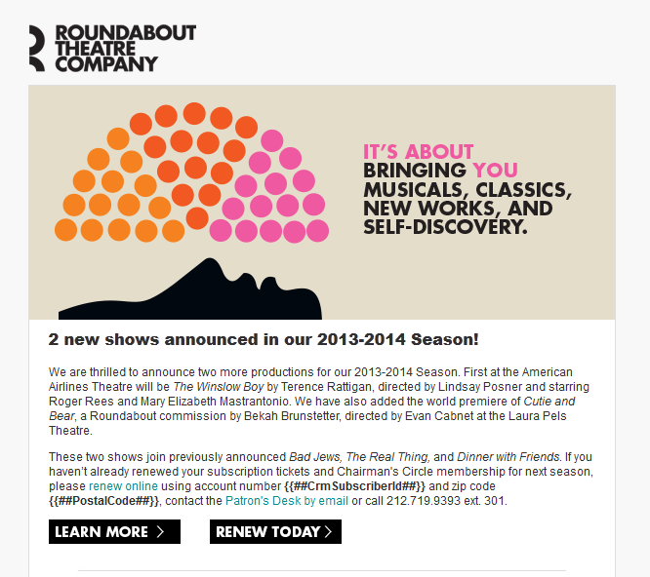
EMAIL SAMPLE
Branding Guidelines
Logo
Inviting Image
Uniform Fonts
Buttons
Email and the Arts: Upgrading Your Digital Strategy with the Resources You've Got

Slide 34
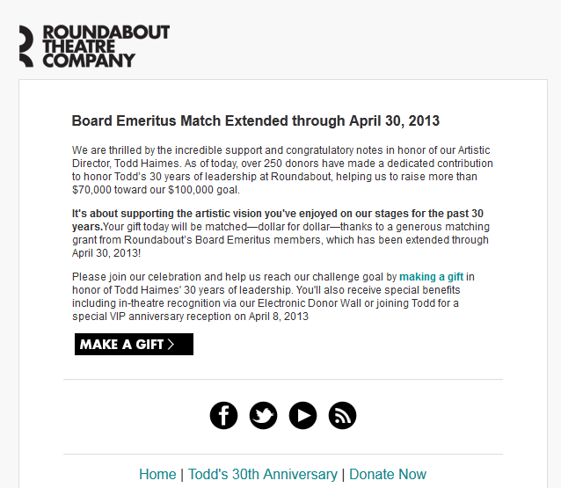
EMAIL SAMPLE
Branding Guidelines
Logo
Letter Copy
Social Media Buttons
Email and the Arts: Upgrading Your Digital Strategy with the Resources You've Got

Slide 35
CUSTOM ASKS
Development Campaigns
Email and the Arts: Upgrading Your Digital Strategy with the Resources You've Got

Slide 36
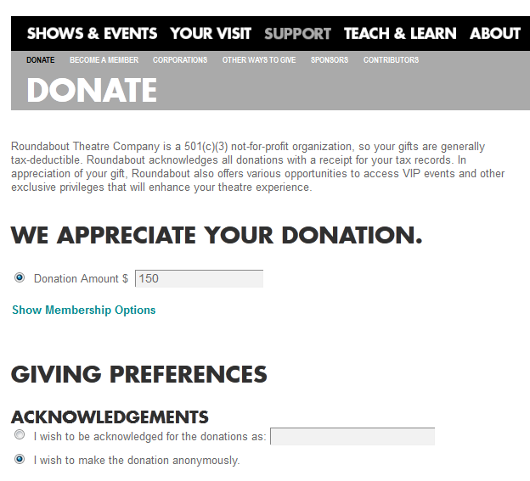
CUSTOM ASKS
Development Campaigns
Email and the Arts: Upgrading Your Digital Strategy with the Resources You've Got

Slide 37
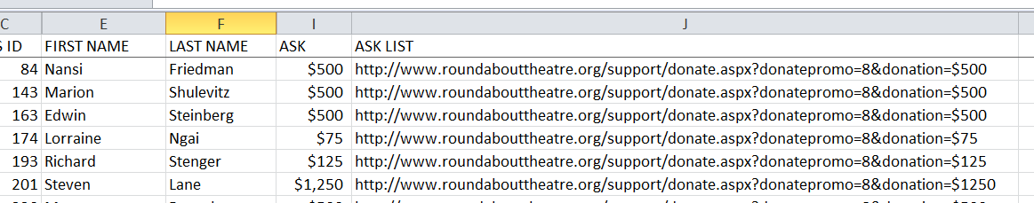
CUSTOM ASKS
Development Campaigns
Initial lists pulled directly from Tessitura
Custom links created and uploaded from Excel
Uploaded to WordFly as Data Field
Email and the Arts: Upgrading Your Digital Strategy with the Resources You've Got

Slide 38
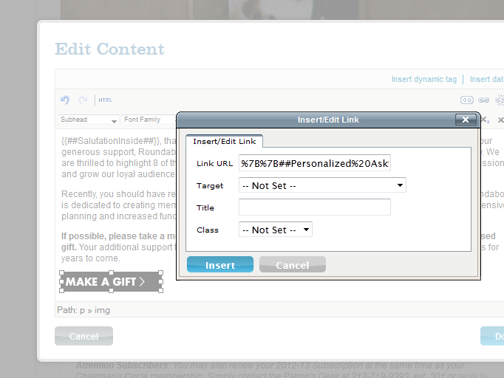
CUSTOM ASKS
Development Campaigns
Email and the Arts: Upgrading Your Digital Strategy with the Resources You've Got

Slide 39
CUSTOM ASKS
Development Campaigns
Email and the Arts: Upgrading Your Digital Strategy with the Resources You've Got

Slide 40
THANK YOU!
Marisa Perry
Manager, Friends of Roundabout
Email: marisap@roundabouttheatre.org
Phone: 212.719.9393, ext. 324

Slide 41




Jamie O’Brien
Senior Manager / Web & Digital Services
jobrien@new42.org
@JamieNYC42

Slide 42

The New 42nd Street is…
The nonprofit organization that oversees the redevelopment of seven historic theaters on 42nd Street and operates these three projects:
The New Victory Theater (499 seat Off-Broadway house that presents family-friendly programming)
The Duke on 42nd Street (Off-Off-Broadway black box theater available for rentals)
The New 42nd Street Studios (10-story rehearsal studio/office/theater complex)

Slide 43
Email list is roughly 30,000.
Existing Email Campaigns (all managed by Marketing/Digital Services):
Show and season announcements
Fundraising asks
“Before” emails (content-focused performance reminders)
“After” emails (post-show surveys)
Member (subscriber) & STB surveys
Member Welcome
Family Workshop reminders
Off-season news
Potential Email Campaigns:
Press Releases and Alerts (managed by Public Relations)
Artist Invites to Workshops and Seminars (managed by Programming)
Donor Newsletters (managed by Development)

Slide 44
“Set It & Forget It” Performance Reminders and Follow-Ups

Slide 45
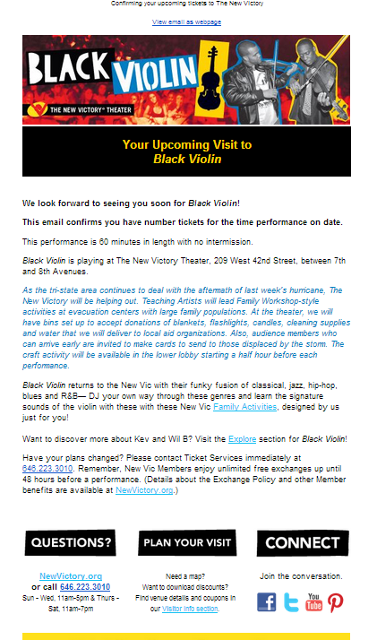
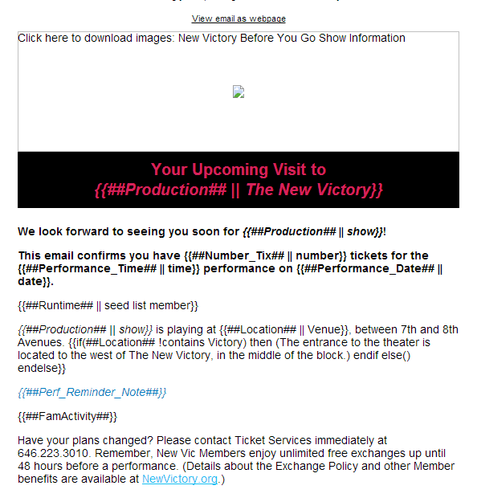
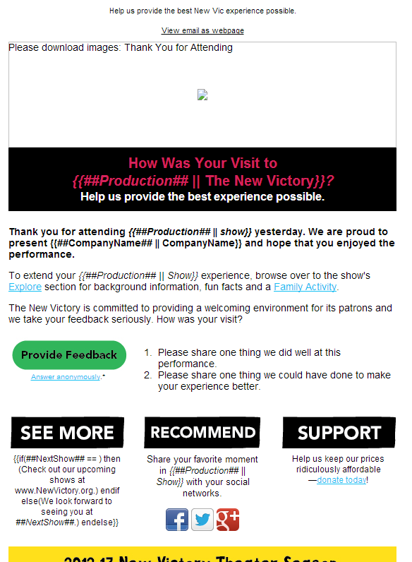
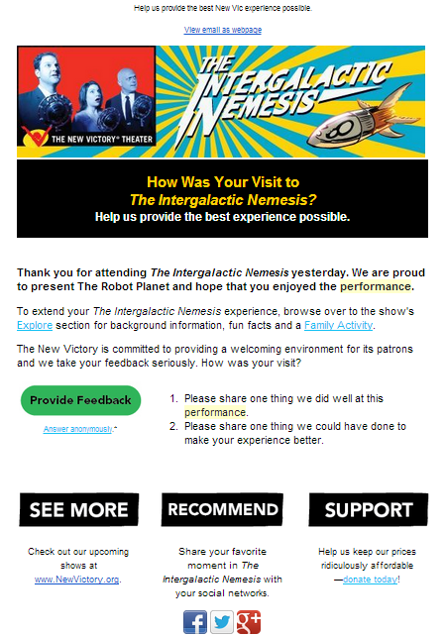
“Set It & Forget It” Performance Reminders and Follow-Ups
One* campaign runs all season, content customized via Tess

Slide 46
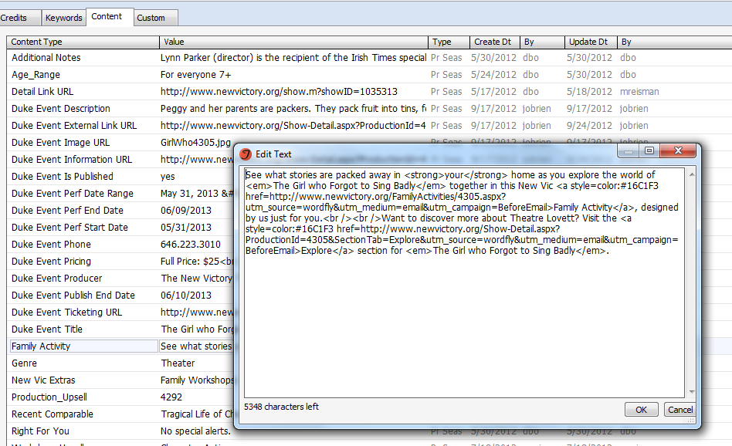
“Set It & Forget It” Performance Reminders and Follow-Ups
The “Explore” message content
In the Production Season Details area, Content tab

Slide 47
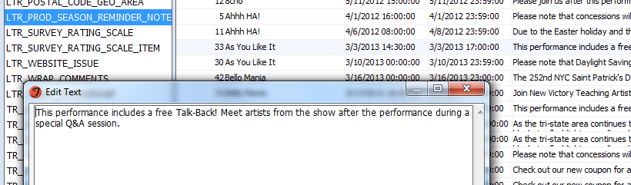
“Set It & Forget It” Performance Reminders and Follow-Ups
The Performance Note
A custom System Table
Choose by production
Choose range of performance times

Slide 48
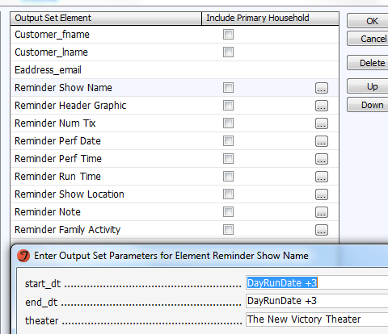
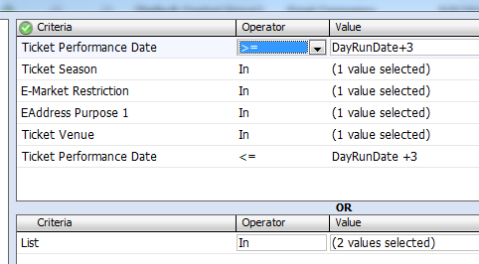
“Set It & Forget It” Performance Reminders and Follow-Ups
Output Set List Criteria

Slide 49
“Set It & Forget It” Performance Reminders and Follow-Ups
Production-specific information (managed via data fields)

Slide 50
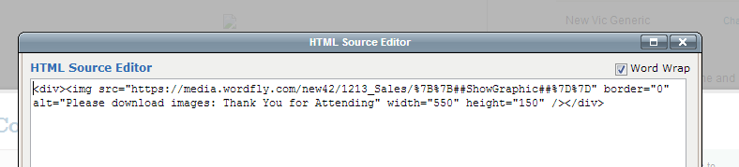
“Set It & Forget It” Performance Reminders and Follow-Ups
Production-specific graphic (managed via HTML and data fields)

Slide 51
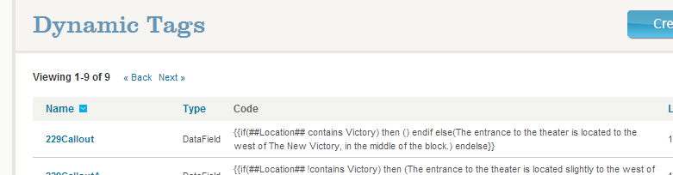
“Set It & Forget It” Performance Reminders and Follow-Ups
WordFly’s “Dynamic Tags” provide IF/THEN calculations

Slide 52
Improving Response Rates (“Retiring” Unengaged Addresses)

Slide 53
Improving Response Rates (“Retiring” Unengaged Addresses)
Unique open rates for the majority of campaigns hover around 15%, with typical unique CTR of .5 – 6%
Seeing about 3,000-5,000 responses for campaigns to full list; therefore, we assumed only a small portion of list was engaged
But needed to confirm rather than assume
Goals:
Improve response rates
Avoid sending unwanted emails
Sender reputation (deliverability, inbox prioritization)
Institutional reputation

Slide 54
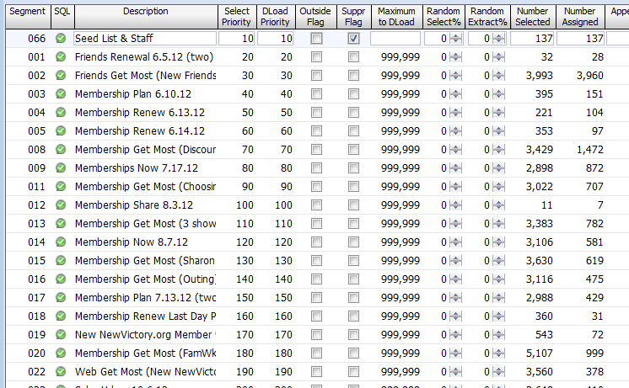
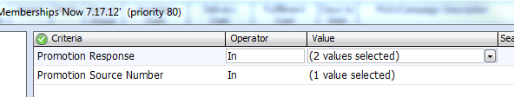
Improving Response Rates (“Retiring” Unengaged Addresses)
But needed to confirm rather than assume
Discovered that we actually had about
20,000 engaged email subscribers

Slide 55
Improving Response Rates (“Retiring” Unengaged Addresses)
Now what?
Officially decide our criteria for “active.”
Recent ticket sale? (What is recent?)
Recent donation history?
Age of record?
Click/open history?
Decide how to note status on constituent record.
Run email campaign to those we might “retire” to ask them to re-up their subscription (multiple reminders).
Set up Tessitura procedure and email campaigns to run quarterly or bi-annually to keep list clean.

Slide 56
A big thank you to Christina Macchiarola, Bryan Drenner, and Lily Peralta-Zapata.
Jamie O’Brien
Senior Manager / Web & Digital Services
jobrien@new42.org
@JamieNYC42

Slide 57
DISCUSSION

Slide 58
TOPICS AND TRENDS
Data Analysis and Reporting
Evaluation and Strategy
Segmentation: Who, What, How Often?
Other Ideas?

