Slide 1

Tessitura
Proficiency Surveys
March 29, 2023
Notes:
Hi everyone! Thanks so much for joining us today. My name is Katie Cullen and I am the CRM Systems Manager for the Columbus Association for the Performing Arts. I’m here to present to you my organizations recent proficiency survey that we sent out to all Tessitura Hosting Services users to help identify strengths and weaknesses within their usage of Tessitura.

Slide 2
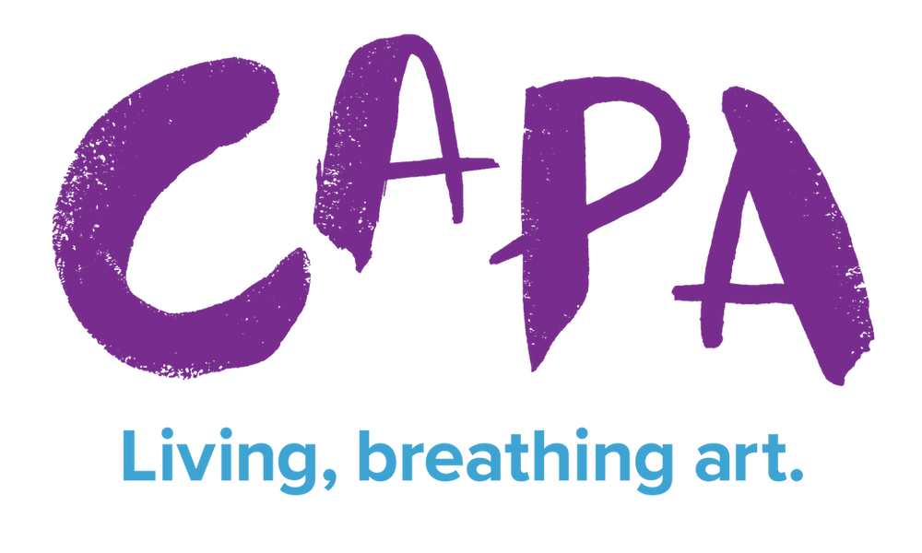













What is CAPA?
Columbus Association for the Performing Arts - founded in 1969 to save the historic Ohio Theatre from a wrecking ball
Leaders in theatre rehabilitation and downtown redevelopment
Own/manage seven theatres and one movie house in two states
Consortium is made up of fourteen organizations
Notes:
A little background on us first. Columbus Association for the Performing Arts was formed in 1969 to save the historic Ohio Theatre from the wrecking ball. After the theatre was saved, CAPA renovated the magnificent 1928 movie palace to its original glory. It was then, that CAPA became the leaders in theatre rehabilitation and downtown redevelopment throughout Central Ohio. We now own and/or manage seven theatres and one movie house in two different states – Ohio and Connecticut. Our consortium is made up of fourteen organizations, all with varying degrees of access to Tessitura as well as usage of our shared services model. This ranges from only providing ticketing support to doing full administrative duties. One thing that is in common throughout is that we are the sole ticket sellers for our theatres. We went live with Tessitura in December 2019 after having been on Ticketmaster for very many years. Of course, the pandemic hit very soon after, interrupting our ability to fully realize our potential on Tessitura (among much else). Between furloughing and new hires, this made everyone’s degree of Tessitura knowledge exist all over the map, even with a structured and systematic training program, which is constantly evolving. Throughout all of this, we had an internal group called the Tessitura Governance Committee, that met biweekly to discuss our trajectory in the system aligned with our business objectives.

Slide 3

Proficiency Survey Building
Task Driven or Functionality Driven?
Task Driven
  Tends to fit how we think of doing things
Functionality Driven
  May provide exact ways to do things but might allow us to get too into the weeds and confuse users
Department/User Group Specific or Holistic?
Department/User Group Specific
  Ensure the people who are taking it knew these were tasks specific to their line of work
  Would require a lot of upkeep to have that many surveys
Holistic
  Allows us to gauge proficiency as well as give the full breadth of what the system can do so that if there were areas of interest outside of required work, can be a professional development opportunity
Notes:
In advance of v16, the committee wanted to get a baseline of how comfortable every THS user felt using the system for their respective jobs and felt a survey would be the best way to get that information. We started off discussing the structure. Should it be task driven or functionality driven? We felt that functionality driven may have allowed us to get too into the weeds and as most users think of things as “how do I get this done” we went with task. Should it be department/user group specific or one holistic survey for everyone to take? Department/user group specific would ensure that the people taking it knew these were things they were meant to know to accomplish their job, CLICK: but it would create a lot of work for us to maintain that many surveys. A holistic survey for everyone to take would allow us to gauge current proficiency as well as potentially expose those “what we don’t knows” for the survey takers. While there may be proficiencies that don't apply to a specific user, we felt that it was important to give them the full breadth of what the system can do so that if there were areas they wished to learn about, it could also be a professional development opportunity where applicable.

Slide 4
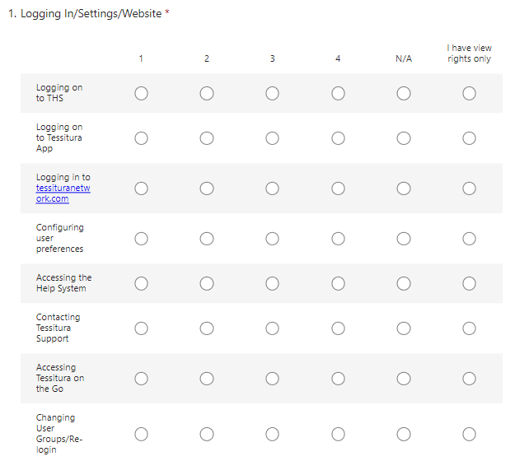
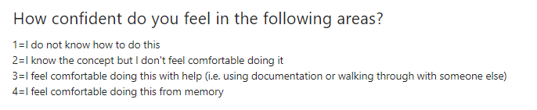
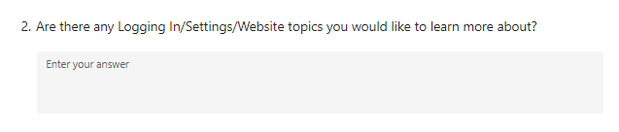
Proficiency Survey Format
Notes:
From here, we worked to build a survey full of different “modules” with tasks broken out underneath each. These included modules such as “logging in/settings/website”, “selling tickets”, “gift processing”, etc. We saved this in an excel document as well as within the survey because we felt that these were good building blocks to making sure that our training program is built out the same as what we are expecting our users to be able to do through the proficiency survey – I will touch on this more later. We decided that a ranking from 1 to 4 to gauge proficiency was a good place to start – you can see here what each number meant. Since this was a holistic survey, we also felt that adding in N/A, for anyone who knew the task was not applicable to their job, as well as I have view rights only for those who may understand the concept but don’t need to do it, were important so that we didn’t get skewed results. We also added in an open-ended response box that was not required for each module so that if anyone wanted to elaborate on what they would like to learn or if it was a module that had topics that didn’t apply to their job but they were interested in learning them, they could express that.

Slide 5
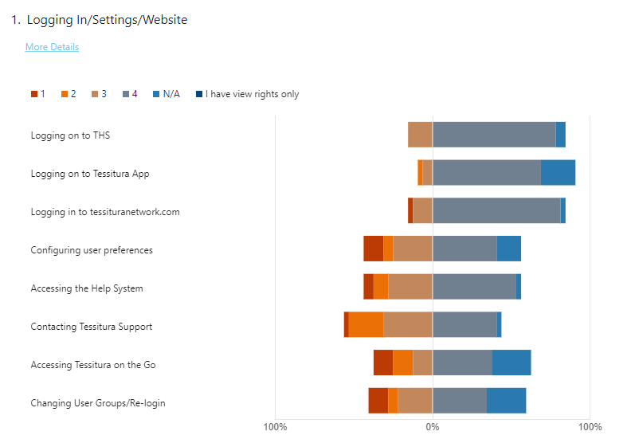
Proficiency Survey Responses
Notes:
We decided to use Microsoft Forms as the platform that we issued our survey on for a few reasons. One of these was that we as a company use the Microsoft suite and our IT department has really been attempting to get us to use Microsoft products more. But a second was that by using a platform that we already all had access to, we could all easily see the results. Microsoft Forms compiles all your results into a nice bar chart to quickly get an overview of how answers are trending. You can also extract the answers out into excel. It also gives you an estimate at the top of the survey of how long it should take to complete it, which really helped us to show it wasn’t going to be an all-day kind of a task but also not something to breeze through. Our survey clocked in at an estimated 14-minute completion time. We decided to issue the survey twice. The first time, we gave users a two-week time period to complete the survey. We felt this was enough time to make sure you planned out for it, but not too long as to still give a sense of urgency. We also set the survey to close at a specific time so that users realized the timeline we were giving was not arbitrary and we meant to stick to the deadline. We did have some people reach out the day after it closed to say they hadn’t realized it was really closing and could we reopen so they could finish it? (Which of course we did). On our first issuance, our response rate was 46%. We waited a week and then reissued, stating that this would be the last time for this year, this time only allowing a week to complete. On the second issuance, the response rate raised to 69%.

Slide 6
Next Steps?
Plan educational sessions, primarily focusing on the modules that had a lot of 1 and 2 responses
  Will be holding off on those that change significantly in v16, ie constituent record and extractions
Reach out directly to those who responded 1 and 2 as well as those who expressed interest in a topic through the open-ended response box
Improve our training by transforming survey tasks into Yes/FYI/No by user group
  Those who responded 4 will be given the opportunity for professional development to becoming SME’s and trainers
1
2
3
Notes:
So now that we have collected all of this data, what are our next steps? While we did outline what each 1 to 4 option was and gave the additional options to answer with N/A or I have view rights only, not everyone did so, so we will be editing some of the data to get a true sense of what people do know compared to what they need to know for their job functionality. For example, there were some people who put N/A for knowing how to login to Tessitura Hosting Services and the Tessitura Application – they are in the system daily, so I know that’s not an N/A for them. From there, we’ll begin to plan educational sessions, primarily focusing on ones that had a large amount of 1 and 2 answers. Ones that we will be holding off on are those that will be changing vastly in v16, like the Constituent Record or Extractions, but we’ll keep the information in mind once we reach the point where we are ready for end user training in v16. We also kept those who are only On the Go users out of the survey as they will need to relearn everything with v16. For anyone who answered 1, “I do not know how to do this” or 2 “I know the concept but don’t feel comfortable doing it,” or expressed that they have interest in learning the topic even if they don’t currently need it, we will reach out to them directly once we have set a date for the educational session surrounding that topic. This also all folds into our efforts to continuously improve our training. As I mentioned earlier, we set up all our tasks that make up the survey in an excel document. Borrowing from a TLCC presentation regarding training by the Missouri Botanical Gardens, we plan on using this excel document as our master training plan, detailing out which topics are crucial, which are good to have knowledge of and which are unnecessary to know by user group. Anyone who responded with a 4 to the survey will have the opportunity to become official subject matter experts within our organization, lending to their ability to lead training on that topic. We feel that this also supports professional development as well as ensures business continuity.

Slide 7
Thank you!
Katie Cullen, MBA, CAPM
CRM Systems Manager
Columbus Association for the Performing Arts
kcullen@capa.com
Notes:
Thank you so much for attending the session today! I’d like to take this time to answer any questions you may have.

