Slide 1

Troubleshooting while CRM Specialist is out of the office

Slide 2
Taking TNEW offline for unexpected closures

Slide 3
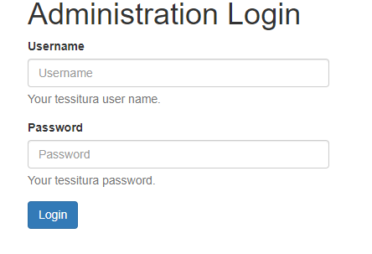
Taking TNEW offline for unexpected closures
If the museum has to close unexpectedly due to a hurricane, power outage, hotel collapse, etc., the easiest way to take tours off sale online is to put TNEW in maintenance mode.
Go to https://my.hnoc.org/admin/login to log into the Admin panel.
Your username is tnhs\username
(i.e., tnhs\arobicha904).
Your password is your RAMP password.

Slide 4
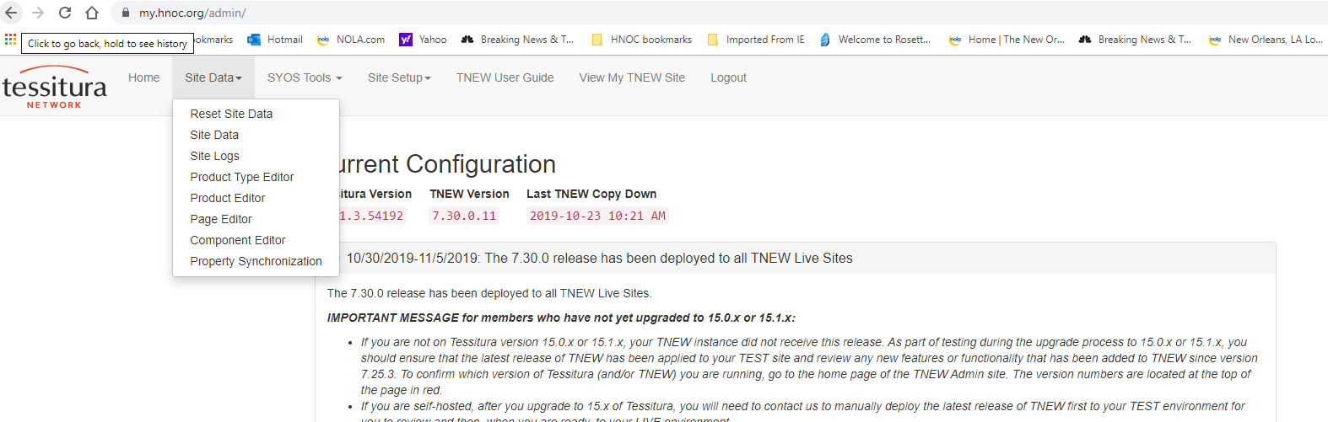
Taking TNEW offline for unexpected closures
Once logged in, select “Site Data” from the menu, then “Page Editor”

Slide 5
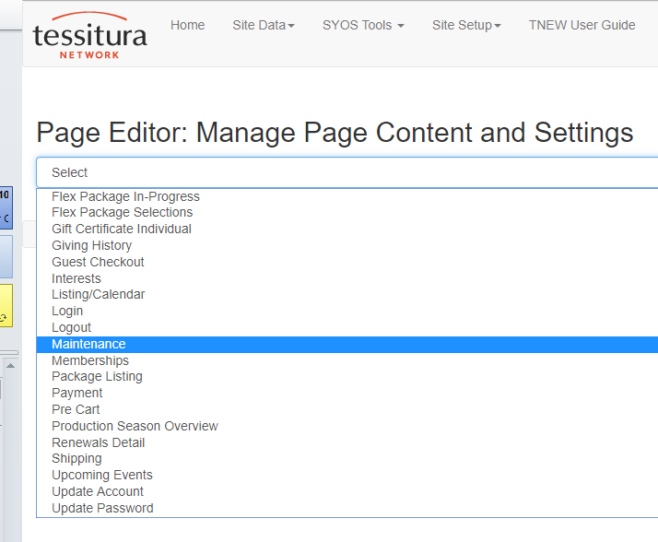
Taking TNEW offline for unexpected closures
Click the Select box and scroll down to select “Maintenance.

Slide 6
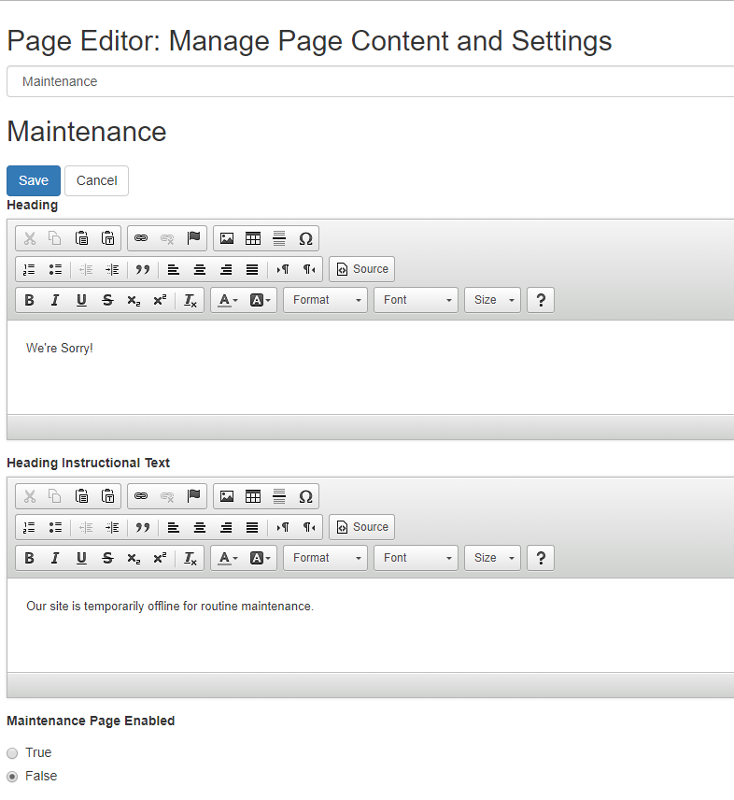
Taking TNEW offline for unexpected closures
There are two text fields that can be changed—the “Heading” and the “Heading Instructional Text.” Change these to the desired message.
To make the Maintenance page active (and make all ticket sales unavailable), change this to True.

Slide 7
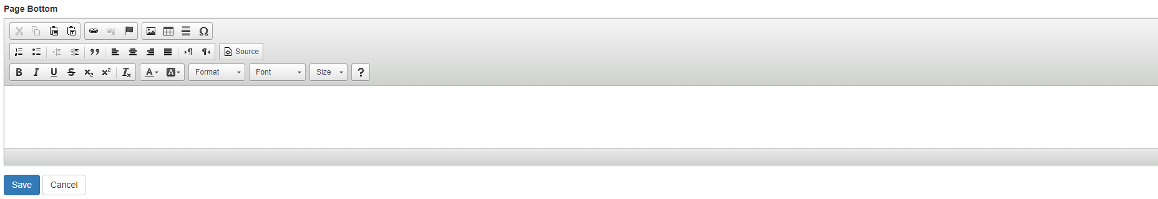
Taking TNEW offline for unexpected closures
Scroll down the page. There is one additional text field you can use, if desired.
To make the changes live, click the Save button at the bottom of the screen.

Slide 8
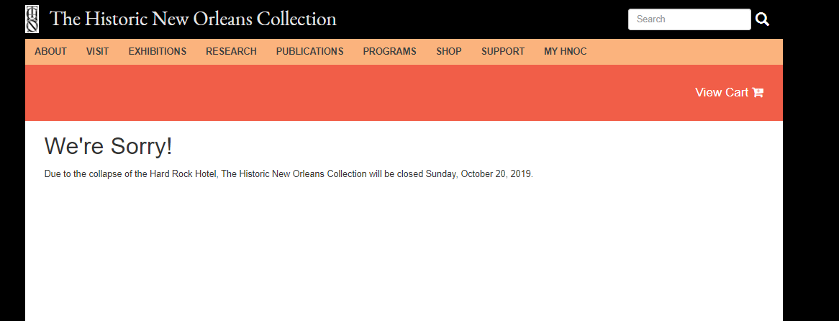
Taking TNEW offline for unexpected closures
Check the site to make sure the message is displaying as desired. (If not, see next slide.)
Don’t forget to change “Maintenance Page Enabled” back to False and hit “Save” when THNOC has reopened.

Slide 9
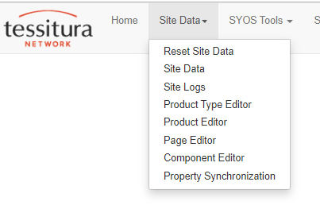
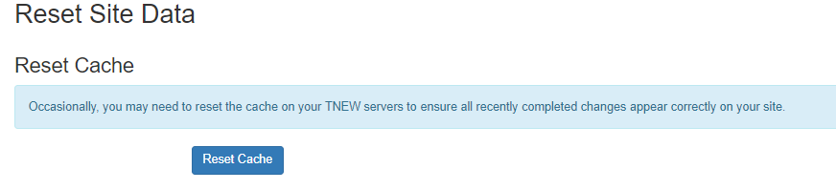
Taking TNEW offline for unexpected closures
If your desired update is not showing, or the page is still up after changing “Maintenance Page Enabled” back to False, then go to Site Data → Reset Site Data.
Then click “Reset Cache” and reload the page again. Changes should now be reflected.

Slide 10
Taking a single event off of TNEW

Slide 11
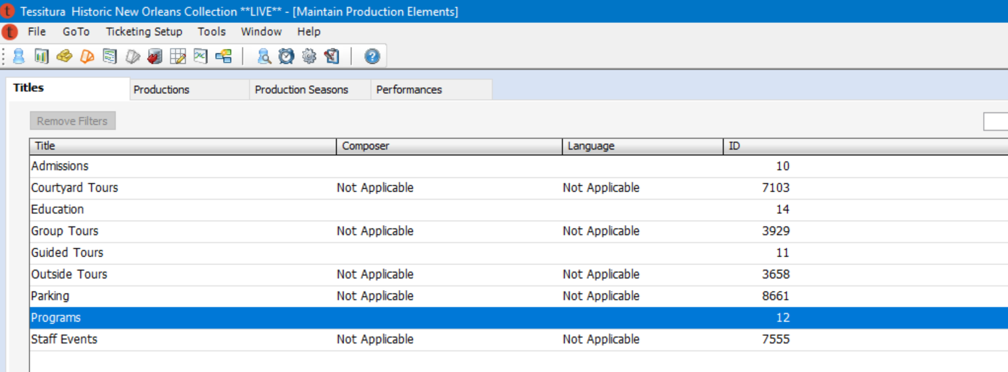
If registration for a single event needs to be taken off of TNEW for any reason, follow these instructions to remove any associated Keywords.
Go To → Ticketing Setup
Highlight (don’t double click!) the appropriate Title
Click the “Productions” tab.

Slide 12
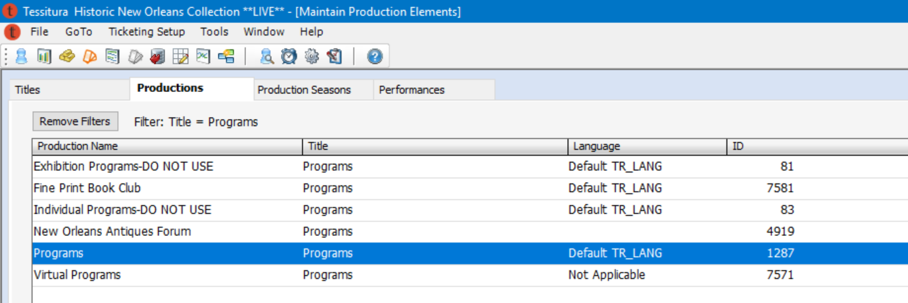
4. Highlight (don’t double click!) the appropriate Production
5. Click the Production Seasons tab.

Slide 13
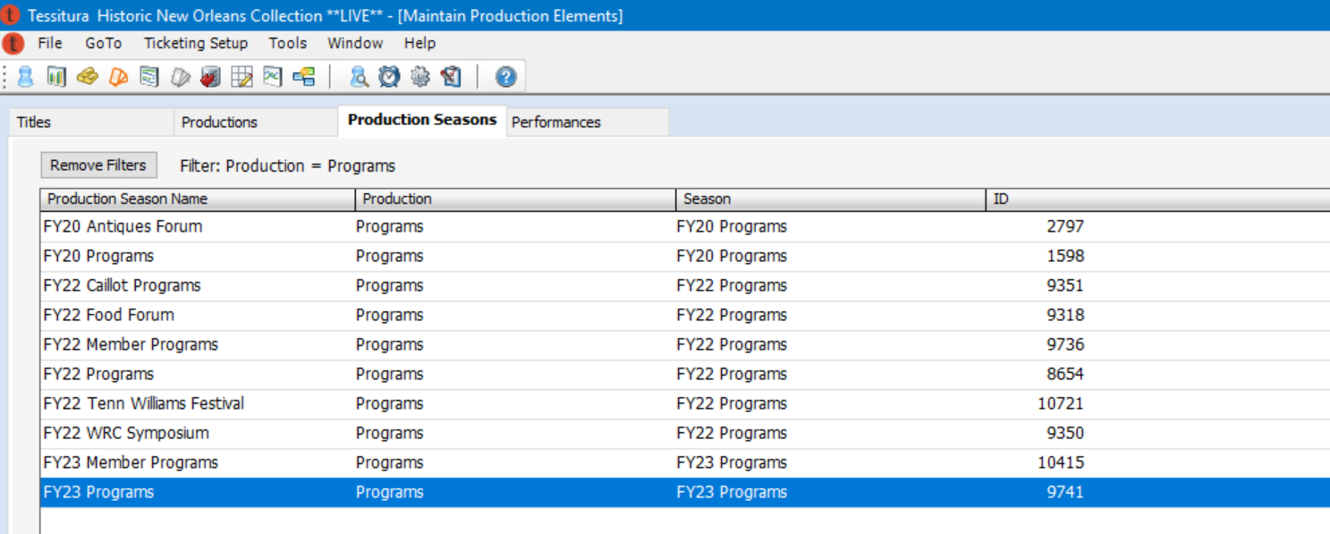
6. Highlight (don’t double click!) the appropriate Production Season.
7. Click the “Performances” tab.

Slide 14
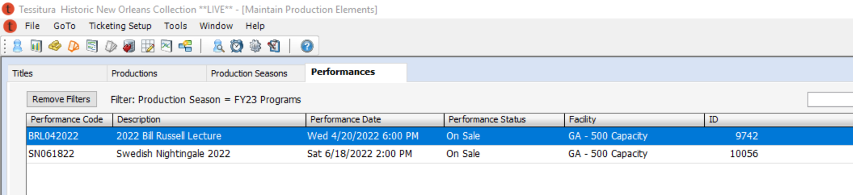
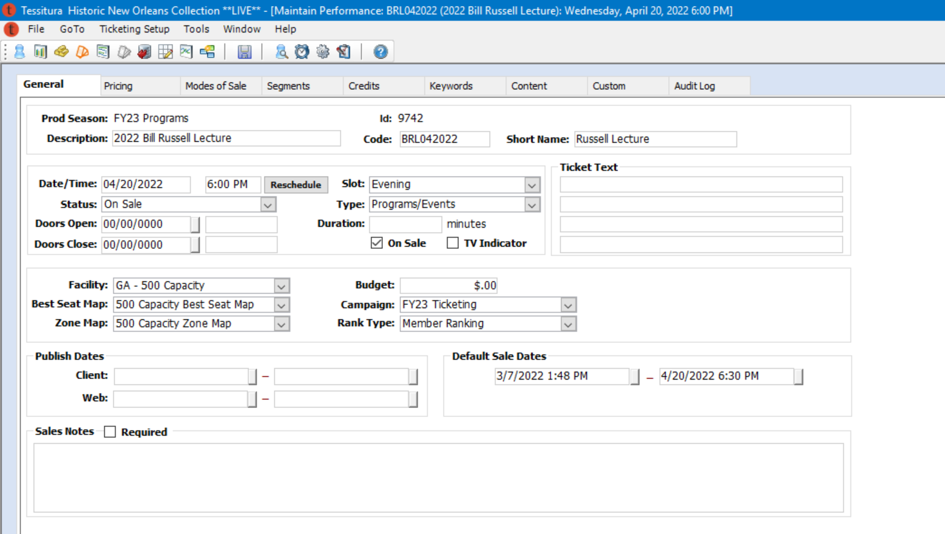
8. Locate the event / performance that needs to be taken off of TNEW and double-click it.
9. Click the “Keywords” tab in the event / performance.

Slide 15
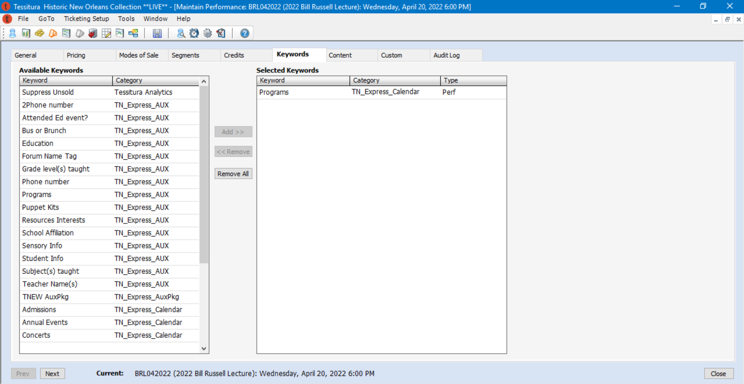
10. Keywords control which events show up on TNEW. The right-hand panel has the keywords associated with the event. Click “Remove All” to remove all keywords from the event.
11. Click “Close” and then “Yes” to save.

Slide 16
If the event is still showing, you will need to clear the cache in the TNEW admin editor.
Go to https://my.hnoc.org/admin/login to log into the Admin panel.
Your username is tnhs\username
(i.e., tnhs\arobicha904).
Your password is your RAMP password.

Slide 17
Click Site Data → Reset Site Data
Then click “Reset Cache” and reload the page again. The event should no longer be showing up.

Slide 18
Syncing and Assigning Tessitura Tokens (fish)

Slide 19
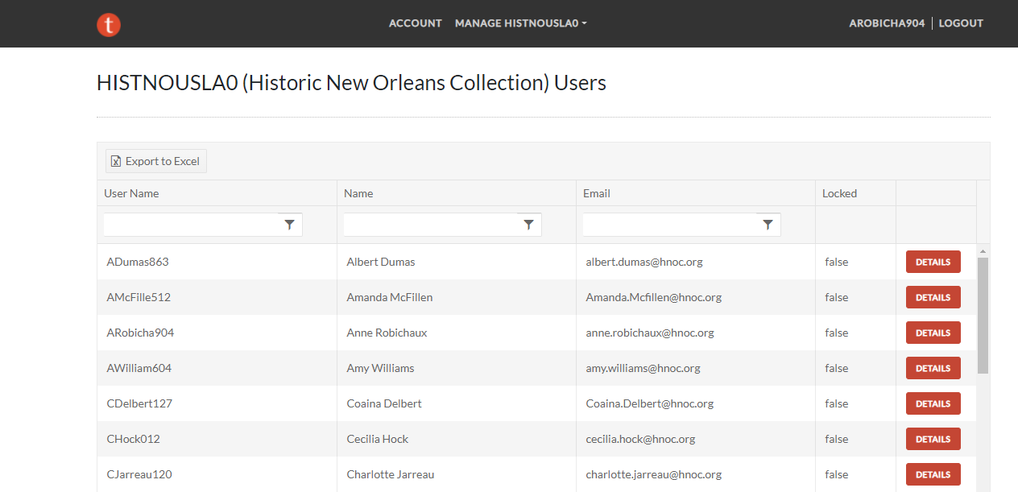
In the Tessitura Self-Service Tool
Go to: https://selfservice.tnhs.cloud/. Login with your RAMP credentials.
→ Manage HNOC → Users
Note: Not all users have access to syncing and assigning tokens. Lori, Jane, and Coaina have access in Anne’s absence.

Slide 20
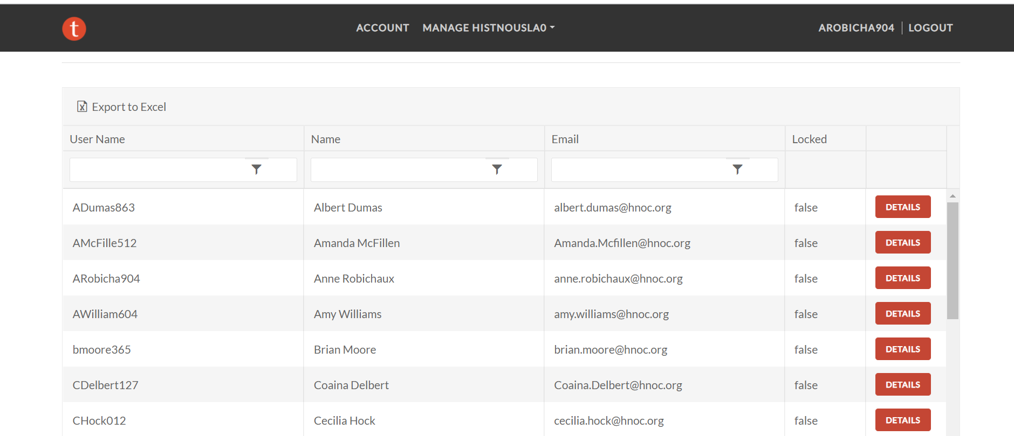
Find the user whose token (fish) needs to be synced or replaced and click “Details.”

Slide 21
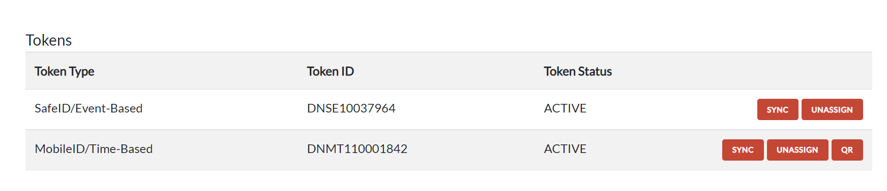
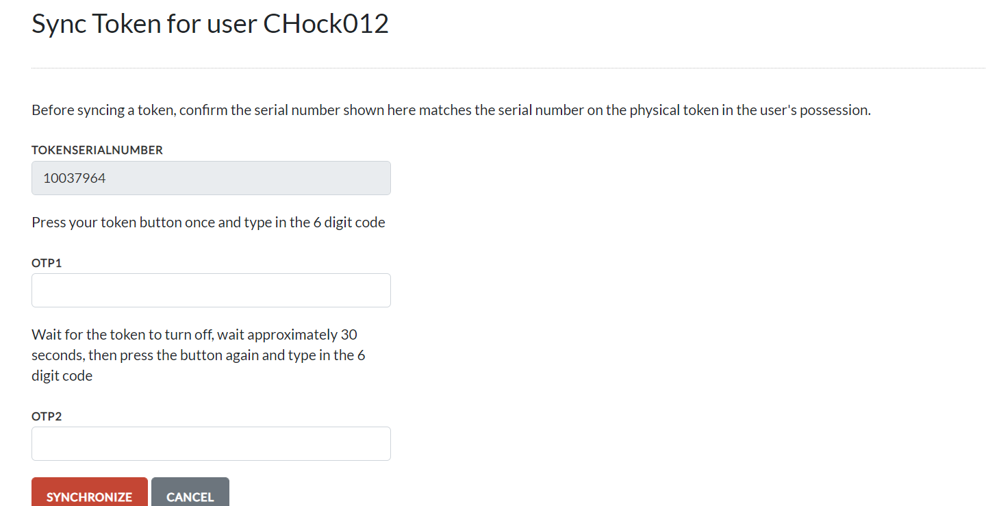
Scroll down the page to the “Tokens” section.
To sync a token that is not working properly, click the “Sync” button next to the “SafeID/Event-Based” Token Type.
Follow the instructions to resync the token.
If the user is still having issues with the token after syncing, it may need to be replaced. See next slides for instructions on unassigning and assigning a new token.

Slide 22
If a token won’t sync or if the battery has died more than once recently, it is time to assign the user a new token (fish).
Log into the Self-Service Tool and navigate to the user.
Click “Unassign” next to the SafeID/Event-Based Token Type.
This will remove the token from the user’s account. Please save the token and send it to the CRM Specialist so it can be marked as deceased in Tessitura’s system.
Once the token has been removed, there will be a button that says “Assign.” Click this button to assign a new token.
You will need the serial number of the token (on the sticker on the back) and you will need to enter the 6-digit code from the token.

Slide 23
Changing passwords for Tessitura web app users

Slide 24
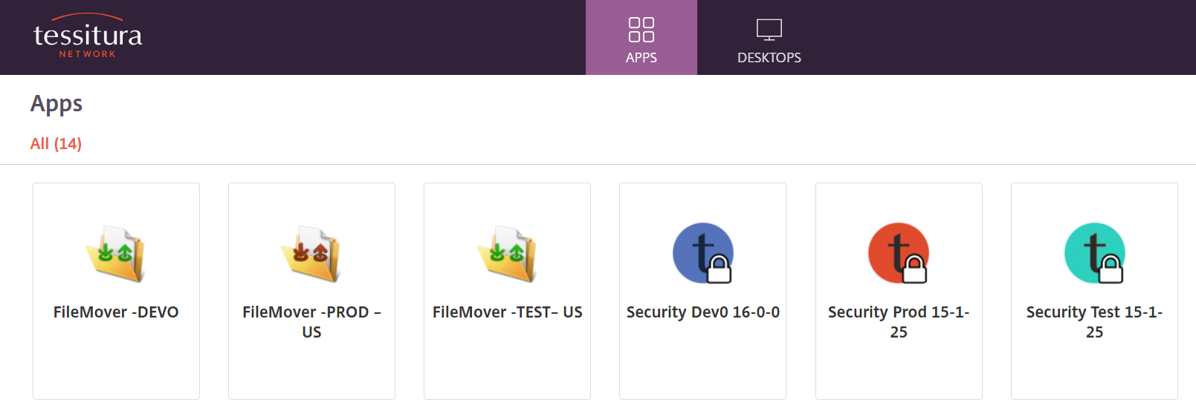
Some THNOC Tessitura users do no have a token / fish and only access the system via the web application—
https://histnousla0webprod.tnhs.cloud/TessituraWeb. Their passwords expire every 90 days, the same as those who login via RAMP. However, they cannot change their passwords themselves. The password must be updated in the Tessitura Security application. Coaina Delbert has access to the Security Application to change these passwords in the CRM Specialist’s absence.

Slide 25
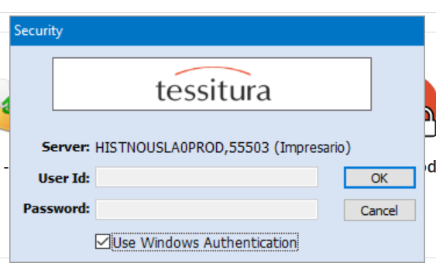
After clicking on the Security PROD app, the box below will pop up. Check the “Use Windows Authentication” box and then click “OK.” You do not have to fill in a User ID or Password.

Slide 26
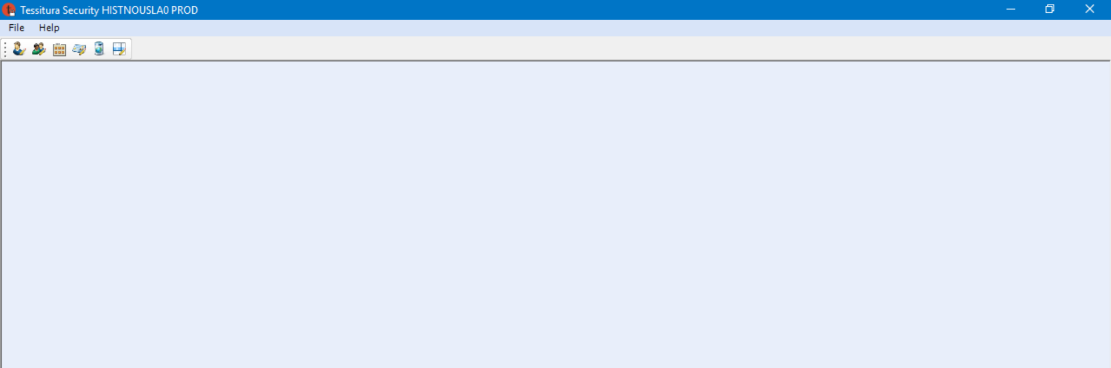
Click the first icon to open the “Maintain Users” module.

Slide 27
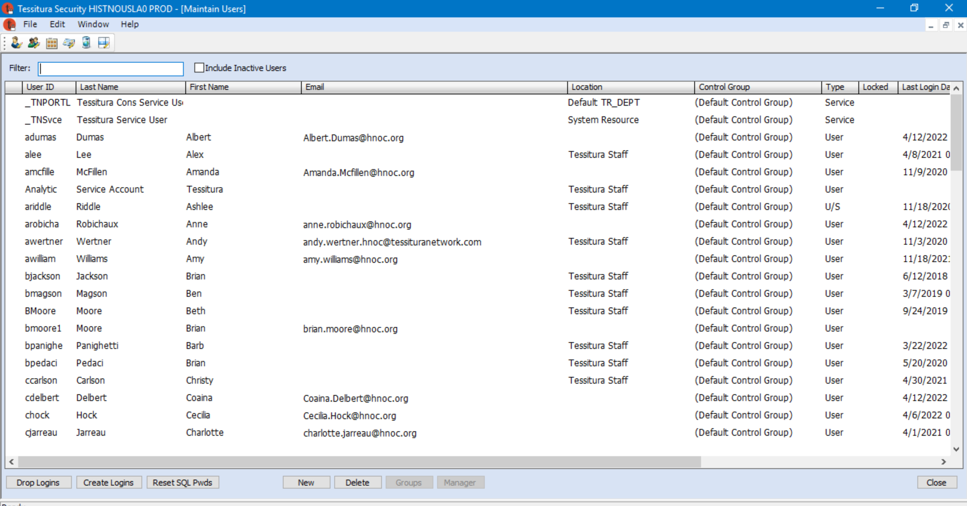
Either find the person in the list or use the “Filter” box to search.

Slide 28
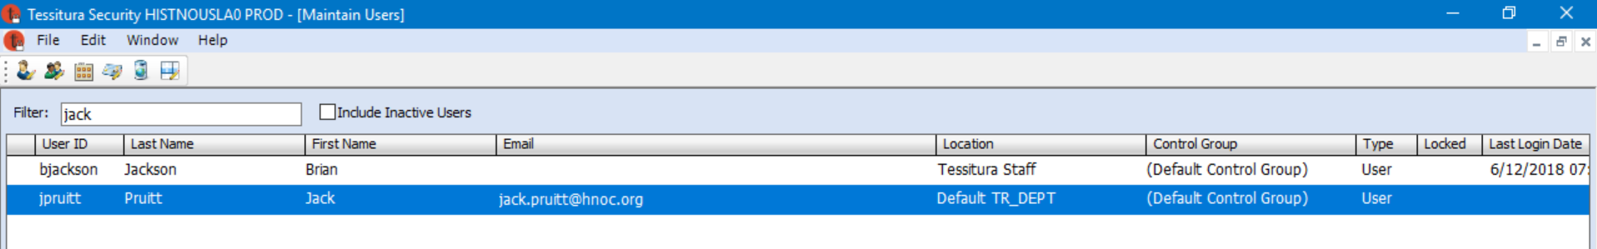
Double-click on the user to open their record.

Slide 29
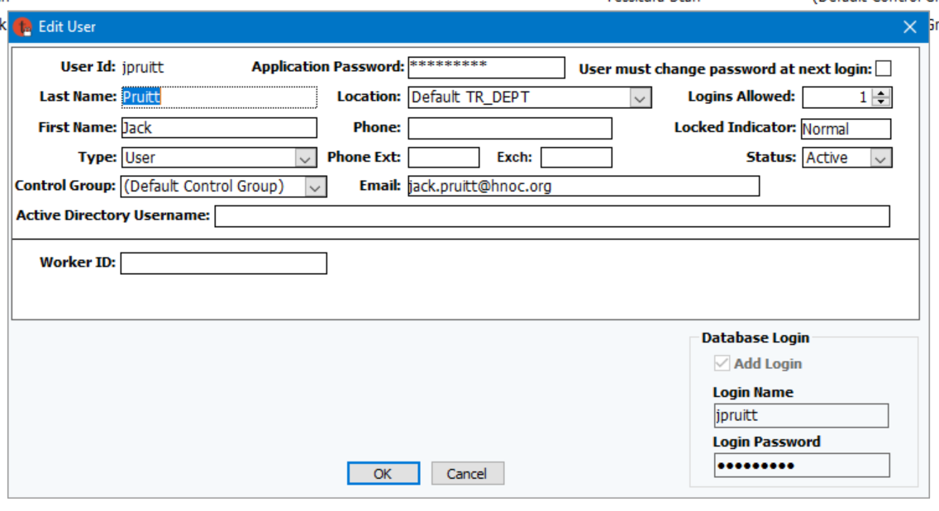
Enter the new password in the “Application Password” box. It must contain at least one uppercase letter, one lowercase letter, one number, and one special character, and be at least seven characters long.
Make sure the “User must change password at next login” box is NOT checked.
Click “OK.” Give the person their new password. DO NOT send in the body of an email.

Slide 30
Restarting EMV Card Readers after they have been unplugged

Slide 31
Restarting EMV Card Readers
If an EMV (credit card) reader has been unplugged and is not loading properly after being plugged back in, the triPOS service will need to be restarted.
Note, you must be logged in as TessAdmn to restart the triPOSservice. The TessAdmn password will not be shared outside the technology / digital services departments. Instructions have been shared with Kacell, RaJanae, Lisa, Kent, Carol, and Candy.

