Slide 1
Tessitura Merchant Services (TMS)
Credit card processor transition

Slide 2
Tessitura Merchant Services (TMS)
TMS will replace Worldpay
Live/Prod transition scheduled to begin 8am Monday 8/28
May take 2-4 hours to complete

Slide 3

Taking payments
Open the money bag/payments screen
Click on one of these
    You do not need to select a payment method first
    The first two buttons are only available if you have an EMV device connected to your computer.
      Select the first button to key the CC# into the EMV
      Select the second button to tap/slide/insert CC on EMV device
      Select the third button for secure deviceless entry
    Follow the instructions on EMV or SDE screen to complete the transaction. You will return to the payment screen to complete and save the order.

Slide 4
Refunding payments
Refunds in TMS are processed by referencing the original payment, rather than by card number
This is for enhanced security/PCI compliance
There is a 90 day window in which we will be able to do unreferenced refunds
After the 90 day window, we will have to submit a check request if a referenced refund is not possible. (See next slide)

Slide 5
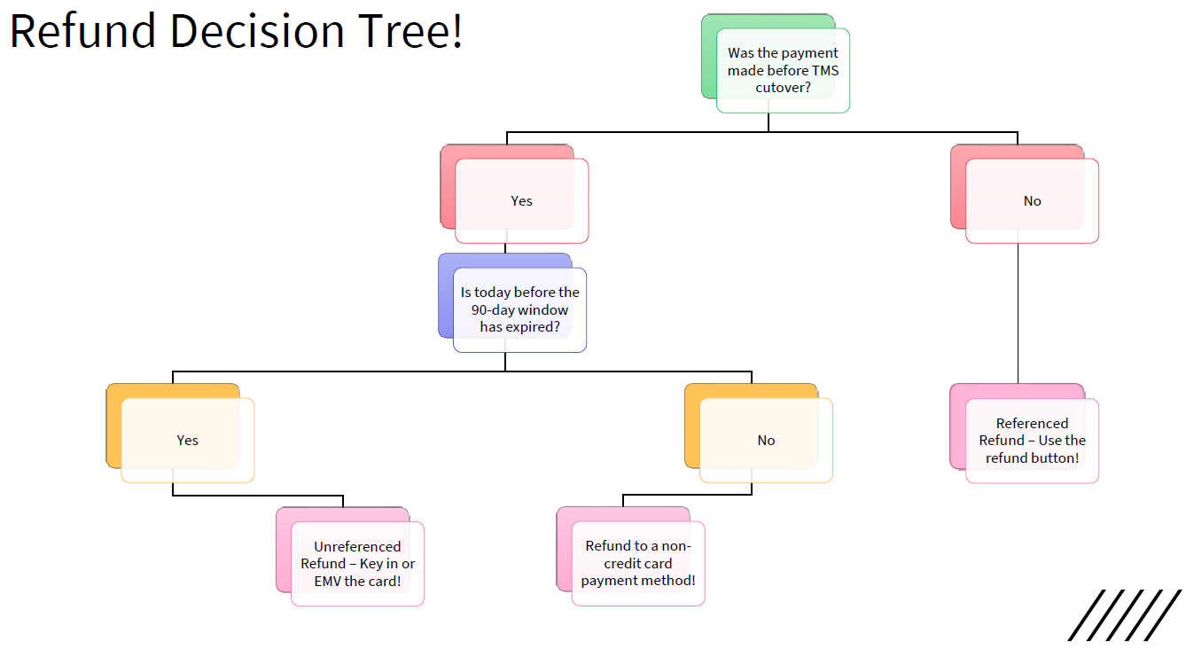
Created by Katina White at Pittsburgh Cultural Trust
8/29/23
11/27/23
Check request!

Slide 6
Q&A

