Slide 1

Tessitura Analytics
Intermediate Workshop
Chris Wallingford, Product Manager

Slide 2
Who are you?
You’ve been using Tessitura Analytics for a while
You know how to navigate in Analytics
You have been creating basic widgets
Hopefully, you’ve been reading and participating in the online Community Reporting & Analytics forum and/or the analytic Coffee! group

Slide 3
What you get?
Understanding of Filter Precedence
Understanding of Filtered Value Formulas
Understanding of Multi-Pass Aggregation
Understanding of Conditional Functions
Understanding of Date Fields
Workshop Dashboards to Take Home

Slide 4
Filter Precedence

Slide 5
Data in a Widget
ALL DATA IN
A DATA SOURCE
e.g. INTERACTIONS
WIDGET
DATA
DASHBOARD
FILTER
WIDGET
FILTER

Slide 6
Data in a Value
ALL DATA IN
A DATA SOURCE
e.g. INTERACTIONS
WIDGET
DATA
DASHBOARD
FILTER
ROW, CATEGORY, SERIES
VALUE
WIDGET
FILTER
ROW, CATEGORY, SERIES
VALUE
VALUE
ROW, CATEGORY, SERIES

Slide 7
Data in a Value
FORMULA
FILTERS
ALL DATA IN
A DATA SOURCE
e.g. INTERACTIONS
WIDGET
DATA
VALUE
DASHBOARD
FILTER
ROW, CATEGORY, SERIES
VALUE
WIDGET
FILTER
ROW, CATEGORY, SERIES
VALUE
ROW, CATEGORY, SERIES
VALUE
VALUE
VALUE
VALUE

Slide 8
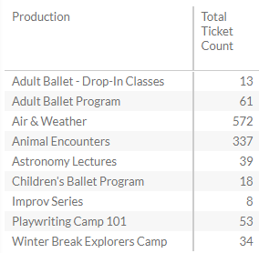
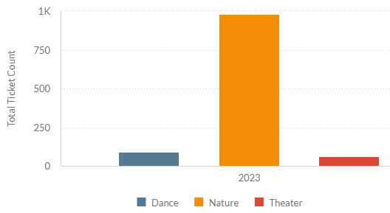
Filtered Values
Group events by genre

Slide 9
Filtered Values
Filters a value prior to applying widget groupings, widget filters, and dashboard filters
  Aggregate your value
    AGG ( [Value Field] )
  Combine with filter field(s)
    ( AGG ( [Value Field] ), [Filter1], [Filter2], …, [FilterN] )

Slide 10
Multi-Pass Aggregation

Slide 11
Multi-Pass Aggregation (MPA)
Aggregate within partitions of your data prior to then aggregating those partitions
  Aggregate your value
    AGG ( [Value Field] )
  With a partition
    [Partition] , AGG ( [Value Field] )
  Aggregate the partitions
    AGG ( [Partition] , AGG ( [Value Field] ) )

Slide 12
Order ID | Performance ID | Ticket Paid Amount
71034 | 2431 | 64
71034 | 2456 | 75
72087 | 2456 | 75
What is the Average Ticket Paid Amount per Order?
Option 1
  SUM ( [Ticket Paid Amount] ) / [# unique Order ID]
    ( 64 + 75 + 75 ) / 2 = 107 ✔
Option 2
  AVG ( [Order ID] , SUM ( [Ticket Paid Amount] ) )
  AVG ( [ 71034 , 139 ] , [72087 , 75] )
    ( 139 + 75 ) / 2 = 107 ✔

Slide 13
Conditionals

Slide 14
Conditionals
Value Flags as Filters
Returning Subset of MPA Results
Varying Formula by Row/Category

Slide 15
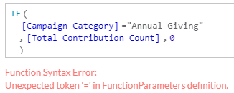

Conditionals: IF
IF (
{true/false value condition}
, {value if true}
, {value if false}
)

Slide 16
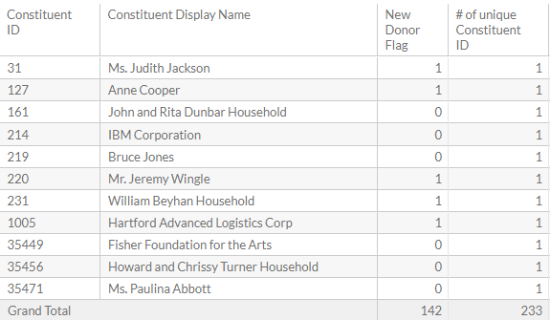
Conditionals : IF
IF ( [Min Campaign Fiscal Year] =
( [Min Campaign Fiscal Year] , ALL( [Campaign Fiscal Year] ) )
, 1
, 0
)

Slide 17
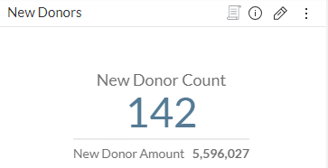
Conditionals: IF & MPA
SUM ( [Constituent ID],
IF ( [Min Campaign Fiscal Year] =
( [Min Campaign Fiscal Year] , ALL( [Campaign Fiscal Year] ) )
, 1
, 0
)
)
[Total Amount]

Slide 18
Date Fields

Slide 19
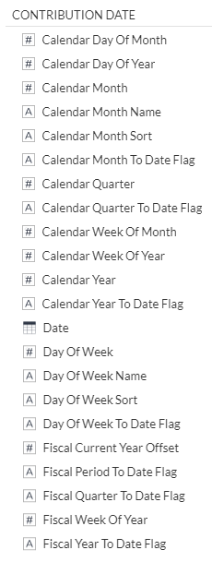
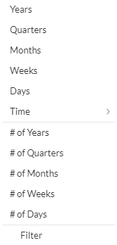
Dates
A date in Analytics typically has a collection of related fields.
A indicates text fields
# indicates numeric fields
indicates date fields
    calendar dates

Slide 20
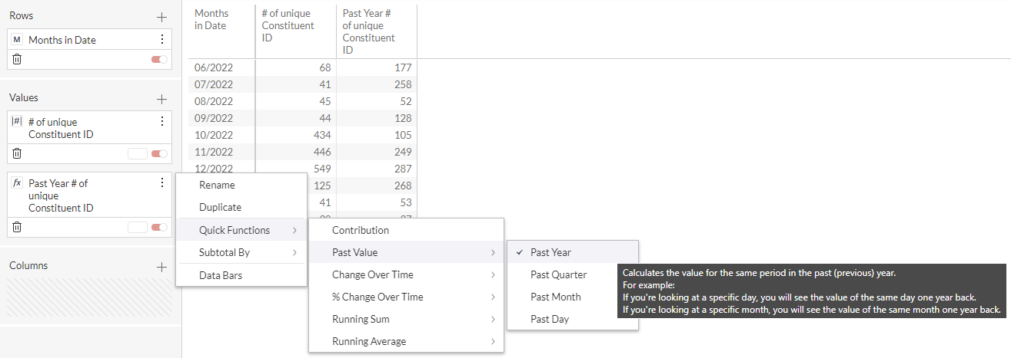
Dates: Quick Functions

Slide 21
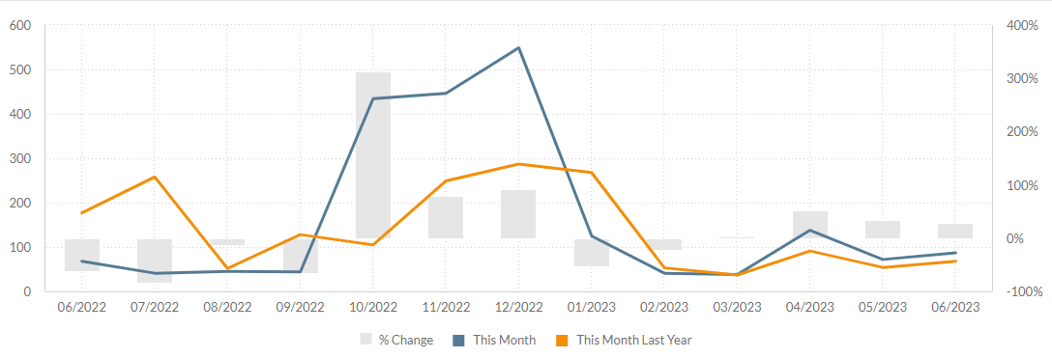
Dates

Slide 22
First-Event Constituents

Slide 23
First-Event Constituents
Multi-Pass Aggregation by constituent
Conditional IF to include only those who meet the criteria for being first-timer buyers
Date fields for Performance Date and First Performance Date
Days Difference date function to compare those two dates for each constituent

Slide 24
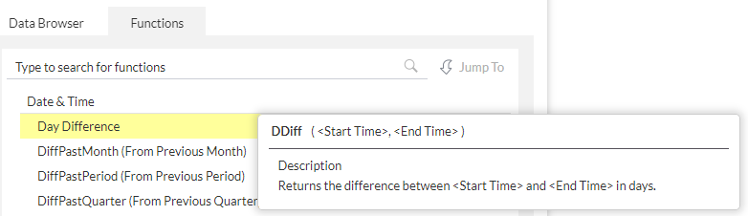
First-Event Constituents
SUM ( [Constituent ID] ,
IF (
MIN (
DDIFF (
[Days in Performance Date]
, [Days in First Performance Date]
)
) = 0
, 1 , 0
)
)

Slide 25
Thank you!

