Slide 1

Using Plans!
Midlands Tessitura User Group
13 September 2019

Slide 2
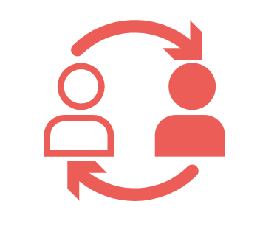
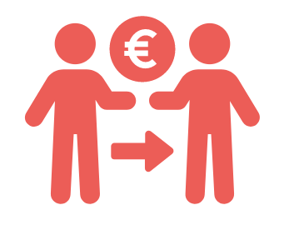

Slide 4
Moves Management
Used primarily with the non-profit sector in relationship to donor development. The process by which a prospective donor is moved from cultivation to solicitation.
What is a ‘move’?
“Moves” are the actions an organisation takes to bring in donors, establish/grow relationships, and renew contributions.

Slide 5
Moves Management
Identification
Qualification
Cultivation
Solicitation
Stewardship
Strategy
Communication
Engagement
Recognition
Evaluation

Slide 6
What can plans do?
Document relationship history, growth, and actions
Provide traffic control across the organisation
Manage portfolios, solicitations, and grant proposals
Establish revenue projections
Highlight staff efficacy and success
Track donors, sponsors, group sales leads, and artists
Much more?!

Slide 7

Structuring Plans
Relationship Management Plan
Primary plan
Exists in perpetuity
Records all general relationship-building

Slide 8

Structuring Plans
Annual Plans
Temporary
New plan created for each financial year or project
Manage steps towards specific and periodic solicitations
Used for patrons in any form of annual solicitation, cultivation, or stewardship

Slide 9
Campaigns, Funds, Designations
Each plan requires a campaign
Funds and designations are optional
Only one plan can exist for a constituent for each unique campaign, fund, and designation combination

Slide 10
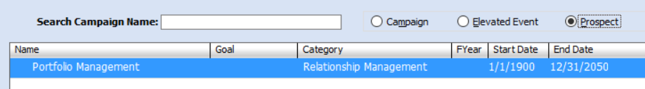
Prospect Campaigns
Existing contribution campaigns, funds, and designations can be used
Non-monetary “prospect” campaigns can be created
Funds and designations can be attached

Slide 11
the conversation
the status
the steps

Slide 12
the conversation
the status
the steps
what is the conversation about
Campaign, Fund and Designation
who is managing the relationship
the Worker
when do you anticipate an outcome
the Start and End Dates
how much are you seeking (if monetary)
Ask and Goal Amounts

Slide 13
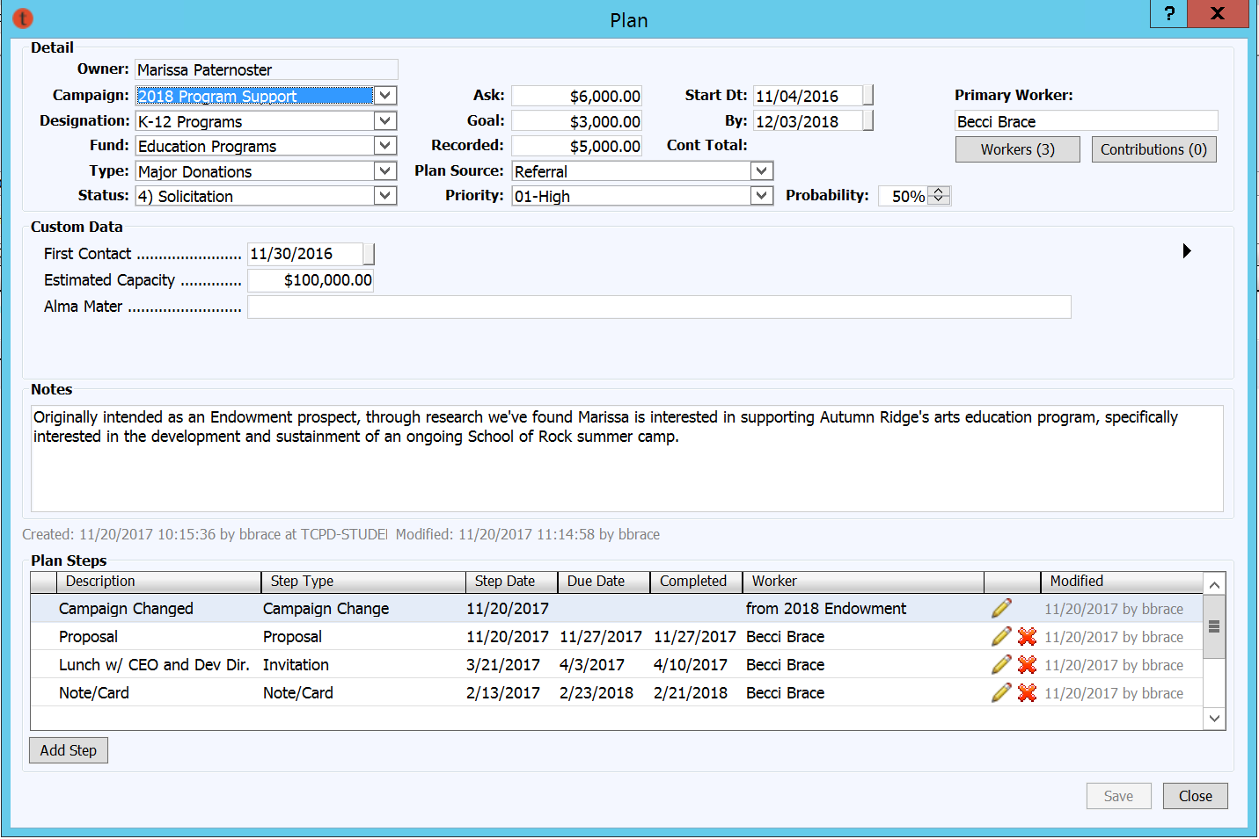

Slide 14
the support
the status
the steps
what is to be supported
Campaign, Fund and Designation
who is asking
the Worker
when do you anticipate support
the Start and End Dates
how much are you seeking
Ask and Goal Amounts
segments
Type
the customer journey
Status

Slide 16
identify
research
cultivate
ask
decision pending
accepted
stewardship
decline
on hold
withdrawn
not yet
no response

Slide 17
DEV
EDU
EXE
COR
Inquiry
Second Option
First Option
Confirmed
Deposit
Contract
Final contract
decline
Date change
cancelled
no response

Slide 18
the support
the status
the steps
the steps
what is to be supported
Campaign, Fund and Designation
who is asking
the Worker
when do you anticipate support
the Start and End Dates
how much are you seeking
Ask and Goal Amounts
donor and prospect segments
Type
the cultivation cycle
Status
The actions taken or required to move the relationship to the next status

Slide 19








identify
research
cultivate
ask
decision pending
accepted
stewardship
decline
on hold
withdrawn
not yet
no response

Slide 21
Plans Management

Slide 22






Slide 23
Reminders

Slide 24
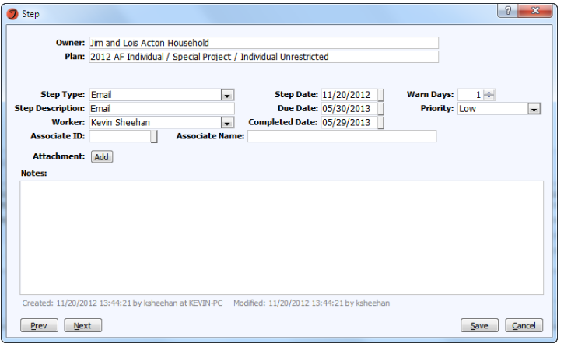
Adding a reminder on a step
Step date – defaults to today’s date
Due Date – Day step needs to be completed by
Warn Days – how many days in advance of the Due date do you want the task to appear in reminders
Priority – Affects how task is displayed in reminders
Completed Date – when the step is completed
Worker – You or assign to someone else!

Slide 25
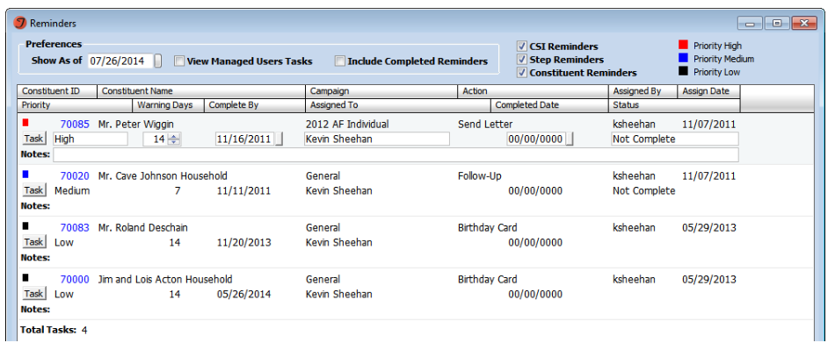
Viewing reminders

Slide 26
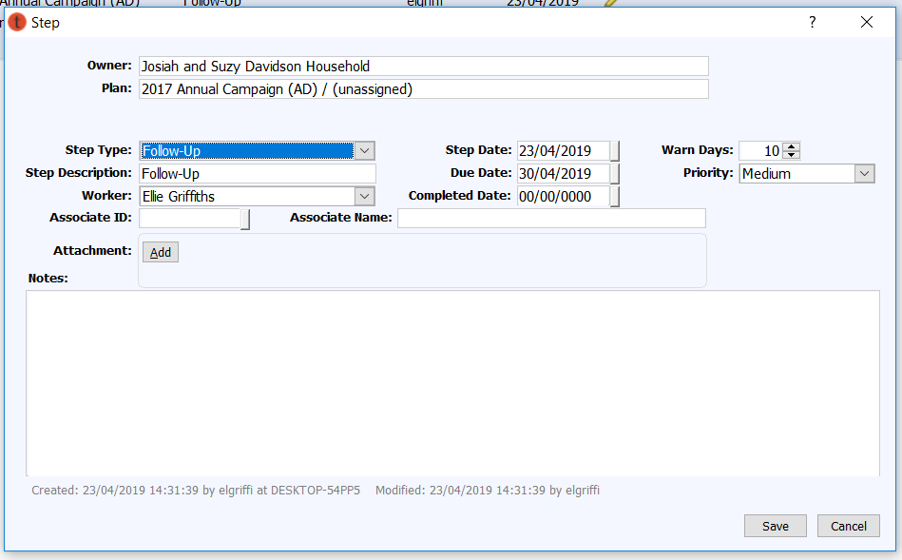
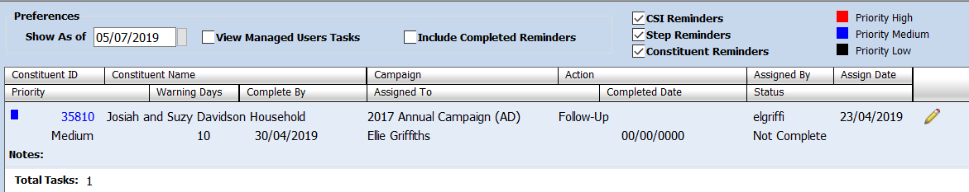
Completing reminders

Slide 27
Portfolios

Slide 28
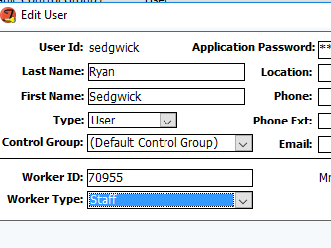
Worker Setup
To access My Portfolio features, a worker’s ID must be linked to their user information in the security module

Slide 29

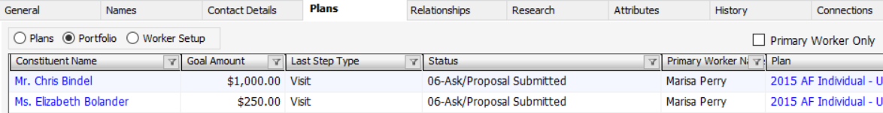

Portfolios
Workers can view their portfolio in their constituent record
Portfolio screens are unique to each user based on filters
Easily copy your portfolio to excel

Slide 30
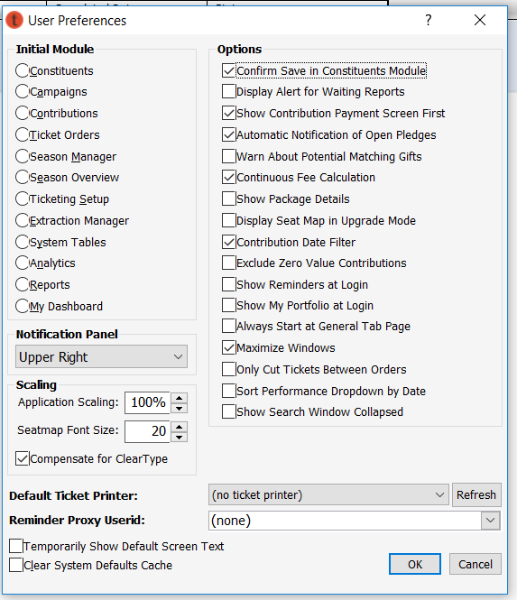
Preferences
Tools > Preferences

Slide 31
Plans Maintenance

Slide 32
Plans Maintenance Tool
Using a list:
Plans can be created and updated
Steps can be added to existing plans
Workers can be added to existing plans
Accessed via the
Campaign menu > Plans Maintenance… or

Slide 33
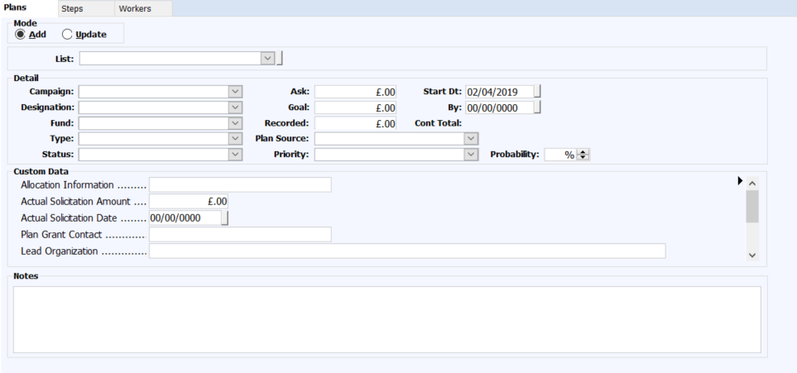
Plans Maintenance Tool
Plans – add or update multiple Plans
Steps – add or update steps to existing plans
Workers – add multiple workers to existing plans

Slide 34
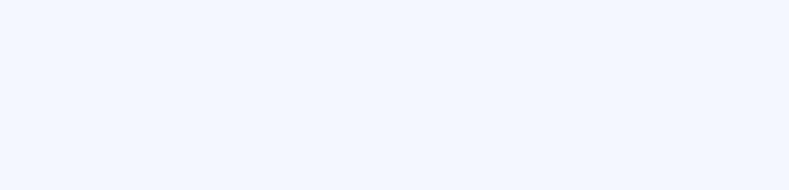
Plans Maintenance Tool

Slide 35
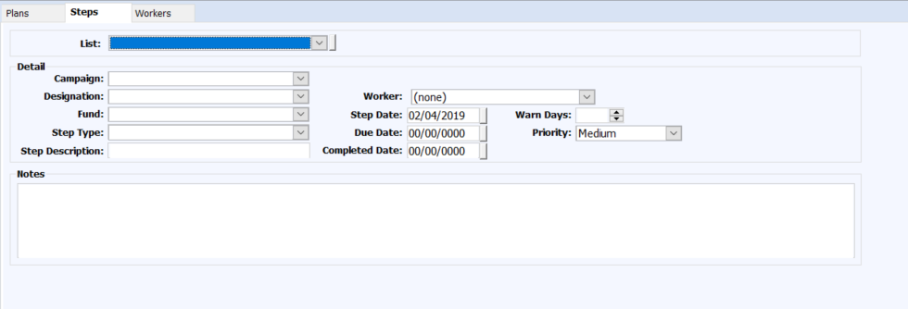
Plans Maintenance Tool

Slide 36
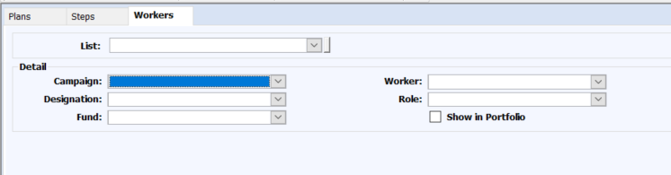

Plans Maintenance Tool

Slide 37
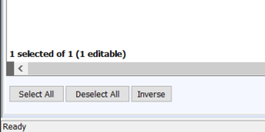
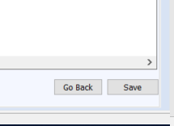
Plans Maintenance Tool

Slide 38
Reporting

Slide 39
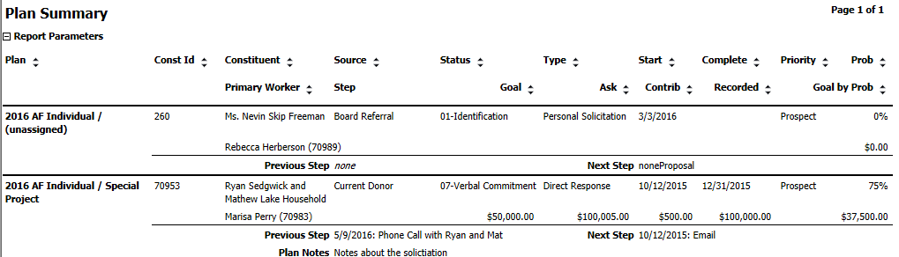
Plan Summary
Access plan details, related steps, and amount/goal totals

Slide 40
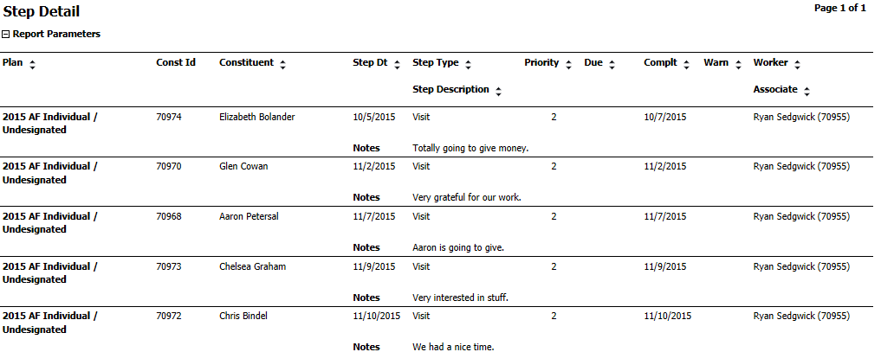
Step Detail Report
Obtain step data including all notes

Slide 41
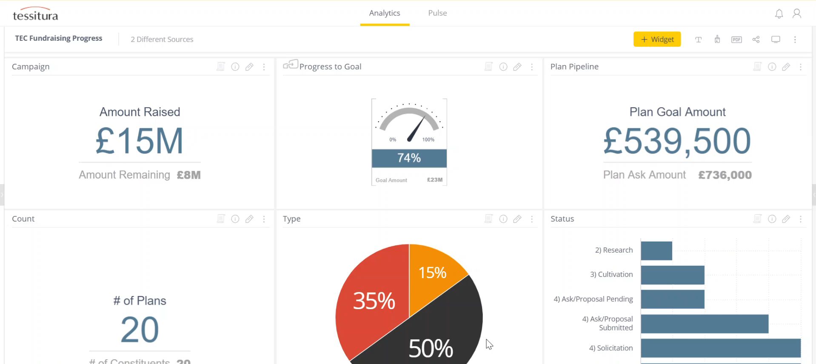
Analytics – Fundraising Progress

Slide 42
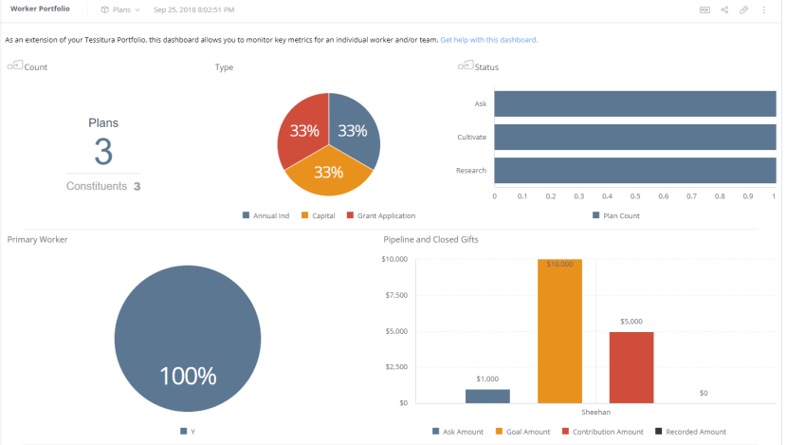
Analytics – Worker Portfolio

Slide 43
Tessitura on the Go

Slide 44
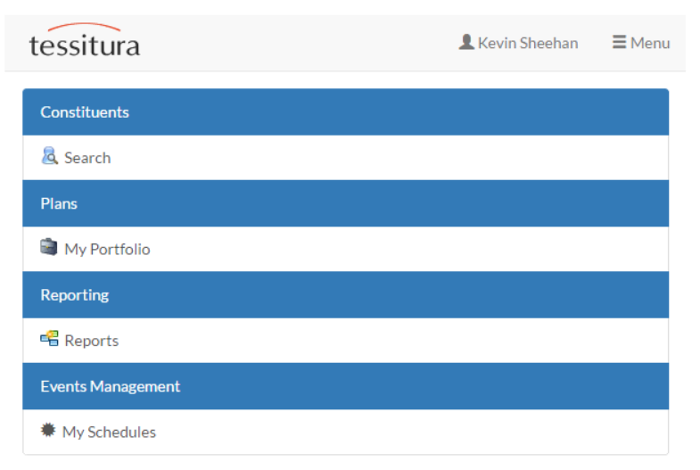

Slide 45
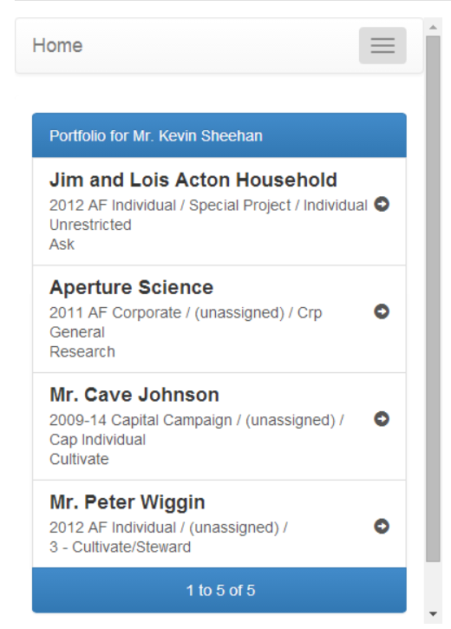
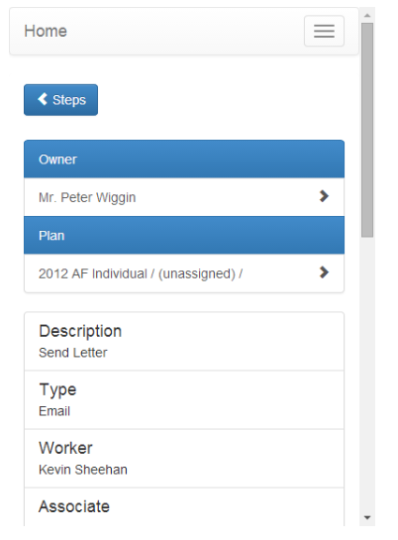

Slide 46
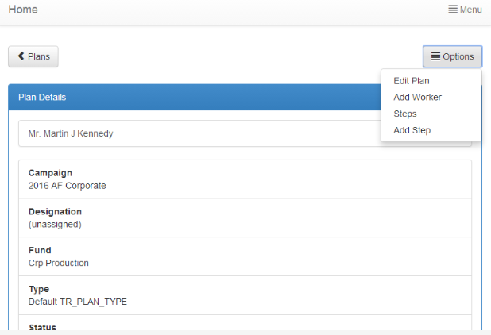

Slide 47
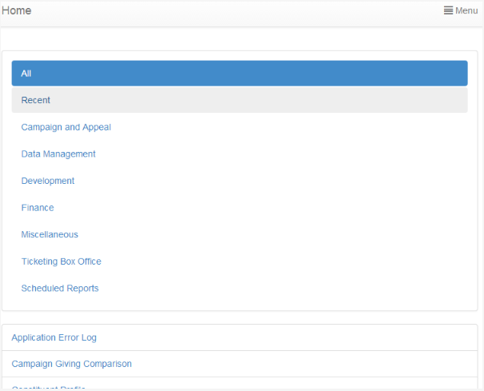
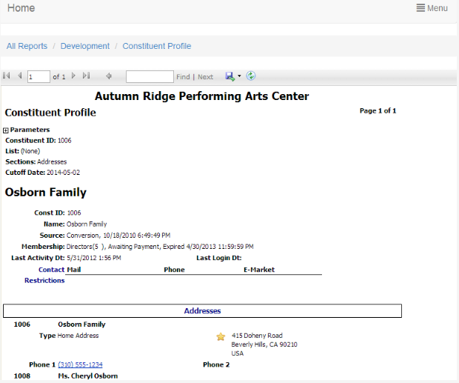

Slide 48
Plans Governance

Slide 49
Plans Considerations
Consider all the fields
Do you need to use them all for your department?
For financial plans, DEFINITELY USE THE END DATES for effective use in analytics
Consider your relationship journeys
have robust statuses for each of your income stream/plan usages
What are the relevant ‘moves’ for your teams?
Do this cross departmentally and think naming conventions
DOCUMENT IT

Slide 50
Plans Considerations
Consider your probability levels in relation to that solicitation cycle
What does 50% look like to you?
DOCUMENT IT!
Does this relationship need a plan?
The Birthday Card Rule
Keep Them
Up To Date!

Slide 51
Plans - User Defined Areas
Plan Type = TR_PLAN_TYPE
Define reason for plan/Income stream
Plan Status = TR_PLAN_STATUS
Define stages of the Donor Journey
Plan Source = TR_PLAN_SOURCE
Where did the plan come from? E.g. Referral
Plan Priority = TR_PLAN_PRIORITY
How important is this plan?
Worker Role = TR_WORKER_ROLE
Role of the worker on a specific plan e.g. Solicitor
Worker Type = TR_WORKER_TYPE
Type of worker at your organisation e.g. Staff, Board
Plan Steps = TR_PLAN_STEPS
Define actions taken with a prospect e.g. Meeting, proposal

