Slide 1

v.16 upgrade chat and a.m.a.
January 19th, 2023
Presentation by Nicki LeGrand

Slide 2
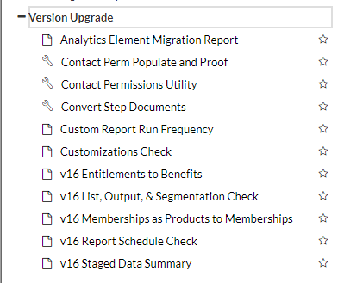
OUR TIMELINE
-August 9th: Ticket opened from tessitura saying that based on our usage we are ready to upgrade
-September 23rd: Test upgrade to 15.2.29 service pack
-September 26th: Prod upgrade to 15.2.29 service pack
-September 26th to October 17th: Worked through the mapping tables that are in the v.16 folder in reports and utilities 15.2.29
-This included a meeting with ben which was billed as an ask the expert session. This may not be needed if you have someone at your organization who is more proficient in sql than I currently am.
-The meeting with ben was a result of the customizations check report and required updating some queries in ssms as well as updating some reference tables. These meetings (test and live)
Added up to 10 hours of consulting time.

Slide 3
OUR TIMELINE CON’t
-October 31st: Test upgrade to v.16 completed
-Make sure you schedule a live to test for the day before so your test environment is as close to your prod environment as possible.
-October 31st to November 25th: testing and training with team leads and tessitura users
-I identified a “team lead” in each department within our organization who was my direct contact for training and testing. I assigned them things to test and we worked together when there were issues. Then the team lead and myself led training sessions for the tessitura users within their departments.
-this was very helpful for me as I had a team instead of just me running around trying to do all the testing for day to day things in each department as well as the other things that I needed to make sure worked as the dba.
-November 28th: Prod upgrade to v.16 completed
-November 28th to December 12th: Updates in prod, making sure everything was working, identifying issues. On December 12th, our upgrade ticket was closed.

Slide 4
Issues that we came across

Slide 5
ANALYTICS
Our analytics didn’t load properly
Tessitura had to do a full reload of our analytics after our test upgrade. The day After, we tested some widgets that we use in box office to track sales and they appeared to be correct so we moved on.
After we upgraded in prod, our Box Office Manager discovered a troubling issue the day after the upgrade, our sales for swan lake and peter pan looked like we’d expect them to, but in the days after she noticed that the sales were going backwards. Subscription sales were becoming less and less. We called this out as quite concerning to tessitura and they informed us that this was a known defect that is going to be resolved in v.16.0.5. As a work around, they implemented a fix in that we don’t just have an incremental analytics load every night, we do a full load every night as this issue is only happening with incremental loads.

Slide 6
Custom reports and items
Custom School Reports
We have several reports that were built custom for the RWB School. When I ran the customization check list before we upgraded, they were not flagged, and when we upgraded, they didn’t work. Two of them were able to be fixed within the ticket for v.16 and one needed to be addressed during consulting hours.
CUSTOM BIRTHDAY FIELD
We have a custom birthday field on our new constituent page that auto-populates a constituency if people qualify for our Under 34 program for cheaper tickets. IT also did not show up in the customization checklist and did not transfer over in our upgrade process. We are still waiting on this to be resolved.
Tessitura is currently working on better ways to identify issues with customizations for the upgrade.

Slide 7
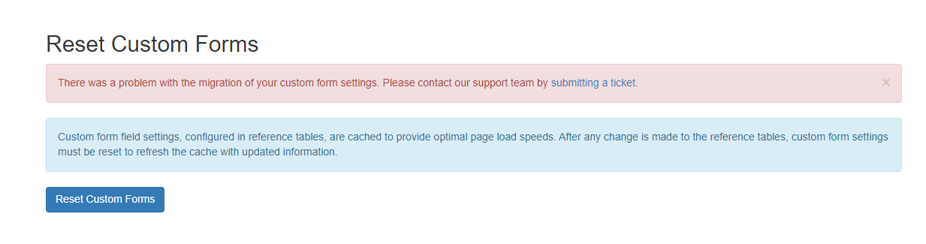
DUPICATE/MISSING VALUES IN LTR_TNEW_CUSTOM_FORM_DATA
CUSTOM FORM DATA WAS NOT REFRESHING FOR TNEW there was an issue where a couple fields were missing values. V.15 allowed the forms to reset, but v.16 did not. If you get this error, double check the table.
CSI’S NOT SAVING from the website we use CSI’s to collect form data for school events. In this reference table, if items pointed to the same intended use have duplicate values in the “field name” column, the CSI will blip and not save. If this happens, you only have 2 weeks for tessitura to pull this data for you. Stay on top of open tickets or you will lose your information… Make it critical if you need to.

Slide 8
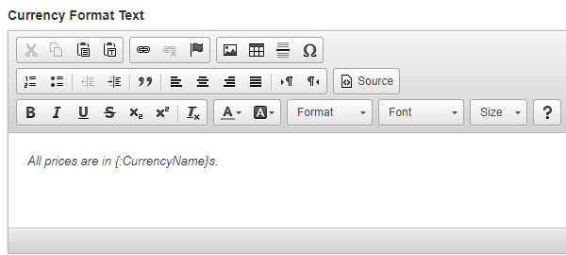
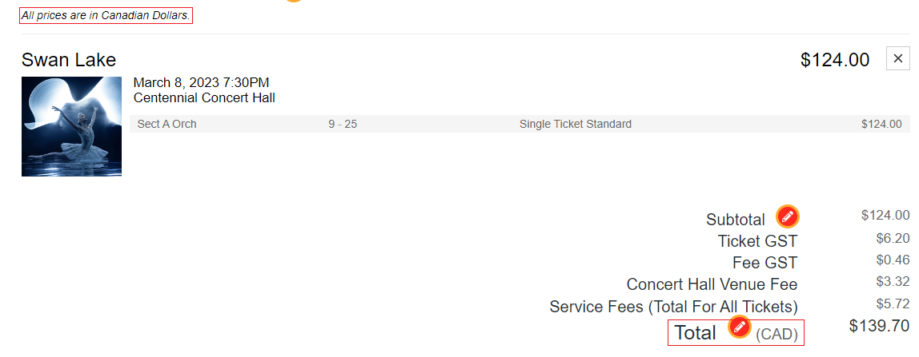
Canadian vs US DOLLARS
For my fellow Canadian orgs… on our tnew pages we noticed that it said “all orders are in US dollars”. This was a setting that was not displayed in v.15 but is now visible in v.16.
Kyle was able to adjust our location settings and it changed to Canadian. It also corresponds in TNEW to one place in the component editor-Cart:

Slide 9
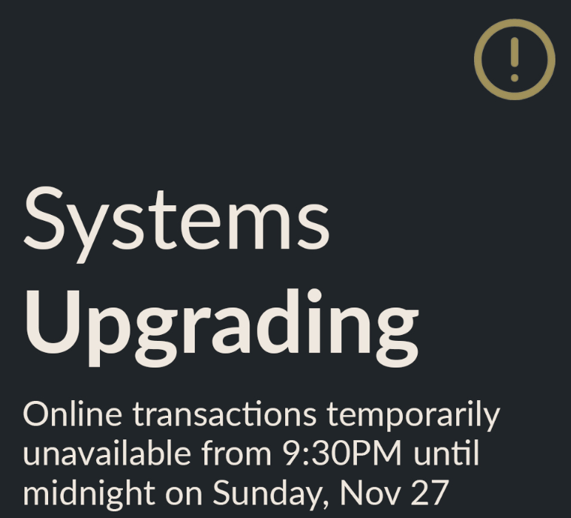
Marketing website issues links broken after our full upgrade
After our live upgrade was complete the “buy ticket” and “donate now” buttons were broken. This is not something we realized while testing as we do not have a marketing test site. Our links were old, set for old versions of TNEW. Update these links before you upgrade.
WEBSITE WILL BE DOWN FOR YOUR LIVE UPGRADE
This one is common sense, but it will interrupt sales.
We did a post on socials to let people know when we’d be down and scheduled the upgrade for a time where we typically don’t have much website activity.

Slide 10
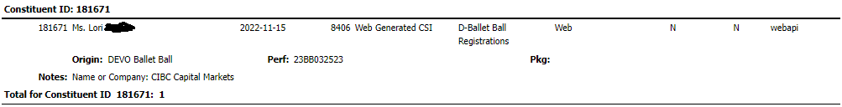
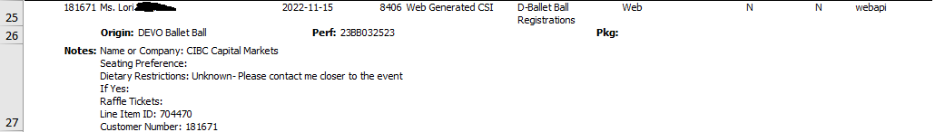
CSI REPORT DISPLAY ISSUES
Information is hidden within the application
There is a current defect that when you pull a csi report it hides everything but the first line of the information within the application. You have to save it into excel and expand the cell to see the information.

Slide 11
Acknowledgement letters and lists
Acknowledgement letters
We realized that there was a defect in v.16 that was excluding pre-upgrade acknowledgment letters. There are new columns in T_ACK_EXT, and AP_acknowledgement_letters is joining it on fund_no which is null for any pre-upgrade letters. Tessitura was able to do a manual fix for this issue.
Lists
This has been resolved for v.16.0.4, but the Tp_UPDATE_TICKET_HISTORY procedure was set to run with a parameter that was causing it to not pull in all ticket buyers. if we pulled a list for Swan lake it would tell us 800 people bought tickets, but the attendance report was giving us 2000. In v.15 the application was deleting and recreating the entire season’s history every night, and in v.16 it only updates an existing row if a change has been made. The defect was around the way that it recognized when the last update to the row was, so it wasn’t pulling in new sales properly.

Slide 12
Tessitura Access control
NSCAN is now Tessitura access control
On the Trello board for completing your testing, making sure your scanners were all up to date and working properly was at the end of the list. After our experience it was moved to near the top of the list.
The process
-ensure your scanners are at least on Android version 8 and no higher than version 10
-install the new apk file on the device
-Update your rest api url
-test scan and verify reporting

Slide 13
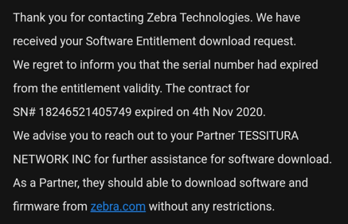
T.A.C. Con’t
We are using t-20 scanners on android version 7.
We realized when we went to test that we needed to upgrade our scanners to version 8, and in doing so, had to reach out to zebra for the appropriate files. Unfortunately, due to several staffing changes and time passing, we no longer had an active account with zebra and our devices were not under warranty.
After several panicked hours trying to reach zebra and figure out what we could do (it was also American thanksgiving) someone from their support team put it in writing that tessitura could access the files for us.
We would have had to postpone our upgrade if this wasn’t figured out because we had nutcracker coming up and you can’t use n-scan with v.16.
Start this process immediately after you upgrade in test!!

Slide 14
SOME other THINGS TO BE AWARE OF BEFORE YOU UPGRADE

Slide 15
-Segmentations are generated differently and can take up to 5 minutes to count
They are now processed by the tessitura processing server which runs every 5 minutes by default.
-When selecting multiple option from a drop down in a report you have to click them individually…. Shift-click is gone
-an mos is now required for donation entry

Slide 16
-You might have issues getting into infomaker
I’m still unable to sign on. It’s giving me a permissions error. Tessitura is investigating.
-We experienced severe lagging for about a week right after we upgraded
-Validation issues in seating maps popped up after we made changes in v.16
IT would appear there were several issues on different seat map screens that we not issues in v.15 but became issues as soon as we tried to change something after we upgraded.

Slide 17
-Kyle was able to make changes to our tnew site while we were testing
He was able to adjust some colouring and update pictures on headers free of charge while we were working through the upgrade.
-Searching by phone is no longer in advanced search. You now do it from the single line search and put in “#5555555555”
-Some reports may over-load if you choose too many seasons and may time out

Slide 18
Any questions!?
Nicki Legrand
Database administrator
Canada’s royal Winnipeg ballet nlegrand@rwb.org

